Slide 1
Simple pub and sub
Terlebih dahulu membuat workspace dan package seperti pada tutorial sebelumnya

Slide 2
Membuat source code
Buat source code pada folder src pada package
masuk kedalam package
cd src
geany first.cpp second.cpp

Slide 3
Pada first.cpp
#include <ros/ros.h>
#include <iostream>
#include <stdio.h>
#include <std_msgs/Int16.h>
#include <std_msgs/Float32.h>
using namespace std;
int one = 1;
float phi;
std_msgs::Int16 num;
void number_cb (const std_msgs::Float32& number);
int main(int argc, char **argv)
{
ros::init(argc, argv, "node_controller");
ros::NodeHandle nh;
ros::Publisher pub_number = nh.advertise<std_msgs::Int16>("int", 1, true);
ros::Subscriber sub_number = nh.subscribe("float", 1, number_cb);
while(ros::ok()){
ros::spinOnce();
num.data = one;
pub_number.publish(num);
cout<<"[first] I publish number "<<one<<endl;
cout<<"[first] I subscribe number "<<phi<<endl;
sleep(2);
}
}
void number_cb (const std_msgs::Float32& number){
phi = number.data;
}

Slide 4
Pada second.cpp
#include <ros/ros.h>
#include <iostream>
#include <stdio.h>
#include <std_msgs/Int16.h>
#include <std_msgs/Float32.h>
using namespace std;
int one;
float phi = 3.14;
std_msgs::Float32 num;
void number_cb (const std_msgs::Int16& number);
int main(int argc, char **argv)
{
ros::init(argc, argv, "node_controller");
ros::NodeHandle nh;
ros::Publisher pub_number = nh.advertise<std_msgs::Float32>("float", 1, true);
ros::Subscriber sub_number = nh.subscribe("int", 1, number_cb);
while(ros::ok()){
ros::spinOnce();
num.data = phi;
pub_number.publish(num);
cout<<"[second] I publish number "<<phi<<endl;
cout<<"[second] I subscribe number "<<one<<endl;
sleep(2);
}
}
void number_cb (const std_msgs::Int16& number){
one = number.data;
}

Slide 5
Pada CMakeList
add_executable(first src/first.cpp)
target_link_libraries(first ${catkin_LIBRARIES})
add_executable(second src/second.cpp)
target_link_libraries(second ${catkin_LIBRARIES})

Slide 6
Membuat launch file
Launch file digunakan untuk menjalankan beberapa node secara bersamaan
Cd ..
Mkdir launch
Geany test.launch
Tambahkan codingan berikut ke test.launch
<launch>
<node name="first" pkg="tutorial_ai" output="screen" type="first" />
<node name="second" pkg="tutorial_ai" output="screen" type="second" />
</launch>

Slide 7
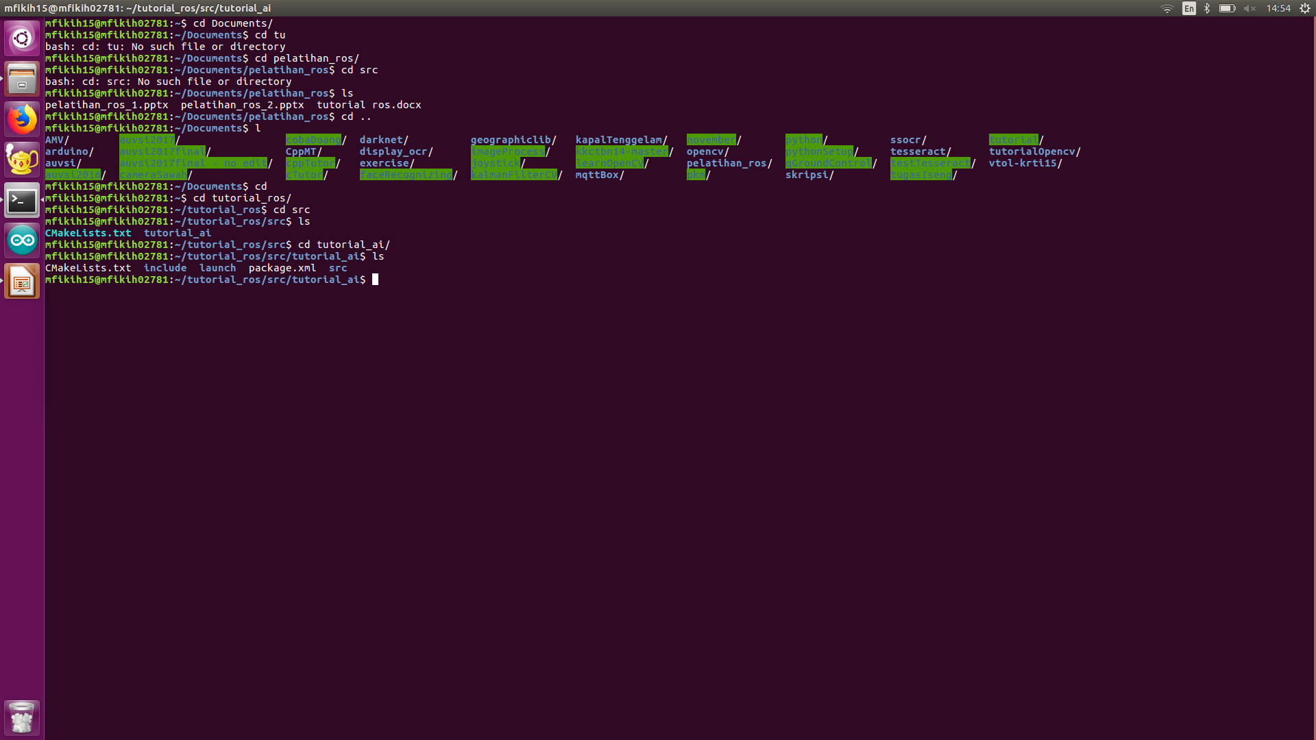
Lokasi directory launch

Slide 8
catkin_make
Cd ../../..
catkin_make
kemudian jalankan launch dengan perintah
roslaunch tutorial_ai test.launch
roslaunch <nama package> <nama launch>

Slide 9
