Slide 1
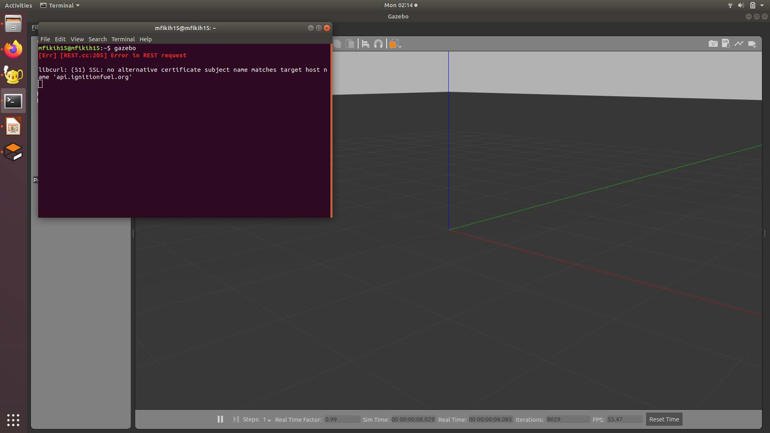
Gazebo
Gazebo adalah software simulasi 3D
Sudah terinstall saat menginstall linux
~$ gazebo

Slide 2
Mavros
Mavros adalah mavlink (protocol komunikasi pixhawk dengan PC) di ros
~$ sudo apt-get install ros-kinetic-mavros ros-kinetic-mavros-extras
~$ wget https://raw.githubusercontent.com/mavlink/mavros/master/mavros/scripts/install_geographiclib_datasets.sh
~$ sudo chmod +x ./install_geographiclib_datasets.sh
~$ sudo ./install_geographiclib_datasets.sh
jika sudah terinstall jalankan
~$ roslaunch mavros apm.launch
ref : https://github.com/mavlink/mavros/blob/master/mavros/README.md

Slide 3
PX4 Firmware
~$ git clone https://github.com/PX4/Firmware.git
~$ cd Firmware
~/Firmware $ make
jalankan wahana (case drone)
~/Firmware $ make px4_sitl gazebo_solo

Slide 4
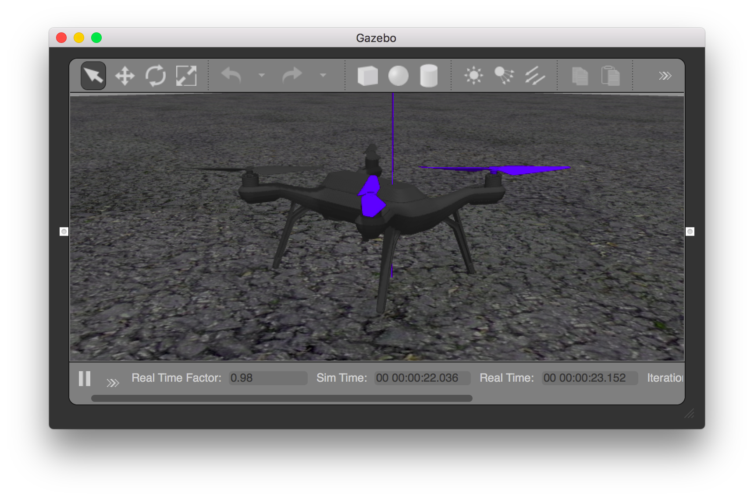
gazebo

Slide 5
Cara menjalankan
Terminal 1, buka gazebo px4
~$ cd Firmware
~/Firmware $ make px4_sitl gazebo_solo

Slide 6
Cara menjalankan
Terminal 2, jalankan mavros
~$ roslaunch mavros px4.launch fcu_url:="udp://:14540@127.0.0.1:14557"
ref : https://dev.px4.io/v1.9.0/en/simulation/ros_interface.html

Slide 7
Cara menjalankan
Terminal 3, copy program gw
~$ git clone https://github.com/lp02781/drone_simulation.git
~$ rm -rf build
~$ catkin_make ~$ source devel/setup.bash
~$ roslaunch lucu complete.launch
tekan “p” untuk take off
tekan “q” untuk data altitude dan compass

Slide 8
Cek messages dan topic
Buka terminal baru
~$ rostopic echo <topic>
Ref message:
Mavros_msgs : http://wiki.ros.org/mavros_msgs
std_msgs : http://wiki.ros.org/std_msgs
sensor_msgs : https://wiki.ros.org/sensor_msgs
Custom messages : http://wiki.ros.org/ROS/Tutorials/CreatingMsgAndSrv

