Slide 1
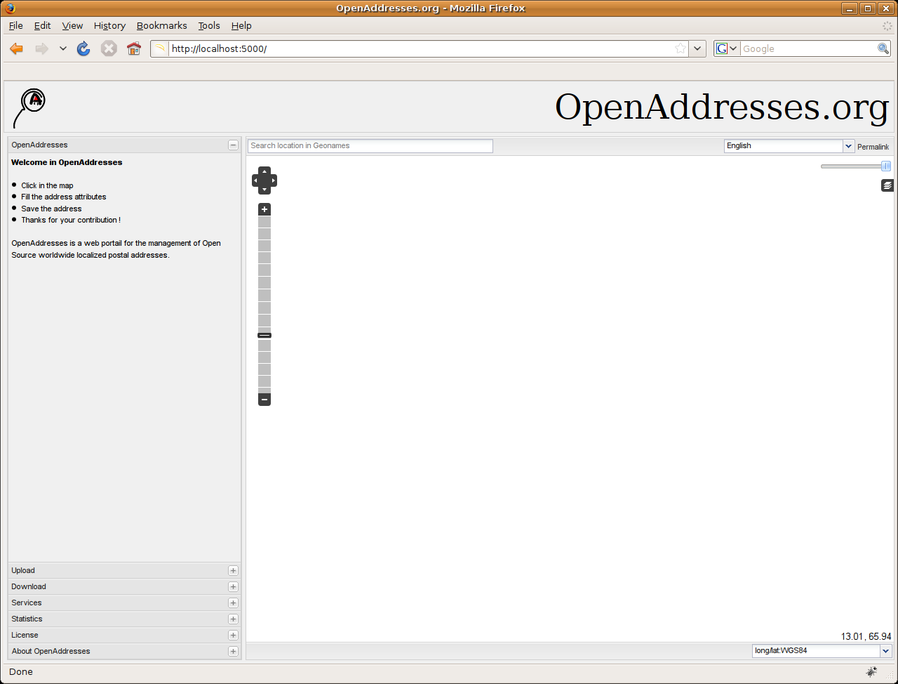
1
Click
2
Edit
3
Save
That's it !

Slide 2
1
Clique
1
Click
2
Edite
2
Edit
3
Sauve
3
Save
Ca y'est !
That's it !
1
Klick in Karte
2
Adressdaten eingeben
3
Speichern
Fertig!

