Slide 1
RxJS 5 Workshop
Ben Lesh
@benlesh

Slide 2
What is RxJS?
“lodash for events”

Slide 3
What is RxJS?
“lodash for async”

Slide 4
Types of Async in Web Apps
AJAX
User events (mouse, keyboard, touch, etc)
Web sockets
Workers
Animations
SSE

Slide 5
Methods for dealing with async
callbacks
promises
observables
generators, CSP and others

Slide 6
Callbacks
getSomeData((data) => {
doSomething(data);
});

Slide 7
Callbacks
getSomeData((err, data) => {
if (err) {
handleError(err);
} else {
doSomething(data);
}
});

Slide 8
Callback Hell
getSomeData((data) => {
foo(data);
getSomeData((data) => {
bar(data);
getSomeData((data) => {
baz(data);
});
});
});

Slide 9
Promises
getSomeData()
.then((data) => {
foo(data);
return getSomeData();
})
.then((data) => {
bar(data);
return getSomeData();
})
.then((data) => {
baz(data);
});

Slide 10
Promises
Guaranteed future
Single value
Immutable
Multicast (caching)
Eager (not lazy)
These two features can be a problem

Slide 11
A “Promise” to a future value
Promises can’t be cancelled

Slide 12
Cancellation
Prevents code from being called unnecessarily
Calls tear down logic

Slide 13
Loading view data without cancellation

Slide 14
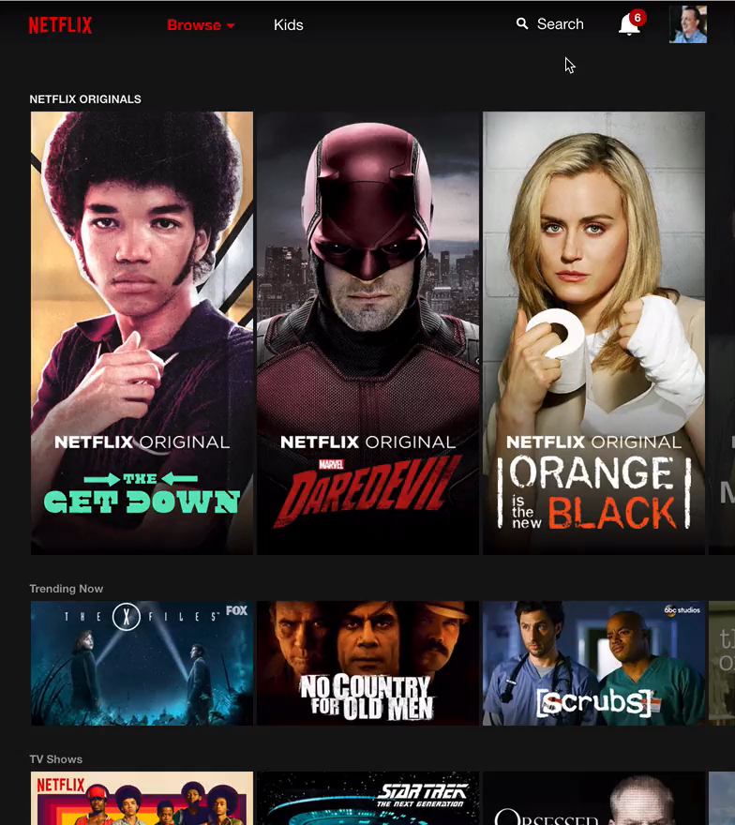
Loading view data without cancellation
Daredevil

Slide 15
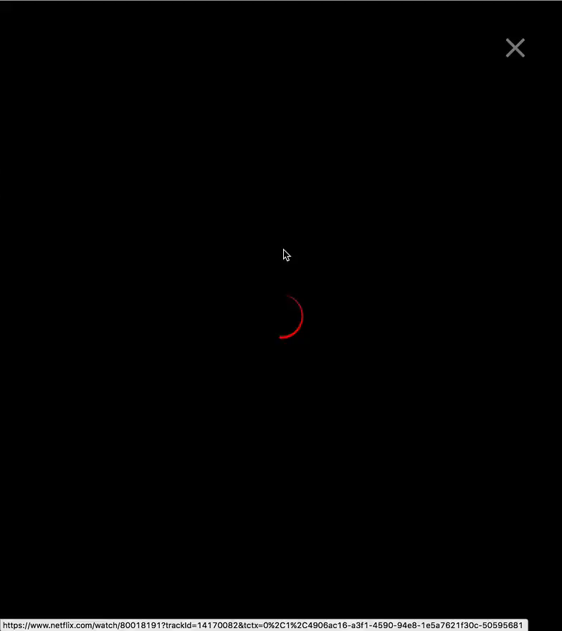

Loading view data without cancellation
Here’s Daredevil!
Daredevil
The Get Down
Since you can’t cancel the previous promise,
you’re stuck processing the response
and somehow signaling “disinterest”

Slide 16
A better scenario
Daredevil

Slide 17
A better scenario
Daredevil
The Get Down
Ideally, when we make a new request
we can abort the the old one
so it’s never handled and processed

Slide 18
We want an async type with cancellation

Slide 19
Promises are a single value
AJAX
User Events (clicks, mousemoves, keyups, etc)
Animations
Sockets
Workers

Slide 20
We want a type that can handle more than one value

Slide 21
JavaScript has a type for more than one value
Iterable

Slide 22
Iterable
iterable.iterator() to get an iterator
iterator.next() to get a result
result.value: the value yeilded
result.done: whether or not it’s complete
errors are thrown during iterator.next() call

Slide 23
Iterable
const iterator = iterable.iterator();
while (true) {
try {
let result = iterator.next();
} catch (err) {
handleError(err);
}
if (result.done) {
break;
}
doSomething(result.value);
}

Slide 24
Iterables alone aren’t great for async
Poll it?
All sorts of problems
Iterator of Promise: Have each value in your result be a promise.
Good for backpressure
But it allocates a promise for each value (imagine mouse move events)
Not great for events where you don’t always need push/pull (e.g. WebSockets)

Slide 25
Observable
Iterable turned inside out

Slide 26
Iterator -> Observer
Instead a method to get a value
let result = iterator.next();
let value = result.value;
// do stuff
We have a method that accepts values
observer.next = (value) => { /* do stuff */ };

Slide 27
Iterator -> Observer
Instead of throwing errors when we call next()
try {
let result = iterator.next();
} catch (err) {
// handle error
}
We push errors to a method as they happen
observer.error = (err) => { /* handle error */ };

Slide 28
Iterator -> Observer
Instead of needing to check `done` on the result for completion
let result = iterator.next();
if (result.done) {
// handle completion
}
We push completions to a method as they happen
observer.complete = () => { /* handle error */ };

Slide 29
Observer
const observer = {
next(value) { /* handle value */ },
error(err) { /* handle error */ },
complete() { /* handle complete */ }
};

Slide 30
Iterable -> Observable
Instead of a method that returns an iterator
let iterator = iterable.iterator();
We have a method that accepts an observer
observable.observer(observer);
observable.subscribe(observer);

Slide 31
Observable is the “dual” of Iterable
It allows us to push values over time

Slide 32
What about cancellation?
That’s easier to show you if we look at how Observables are created

Slide 33
Use the Observable constructor
var myObservable = new Rx.Observable();

Slide 34
Pass it a subscriber function that gives you an observer
var myObservable = new Rx.Observable((observer) => {});

Slide 35
Use `next` on the observer to emit values from your observable
var myObservable = new Rx.Observable((observer) => {
observer.next(‘hello world!’);
});

Slide 36
Call `complete` to signal the observable is done successfully
var myObservable = new Rx.Observable((observer) => {
observer.next(‘hello world!’);
observer.complete();
});

Slide 37
or use `error` to signal a problem caused the observable to stop
var myObservable = new Rx.Observable((observer) => {
observer.next(‘hello world!’);
observer.error(new Error(‘sad things’));
});

Slide 38
Observables are lazy!
Remember: They won’t do anything until you subscribe!

Slide 39
Subscribe using the `subscribe` function
myObservable.subscribe();

Slide 40
Provide `subscribe` with an observer
myObservable.subscribe({
next: x => console.log(‘next’, x),
error: err => console.error(err),
complete: () => console.info(‘done’)
});

Slide 41
As shorthand, RxJS `subscribe` can also take up to 3 handlers
myObservable.subscribe();

Slide 42
As shorthand, RxJS `subscribe` can also take up to 3 handlers
myObservable.subscribe(
x => console.log(‘next’, x) // next
);

Slide 43
As shorthand, RxJS `subscribe` can also take up to 3 handlers
myObservable.subscribe(
x => console.log(‘next’, x),
err => console.error(err) // error
);

Slide 44
As shorthand, RxJS `subscribe` can also take up to 3 handlers
myObservable.subscribe(
x => console.log(‘next’, x),
err => console.error(err),
() => console.info(‘done’) // complete
);

Slide 45
Try it out
examples/node/easy-as-123.js

Slide 46
Recap: Observables
any number of values
any amount of time
lazy
cancellable
“sets” like iterables
push values

Slide 47
Sync vs Async
… but this is an async type???

Slide 48
Beware: Sync vs Async
var myObservable = new Rx.Observable((observer) => {
observer.next(‘hello world!’);
observer.complete();
});
console.log(‘before subscribe’);
var subscription = myObservable.subscribe(
x => console.log(‘next’, x),
err => console.error(err),
() => console.info(‘done’)
);
console.log(‘after subscribe’);

Slide 49
Synchronous??
> “before subscribe”
> “next” “hello world”
> “done”
> “after subscribe”

Slide 50
Why allow synchronous behavior?
DOM events can be registered and triggered in the same job.
Observables are just functions…

Slide 51
Async behavior is determined by producer
var myObservable = new Rx.Observable((observer) => {
var id = setTimeout(() => {
observer.next(‘hello world!’);
observer.complete();
});
return () => clearTimeout(id);
});
console.log(‘before subscribe’);
var subscription = myObservable.subscribe(
x => console.log(‘next’, x),
err => console.error(err),
() => console.info(‘done’)
);
console.log(‘after subscribe’);

Slide 52
TRY IT
examples/node/sync-vs-async.js

Slide 53
Part 1a – Observable Creators

Slide 54
Common Observable Types
Observable.of(a) – scalar value
Observable.of(a, b, c) – sync array
Observable.empty() – just completes
Observable.never() – never emits or completes
Observable.throw(new Error()) – sync throw

Slide 55
Scalar Observables
Observables of a single, synchronous value.
Observable.of(1);
Observable.from([‘one’]);
In RxJS 5 there are performance optimizations for scalar observables.

Slide 56
Empty Observables
Never emits, just completes.
Observable.empty()
Always returns the same, static instance
Used as “null” in merges
Used to complete `retryWhen`
Optimizations in RxJS 5

Slide 57
Error Observables
Just throws immediately
Observable.throw()
Observable.throw(new Error(‘test’))
Roughly equivalent to Promise.reject()

Slide 58
Part 2 - Scheduling

Slide 59
What is Scheduling?
Managing the triggering of tasks to be run
nexting
erroring
completing
subscription

Slide 60
Schedulers can be provided to most Observable creation methods
Observable.of(1, 2, 3, scheduler)
Observable.timer(100, scheduler)
Observable.range(0, 10, scheduler)
Observable.from([1, 2, 3], scheduler)
…and many more

Slide 61
You can also schedule a pre-existing observable
subscribeOn(scheduler)
observeOn(scheduler)

Slide 62
Scheduler API
interface Scheduler {
schedule<T>(
action: (state?: T) => void,
delay?: number,
state?: T
)
now(): number
}

Slide 63
Why?
Preventing Stack Overflows
Sometimes to ensure asynchronous behavior
To coordinate with outside lifecycles
To enable deterministic tests

Slide 64
Schedulers
none (default)
queue
asap
async
animationFrame
TestScheduler

Slide 65
Scheduling
fn9
fn8
fn7
fn6
fn5
fn9
fn4
fn8
fn3
fn3
fn5
fn7
fn2
fn2
fn4
fn6
fn1
fn1
main
main
Recursive
Trampoline

Slide 66
no scheduler (default)
Delay 0 – immediate execution
Delay > 0 – setTimeout scheduling

Slide 67
queue scheduler (aka trampoline)
Delay 0 – adds task to queue, if the queue isn’t already being processed, starts processing the queue.
Delay > 0 – setTimeout scheduling

Slide 68
queue scheduler (basic impl)
const queue = [];
let flushing = false;
function queueSchedule(fn, delay) {
queue.push(fn);
if (!flushing) flush();
}
function flush() {
flushing = true;
while (queue.length > 0) {
const fn = queue.shift();
fn();
}
flushing = false;
}

Slide 69
asap scheduler
delay 0
aka “next job”, “microtask” or “next tick”
Same scheduling as promises
before setTimeout(fn, 0)
delay > 0 uses setTimeout scheduling

Slide 70
async scheduler
uses setTimeout or setInterval for all scheduling

Slide 71
animationFrame scheduler
uses requestAnimationFrame to schedule
An example of using scheduling to coordinate with a lifecycle

Slide 72
TestScheduler
completely synchronous
does not execute until `flush` is called
deterministic tests
helper functions for creating and asserting test observables
Used to run > 2000 tests in under 2 seconds for RxJS 5

Slide 73
Part 3 - Operators

Slide 74
Observables are sets
(Just like Iterables)

Slide 75
Sets have operators
Methods that tranform sets

Slide 76
Array filter, map, reduce
const source = [1, 2, 3, 4, 5];
const result = source
.filter(x => x % 2 === 0)
.map(x => x + ‘!’)
.reduce((state, x) => state + ‘>’ + x, ‘’);
console.log(result); // “>2!>4!”

Slide 77
Try it
exercises/node/array-methods.js

Slide 78
Observables have operators
Methods on observable that return new observables

Slide 79
Most basic example… map
Observable.of(‘Ben’)
.map(name => `Hello, ${name}`)
.subscribe(x => console.log(x))

Slide 80
Try it
exercises/node/operators-basic.js

Slide 81
The anatomy of an operator (basically)
Observable.prototype.map = function (project) {
return new Observable(
observer => this.subscribe({
next(value) { observer.next(project(value)); },
error(err) { observer.error(err); },
complete() { observer.complete() }
})
)
};

Slide 82
Operators
return a new observable
new observable creates an observer that does the “work” of the operator
observer is linked to a destination observer “down stream”

Slide 83
What happens when we map to something async though?
keyUps.map(e => ajax(url))
.subscribe(x => console.log(x));
[object Object]
[object Object]
[object Object]

Slide 84
Part 4 - Flattening and Merging

Slide 85
The Three Most Common Strategies
Merge
Concat
Switch

Slide 86
mergeAll
const result = observables.mergeAll();
// observable of observables -------A-------B-------C-------D-------|
// A ---a------a------a--|
// B ----b------b------b-|
// C -----c--------c---|
// D ----d--|
// result
----------a------a-b----a-b-c----b-d-c---|

Slide 87
Merge
will subscribe to ALL observables
and forward ALL of their values
until ALL observables are complete (including the source observable)

Slide 88
Merge Operators
mergeAll()
mergeMap(fn) = map(fn).mergeAll()
a.merge(b, c);
Observable.merge(a, b, c);

Slide 89
Try it
exercises/node/merge.js

Slide 90
concatAll
const result = observables.concatAll();
// observable of observables -------A---B------|
// A ---a---a---a--|
// B ----b---b---b-|
// result
----------a---a---a------b---b---b-|

Slide 91
Concat Strategy
Subscribes to all Observables, but only ONE at a time.
Other arriving observables wait in a queue and are subscribed as soon as the active one is done.
Does not complete until all observables complete (including the source)

Slide 92
Concat Operators
concatAll()
concatMap(fn) = .map(fn).concatAll()
a.concat(b, c)
Observable.concat(a, b, c)

Slide 93
Try it
exercises/node/concat.js

Slide 94
switch
const result = observables.switch();
// observable of observables -------A--------B--------C----------|
// A ---a---a---a---a---a---a--|
// B ----b---b---b-|
// C ---c--c----c---|
// result
----------a---a-----b---b---c--c----c---|

Slide 95
Switch Strategy
Subscribes to each observable as soon as it arrives, but only ONE subscription at a time.
If one arrives while another is active, the active subscription is unsubscribed and thrown away.

Slide 96
Switch Operators
switch()
switchMap(fn) = .map(fn).switch()

Slide 97
Try it
exercises/node/switch.js

Slide 98
Part 4 - Observable Chains

Slide 99
Observable Chains
let source = Observable.of(1, 2, 3)
.filter(x => x % 2 === 0)
.map(x => x + ‘!!!’);

Slide 100
Observable Chains
Return a new observable at each step
Observables are lazy
At subscription time, Observables tie an observer to a provider
In an operator chain, the “provider” is the previous observable (subscription)

Slide 101
Observable Chains
On subscribe
Sets up many observers and chains them together
All the way up to the original source provider
Ties it all to a single subscription

Slide 102
Observables are really just templates
To set up chains of observers

Slide 103
Chain of Observers
Observable.interval(1000)
.filter(x => x % 2 === 0)
.map(x => x + x)
.subscribe(nextFn, errorFn, completeFn)
next
error
complete

Slide 104
These are observers
Observable.interval(1000)
.filter(x => x % 2 === 0)
.map(x => x + x)
.subscribe(nextFn, errorFn, completeFn)
next
error
complete

Slide 105
One for the producer at the head
Observable.interval(1000)
.filter(x => x % 2 === 0)
.map(x => x + x)
.subscribe(nextFn, errorFn, completeFn)
next
error
complete

Slide 106
One for your filter operator
Observable.interval(1000)
.filter(x => x % 2 === 0)
.map(x => x + x)
.subscribe(nextFn, errorFn, completeFn)
next
error
complete

Slide 107
One for your map operator
Observable.interval(1000)
.filter(x => x % 2 === 0)
.map(x => x + x)
.subscribe(nextFn, errorFn, completeFn)
next
error
complete

Slide 108
One at the tail that wraps your handlers
Observable.interval(1000)
.filter(x => x % 2 === 0)
.map(x => x + x)
.subscribe(nextFn, errorFn, completeFn)
next
error
complete

Slide 109
The producer nexts 0 to the filter
Observable.interval(1000)
.filter(x => x % 2 === 0)
.map(x => x + x)
.subscribe(nextFn, errorFn, completeFn)
next
error
complete

Slide 110
The filter passes for 0 and nexts to map
Observable.interval(1000)
.filter(x => x % 2 === 0)
.map(x => x + x)
.subscribe(nextFn, errorFn, completeFn)
next
error
complete

Slide 111
The value is mapped and sent along
Observable.interval(1000)
.filter(x => x % 2 === 0)
.map(x => x + x)
.subscribe(nextFn, errorFn, completeFn)
next
error
complete

Slide 112
The value then hits the next handler
Observable.interval(1000)
.filter(x => x % 2 === 0)
.map(x => x + x)
.subscribe(nextFn, errorFn, completeFn)
next
error
complete

Slide 113
Next we’re sending along a 1
Observable.interval(1000)
.filter(x => x % 2 === 0)
.map(x => x + x)
.subscribe(nextFn, errorFn, completeFn)
next
error
complete

Slide 114
But the value 1 doesn’t pass the filter
Observable.interval(1000)
.filter(x => x % 2 === 0)
.map(x => x + x)
.subscribe(nextFn, errorFn, completeFn)
next
error
complete

Slide 115
… so it’s not sent along to map.
Observable.interval(1000)
.filter(x => x % 2 === 0)
.map(x => x + x)
.subscribe(nextFn, errorFn, completeFn)
next
error
complete

Slide 116
Part 5 – Error Handling

Slide 117
Observers will no longer pass along values after:
they receive an error
they receive a completion
the accompanying subscription is unsubscribed

Slide 118
What does that mean for error handling?
Observable.interval(1000)
.map(x => {
if (x === 1) throw new Error (‘haha’);
return x;
})
.subscribe(nextFn, errorFn, completeFn);
next
error
complete

Slide 119
sending 0
Observable.interval(1000)
.map(x => {
if (x === 1) throw new Error (‘haha’);
return x;
})
.subscribe(nextFn, errorFn, completeFn);
next
error
complete

Slide 120
sending 0
Observable.interval(1000)
.map(x => {
if (x === 1) throw new Error (‘haha’);
return x;
})
.subscribe(nextFn, errorFn, completeFn);
next
error
complete

Slide 121
sending 0
Observable.interval(1000)
.map(x => {
if (x === 1) throw new Error (‘haha’);
return x;
})
.subscribe(nextFn, errorFn, completeFn);
next
error
complete

Slide 122
sending 1
Observable.interval(1000)
.map(x => {
if (x === 1) throw new Error (‘haha’);
return x;
})
.subscribe(nextFn, errorFn, completeFn);
next
error
complete

Slide 123
1 throws in our map!
Observable.interval(1000)
.map(x => {
if (x === 1) throw new Error (‘haha’);
return x;
})
.subscribe(nextFn, errorFn, completeFn);
next
error
complete

Slide 124
… so the observer is rendered inert.
Observable.interval(1000)
.map(x => {
if (x === 1) throw new Error (‘haha’);
return x;
})
.subscribe(nextFn, errorFn, completeFn);
next
error
complete

Slide 125
(that means nothing else can pass through it)
Observable.interval(1000)
.map(x => {
if (x === 1) throw new Error (‘haha’);
return x;
})
.subscribe(nextFn, errorFn, completeFn);
next
error
complete

Slide 126
… and an error is signaled down the chain
Observable.interval(1000)
.map(x => {
if (x === 1) throw new Error (‘haha’);
return x;
})
.subscribe(nextFn, errorFn, completeFn);

Slide 127
… and an error is signaled down the chain
Observable.interval(1000)
.map(x => {
if (x === 1) throw new Error (‘haha’);
return x;
})
.subscribe(nextFn, errorFn, completeFn);

Slide 128
The `catch` operator
Takes a function that gives you and error and expects you to return an observable
Very similar to promise `catch`
Observable.of(1)
.map(someFn)
.catch(err => Observable.of(‘this is fine’))
.subscribe(nextFn, errorFn, completeFn);

Slide 129
Using catch
Observable.of(1)
.map(x => {
throw new Error(‘I hate ones!’);
})
.catch(err => Observable.of(2))
.subscribe(nextFn, errorFn, completeFn)
next
error
complete

Slide 130
Send the 1
Observable.of(1)
.map(x => {
throw new Error(‘I hate ones!’);
})
.catch(err => Observable.of(2))
.subscribe(nextFn, errorFn, completeFn)
next
error
complete

Slide 131
Uh oh… error!
Observable.of(1)
.map(x => {
throw new Error(‘I hate ones!’);
})
.catch(err => Observable.of(2))
.subscribe(nextFn, errorFn, completeFn)
next
error
complete

Slide 132
Send the error to `catch`, observers from this point and up are “dead”
Observable.of(1)
.map(x => {
throw new Error(‘I hate ones!’);
})
.catch(err => Observable.of(2))
.subscribe(nextFn, errorFn, completeFn)

Slide 133
The `catch` observer got an error, so it’s actually “dead” too.
Observable.of(1)
.map(x => {
throw new Error(‘I hate ones!’);
})
.catch(err => Observable.of(2))
.subscribe(nextFn, errorFn, completeFn)

Slide 134
But the error path in `catch` will map to a new Observable!
Observable.of(1)
.map(x => {
throw new Error(‘I hate ones!’);
})
.catch(err => Observable.of(2))
.subscribe(nextFn, errorFn, completeFn)

Slide 135
Which is subscribed to with an observer
Observable.of(1)
.map(x => {
throw new Error(‘I hate ones!’);
})
.catch(err => Observable.of(2))
.subscribe(nextFn, errorFn, completeFn)

Slide 136
Signaling a 2
Observable.of(1)
.map(x => {
throw new Error(‘I hate ones!’);
})
.catch(err => Observable.of(2))
.subscribe(nextFn, errorFn, completeFn)

Slide 137
to the next handler
Observable.of(1)
.map(x => {
throw new Error(‘I hate ones!’);
})
.catch(err => Observable.of(2))
.subscribe(nextFn, errorFn, completeFn)

Slide 138
then completing (because `of`)
Observable.of(1)
.map(x => {
throw new Error(‘I hate ones!’);
})
.catch(err => Observable.of(2))
.subscribe(nextFn, errorFn, completeFn)

Slide 139
and we’re all done.
Observable.of(1)
.map(x => {
throw new Error(‘I hate ones!’);
})
.catch(err => Observable.of(2))
.subscribe(nextFn, errorFn, completeFn)

Slide 140
Try it
exercises/node/first-catch.js

Slide 141
But catching still allows the source to die…

Slide 142
What if I want this interval to continue?
Observable.interval(1000)
.map(x => {
if (x === 4) throw new Error(‘no fours’);
return x + ‘!’;
})
.catch(err => Observable.of(‘nah, 4 is okay’))
.subscribe(nextFn, errorFn, completeFn)
// “0!”
// “1!”
// “2!”
// “3!”
// “nah, 4 is okay”
// done

Slide 143
Part 6 – Isolating Observer Chains

Slide 144
We can use other observables to set up alternate observer chains

Slide 145
Using a merge operator to create an isolated observer chain
Observable.interval(1000)
.mergeMap(x =>
Observable.of(x)
.map(x => {
if (x === 4) throw new Error(‘no fours’);
return x + ‘!’;
})
.catch(err => Observable.of(‘nah, 4 is okay’))
)
.subscribe(nextFn, errorFn, completeFn)

Slide 146
Isolate what can fail to it’s own observable
Observable.interval(1000)
.mergeMap(x =>
Observable.of(x)
.map(x => {
if (x === 4) throw new Error(‘no fours’);
return x + ‘!’;
})
.catch(err => Observable.of(‘nah, 4 is okay’))
)
.subscribe(nextFn, errorFn, completeFn)

Slide 147
… protecting what you don’t want to fail
Observable.interval(1000)
.mergeMap(x =>
Observable.of(x)
.map(x => {
if (x === 4) throw new Error(‘no fours’);
return x + ‘!’;
})
.catch(err => Observable.of(‘nah, 4 is okay’))
)
.subscribe(nextFn, errorFn, completeFn)

Slide 148
Try it
exercises/node/isolation.js

Slide 149
A little vocabulary

Slide 150
“side effect”
Code that updates state outside of it’s scope
var state = 0;
var fn = () => state++;
// or even
var fn2 = () => console.log(‘wee’);

Slide 151
In Rx, side effects can be added anywhere
Observable.of(1).map(x => {
console.log(‘I am a side effect!’);
return x + 1;
})
.subscribe(x => console.log(‘side effect’, x))

Slide 152
But generally, we use `do` or `subscribe` for side effects
Observable.of(1)
.do(() => console.log(‘I am a side effect!’))
.map(x => x + 1)
.subscribe(x => console.log(‘side effect’, x))

Slide 153
Observable subscriber functions are also a valid place for side effects
new Observable((observer) => {
console.log(‘side effect!’);
observer.next(‘hi’);
observer.complete();
});

Slide 154
Common side effects
Updating a variable in an outer scope
Logging
Persisting data
AJAX
DOM updates
… and many more

Slide 155
Pure functions
No side effects
Does not mutate input
input determines output 100% of the time

Slide 156
Why is “purity” good?
Caching results for performance gains later… and many other reasons.
Recommended Reading:
https://drboolean.gitbooks.io/mostly-adequate-guide/content/ch3.html

Slide 157
Cold vs Hot
… warm?

Slide 158
Observables are “cold” and “lazy”
let starts = 0;
const cold = new Observable(observer => {
starts++; // side effect to count starts
const id = setTimeout(() => {
observer.next('hi');
observer.complete();
}, 500);
return () => clearTimeout();
});
cold.subscribe(x => console.log('next', x));
console.log('starts:', starts);
cold.subscribe(x => console.log('next', x));
console.log('starts:', starts);

Slide 159
Making a “hot” observable
let starts = 0;
const cold = new Observable(observer => {
starts++; // side effect to count starts
const id = setTimeout(() => {
observer.next('hi');
observer.complete();
}, 500);
return () => clearTimeout();
});
const hot = cold.share();
hot.subscribe(x => console.log('next', x));
console.log('starts:', starts);
hot.subscribe(x => console.log('next', x));
console.log('starts:', starts);

Slide 160
TRY IT
exercises/node/cold-vs-hot.js

Slide 161
What happened with the cold/sync observable???
(It synchronously completed the hot observable before the next subscription to it)

Slide 162
I’ll tell you the workaround,
but first...

Slide 163
Subjects!

Slide 164
Subjects
Observer Pattern
Register multiple observers
Observer on one side
Observable on the other
No longer usable once closed

Slide 165
Basics
var subject = new Subject();
subject.subscribe(
x => console.log(x),
err => console.error(err),
() => console.info(‘done’)
);
subject.next(1);
subject.next(2);
subject.next(3);
subject.complete();

Slide 166
TRY IT
exercises/node/my-first-subject.js

Slide 167
Take aways
Subjects pass values through as an Observable
Subjects multicast
Once a Subject completes or errors, it’s silently unusable. (nexting ceases to work)

Slide 168
Subjects can be used as Observers!

Slide 169
Subjects as an Observer
const source = Observable.timer(1000)
.mapTo(‘hello there’);
const subject = new Subject();
subject.subscribe(x => console.log(x));
source.subscribe(subject);

Slide 170
Try it
exercises/node/subject-observer.js

Slide 171
Subjects: Two ways to unsubscribe
subscription.unsubscribe(): removes an individual observer from a subject, but the subject stays “alive”
subject.unsubscribe(): removes all observers from subject, “killing” it. Subsequent subscriptions will error.

Slide 172
Try it
exercises/node/subject-unsubscribe.js

Slide 173
Takeaway: Killing Subjects
Subjects are immutable
Once they’re done, they’re done
`complete` and `error` will kill a subject without causing future interactions to error
`subject.unsubscribe()` will kill a subject and cause future interactions to error
unsubscribing from subscriptions that consume the subject will not kill the subject

Slide 174
In RxJS 5, operators on Subjects return Subjects
var subject = new Subject();
var mapped = subject.map(x => x + x);
mapped.subscribe(x => console.log(x));
mapped.subscribe(x => console.log(x));
subject.next(1);
subject.next(2);
subject.next(3);
subject.complete();

Slide 175
What are Subjects used for?
EVERYTHING!

Slide 176
What are Subjects used for?
EVERYTHING!
Multicasting
As an adapter

Slide 177
Multicast
(verb) to send data to multiple users across a computer network at the same time

Slide 178
Subject subscription
Adds an observer to a list of observers to notify

Slide 179
Multicasting
Using `multicast` operator or some derivative
`publish()`
`publishReplay()`
`share()`

Slide 180
Multicast
var subject = new Subject();
// Tie source observable into `subject` and have
// all subscribers to the returned observable register
// on that subject.
var connectable = sourceObservable.multicast(subject);
// subscribe a few times
connectable.subscribe(x => console.log(1, x));
connectable.subscribe(x => console.log(2, x));
// calling `connect()` subscribes `subject` to the
// `sourceObservable` and makes it “live”
connectable.connect();

Slide 181
“Cold” Observable
On subscription
Create data producer
Connect data producer to observer
On unsubscription
Tear down data producer
Don’t share data producer with other observables

Slide 182
“Hot” Observable
Subscription closes over previously created data producer.
unsubscription does not tear down data producer.

Slide 183
“Cold” Observable
const cold = new Observable(observer => {
let i = 0;
const id = setInterval(() => observer.next(i++), 1000);
return () => clearInterval(id);
});

Slide 184
“Hot” Observable
let i = 0;
let handlers= [];
setInterval(() => {
handlers.forEach(fn => fn(i));
i++;
}, 1000);
const hot = new Observable(observer => {
const handler = (x) => observer.next(x);
handlers.push();
return () => {
const index = handlers.indexOf(handler);
if (index !== -1) {
handlers.splice(index, 1);
}
};
});

Slide 185
“Hot” Observable
let i = 0;
let subject = new Subject();
setInterval(() => subject.next(i++), 1000);
const hot = new Observable(observer =>
subject.subscribe(observer));

Slide 186
But now we don’t have teardown for the source!

Slide 187
“Hot” from “cold”
const cold = new Observable(observer => {
let i = 0;
const id = setInterval(() => observer.next(i), 1000);
return () => clearInterval();
});
function makeHot(cold) {
const subject = new Subject();
let connectable = new Observable(observer => {
return subject.subscribe(observer);
});
connectable.connect = () => cold.subscribe(subject);
return connectable;
}
const hot = makeHot(cold);

Slide 188
“Hot” from “cold”
const cold = Observable.interval(1000);
function makeHot(cold) {
const subject = new Subject();
let connectable = new Observable(observer => {
return subject.subscribe(observer);
});
connectable.connect = () => cold.subscribe(subject);
return connectable;
}
const hot = makeHot(cold);

Slide 189
“Hot” from “cold”
const cold = Observable.interval(1000);
const hot = makeHot(cold).multicast(new Subject());

Slide 190
“Hot” from “cold”
const cold = Observable.interval(1000);
const hot = makeHot(cold).publish();

Slide 191
Recap
Cold
subscription creates producer
unicast
Hot
subscription wraps external producer
multicast
Usually created from cold observables with `share`, `publish` or `multicast`

Slide 192
Subscription Management

Slide 193
Prevent resource leaks!
It’s important to manage your subscriptions carefully.
Unsubscribing is what tears down your data producers. Leaving a subscription running will likely result in memory and other resource leaks in your app!

Slide 194
Managing imperatively
const subscription = source.subscribe(observer);
// later
subscription.unsubscribe();

Slide 195
Managing imperatively
const subscription1 = source1.subscribe(observer);
const subscription2 = source2.subscribe(observer);
const subscription3 = source3.subscribe(observer);
const subscription4 = source4.subscribe(observer);
const subscription5 = source5.subscribe(observer);
const subscription6 = source6.subscribe(observer);
const subscription7 = source7.subscribe(observer);
const subscription8 = source8.subscribe(observer);
// later
subscription1.unsubscribe();
subscription2.unsubscribe();
subscription3.unsubscribe();
subscription5.unsubscribe();
subscription6.unsubscribe();
subscription7.unsubscribe();
subscription8.unsubscribe();
// oops?

Slide 196
Managing (mostly) Declaratively
const kill1 = Observable.fromEvent(button, ‘click’);
const kill2 = getStreamOfRouteChanges();
const kill3 = new Subject();
const merged = Observable.merge(
source1.takeUntil(kill1),
source2.takeUntil(kill2)
source3.takeUntil(kill3);
);
const sub = merged.subscribe(observer);
// later
sub.unsubscribe();
// or any of the kill events could fire…
kill3.next(true);

Slide 197
Advantages to declarative approach
Less likely to miss unsubscribing from a resource
Can compose cancellation from any event source

Slide 198
Subscription rule of thumb:
If you find yourself managing more than one or two subscriptions you’re more likely to miss an unsubscribe.

Slide 199
Another approach to Subscription management
Let your framework or libraries handle it for you.

Slide 200
Use In Angular 2
(finally)

Slide 201
BYORX (Bring your own RxJS)
Rather than include ALL of Rx.. (import Rx from ‘rxjs’)
…You can pull in just what you need, since RxJS 5 is modular.
This will reduce your deployed application size.

Slide 202
BYORX (Bring your own RxJS)
Add a file in your app root (I call mine `app.rx.ts`)
Build your own Rx with RxJS 5 patch modules
export { Observable } from ‘rxjs/Observable’;
import ‘rxjs/add/operator/operatorName’;
import ‘rxjs/add/observable/fromWhatever’;

Slide 203
app.rx.ts
// direct exports
export { Observable } from 'rxjs/Observable';
export { Subject } from 'rxjs/Subject';
// static methods
import 'rxjs/add/observable/timer';
import 'rxjs/add/observable/empty';
// operators
import 'rxjs/add/operator/scan';
import 'rxjs/add/operator/map';
import 'rxjs/add/operator/switchMap';
import 'rxjs/add/operator/startWith';
import 'rxjs/add/operator/do';

Slide 204
Usage in a component
// import all Rx stuffs through your module
import { Observable, Subject } from ‘../app.rx’;

Slide 205
Advantages to this approach
Better than using patch operators at the top of every file
Can point your Rx module at different implementations of Observable if you want
Easier to figure out which operators you’re using in your app

Slide 206
Two Basic Subscription Methods
OnInit, OnDestroy
async pipe

Slide 207
OnInit, OnDestroy
class MyComponent implements OnInit, OnDestroy {
subscription: Subscription;
value: string;
source$: Observable<number> = Observable.interval(1000);
ngOnInit() {
this.subscription = this.source$.subscribe(
(value) => this.value = value
);
}
ngOnDestroy() {
if (this.subscription) this.subscription.unsubscribe();
}
}

Slide 208
OnInit, OnDestroy
Pros
Granular control
Doesn’t have to be OnInit and OnDestroy
Cons
Could end up maintaining too many Subscriptions
Easier to miss an unsubscription, causing leaks
More verbose

Slide 209
Async Pipe
@Component({
…
template: `<span>{{ value$ | async }}</span>`
})
export class MyComponent {
value = Observable.interval(1000);
}

Slide 210
Async Pipe Gotcha
let counter = 0;
@Component({
…
template: `
<span>{{ foo$ | async }} {{ bar$ | async }}</span>
`
})
export class MyComponent {
value$ = new Observable(observer => {
if (counter++ > 1) throw new Error(‘one only!’);
observer.next({ foo: ‘hi’, bar: ‘there’ });
observer.complete();
});
get foo$() {
return this.value$.map(x => x.foo);
}
get bar$() {
return this.value$.map(x => x.bar);
}
}

Slide 211
Async Pipe Gotcha Fix
let counter = 0;
@Component({
…
template: `
<span>{{ foo$ | async }} {{ bar$ | async }}</span>
`
})
export class MyComponent {
value$ = new Observable(observer => {
if (counter++ > 1) throw new Error(‘one only!’);
observer.next({ foo: ‘hi’, bar: ‘there’ });
observer.complete();
})
.share();
get foo$() {
return this.value$.map(x => x.foo);
}
get bar$() {
return this.value$.map(x => x.bar);
}
}

Slide 212
Async Pipe
Pros
Cons
terse
no subscription management
subscription management limited to what is displayed
Encourages too much use of `share()`

