Slide 1
Develop your Bioinformatics Shiny App - day 1 out of 4
https://hsph-harvard.bluejeans.com/256816197
9-18-2018
Lorena Pantano

Slide 2
Agenda
Introduction about yourself and the project idea, if any
Slides about modules, functions, debugging
Live coding to produce the first milestone of the tool: in my case SC clustering

Slide 3
Modular programming
is a software design technique that emphasizes separating the functionality of a program into independent, interchangeable modules, such that each contains everything necessary to execute only one aspect of the desired functionality.
Main function
task1
task2
task3

Slide 4
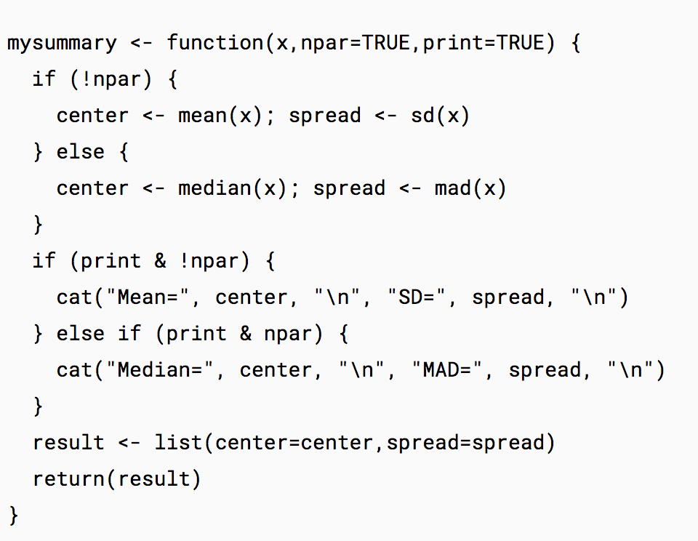
Functions in R
https://www.statmethods.net/management/userfunctions.html

Slide 5
Debug in R
https://support.rstudio.com/hc/en-us/articles/205612627-Debugging-with-RStudio
Debug: while running your code, if an error happens, you enter in an special environment just where the error happened
Browser: you inject this in your code, and you enter in an special environment at that specific point

Slide 6
Next sessions
Session 02 - Rshiny II (October, 2nd) Prototype: create the smallest app possible and getting it running in people computer.
Session 03 - Rshiny II (November, 20th) Generalization: how to have the data outside the app.
Session 04 - Docker (December, 4h) Deployment: how to create an image and upload it to docker hub.

