Slide 1
16S metagenomics
Lina L. Faller
Forsyth Institute
Notes:
Lina will discuss how to perform a basic "16S metagenomics" experiment that can tell you about microbial abundances in a clinical or environmental sample. She will expand on her experiences with two of the most commonly used tools in the field, qiime and mothur. If time permits, she will also touch briefly on how to perform functional metagenomics studies, i.e. determining not just who is there but also what the bacteria in the community are doing.

Slide 2
Overview
Microbes live in communities
Why do a metagenomics experiment?
16S
Qiime
Mothur
Functional metagenomics

Slide 3
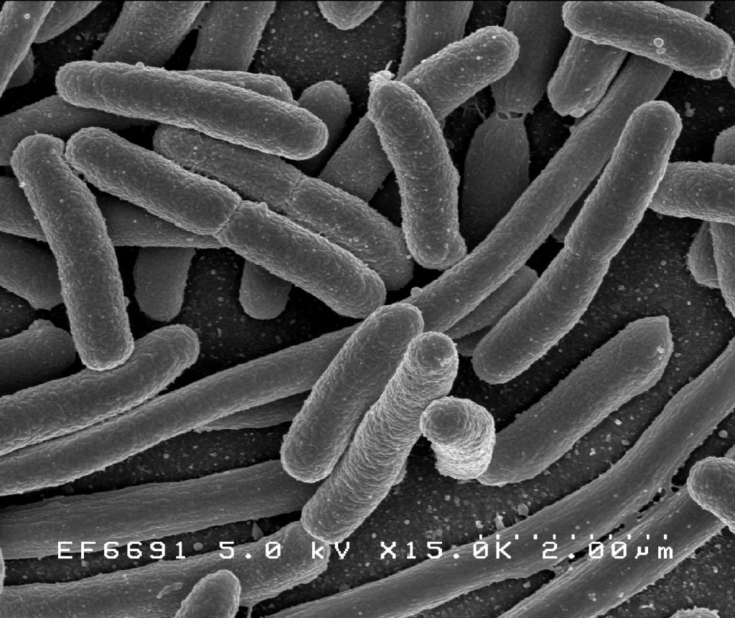
Microbes live in communities
Single-celled organisms with short, often circular genomes
E. coli is ~ 5Mb long
Computationally often easier to deal with than large eukaryotic or plant genomes ;-)
Live in often complex communities on many surfaces
Environmental: soil, ocean, ice, etc
Human body
Do they play a role in human disease??
Source: https://en.wikipedia.org/wiki/Escherichia_coli

Slide 4
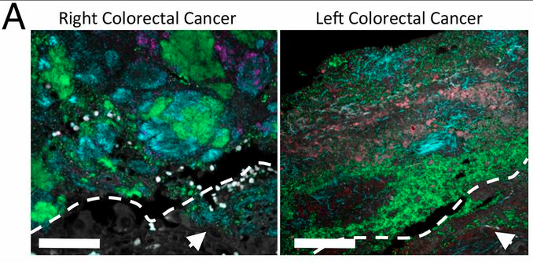
Microbes have been implicated in human diseases
Multiprobe spectral images of FISH-targeted bacterial groups (40×). Bacteroidetes (green), Lachnospiraceae (magenta), Fusobacteria (cyan), Enterobacteriaceae (orange), Bacteroides fragilis (red) are represented within the biofilms, and tissue autofluorescence is white.
Source: Dejea et al. 2015. PNAS. doi:10.1073/pnas.1406199111

Slide 5
Challenges
We know a lot about some microbes (E. coli etc) but about most of them we have no clue
What do they need to live?
What can they produce? i.e. metabolites
How do they influence their environment?
Who are the good guys, who are the bad guys?
Who is the boss in a microbial community? Is there just one, or many?
Need to answer these questions to find out how they affect human health.

Slide 6
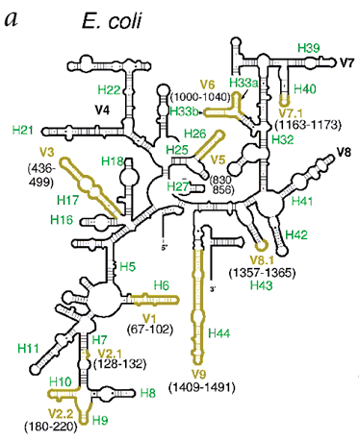
16S ribosomal RNA gene
A component of the 30S small subunit of prokaryotic ribosomes
Virtually every bacterium has it
Variable regions can distinguish between different genera or even species
Can design primers for variable regions and sequence those to get an idea of which microbes are present
Source: Tung et al. 2002. doi:10.1038/nsb841

Slide 7
Basic workflow
Use universal primers for your favorite variable region, pull out DNA, sequence it
We use Illumina MiSeq machines
Merge paired-end reads if you have them
Pick OTUs (operational taxonomic units)
Can use a reference database
Or use “de novo” OTU picking
We use ref database first, then do “de novo” on any leftovers
A good overview: http://qiime.org/tutorials/otu_picking.html
Remove chimeras
Sequences that have more than one parent; artifact of PCR step
http://qiime.org/tutorials/denoising_and_chimera_detection_usage_comparison.html
Map OTUs to taxonomy
Result: abundance table (counts)
 | Sample1 | Sample2 | … | SampleN
Org1 | 14 | 78 | … | 53
Org2 | 1277 | 64 | … | 189
… | … | … | … | …
OrgN | 67 | 354 | … | 876

Slide 8
Bioinformatics solutions
Qiime
Developed by Knight Lab (Univ of Colorado)
Collection of python scripts, plus some 3rd party tools
Has some useful visualizations
http://qiime.org/
mothur
Developed by Schloss Lab (Univ of Michigan)
Written in C++, takes advantage of parallel processors
Little visualization built-in
http://www.mothur.org/wiki/Main_Page
Both tools have tons of tutorials, are open-source, and have an active, supportive community

