Slide 1

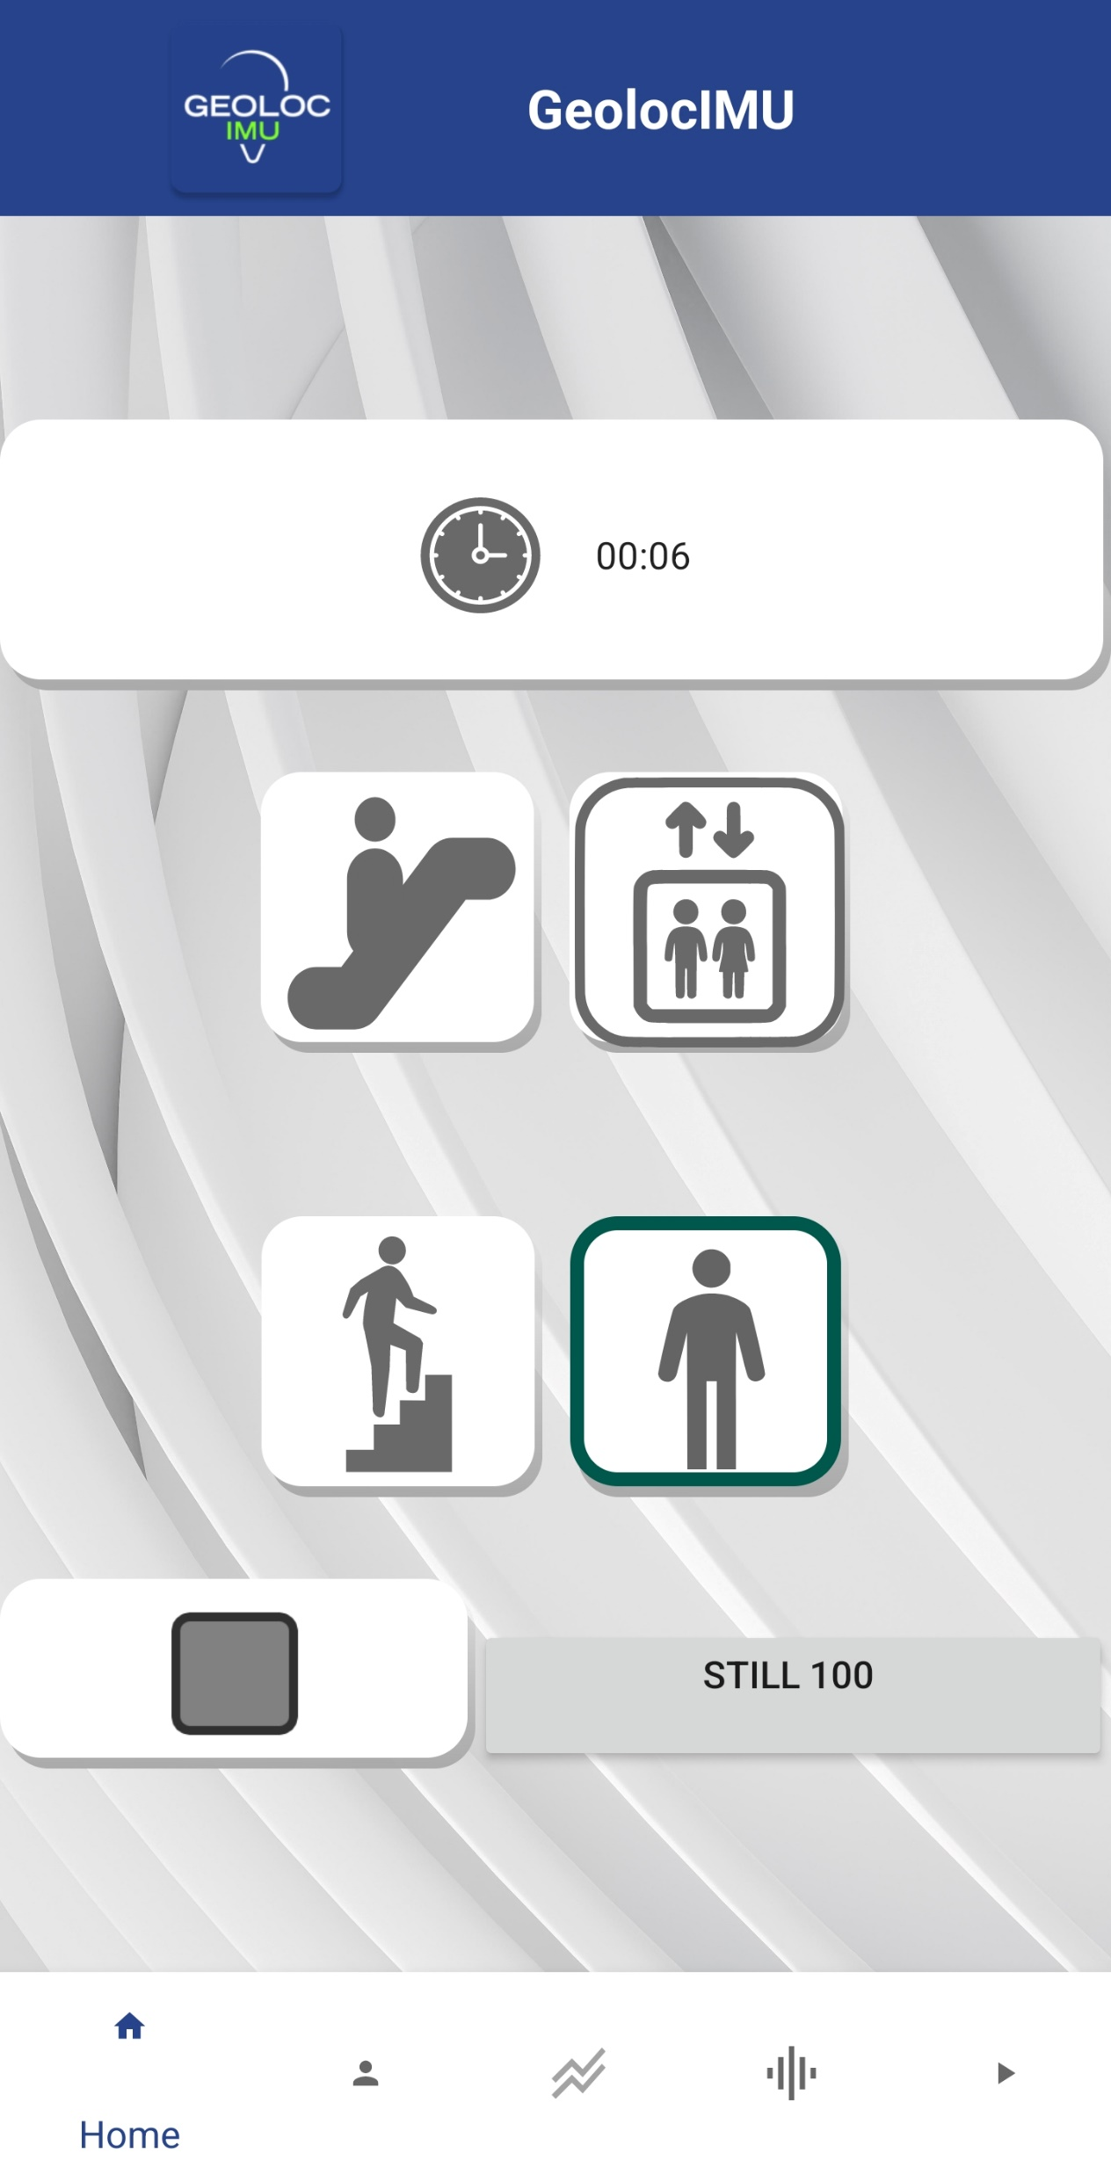
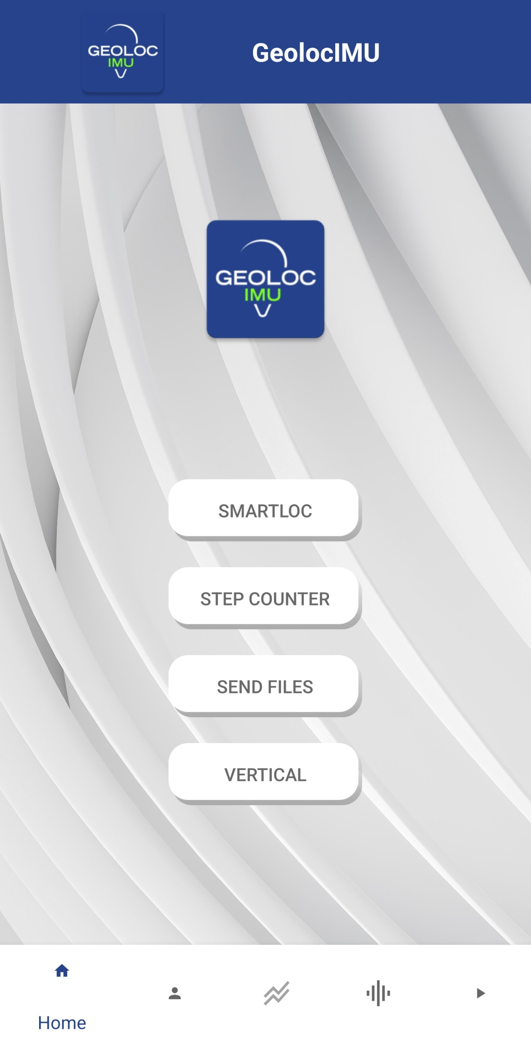

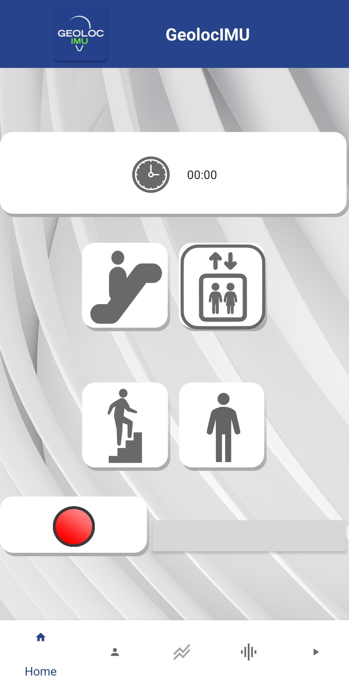



DATA COLLECTION PROTOCOL CHANGE OF FLOOR
Choose the floor change method you are going to use from the 4 choices below by pressing the icon defining it.
The button will appear with a green outline
To start recording, press the red button
Put your phone
in your pocket
In your bag
in your hand with your arm bent
in your hand with your arm at your side
Hold this position and take your travel mode
escalator
elevator/lift
stairs
standing still
Open the GeolocIMU application and
Select the ‘VERTICAL’ button on the home page
To stop recording, press the grey square button

Slide 2

DATA COLLECTION PROTOCOL CHANGE OF FLOOR ESCALATOR
Stand in front of the escalator and press the red button to start recording.
Then place your phone in your pocket or in your hand with your arm at your side.
Then use the escalator, standing still until you reach the end.
When the escalator is finished, take out your phone to stop the recording by pressing the grey button.

Slide 3
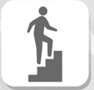
DATA COLLECTION PROTOCOL CHANGE OF FLOOR STAIRS
In front of the stairs at the top or bottom, position yourself and press the red button to start recording. Then place your phone in your pocket or in your hand, holding your arm at your side.
When you have finished, stop recording by pressing the grey button.

Slide 4
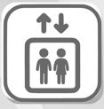
DATA COLLECTION PROTOCOL CHANGE OF FLOOR ELEVATOR
Position yourself in the lift with the lift doors closed.
Choose your floor and press the red button to start recording.
Then place your phone in your pocket or in your hand, holding your arm at your side or at an angle.
Use the lift by standing still until it is completed.
After the lift doors have opened on your arrival, take out your phone and stop the recording.

Slide 5

DATA COLLECTION PROTOCOL CHANGE OF FLOOR UNDEFINED
You can select this icon when you're standing still, for example waiting for the elevator.
You must be standing still for a long time (more than 3 seconds).

