Slide 1
Operation amplifier
Symbol
Example
Characteristics
Structure
Operation
Applications
μp 741

Slide 2
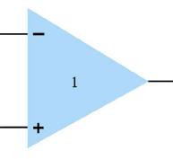
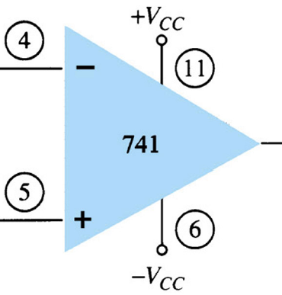
Symbol

Slide 3
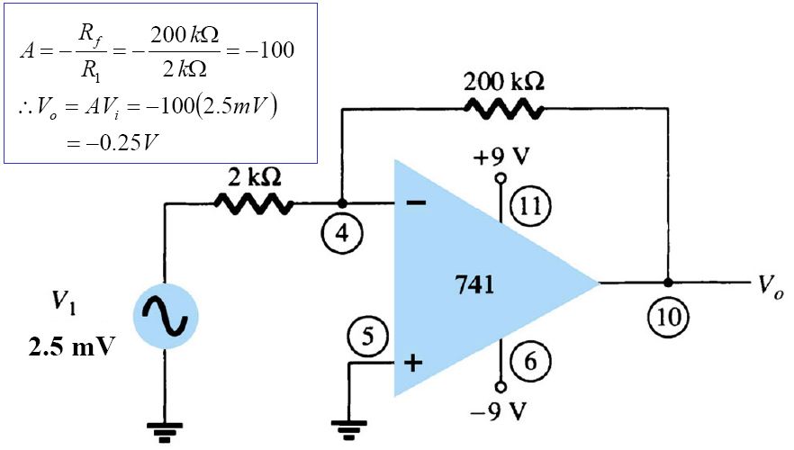
Example

Slide 4
Characteristics
Characters of circuits depend on outside circuit structure, not the opamp itself
Gain A_{V}: very high, ideally ∞
Zin: very large, ideally ∞
Zout: very small, ideally 0
Current entering the amp at either terminal: extremely small, ideally 0
Voltage out (when voltages into each other are equal): small, ideally 0
Bandwidth: broad, ideally infinite

Slide 5
Characteristics
Input: 2 inputs (positive and negative)
  Single-ended input: 1 input to signal source, 1 input to ground
  Double-ended input: 2 different signal sources or 1 signal source apply between 2 inputs
Output: 1 or 2 outputs, typically 1 output
Mode gain:
  Differential-mode gain A_{dm} - large
  Common-mode gain A_{cm} - small
  Common-mode rejection ratio CMRR=G=A_{dm}/A_{cm}, usually about 10³-10⁵

Slide 6
Structure
Requirement:
  Gain: large
  Offset: small
  Currents: small
  Input impedance: large
  Output impedance: small
  Input: symmetric

Slide 7
Structure
Input stage
Intermediate stage
Level shifting stage
Output stage
Example: 741 – at the end of chapter

Slide 8
Applications
Basic and advance applications
Basic applications:
  Inverting, non-inverting amplifier
  Uni-gain circuit
  Addition and subtraction circuits
  Integration and differential circuits
  Multi-stages circuit

Slide 9
Applications
Advance applications
  Current-controlled voltage source
  Voltage-controlled current source
  DC voltmeter
  AC voltmeter
  Driver circuit
  Active filters
  NIC
  .etc.

Slide 10
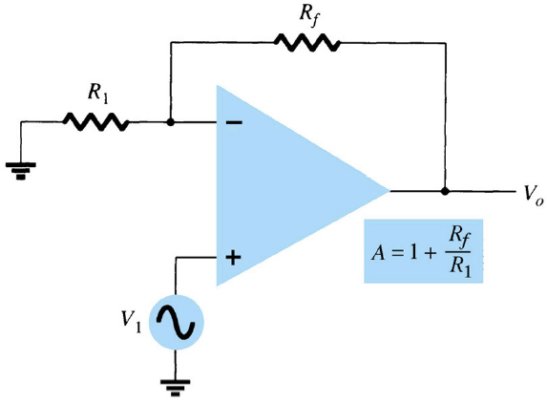
Non-inverting fixed-gain amplifier
Prove:
V- = V+ = V₁
I- = I+ = 0
=>I_{R1} = I_{rf} = V₁/R₁
=>A = 1+R_{f}/R₁

Slide 11
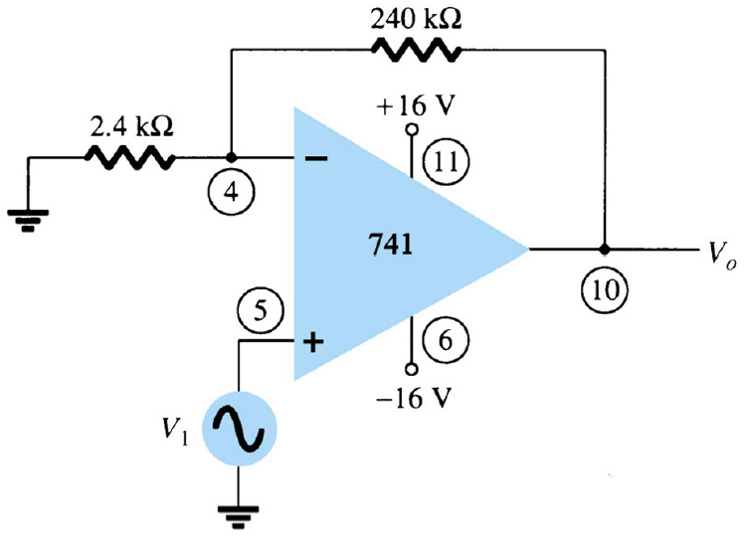
Non-inverting fixed-gain amplifier
A = 1+R_{f}/R₁=101
V_{o}=101V_{i}

Slide 12
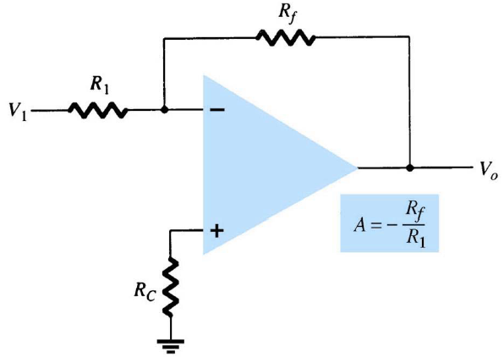
Inverting fixed-gain amplifier
Prove:
V- = V+ = 0
I- = I+ = 0
=>I_{R1} = I_{rf} = V₁/R₁
=>A = -R_{f}/R₁

Slide 13
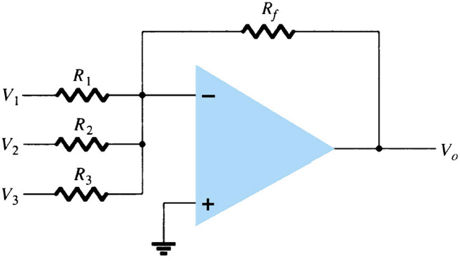
Voltage addition
V_{o} = -V₁R_{f}/R₁-V₂R_{f}/R₂ –V₃R_{f}/R₃
If V₁=V₂=V₃ then:
A= -R_{f}/R₁-R_{f}/R₂ –R_{f}/R₃

Slide 14
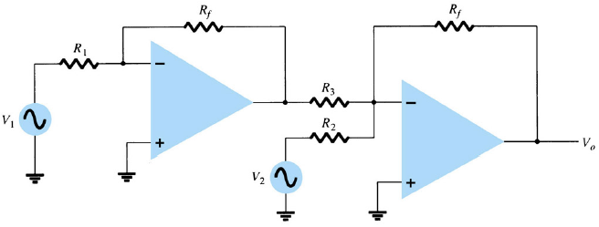
Voltage subtraction
V_{out1} = -R_{f}/R₁V₁
V_{out} = -R_{f}/R₂V₂ - R_{f}/R₂V_{out1} = -R_{f}/R₂V₂ + R_{f}/R₂V₁
= -R_{f}/R₂(V₁ – V₂)

Slide 15
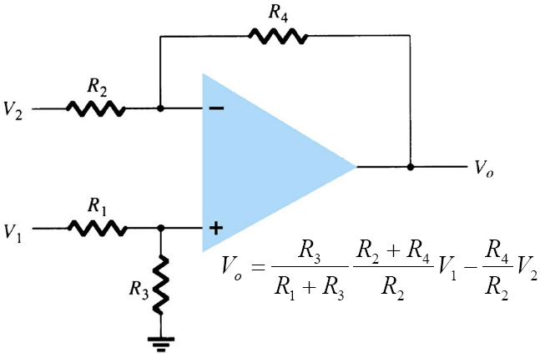
Voltage subtraction with 1 amp
Prove:
V-=V+=V₁*R₃/(R₁+R₃)
I- = I+ = 0
=>I_{R2} = I_{R4} = (V₂- V₁*R₃/(R₁+R₃))/R₂
=>Vo=V₁*R₃/(R₁+R₃)*
(R₂+R₄)/R₂ – V₂*R₄/R₂

Slide 16
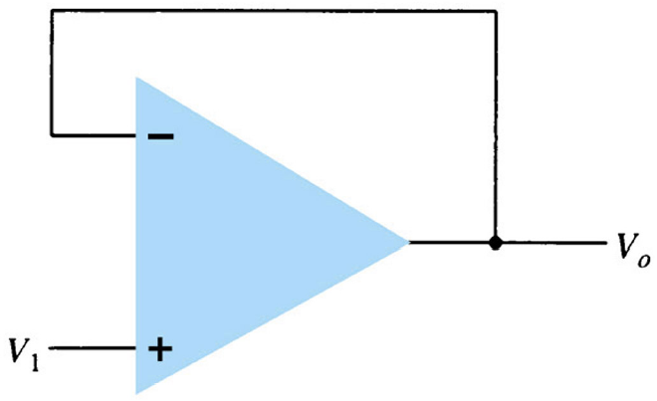
Uni-gain (buffer) amplifier
Provide required input and output resistant stage
Provide multiple identical output signals

Slide 17
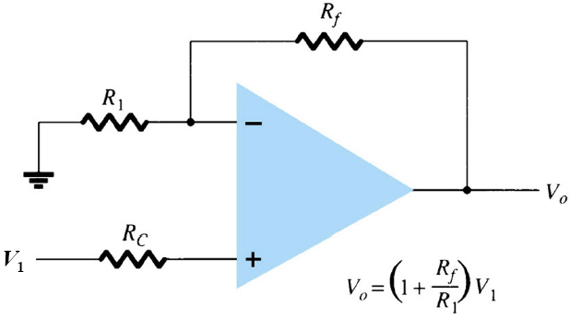
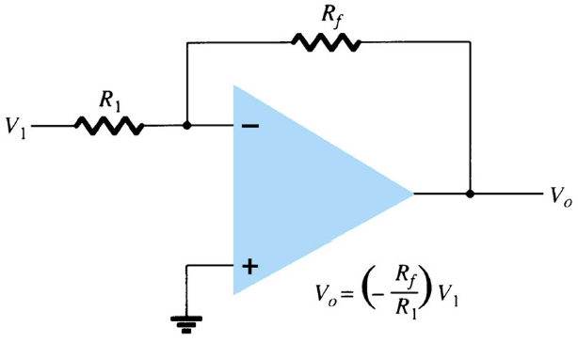
Voltage-controlled voltage source
V_{o}=(1+R_{f}/R₁)V₁
V_{o}=(-R_{f}/R₁)V₁

Slide 18
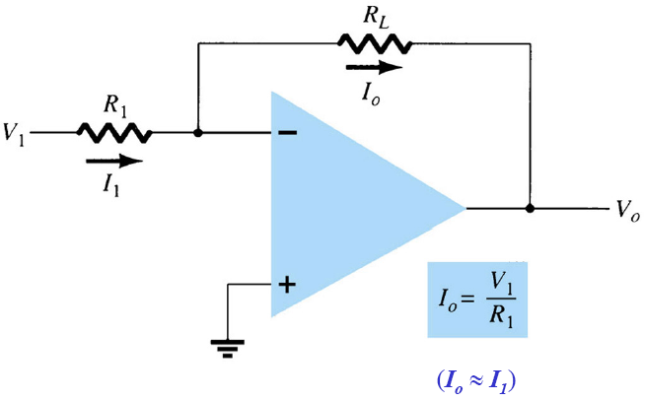
Voltage-controlled current source
I_{o}=V₁/R₁

Slide 19
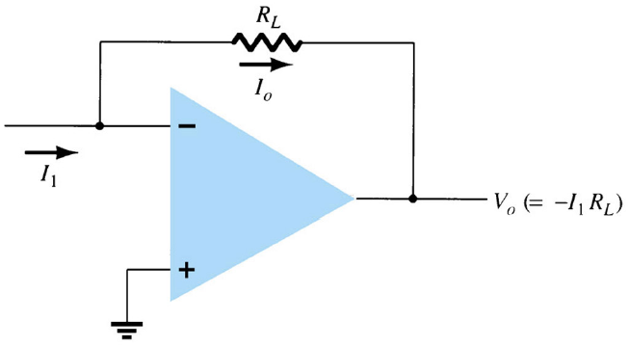
Current-controlled voltage source
V_{o}=-I₁R_{L}

Slide 20
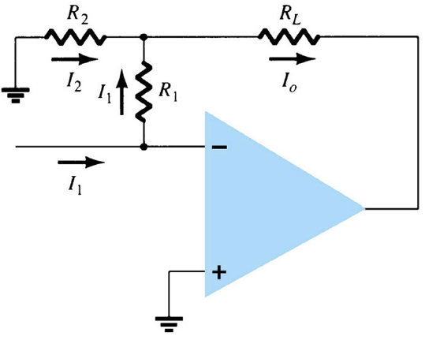
Current-controlled current source
I_{o}=I₁(R₂+R₁)/R₂

Slide 21
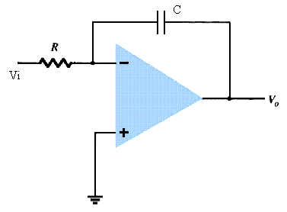
Integration circuit
V_{o}=(V_{i}/RC)₀ƒ^{T}V_{i}(t)dt+V_{out(t=0)}

Slide 22
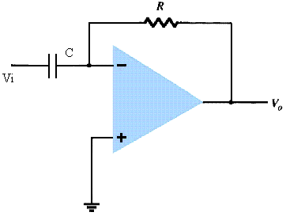
Differential circuit
V_{o}=-RC dV_{i}/dt

Slide 23
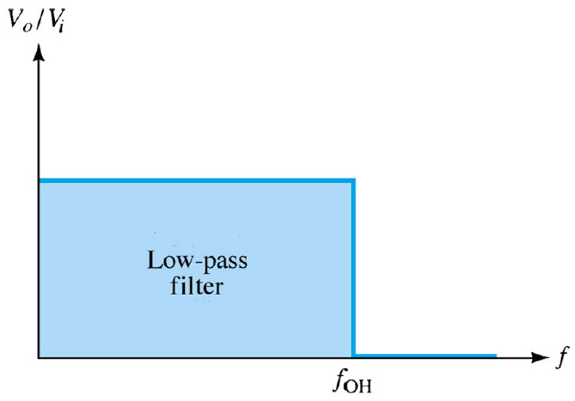
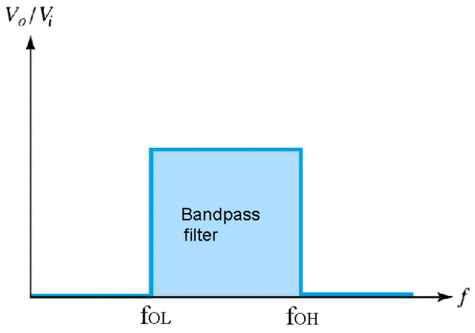
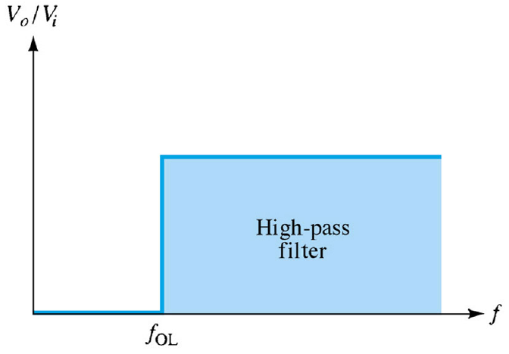
Filter
Low pass filter
High pass filter
Band pass filter

Slide 24
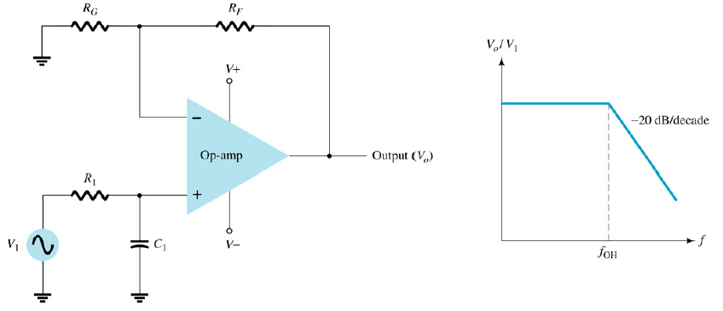
1st order low pass filter
Cutoff frequency: f_{OH}=1/(2πR₁C₁)
Voltage gain below cutoff freq: A_{v}=1+R_{f}/R_{G}

Slide 25
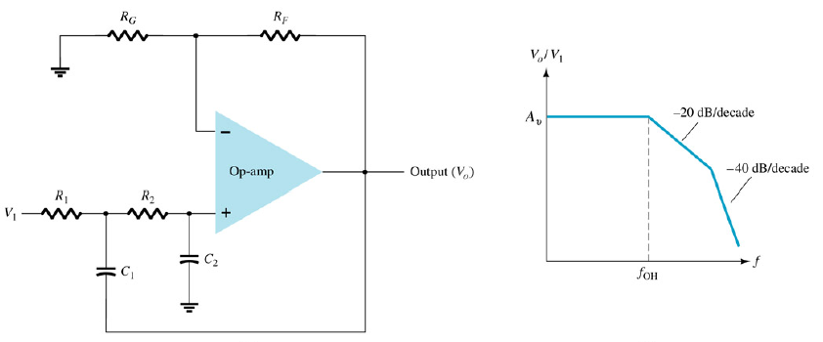
2nd order low pass filter
Cutoff frequency: f_{OH}=1/(2πR₁C₁)
Voltage gain below cutoff freq: A_{v}=1+R_{f}/R_{G}

Slide 26
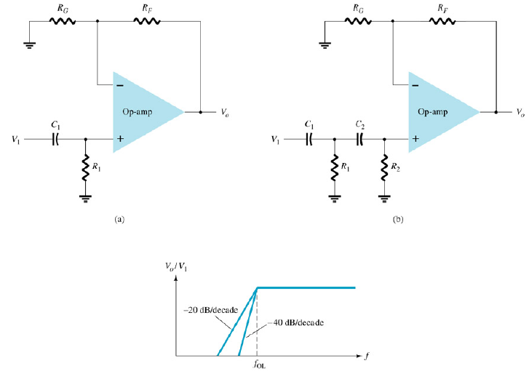
1st and 2nd order high pass filter
Cutoff frequency: f_{OL}=1/(2πR₁C₁)
Voltage gain above cutoff freq: A_{v}=1+R_{f}/R_{G}

Slide 27
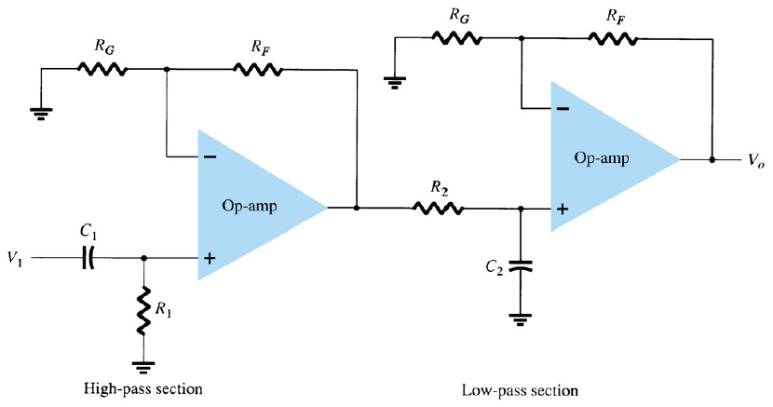
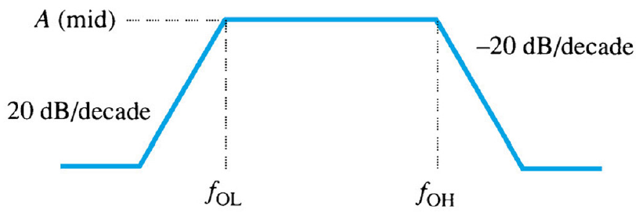
Band pass filter

Slide 28
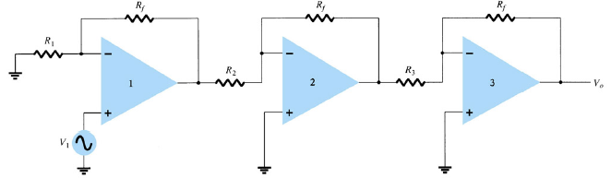
Multi-stages gain
A = A₁*A₂*A₃

Slide 29
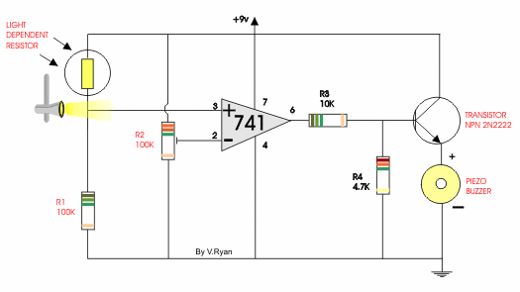
741 application-Light activated alerter

Slide 30
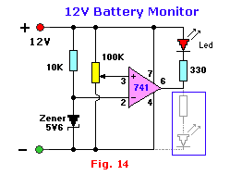
12V battery monitor

Slide 31
Homework
Chapter 14: 1, 4, 9, 10, 12, 15, 17, 18
Chapter 15: 1, 6, 8, 11, 14, 16, 17

Slide 32
OpAmp 741
Maximum ratings
Inside structure

Slide 33
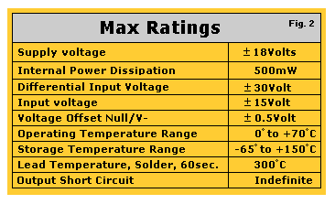
Maximum ratings

Slide 34
OpAmp 741 inside structure
Biasing Currents
Input Stage
Second Stage
Output Stage
Short Circuit Protection

Slide 35
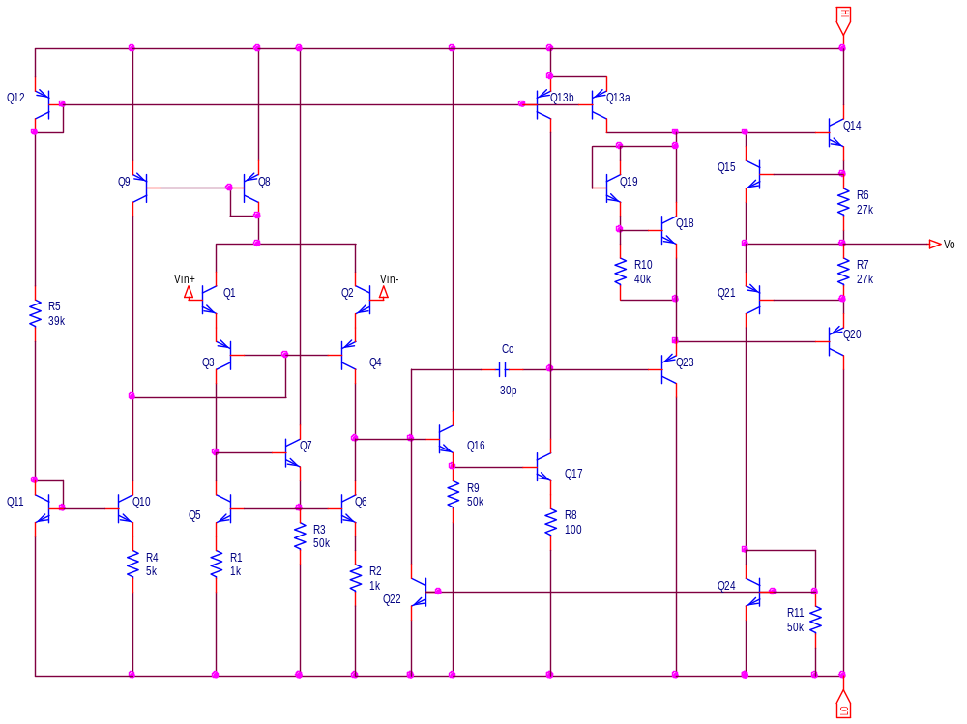
Inside structure: Schematic

Slide 36
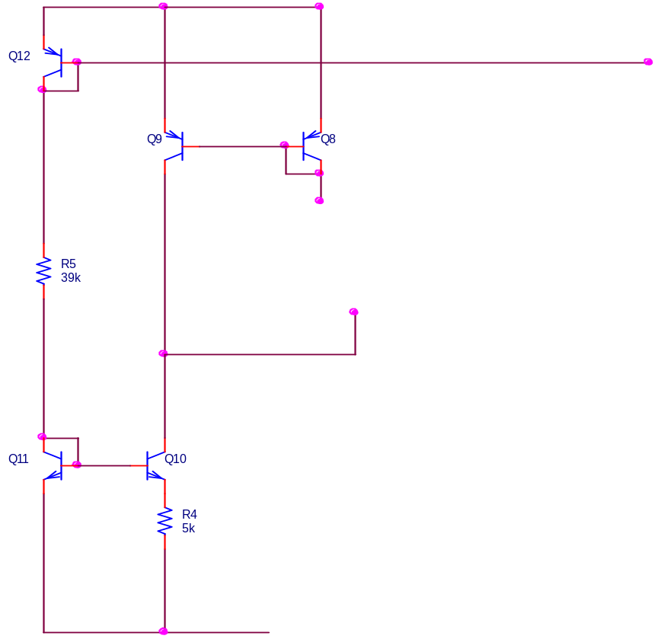
Biasing Current Sources
Generates reference bias current through R₅
The opAmp reference current is:
I_{ref}=[V_{CC}-V_{EB12}-V_{BE11}-(-V_{EE})]/R₅
For V_{CC}=V_{EE}=15V and V_{BE11}=V_{BE12}=0.7V, we have I_{REF}=0.73mA

Slide 37
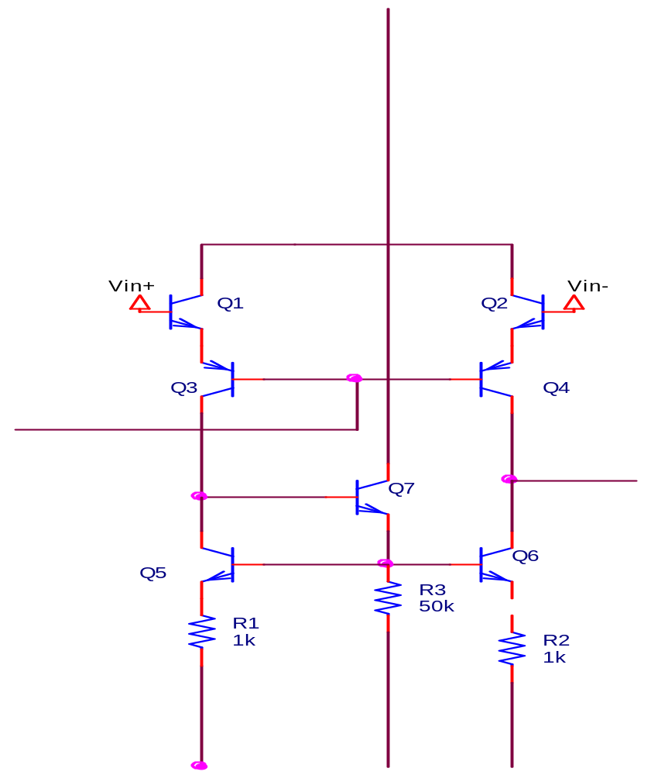
Input Stage
The differential pair, Q1 and Q2 provide the main input
Transistors Q5-Q7 provide an active load for the input

Slide 38
Input Stage:
DC Analysis - 1
Assuming that Q10 and Q11 are matched, we can write the equation from the Widlar current source:
Using trial and error, we can solve for I_{C10}, and we get: I_{C10}=19μA

Slide 39
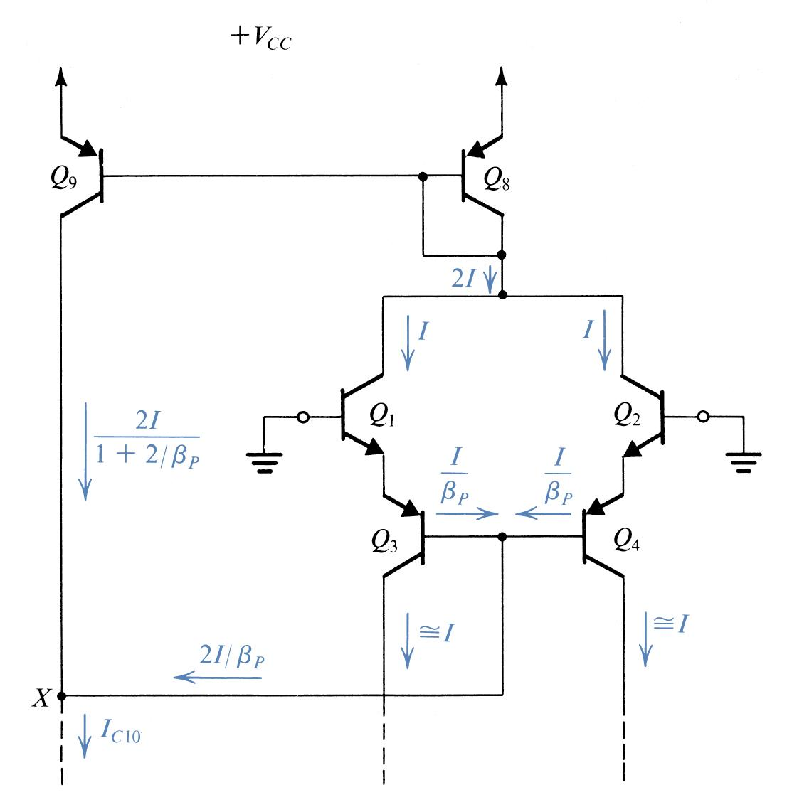
Input Stage: DC Analysis -2
From symmetry we see that I_{C1}=I_{C2}=I, and if the npn β is large, then I_{E3}=I_{E4}=I
Analysis continues:

Slide 40
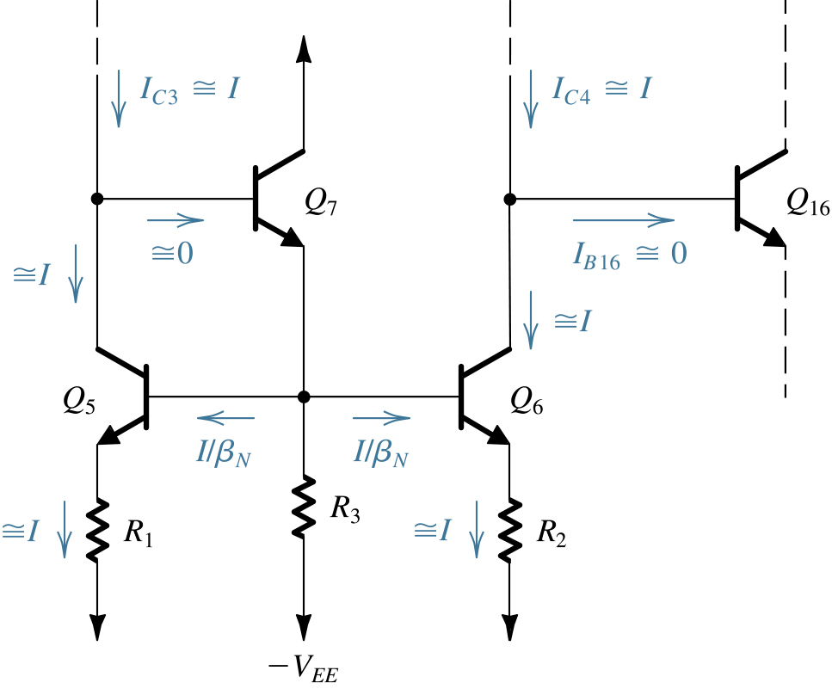
Input Stage: DC Analysis -3
Analysis of the active load:

Slide 41
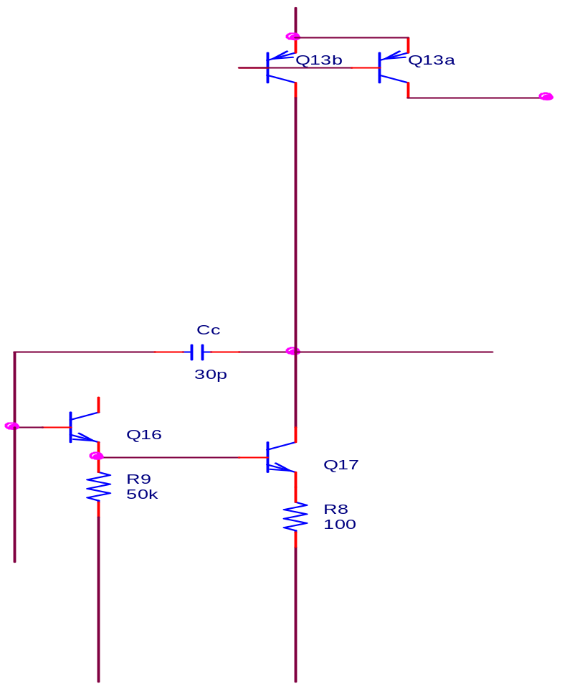
Second (Intermediate) Stage
Transistor Q16 acts as an emitter-follower giving this stage a high input resistance
Capacitor Cc provides frequency compensation using the Miller compensation technique

Slide 42
Second Stage:
DC Analysis
Neglecting the base current of Q23, I_{C17} is equal to the current supplied by Q13b
I_{C13b}=0.75I_{REF} where β_{P} >> 1
Thus: I_{C13b}=550uA=I_{C17}
Then we can also write:

Slide 43
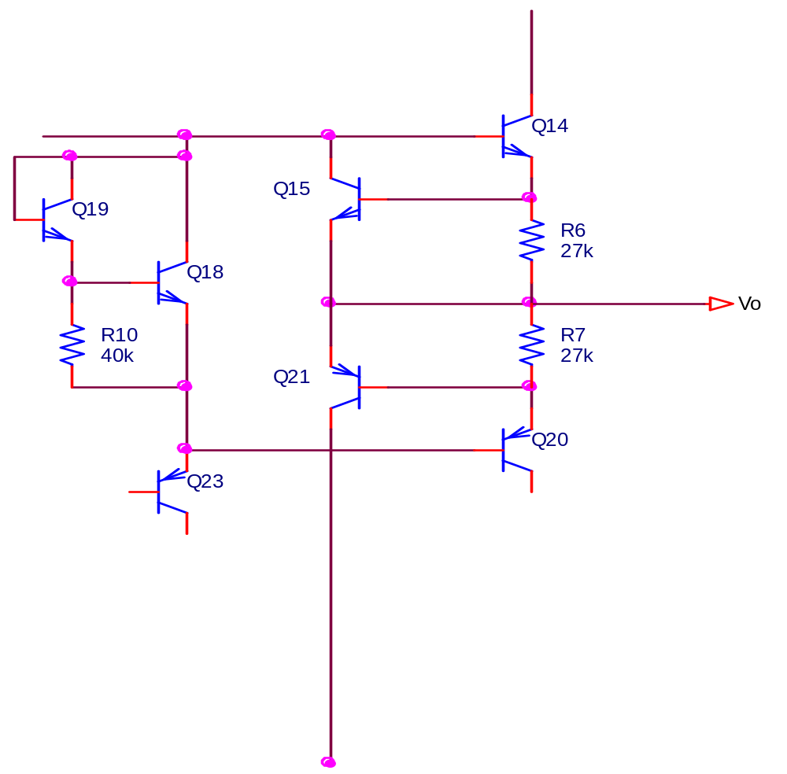
Output Stage
Provides the opAmp with a low output resistance
Class AB output stage provides fairly high current load capabilities without hindering power dissipation in the IC

Slide 44
Output Stage:
DC Analysis
Q13a delivers a current of 0.25I_{REF}, so we can say: I_{C23}=I_{E23}=0.25I_{REF}=180μA
Assuming V_{BE18} = 0.6V, then I_{R10}=15μA, I_{E18}=180-15=165μA and I_{C18}=I_{E18}=165μA
I_{C19}=I_{E19}=I_{B18}+I_{R10}=15.8μA

Slide 45
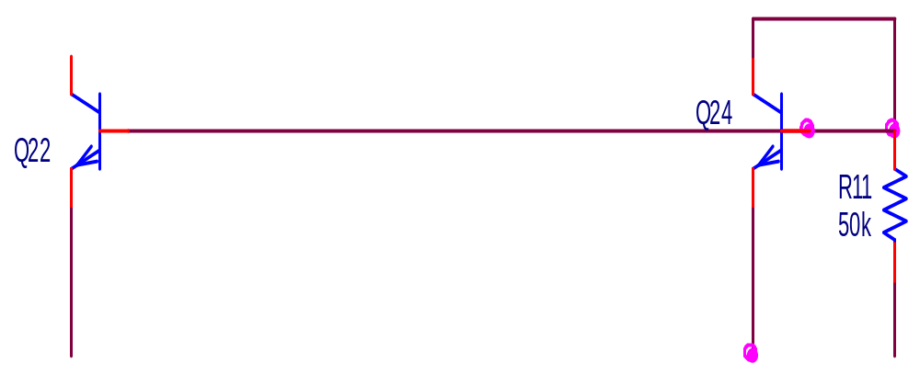
Short Circuit Protection
These transistors are normally off
They only conduct in the event that a large current is drawn from the output terminal (i.e. a short circuit)

