Slide 1
Digital Design And Synthesis
Lecture 1
  Instructor Introduction
  Course Introduction
  Introduction to Verilog

Slide 2
Instructor
Dr. Vo Le Cuong
Email: vlcuong231@yahoo.com or cuong.vole@hust.edu.vn
Mobile: 0938628986
Reseach Directions
Heart rate and/ or blood preasure measurement using mobile device (collaboration with Samsung Electronics Vietnam).
Heart rate measurement on Matlab and Android by analysing video signal of a finger or heart sound at chess.
Bood preasure measurement on Matlab and Android by analysing combined of video signal of a finger and heart sound at chess.

Slide 3
Instructor
Dr. Vo Le Cuong
Reseach Directions (cont.)
2. Development of 3D camera (collaboration with KAIST, Korea)
Image sensor design: (1) Increasing SNR, (2) Reducing cross talk.
Image signal processing: (1) Depthmap extraction: accuracy and real time processing, (2) High quality color: shapness, color restoration.
3. Car’s headlight detection (collaboration with KAIST, Korea)
Application for Intelligent transport system.
Application for traffic observation at night.
4. High speed video camera (collaboration with Ritsumeikan University, Korea)

Slide 4
Course Goals
Provide knowledge and experience in:
  Digital circuit design using a HDL (Verilog)
  HDL simulation
  How to build self checking test benches
  Good practices in digital design verification
  Synthesis of dataflow and behavioral designs
  Basic static timing analysis concepts
  Optimizing hardware designs (timing, area, power)
  Design tools commonly used in industry
Teach you to be able to “think hardware”

Slide 5
What You Should Already Know
Principles of basic digital logic design (Digital Electronics course)
  Number representations (unsigned, signed, Hex & Binary)
  Boolean algebra
  Gate-level design
  K-Map minimization
  Finite State Machines
  Basic datapath structures (adders, shifters, SRAM)

Slide 6
Course Materials
Lectures
Textbook
  Samir Palnitkar, Verilog HDL, Prentice Hall, 2003.
Standards
  IEEE Std.1364-2001, IEEE Standard Verilog Hardware Description Language, IEEE, Inc., 2001.
  IEEE Std 1364.1-2002, IEEE Standard for Verilog Register Transfer Level Synthesis, IEEE, Inc., 2002
Synopsys on-line documentation
Other useful readings
  Michael D. Cilleti, Advanced Digital Design with Verilog HDL, Prentice Hall, 2005
  .

Slide 7
Evaluation and Grading
Approximately:
  30% Midterm: Project (groups of about 3 students, Establish team soon, Additional points to final exam if achieve excellent Project results).
  70% Final exam.
Homework and quiz at class
  Completion of all homework and quiz before final exam is a must
  Additional points to final exam if achieve excellent results.

Slide 8
Class Project
Work in groups of about 3 students
Design, model, simulate, synthesize on FPGA and/ or on ASIC, and test a complex digital system
Several milestones
  Forming teams
  Project status report two times before the last report
  Final demonstration & report at the last week of class
More details coming later in the course

Slide 9
Course Tools
Industry-standard design tools:
  Modelsim HDL Simulation Tools (Mentor), Quatus ii Synthesis tool for Altera FPGA.
  Design Vision Synthesis Tools (Synopsys)
  LSI Logic Gflx 0.11 Micron CMOS Standard Cell Technology Library
Tutorials will be available for all tools
  Modelsim and Quatus ii tutorial the week after next week.
  Design Vision tutorial a few weeks later
  Tool knowledge will be required to complete project
  TA will be a resource for help on tools

Slide 10
Readings for Week 1
Read Chapter 1 (short)
  Overview of Digital Design with Verilog HDL
Read Chapter 2 (short)
  Hierarchical Modeling Concepts
Read Chapter 3
  Basic Verilog Syntax
  Samir Palnitkar, Verilog HDL, Prentice Hall, 2003.

Slide 11

Why Digital?
RTL Hardware Design
Chapter 1
3
by Cuong Vo Le

Slide 12
Advantages
Advantage of digital devices
- Reproducibility of information
- Flexibility and functionality: easier to store, transmit
and manipulate information
- Economy: cheaper device and easier to design
Moore’s law
- Transistor geometry
- Chips double its density (number of transistor) in
every 18 months
- Devices become smaller, faster and cheaper
- Now a chip consists of hundreds of million gates
- And we can have a “wireless-PDA-MP3-player-
camera-GPS-cell-phone”.
RTL Hardware Design
Chapter 1
4
by Cuong Vo Le
Notes:
Reproductibility means copy
Search Transistor Count

Slide 13
Applications of digital systems
• “Digitization” has spread to a wide range of
applications, including information (computers),
telecommunications, control systems etc.
• Digital circuitry replaces many analog systems:
- Audio recording: from tape to music CD to MP3
(MPEG Layer 3) player
- Image processing: from silver-halide film to digital
camera
- Telephone switching networks
- Control of mechanical system: e.g., “flight-by-wire”
RTL Hardware Design
Chapter 1
5
by Cuong Vo Le
Notes:
flight-by-wire =/ manual flight controls
Automatic signal sent by computer controls the fligt without pilots and electronic signals transmitted by wires
A silver halide is one of the compounds formed between silver and one of the halogens — silver bromide (AgBr), chloride (AgCl), iodide (AgI), and three forms of silver fluorides

Slide 14
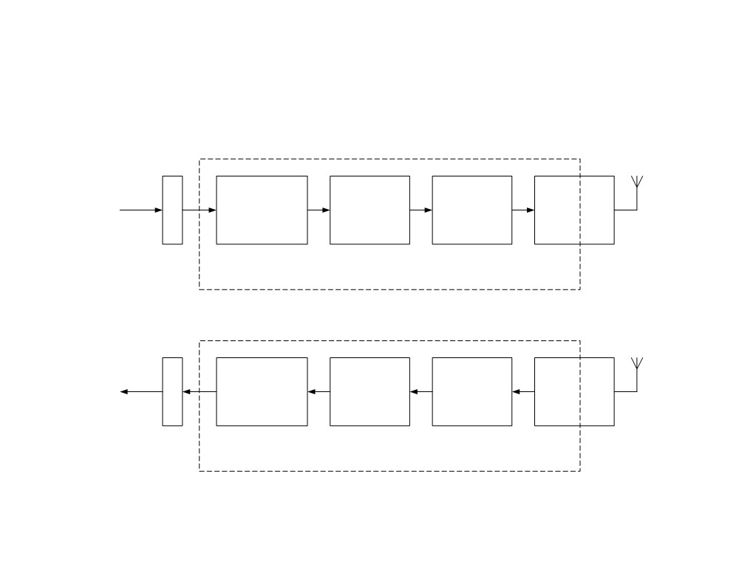
e.g, digital circuit in a wireless
communication system
transmitter
A
Data
compression
Error
Data
info /
correction Modulation
encryption
D
coding
digital implementation
D
Data de-
compression
Data
Error
De-
info /
correction
decryption
modulation
A
de-coding
digital implementation
receiver
RTL Hardware Design
by Cuong Vo Le
Chapter 1
6

Slide 15
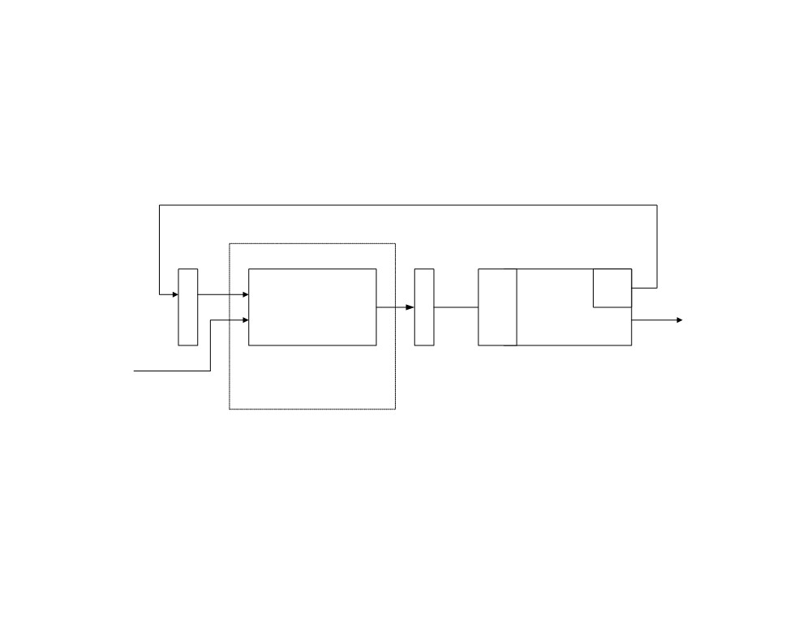
e.g, digital circuit in a control
system
A
/
D
Sen
sor
Controller /
actu
ator
Plant
output
D
A
set point
digital
implementation
RTL Hardware Design
by Cuong Vo Le
Chapter 1
7
Notes:
An actuator is a type of motor for moving or controlling a mechanism or system

Slide 16
How to implement a digital system
• No two applications are identical and every one
needs certain amount of customization
• Basic methods for customization
(1) “General-purpose hardware” with custom software
• General purpose processor: e.g., performance-oriented
processor (e.g., Pentium), cost-oriented processor
(e.g., PIC micro-controller)
• Special purpose processor: with architecture to perform
a specific set of functions: e.g., DSP processor (to do
multiplication-addition), network processor (to do
buffering and routing), “graphic engine” (to do 3D
rendering)
RTL Hardware Design
Chapter 1
8
by Cuong Vo Le

Slide 17
(2) Custom hardware
(3) Custom software on a custom processor (known as
hardware-software co-design)
• Trade-off between Programmability, Coverage,
Cost, Performance, and Power consumption
• A complex application contains many different
tasks and use more than one customization
methods
RTL Hardware Design
Chapter 1
9
by Cuong Vo Le

Slide 18
What is an HDL?
HDL = Hardware Description Language
  Allows for modeling & simulation (with timing) of digital designs
  Can be synthesized into hardware (netlist) by synthesis tools (Synopsys, Ambit, FPGA compilers)
  Two major standards in industry & academia
    Verilog (Flexible, loose, more common in industry)
    VHDL (Strongly typed, more common in defense and automotive)
    Having used both but this course will use Verilog
    Once you have the concept of an HDL down (can think and code hardware), the language makes little difference.

Slide 19
What is an HDL? (continued)
module counter(clk,rst_n,cnt);
input clk,rst_n;
output [3:0] cnt;
reg [3:0] cnt;
always @(posedge clk) begin
if (~rst_n)
cnt = 4’b0000;
else
cnt = cnt+1;
end
endmodule
It looks like a programming language
It is NOT a programming language
  It is always critical to recall you are describing hardware
  This codes primary purpose is to generate hardware
  The hardware this code describes (a counter) can be simulated on a computer. In this secondary use of the language it does act more like a programming language.

Slide 20
Simulating/Validating HDL
The sad truth…
  10% design, 90% validation
  If you do it right you will spend 9X more time testing/validating a design than designing it.
Testbenchs are written in verilog as well.
Testbench verilog is not describing hardware and can be thought of as more of a program.
Stimulus
Generation
(verilog)
Design
Under Test
(verilog)
Output
Monitoring
Self Checking
(verilog)
file
Verilog test bench shell
file

Slide 21
What is Synthesis?
Takes a description of what a circuit DOES
Creates the hardware to DO it
Output is actually a text
netlist, not a GUI schematic
form.
module counter(clk,rst_n,cnt);
input clk,rst_n;
output [3:0] cnt;
reg [3:0] cnt;
always @(posedge clk) begin
if (~rst_n)
cnt = 4’b0000;
else
cnt = cnt+1;
end
endmodule
Synthesis Tool
(Synopsys)
Increment
Combinational
Logic
cnt[3:0]
rst_n
4
4
4
clk

Slide 22
Synthesizing the Hardware Described
All hardware created during synthesis
  Even if a is true, still computing d&e
Learn to understand how descriptions translated to hardware
if (a) f = c & d;
else if (b) f = d;
else f = d & e;
c
f
d
e
b
a

Slide 23
Why Use an HDL?
Enables Larger Designs
  More abstracted than schematics, allows larger designs.
    Register Transfer Level Description
    Wide datapaths (16, 32, or 64 bits wide) can be abstracted to a single vector
    Synthesis tool does the bulk of the tedious repetitive work vs schematic capture
  Work at transistor/gate level for large designs: cumbersome
Portable Design
  Behavioral or dataflow Verilog can be synthesized to a new process library with little effort (i.e. move from 0.11μ to 45nm process)

Slide 24
Why Use an HDL? (continued)
Portable Design (continued)
  Verilog written in ASCII text. The ultimate in portability. Much more portable than the binary files of a GUI schematic capture tool.
Explore larger solution space
  Synthesis options can help optimize (power, area, speed)
  Synthesis options and coding styles can help examine tradeoffs
    Speed
    Power
    area

Slide 25
Why Use an HDL? (continued)
Better Validated Designs
  Verilog itself is used to create the testbench
    Flexible method that allows self checking tests
    Unified environment
  Synthesis tool are very good from the boolean correctness point of view
    If you have a logic error in your final design there is a 99.999% chance that error exists in your behavioral code
    Errors caused in synthesis fall in the following categories
      Timing
      Bad Library definitions
      Bad coding style…sloppyness

Slide 26
Other Important HDL Features
Are highly portable (text)
Are self-documenting (when commented well)
Describe multiple levels of abstraction
Represent parallelism
Provides many descriptive styles
  Structural
  Register Transfer Level (RTL)
  Behavioral
Serve as input for synthesis tools
Notes:
Parallelism: the state of being similar; a similar feature
Show example of levels of abstration.
Descriptive styles through 2-1 Mux.

Slide 27
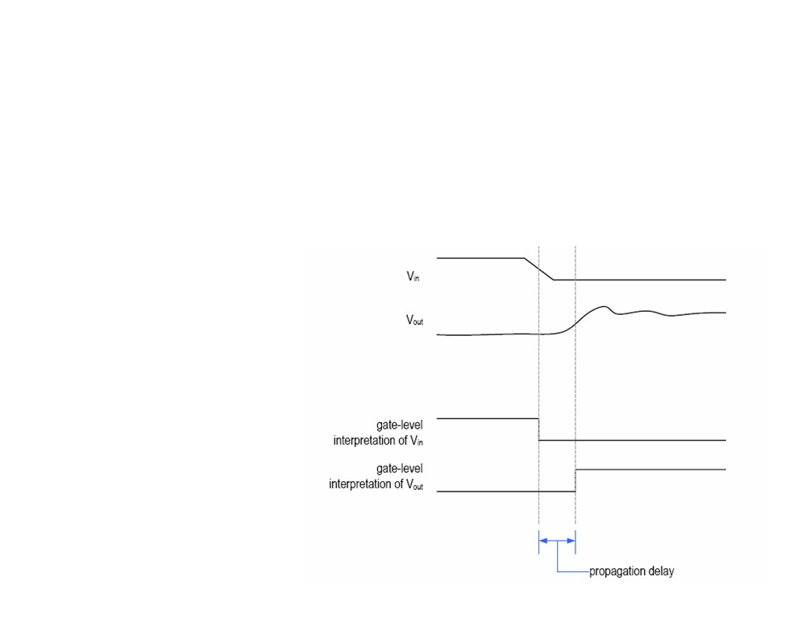
• How to manage complexity for a chip with hundreds of
millions of transistors?
• Abstraction: simplified model of a system
- show the selected features
- Ignore associated detail
Transistor Level Abstraction
• E.g., timing of
an inverter
Gate Level Abstraction
RTL Hardware Design
by Cuong Vo Le
Notes:
Example of two different levels of abstraction

Slide 28
Hardware Implementations
HDLs can be compiled to semi-custom and programmable hardware implementations
Full Custom
Semi-Custom
Programmable
Manual VLSI
Standard Cell
Gate Array
FPGA
PLD
less work, faster time to market
implementation efficiency
Notes:
In Fab: Full custam and semi-custom
In Field: Programmable.

Slide 29
Hardware Building Blocks
G
Transistors are switches
Use multiple transistors to make a gate
Use multiple gates to make a circuit
D
S
A
A
A
A

Slide 30
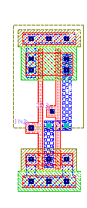
Standard Cells
Library of common gates and structures (cells)
Decompose hardware in terms of these cells
Arrange the cells on the chip
Connect them using metal wiring
…
Notes:
Content of this course

Slide 31
FPGAs
“Programmable” hardware
Use small memories as truth tables of functions
Decompose circuit into these blocks
Connect using programmable routing
SRAM bits control functionality
FPGA Tiles
P1
P2
P
P3
OUT
P4
P5
P6
P7
P8
I1
I2
I3
Notes:
Content of this course
Tham khao sach Digital System Design using VHDL ve Xilinx XC3020, page 201

Slide 32
What is a Netlist?
A netlist is a ASCII text representation of the interconnect of a schematic
Many Standards Exist:
  Spice Netlist
  EDIF (Electronic Data Interchange Format)
  Structural Verilog Netlist (this is what we will use)
module comb(Z,A,B,C);
input A,B,C;
output Z;
wire n1, n2;
and02d1 A1(n1,A,B);
inv01d1 I1(n2,C);
and02d1 A2(Z,n1,n2);
endmodule
A
comb
n1
A1
=
B
A2
C
I1
n2
Z

Slide 33
FSM Review
Combinational and sequential logic
Often used to generate control signals
Reacts to inputs (including clock signal)
Can perform multi-cycle operations
Examples of FSMs
  Counter
  Vending machine
  Traffic light controller
  Bus Controller
  Control unit of serial protocol (like RS232, I2C or SPI)

Slide 34
Mealy/Moore FSMs
Mealy
Inputs
Next State
Logic
Outputs
Output
Logic
State Register
Next State
Current State
FF

Slide 35
FSMs
Moore
  Output depends only on current state
  Outputs are synchronous (but not necessarily glitch free)
Mealy
  Output depends on current state and inputs
  Outputs can be asynchronous
    Change with changes on the inputs
  Outputs can be synchronous
    Register the outputs
    Outputs delayed by one cycle

Slide 36
Remember Bubble Diagrams?
They can be useful. I sometimes will draw a bubble diagram first for a complex FSM. Then code it.
Notes:
Example: Digital System design using VHDL, Traffic light controller, page 104

Slide 37
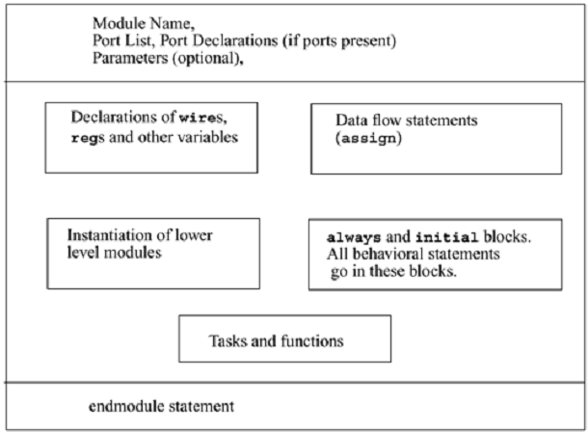
Verilog Module
Notes:
Can’t use keywords as module/port/signal names
Choose a descriptive module name
Declare any internal signals
- Write the main content of the module (functionality)
Declare type of port
input
output
inout (bidirectional)
Scalar (single bit) - don’t specify a size
input cin;
Vector (multiple bits) - specify size using range
Range is MSB to LSB (left to right)
Don’t have to include zero if you don’t want to… (D[2:1])
output [7:0] OUT;
input [0:4] IN;
Modules can be specified different ways
Structural – connect primitives and modules
Dataflow– use continuous assignments
Behavioral – use initial and always blocks
A single module can use more than one method!
What are the differences?

Slide 38
Verilog Module
A[1:0]
In Verilog, a circuit is a module.
2
Decoder
2-to-4
module decoder_2_to_4 (A, D) ;
input [1:0] A ;
output [3:0] D ;
assign D = (A == 2'b00) ? 4'b0001 :
(A == 2'b01) ? 4'b0010 :
(A == 2'b10) ? 4'b0100 :
(A == 2'b11) ? 4'b1000 ;
endmodule
4
D[3:0]

Slide 39
Verilog Module
A[1:0]
module name
port list
2
Decoder
2-to-4
module decoder_2_to_4 (A, D) ;
input [1:0] A ;
output [3:0] D ;
assign D = (A == 2'b00) ? 4'b0001 :
(A == 2'b01) ? 4'b0010 :
(A == 2'b10) ? 4'b0100 :
(A == 2'b11) ? 4'b1000 ;
endmodule
port types
port sizes
4
D[3:0]
module contents: dataflow statement
End module statement

Slide 40
Module Styles
Modules can be specified different ways
  Structural – connect primitives and modules
  Dataflow– use continuous assignments
  Behavioral – use initial and always blocks
A single module can use more than one method!
What are the differences?

Slide 41
Structural
A schematic in text form (i.e. A netlist)
Build up a circuit from gates/flip-flops
  Gates are primitives (part of the language)
  Flip-flops themselves described behaviorally
Structural design
  Create module interface
  Instantiate the gates in the circuit
  Declare the internal wires needed to connect gates
  Put the names of the wires in the correct port locations of the gates
    For primitives, outputs always come first

Slide 42
Structural Example
module majority (major, V1, V2, V3) ;
output major ;
input V1, V2, V3 ;
wire N1, N2, N3;
and A0 (N1, V1, V2),
A1 (N2, V2, V3),
A2 (N3, V3, V1);
or Or0 (major, N1, N2, N3);
endmodule
V1
N1
A0
V2
V2
A1
N2
Or0
major
V3
V3
A2
N3
V1
majority

Slide 43
RTL Example
module majority (major, V1, V2, V3) ;
output major ;
input V1, V2, V3 ;
assign major = V1 & V2
| V2 & V3
| V1 & V3;
endmodule
majority
V1
V2
major
V3

Slide 44
Behavioral Example
module majority (major, V1, V2, V3) ;
output reg major ;
input V1, V2, V3 ;
always @(V1, V2, V3) begin
if (V1 && V2 || V2 && V3
|| V1 && V3) major = 1;
else major = 0;
end
endmodule
majority
V1
V2
major
V3

Slide 45
Things to do
Read Chapter 1 (short)
  Overview of Digital Design with Verilog HDL
Read Chapter 2 (short)
  Hierarchical Modeling Concepts
Read Chapter 3
  Basic Verilog Syntax (a little dry/boring but necessary)

Slide 46
Review Questions
What are some advantages of using HDLs, instead of schematic capture?
What advantages and disadvantages do standard cell designs have compared to full-custom designs?
What are some ways in which HDLs differ from conventional programming languages? How are they similar?
What are the different styles of Verilog coding?
Notes:
Complete exercises of chapter 2, Verilog HDL book, Samir.

