Slide 1
ECE 551
Digital Design And Synthesis
Fall ‘09
Parasitic Capacitance
SDF & Back Annotation

Slide 2
Administrative Matters
Project…How is it going?
  Time is running out…This is Dec 2nd. Due in 14 to 16 days
  Testbench?
  Statemachine?
  Datapath?
  Synthesis script & post synthesis run
HW6 100 pts. Meet with Vinod or Myself by end of this week (Friday Dec 4th) and show progress on design (code for testbench, statemachine, & datapath).
Wednesday Dec 9th will be last class period

Slide 3
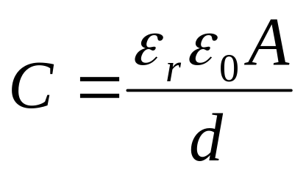
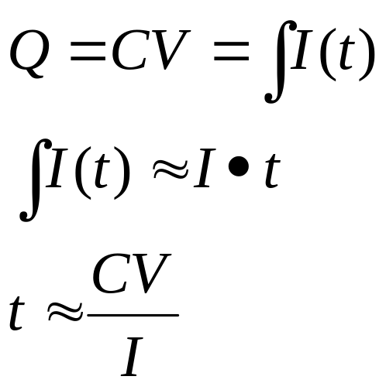
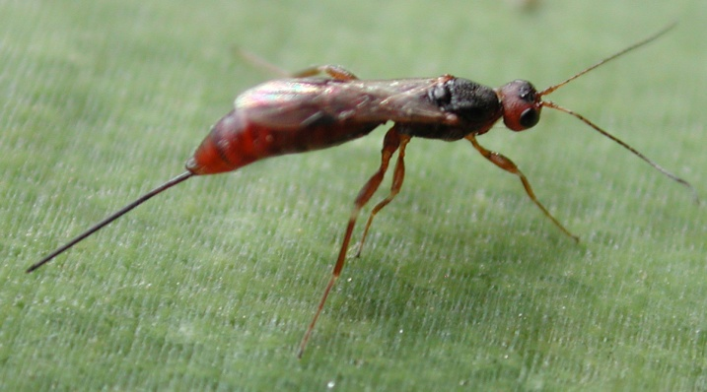
Capacitance is Unavoidable
Any two conducting geometries separated by an insulator will have capacitance between them.
In digital circuits capacitances slow the circuit down.
Time to charge a capacitance C to a voltage V is proportional to C.
More cap ➔ Slower charge up
Unavoidable & Undesireable:
Any questions on why we call it parasitic capacitance?

Slide 4
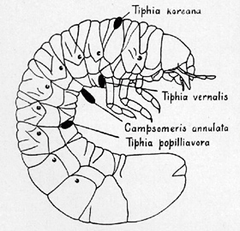
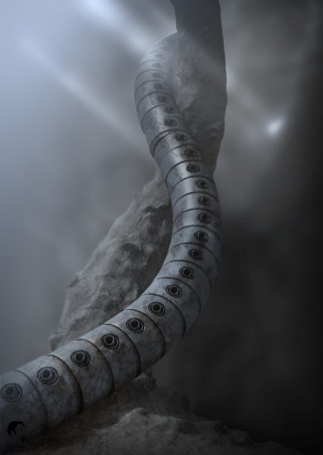

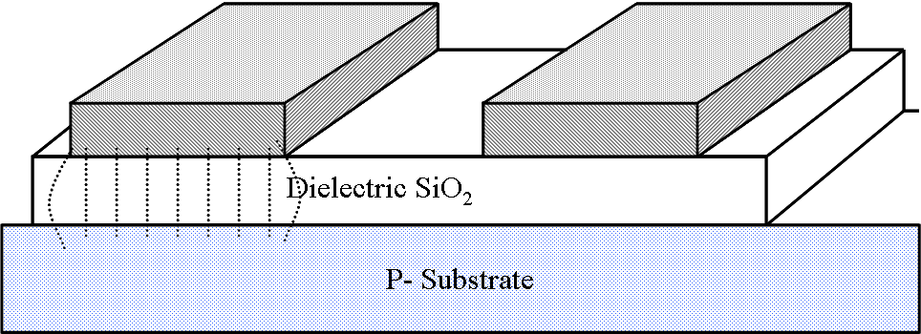
What do Our Parasitics Look Like?
Wisconsin’s
most prevalent
No…I meant on
an integrated circuit

Slide 5
Modern Processes Are Worse
As the spacing shrank the height did not shrink, or even grew to try to recoup some of the conductance lost by narrowing the line.
As technologies scaled smaller the aspect ratio of the wires changed. Typical wire is now “taller” than it is wide.
Fringe components and
line to line components
now dominate. Parallel
plate is a small percent of
the total cap.
SiO₂
P- Substrate

Slide 6
Cap to ground & Cap to neighbors
3
C_{TOTAL}
2
C_{GROUND}
This graph is for the
middle conductor
“sandwiched” between
two other conductors
at minimum spacing.
Capacitance (pF/cm)
1
C_{LINE-LINE}
1
2
3
4
Not only is this sidewall and fringing capacitance brining the total cap higher, but it creates a whole new noise problem called cross-talk due to the line to line capacitances.
Design Rule (μ)

Slide 7
How do we Simulate this Effect?
Synopsys Doesn’t Have a Clue
  Sad reality is wireload model is a S.W.A.G.
  Might as well go ask the local fortune teller if your circuit is going to work
Need to extract the value of parasitic capacitance from actual layout of the circuit.
  Since parasitics are dominated by wiring, the wiring has to be routed to extract it.
  Need to perform APR first!

Slide 8
What is an APR (Auto Place & Route) Block?
  Netlist mapped to standard logic cells (from synthesis tool) is read into a CAD tool.
  Standard Cells (typically of a fixed height) are placed by an automated program in
  cell rows (Place)
  Then they are interconnected (Route)

Slide 9
What is a Parasitic Extractor
Does it remove the parasitics?
  Quit asking stupid questions…”I cannot change the laws of physics Captain”
No, it just reads all the geometries of the interconnecting and overlapping metal layers that wire up the standard cells in the APR blocks
It analyzes these geometries and extracts the value of the parasitic capacitances

Slide 10
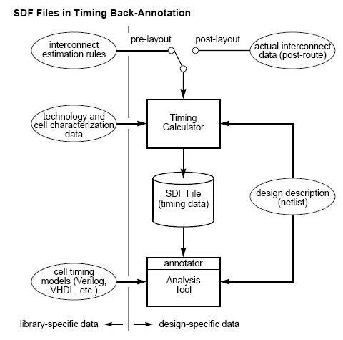
What is Done with These Values?
Extracted Parasitic values used here
The functionality of this “Timing Calculator” is typically built into the APR tool
A file called a .SDF file is generated
SDF = Standard Delay Format
The analysis tool can be ModelSim
ModelSim can read .SDF files.

Slide 11
Post Layout Simulation
This whole process of analyzing with extracted parasitics is often referred to as “back annotation”
Back annotation of parasitics can be to dynamic or static timing analysis tools
  Static timing analysis tools are like what Synopsys does
    Timing reports like Synopsys shows for max and min paths
    PathMill (also a Synopsys tool (since they buy anything that threatens them)) is a really good static timing analysis tool
  ModelSim can accept .SDF files for back annotation of parasitics.
    Now you would re-run some/all of your tests with this timing back annotated. (This is dynamic simulation)

Slide 12
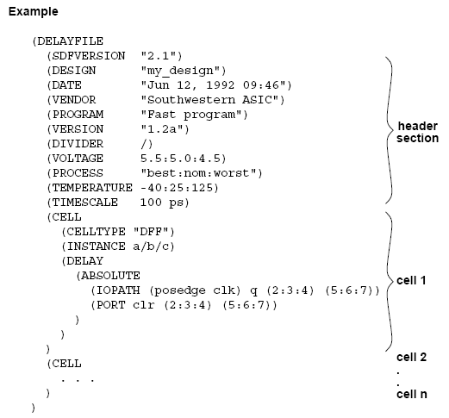
What Does This SDF File Look Like?
PVT for which the delay data was
calculated, is specified in header
Cell instance for which this data applies
clk2q delay (min:typ:max)
(use min for hold-time checking)
(use max for setup-time checking)
clr2q delay (asynch reset to Q out)

Slide 13
Parasitics Don’t Just Slow Down Cells
Resistance:
  When Rdriver >> Rwire then it is not useful to look at interconnect in terms of
  RC. Lumped capacitance works fine.
  Now that chips are larger and drivers are faster these RC components become
  significant.
Consider a 2000μ M2 line at 0.6u wide. The route it self has a 0.6pF capacitance. It
drives a 0.4pF load. The resistance M2 = 35mΩ/sq.
Wires have delay too…RC Delay
117Ω
If your targeting
1GHz this is over
10% of your period
0.4pF
0.6pF
0.69RC = 0.12ns

Slide 14
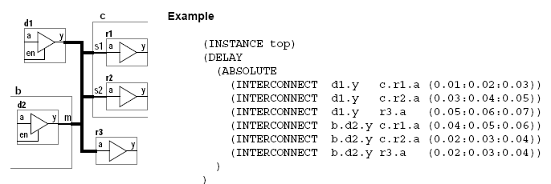
SDF Can Handle Wire RC Delay Too
The timing calculation tool can calculate RC delays of intecconnects between cells.
It uses both the extracted parasitic capacitance data, as well as extracted resistance data.
SDF file has an INTERCONNECT delay specifier

Slide 15
How Do I Use SDF with Verilog?
Back annotate SDF to your post-synthesis (gate level) netlist simulation.
  Now you will be simulating with accurate timing
  Simulate your test suite (or a least a large fraction of it)
    Simulate at typical delays to sanity check the whole environment
    Simulate at max delays to stress setup times
    Simulate at min delays to stress hold times
Verilog contains a directive: $sdf_annotate to control .SDF back annotation.
$sdf_annotate ("sdf_file" [ , [ module_instance ] [ , [ "config_file" ]
[ , [ "log_file" ] [ , [ "mtm_spec" ]
[ , [ "scale_factors" ] [ , [ "scale_type" ] ] ] ] ] ] ] );

Slide 16
How Do I Use SDF with Verilog?
Example: Your APR tool created 3 separate files for max/typ/min delays of your digital core (dig_core). (sss=slow,slow,slow PVT), (fff=fast,fast,fast PVT)
Inside the testbench code you apply the SDF to the instance of the digital core. You have 3 such $sdf_annotate lines and just comment out the ones you are not simulating.
module testbench();
// $sdf_annotate(“~ehoffman\verilog\dig_core_sss.sdf”,testbench.idig_core);
$sdf_annotate(“~ehoffman\verilog\dig_core_fff.sdf”,testbench.idig_core);
// $sdf_annotate(“~ehoffman\verilog\dig_core_typ.sdf”,testbench.idig_core);
dig_core idig_core(.clk(clk), .por_n(por_n), .dst(dst), …
.
.
.
endmodule

Slide 17
Refining your S.W.A.G.
Extracted
Parasitics
Post APR
Netlist
Physical Synthesis
EDA Tool
(APR tool or
Synopsys option)
Verilog
Code
Constraints
Refined
Wireload
model
Synopsys
or other synthesis
tool
New
Gatelevel
Netlist
Back to APR

