Slide 1
ECE 551
Digital Design And Synthesis
Fall ‘09
Digital Circuit Implementations:
  Standard Cell
  FPGA
  Custom Logic

Slide 2
Administrative Matters
HW6 Meeting (due today by 4:00PM)

Slide 3
Now What?
After synthesis, implement as hardware
  FPGAs
  Standard cells
  Custom logic
Choose implementation based on cost and performance requirements

Slide 4
FPGAs
Field Programmable Gate Array
  Temporary (SRAM based)
  Permanent (Flash) not as common
Pros
  Allow for very complex implementations
  Generally reuseable (upgrades/bugfixes/prototype)
  Low non-recurring engineering costs (NREs)
Cons
  Expensive per-unit (10s-100s of $)
  Slower than gates
  Need support cirucuits (configuration loading)
  Not as robust (mission critical operations)

Slide 5
Programming an FPGA
Most designs based on SRAM
  Writing to the SRAM “configures” device
  Different circuits implemented based on values
Q
Q
READ or WRITE
DATA

Slide 6
Configurable Routing Elements
Programmable connection
Programmable bypass
P
Routing
Resource #1
Routing
Resource #2
OUT
DFF
SIGNAL
P

Slide 7
Logic Elements
Look-Up Table (LUT)
  Essentially a very small memory
  Most common size is 4-input LUT (shown is 3-input)
P1
0
P2
1
P3
2
P4
3
OUT
P5
4
P6
5
P7
6
P8
7
a
b
c

Slide 8
Logic Elements
Look-Up Table (LUT)
  OUT = a XOR b XOR c
abc | OUT
000 | 0
001 | 1
010 | 0
011 | 1
100 | 0
101 | 1
110 | 0
111 | 1
0
0
1
1
0
2
1
3
OUT
1
4
0
5
0
6
1
7
a
b
c

Slide 9
Logic Elements
Look-Up Table (LUT)
  OUT = ab + ac + bc
abc | OUT
000 | 1
001 | 0
010 | 1
011 | 1
100 | 1
101 | 1
110 | 0
111 | 1
1
0
0
1
1
2
1
3
OUT
1
4
1
5
0
6
1
7
a
b
c

Slide 10
Logic Elements
Look-Up Table (LUT)
  Extremely flexible in implementing logic
  Larger and slower than just using gates
P1
0
P2
1
P3
2
P4
3
OUT
P5
4
P6
5
P7
6
P8
7
a
b
c

Slide 11
FPGA Logic Structure
“Cell” or “logic block”:
  1 or more LUTs (generally 4-input)
  At least one D flip-flop
  Possibly fast carry logic
Connect several logic blocks to form circuit
I1 I2 I3 I4
Cout
Cin
carry logic
DFF
4-LUT
OUT

Slide 12
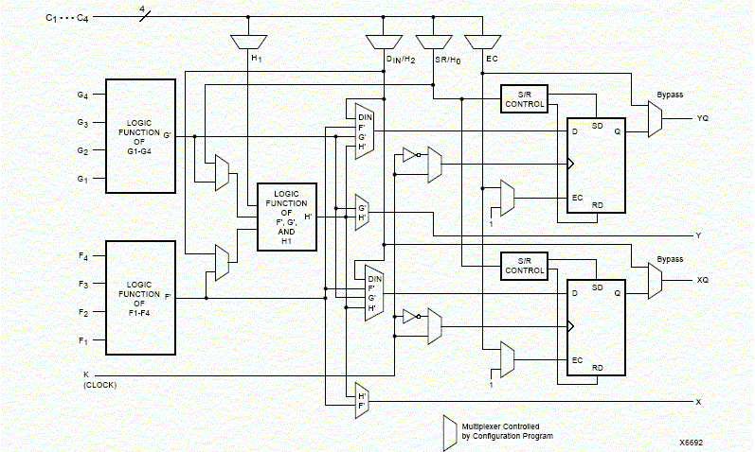
Xilinx 4000 Combinational Logic Block

Slide 13
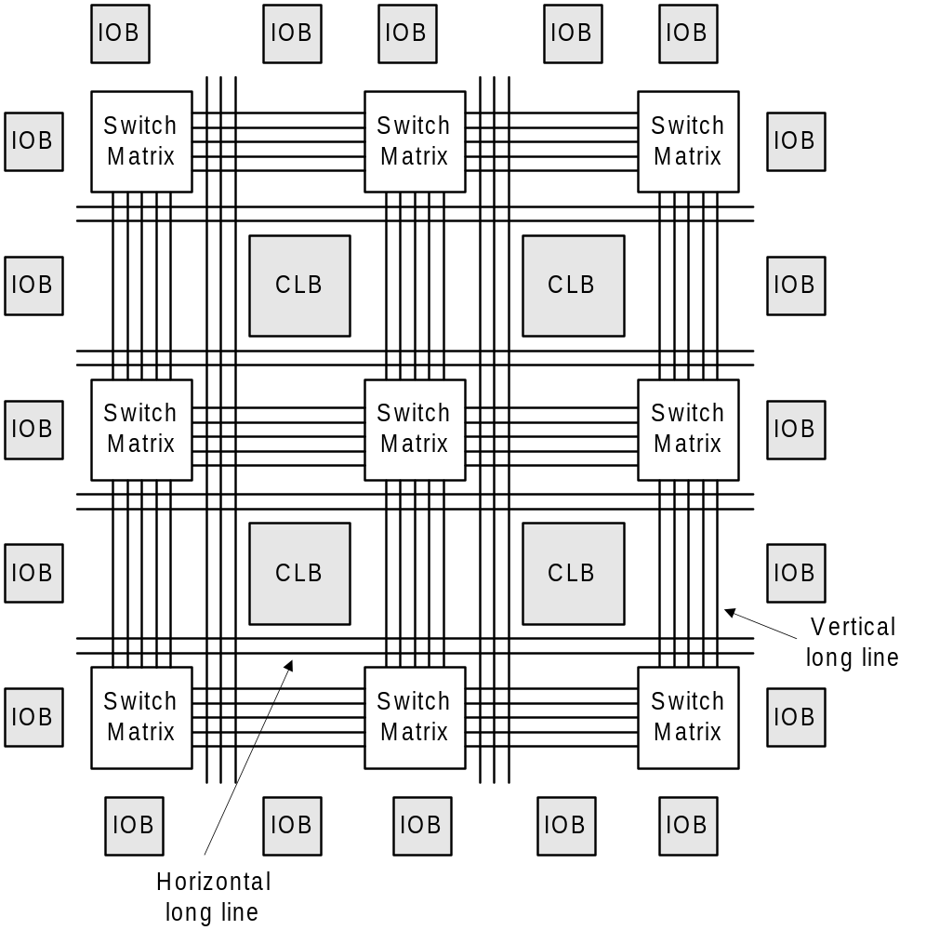
Xilinx 4000 FPGA
Really much more than 4 CLB’s and 9 configurable routing channels but this gives an idea of the structure

Slide 14
FPGAs
Allow for complex implementations
Generally reuseable (upgrades/bugfixes/prototype)
Low non-recurring engineering costs (NREs)
Expensive per-unit (10s-100s of $)
Slower than gates (Programming points)
Newer FPGAs often incorporate memories, multipliers, peripherals, and even processors all on the same chip

Slide 15
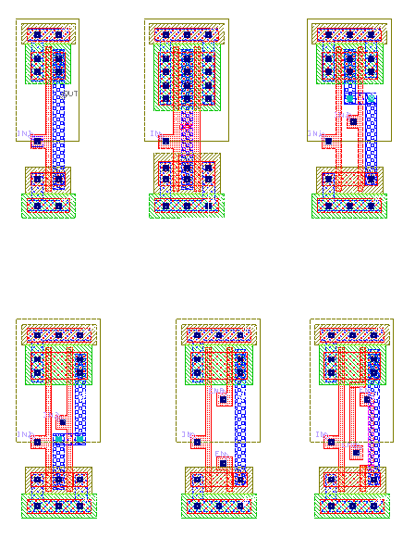
Standard Cells
Gates and other small structures
Can also use macroblocks
  Groups of pre-optimized cells
  Larger custom-layout structures
  More efficient when possible
From: http://www.zuraleff.com/layout

Slide 16
Standard Cell Layouts
Gate, flip-flop, 1-bit adder, …
…
Adjustable Spacing
Metal interconnect placed in channels between cells
Megacells

Slide 17
Standard Cells
Cheap per-unit pricing ($0.50-$10s)
Fast compared to FPGAs
High NREs (design time, mask fabrication...)
  $50K-$5M
  Cost of a respin is very high in time & $$
Only makes sense for
  Large quantities and/or
  Critical operations

Slide 18
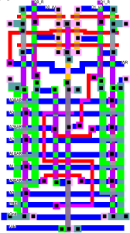
Custom Logic
Manual layout
Very high NREs
  Huge design time!
  Design changes painful.
Human is still better than the CAD tool at tight layout.
There exists a compromise between standard cell APR and full custom. These datapath synthesis tools do APR on a bitslice basis exploiting symmetry in the netlist.

Slide 19
Hardware Implementations
There is no one “best” method
Tradeoffs between cost and speed
  Design complexity matters, too
Standard cells are getting more expensive…
FPGAs are getting faster and bigger…
  This will affect future design choices
  For a given design, current best choice may not == future best choice!
Another choice to implement your digital design might be a programmable μController with off the shelf support hardware

Slide 20
Tech Mapping: Std. Cells
Example boolean equation:
  z = a b c + c d + e
Example cell library:
  2-input NAND, INV
Been there…Done that…
This is what we are doing with our designs when synthesizing to the 0.11μ gflxp library
Resulting Tech Mapped Circuit:
a
c
b
z
e
c
d

Slide 21
Tech Mapping: FPGAs
Need to know building blocks of the FPGA
  LUT size (if uses LUTs)
  Any special resources (Multipliers, RAMs)
Tech mapping then implements your netlist in terms of those building blocks

Slide 22
Tech Mapping: FPGAs
Example boolean equation:
  z = a b c + c d + e
Example basic block:
  4-input LUT
Resulting tech-mapped circuit:
a
LUT #1
c
b
z
e
c
d
LUT #2

Slide 23
Tech Mapping: FPGAs
Example boolean equation:
  z = a b c + c d + e
Example basic block:
  4-input LUT
Resulting tech-mapped circuit:
a
a b c
LUT #1
c
b
y
y + c d + e
e
LUT #2
c
z
d

Slide 24
Placement
Standard Cells:
  Choosing a row for each cell
  Choosing a location within the row for each cell
  Cost function based
  Minimize ratsnest (interconnection)
  CTS will have priority in placing clock buffers
FPGAs:
  Choosing which physical LUTs implement each netlist LUTs

Slide 25
Routing
Have locations for all the cells/LUTs in the netlist
Now need to connect them together to actually make the circuit
Different techniques for std. cell vs. FPGA
Divided into:
  Global
  Detailed (local)

Slide 26
Global Routing
Find a rough path for each net
Figure out what areas a signal passes through

Slide 27
Detailed Routing: Std. Cells
Connect the cells within the global regions
Goal: minimize channel width
1 2 2 4 4 0 3 0 4
Channel Width
2 4 4 3 0 0 3 3 1

Slide 28
Detailed Routing: FPGAs
Assign signals in netlist to:
  Wires
  Switchbox points
Fixed set of available resources
  Can’t “widen” routing channels
Goal: Reduce congestion
  Congestion is the ratio of signals:wires
  By keeping areas “open”, more likely to be able to route later signals

Slide 29
Detailed Routing: FPGAs
Goal: Reduce congestion

Slide 30
Detailed Routing: FPGAs
Goal: Reduce congestion

Slide 31
Detailed Routing: FPGAs
Frequently start with an “idealized” routing
  Signals can share wires
Repeatedly “rip up” and reroute
  One or more nets (signals)
Stop when no wires are shared

Slide 32
Conclusion
Synthesis isn’t the end of the process!
  Many steps after it
Choose target implementation
  Examine cost/performance tradeoffs
Use CAD tools to implement synthesized circuit on FPGA or std. cells
  Place & Route
  Generate bitstream or layout masks
See ECE556 for more details on CAD algorithms

