Slide 1
ECE 551
Digital System Design & Synthesis
Synthesis

Slide 2
Synthesis Priorities
First there is functionality
  Is function coded in Verilog same as synthesized netlist?
    Boolean correct
    Sequential correct
    No uninteded latches or strange clock gating
Next there are design rules
  Is the fanout reasonable.
  Are my transition times fast enough (Hot Electron)
Finally there are performance criteria
  Speed
  Power
  Area

Slide 3
Synthesis is cost function driven
Cost is a function of:
  Timing
  Area
  Power
Cost(mapping) = -Slack(mapping) +
Area(mapping) +
[power(mapping)]
In this priority order
Explore mapping space to minimize
this function (not the exact function)
Mapping refers to the mapping of the logic (elaborated data base) to the cell library
Synopsys is a bit like the typical ECE Student…Smart, but a touch lazy
  Loose Constraints ➔ Loose Design
Notes:
Slack needs to be possitve to meet timing.
If not, can be able to reduce area/ power and can not be able to meet timing during the place and route.
Tset(slack) = Tclk - Tclk_q - Tcomb - Tsetup > 0
Thld(slack) = Tclk_q + Tcomb - Thold > 0
slack= required time - expected time

Slide 4
What Needs Constraint?
clk
input delay
input to D
delays
cycle time
Q to output
delays
output delay
primary
inputs
primary
outputs
Combinational
Combinational
Combinational
clk

Slide 5
Setting Basic Timing Constraints
Establishing clock period, waveform, and pin it is sourced to:
create_clock -name "clk" -period 20 -waveform { 0 10 } clk
Name of clock, (a handle) not the pin it is sourced to
rise @ 0ns
fall @ 10ns
Pin this clock is sourced to
period = 20ns
Clock is no ordinary input. Can’t let Synopsys buffer it and do other silly such things.
If clock distribution requires buffering then that will be done by a separate tool (CTS) inside the APR environment.

Slide 6
Defining Input Delay
clk
input delay
τ – input_delay
DUT
Combinational
Combinational
source
of input
to DUT
clk
clk
input delay is specified as time after the clock edge (of prior clock cycle)
that the input to the DUT is valid.

Slide 7
Defining Output Delay
clk
τ – output_delay
output delay
DUT
Combinational
Combinational
clk
clk
output delay is specified as time prior to next rising edge that the output has to be valid.

Slide 8
What Else Needs Constraint?
in
in
in
out
out
out
t_{PHL}
t_{PHL}
Propagation delay of a gate is not constant
  There is a term that depends on input slope
  Synthesis knows the capacitance of a primary input
  Synthesis does not know the drive strength of a primary input
We must inform Synopsys about the drive strength of the inputs
  set_driving_cell -lib_cell <cell> -pin Z -library <lib> <list_of_inputs>
  set_drive <# of ohms> <signal>

Slide 9
What Else Needs Constraint?
in
in
in
out
in
out
out
out
Small
load
Big
load
t_{PHL}
t_{PHL}
Capacitive loading affects the propagation delay of a gate
  For a given drive strength the slope of the output will elongate with increased capacitive load
  Synopsys needs to know the capacitive load of primary outputs so it can size gates (or buffer up) to drive load with “crisp” transition times.
We must inform Synopsys about the load on primary outputs
  set_load <capacitance> <list of outputs>

Slide 10
Anything More Need Constraints?
in
parasitic
??pF
What is the parasitic capacitance of this node?
  gate capacitance is known by Synopsys
  routing capacitance is the unknown
  how to estimate?
    fanout
    size of design (gate count)
set_wire_load_model -name <m_name> -library <lib_name>

Slide 11
Are We Done Yet…Not Quite
2.0V
2.0V
I_{DS}
V_{GS}=2.0
V_{GS}=1.5
n+
n+
p-substrate
V_{GS}=1.0
When both V_{DS} and V_{GS} are high a transistor is conducting heavily.
Electrons “flying” across the channel get a lot of kinetic energy.
These electrons are also attracted to the surface by the high gate potential.
They can embed themselves in the gate oxide (causes V_{T} degradation).
This is called “Hot Electron Effect”
Need to limit operating time at high V_{DS} & V_{GS}. Need “snappy” transitions.
V_{DS}
set_max_transition_time <time> [current_design]

Slide 12
GUI’s are for Children
GUI’s are for learning and some instances of debugging.
Once you know the tool you will mainly work in shell mode (at least that is my preference):
  unix_prompt>design_vision –shell dc_shell
Notes:
Shell is an external program.
Shell mode inherits the ability to interact with the program.

Slide 13
Sample DC Shell Script [1]
read_file -format verilog {./source/ss_a2d_dp.v}
###########################
# Define clock and set don't mess with it #
##########################
create_clock -name "clk" -period 20 -waveform { 0 10 } { clk }
set_dont_touch_network [find port clk]
# setup pointer that contains all inputs except clock #
set prim_inputs [remove_from_collection [all_inputs] [find port clk]]
#########################
# Set input delay & drive on all inputs #
########################
set_input_delay -clock clk 5 [copy_collection $prim_inputs]
set_driving_cell -lib_cell BUFM1P -pin Z -from_pin A -library \
gflxp [copy_collection $prim_inputs]
# tell it por_n strongly driven so it won't buffer
set_drive 0.1 por_n
Notes:
usually generate the reset tree during layout
dont_touch_network on a clock object prevents compile from modifying the clock buffer network.

Slide 14
Sample DC Shell Script [2]
##########################
# Set output delay & load on all outputs #
##########################
set_output_delay -clock clk 5 [all_outputs]
set_load 0.25 [all_outputs]
#####################################
# Wire load model allows it to estimate internal parasitics #
####################################
set_wire_load_model -name B0.2X0.2 -library gflxp
##################################
# Max transition time is important for Hot-E reasons #
#################################
set_max_transition 0.25 [current_design]
#########################
# Now actually synthesize for 1st time #
#########################
compile -map_effort low

Slide 15
Sample DC Shell Script [3]
check_design
## design ware component caused extra pins
report_area
########################
# Take a look at max & min timings #
#######################
report_timing -path full -delay max -nworst 3
report_timing -path full -delay min -nworst 3
## smash the hierarchy (design ware component)
ungroup -all
compile -map_effort medium
check_design
report_area
#### write out final netlist ######
write –format verilog ss_a2d_dp –output ss_a2d_dp.vg
Now lets run this line by line and
see what it does

Slide 16
Some “Nice to Have” Constraints
set_max_area 20000
  Sets maximum area to 20,000 area units (square microns)
set_max_dynamic_power 10
  Sets maximum dynamic power to 10 mW (default unit for our library is mW)
Note: Power & Speed often work against each other.
  A tight timing contrained design will use more parallel hardware.
  More nodes toggling, resutls computed and then discarded
Note: Area & Power often work together.
  In general less area => less toggling nodes
  less net capacitance switching

Slide 17
Timing Reports….How do I read these?
dc_shell-xg-t> report_timing -delay max –nworst 1
****************************************
Report : timing
-path full
-delay max
-max_paths 1
Design : ss_a2d_dp
Version: Y-2006.06-SP1
Date : Thu Oct 2 09:00:42 2008
****************************************
Operating Conditions: NOM Library: gflxp
Wire Load Model Mode: enclosed
Startpoint: DAC_reg[0] (rising edge-triggered flip-flop clocked by clk)
Endpoint: DAC_full (output port clocked by clk)
Path Group: clk
Path Type: max
report the worst timing path for max delay scenario
Startpoint <signal> <type>
Endpoint <signal> <type>
Very useful to look at
Report continued next page

Slide 18
Timing Reports….How do I read these?
Point Incr Path
-----------------------------------------------------------
clock clk (rise edge) 0.00 0.00
clock network delay (ideal) 0.00 0.00
DAC_reg[0]/CP (FD2LQM3P) 0.00 0.00 r
DAC_reg[0]/Q (FD2LQM3P) 0.25 0.25 r
U59/Z (AND3M1P) 0.10 0.35 r
U55/Z (ND4M2P) 0.13 0.48 f
U56/Z (NR3M6P) 0.21 0.69 r
DAC_full (out) 0.00 0.69 r
data arrival time 0.69
clock clk (rise edge) 20.00 20.00
clock network delay (ideal) 0.00 20.00
output external delay -5.00 15.00
data required time 15.00
-----------------------------------------------------------
data required time 15.00
data arrival time -0.69
-----------------------------------------------------------
slack (MET) 14.31
+ slack is a good thing, it means met timing

Slide 19
Timing Report…min delay
dc_shell-xg-t> report_timing -delay min -nworst 1
Information: Updating design information... (UID-85)
****************************************
Report : timing
-path full
-delay min
-max_paths 1
Design : ss_a2d_dp
Version: Y-2006.06-SP1
Date : Thu Oct 2 09:17:50 2008
****************************************
Operating Conditions: NOM Library: gflxp
Wire Load Model Mode: enclosed
Startpoint: accum_reg_reg[0]
(rising edge-triggered flip-flop clocked by clk)
Endpoint: accum_reg_reg[0]
(rising edge-triggered flip-flop clocked by clk)
Use keywork min to get this report
Surprise, Surprise, the min delay is a path between two flops
Report continued next page

Slide 20
Timing Report…min delay
Point Incr Path
-----------------------------------------------------------
clock clk (rise edge) 0.00 0.00
clock network delay (ideal) 0.00 0.00
accum_reg_reg[0]/CP (FD2LQM1P) 0.00 0.00 r
accum_reg_reg[0]/Q (FD2LQM1P) 0.11 0.11 f
U67/Z (EOFM1P) 0.05 0.16 r
accum_reg_reg[0]/D (FD2LQM1P) 0.00 0.16 r
data arrival time 0.16
clock clk (rise edge) 0.00 0.00
clock network delay (ideal) 0.00 0.00
accum_reg_reg[0]/CP (FD2LQM1P) 0.00 0.00 r
library hold time 0.08 0.08
data required time 0.08
-----------------------------------------------------------
data required time 0.08
data arrival time -0.16
-----------------------------------------------------------
slack (MET) 0.09
Oh good, we made it

Slide 21
Hold time (worst case is back to back FF’s)
T_{clk2q}=0.11ns
T_{hold}=0.08ns
Hold time slack for back to back flop
scenario with our library
Slack = Clk2q – Hold = +0.03ns
We are “golden” we don’t even have to
worry about this…right?
clk
1
clk
2
Any large design will require a clock tree to distribute the clock.
Clock is a large capacitive load. Can’t just drive with one honking driver (RC of wires will kill you then)
Now you have clock skew
clk_root
set_clock_uncertainty 0.15 clk
Inform Synopsys about your skew

Slide 22
Hold Time…how do we fix?
T_{clk2q}=0.11ns
T_{hold}=0.08ns
Slack = Clk2q – Hold – Uncertainty = -0.12ns
-.05
+.10
CTS did the best it could already
clk
1
clk
2
Have to add a buffer to slow the
signal down
Referred to as a: min-delay buffer
clk_root

Slide 23
Lets Play…fire up design_vision
With the ss_a2d_dp design already synthesized with the previously covered DC script lets:
  report our min-delays
  set_clock_uncertainty 0.15 (then report min-delays again)
  set_fix_hold clk & compile –map_effort medium
  report our min-delays (see how it fixed it) (was it stupid?)
  explore for preference in fixing min delays
    (set_prefer –min [get_lib_cells gflxp/DEL*]
  Now lets crank up the clock frequency and check out our max delays
  re-compile to fix these problems
  what has been happening to our area this whole time?

Slide 24
“Holy Mackerel Batmat, This thing is a monster”
Synopsys is 1 of only 2 significant players in the EDA world
  Any startup with an interesting EDA tool gets “assimulated”
  Their EDA tool offering is vast (many good tools)
    We are only interested in Design Vision/Design Compiler
  Design Compiler is their oldest most used tool (around in one form or another since 1986)
    22 years of development makes for a monster of a CAD tool

Slide 25
Getting Lost in a Sea of Documentation
Add the following line to your .cshrc:
alias synopsys_doc ‘acroread /afs/.engr.wisc.edu/apps/eda/synopsys/
syn_Z-2007.03-SP3/doc/online/top.pdf’
Use this to kick off the Synopsys On-Line Documentation (SOLD)
  Only look at Design Compiler Related Stuff
    Command Line Interface Guide
    Constraints and Timing
    Optimization and Timing Analysis
    Full command set (on 2nd page) (Synthesis Commands) (man2)

Slide 26
Optimization Priorities
Design rules have priority over timing goals
Timing goals have priority over area goals
  Max delay has priority over min-delay
To prioritize area constraints:
  use the ignore_tns (total negative slack) option when you specify the area constraint:
  set_max_area -ignore_tns 10000
To change priorities use set_cost_priority
  Example: set_cost_priority -delay
Specifies that area is to be prioritized above TNS
prioritizing delay over max transition rules

Slide 27
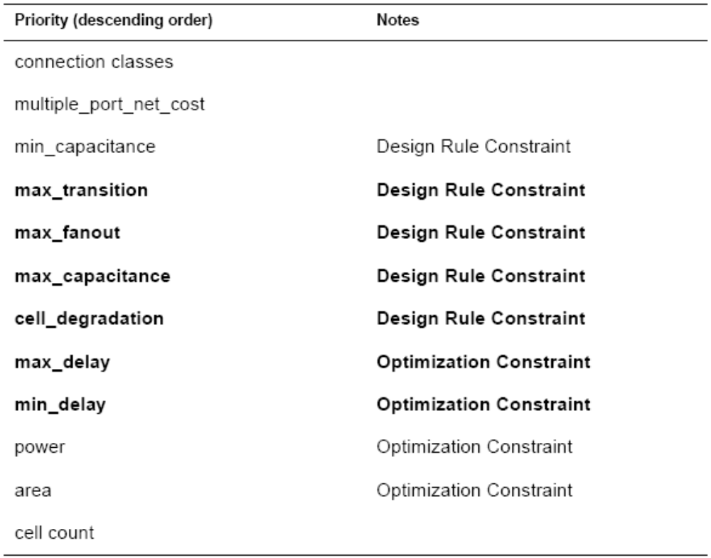
Constraints Default Cost Vector

Slide 28
Compiling the Design
Useful compile options include:
-map_effort low | medium | high (default is medium)
-area_effort low | medium | high (default same as map_effort)
-incremental_mapping (may improve already-mapped)
-verify (compares initial and synthesized designs)
-ungroup_all (collapses all levels of design hierarchy)
New compile_ultra command
  Two pass high effort compile of the design
  May want to compile normally first to get ballpark figure (higher effort == longer compilation)

Slide 29
Top-Down Compilation
Use top-down compile strategy for medium to small designs
Basic steps are:
  Read in the entire design
  Resolve multiple instances of any design references with uniquify
  Apply attributes and constraints to the top level
  Compile the design using compile or compile_ultra
Notes:
uniquify command is used to generate separate instances within the netlist... It is used before importing the list to place and route tool.... Never miss this command...

Slide 30
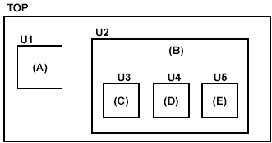
Example Top-Down Script
# read in the entire design
read_file -library WORK -format verilog {E.v D.v C.v B.v A.v TOP.v}
current_design TOP
# link TOP.v to libraries and modules it references
Link
# set design constraings
…
set_max_area 2000
# resolve multiple references
uniquify
# compile the design
compile –area_effort high
What??
Will cover this a bit later

Slide 31
Bottom-Up Compile Strategy
The bottom-up compile strategy
  Compile the subdesigns separately and then incorporate them
  Top-level constraints are applied and the design is checked for violations.
Advantages:
  Compiles large designs more quickly (divide-and-conquer)
  Requires less memory than top-down compile
Disadvantages
  Need to develop local constraints as well as global constraints
  May need to repeat process several times to meet design goals
Only likely to use if running into serious memory or performance issues
This is a royal pain in the butt

Slide 32
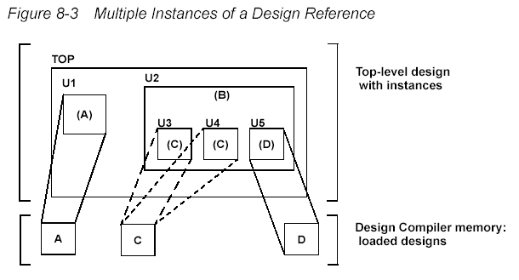
Resolving Multiple References
In a hierarchical design, subdesigns are often referenced by more than one cell instance

Slide 33
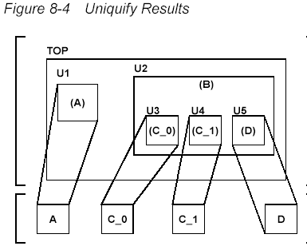
Uniquify Method
The uniquify command creates a uniquely named copy of the design for each instance.
current_design top
uniquify
compile
Each design optimized separately
What are advantages and disadvantages?

Slide 34
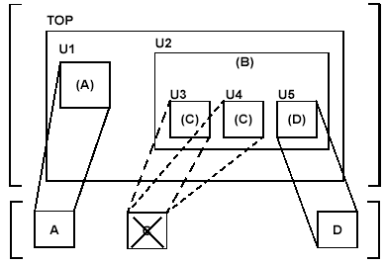
Compile-once-don’t-touch Method
The compile-once-don’t-touch method uses the set_dont_touch command to preserve the compiled subdesign
  current_design top
  characterize –constraints U2/U3
  current_design C
  compile
  current_design top
  set_dont_touch {U2/U3 U2/U4}
  compile
What are advantages and disadvantages?

Slide 35
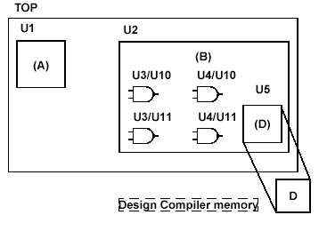
Ungroup Method
The ungroup command makes unique copies of the design and removes levels of the hierarchy
  current_design B
  ungroup {U3 U4}
  current_design top
  compile
What are advantages and disadvantages?

Slide 36
Flattening Hierarchy
module logic1(input a, c, e, output reg x);
always @(a, c, e)
x = ((~a|~c) & e) | (a&c);
endmodule
module logic2(input a, b, c, d, output reg y);
always @(a, b, c, d)
y = ((((~a|~c)&b) | ((a|~b)&c))&d) | ((a|~b)&~d);
endmodule
module logic(input a, b, c, d, e, f, output reg z);
wire x, y;
logic1(a, c, e, x);
logic2(a, b, c, d, y);
always @(x, y, f)
z = (~f&x) | (f&y);
endmodule
Unflattened Hierarchy
Area: 36.15
Delay: 0.25
Flattened Hierarchy
Area: 34.15
Delay: 0.25

Slide 37
Checking your Design
Use the check_design command to verify design consistency.
  Usually run both before and after compiling a design
  Gives a list of warning and error messages
  Errors will cause compiles to fail
  Warnings indicate a problem with the current design
    Try to fix all of these, since later they can lead to problems
    Use check_design –summary or check_design -no_warnings to limit the number of warnings given
  Use check_timing to locate potential timing problems
  Use report_contraints –all_violators (check everything)

Slide 38
Analyzing your Design [1]
There are several commands to analyze your design
  report_design
    display characteristics of the current design
    operating conditions, wire load model, output delays, etc.
    parameters used by the design
  report_area
    displays area information for the current design
    number of nets, ports, cells, references
    area of combinational logic, non-combinational, interconnect, total

Slide 39
Analyzing your Design [2]
  report_hierarchy
    displays the reference hierarchy of the current design
    tells modules/cells used and the libraries they come from
  report_timing
    reports timing information about the design
    default shows one worst case delay path
  report_resources
    Lists the resources and datapath blocks used by the current design
  Can send reports to files
    report_resources > cmult_resources.rpt
Lots of other report commands available

Slide 40
Optimization Strategies
Area vs. Delay - Often only really optimize for one
  “Fastest given an area constraint”
  “Smallest given a speed constraint”
Design Compiler Reference Manual has several pointers on synthesis settings for these goals

