Slide 1
ECE 551
Digital Design And Synthesis
Fall ‘09
Synthesis Flow
Synthesis Optimizations

Slide 2
Administrative Matters
Project Demos will be held in B555
  Wednesday (12/16/09) from 1:00PM till evening.
  Friday (12/18/09) from 1:00PM till evening.
Final Exam is:
  Tuesday: 12/22/09 @ 10:05AM

Slide 3
Internal Synthesizer Flow
HDL Description
Structural
Representation
Parsing and
Syntax & Semantic
Error Checking
Architectural
Optimization
Technology
Library
Synthesizer
Policy Checking
Multi-Level Logic
Optimization
Technology
Mapping
Translation
(Elaboration)
Technology-Based
Implementation
(netlist)

Slide 4
Getting Lost in a Sea of Documentation
Add the following line to your .cshrc:
alias synopsys_doc ‘acroread /afs/.engr.wisc.edu/apps/eda/synopsys/
syn_Z-2007.03-SP3/doc/online/top.pdf’
Use this to kick off the Synopsys On-Line Documentation (SOLD)
  Only look at Design Compiler Related Stuff
    Command Line Interface Guide
    Constraints and Timing
    Optimization and Timing Analysis
    Full command set (on 2nd page) (Synthesis Commands) (man2)

Slide 5
Initial Steps (Analyze Verilog File)
Parsing for Syntax and Semantics Checking
  Gives error messages and warnings to user
  User may modify the HDL description in response
Synthesizer Policy Checking
  Check for adherence to allowable language constructs
  Check for usage recommendations
This is where you find out you can’t use certain Verilog constructs
This is synthesizer-dependent
  Example: Design Vision allows indexed part-select
  (guess[i*2 : 2]), but the Xilinx Foundation tool does not
  Certain things common to MOST synthesizers

Slide 6
Translation (Elaboration)
Builds a structural representation of the design
Like a netlist, but includes larger components
  Not just gate-level, may include adders, etc.
Gives additional errors or warnings to the user
  Issues in initial transformation to hardware.
Affects quality achieved by optimization steps
  Structural representation depends on HDL quality
  Poor HDL can prevent optimization

Slide 7
Optimization in Synthesis
None of these are guaranteed!
  Most synthesizers will make at least some attempt
Detect and eliminate redundant logic
Detect combinational feedback loops
Exploit don't-care conditions
Try to detect unused states (logic states you can’t get to)
Synthesize optimal, multilevel realizations subject to:
  constraints on area and/or speed
  available technology (library)

Slide 8
Optimization Process
Optimization modifies the initial netlist resulting from elaboration.
  Architecture choices made first (CLA,RCA,…)
  Maps to cells from the technology library
  Attempts to meet all specified constraints
The process is divided into major phases
  All or some selection of the major phases may be performed during optimization
  Phase selection can be controlled by the user

Slide 9
Optimization Phases
Architectural optimization
  High-level optimizations that occur before the design is mapped to the logic-level
  Based on constraints and high-level coding style
  Level of parallelism?
  Building block choices like adder architecture (DW components)
  After optimization circuit function is represented by a generic, technology-independent netlist (GTECH)

Slide 10
Architectural Optimization
In Synopsys, types include:
  Sharing common mathematical subexpressions
  Sharing resources
  Selecting DesignWare implementations
  Reordering operators
  Identifying arithmetic expressions for datapath synthesis

Slide 11
Architectural Optimization
Examples:
  Replace an adder used as a counter with incrementer
  Replace adder and separate subtractor with adder/subtractor if not used simultaneously
  Performs selection of pre-designed components (Synopsys DesignWare)
    adders, multipliers, shifters, comparators, muxes, etc.
Need good code for synthesizer to do this
Designer still knows more about the project

Slide 12
Logic/Gate-Level Optimization
Works on the generic netlist created by logic synthesis
Produces a technology-specific netlist.
In Synopsys, it consists of four stages:
  Mapping
  Delay optimization
  Design rule fixing
  Area optimization

Slide 13
Logic/Gate-Level Optimization
Mapping
  Generates a gate level implementation
  Tries to meet timing and area goals
Delay optimization
  Tries to fix delay violations from mapping phase.
  Does not fix design rule violations or meet area constraints.
Design rule fixing
  Tries to correct design rule violations
    Inserting buffers or resizing existing cells
  If necessary, violates optimization constraints
Area optimization
  Tries to meet area constraints, which have lowest priority

Slide 14
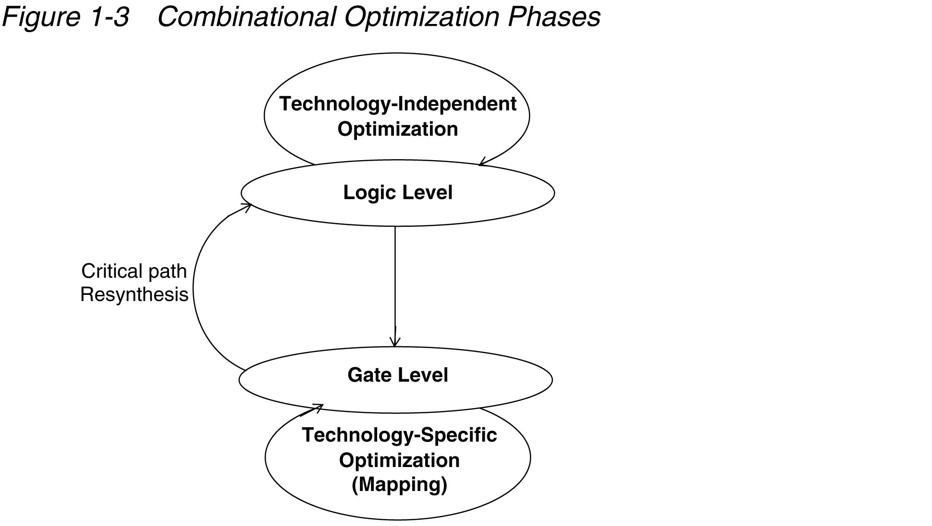
Combinational Optimization
Boolean equation manipulation
  Boolean reduction
  Factoring
  Sharing common terms
Mapping Optimizations
  Gate mapping based on CF
  Applying De-Morgans
  Sizing Gates & Buffering

Slide 15
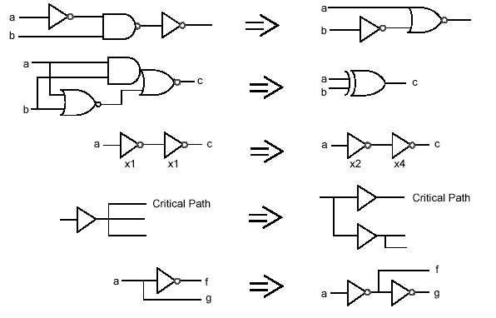
Gate-Level Optimization

Slide 16
Logic-Level Optimizations
Verilog
Technology
Description
Libraries
TRANSLATION
OPTIMIZATION
MAPPING
ENGINE
ENGINE
ENGINE
Optimized
Two-level
Technology
Multi-level Logic
Logic Functions
Implementation
Functions

Slide 17
Logic Optimizations
Area
  Number of gates fewer == smaller
  Fan in of gates (# inputs) fewer == smaller
  Drive Strength (transistor width) narrower == smaller
Delay
  Number of logic levels fewer == faster (usually)
  Size of gates (# inputs) fewer == faster
Note that examples that follow ignore NOT gates for gate count / levels of circuits

Slide 18
Logic Optimizations
Decomposition
Extraction
Factoring
Substitution
Elimination
You don’t have to remember the names of these
But understand the concept and the motivation

Slide 19
Decomposition
Find common expressions
Reduce redundancy
  Reduce area (number/size of gates)
May increase delay
  More levels of logic

Slide 20
Decomposition Example
F = abc + abd + a’c’d’ + b’c’d’
~7 gates, ~3 levels
F = ab(c + d) + c’d’(a’ + b’)
F = ab(c + d) + (c + d)’(ab)’
X = ab 1 gate, 1 level
Y = c + d 1 gate, 1 level
F = XY + X’Y’ 5 gates, 3 levels (or what?)
Gate Effort = 4*(3-input AND) + 4-input OR = 16 effort
Gate Effort = 2-input AND + 2-input OR + 2*(2-input AND) + 2-input OR = 10 effort

Slide 21
Extraction
Find common sub-expressions in functions
Like decomposition, but across more than one function
Reduce redundancy
  Reduce area (number/size of gates)
May increase delay if more logic levels introduced

Slide 22
Extraction Example
F = (a + b)cd + e 3 gates, 3 levels
G = (a + b) e’ 2 gates, 2 levels
H = cde 1 gate, 1 level
Define common terms: X = a + b, Y = cd 1 gate, 1 level (each)
F = XY + e 4 gates, 3 levels
G = Xe’ 2 gate, 2 levels
H = Ye 2 gate, 2 levels
Before:
  (3) 2-input ORs, (2) 3-input ANDs, (1) 2-input AND
  Gate Effort = 6 + 6 + 2 = 14
After
  (2) 2-input ORs, (4) 2-input ANDs
  Gate Effort = 4 + 8 = 12

Slide 23
Factoring
Traditional two-level logic is sum-of-products
Sometimes better expressed by product-of-sums
  Fewer literals => less area
May increase delay if logic equation not completely factored (becomes multi-level)

Slide 24
Factoring Example
Definitely good:
  F = ac + ad + bc + bd Gate Effort = 8 + 4
  F = (a + b)(c + d) Gate Effort = 4 + 2
Maybe good:
  F = ac + ad + e Gate Effort = 7
  F = a(c + d) + e Gate Effort = 6
  Factoring may improve area...
  But will likely increase delay (tradeoff)

Slide 25
Substitution
Similar to Extraction (in fact a sub-case of extraction)
When one function is subfunction of another
Reduce area
  Fewer gates
Can increase delay if more logic levels

Slide 26
Substitution Example
G = a + b 1 gate, 1 level
F = a + b + c 1 gate, 1 level
F = G + c 2 gate, 2 levels
Before:
  (1) 2-input OR, (1) 3-input OR => Gate Effort = 5
After
  (2) 2-input ORs (but increased levels) => Gate Effort = 4

Slide 27
Elimination (Flattening)
Opposite of previous optimizations
Goal is to reduce delay
  Make signals travel though as few logic levels as possible
But will likely increase area
  Gate replication / redundant logic

Slide 28
Elimination Example
G = c + d 1 gate, 1 level
F = Ga + G' b 3 gates, 3 levels
G = c + d 1 gate, 1 level
F = ac + ad + bc’d’ 4 gates, 2 levels
Before:
  (2) 2-input ORs, (2) 2-input ANDs
After:
  (1) 2-input OR, (1) 3-input OR, (2) 2-input ANDs,
  (1) 3-input AND (but fewer levels)

Slide 29
compile_ultra Optimizations
High effort, maximum optimization
Automatic hierarchical ungrouping
  Ungroups small modules before mapping
  Ungroups critical path based on delay
Automatic datapath extraction
  E.g. carry-save adders
Boundary optimization
  Propagates logic across hierarchical boundaries (constants, NC inputs/outputs, NOT)
Sequential inversion
  Sequential elements can have their outputs inverted

Slide 30
Register Retiming
At the HDL level, determining the optimal placement of registers is difficult and tedious at best, or just plain impossible at worst
The register retiming tool moves registers through the synthesized combinational logic network to improve timing and/or area
  Equalize delay (i.e. reduce critical path delay by increasing delay in other paths)
  Reduce the number of flip-flops if timing criteria are met
    Usually propagate registers forward
Can also automatically pipeline combinational logic modules

Slide 31
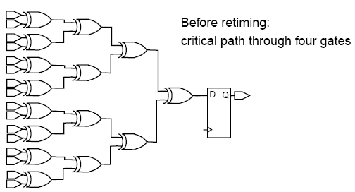
Register Retiming Example [1]

Slide 32
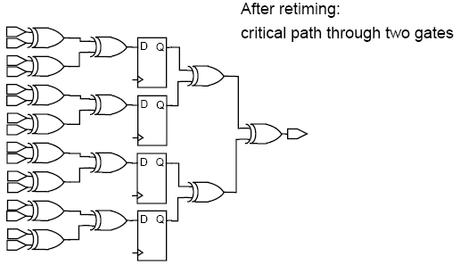
Register Retiming Example [2]
Personally: I would never use this. I have an inherent mis-trust of CAD tools. I would never let it move any of my flops, and certainly never trust it to rearrange my pipelined processor.

