Slide 1
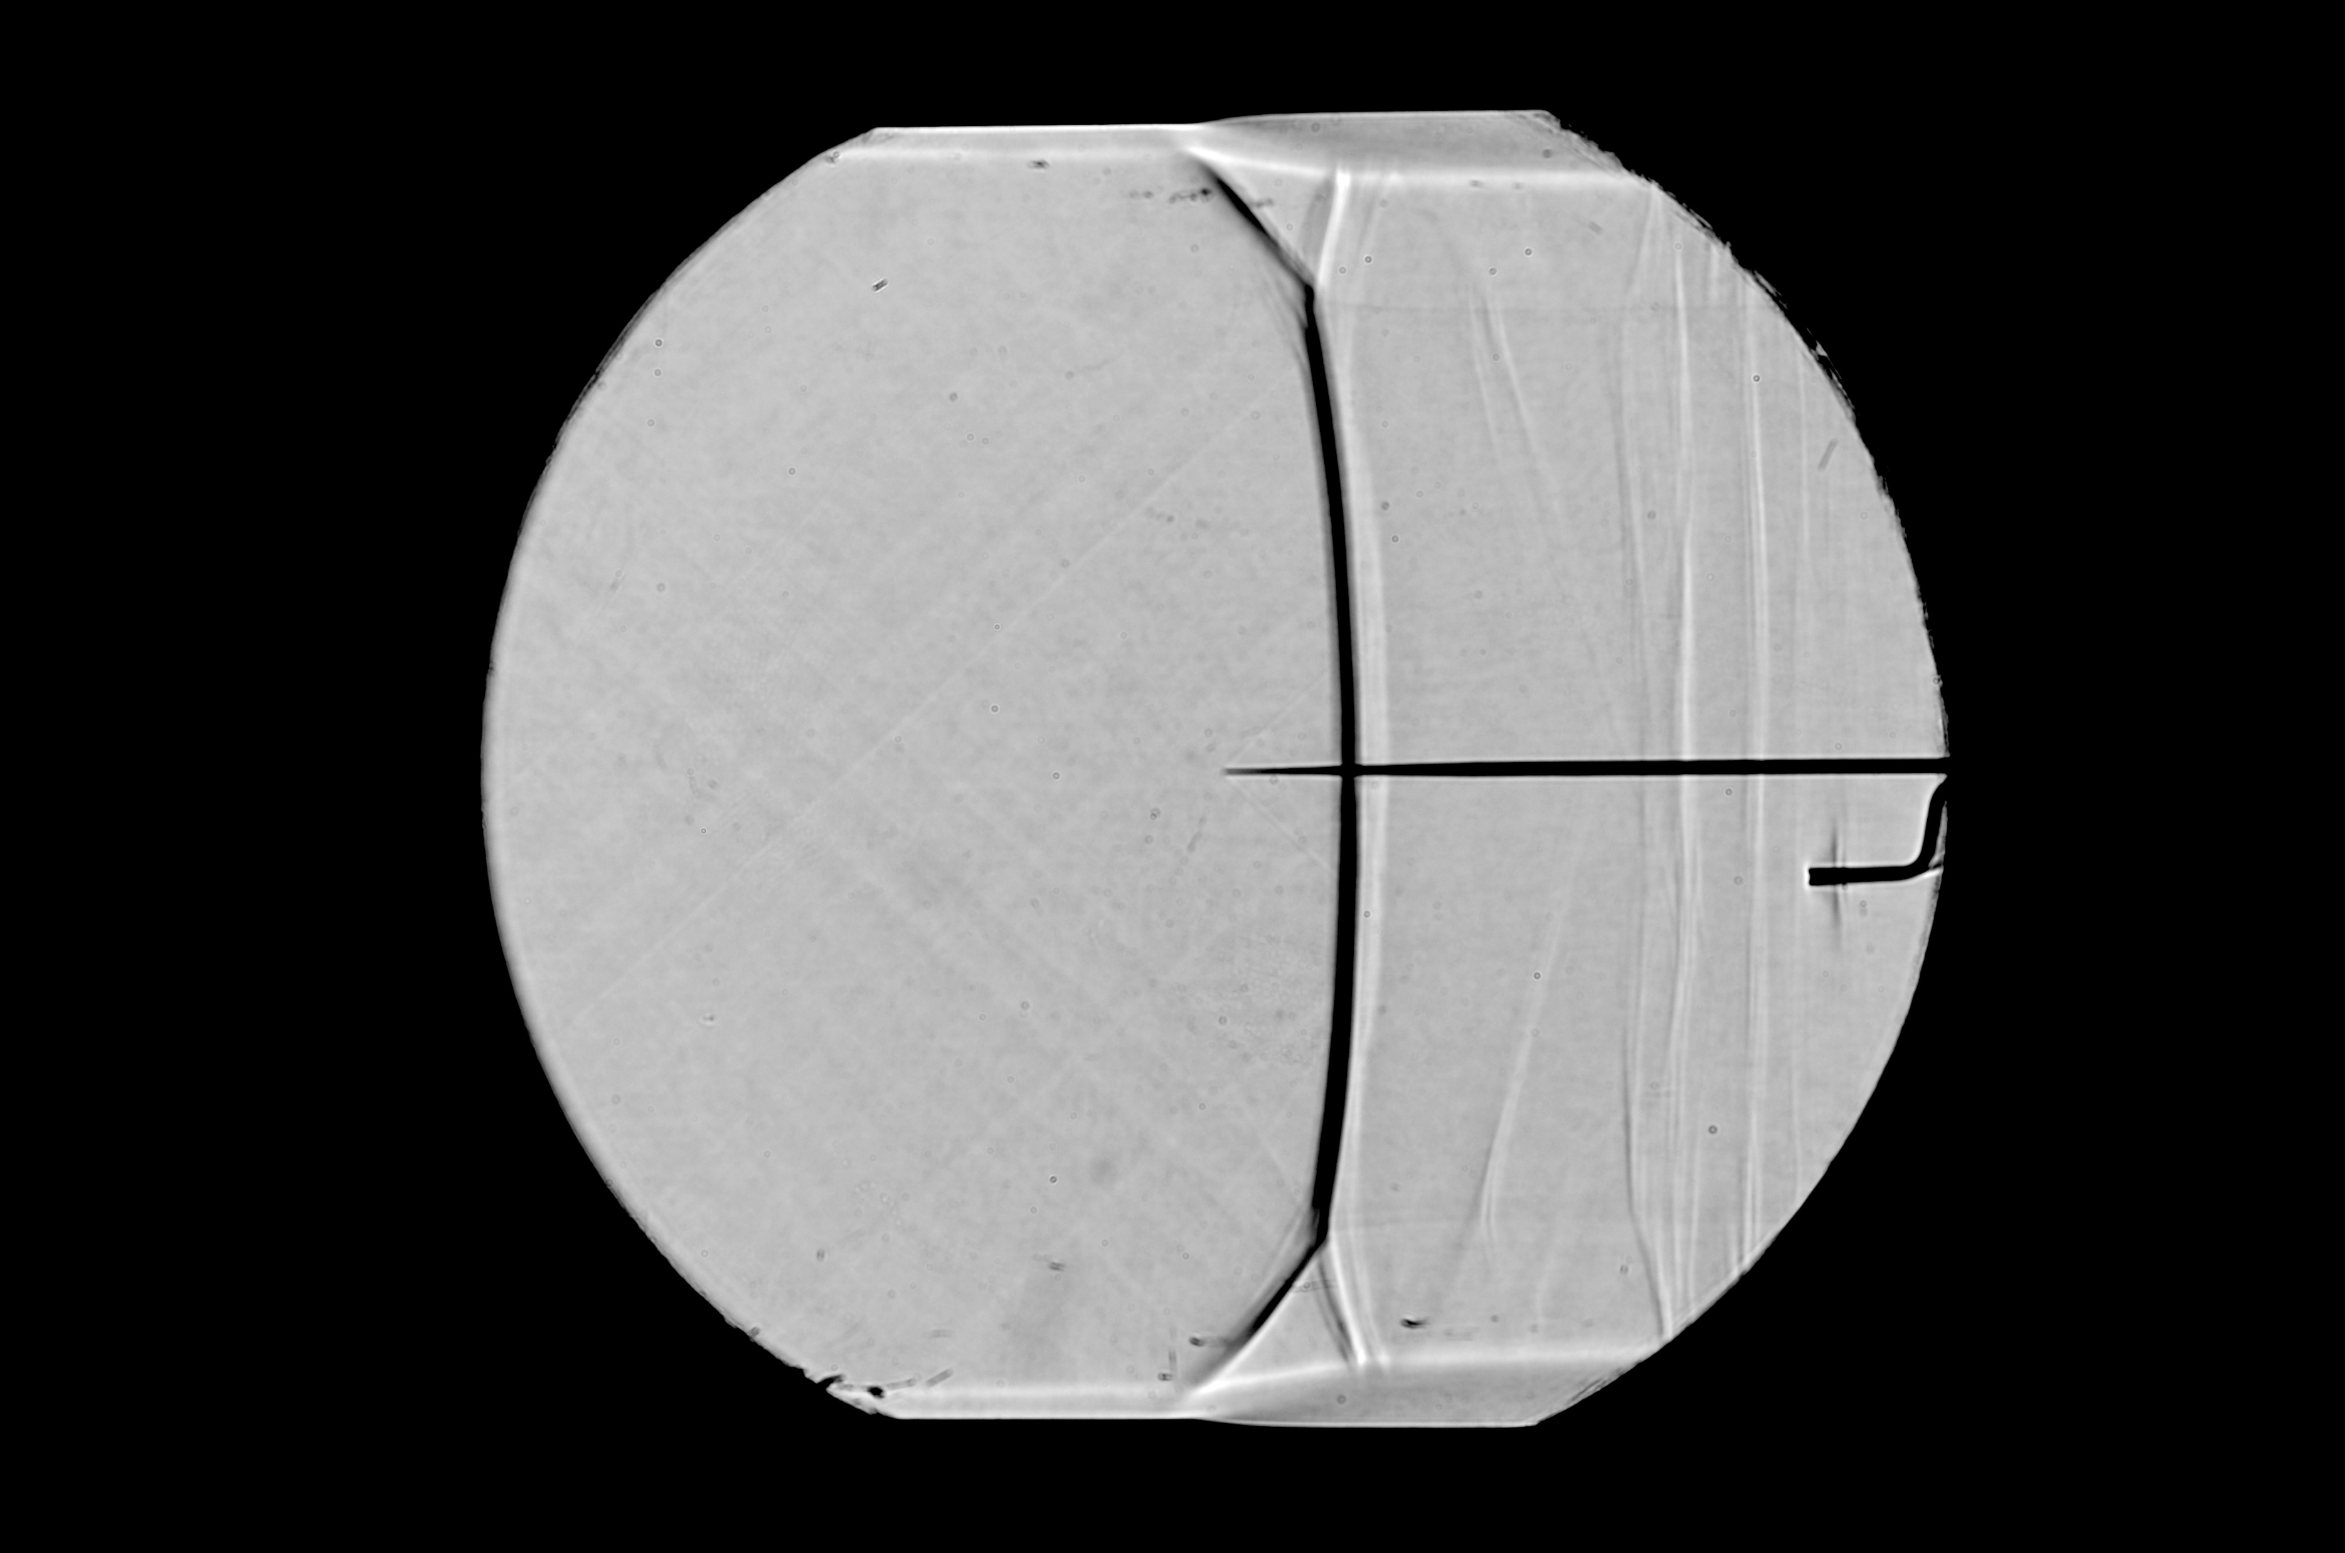
Boundary layer thicker downstream of shock
Train of shocks due to flow re-accelerating
Weak oblique shocks in working section
Static pressure sensor
Low strength Oblique shock from static sensor
Pitot sensor
Secondary boundary layer shock
Oblique boundary layer shock

Slide 2
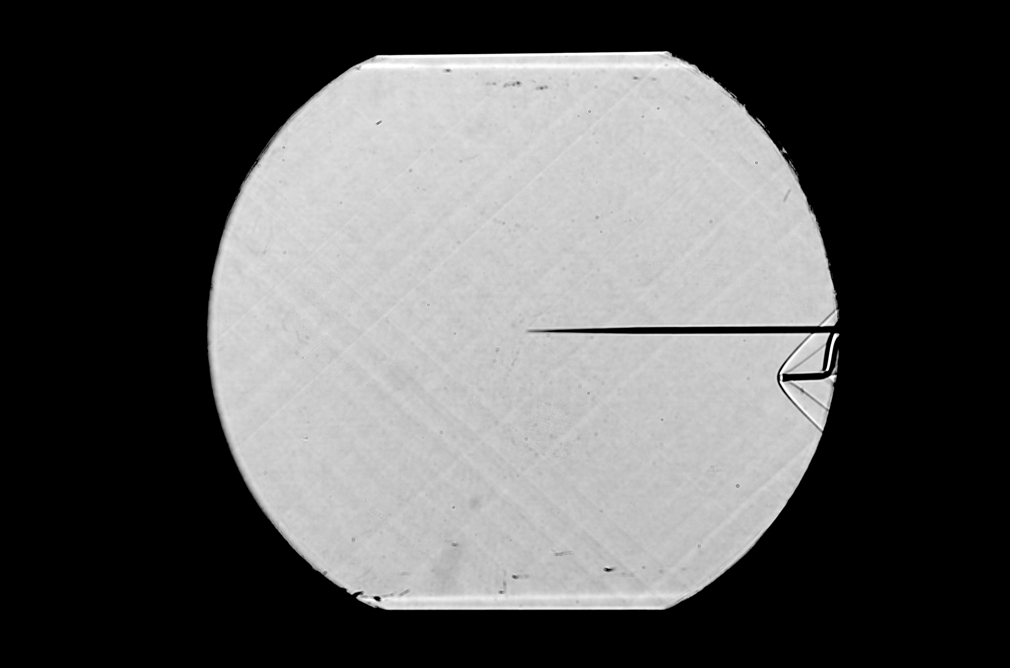
Weak oblique shocks in working section
Oblique shock from sensor edge
Bow shock in front of Pitot sensor

