Slide 1
Acoustic Signatures of Quadcopter Propellers
Louis Pender
Supervised by Dr Shreyas Mandre

Slide 2
Context and application
Noise pollution is a barrier for adoption of drone-based services
Propellers are the primary source of noise
Must optimise aerodynamic and aero-acoustic performance
Notes:
The noise made by drones acts as a barrier to their wider adoption for drone-based services such as
logistics, surveying and mapping.
Propellers are a small part of a drone’s cost to produce,
but efficient designs can increase productivity such as payload and flight time.
Propellers are also the main source of noise from drones

Slide 3
Sources of propeller noise
Broadband
Formation and shedding of vortices
Trailing edge turbulent interaction
Flow separation
Discrete frequency tonal noise
Thickness noise
Loading noise
Interaction and distortion effects
Blade passing frequencies
Notes:
The sound can be split into two:
Broadband distributed over a wide range of frequencies
Tonal at discrete frequency
Broadband noise primarily consists of formation and shedding of vortices
Trailing edge turbulent interaction and flow separation
Tonal noise primarily consists of
oscillating thickness displacement and pressure loading
But can include BVI and blade wake interactions

Slide 4
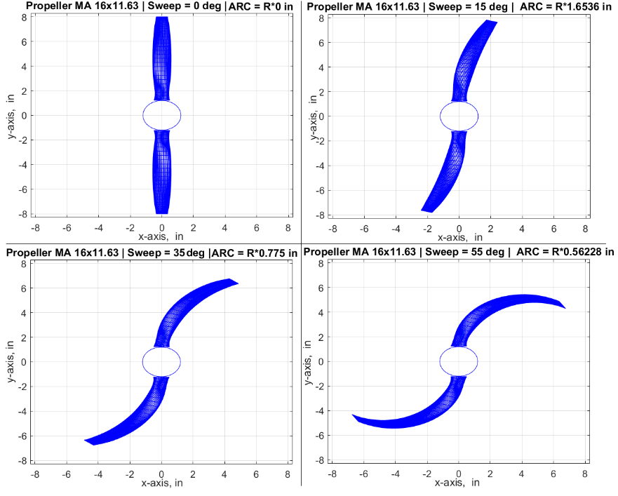
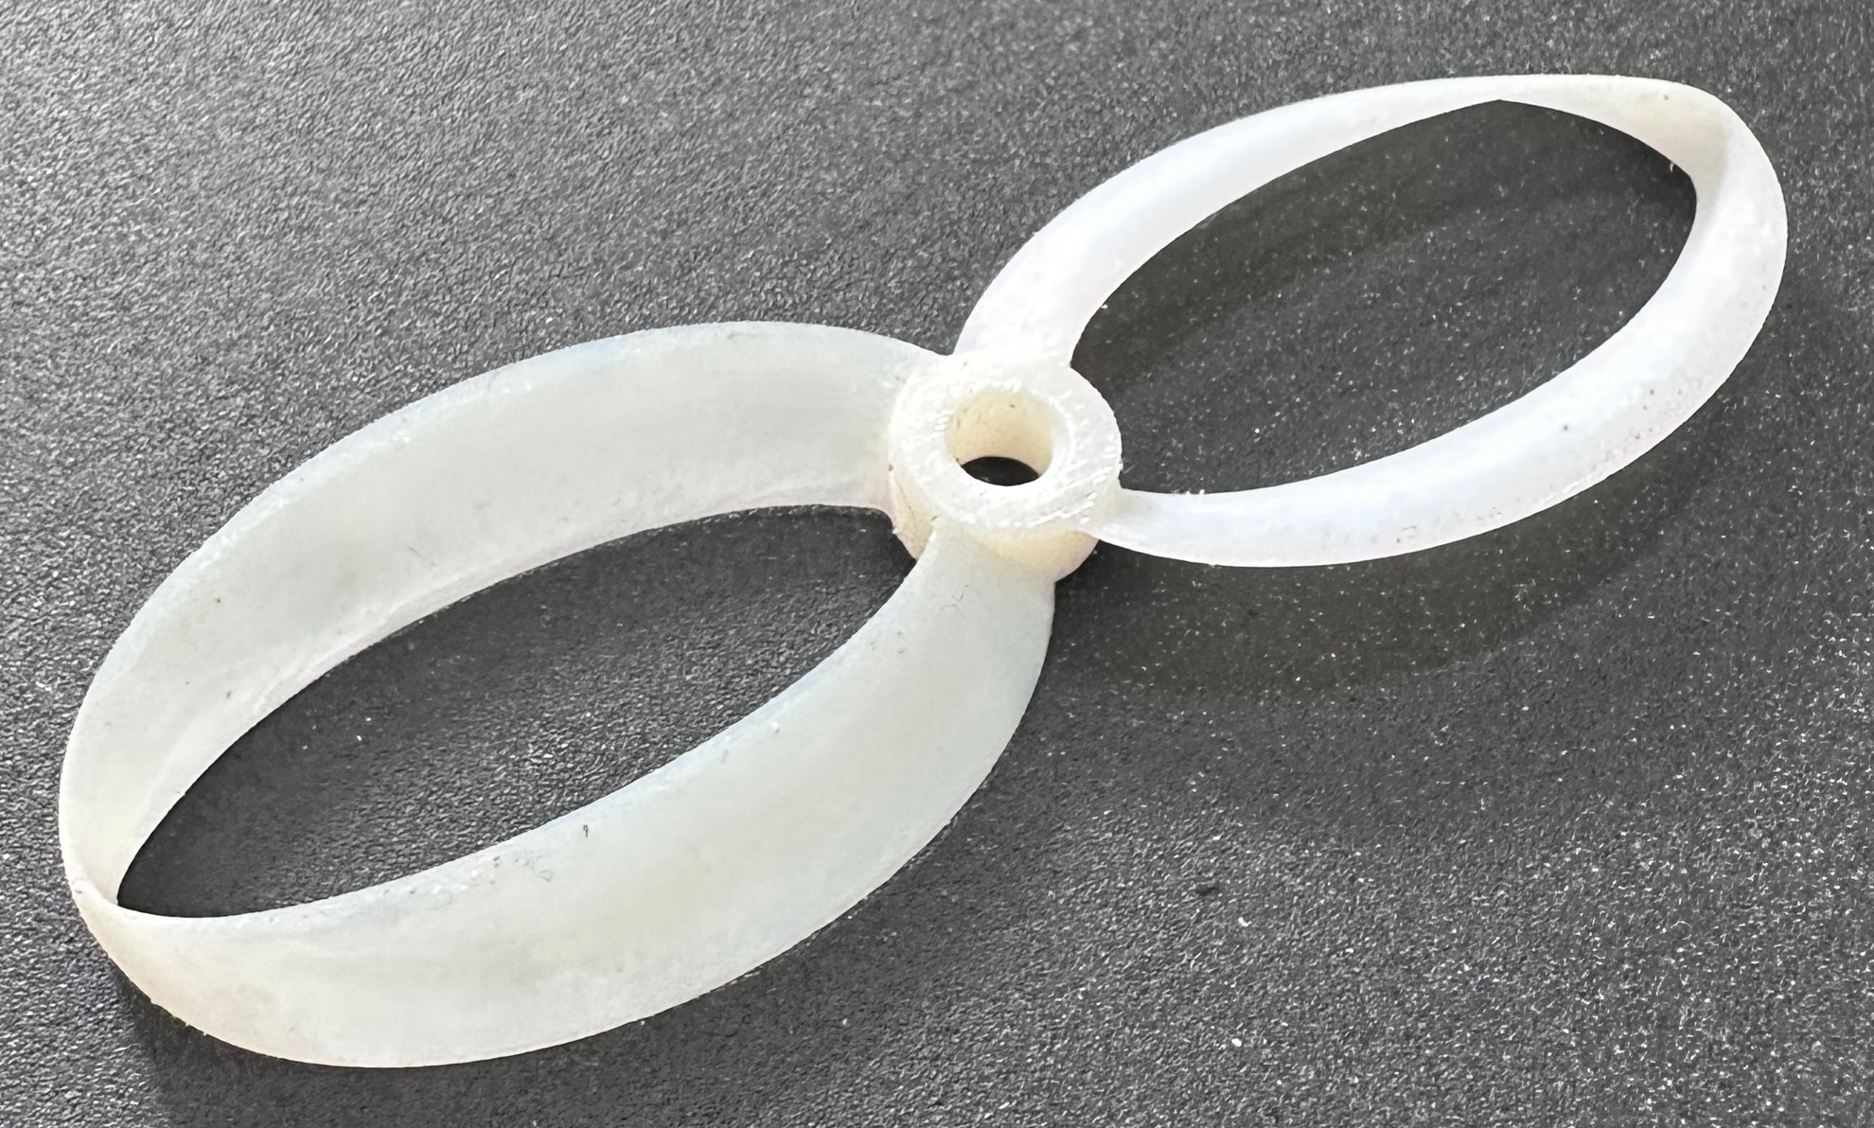
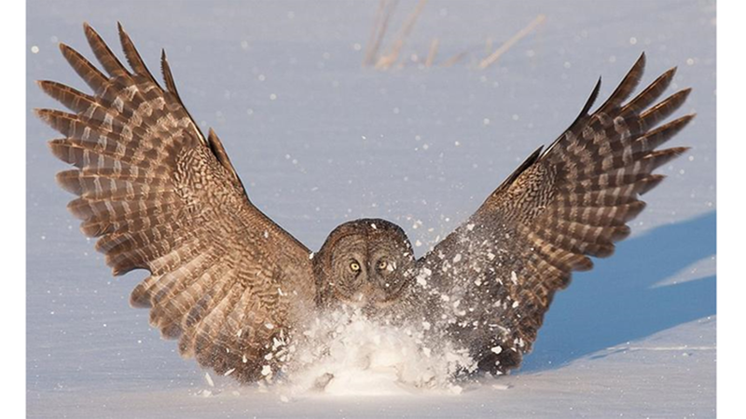
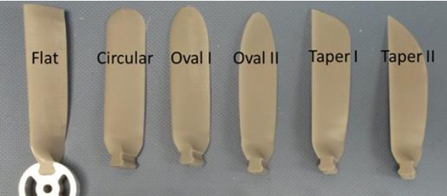
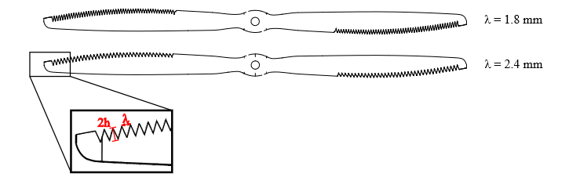
Noise reduction geometry
Geometry
Tip geometry
Blade sweep
Varying blade spacing
Trailing edge serrations
L. Wang et al.
A. D. Wiedemann et al.
Bi-loop “Toroidal”
Propeller Thingyverse
C. F. Wisniewski et al.
B. Zang et al.
Notes:
Noise reduction at a similar level of performance has been achieved.
Tip geometry has reduced broadband and in some cases blade pass frequency tones.
Variable blade spacing and trailing edge serrations reduced the broadband noise by destructive acoustic interference and mixing
It's also worth noting that these trailing edge serrations at low Reynolds numbers were inspired by owl wings.

Slide 5
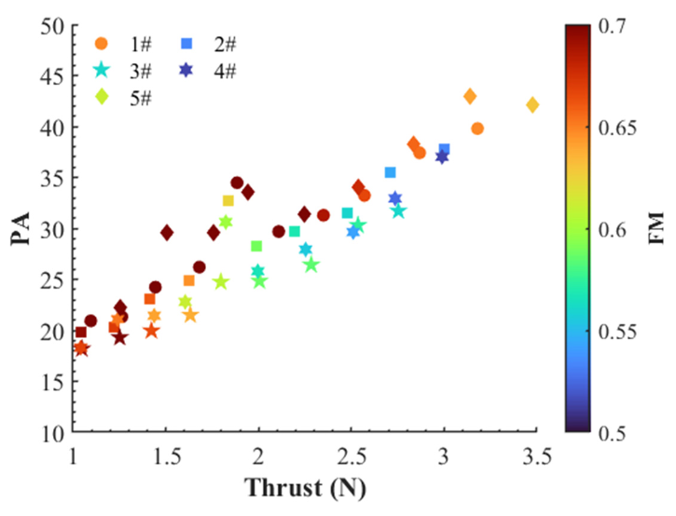
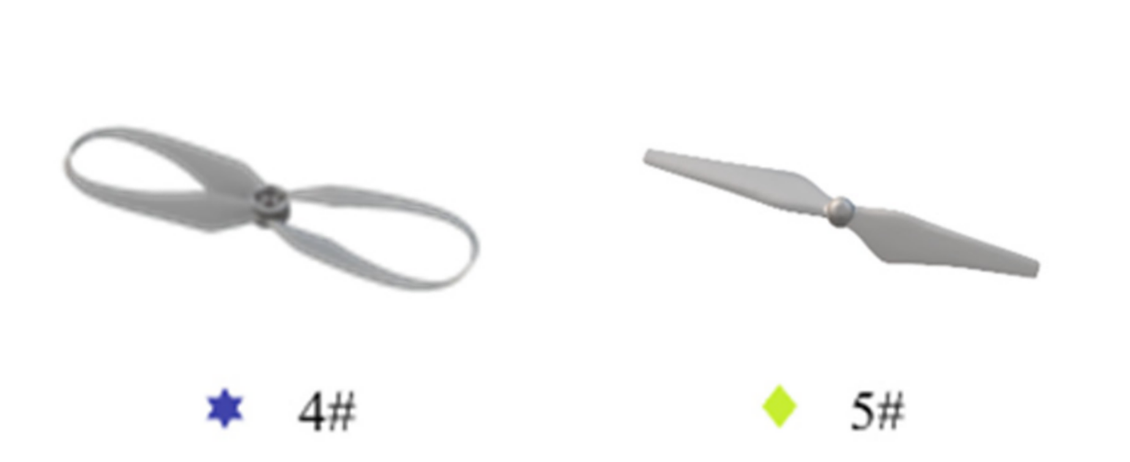
PA quantifies:
Psychoacoustic annoyance
Notes:
The Y axis represents a psychoacoustic annoyance factor which is used to quantify subjective feelings caused by sound.
The FM colour bar represents a static efficiency.
This graph shows two important things
Reducing thrust can significantly reduce acoustic annoyance
For a fixed thrust a reduction in acoustic annoyance comes at a penalty of efficiency.

Slide 6
FM quantifies:
Static efficiency
Notes:
The Y axis represents a psychoacoustic annoyance factor which is used to quantify subjective feelings caused by sound.
The FM colour bar represents a static efficiency.
This graph shows two important things
Reducing thrust can significantly reduce acoustic annoyance
For a fixed thrust a reduction in acoustic annoyance comes at a penalty of efficiency.

Slide 7
Hypothesis
Redistributing loading away from the tip will decrease tonal and broadband noise
Closed loop toroidal propellers predicted to have
reduced tonal components due to sweep
reduced broadband due to low tip loading.
Trailing edge serrations predicted to reduce blade wake interaction and hence the broadband noise.

Slide 8
Objectives
Design and build experimental setups to measure aerodynamic performance and acoustic signatures of various propeller designs
Attribute changes in the acoustic spectrum to flow phenomena caused by propeller geometry modifications.
Analyse trade-off in performance of the different designs
Notes:
The objectives of this project are to design and build an experimental setup to measure aerodynamic and aeroacoustics performance.
This will be done for varying propeller geometry

Slide 9
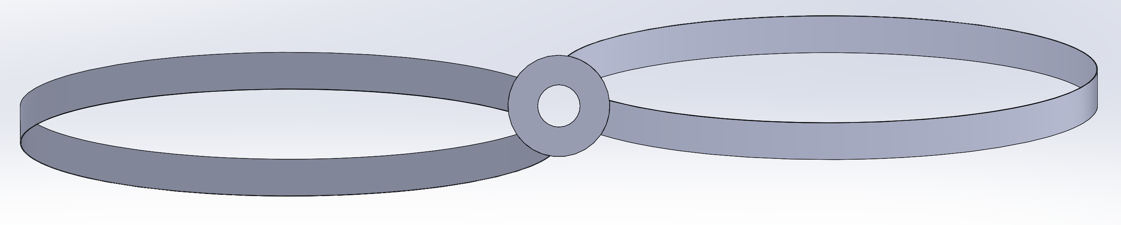
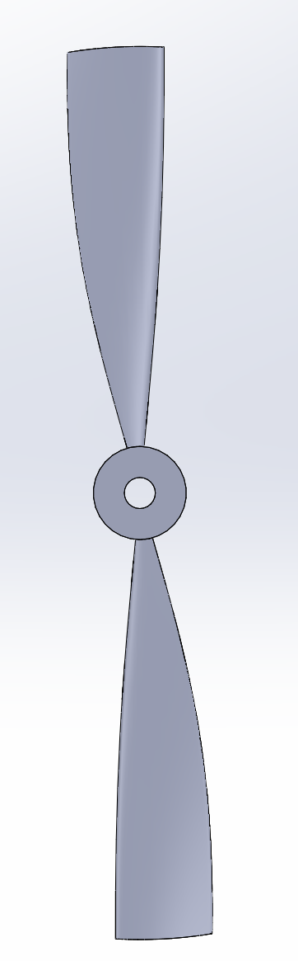
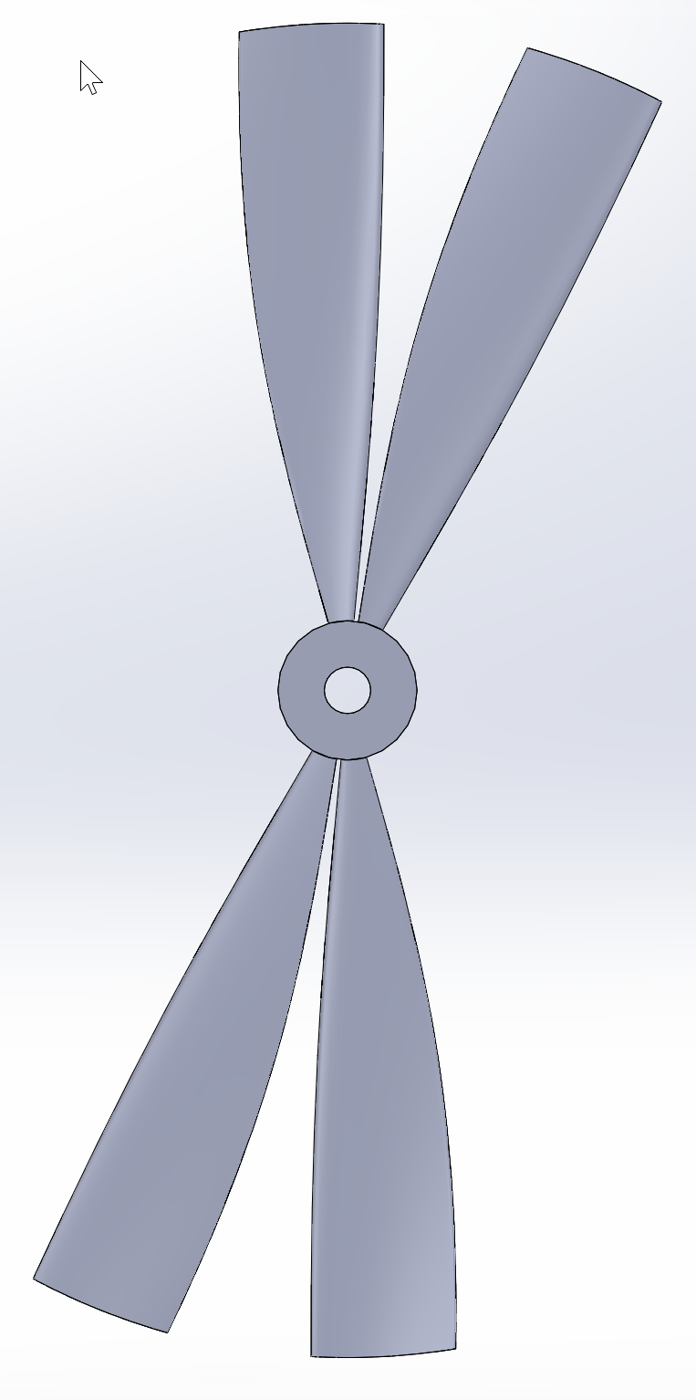
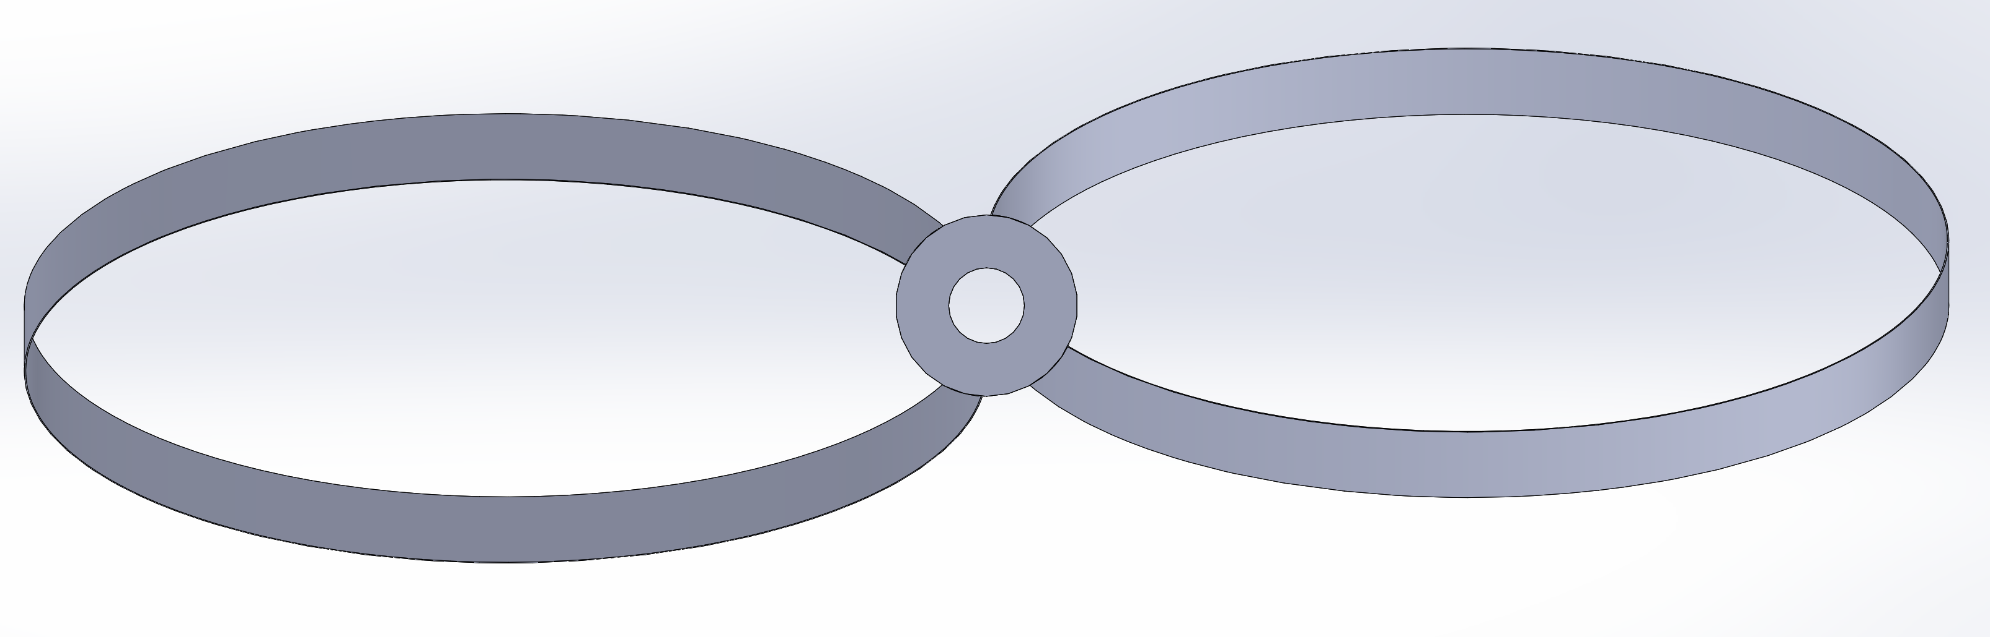
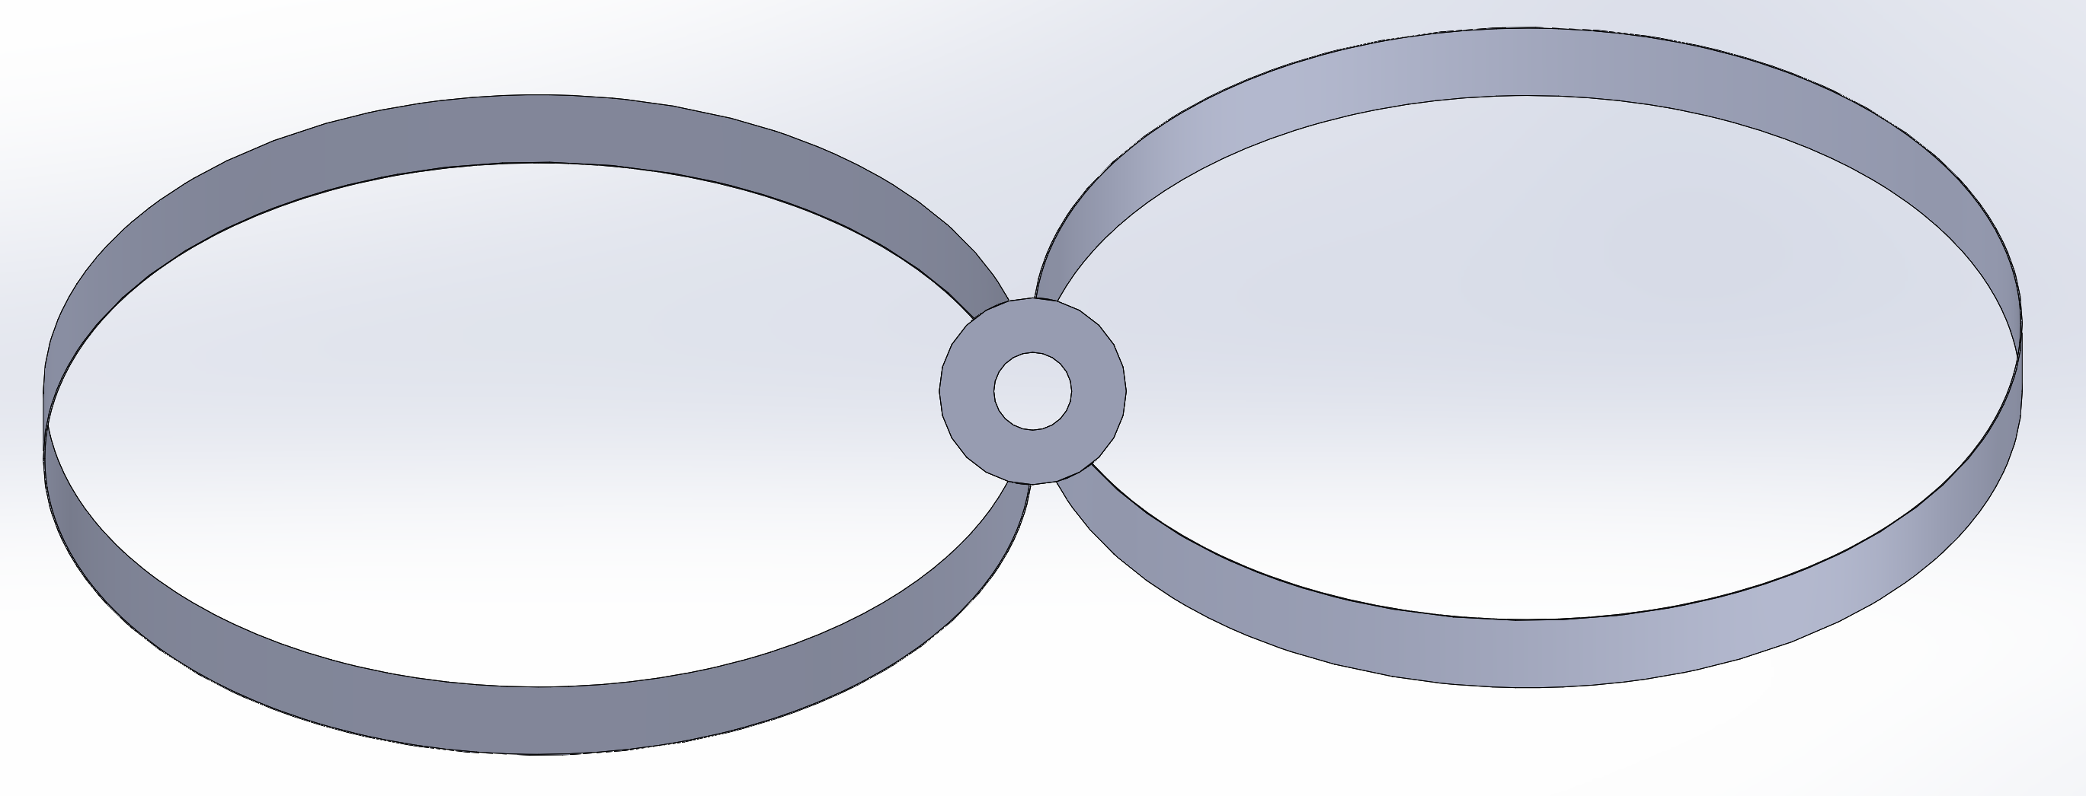
Geometry Modifications
Design using blade element method
Chord, twist and sweep distribution
Blade spacing
Notes:
These are some examples of geometry modifications that are planned to be made.
A conventional propeller optimised for efficiency will be used as a base case.
The left shows varying amounts of sweep for the toroidal propeller.
Trailing edge serrations will also be added to toroidal and an uneven blade spacing design to test this hypothesis

Slide 10


Aerodynamic performance
Aerodynamic performance quantities
$$C_{T}=\frac{T}{ρ{\left(rΩ\right)}^{2}A}, C_{Q}=\frac{P}{ρ{\left(rΩ\right)}^{2}rA}$$
Require measurements for torque, thrust and angular speed.
$$FOM=\frac{C_{T}^{2/3}}{\sqrt{2}C_{Q}}$$
Notes:
For the experimental setup it's important to consider the parameters needed to define a given propellers performance. Dimensionless thrust and torque coefficients can be found from blade tip speed and area.
These can then be combined into a static efficiency, or figure of merit which is the ratio the ideal power required to hover to the actual power required.

Slide 11
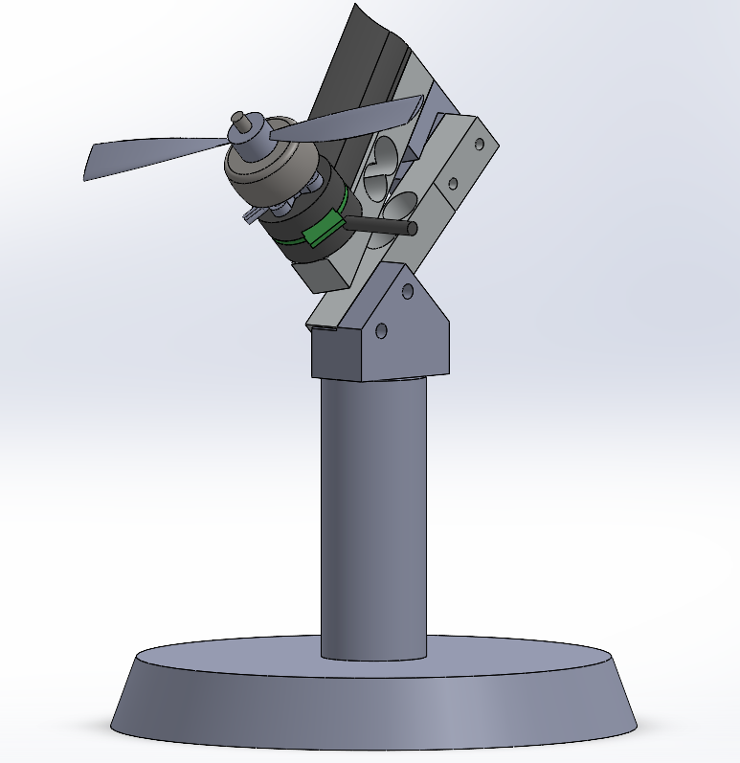
Aerodynamic measurements
Airflow
Torque and thrust measured by strain gauge load cells
Cantilever models selected for sensitivity
Full bridge strain gauge for resistance to off-axis forces
Orientation selected for accuracy, and ease of calibration
Calibration load

Slide 12
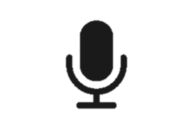
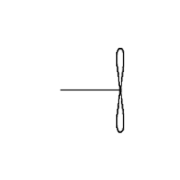


Acoustic measurements
Separate acoustic setup
Acoustically insulate motor
Calibrated microphone is moved to measure directivity
$$R$$
$$θ$$
M

Slide 13
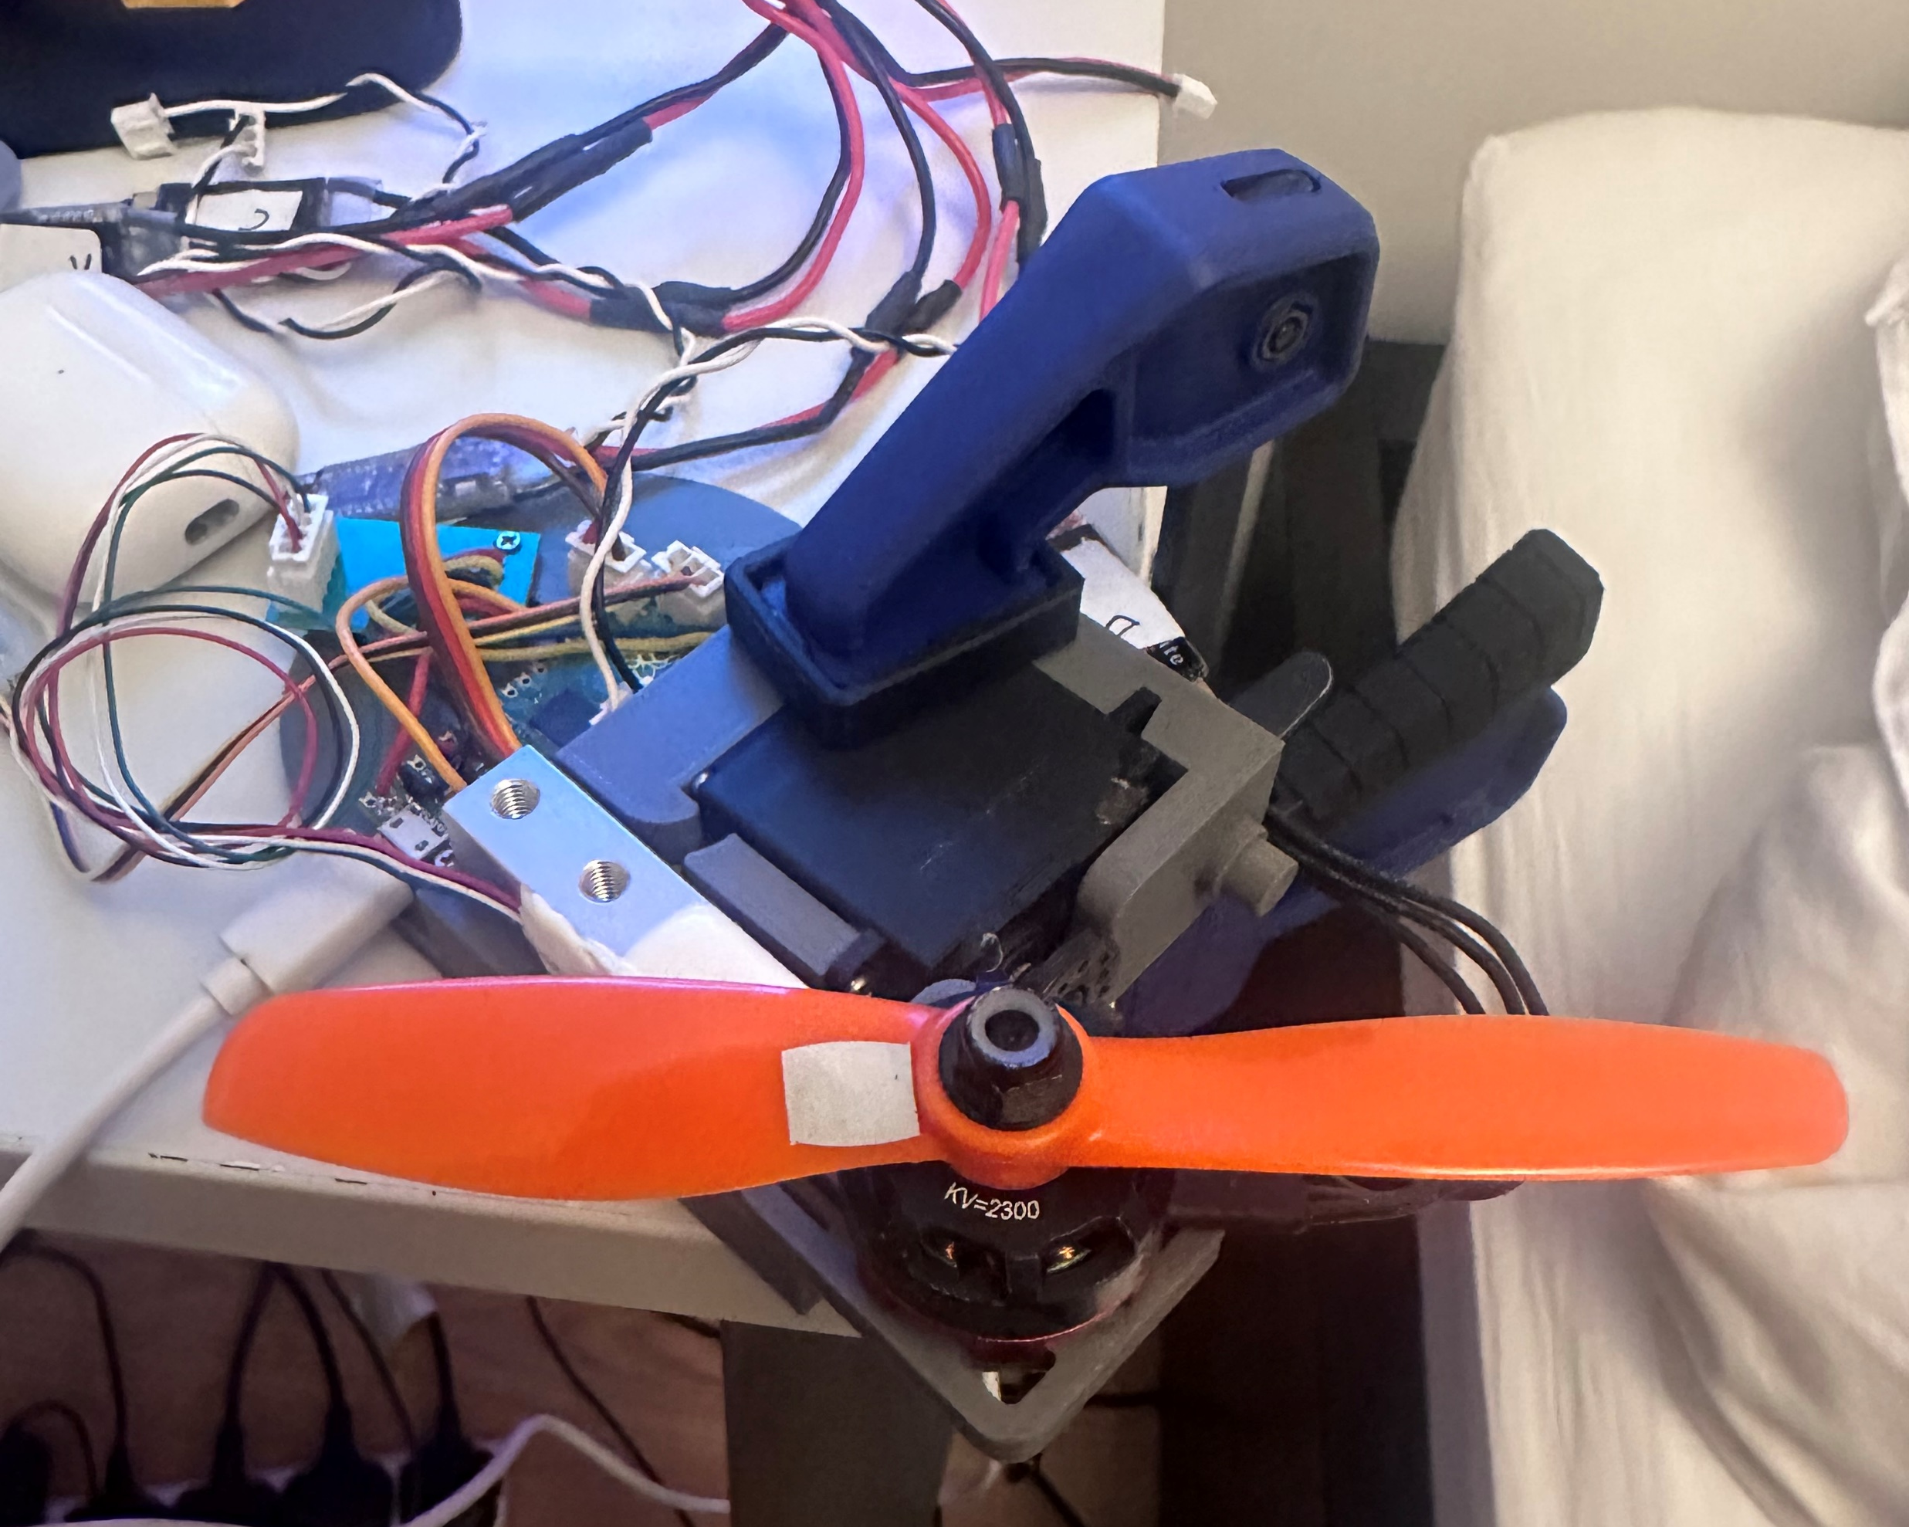
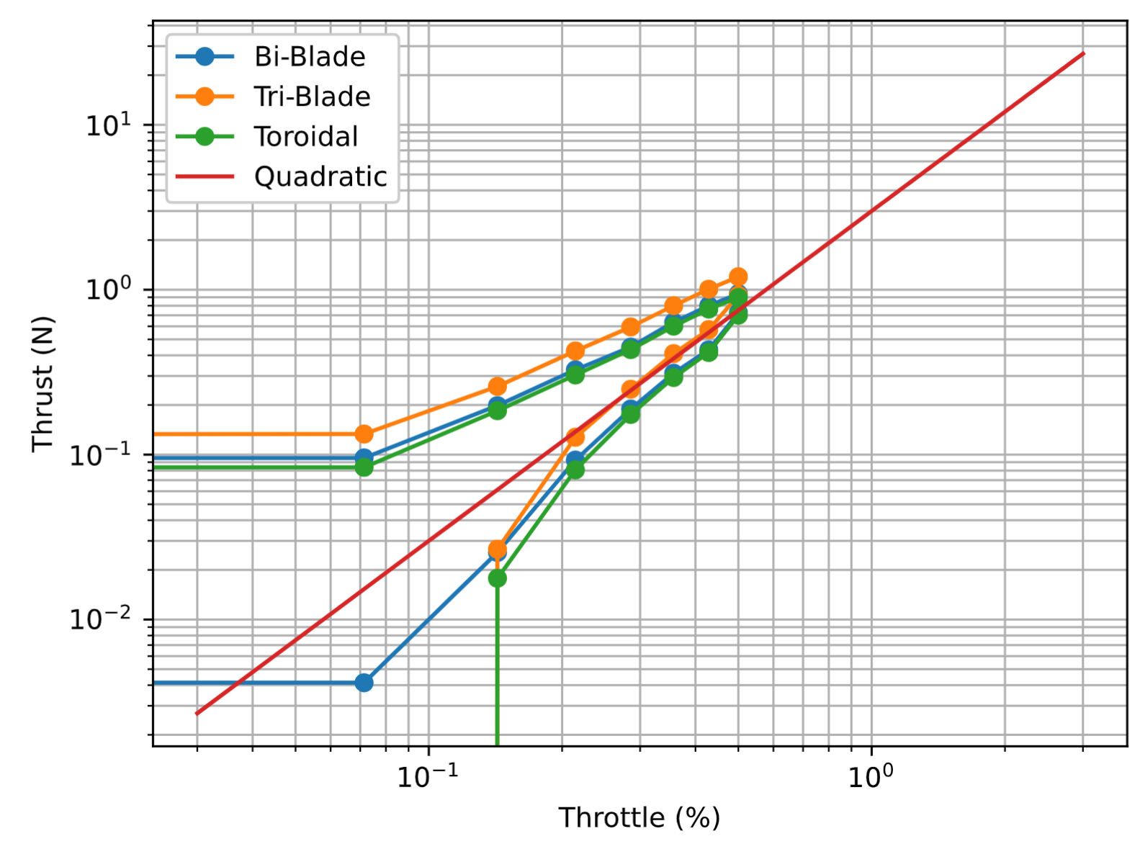
Preliminary setup
Notes:
A preliminary setup to measure thrust against a speed control input was built.
Throttle is supposed to be proportional to speed

Slide 14
Summary
Future work
Reducing drone noise important for adoption
Not an easy problem, large design space with trade-offs
Change blade loading, sweep and blade spacing
Aerodynamic and aeroacoustics setups
Blade element method propeller designs
Design of detailed acoustic setup
Experimental data collection
Possibility for aeroacoustic modelling with Ffowcs Williams Hawkings equation.
Questions?
Notes:
A preliminary setup to measure thrust against a speed control input was built.

