Slide 1
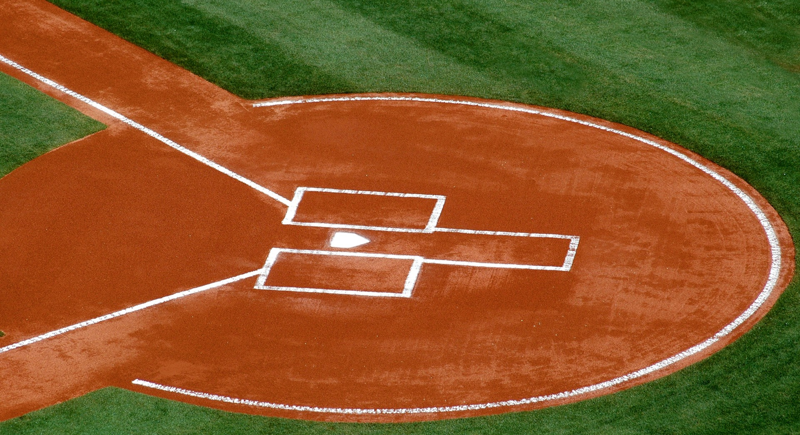
Major League Baseball Disabled List Transactions 2015-2017
Lacey Gleason

Slide 2


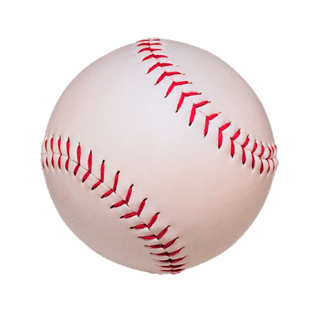
Cost of Injuries in the MLB
A study covering the MLB from 1998-2015 found that the average annual cost of designating players to the DL was $423,267,634
Over $7 billion was spent cumulatively over the 18 seasons
Cost includes:
The cost to pay the player while inactive on the DL
But also, the cost to pay the replacement player
Significant portion of total player cost
~16% in 2015
Source: Stan Conte et al, Injury Trends in Major League Baseball Over 18 Seasons: 1998 – 2015, Amer. J. Orthop. 2016; 45(3): 116-123. Accessed at: https://www.researchgate.net/publication/298909145_Injury_Trends_in_Major_League_Baseball_Over_18_Seasons_1998-2015
Payroll data: http://www.stevetheump.com/index.htm

Slide 3
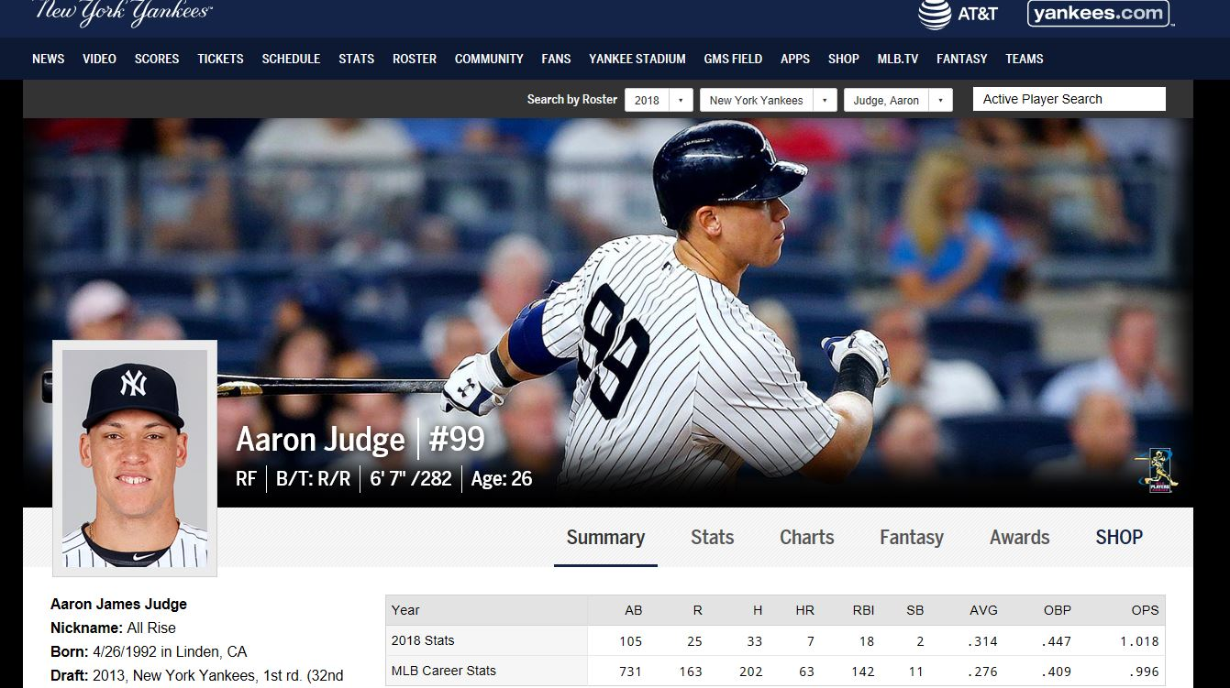
Data Source: MLB.com

Slide 4
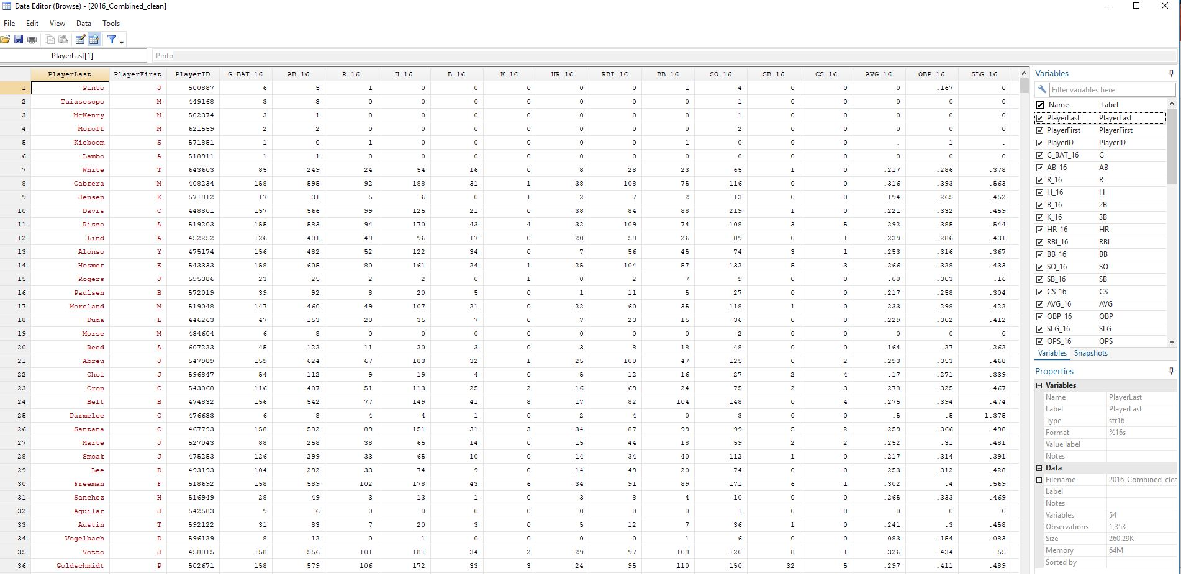

Slide 5
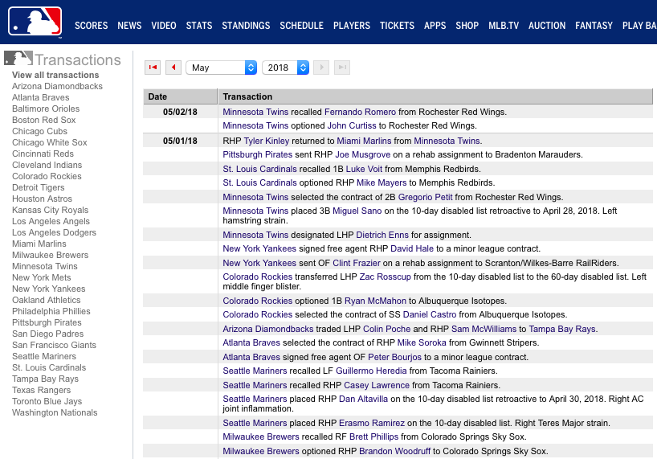
Data Source: MLB.com

Slide 6
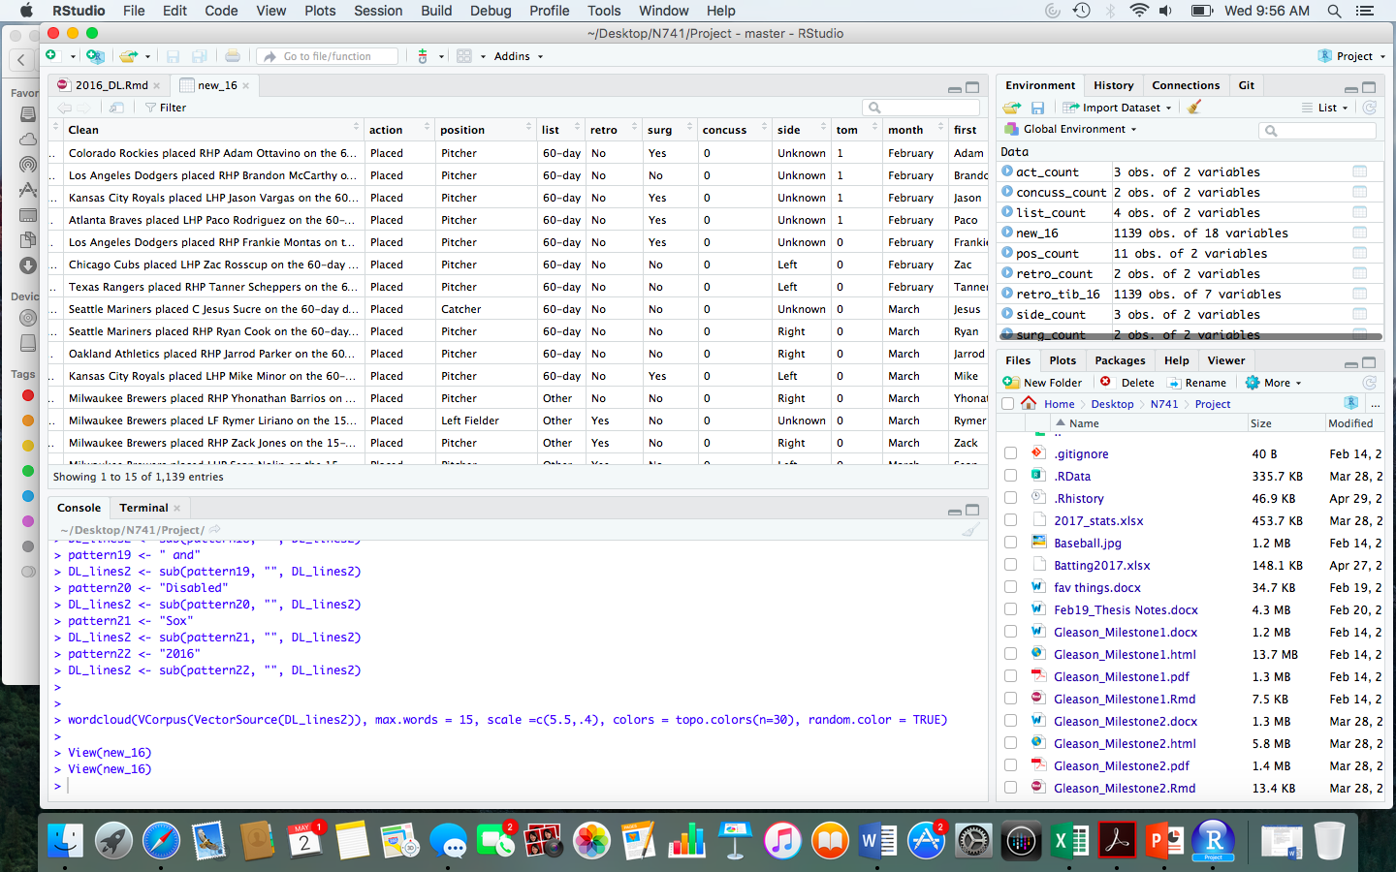

Slide 7
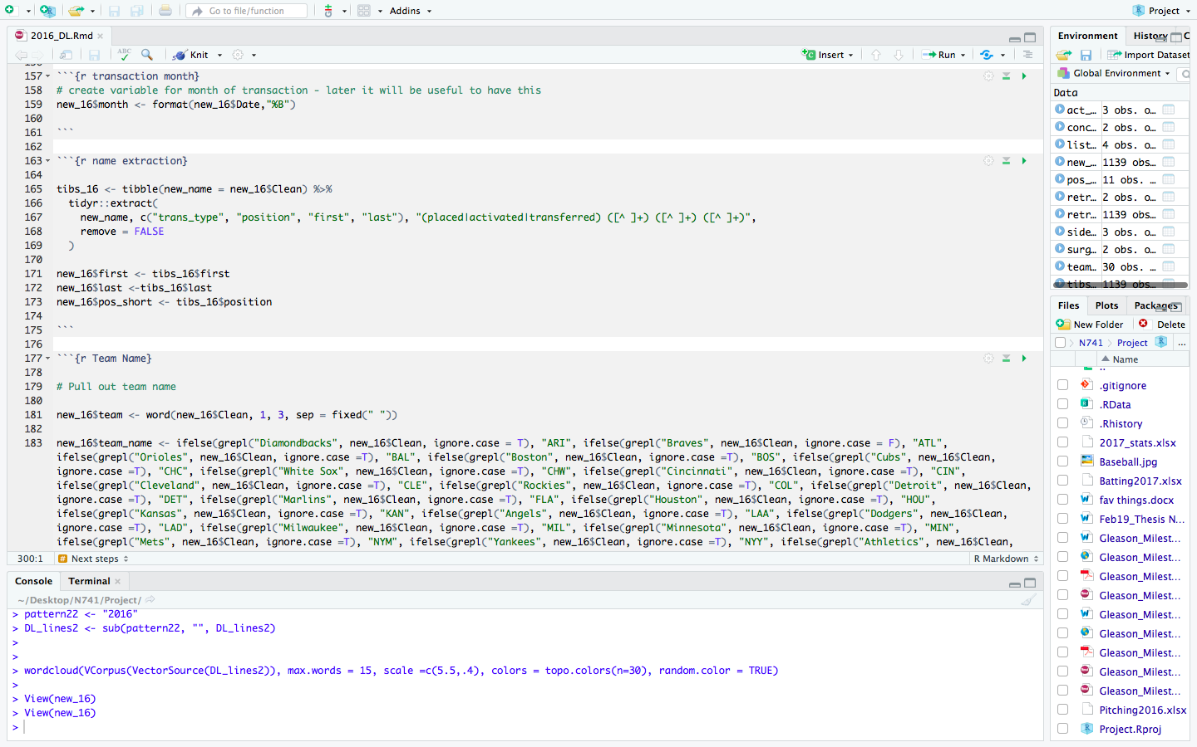

Slide 8
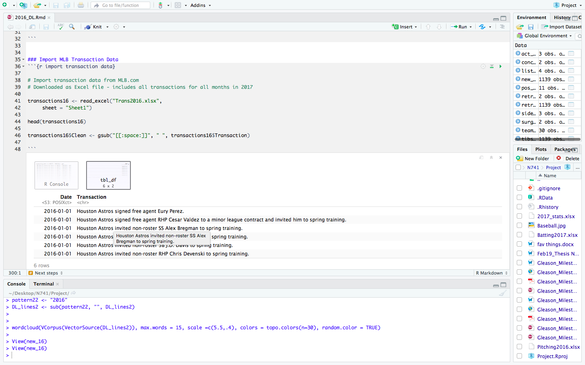

Slide 9
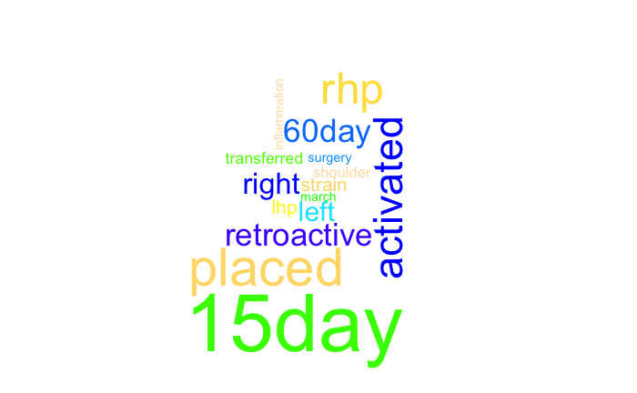
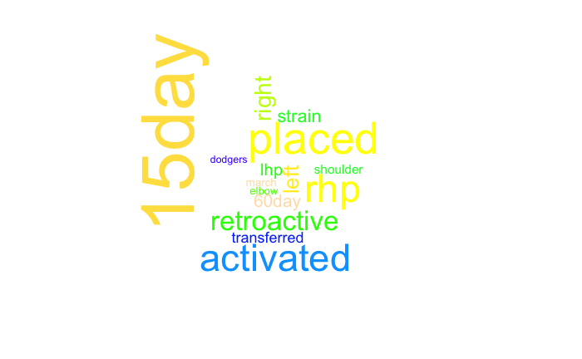
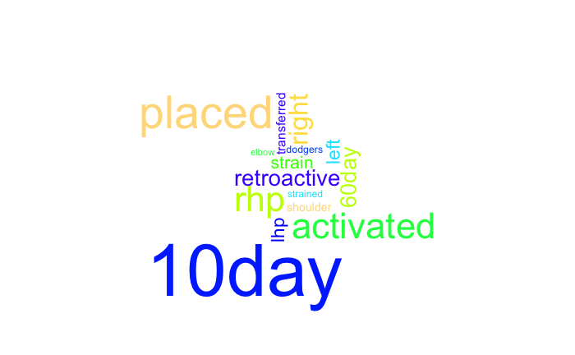
2015
Word Clouds of Disabled List Transactions
2016
2017

Slide 10
Type of Disabled List Utilized
 | 2015 | 2016 | 2017
7-day DL | 11 (3%) | 5 (1%) | 21 (4%)
10-day DL | 1 (<1%) | 5 (1%) | 471 (89%)
15-day DL | 372 (85%) | 375 (81%) | 0 (0%)
60-day DL | 52 (12%) | 76 (16%) | 36 (7%)

Slide 11
Position of Players
Entire League | 2015 | 2016 | 2017
Catcher | 111 (8%) | 107 (8%) | 114 (8%)
DH | 13 (1%) | 16 (1%) | 14 (1%)
Infielder | 279 (21%) | 273 (20%) | 268 (20%)
Outfielder | 232 (17%) | 238 (18%) | 230 (17%)
Pitcher | 712 (53%) | 719 (53%) | 732 (54%)
Placed on DL | 2015 | 2016 | 2017
Catcher | 31 (7%) | 34 (7%) | 35 (7%)
DH | 2 (<1%) | 4 (1%) | 6 (1%)
Infielder | 77 (18%) | 73 (16%) | 99 (19%)
Outfielder | 72 (17%) | 90 (20%) | 91 (17%)
Pitcher | 254 (58%) | 260 (56%) | 297 (56%)

Slide 12
Major League Baseball Disabled List Transactions 2015-2017
Lacey Gleason

