Slide 1

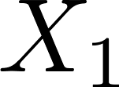
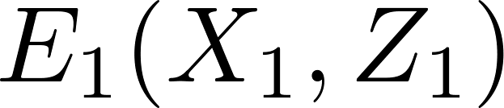
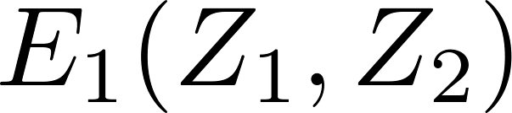
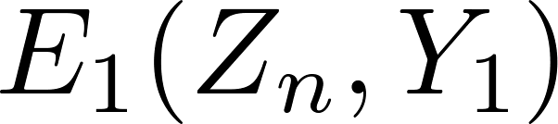

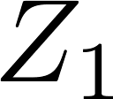
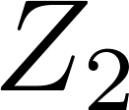


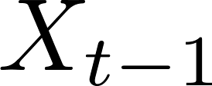
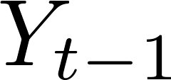

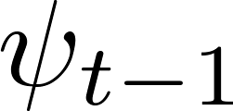
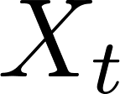
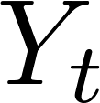

…
…
…
…
…
…
…
…
…
…

Slide 2

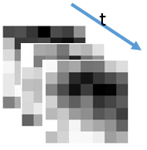









10@7*7*3
3D convolution
2*2
max pooling
20@6*6*2
3D convolution
. . .
. . .
t
. . .
Input: 60*80*5
H1: 10@54*74*3
H2: 10@27*37*3
H3: 20@22*32*2
Trainable parameters:
1470
Trainable parameters:
1440
2*2
max pooling
30@6*7*2
3D convolution
2*2
max pooling
Fully
connected
Fully
connected
output: 26*5=130
. . .
. . .
. . .
t
H6: 30@3*5*1
H4: 20@11*16*2
H5: 30@6*10*1
H7: 500
Trainable parameters:
2520
Trainable parameters:
225,000
Trainable parameters:
65,000

Slide 3
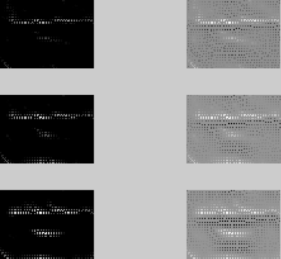
Filtered spatial-time images
Total recognition rate is: 0.596154
--
3d CNN+ HMM,
enhanced dataset,
conjugate gradient for last layer
50 epochs

Slide 4








Learned filter banks
(normalized for visualization)
Wrongly learned filter
(not normalize input by dividing 255)
time
t
Layer2 * 10
Note that you're not likely to get such pretty filters in higher layers. So this visualization is mostly useful only for looking at data-connected layers.
—Alex Krizhevsky
time
Layer4 * 20
Another filter bank
Layer6 * 30
time

Slide 5
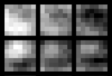
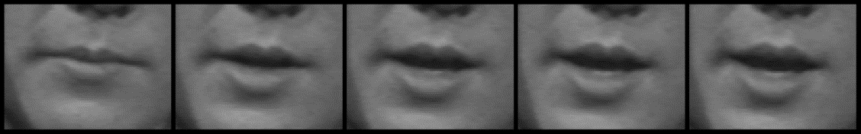
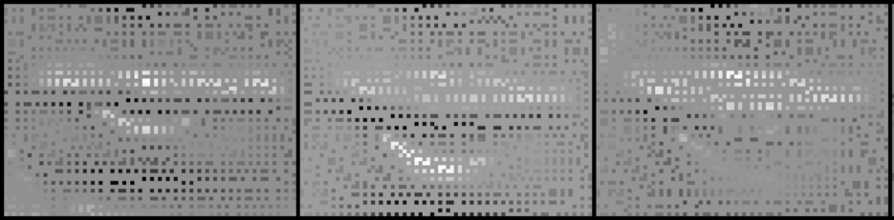
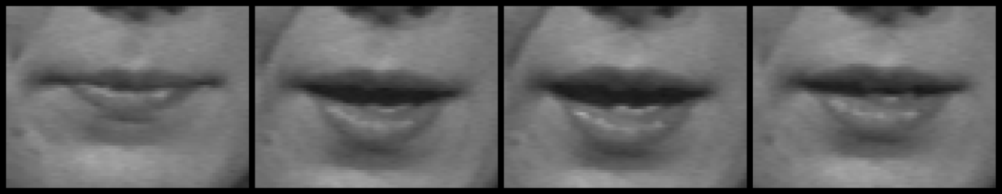

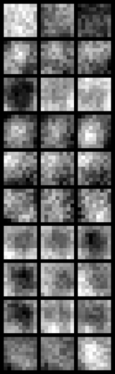
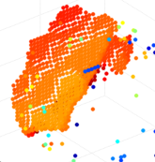
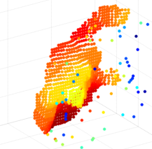
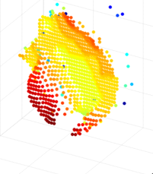
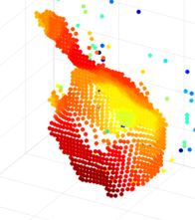
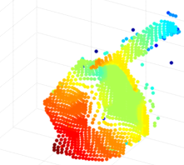
time
time

Slide 6
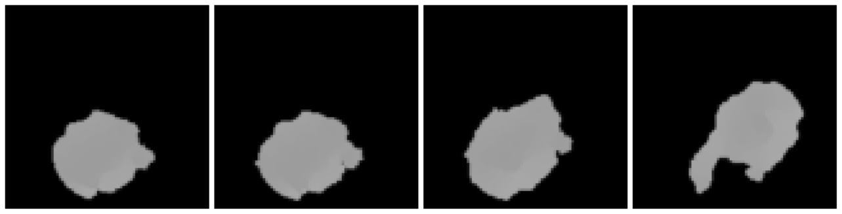
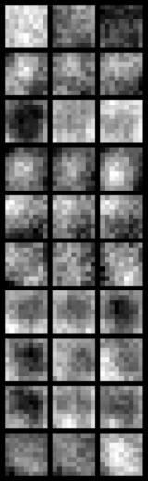


Slide 7
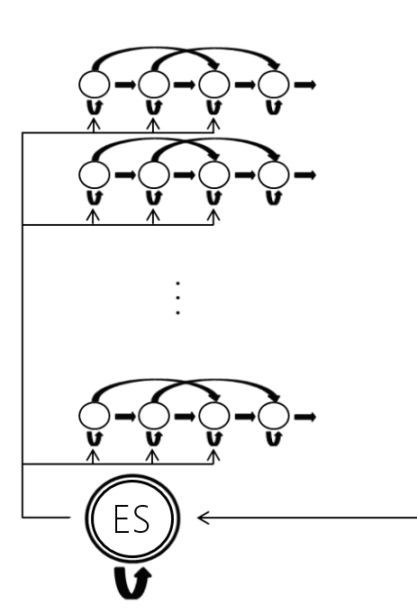
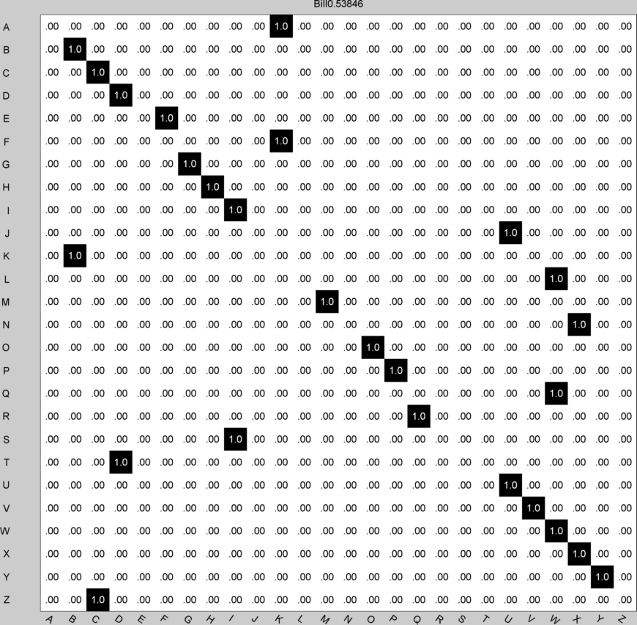
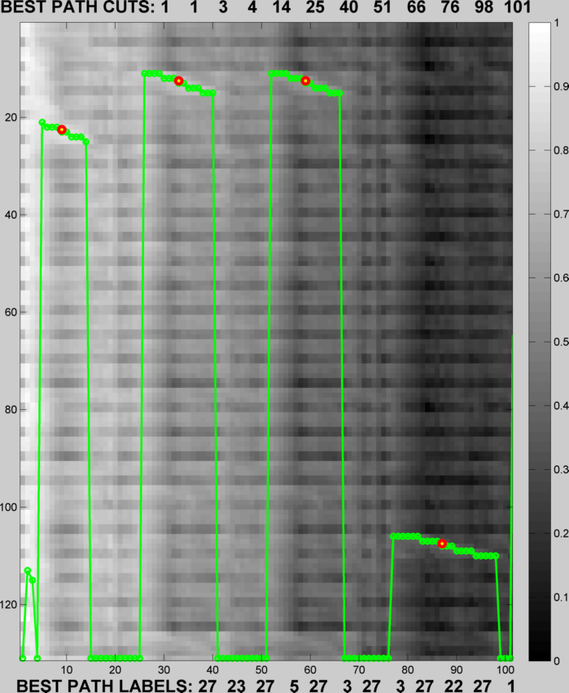
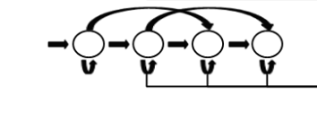

…
class 1
…
class 2
…
…
…
class k

Slide 8
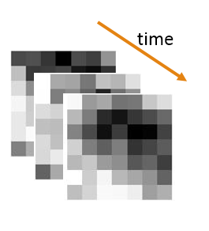
Convolution neuron: modified hyperbolic tangent
Never temporal pooling (because input time is only 5 frames)
10@7*7*3
3D convolution
2*2
max pooling
20@6*6*2 3D convolution
. . .
. . .
t
. . .
Input: 60*80*5
H1: 10@54*74*3
H2: 10@27*37*3
H3: 20@22*32*2
Trainable parameters:
1470
Trainable parameters:
1440
2*2
max pooling
30@6*7*2 3D convolution
2*2
max pooling
Fully
connected
Fully
connected
output: 26*5=130
. . .
. . .
. . .
t
H6: 30@3*5*1
H4: 20@11*16*2
H5: 30@6*10*1
H6: 1000
Trainable parameters:
450,000
Trainable parameters:
130,000
Trainable parameters:
2520

Slide 9
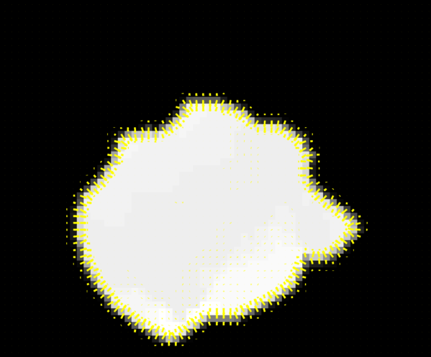
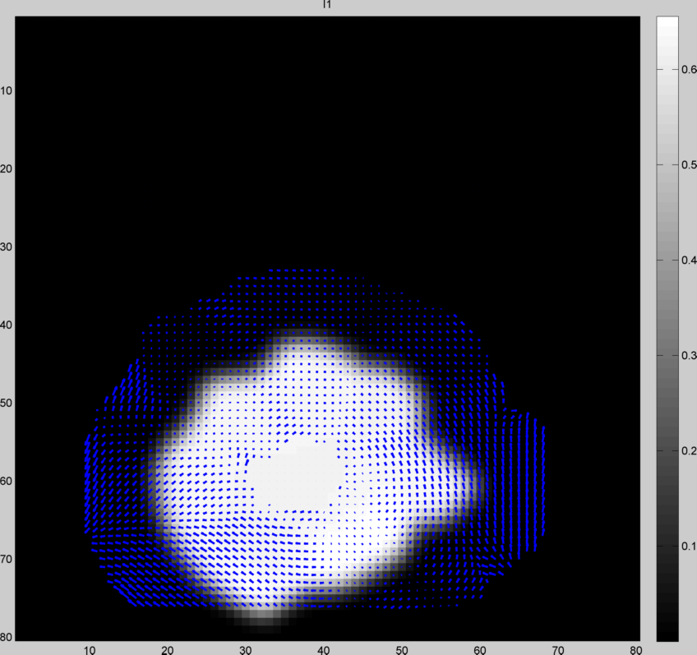
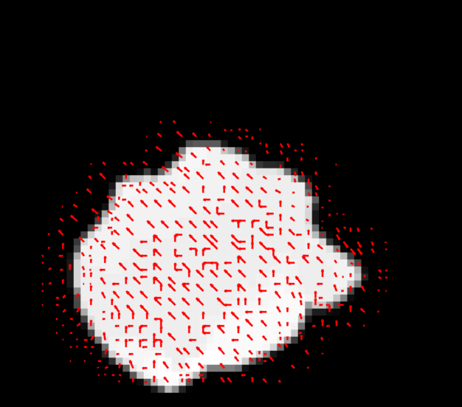

Slide 10
