Slide 1





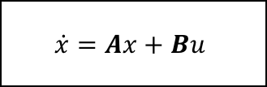
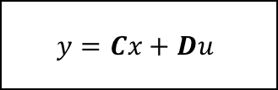






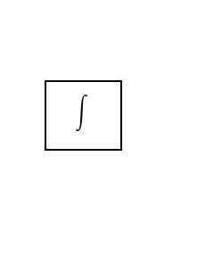
$$u_{D}$$
$$x_{1}$$
$$r$$
$$\dot{z}$$
$$z$$
$$u$$
$$\dot{x}=Ax+Bu$$
$$y=Cx+Du$$
$$y$$
$$K_{i}$$
$$x_{2}$$
$$K_{1}$$
$$K_{2}$$

