Slide 1

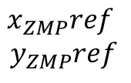
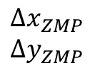

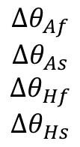

$$x_{ZMP}, y_{ZMP}$$
ZMP Computation
Reference Joint Angles
HUMANOID
ROBOT
$$θ_{Af}, θ_{As}, θ_{Hf},θ_{Hs}$$
Reference
ZMP
STABILIZER
ZMP Control
Force / Torque Sensors
$$x_{ZMP}ref$$
$$y_{ZMP}ref$$
$${∆x}_{ZMP}$$
$${∆y}_{ZMP}$$
$${Δθ}_{Af}$$
$${Δθ}_{As}$$
$${Δθ}_{Hf}$$
$$Δθ_{Hs}$$
$$F_{x}, F_{y}, F_{z}, τ_{x}, τ_{y}, τ_{z}$$

