Slide 1
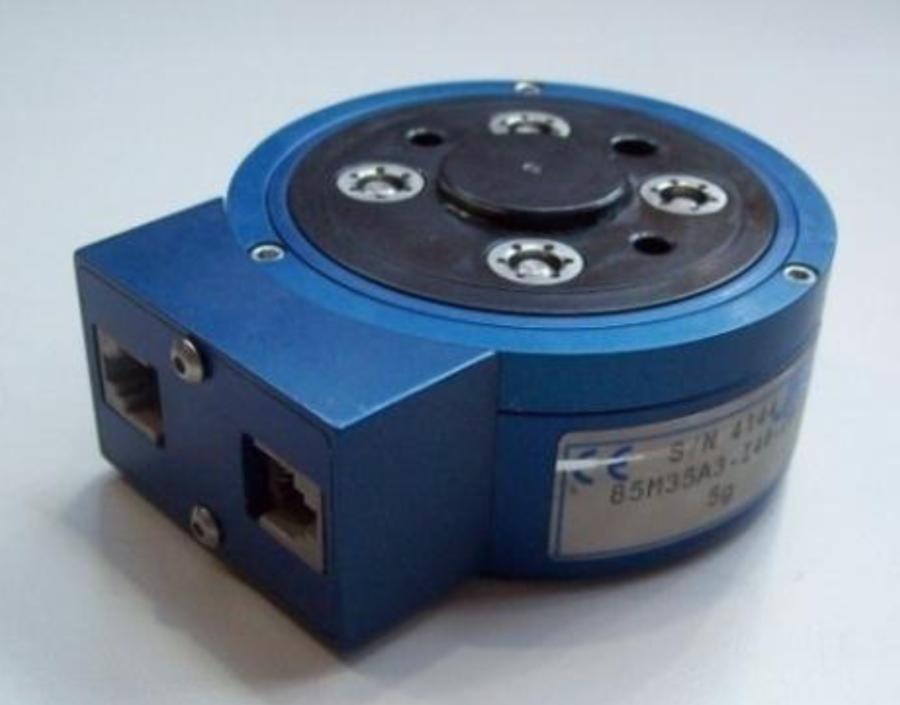
International
System Units
Imperial System Units

