Slide 1

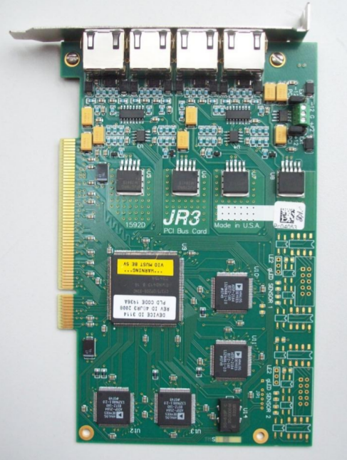
Channel:
0
1
2
3

