Slide 1
Optimization of Secure Function Evaluation
Ph.D preliminary exam
May 16, 2007
Louis Kruger
Notes:
Don’t mumble
You can do it!

Slide 2

“Automakers Rev Up Data-Mining Efforts”
- InformationWeek, March 31, 2003
Notes:
Vaidya/Clifton - requires detailed sharing of product/business data - Year 2000 – treads split / not all vehicles
>250 deaths, ~1000 injuries - would have required joint data mining

Slide 3


What if?
We need to find safety
problems in advance
We’ll get sued if
we don’t..
Our data mining isn’t
showing anything
Neither is ours..
But, what about
  NDA agreements
  Business secrets
What if we combined
information?
Have you heard of “Secure
function evaluation” ?
This is all “theory”.
It can’t be efficient.

Slide 4
Privacy is Important
Privacy preserving data mining
  legal, ethical issues (e.g. patient data)
  confidential business data
Customer privacy
Lots of thieves on the internet
Even “trusted” parties have data theft
  e.g. UPS, Wells Fargo, TSA, many more…
Moral: share as little data as possible
Notes:
Health Insurance Portability and Accounting Act – mandates privacy of medical data
Want to share as little info as possible: backup tapes / financial data & SSN / TSA employee payroll

Slide 5
Preserving Privacy
Two basic approaches:
  Randomization
    Scramble identifying information
    Doesn’t work for all problems, and information may leak anyway
    Lightweight approach
  Secure Function Evaluation (SFE)
    Provable security guarantees
    Heavyweight overhead
    Focus of my work

Slide 6
Secure Function Evaluation
  Alice and Bob have private data.
  joint function
  F(x_{alice}, y_{bob})
x_{alice}
y_{bob}
  F(x_{alice}, y_{bob})
  F(x_{alice}, y_{bob})
Neither Alice nor Bob learn any
information except for the function output
Notes:
Contrast with data anonymization

Slide 7
Secure Function Evaluation
What’s the problem?
  General protocol are very expensive
    Yao’s protocol requires an encrypted Boolean circuit with 4 keys for every gate and 2 keys for every input
    Many invocations of cryptographic primitives
  Efficient protocols must be manually designed
Notes:
Analogy: used to have to write fast code in machine language
Compiler research has come a long way since then in

Slide 8
Thesis Statement
SFE can be made efficient enough for practical use.

Slide 9
Outline
Motivation
Background
How to create efficient protocols
Optimizing protocol compiler
Optimizing cryptographic primitives
An application: SSH authentication
Timeline/conclusion

Slide 10
Fundamental Result
Theorem: Any function that can be evaluated in polynomial time, can be securely evaluated in polynomial time.*
  garbled circuits (Yao 86)
  SCWS (GMW 87)
* Under certain cryptographic
complexity assumptions
Notes:
Trapdoor functions exist (which implies P != NP)

Slide 11
1-2 Oblivious Transfer (OT)
Sender has values v₁ and v₂
Chooser has s=1 or s=2.
Using OT:
  Chooser learns v_{s}
  Chooser does not learn anything else
    i.e. v_{3-s}
  Sender learns nothing
Notes:
Next slide is picture

Slide 12
1-2 Oblivious Transfer (OT)
I have v₁ and v₂
I want v₁
but Alice can’t know that
v₁
= g^{x}
v₂
= C/g^{x}
= g^{x} (or C/g^{x})
for v₁ (or v₂)
respectively
Notes:
SFE exists if and only if OT exists / OT exists if and only if trapdoor functions exist
Unconditional Information theoretic security for chooser, cryptographic security for sender.
(reg comm channel) Can’t have unconditional security for both

Slide 13
Fairplay
Fairplay is a secure circuit evaluation system described in [Malkhi et al 04]
Alice
program foo {
…
}
SFDL
SHDL
Compiler
Yao
protocol
Bob
Notes:
Because it uses generic Yao protocol – we can do much better!

Slide 14
Additive Homomorphic Encryption
A class of public key encryption schemes that satisfy linear homomorphism properties:
  Given E(x) and E(y), can efficiently compute E(x+y) (without secret keys)
  Given E(x) and k, one can efficiently compute E(kx) (without secret keys)
Examples:
  Benaloh 94
  Paillier 99

Slide 15
Threat Models of SFE
Semi-honest (“honest but curious”)
  Parties faithfully follow the protocol
  But expend extra computation to learn things they’re not supposed to
Malicious
  Adversarial party uses “any means necessary” to thwart your privacy
    May send any message at any time
  Threat model covers the protocol, not the implementation (buffer overflows aren’t included)

Slide 16
Malicious Protocol Compiler
Theorem (GMW 87)
  Any protocol that is secure in the semi-honest model, can be automatically transformed into a protocol secure in the malicious model
The semi-honest model is sufficient for theoretical results
Real world protocols should be secure in the malicious model
Notes:
Proof uses input bit commitment, interactive proofs, etc.

Slide 17
Outline
Motivation
Background
How to create efficient protocols
Optimizing protocol compiler
Optimizing cryptographic primitives
An application: SSH authentication
Timeline/conclusion

Slide 18
K-Means Clustering
Common data mining technique
  Unsupervised learning and classification
Notes:
Clustering finds groups of related points based on a distance metric

Slide 19
K-Means Clustering
Initialize K cluster centers
Assign points to nearest cluster
Recompute cluster means
Convergence

Slide 20
Distributed Clustering
Can be done locally
Initialize K cluster centers
Assign points to nearest cluster
Recompute cluster means
Must be distributed
Convergence

Slide 21
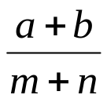
Secure Averaging Problem
For the data assigned to each cluster k:
  a_{k} is the vector sum of Alice’s data
  b_{k} is the vector sum of Bob’s data
  m_{k} is the count of Alice’s data
  n_{k} is the count of Bob’s data
Secure clustering reduces to Secure Averaging Problem
Initialize K cluster centers
Assign points to nearest cluster
Recompute cluster means
Convergence

Slide 22
Approaches
Fairplay (Yao circuit evaluation)
  Baseline comparison
Oblivious Polynomial Evaluation (OPE)
  Algorithm [Naor Pinkus 99]
  Performs a secure multiparty computation of p(x1,…,xn) where p is a polynomial
  Avoids simulating the circuit computation for division
Homomorphic Encryption
  A class of public key encryption schemes that satisfy linearity properties:
    Given E(x) and E(y), one can efficiently compute E(x+y) without decryption
    Given E(x) and k, one can efficiently computer E(kx) without decryption
  Evaluation using Dense Probabilistic Encryption [Benaloh 94]

Slide 23
Using Homomorphic
Encryption
a, m
b, n
D, E
E
E(a), E(m)
E(a), E(m)
z (random)
Homomorphic properties allow this
E(zb), E(zn)
E(za+zb)
E(za+zb)
za+zb
a+b
m+n
E(zm+zn)
E(zm+zn)
zm+zn

Slide 24
Performance Test
Five data sets
  From 3 to 36 features (dimensionality of data)
  From 4 to 28,392 samples (data points)
  Taken from Computation Intelligence and Learning (COIL) competition, also a home-grown set based on ping times
Test setup:
  2 computers, 3ghz Pentium 4, plenty of RAM
  Unloaded 100 Mbit LAN

Slide 25
Performance Test
 | Byte overhead | Time overhead
Fairplay | 2Mb per feature per round | 60000 ms per feature per round
OPE | 126kb per feature per round | 800 ms per feature per round
DPE | 0.8kb per feature per round | 250 ms per feature per round

Slide 26
An idea
What if we use something besides Boolean circuits?
  Ordered Binary Decision Diagram (OBDD)

Slide 27
OBDD
Defined in [Bryant 86]
x1
Many uses
  Computer aided design
  Model checking
  Hardware verification
0
1
x2
x2
1
0
0
1
x3
0
1
x4
1
0
0
1

Slide 28
Decision Tree vs OBDD
Node sharing can reduce nodes from
O(2^{n}) to O(n)
x1
x1
0
1
0
1
x2
x2
x2
x2
1
0
1
0
0
1
0
1
x3
x3
x3
0
1
0
1
1
0
x4
x4
x4
1
0
1
1
0
0
0
1
0
0
0
1
0
0
1
1
Notes:
Decision trees in general are 2^n, OBDD in general is a DAG, not a tree

Slide 29
Secure OBDD Protocol
Preliminary Steps
Alice must add dummy nodes so all paths are the same length (this prevents information leak)
x1
x1
x1
0
1
0
0
1
1
x2
x2
x2
x2
x2
x2
1
1
0
0
1
0
1
1
0
0
1
0
x3
x3
x3
x3
x3
1
1
0
0
1
0
x4
x4
x4
x4
x4
1
0
1
0
1
0
0
1
0
1
0
1
Notes:
Assume: Alice and Bob both know the circuit, but xi values are private

Slide 30
Secure OBDD Protocol
Preliminary Steps
Alice computes the restriction on her inputs
  Alice knows x1=1, x3=0
New head
node
x1
Unreachable nodes must
be kept to maintain privacy
0
1
x2
x2
x2
x2
x2
x2
1
0
0
1
0
1
x3
x3
x3
0
1
This step is a
performance
optimization
x4
x4
x4
x4
x4
x4
x4
1
0
1
0
0
1
0
1

Slide 31

Secure OBDD Protocol
Encryption
Alice encrypts the restricted OBDD
Alice chooses a pair of keys for each of Bob’s variables: x2 and x4
they correspond to 0 and 1
head
node
Alice encrypts the OBDD
all links are encrypted
nodes are scrambled
(except for the head)
x2
x2
0
x2
1
x4
x4
x4
1
Bob
0
0
1

Slide 32
Secure OBDD Protocol
1-2 Oblivious Transfer
Bob selects and receives one of the two keys from Alice for each of his variables. Alice doesn’t know which one he chose
Alice
Bob
x2
x2=1
x2
Oblivious Transfer
x4
x4=0

Slide 33
Secure OBDD Protocol
Evaluation
Bob uses the keys from the previous step to decrypt a path through the OBDD
x2
Bob
x2
x4
x4
0

Slide 34
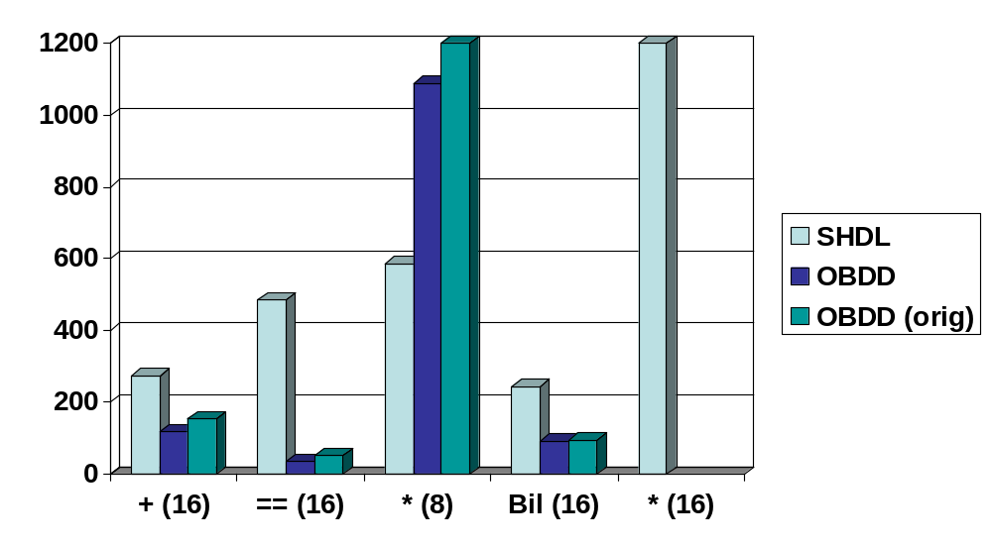

Nodes in Circuit
1685
2682
“out of
memory”

Slide 35
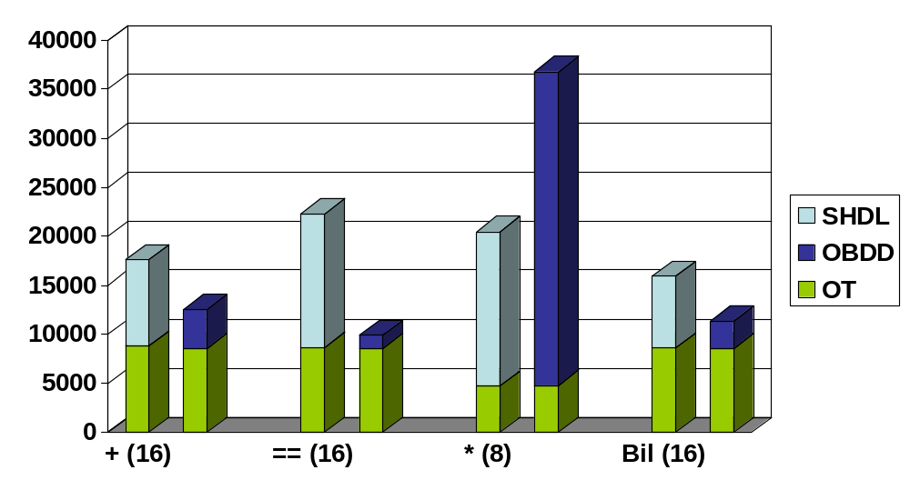
Bandwidth (bytes)

Slide 36
BDD Generalizations
Multi-Terminal BDD
Binary Moment
Hybrid Decision Diagrams
Binary Expression Diagrams

Slide 37
Multi-Terminal BDD
Just like OBDD, but with non-Boolean output values
x1
2 x1+x2
x2
x2
0
1
2
3
Notes:
Multi-terminal BDD

Slide 38
Binary Moment Diagram
Like MTBDD, but multiple output values are combined linearly
False edges are always followed
x1
2 x1+x2
x2
(1, 1)
0
1
2
+ +
= 3
Notes:
Multi-terminal BDD

Slide 39
And many others
Hybrid BDDs (Clarke 95)
  Further refinement of BMD
Boolean Expression Diagrams (Andersen 02)
  Combines decision nodes and Boolean gates in single entity
Can be more efficient for some functions
Will these lead to efficient
secure circuits?

Slide 40
Partial Information Leakage
Modified Millionaire’s problem:
  Alice and Bob want to compare their net worth (8 decimal digits each)
  They consider the bottom 6 digits “rounding error”: doesn’t matter if revealed.
$AA293847 ? $BB928374
Will this lead to an
efficient secure circuit?

Slide 41
Outline
Motivation
Background
How to create efficient protocols
Optimizing protocol compiler
Optimizing cryptographic primitives
An application: SSH authentication
Timeline/conclusion

Slide 42
Optimizing Protocol Compiler
Bringing it all together:
  Express computation using a language (like Fairplay)
  Compile to representation that can be securely evaluated
int foo(
int x: alice,
int y: bob) {
…
}
Optimizer
compiler
0
1
2
Notes:
IMPORTANT SLIDE!!!

Slide 43
Optimizing Protocol Compiler
Optimizer tries different representations to find most efficient protocol
0
1
2
Notes:
Also, language allows marking data as trusted or untrusted, etc.

Slide 44
Privacy Annotations
void foo(int x: alice, int y: bob) {
…
int z: nonprivate
…
}

Slide 45
Outline
Motivation
Background
How to create efficient protocols
Optimizing protocol compiler
Optimizing cryptographic primitives
An application: SSH authentication
Timeline/conclusion

Slide 46
Cryptographic Primitives
Observations:
  Oblivious Transfer is expensive!
  Homomorphic encryption is expensive!
34254372167943146731467162717964
1374169734691736973048572085702
Can we do better?
59883543574327348528374827384234
8475875834750274782748205783724
48323284562459643754375436754738
3484875432547325745687267547547

Slide 47
OT with Modular √’s
Assumption: Factoring n=pq cannot be done in polynomial time
Fastest known factoring algorithms search for pairs a²≡b² (mod n).
  If one is found then (a-b)(a+b)=kpq
Given a, finding b is equivalent to factoring n. Conversely, finding b is easy if p and q are known.

Slide 48
OT with Modular √’s
Sender has values v₁ and v₂
Chooser has s=1 or s=2. Chooser will receive v_{s} obliviously
Setup:
  Sender chooses large primes p and q
  with p ≡ q ≡ 3 (mod 4). Sends n=pq to chooser
Observation: For any a² ≡ b² and a≠-b, then ( - ) = -( - )
a
b
n
n

Slide 49
OT with Modular √’s
I have v₁ and v₂
I want v₁
but Alice can’t know that
v₁
v₂
= x
= other √x²
= x²
Notes:
SFE exists if and only if OT exists

Slide 50
OT with Modular √’s
Chooser’s steps:
  Chooser picks random x.
  Let ( - ) = -1 or +1 to choose v₁ or v₂
  respectively
  Chooser sends y ≡ x² (mod n) to sender
Sender’s steps:
  Calculate a² ≡ b² ≡ y (mod n)
  Send E_{a}(v₁) and E_{b}(v₂) to chooser
Chooser decrypts v_{s}
x
x
n
n

Slide 51
OT with Modular √’s
Bandwidth requirements:
  log n bits from chooser to sender
  log v₁ + log v₂ bits from sender to chooser
2 log n + log v₁ + log v₂ bits from sender to chooser in other protocols

Slide 52
Outline
Motivation
Background
How to create efficient protocols
Optimizing protocol compiler
Optimizing cryptographic primitives
An application: SSH authentication
Timeline/conclusion

Slide 53
SSH problem
SSH has man-in-the-middle vulnerabilities:
  Passwords are sent in the “clear” (over the encryption session)
  An untrustworthy server can learn your password
  A man-in-the-middle can learn your password and log your entire session

Slide 54
SSH problem
Standard SSH solution: host key authentication
  Requires client to know all server keys
  or
  User must decide if a new server key is valid
  The authenticity of host 'prospero (128.105.121.27)' can't be established. RSA key fingerprint is 3f:76:22:43:c2:03:b9:71:b0:31:ce:87:37:45:cb:02. Are you sure you want to continue connecting (yes/no)?
Since when do we trust users?

Slide 55
SPAKA
“Secure Password and Key Agreement”
( Bellovin 92)
  Protocols for securing mutual password authentication
  Simultaneously prove that I know password “X” and you know “H(X)” in a cryptographically secure way.
  Sounds like SFE
  Why doesn’t SSH already have this?

Slide 56
SPAKA using SFE
Existing SPAKA protocols:
  All theory, no practice
    multiple key servers, special hash functions, etc
With SFE: compile any hash algorithm into a secure protocol
  Client and Server securely evaluate X==H(X)
  Fits into existing authentication infrastructures
Challenge: make it efficient and useful
Notes:
Implement and benchmark

Slide 57
Outline
Motivation
Background
How to create efficient protocols
Optimizing protocol compiler
Optimizing cryptographic primitives
An application: SSH authentication
Timeline/conclusion

Slide 58
Timeline
Summer 2007 Secure authentication in SSH
Fall 2007 Cryptographic optimizations
Winter/Spring 2008 Other circuit representations
Spring/Summer 2008 Allowing information leakage
Fall/Winter 2008 Optimizing protocol compiler
Spring 2009 Write dissertation and graduate

Slide 59
Optimization of Secure Function Evaluation
Ph.D preliminary exam
May 16, 2007
Louis Kruger
Notes:
Don’t mumble
You can do it!

