Slide 1
EE6470 ManyCoreSystem Final Project
109061634 蕭詠倫

Slide 2
Guide line
Task
Architecture
Principal Component Analysis and Two-layer Neural Network
PCA and Two-layer NN in RISCV-VP Platform
PCA and Two-layer NN in HLS

Slide 3



Task : classify three kinds of fruits
Carambula (type 1)
Lychee (type 2)
Pear (type 3)
Each image 32 x 32 (1024) pixels

Slide 4
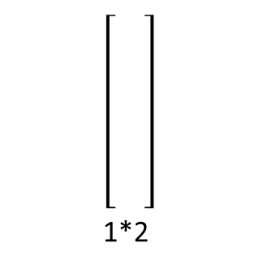
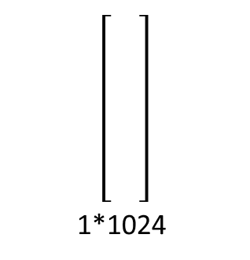
Architecture
Hardware
1*1024
1*2
PCA
Max
Input layer
Output layer
Hidden layer
Carambola or Lychee or Pear ?

Slide 5
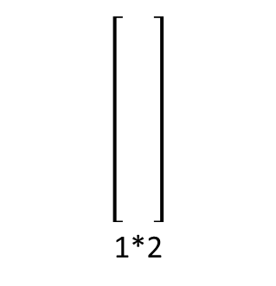
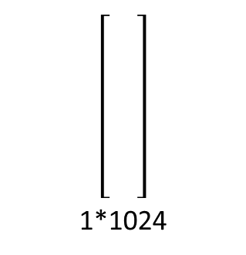
Principal Component Analysis
Matlab.m
[coeff,score,latent] = pca(trainset ,'NumComponents',2)
[trainset-mean(trainset)] x coeff = score
[testset - mean(trainset)] x coeff = testset2D
Two parameters in SystemC
mean(trainset) = [ ]_{1*1024}
coeff = [ ]_{1024*2}
1*1024
1*2
PCA
testset
testset2D

Slide 6
Two-layer Neural Network
Four parameters in SystemC
Hidden layer weight (H_W) = [ ]_{2*4}
Hidden layer bias (H_B) = [ ]_{1*4}
Output layer weight (O_W) = [ ]_{4*3}
Output layer bias (O_B) = [ ]_{1*3}
Input layer
Output layer
Hidden layer

Slide 7
Parameters in .h file
mean(trainset) = [ ]_{1*1024}
coeff = [ ]_{1024*2}
Hidden layer weight (H_W) = [ ]_{2*4}
Hidden layer bias (H_B) = [ ]_{1*4}
Output layer weight (O_W) = [ ]_{4*3}
Output layer bias (O_B) = [ ]_{1*3}

Slide 8
Activation Function
Activation Function
RISCV-VP Platform(Sigmoid)
F(x) = 1/(1+exp(-x))
HLS
F(x) = 1 if x >= 4
0 if x <= -4
1/2 + x/8 if 4 > x > -4
{

Slide 9
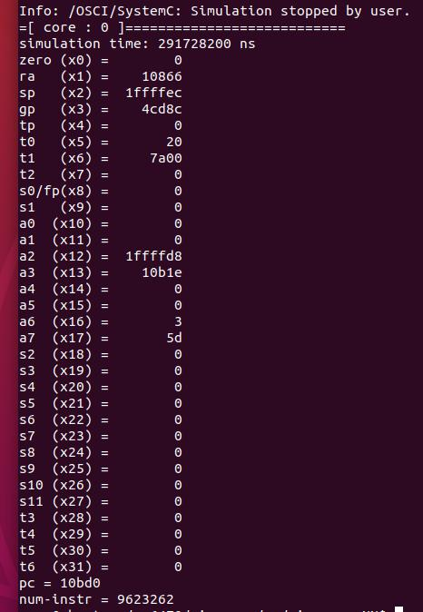
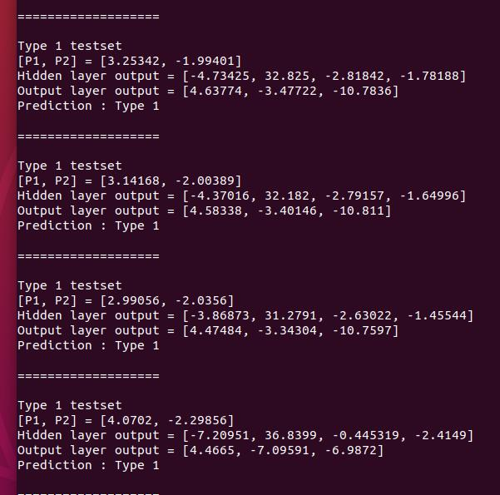
RISCV-VP Platform single-core

Slide 10
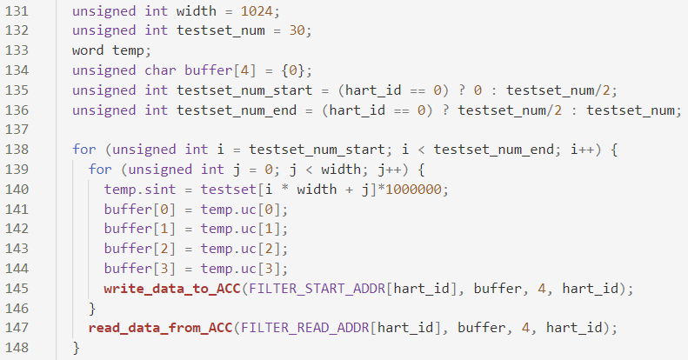
RISCV-VP Platform multi-core(two core)

Slide 11
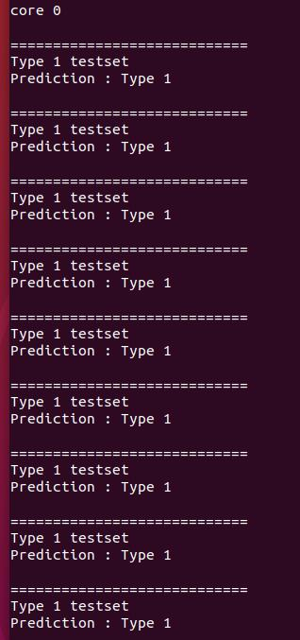
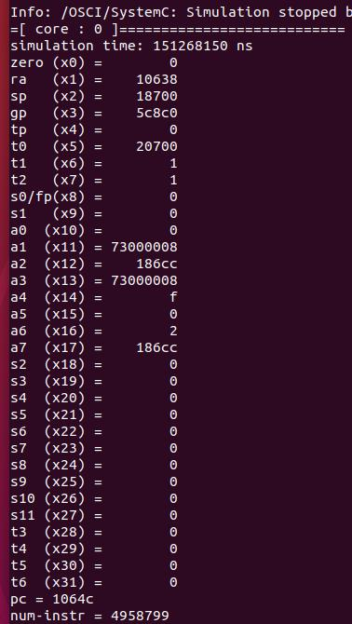
multi-core (core0)

Slide 12
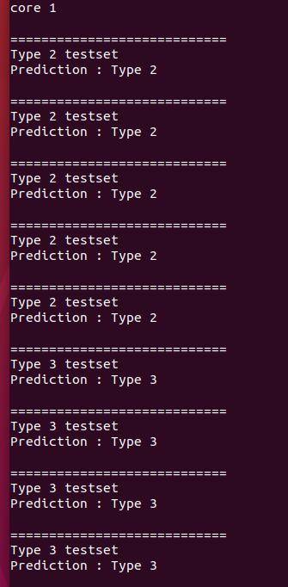
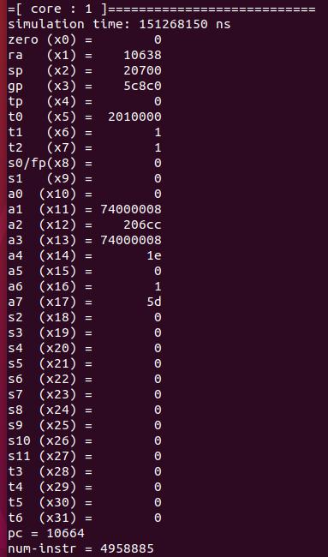
multi-core (core1)

Slide 13
Single-core vs multi-core
 | Single-core | Multi-core
Simulation time(ms) | 291.728600 | 151.268150
Instructions | 9,623,262 | 4,958,799 + 4,958,885 = 9,917,684

Slide 14
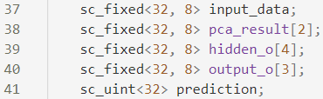
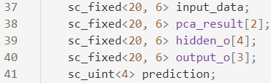
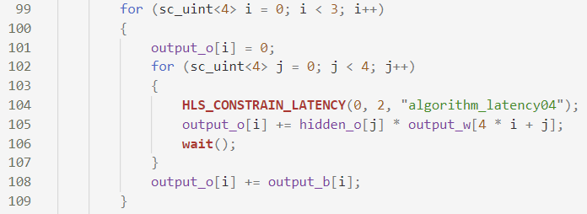
PCA and Two-layer NN in HLS
Version 1
origin
Version 2
Variables sizing : use sc_fixed<20, 6> instead of sc_fixed<32, 8>
Ex : for loop parameter datatype, buffer datatype…
Version 3
Variables sizing
Constrain Latency
non-sizing
sizing
Constrain Latency

Slide 15
HLS run time
(ns) | Version 1 | Version 2 | Version 3
BASIC | 1,556,400 | 1,556,400 | 1,553,700
DPA | 1,552,500 | 1,552,500 | 1,548,900
HLS area
 | Version 1 | Version 2 | Version 3
BASIC | 10,709 | 5,934 | 5,826
DPA | 17,648 | 8,421 | 8,349

Slide 16
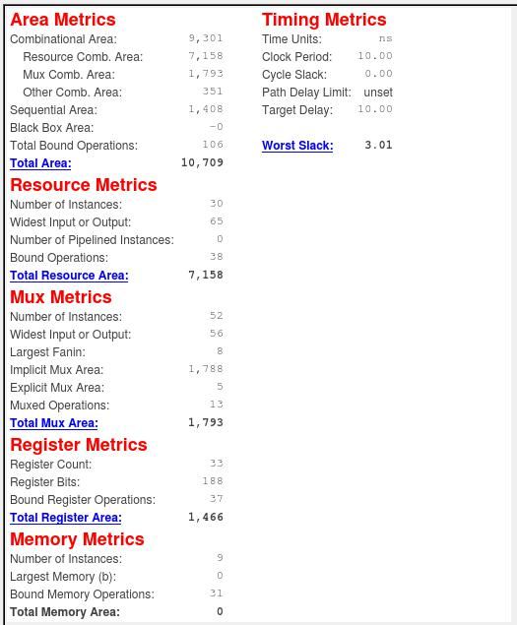
Version 1 - BASIC

Slide 17
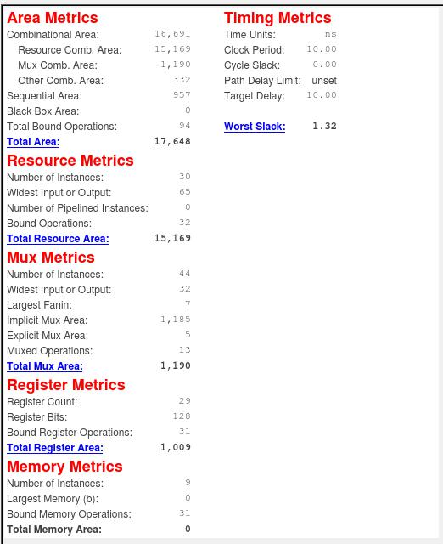
Version 1 - DPA

Slide 18

Version 2 - BASIC

Slide 19

Version 2 - DPA

Slide 20
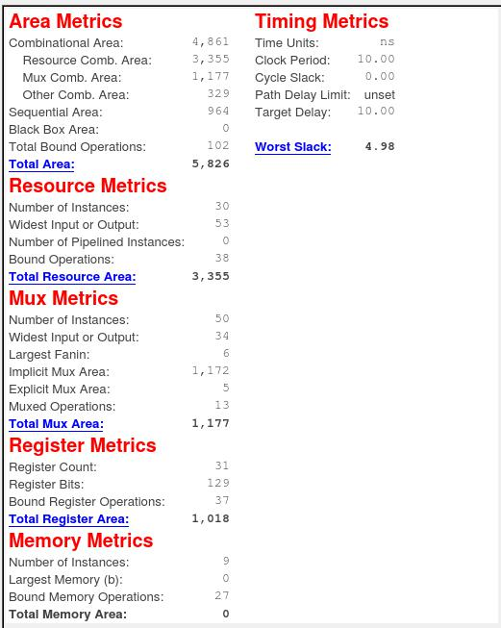
Version 3 - BASIC

Slide 21
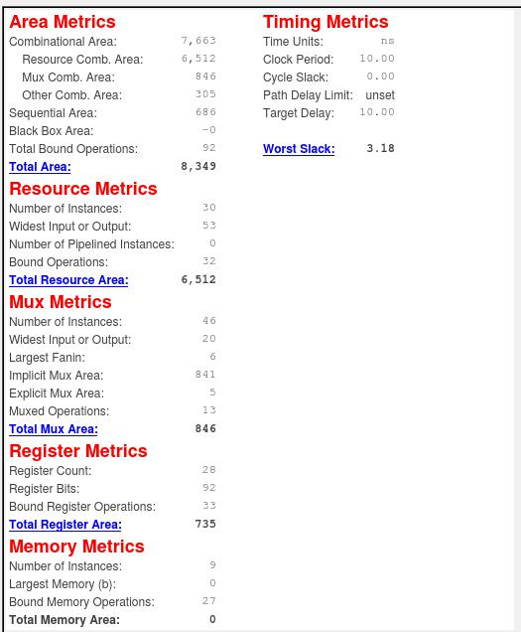
Version 3 - DPA

