Slide 1
EE6470 ManyCoreSystem Midtern Project
109061634 蕭詠倫

Slide 2
Guide line
Double Convolution Filter (DC_Filter)
Data reused algorithm
Double Convolution Filter in HLS
Double Convolution Filter in TLM platform
HLS result (3 version)

Slide 3
Double Convolution Filter
DC_Filter
…..
…..
 |  | …
 |  | …
. . | . . |  | . . | . .
 |  | …
 |  | …
 |  | …
 |  | …
. . | . . |  | . . | . .
 |  | …
 |  | …
 |  | …
 |  | …
. . | . . |  | . . | . .
 |  | …
 |  | …
….
….
….
….
( )
=
*
*
…..
…..
Filter_1
Filter_2
result
bmp

Slide 4

Data reused algorithm
256 X 256 pixels
3 X 3 filter
…..
0 | 0 |  | 0 | 0
0 |  |  |  | 0
0 |  |  |  | 0
…..
$$∗ \left[\begin{matrix}1/16 & 2/16 & 1/16 \\ 2/16 & 4/16 & 2/16 \\ 1/16 & 2/16 & 1/16\end{matrix}\right]$$
…..
…..
….
….
….
….
…..
3 X 258 (buffer)
…..
=
…..
…..
256 X 256 (bmp)
1 X 256 (result)

Slide 5
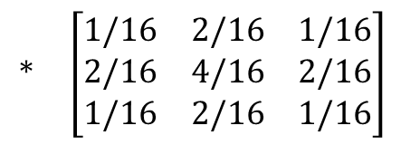
0 | 0 |  | 0 | 0
0 |  |  |  | 0
0 |  |  |  | 0
…..
…..
Shifting row data
…..
…..
3 X 258 (buffer)
…..
0 |  |  |  | 0
0 |  |  |  | 0
0 |  |  |  | 0
…..
$$∗ \left[\begin{matrix}1/16 & 2/16 & 1/16 \\ 2/16 & 4/16 & 2/16 \\ 1/16 & 2/16 & 1/16\end{matrix}\right]$$
….
….
….
….
…..
…..
…..
…..
3 X 258 (buffer)
…..
=
256 X 256 (bmp)
…..
1 X 256 (result)

Slide 6
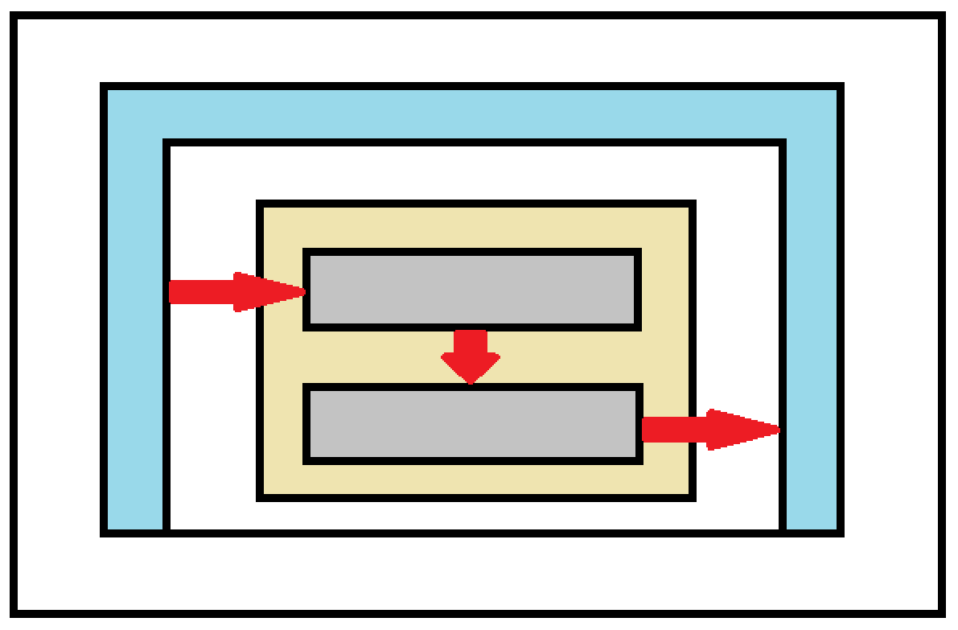
System
Testbench
DC_Filter
rgb
do_filter_1()
rgb_inside
do_filter_2()
result

Slide 7
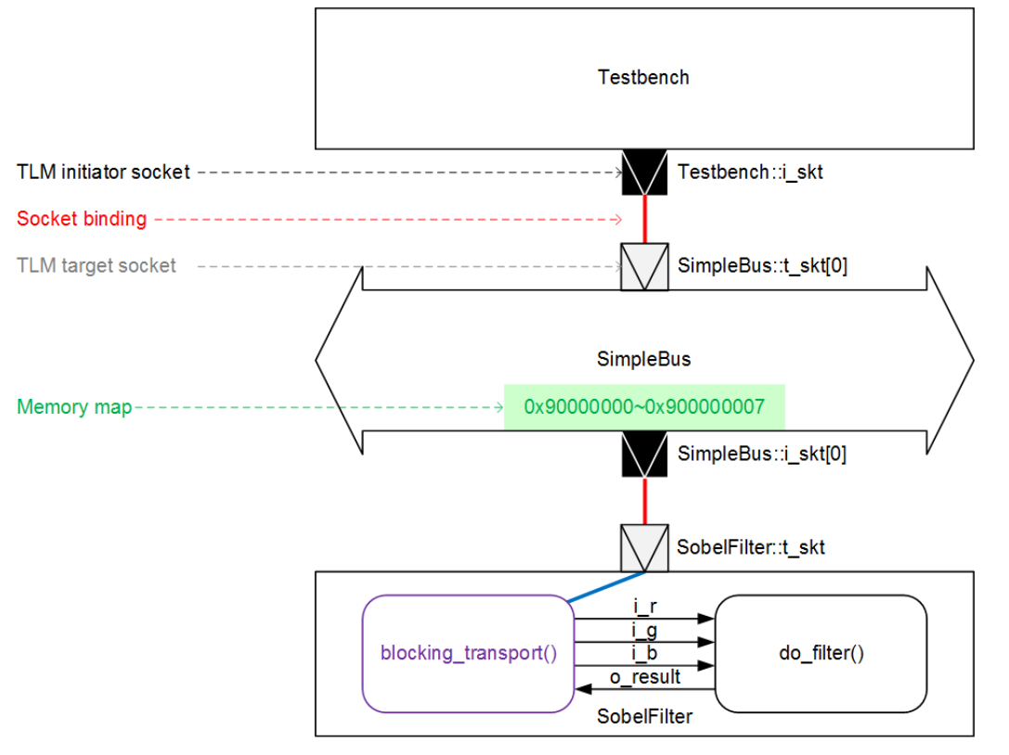
DC_Filter::t_skt
do_filter_1()
i_rgb
blocking_transport()
rgb_inside
result
do_filter_2()

Slide 8
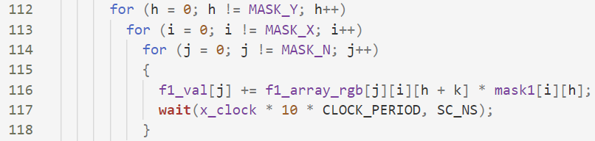
TLM platform clock cycle assumption
load /store 1 cycle
add 2 cycles
mult 8 cycles
div 40 cycles

Slide 9
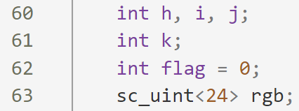
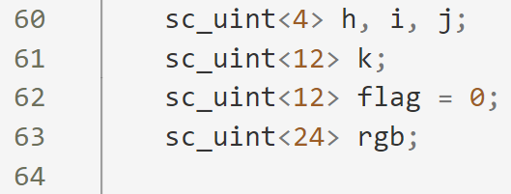
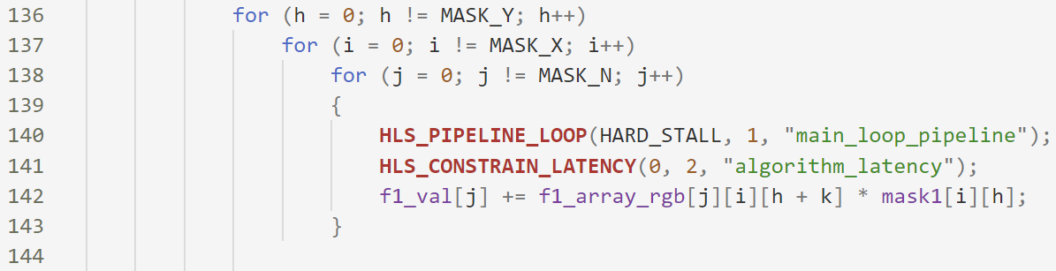
HLS result
Version 1
origin
Version 2
Variables sizing : use sc_uint< > instead of int
Ex : for loop parameter datatype, buffer datatype…
Version 3
Variables sizing
Constrain Latency
Loop pipelining
non-sizing
sizing
Convolution part

Slide 10
HLS run time
(ms) | Version 1 | Version 2 | Version 3
BASIC | 268.433240 | 184.658440 | 51.136900
DPA | 205.509890 | 117.846460 | 47.204740
HLS area
 | Version 1 | Version 2 | Version 3
BASIC | 18272 | 6475 | 7940
DPA | 17051 | 6766 | 6762

Slide 11
HLS run time
(ms) | Version 1 | Version 2 | Version 3
BASIC | 268.433240 | 184.658440 | 51.136900
DPA | 205.509890 | 117.846460 | 47.204740
TLM platform x_clock parameter
 | Version 1 | Version 2 | Version 3
BASIC | 6.2 - 6.3 | 4.2 - 4.3 | 1.0 - 1.1
DPA | 4.7 - 4.8 | 2.6 - 2.7 | 0.9 - 1.0

Slide 12
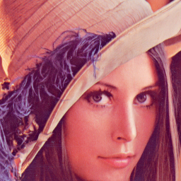
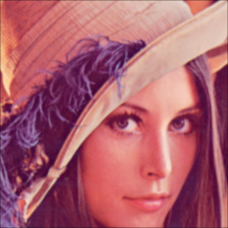



Result (Gaussian blur filter)
$$\left[\begin{matrix}1/16 & 2/16 & 1/16 \\ 2/16 & 4/16 & 2/16 \\ 1/16 & 2/16 & 1/16\end{matrix}\right]$$
F1 =
$$\left[\begin{matrix}0 & 0 & 0 \\ 0 & 1 & 0 \\ 0 & 0 & 0\end{matrix}\right]$$
F2 =
Origin
Gaussian blur
Double Gaussian blur
(Origin * F1 * F2)
(Origin * F1 * F1)

Slide 13
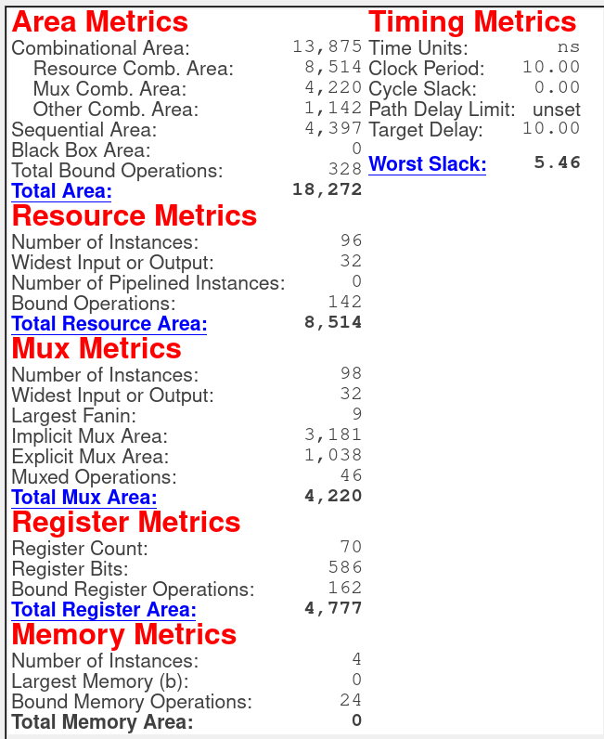
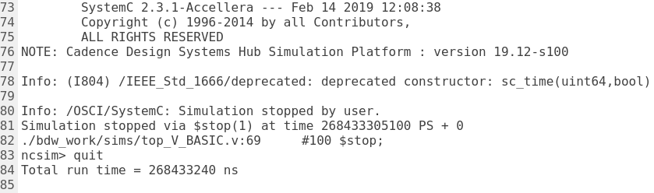
Version 1 - BASIC

Slide 14
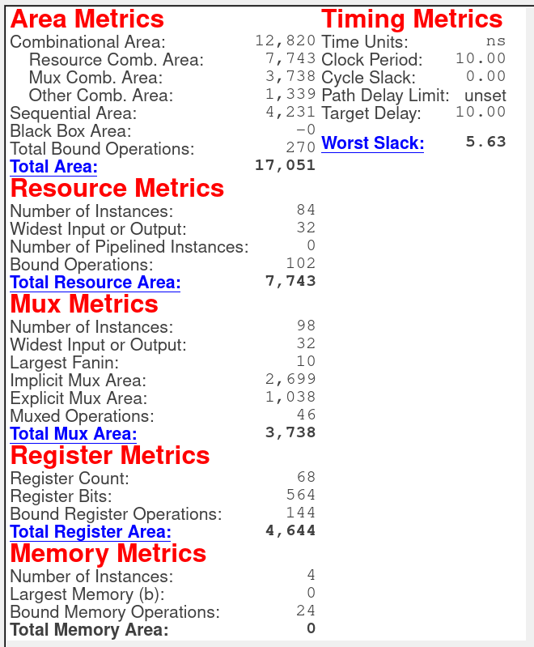
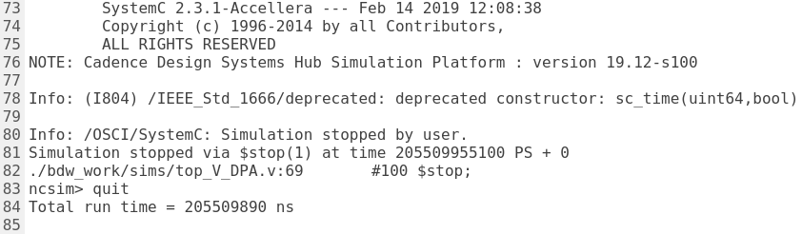
Version 1 - DPA

Slide 15

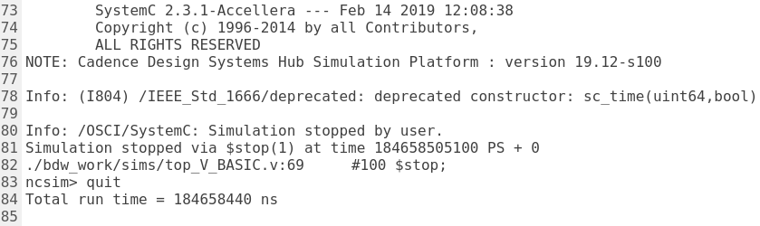
Version 2 - BASIC

Slide 16

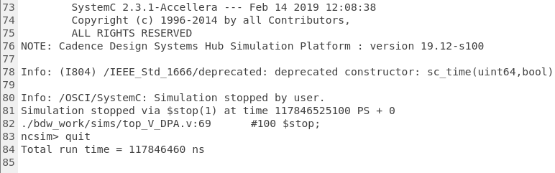
Version 2 - DPA

Slide 17
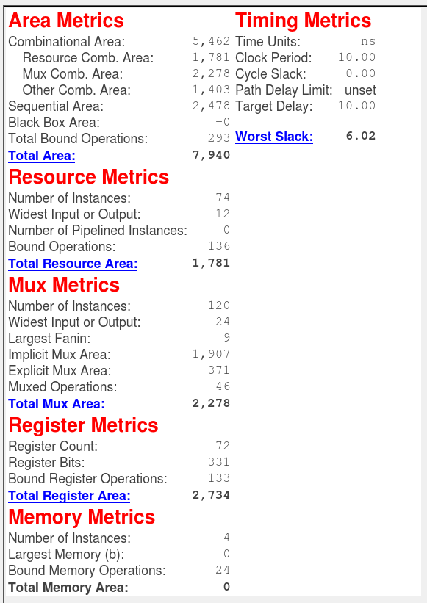

Version 3 - BASIC

Slide 18
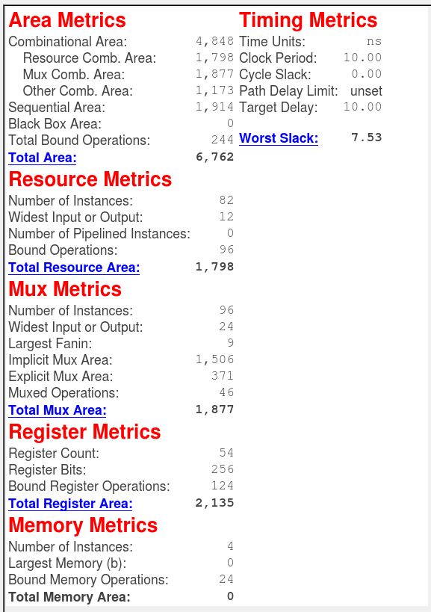
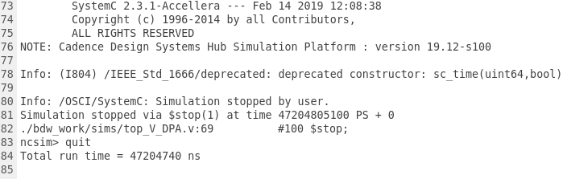
Version 3 - DPA

