Slide 1
Milestone 5

Slide 2
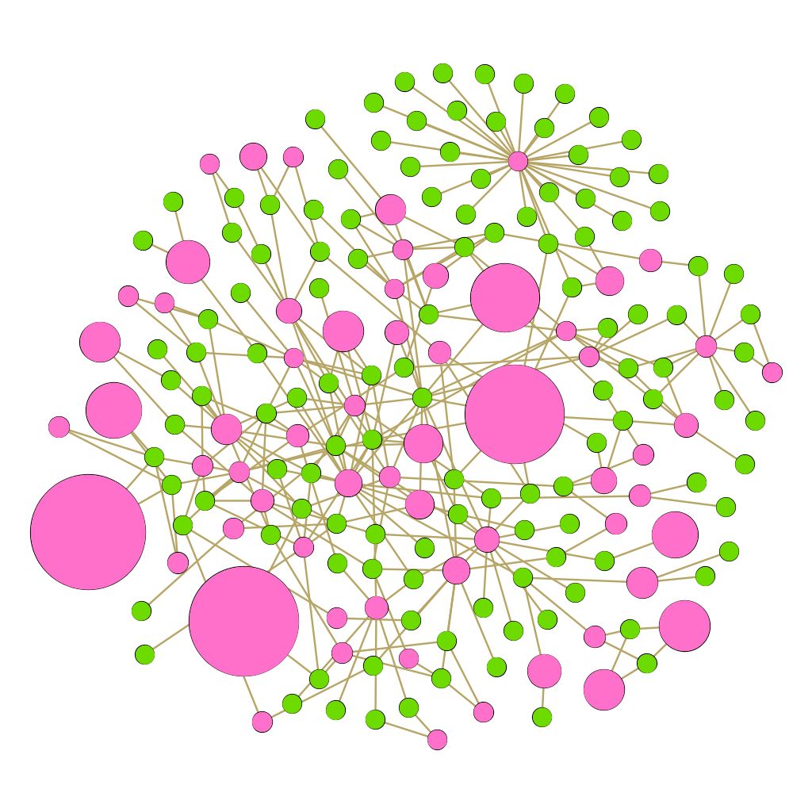
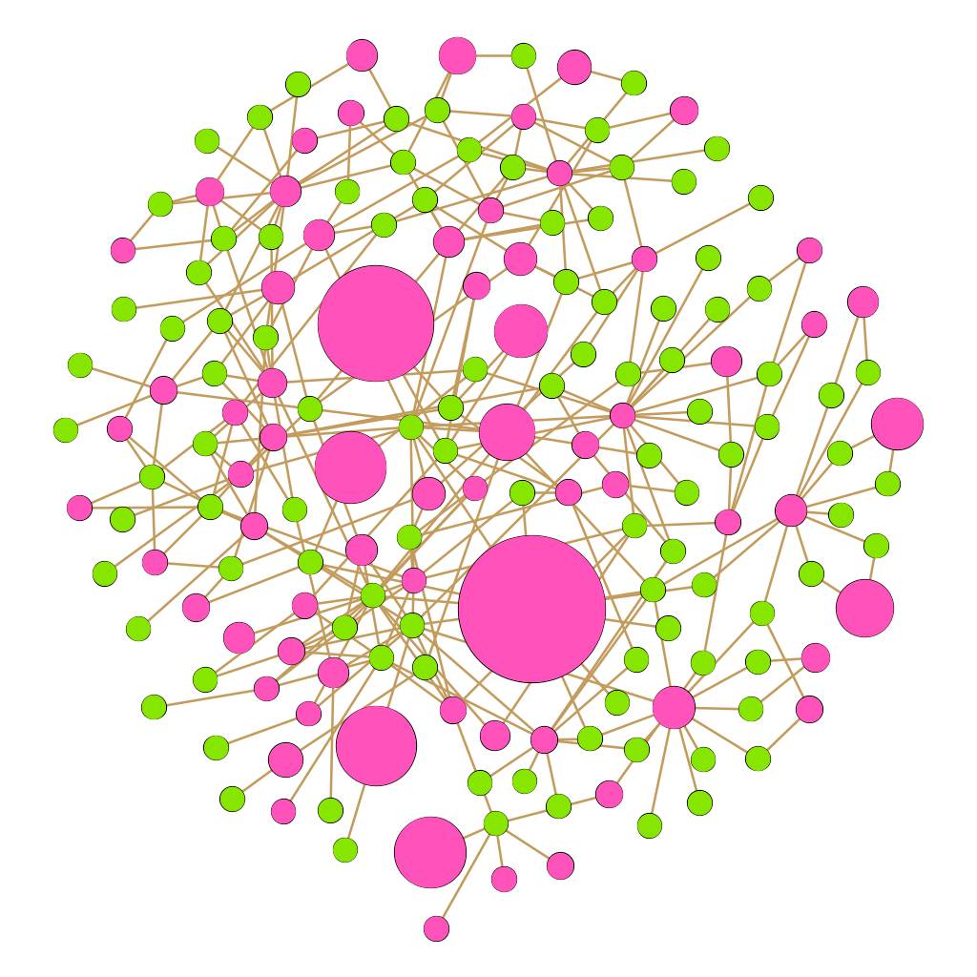
Fruchterman Reingold, Graph 1 (Gephi)
Lord of the Rings
Star Trek→

Slide 3
Graph 1 Analysis
The data being shown in this pair of graphs are the blogs (in pink) and their associated tags (in green). The edges represent the use of a tag in a post, some blogs have used the same tag therefore are sometimes connected to the same tag node. The blog nodes have been sized by total post meaning the larger nodes that you see in these networks represent blogs with a lot of posts on their page. The highest total post in the Lord of the Rings networks tops off at a whopping 348,298 from the blog “cadoized.” The blog with the most posts in the Star Trek network is “spikeghost” with 492,938 total posts. That is a difference of 144,640 posts… Compare these two maximum values with the average posts made on blogs from these networks. The average amount of posts for blogs on the gathered LOTR network is 21,969, while the average amount of posts on the gathered Star Trek network is 27, 031. This could mean that the fans and bloggers on the Star Trek network are just way more active within their community. Posting more within their blogs, or reposting other blogs. Based on the visuals you can see that within the LOTR network there are really only 3 powerful blogs with the most post while in the Star Trek network there are about 5 highly active posting blogs. *Rendered with the Fruchterman Reingold layout.

Slide 4
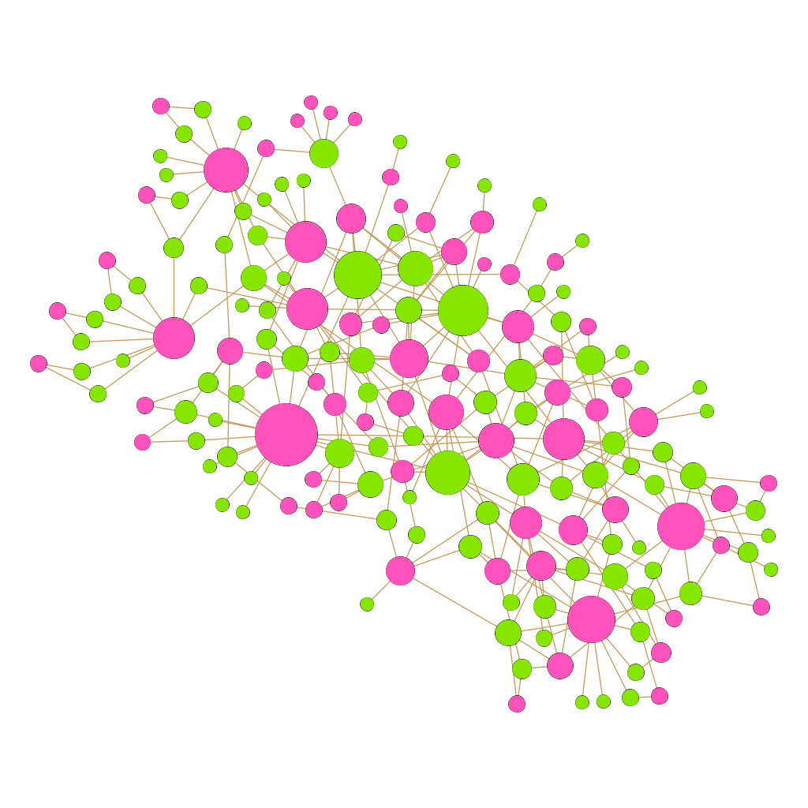
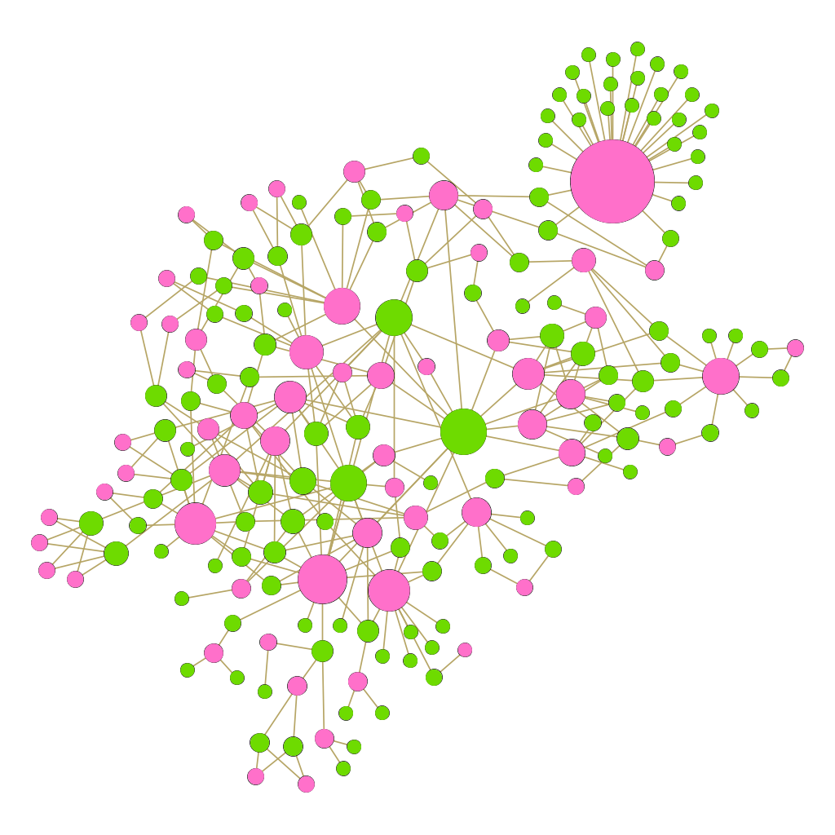
Yifan Hu, Graph 2 (Gephi)
Lord of the Rings
Star Trek→

Slide 5
Graph 2 Analysis
In this visualization the graphs are represented using the Yifan Hu *Proportional rendering. All of the nodes blogs (pink) and tags (green) have been sized by degree. To have a high degree can mean one of two things. Either you are a blog who posted and used a lot of tags *each tag would increase your degree by 1* OR you are a tag of which a lot of posts have used. Common tags among the community are more often the higher degree nodes. Tags such as “lotr” or simply “lord of the rings” are most common and high very high degrees within the Lord of the Rings network. For the Star Trek network it would be tags such as “star trek” or “ds9” which refers to one of the series’ seasons. In the Star Trek graph you can see a particularly large pink blog node with many green nodes attached to it. This would be the case in which a blog has posted a post and used many tags within the description. However, there are a couple other blogs that have used the same tag as the large post.

Slide 6
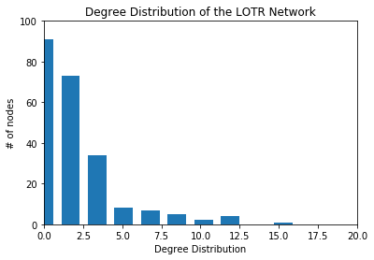
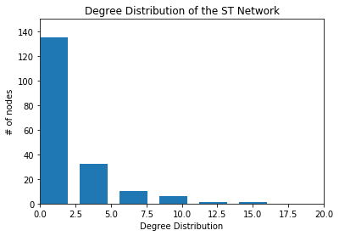
Degree Distribution – Network X, Graph 3

Slide 7
Graph 3 Analysis
In both networks, the degree distribution is left skewed. Essentially what this means is that more nodes will have a low degree and very few will have a high degree. We can assume that the nodes with high degree are nodes which are more “popular” in the network. In other words, tags or blogs want to be connected with those nodes. Although both graphs have a similar skew, the Lord of the Rings network has a much greater drop when looking at nodes of degree 2 and higher from the distribution of degree 1. The Star Trek network also have less different distribution which means that the star trek network have more consistencies than the Lord of the Rings fandom.

Slide 8
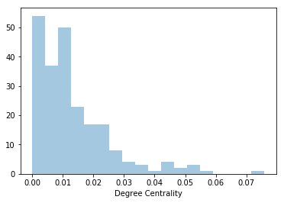
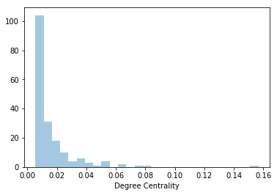
Degree Centrality – Network X, Graph 4
Lord of the Rings
Star Trek

Slide 9
Graph 4 Analysis
The degree centrality for both networks are fairly different. The Star Trek network has an obvious outlier at the end of the graph. This ‘outlier’ is located at about .10 centrality which means that this node is considered to be the most prevalent node in the graph and has the most connection in that network. The LOTR network on the opposite hand, has a much smoother decline when viewing the degree centrality. This means there are multiple nodes that have a high degree. We can come to the conclusion that the LOTR network have more influential nodes whereas the Star Trek network have very few influential nodes. Another way the think of this, the Lord of the Rings fandom is more popular than the Star Trek network because there is more active bloggers and tags surrounding the network.

Slide 10
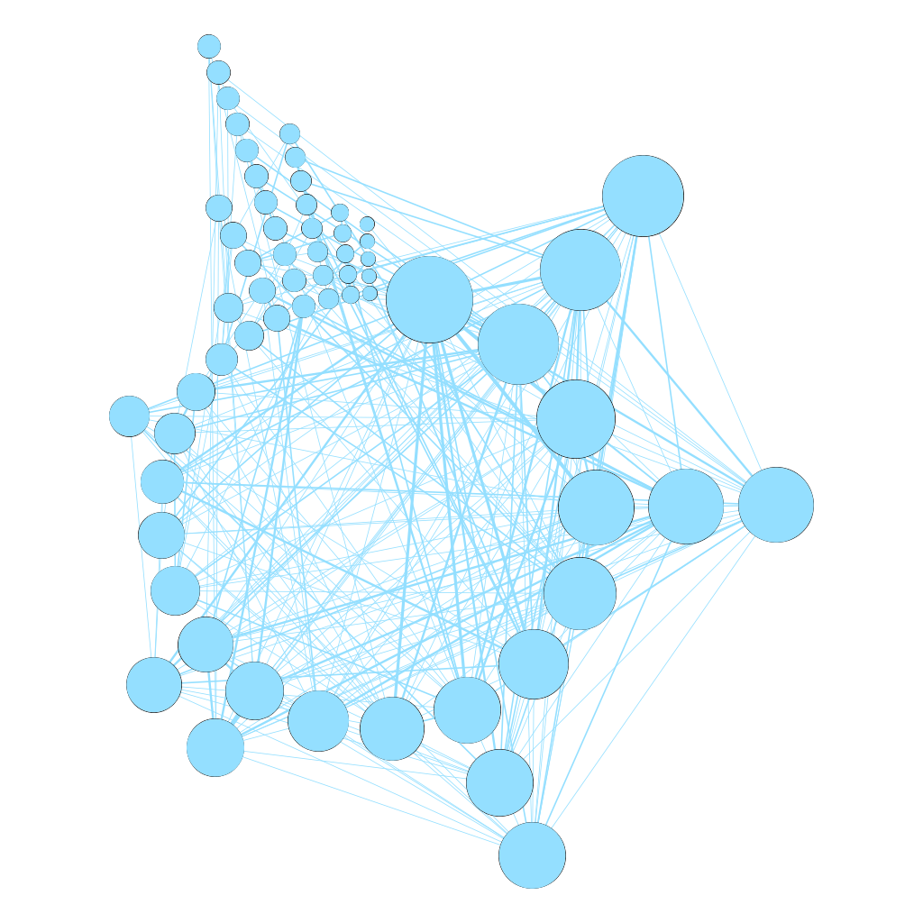
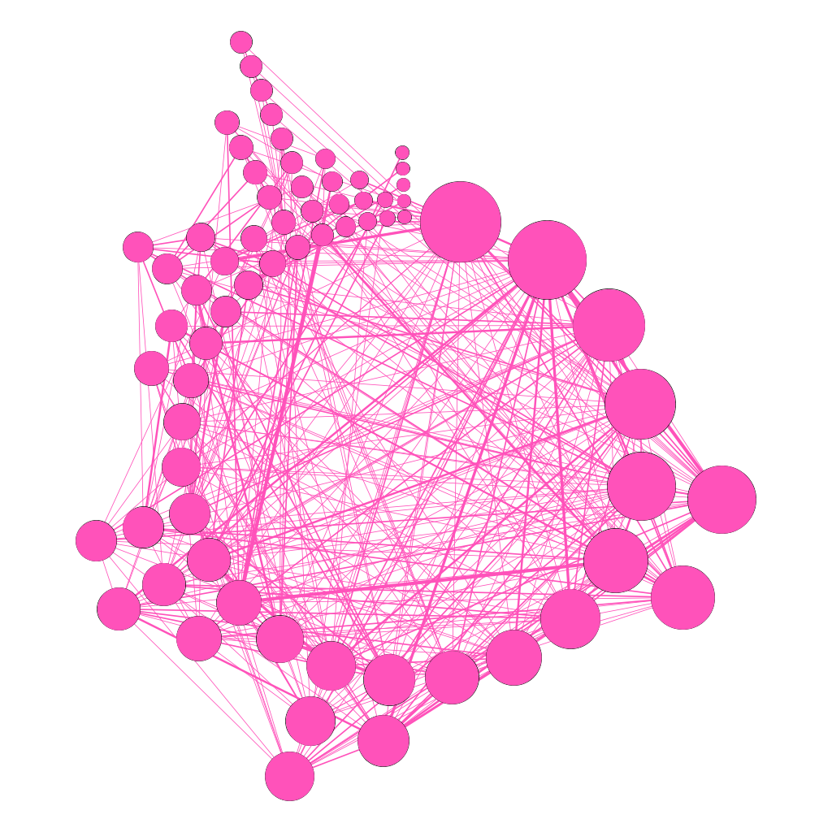
Radial Axis, Blog to Blog Projected, Graph 5 (Gephi)
Lord of the Rings
Star Trek→

Slide 11
Graph 5 Analysis
According to these projected graphs, each blog node is connected to another blog who has used the same tag. The LOTR blogs seem to all connect very well with one another. The nodes are sized by degree and there are several blog nodes with considerably high degree in the LOTR network. Thus, there are a more blogs that influence the rest of the fandom blogs. On the other hand, the Star Trek network seems to have a slightly dominate blog that has used the same tag with multiple blogs. These dominating blogs are usually more active within the fandom since they share popular tags with other bloggers. The nodes with high degree are a tad unrelated, they are more random within the community. For these current graphs the blogs with the highest degree in the LOTR network are names such as “nathanernstart” and “arwencuar.” While the lowest degree nodes, degree 1, are names like “errantgoat” and “mikaeled.” For the Star Trek network the largest degree blogs have names that possess some randomness, although the very largest blog is named “deepspacevalkyrie” which is relevant to the community, the next largest being “ao3feed-ds9.” A lot of the tags and blogs in the Star Trek network seem to focus on Deep Space 9, which leads to the assumption that it must have been a popular season. Degree one nodes have blog names like “lemedy” and “shandee200” which are obviously less relative to the subject/community.

Slide 12

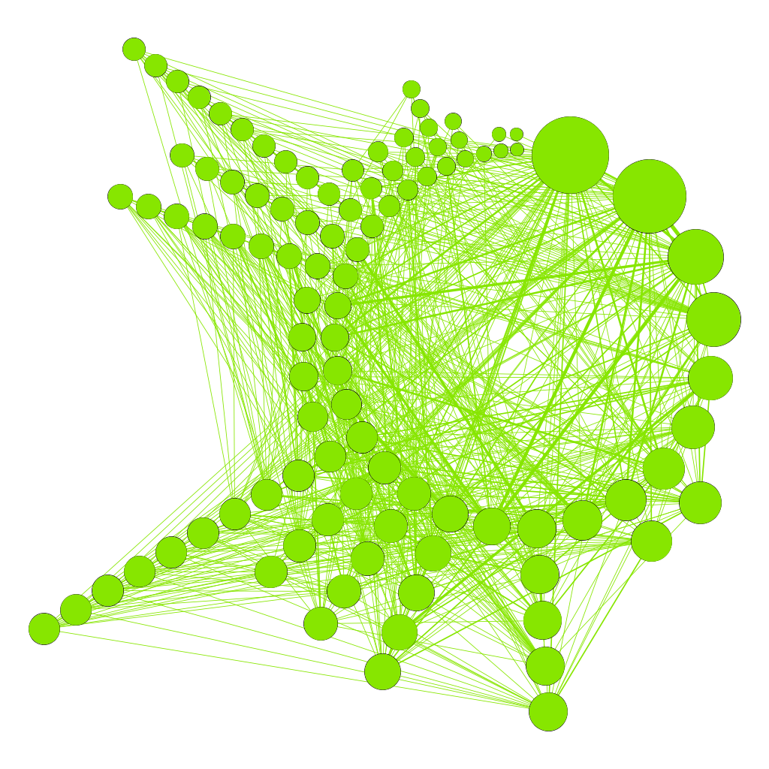
Radial Axis, Tag to Tag Projected, Graph 6 (Gephi)

Slide 13
Graph 6 Analysis
According to these projected graphs, each tag node is connected to another tag who were used in the same post. The communities in the LOTR Graph tend to have more tags that bridge communities. These tags are more commonly used inside the community. Essentially, LOTR seems to have a slightly more cohesive community. The long string of nodes you see in the Star Trek graph are actually from a post based on Star Wars, we can only assume that these Sci-Fi series get entangled with one another quite often. The nodes with higher degrees in both networks are tags that make sense in the community, the largest one in the LOTR is “tolkien” while the nodes with one degree are more unrelated to the community such as “Anonymous” or “replies.” For the Star Trek network the largest tag is “startrek” or “ds9” (which stands for Deep Space 9), while tags of degree one are “adoptables” or “loving myself.”

