Slide 1
Optimizing the Discovery of Underlying Nonlinear Beam Dynamics
Liam A. Pocher, Levon Dovlatyan, Irving Haber, Thomas M. Antonsen Jr., Patrick G. O’Shea

Slide 2
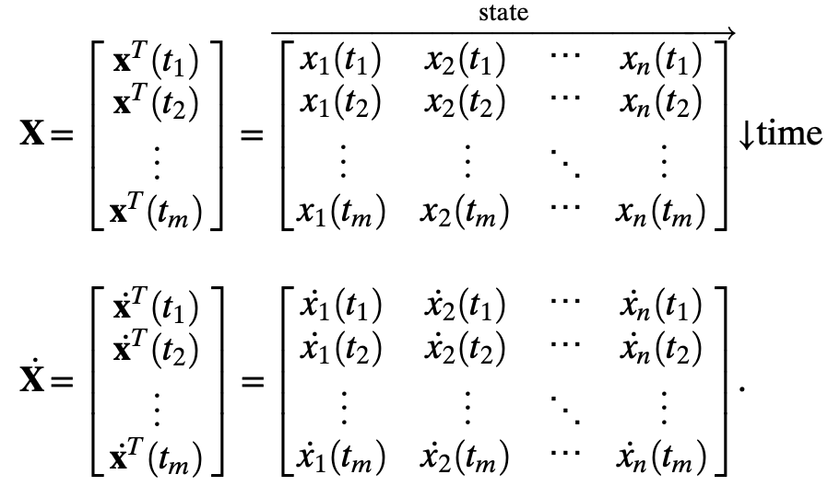
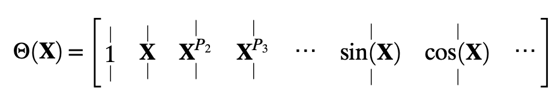


What is SINDy?
New, slick thing
Declarative statement per slide.
3 main takeaways from talk: Liam’s smart/hardworking, Liam had cool idea, talk to Liam after
Sparse coeff matrix $Ξ$

Slide 3
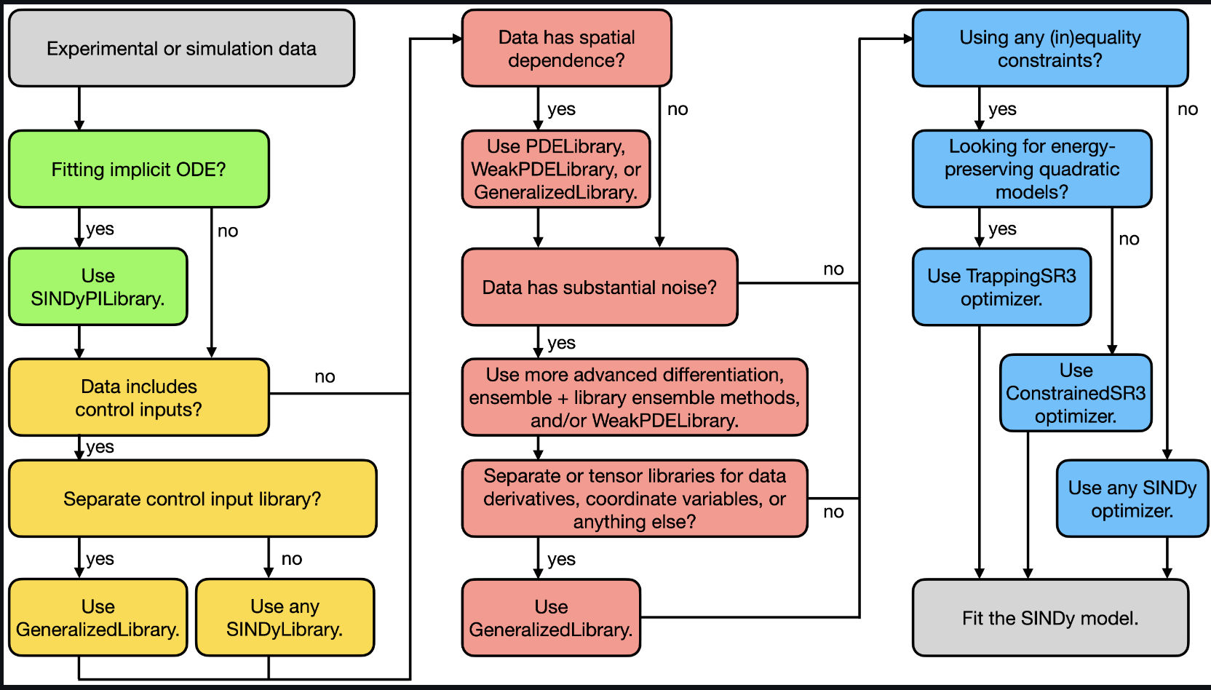
How can it be applied to Beam Physics
Undercover physics in problems that can’t be solved analytiacly
Speed up commissioning and design studies

Slide 4
Example Problem
Moment equations things from Irv and Levon and Heidi example

Slide 5
Comparison to Theory, ML, and ”true” model

Slide 6
Future Extension with PySINDyVA

Slide 7
References

