Slide 1
Sparse Identification of Nonlinear Dynamical systems (SINDy). How can it be applied to Beam Physics?

Slide 2
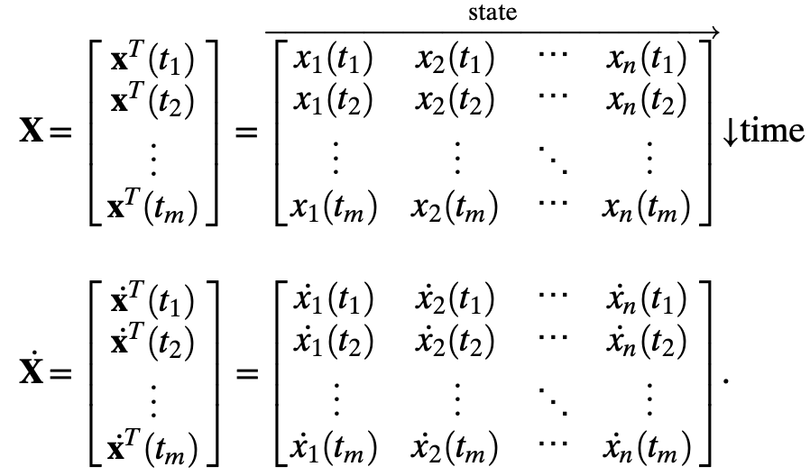
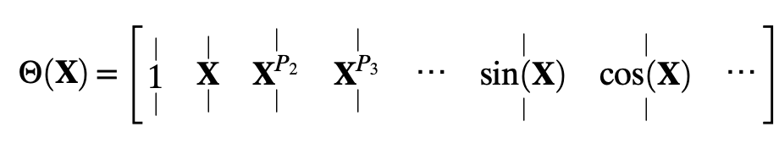

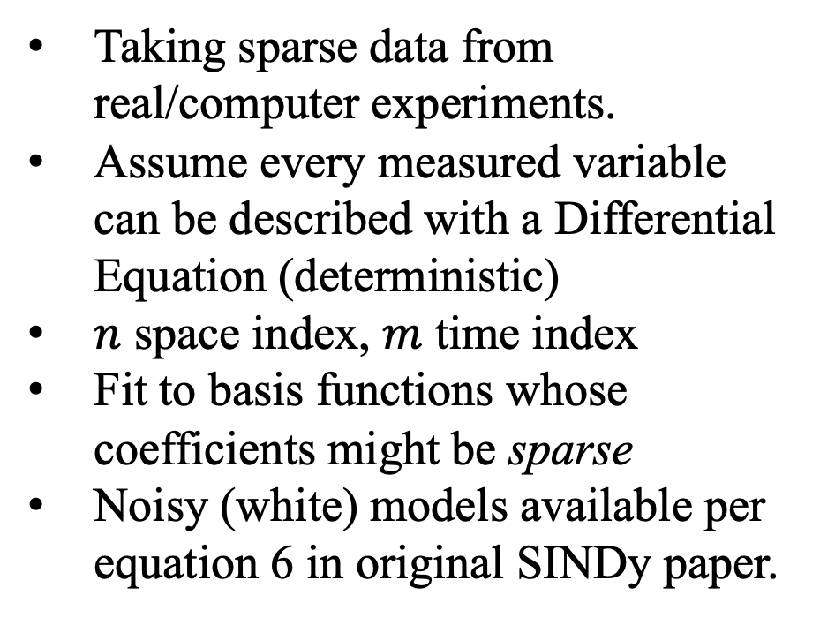
General Overview
Taking sparse data from real/computer experiments.
Assume every measured variable can be described with a Differential Equation (deterministic)
$n$ space index, $m$ time index
Fit to basis functions whose coefficients might be sparse
Noisy (white) models available per equation 6 in original SINDy paper.

Slide 3
Examples
PySINDy 1.7.0 required for the example scripts currently on GitHub/Website.
Simple SHO, DHO, Lorenz equations
Other examples and applications on website and GitHub.
Jupyter Notebook examples

Slide 4
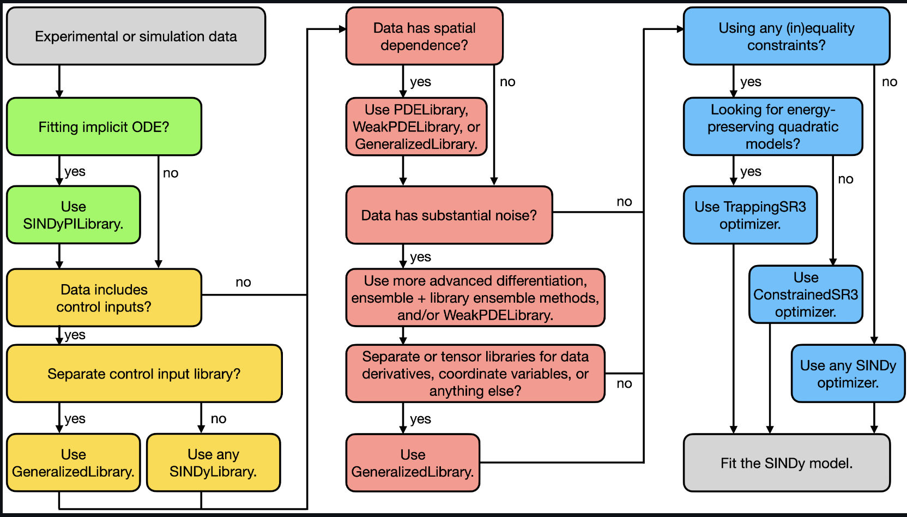

How can this be applied to Beam Physics
Rich interplay of chaos and nonlinear dynamics in the context of beam physics.
Small, niche field with lots of low hanging fruit (at least to my perspective) for various reasons.
One problem we have in experiments is poor knowledge of initial conditions and distribution system details. Even if we know the underlying equations, in intense beams how can we overcome the sparseness of our distribution function data either initially or at later times
Zoo of plasma physics phenomena + non neutral plasma effects:
Centroid and Moment oscillations
Higher order beam moment evolution
Emittance growth attribution to specific physics/terms
Dispersion relations of various waves (E&M and plasma/sonic in beam slug)
Momentum diffusion in bends
Noise type determination? (white, pink, systemic)
Etc.
Simple test case problem needed to determine viability
Integrated Deliverable
Theory
Experiment
Simulation

Slide 5
References/Quick Links
PySINDy website with tutorials etc: https://pysindy.readthedocs.io/en/latest/index.html
GitHub: https://github.com/dynamicslab/pysindy#installing-with-pip
Original Paper: Discovering governing equations from data by sparse identification of nonlinear dynamical systems by Brunton, Proctor, and Kutz
Example paper (slick) of “physics informed/injected” neural networks: Physics-informed neural networks: A deep learning framework for solving forward and inverse problems involving nonlinear partial differential equations. Honeslty a buzzword soup example that is/was super hot.
Another of Brunton’s example work from the vein of computational science: Machine Learning for Fluid Mechanics, Modal Analysis of Fluid Flows: An Overview
YouTube tutorial.: https://www.youtube.com/watch?v=SfIJiuJ38W0&list=PLN90bHJU-JLoOfEk0KyBs2qLTV7OkMZ25&ab_channel=AlanKaptanoglu

Slide 6
Lessons Learned from playing over weekend
Active research code, getting it to work was a bit of headache.
Need PySINDy 1.7.0 for current documentation/tutorial examples to work fully.
Require < v1.0 of scikit-learn to make sure all the hardcoded module variables play well with each other.
Brunton has some slick YouTube video/outreach capability. I believe this is the way of the future (remote education/technology enabled outreach). We should maybe try to get something similar, if not as professional. It could be used for example at UMD’s 3MT competition.

