Slide 1
WARSZTATY Z CYKLU
„WAKACJE Z ELEKTRONIKĄ”
CZĘŚĆ I
Wprowadzenie do AVR

Slide 2
Agenda
Introduction to AVR
ATtiny85
About DevKit
Project Zero
Workshop
  Digital Input-Output
  Serial Communication (Software UART)
  Timers
  Watchdog
  External Interrupt (INT0)
  Analog Input-Autput (ADC/DAC)

Slide 3
Introduction to AVR
modified Harvard architecture 8-bit RISC single-chip microcontroller
developed by Atmel in 1996 one of the first microcontroller families to use on-chip flash memory for program storage
a small computer – includes a CPU, some flash program memory, some SRAM and some EEPROM. All in one little chip – it is little black thing with pins coming out of it.

Slide 4
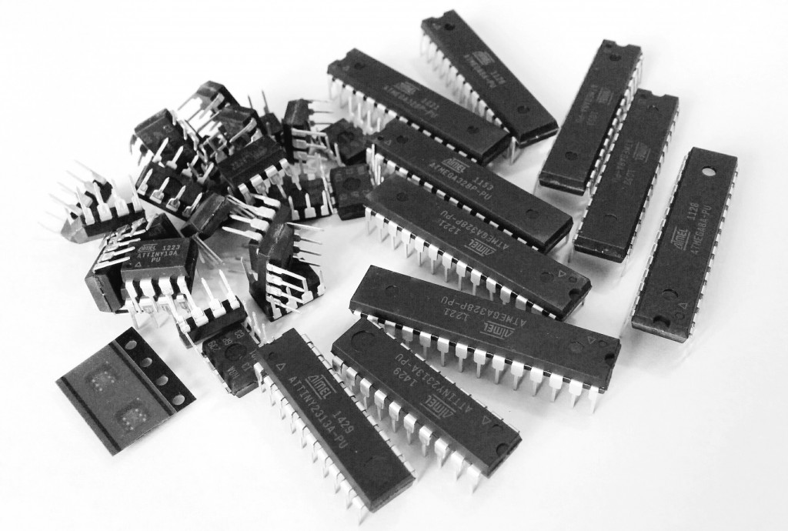
Introduction to AVR
MCU Architecture

Slide 5
Introduction to AVR
Overview of popular AVR families
TinyAVR – ATtiny series (i.e. ATtiny85)
0.5–16 kB Flash
32–1024 bytes SRAM
64-512 bytes EEPROM
6–32-pin package
Limited peripheral set
MegaAVR – ATmega series (i.e. ATmega8)
4–512 kB Flash
0.5–16 kB SRAM
256–4096 bytes EEPROM
28–100-pin package
Extended instruction set (multiply instructions and instructions for handling larger program memories)
Extensive peripheral set

Slide 6
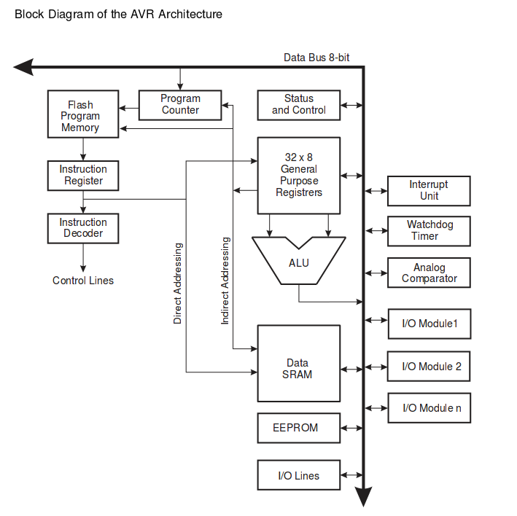
Introduction to AVR

Slide 7
Introduction to AVR
AVR’s CPU
The AVR’s CPU is similar but much simpler like the one in a computer. The main function of the CPU is to ensure correct program execution. The CPU must therefore be able to access memories, perform calculations, control peripherals and handle interrupts. Atmel’s 8- and 32-bit AVR CPUs are based on an advanced Harvard architecture thus every chip has two busses – one instruction bus where the CPU reads executable instructions and one data bus to read or write the corresponding data. The AVR’s CPU core consists of:
ALU - short for Arithmetic Logic Unit, supports arithmetic and logic operations between registers or between a constant and a register. After an operation is executed, the Status Register is updated to reflect information about the result of the operation.
General Purpose Registers – Register File that contains 32 x 8-bit general purpose working registers. All registers have single clock cycle access time what allows ALU a single-cycle operation on two operands which are output from the Register file and store the result back in the Register file – it all in one clock cycle!
Program Counter – hold/store the address of the next instruction to be executed.
Instruction Register – the register where instruction opcode is stored temporarily.
Instruction Decoder – decode the instruction opcode from Instruction Register and generate appropriate control signals to execute the instruction.
Status Register – apart of Status and Control block, contains information about the result of the most recently executed arithmetic instruction. The Status Register is updated after all ALU operations.
Stack Pointer (SP) – apart of Status and Control block, usually is implemented as two 8-bit registers. The Stack is mainly used for storing temporary data, for storing local variables and for storing return addresses after interrupts and subroutine calls. The Stack Pointer Register always points to the top of the Stack. Note that the Stack is implemented as growing from higher memory locations to lower memory locations. It implies that a Stack PUSH command decreases the Stack Pointer.

Slide 8
Introduction to AVR
AVR’s Flash Program Memory
compiled program is stored in non-volatile (persistent on power-down) programmable Flash program memory which is just like the flash storage in your Mp3 Player or SD Card
the flash program memory is divided into two sections. The first section is the Application Flash section. It is where the AVR’s program is stored. The second section is called the Boot Flash section and can be set to execute immediately when the device is powered up.
note that the AVR’s Flash program memory has an endurance of at least 10,000 write/erase cycles.

Slide 9
Introduction to AVR
AVR’s SRAM
SRAM - short for Static Random Access Memory, is just like computer RAM
is used to store data during runtime
this volatile memory is organized in 8-bit registers

Slide 10
Introduction to AVR
AVR’s EEPROM
EEPROM - short for Electronically Erasable Read-Only Memory, is kinda like flash storage (non volatile memory), except you can’t run a program from it, but its used as long term storage
the EEPROM doesn’t get erased when the chip loses power
it’s a great place for storing data such as device parameters and system configuration at runtime so that it can persist between resets of the application processor.
note that the AVR’s EEPROM memory has a limited lifespan of 100,000 writes per EEPROM page – reads are unlimited. Keep this in mind in your application and try to keep writes to a minimum, so that you only write the least amount of information required for your application each time you update the EEPROM

Slide 11
Introduction to AVR
AVR’s Digital I/O Modules
allow digital/logic communication with the microcontroller and the external world
communication signals are that of TTL or CMOS logic

Slide 12
Introduction to AVR
AVR’s Analog I/O Modules
input/output analog information from/to the external world
analog modules include Analog Comparators (AIN) and Analog-to-Digital Converters (ADC)
10-bit resolution for input (AIN)
8-bit resulution for output (ADC)

Slide 13
Introduction to AVR
AVR’s Interrupt Unit
interrupts enable the AVR to monitor certain events in the background while executing and application program and react to the event if necessary pausing the original program
interrupts can be established for events such as a counter's number, a pin changing state (from low to high or high to low), serial communication receiving of information, or the Analog to Digital having established a conversion

Slide 14
Introduction to AVR
AVR’s Timer/Counter
most AVRs have at least one Timer/Counter
to perform timing or counting operations in the controller - these include time stamping, measuring intervals, counting events, etc.
counting and timing allows for some really cool things, like controlling the brightness of LEDs, controlling the angle of servo shafts, receiving sensor data that transmit in PWM (Pulse Width Modulation), making a timer (like on the stove), or just simply adding a time variable to your microcontroller project

Slide 15
Introduction to AVR
AVR’s Watchdog
all AVR microcontrollers have internal Watchdog Timer (WDT)
key features: separate 128kHz clock source, ability to reset microcontroller and generate interrupt

Slide 16

Introduction to AVR
The relationship between AVR and Arduino
arduino is a prototyping board using AVR microcontroller, and also the term “Arduino” is used to refer to the cross-platform IDE, library, and all its ecosystem
there’s a whole bunch of 8-bit AVRs with various Flash/SRAM/peripheral/pin configurations, just as there are a bunch of different Arduino boards and clones.

Slide 17
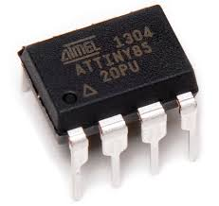
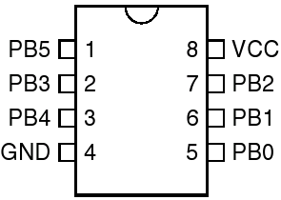
ATtiny85
PINOUT

Slide 18
ATtiny85
KEY FEATURES
Advanced RISC Architecture
120 Powerful Instructions – Most Single Clock Cycle Execution
32 x 8 General Purpose Working Registers
Non-volatile Program and Data Memories
8K Bytes of In-System Programmable Program Memory Flash with endurance: 10,000 Write/Erase Cycles
512 Bytes In-System Programmable EEPROM with endurance: 100,000 Write/Erase Cycles
512 Bytes Internal SRAM
Programming Lock for Self-Programming Flash Program and EEPROM Data Security

Slide 19
ATtiny85
KEY FEATURES
Peripheral Features
8-bit Timer/Counter with Prescaler and Two PWM Channels
8-bit High Speed Timer/Counter with Separate Prescaler
  2 High Frequency PWM Outputs with Separate Output Compare Registers
  Programmable Dead Time Generator
USI – Universal Serial Interface with Start Condition Detector
10-bit ADC
4 Single Ended Channels
2 Differential ADC Channel Pairs with Programmable Gain (1x, 20x)
Temperature Measurement
Programmable Watchdog Timer with Separate On-chip Oscillator
On-chip Analog Comparator

Slide 20
ATtiny85
KEY FEATURES
I/O and Packages
Six Programmable I/O Lines
8-pin PDIP, 8-pin SOIC, 20-pad QFN/MLF, and 8-pin TSSOP (only ATtiny45/V)
Operating Voltage
1.8 - 5.5V for ATtiny85V
2.7 - 5.5V for ATtiny85
Speed Grade
ATtiny85V: 0 – 4 MHz @ 1.8 - 5.5V, 0 - 10 MHz @ 2.7 - 5.5V
ATtiny85: 0 – 10 MHz @ 2.7 - 5.5V, 0 - 20 MHz @ 4.5 – 5.5V
Low Power Consumption
Active Mode: 1 MHz, 1.8V: 300 μA
Power-down Mode: 0.1 μA at 1.8V

Slide 21
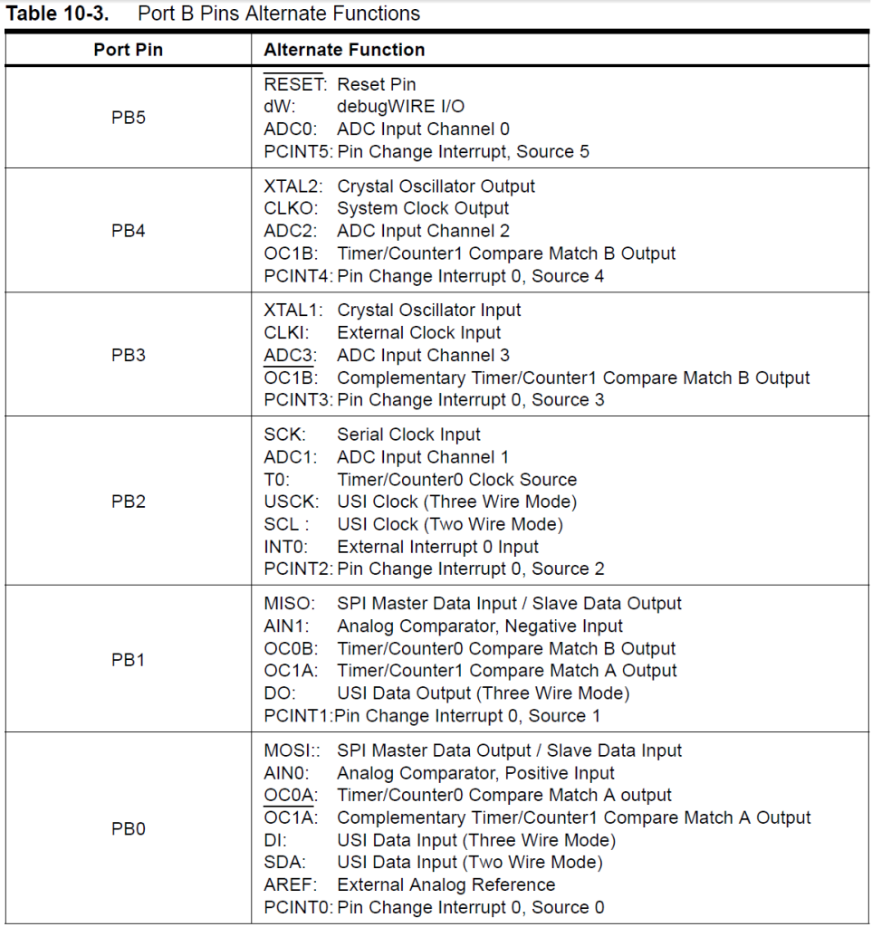
ATtiny85
PINS ALTERNATIVE FUNCTIONS

Slide 22
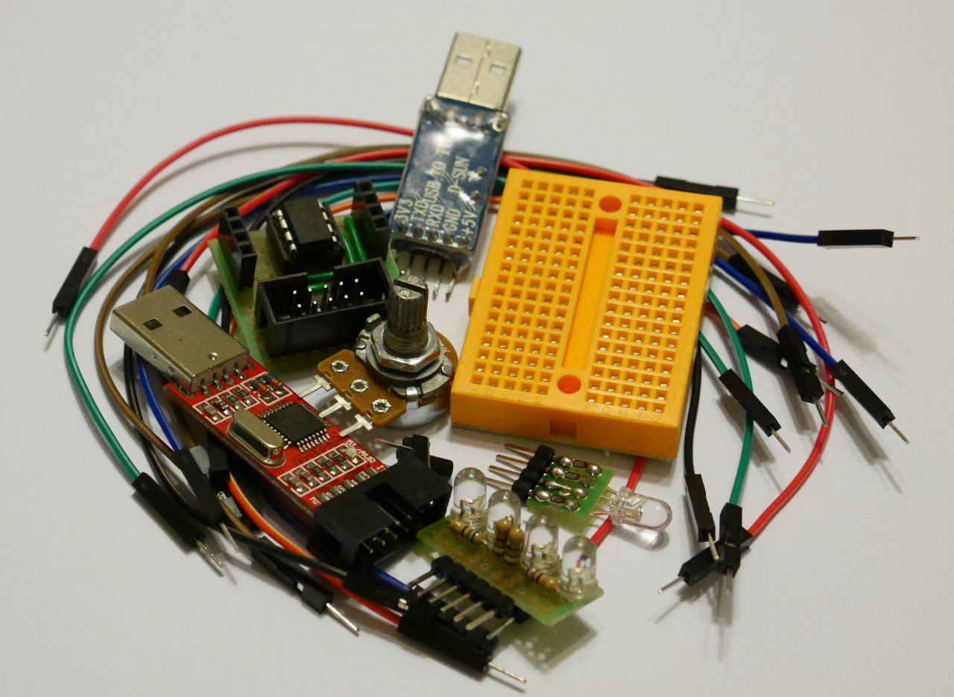
DEVKIT
HARDWERE

Slide 23
DEVKIT
SOFTWERE
sudo apt-get install avrdude avr-libc
git clone https://github.com/lpodkalicki/avr-course-part-one.git
favourite editor (C code)

Slide 24
PROJECT ZERO
Connect attiny-board to programmer, then programmer to usb port of your computer.
Now compile „project zero” and flash your ATtiny85:
$/> cd avr-course-part-one/exercises/start/E00
$/> make
$/> [sudo] make flash
Voila!
Your DEVKIT is working properly! ..but is doing nothing, yet ;)

