Slide 1
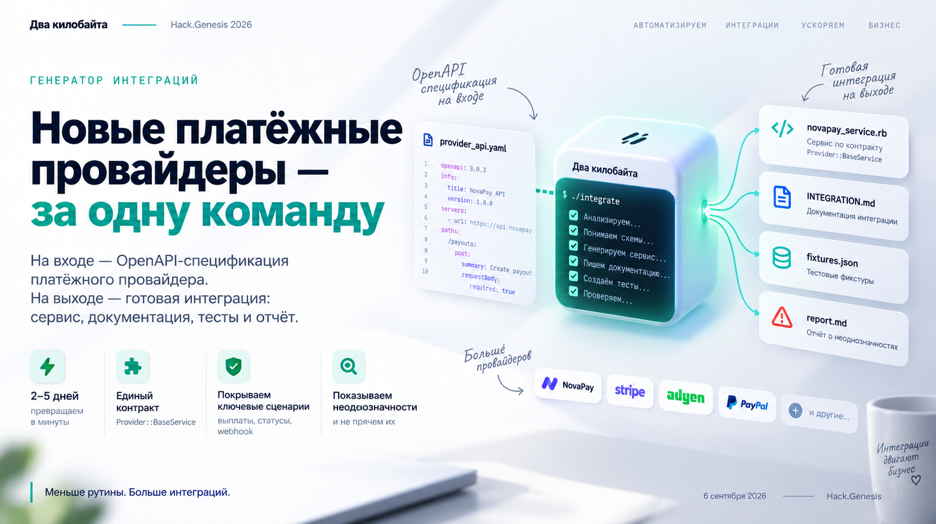
Notes:
Sources: - Slide image generated in ChatGPT Image based on the user's uploaded case materials and requested visual style.

Slide 2
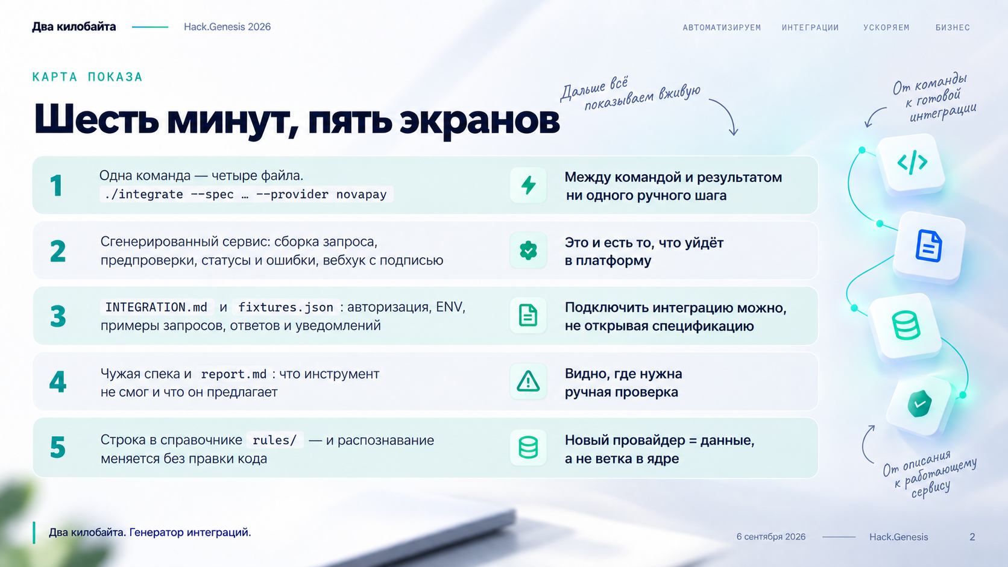
Notes:
Sources: - Slide image generated in ChatGPT Image based on the user's uploaded case materials and requested visual style.

Slide 3
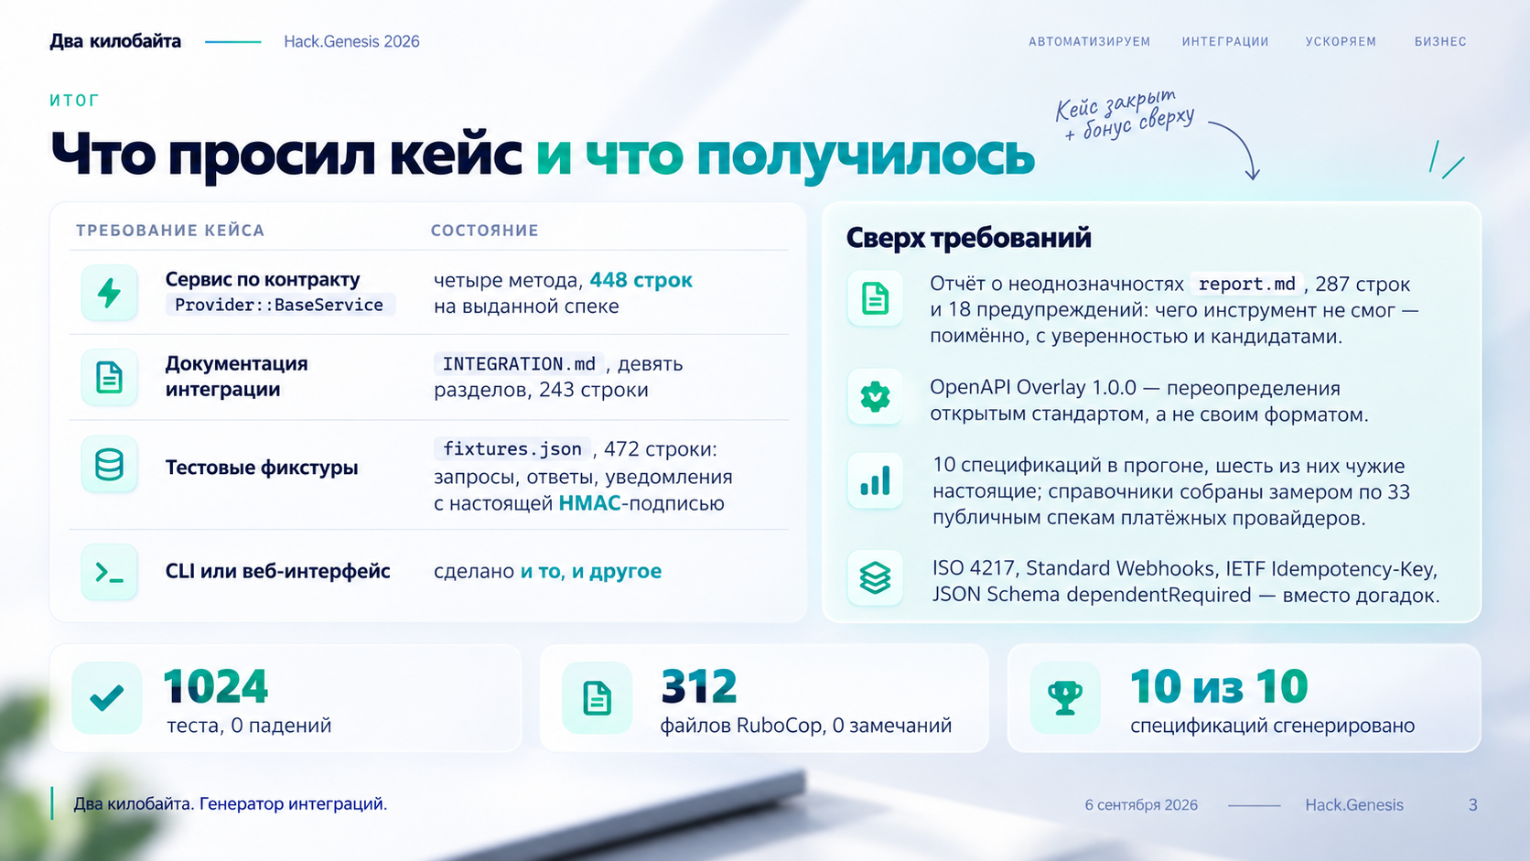
Notes:
Sources: - Slide image generated in ChatGPT Image based on the user's uploaded case materials and requested visual style.

