Slide 1
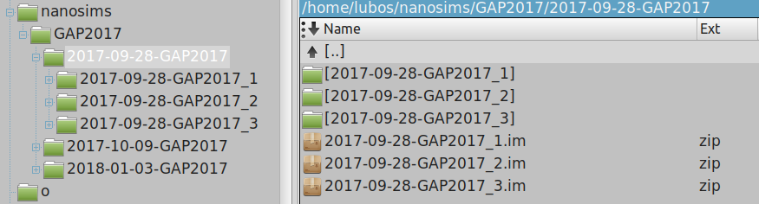
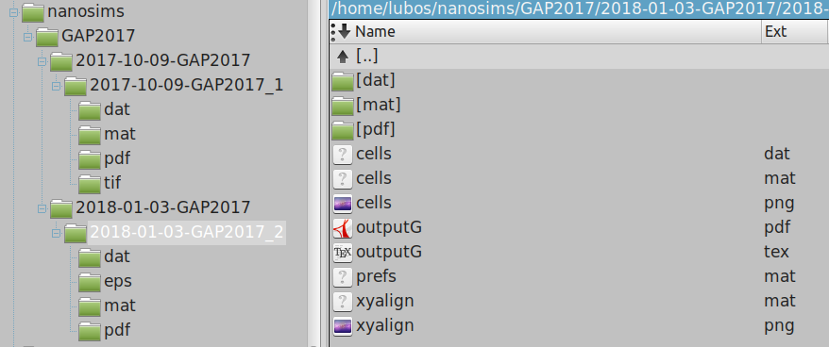
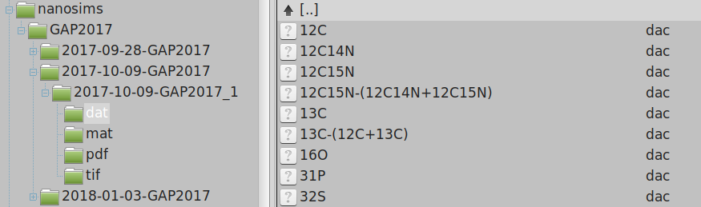
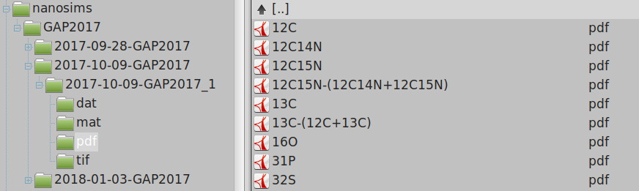
A
1. Root folder with all nanosims data
2. Folder for a specific project
5. Sub-folder with processed data from
a particular dataset
!
same name
4. Raw dataset from a specific day
3. Sub-folders with data from different measurement days
B
5. Sub-folder with processed data from a particular dataset
ASCII output (e.g., values of isotope ratios)
PDF output (images, graphs)
ROI definition & classification
Graphical output
Preferences
Frames (planes) alignment
C
6. ASCII output (e.g., values of isotope ratios in ROIs)
D
7. PDF output (images, graphs, histograms, etc.)

