Slide 1
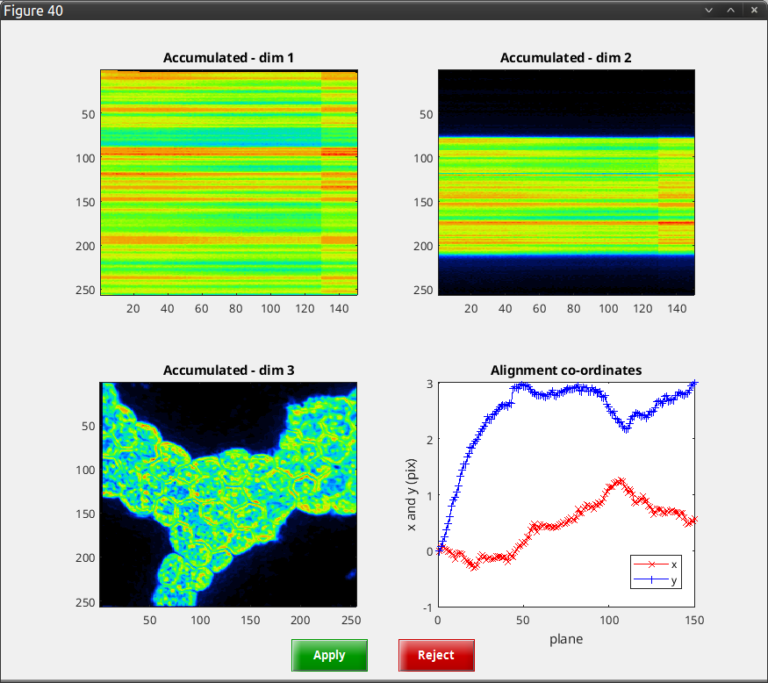
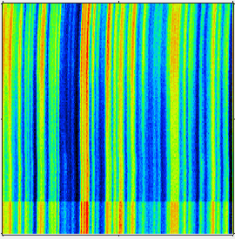
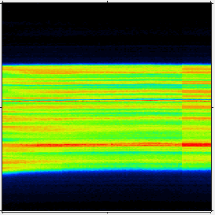
Drift before
drift-correction
Drift before
drift-correction
No-drift after
drift-correction
No-drift after
drift-correction

