Slide 1
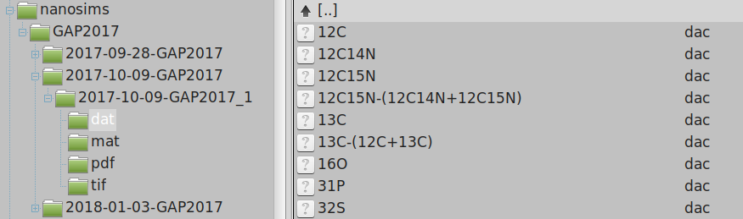
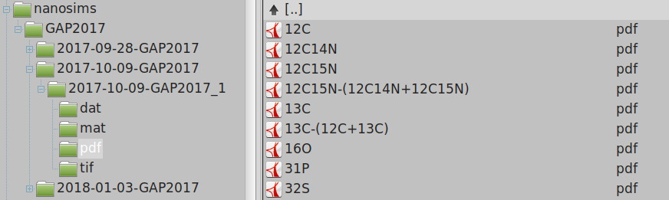
C
6. ASCII output (e.g., values of isotope ratios in ROIs)
D
7. PDF output (images, graphs, histograms, etc.)

