Slide 1
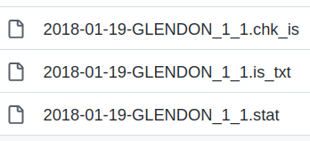
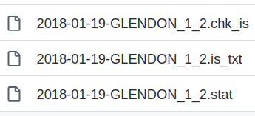
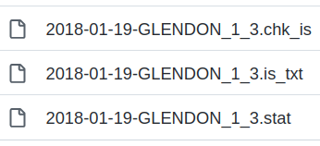
Output of an analysis in point 1:
Output of an analysis in point 2:
Output of an analysis in point 3:

