Slide 1
Test data Classification Scores with Visual grouped by output

Slide 2
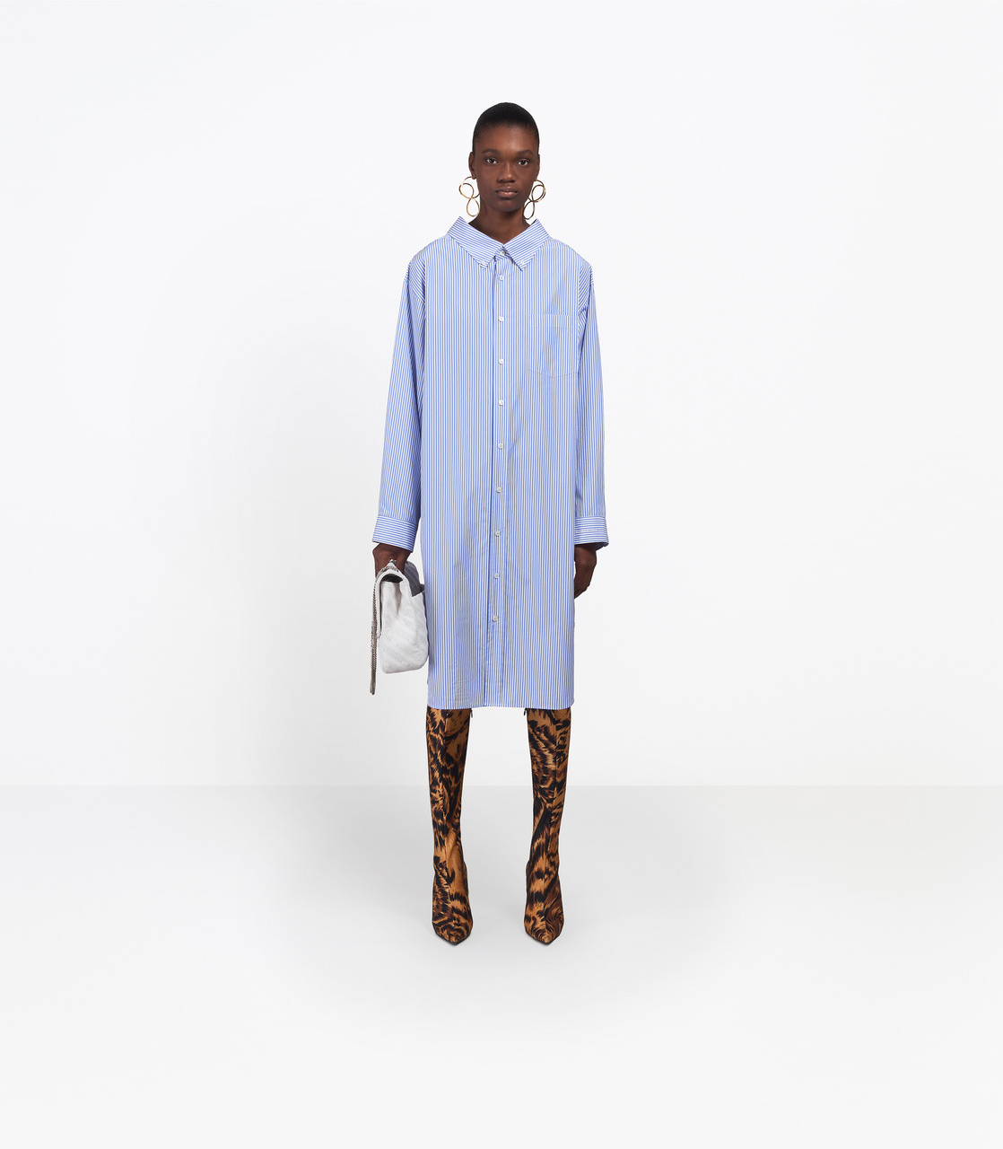
Balenciaga 20
balenciaga (score=1.00000)
gucci (score=0.00000)

Slide 3
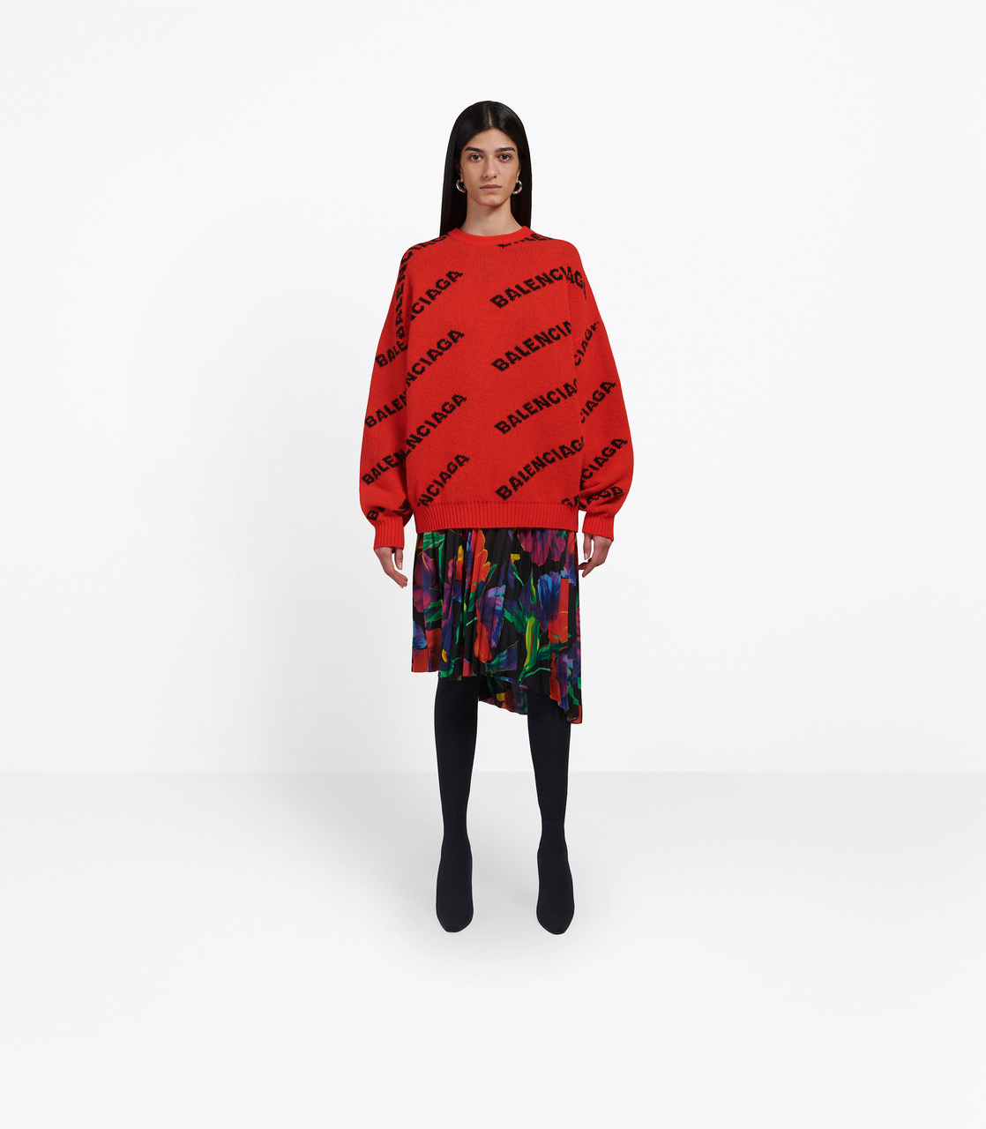
Balenciaga 13
balenciaga (score=0.99999)
gucci (score=0.00001)

Slide 4
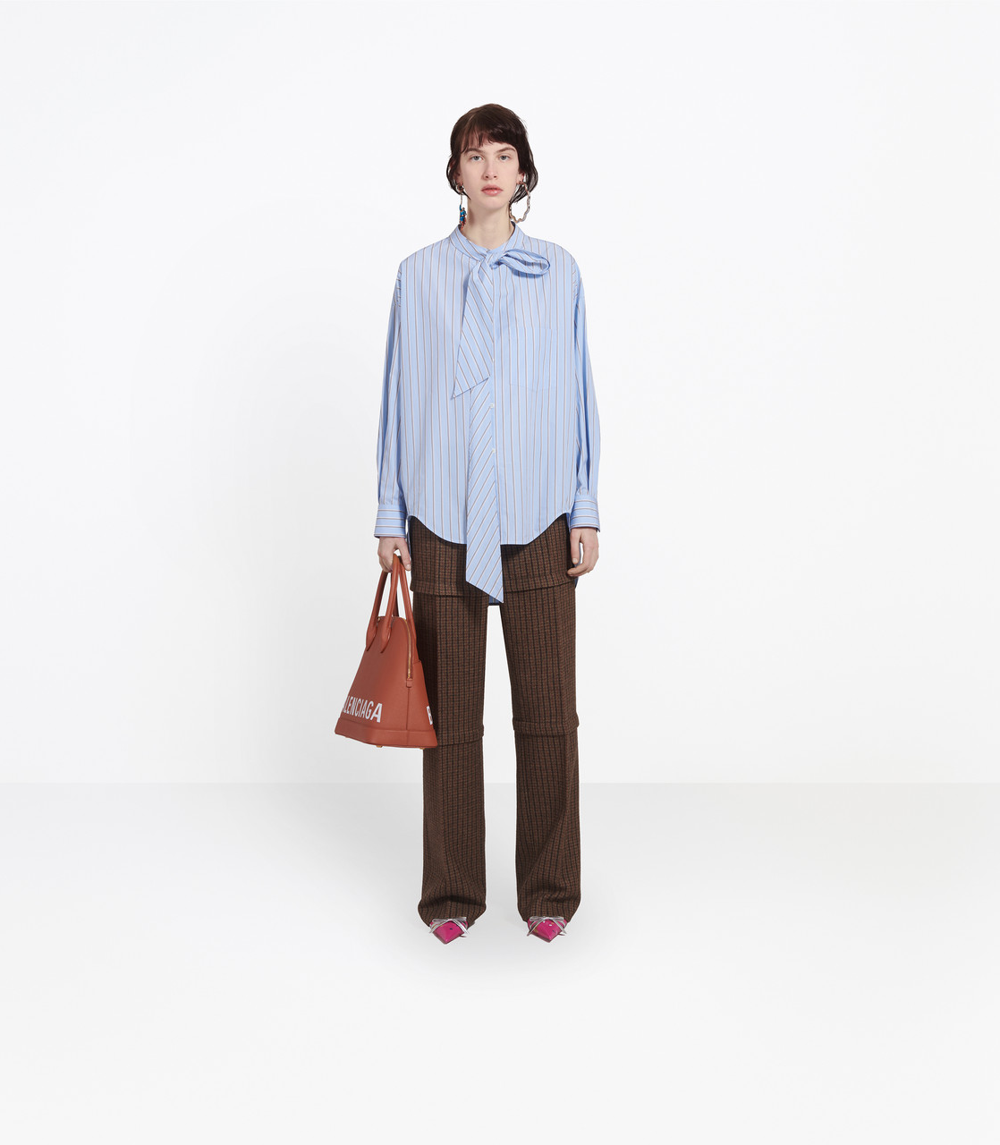
Balenciaga 14
balenciaga (score=0.99955)
gucci (score=0.00045)

Slide 5
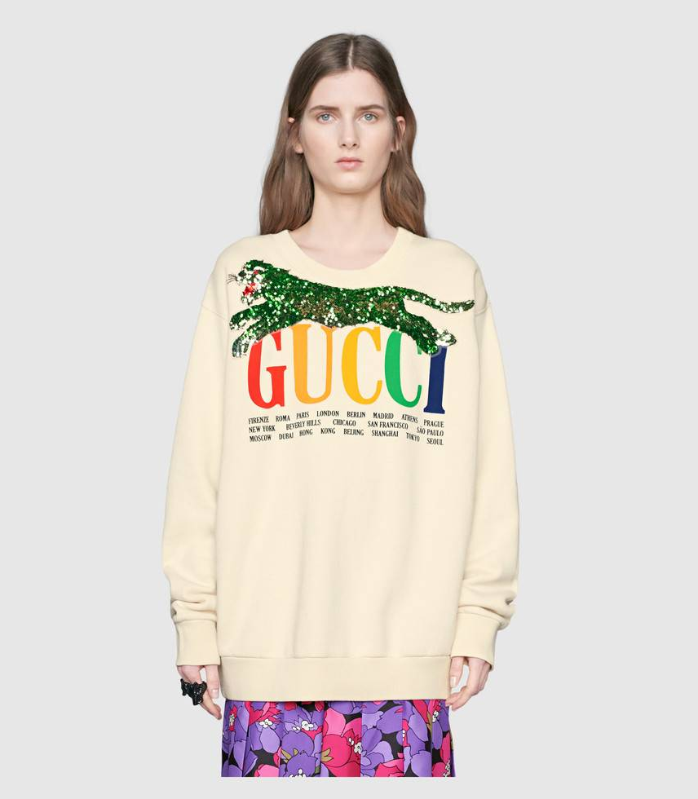
Gucci 19
balenciaga (score=0.99014)
gucci (score=0.00986)

Slide 6
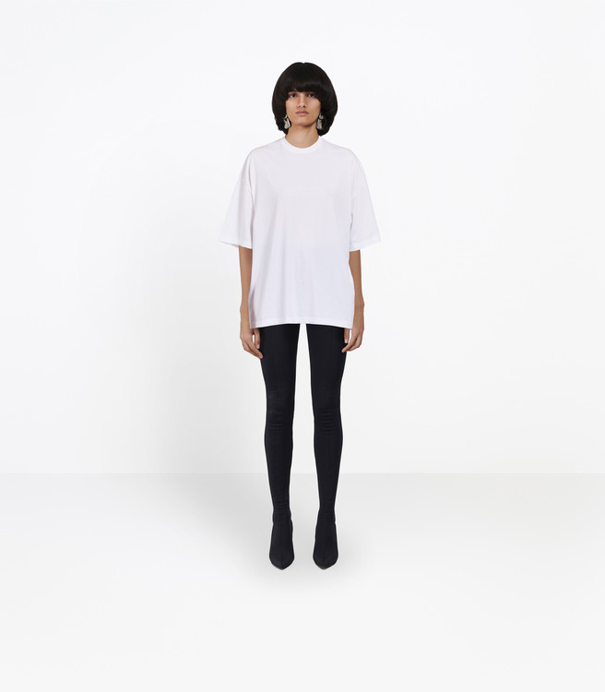
Balenciaga 5
balenciaga (score=0.98891)
gucci (score=0.01109)

Slide 7
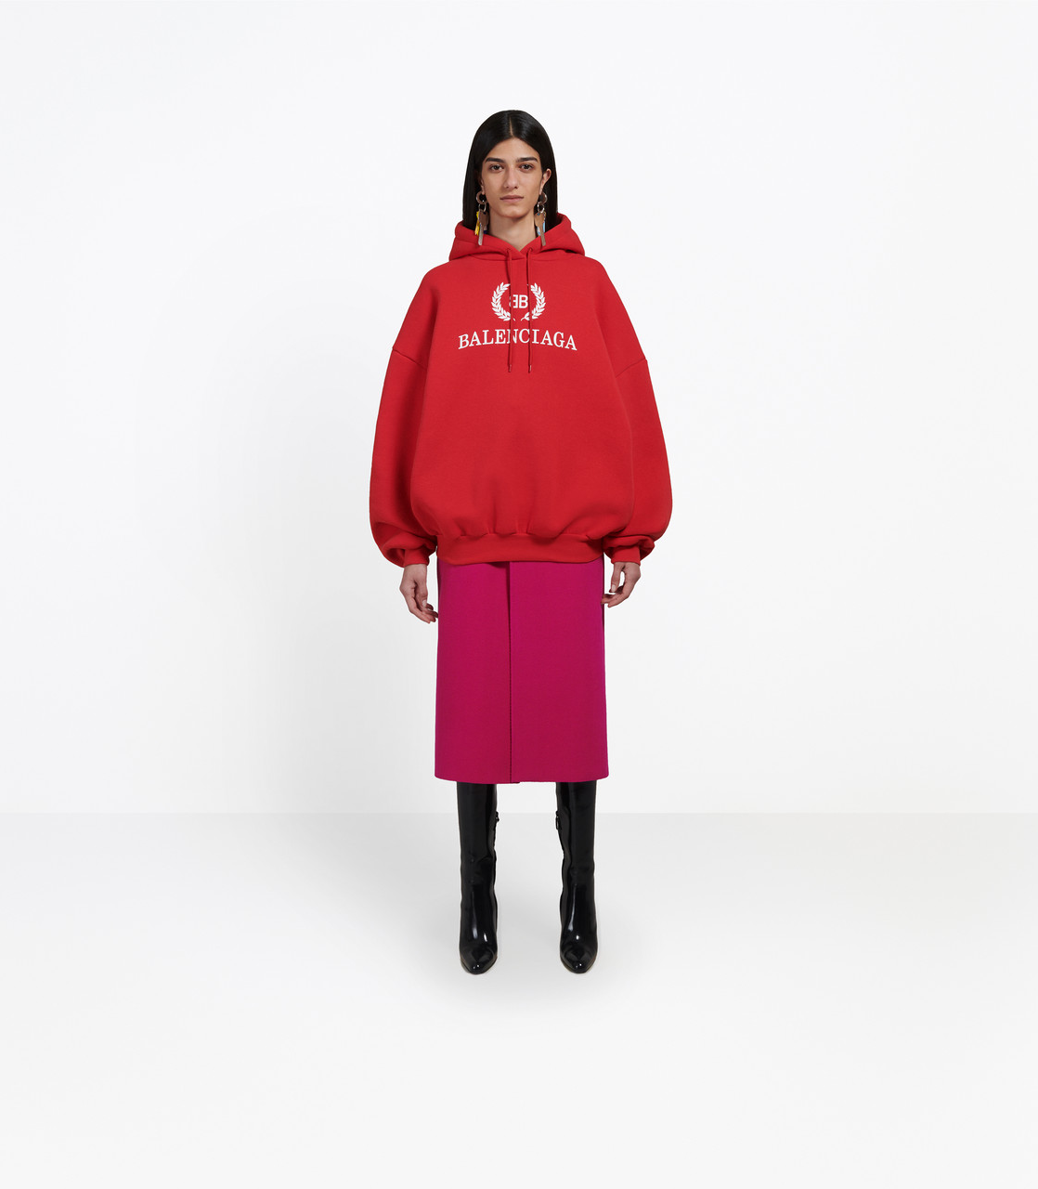
Balenciaga 15
balenciaga (score=0.98655)
gucci (score=0.01345)

Slide 8
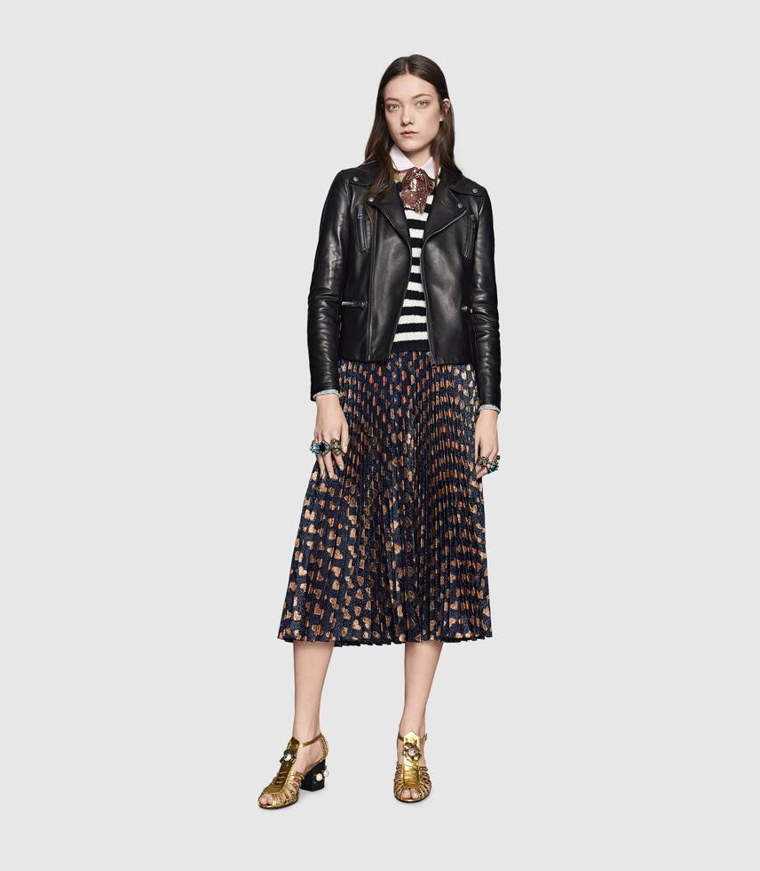
Gucci 14
balenciaga (score=0.98589)
gucci (score=0.01411)

Slide 9
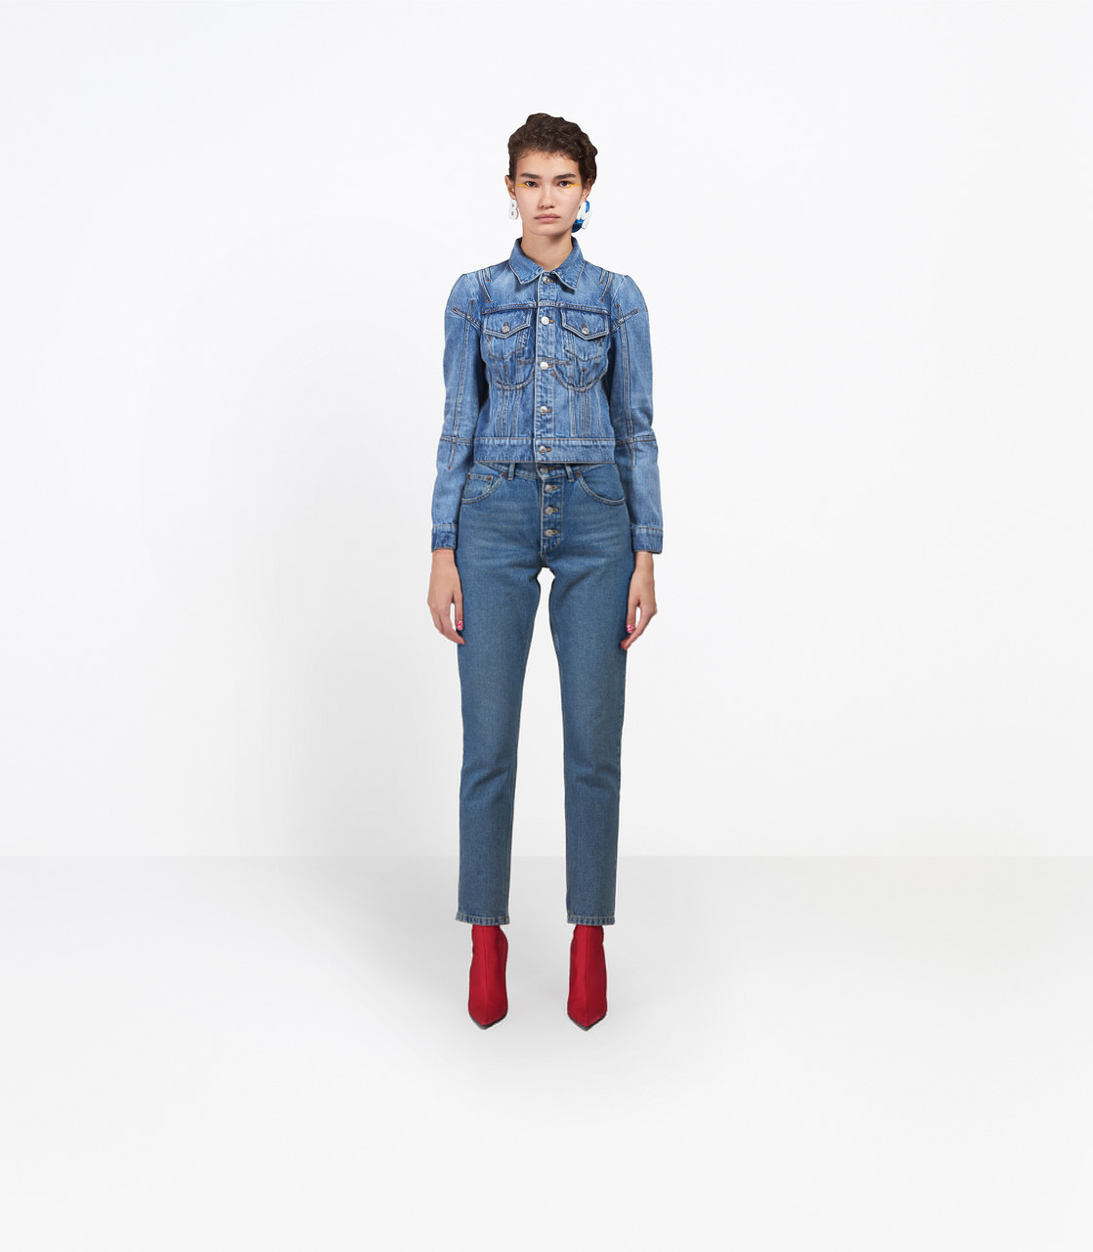
Balenciaga 6
balenciaga (score=0.98576)
gucci (score=0.01424)

Slide 10
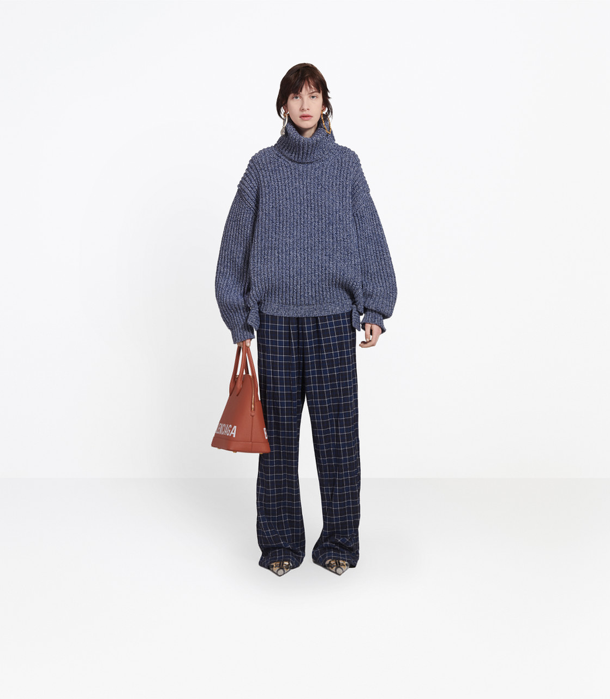
Balenciaga 12
balenciaga (score=0.95879)
gucci (score=0.04121)

Slide 11
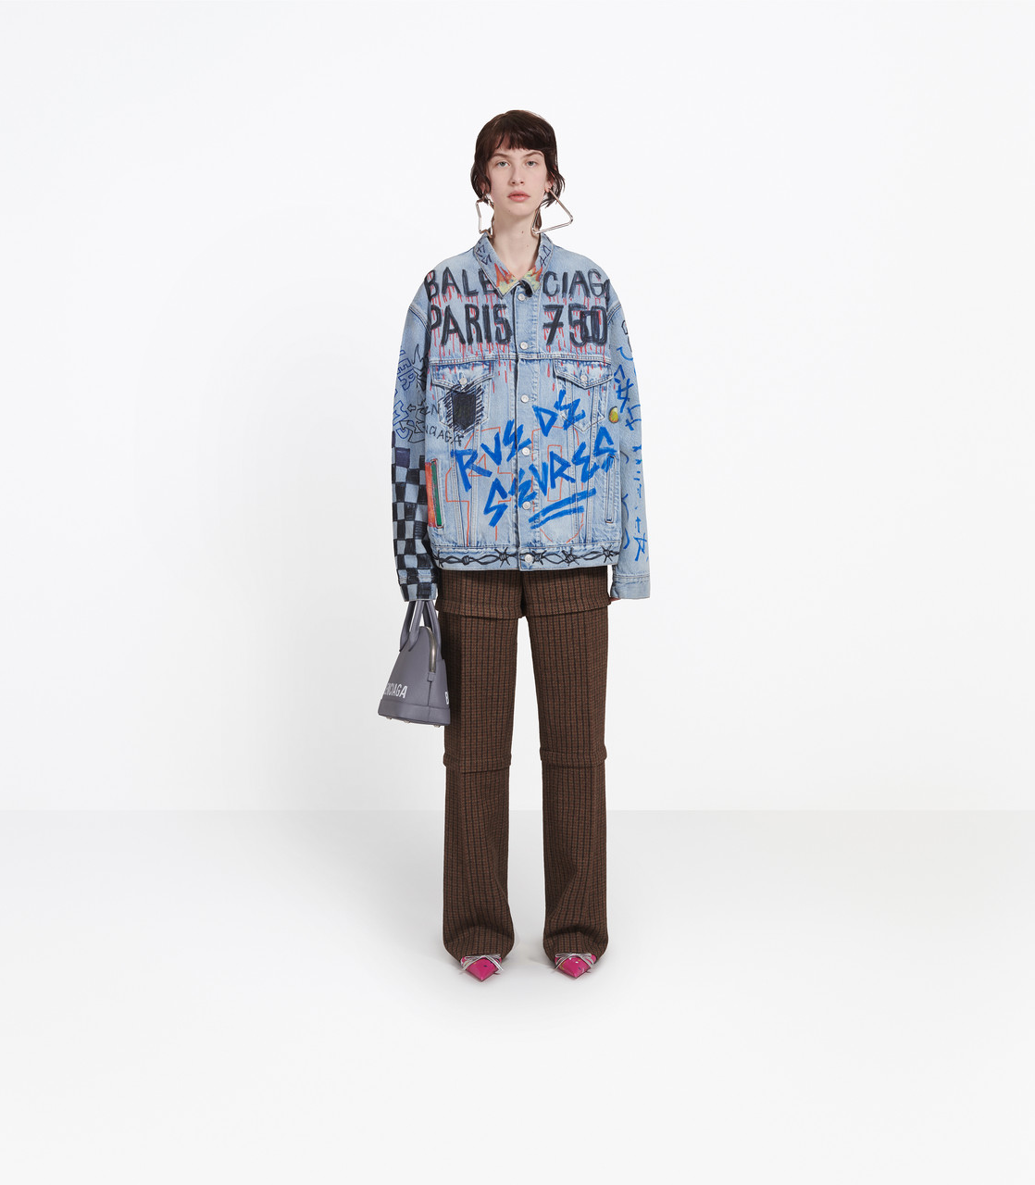
Balenciaga 9
balenciaga (score=0.94519)
gucci (score=0.05481)

Slide 12
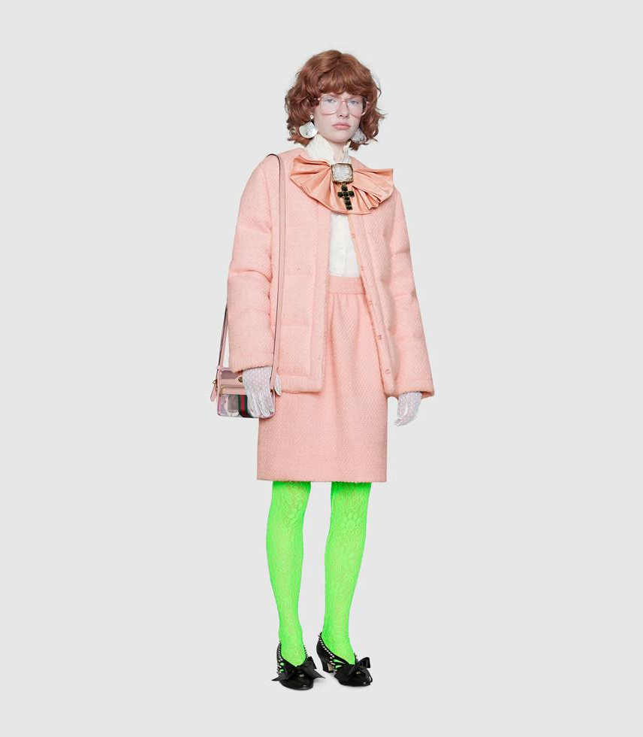
Gucci 2
balenciaga (score=0.90103)
gucci (score=0.09897)

Slide 13
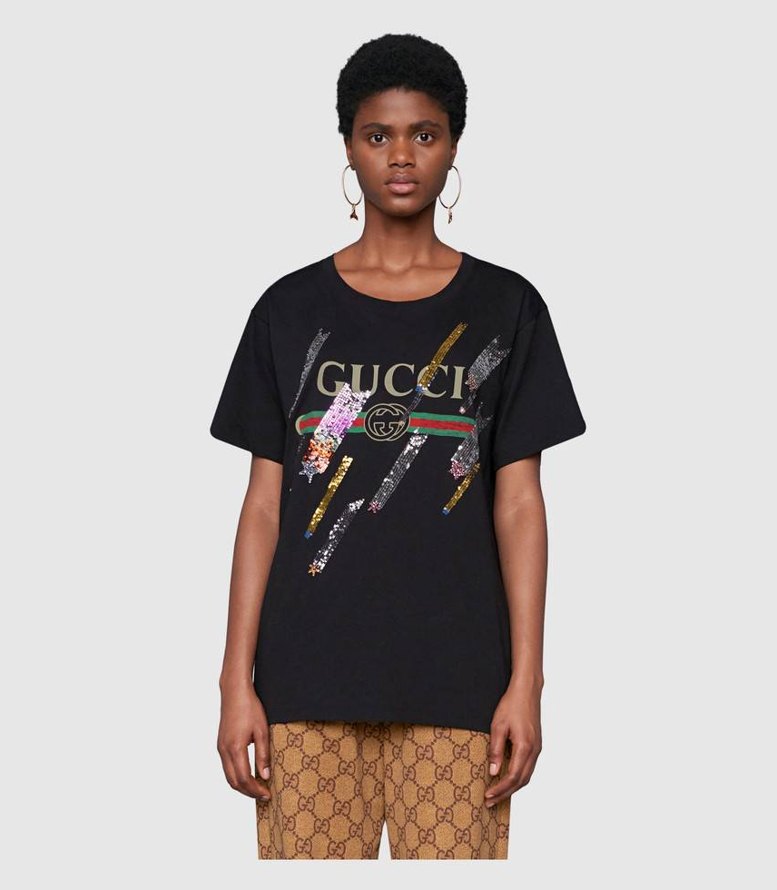
Gucci 6
balenciaga (score=0.67499)
gucci (score=0.32501)

Slide 14
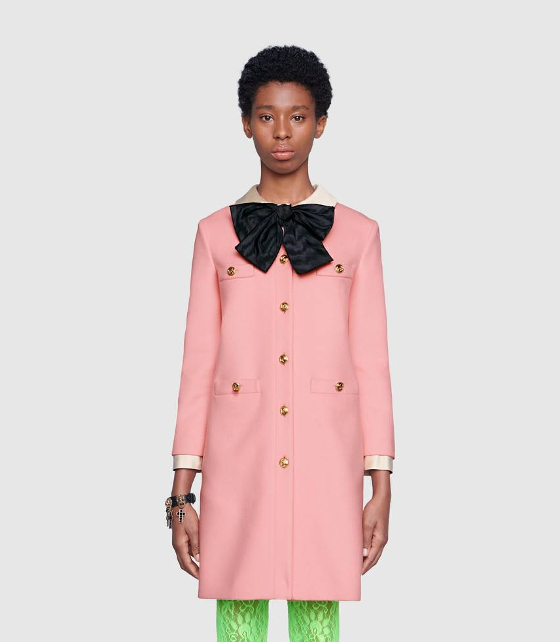
Gucci 1
gucci (score=1.00000)
balenciaga (score=0.00000)

Slide 15
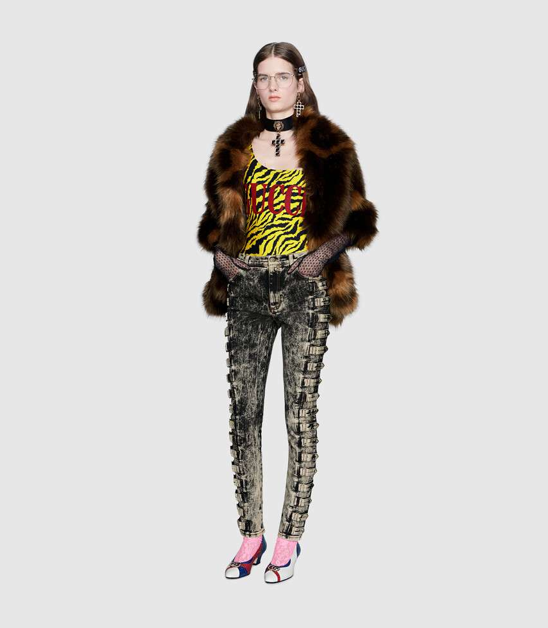
Gucci 10
gucci (score=1.00000)
balenciaga (score=0.00000)

Slide 16
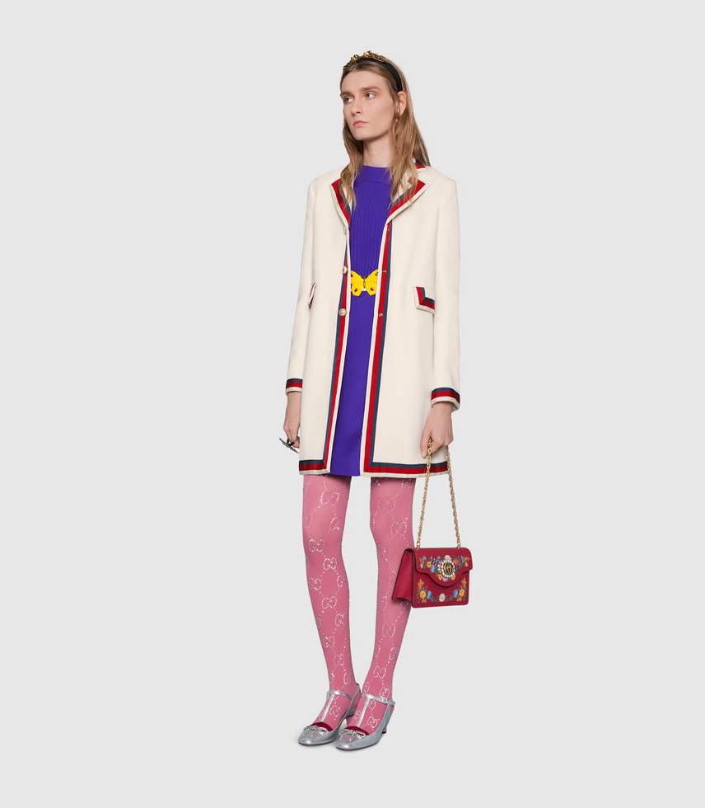
Gucci 12
gucci (score=1.00000)
balenciaga (score=0.00000)

Slide 17
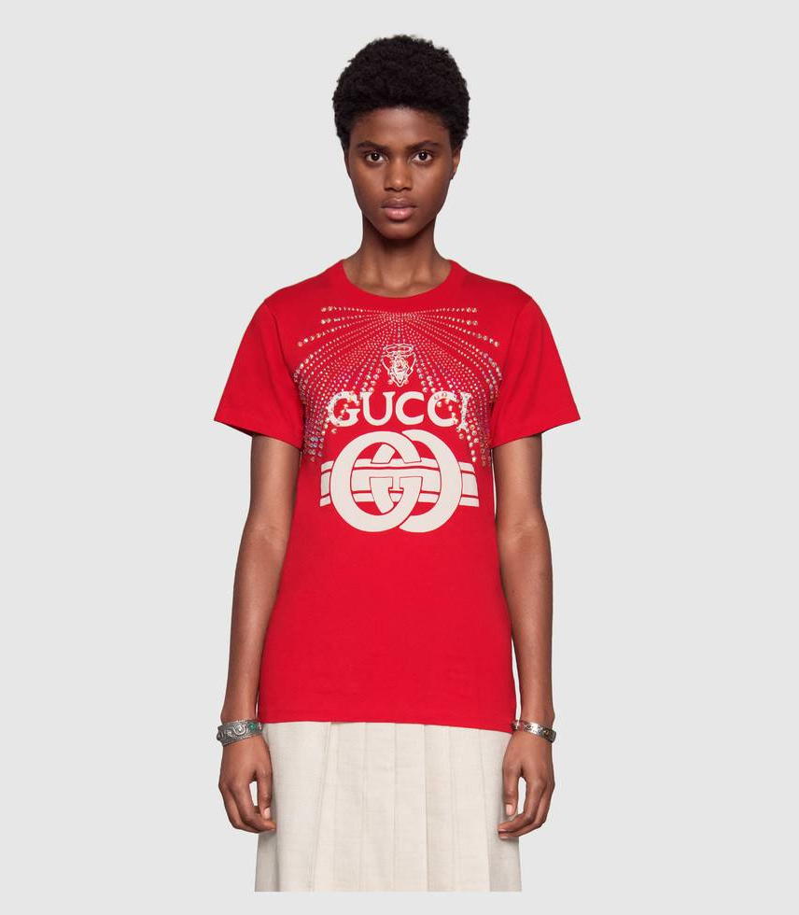
Gucci 20
gucci (score=1.00000)
balenciaga (score=0.00000)

Slide 18
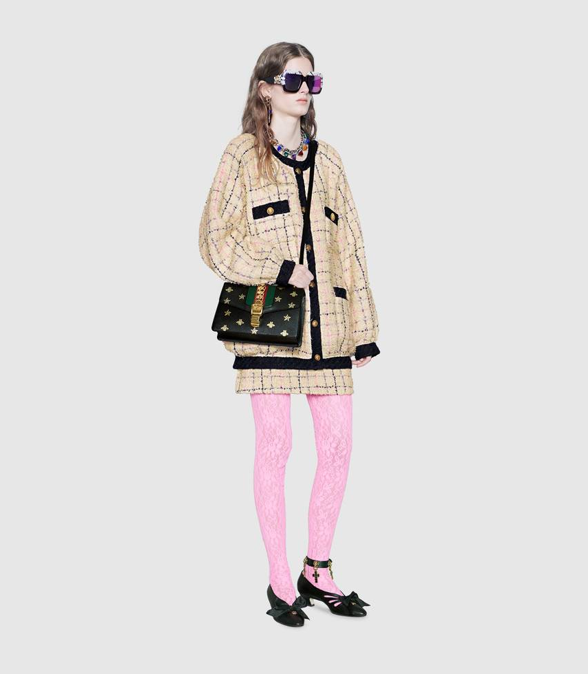
Gucci 3
gucci (score=1.00000)
balenciaga (score=0.00000)

Slide 19
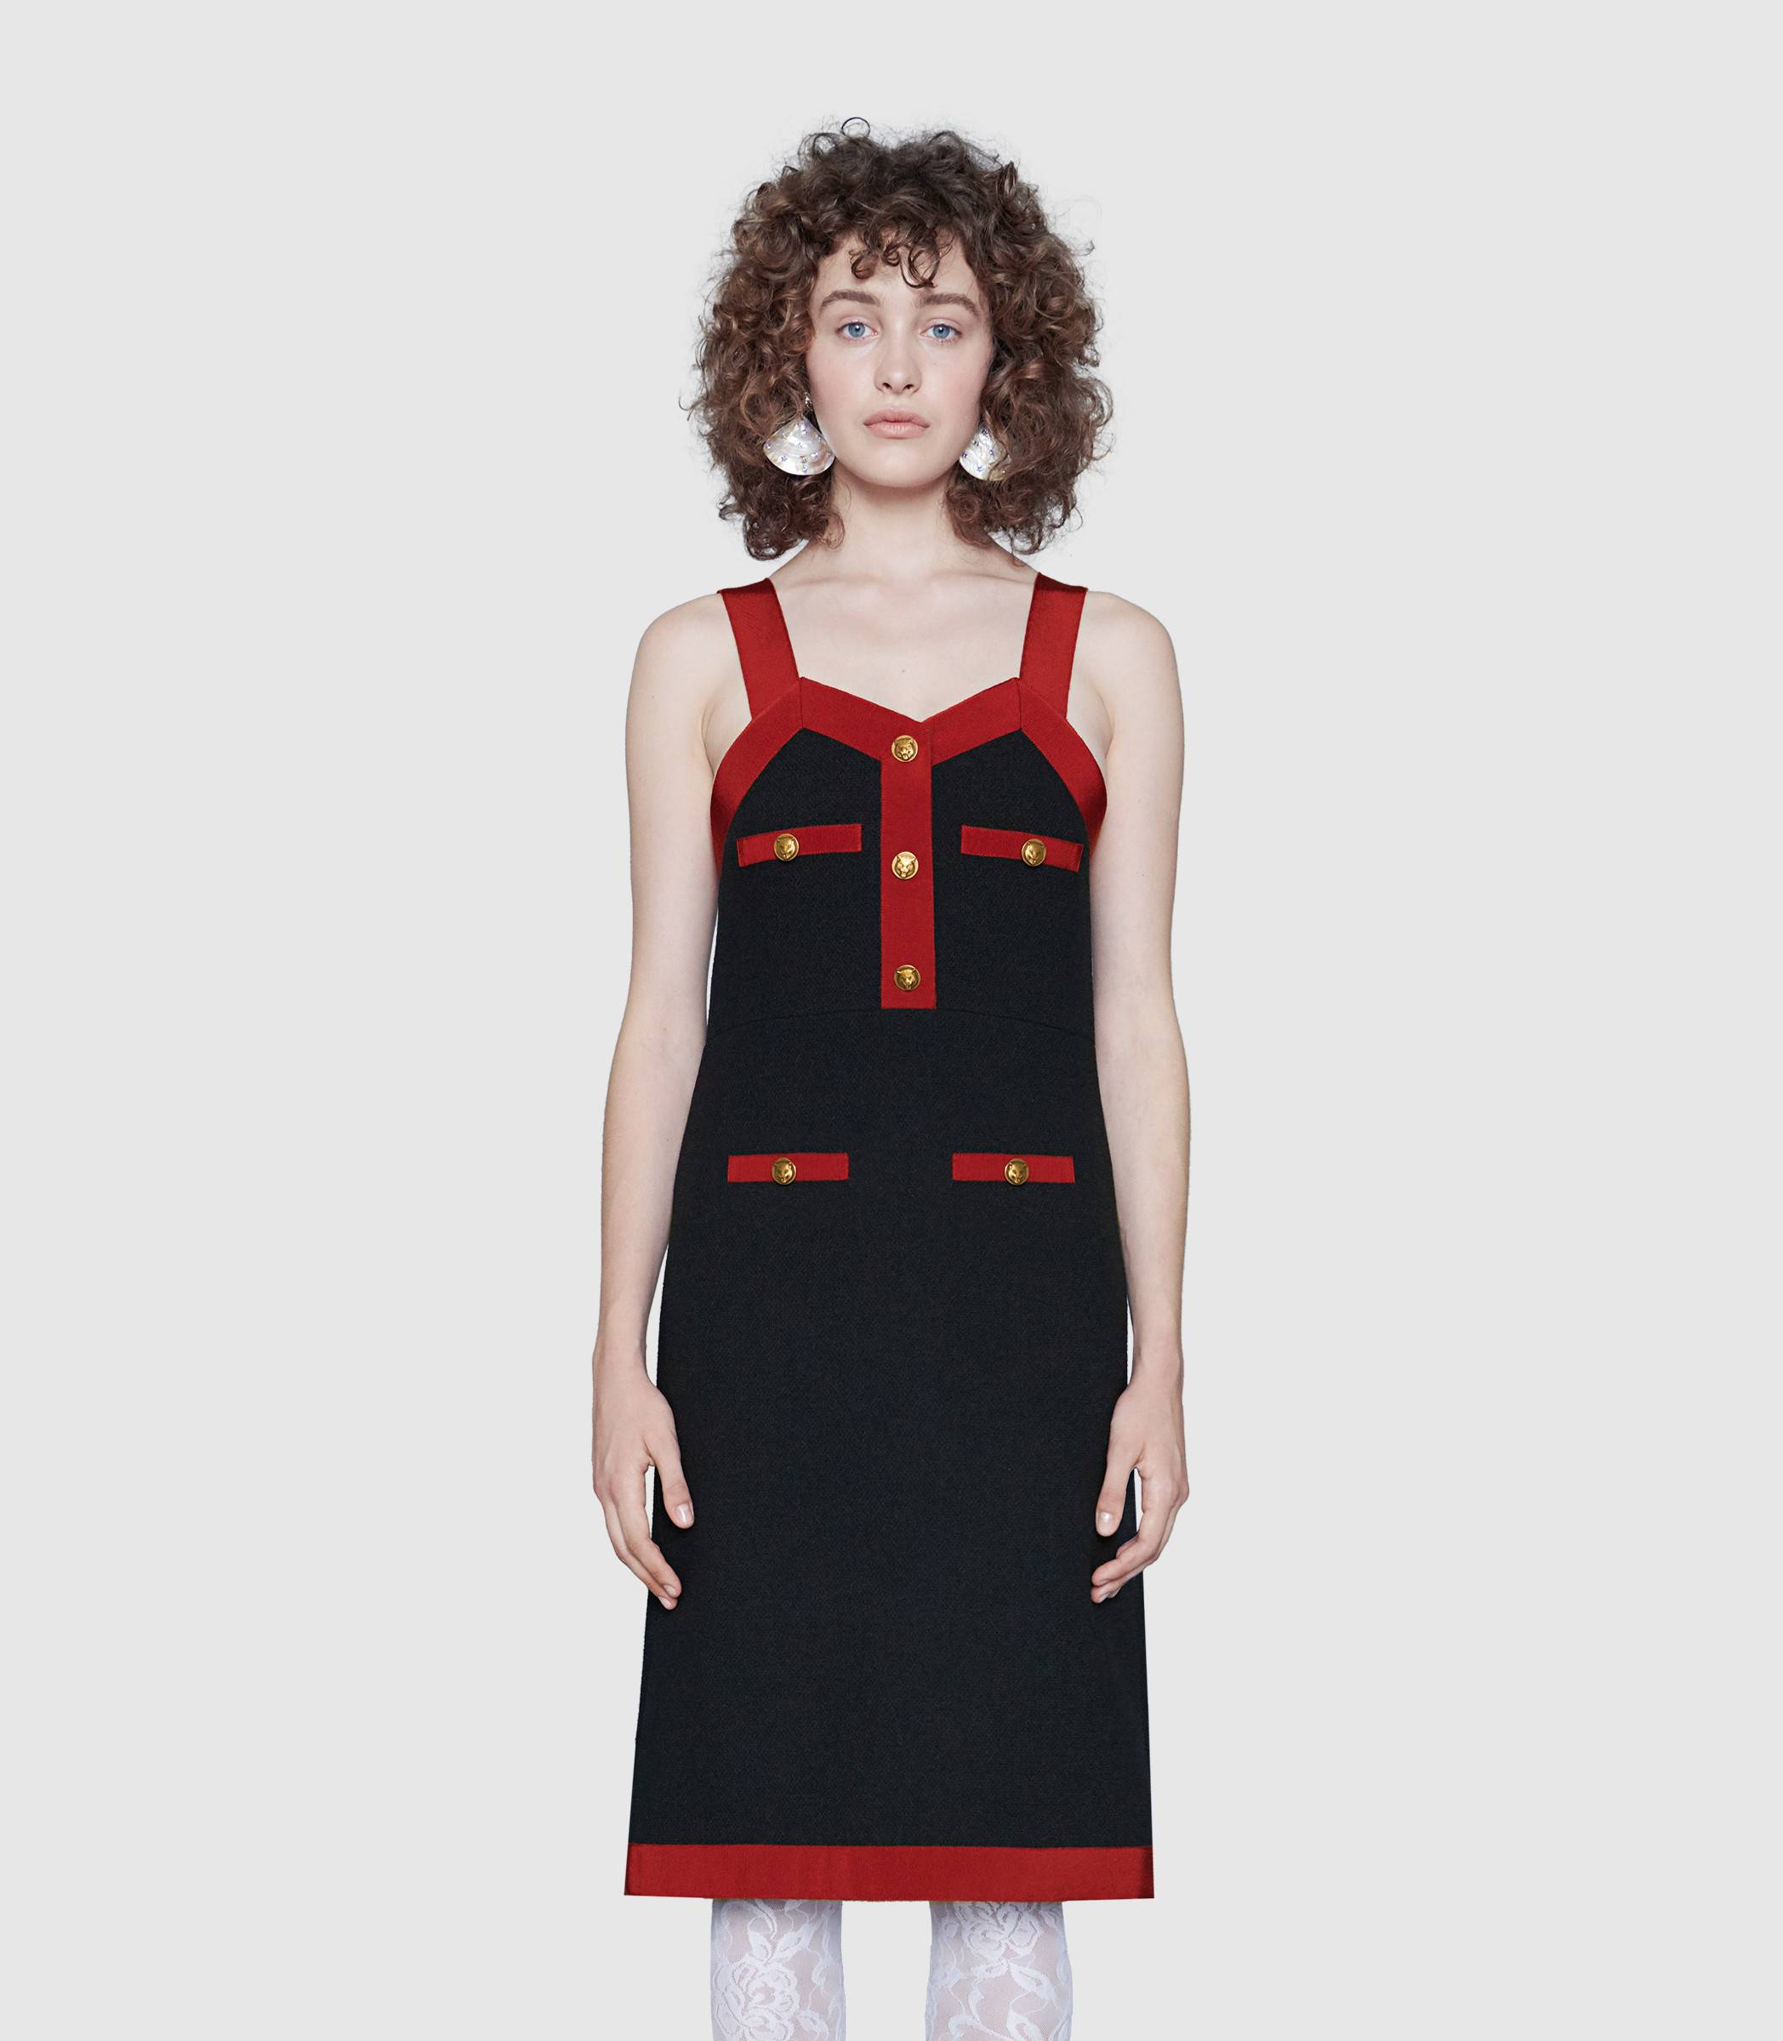
Gucci 4
gucci (score=1.00000)
balenciaga (score=0.00000)

Slide 20

Gucci 18
gucci (score=1.00000)
balenciaga (score=0.00000)

Slide 21
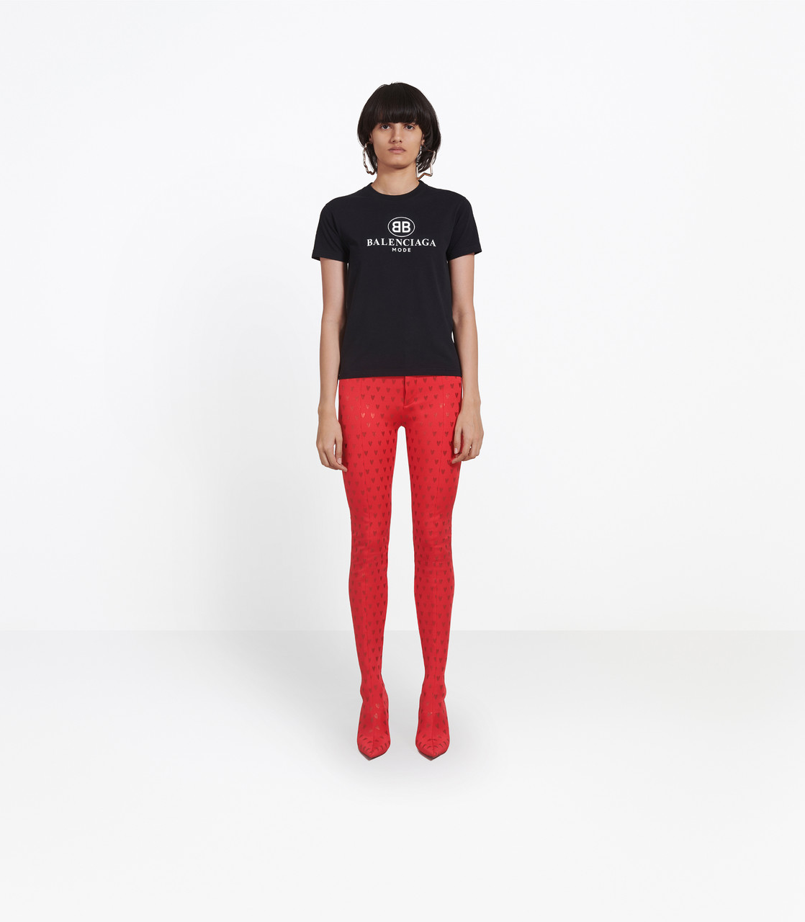
Balenciaga 2
gucci (score=1.00000)
balenciaga (score=0.00000)

Slide 22
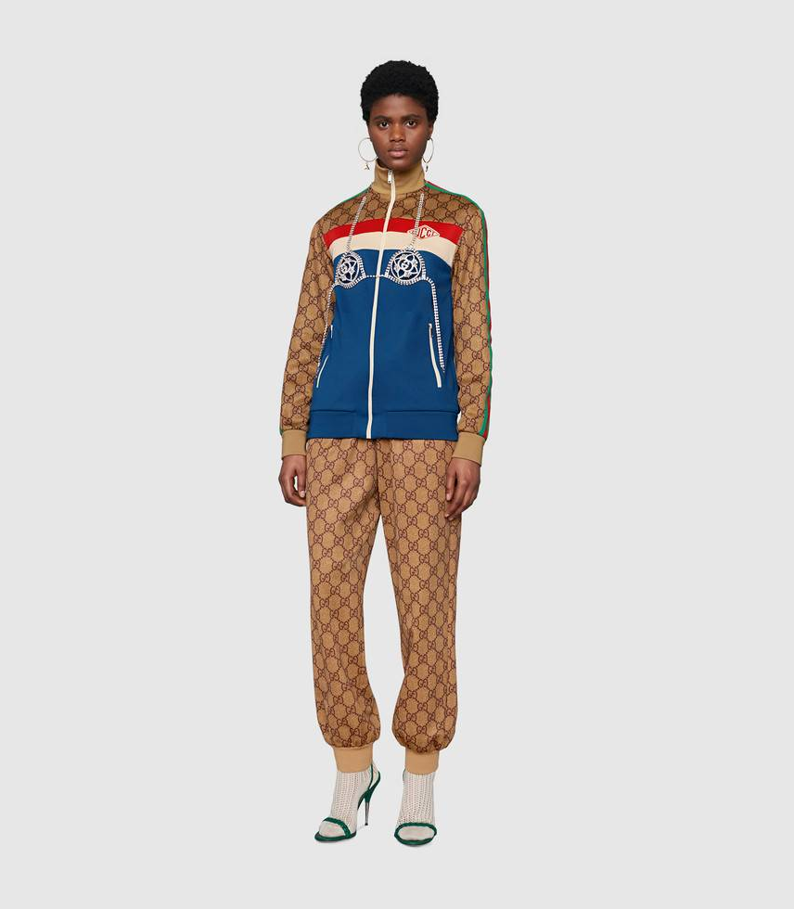
Gucci 7
gucci (score=1.00000)
balenciaga (score=0.00000)

Slide 23
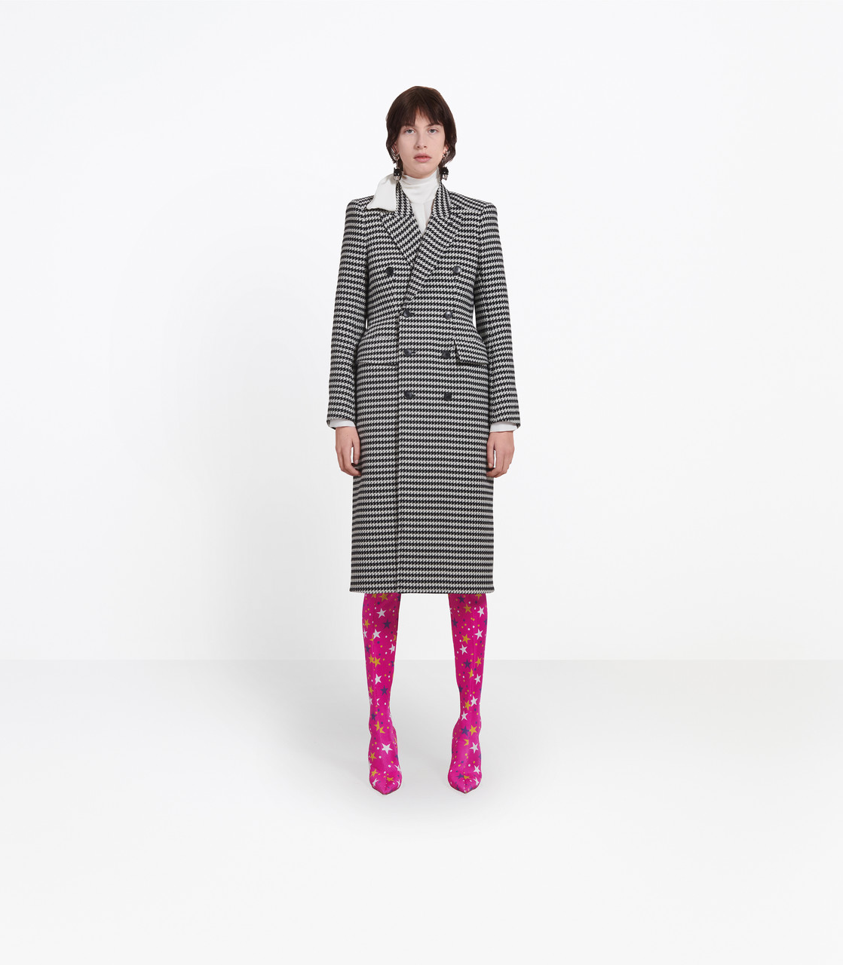
Balenciaga 1
gucci (score=1.00000)
balenciaga (score=0.00000)

Slide 24
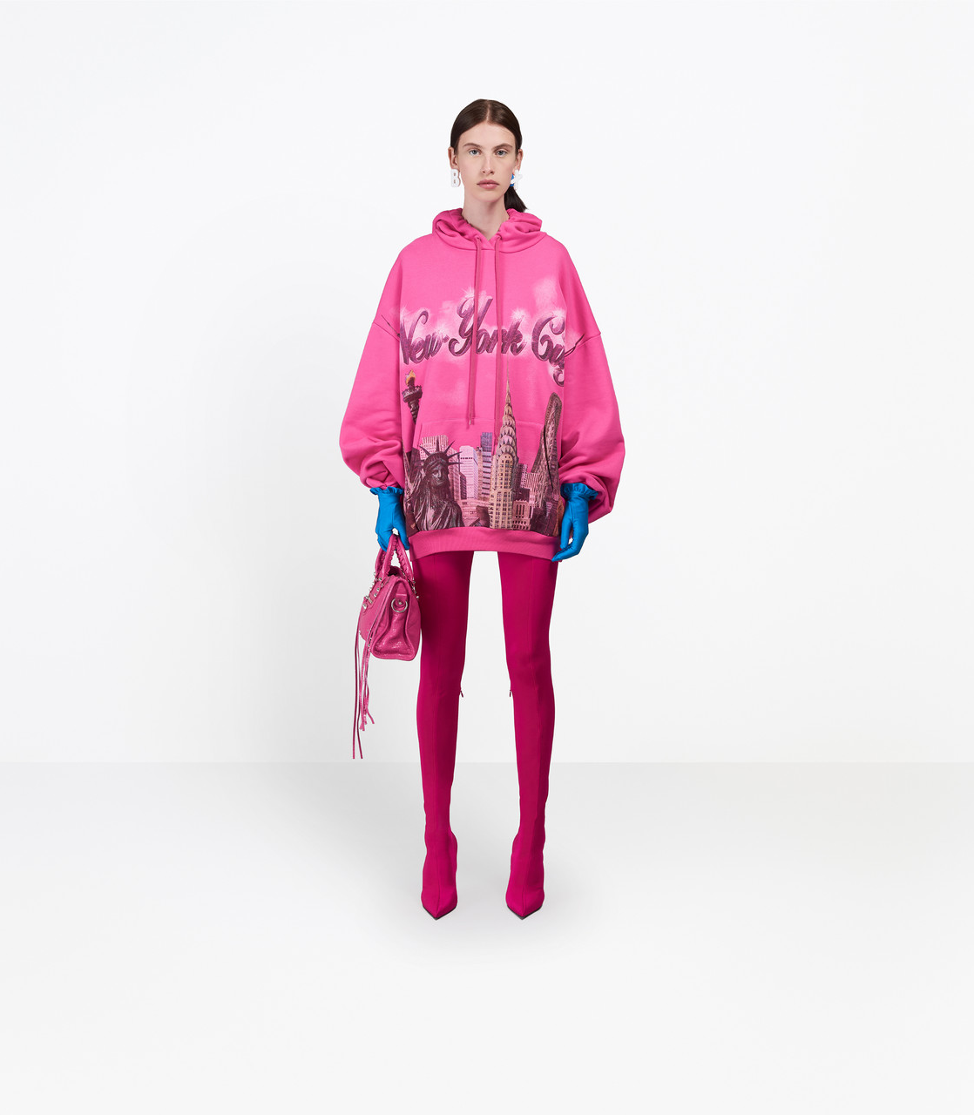
Balenciaga 7
gucci (score=1.00000)
balenciaga (score=0.00000)

Slide 25
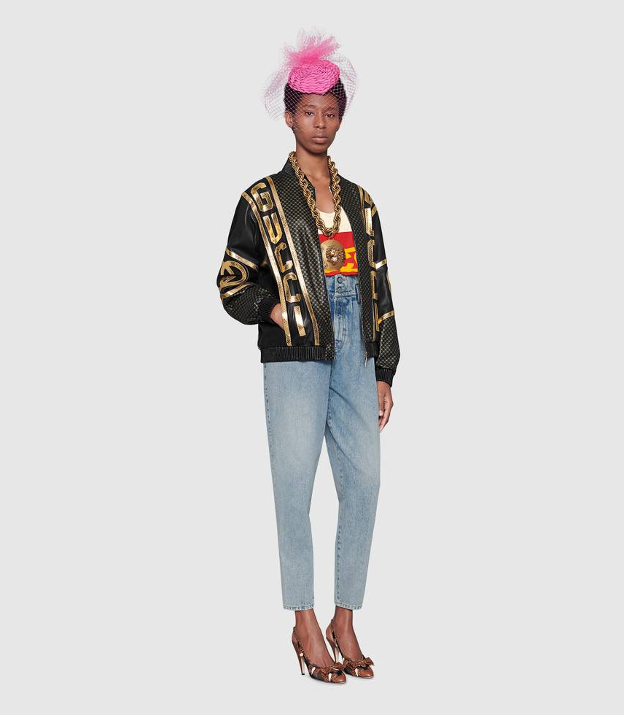
Gucci 13
gucci (score=0.99999)
balenciaga (score=0.00001)

Slide 26
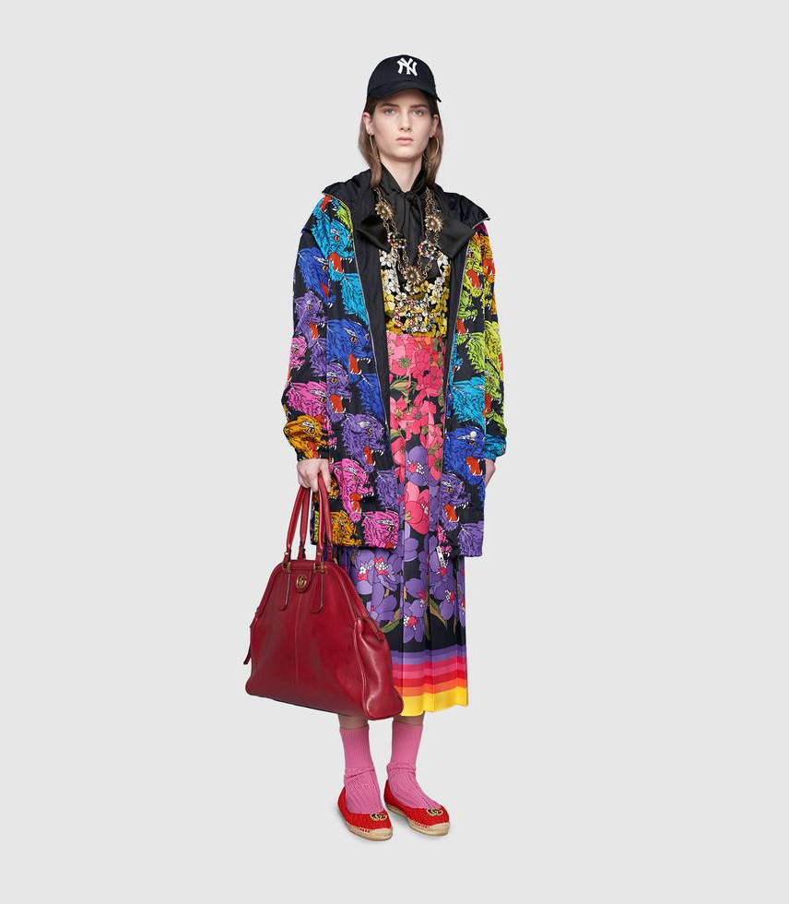
Gucci 15
gucci (score=0.99999)
balenciaga (score=0.00001)

Slide 27

Gucci 8
gucci (score=0.99999)
balenciaga (score=0.00001)

Slide 28
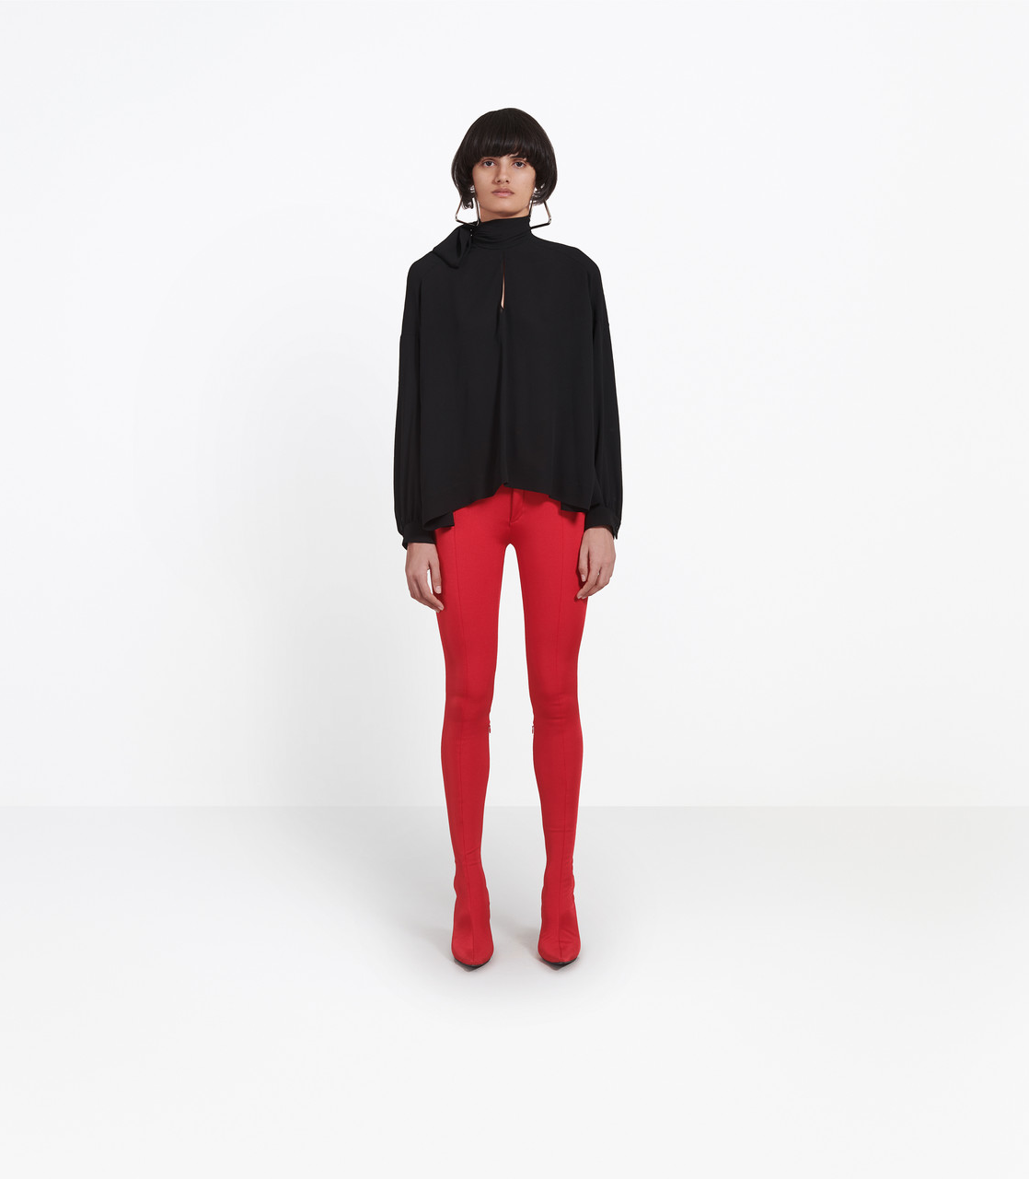
Balenciaga 11
gucci (score=0.99999)
balenciaga (score=0.00001)

Slide 29
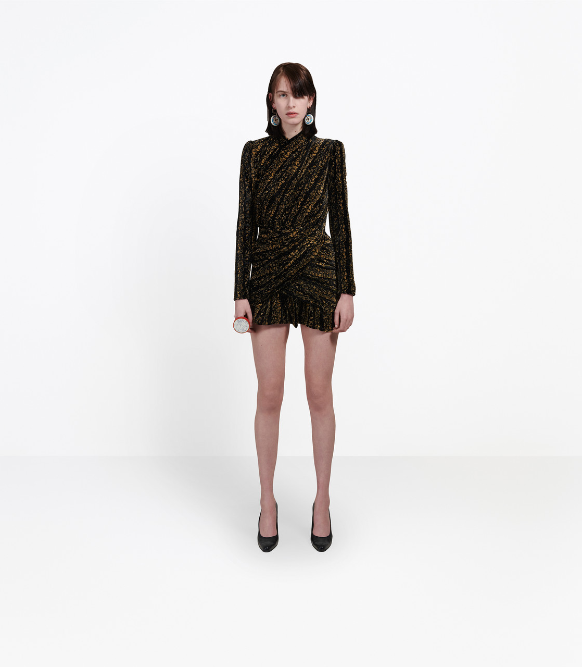
Balenciaga 18
gucci (score=0.99999)
balenciaga (score=0.00001)

Slide 30
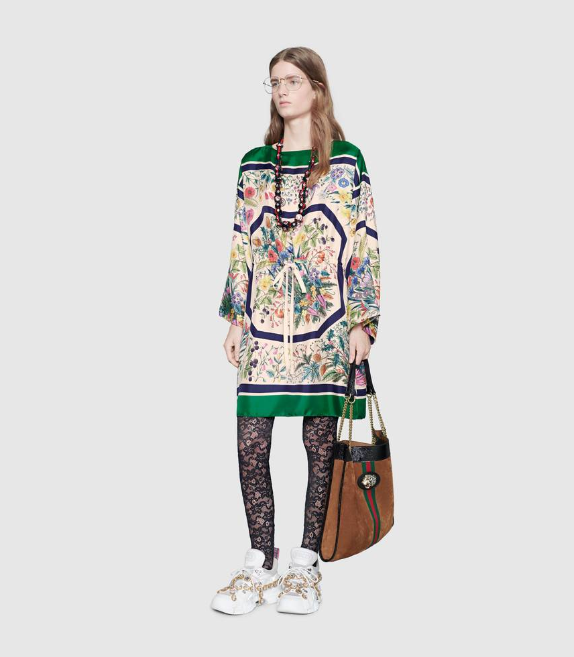
Gucci 16
gucci (score=0.99998)
balenciaga (score=0.00002)

Slide 31

Gucci 9
gucci (score=0.99998)
balenciaga (score=0.00002)

Slide 32
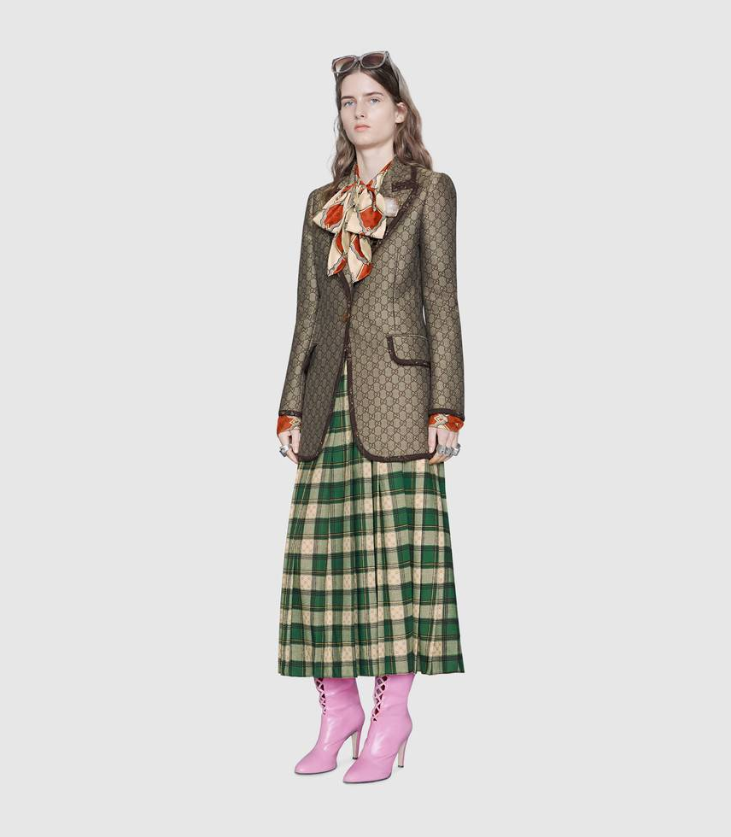
Gucci 5
gucci (score=0.99997)
balenciaga (score=0.00003)

Slide 33
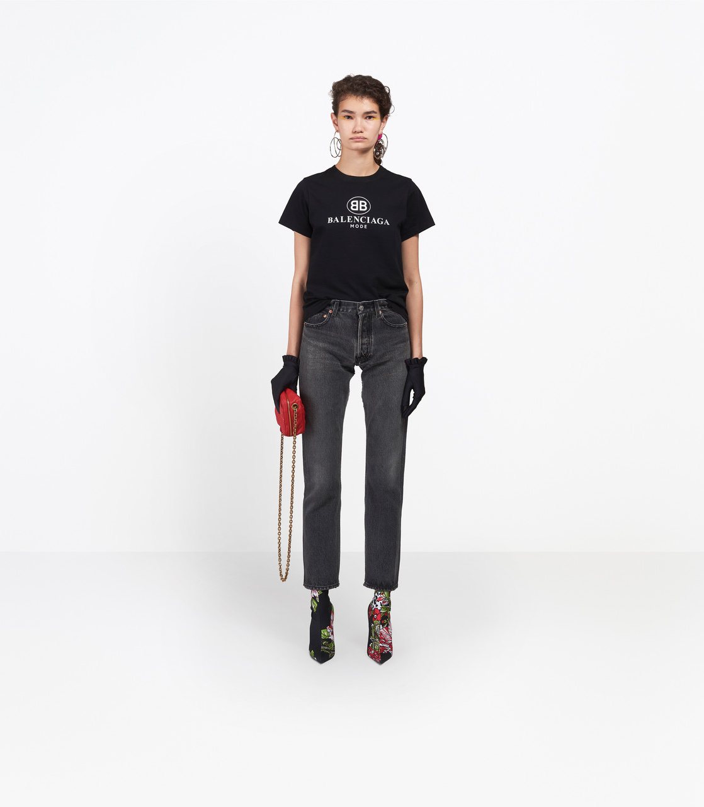
Balenciaga 10
gucci (score=0.99962)
balenciaga (score=0.00038)

Slide 34
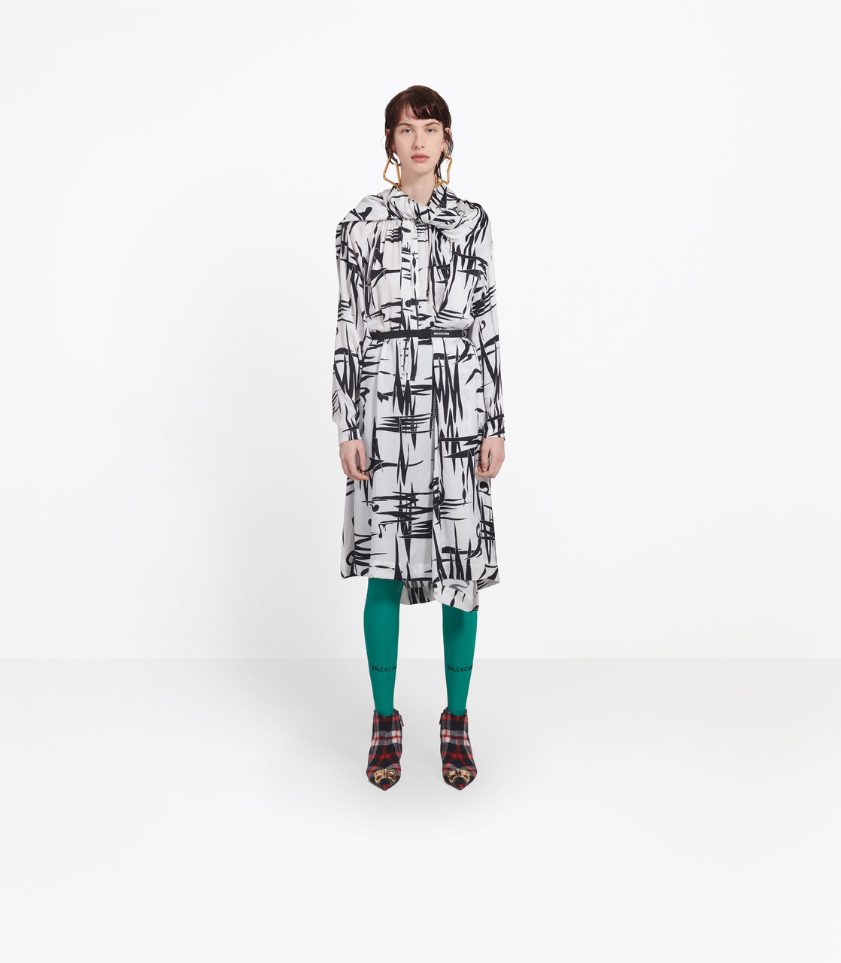
Balenciaga 17
gucci (score=0.99972)
balenciaga (score=0.00028)

Slide 35
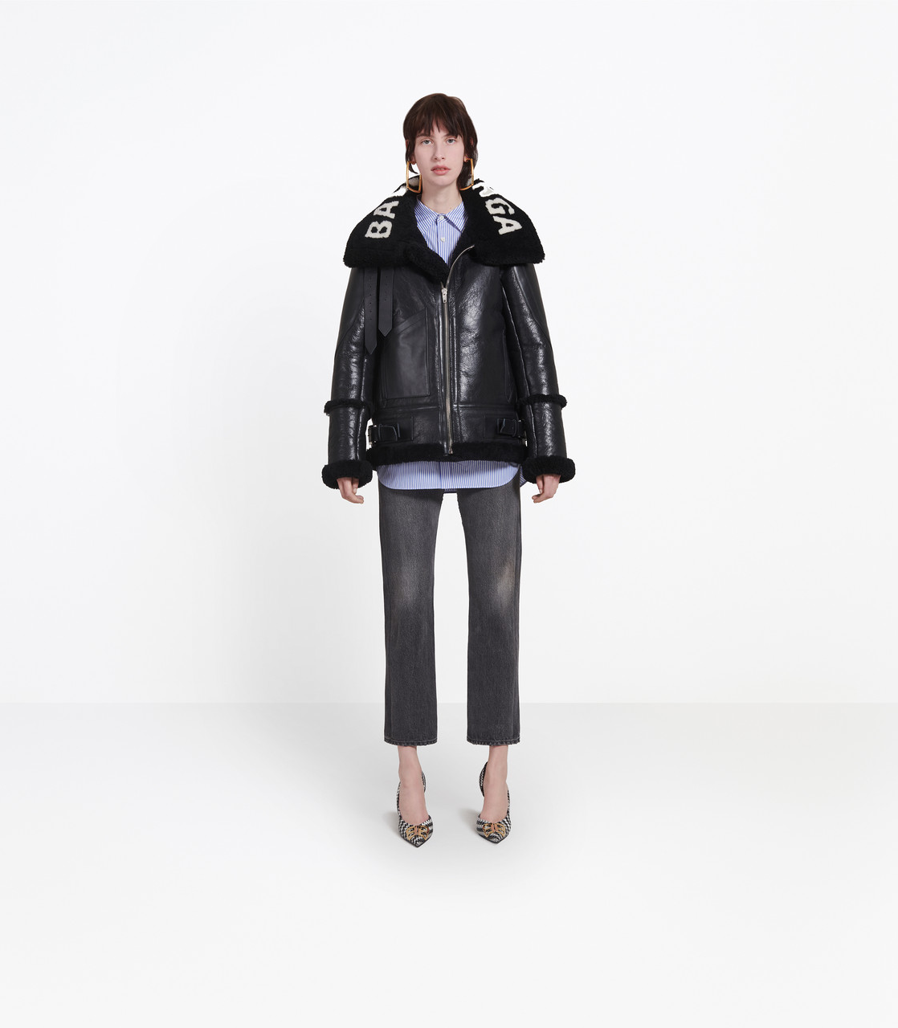
Balenciaga 8
gucci (score=0.99956)
balenciaga (score=0.00044)

Slide 36
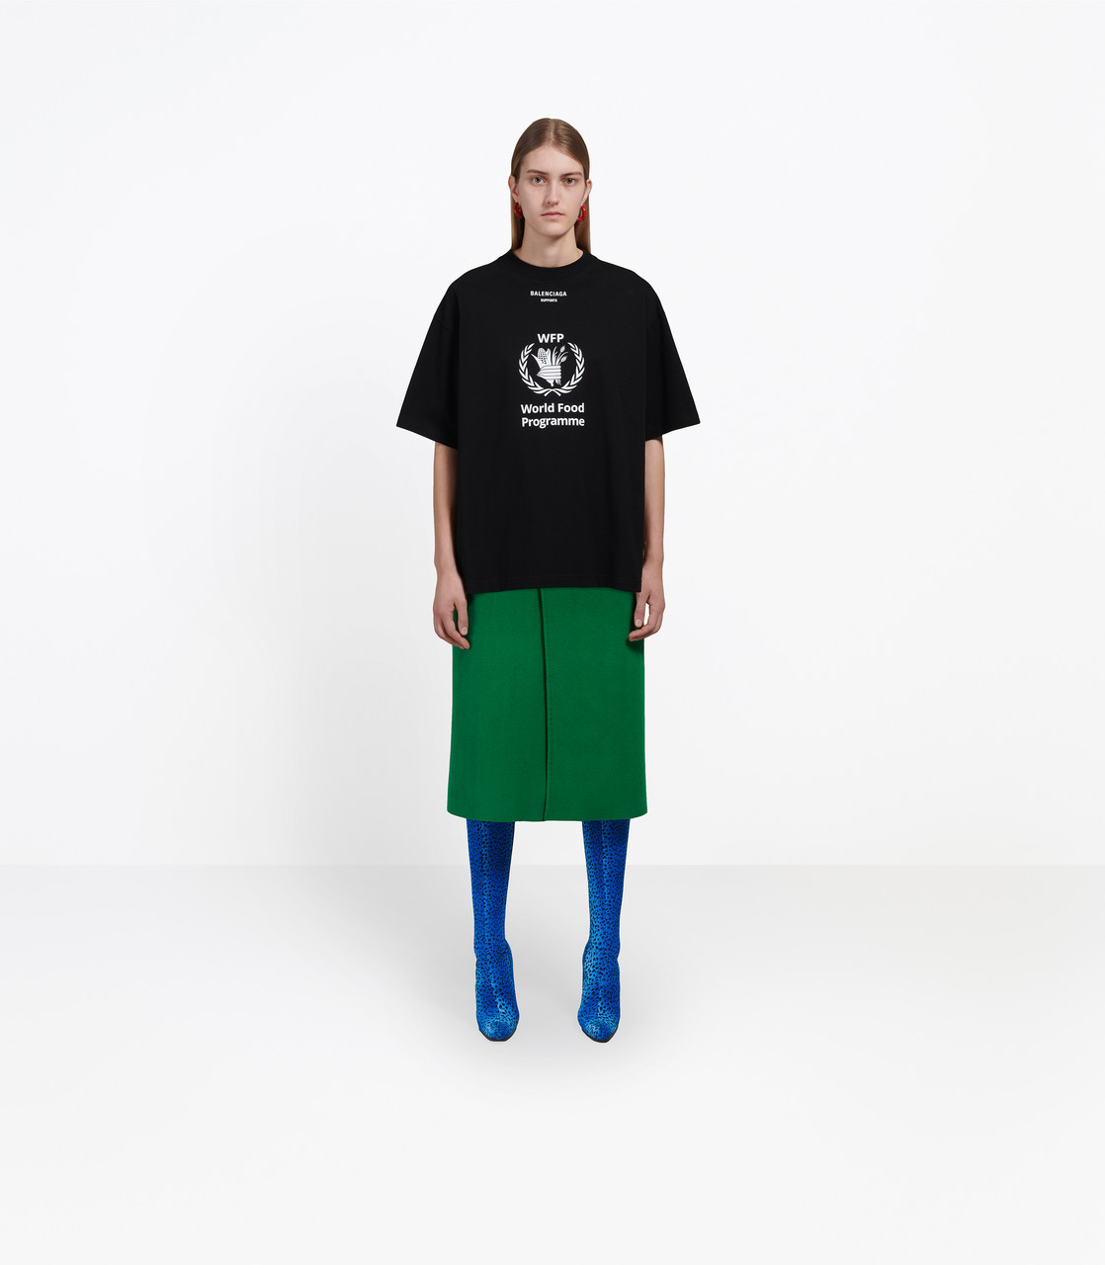
Balenciaga 16
gucci (score=0.99878)
balenciaga (score=0.00122)

Slide 37
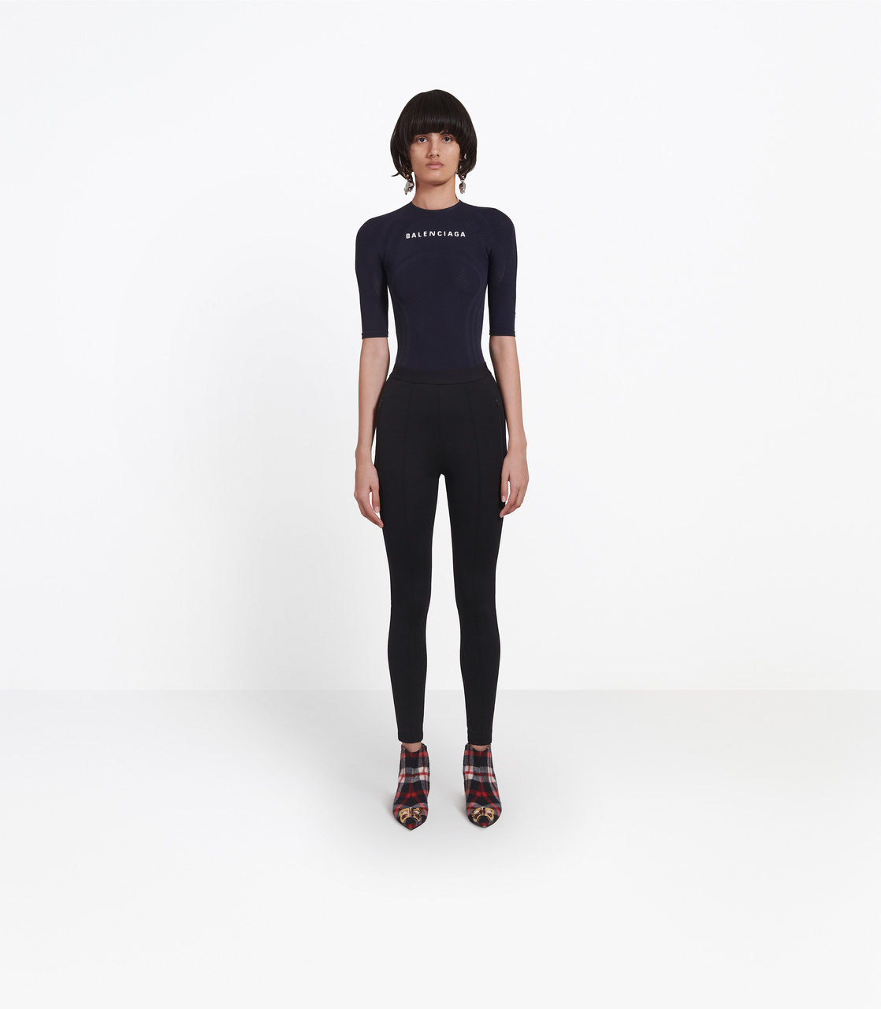
Balenciaga 4
gucci (score=0.99614)
balenciaga (score=0.00386)

Slide 38
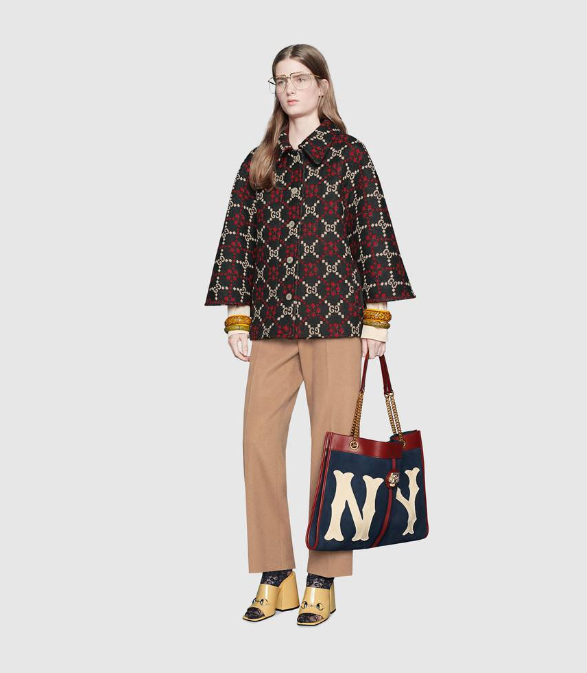
Gucci 11
gucci (score=0.97412)
balenciaga (score=0.02588)

Slide 39
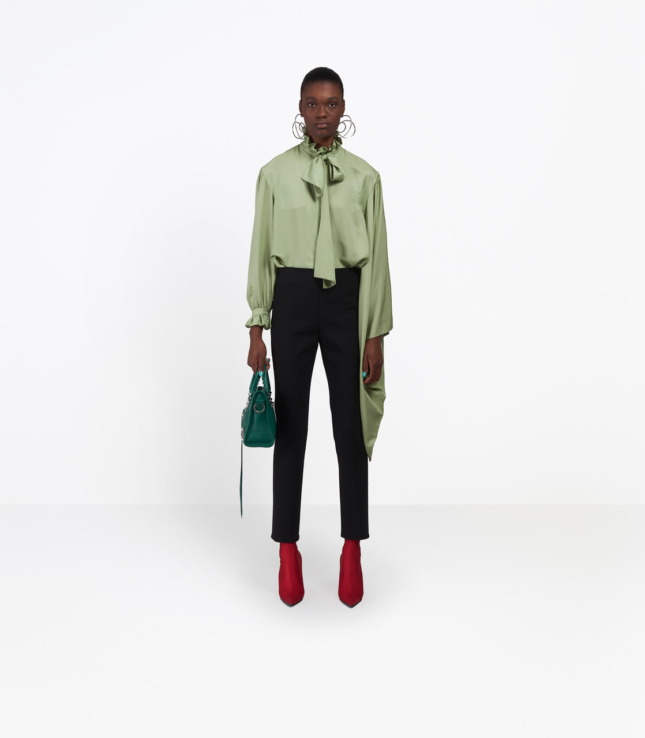
Balenciaga 3
gucci (score=0.96505)
balenciaga (score=0.03495)

Slide 40
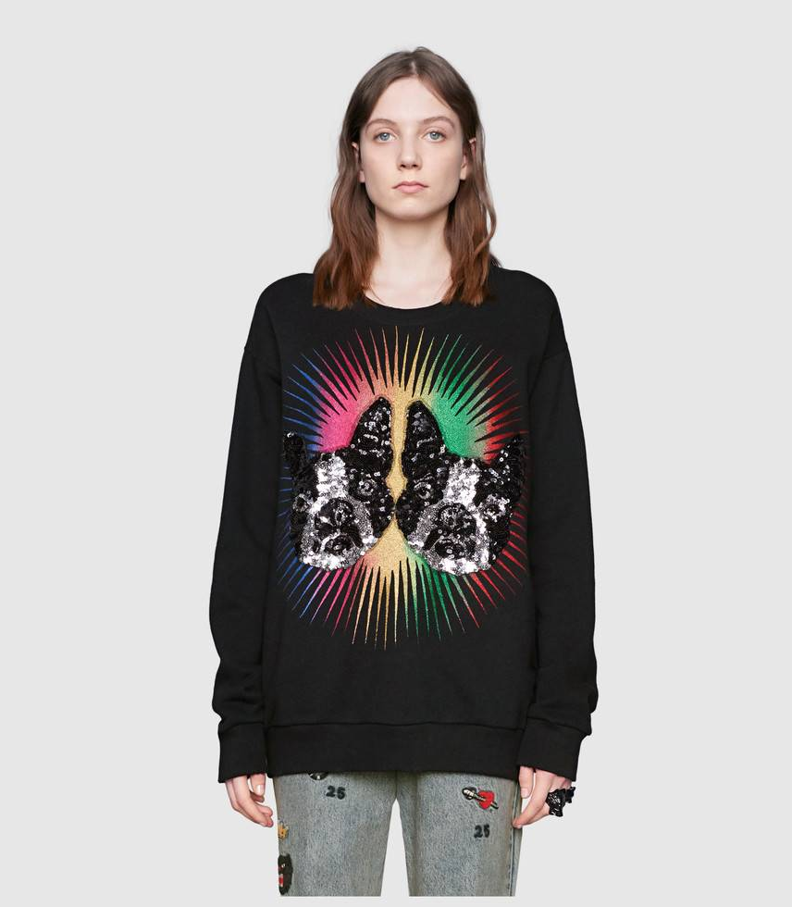
Gucci 17
gucci (score=0.96407)
balenciaga (score=0.03593)

Slide 41
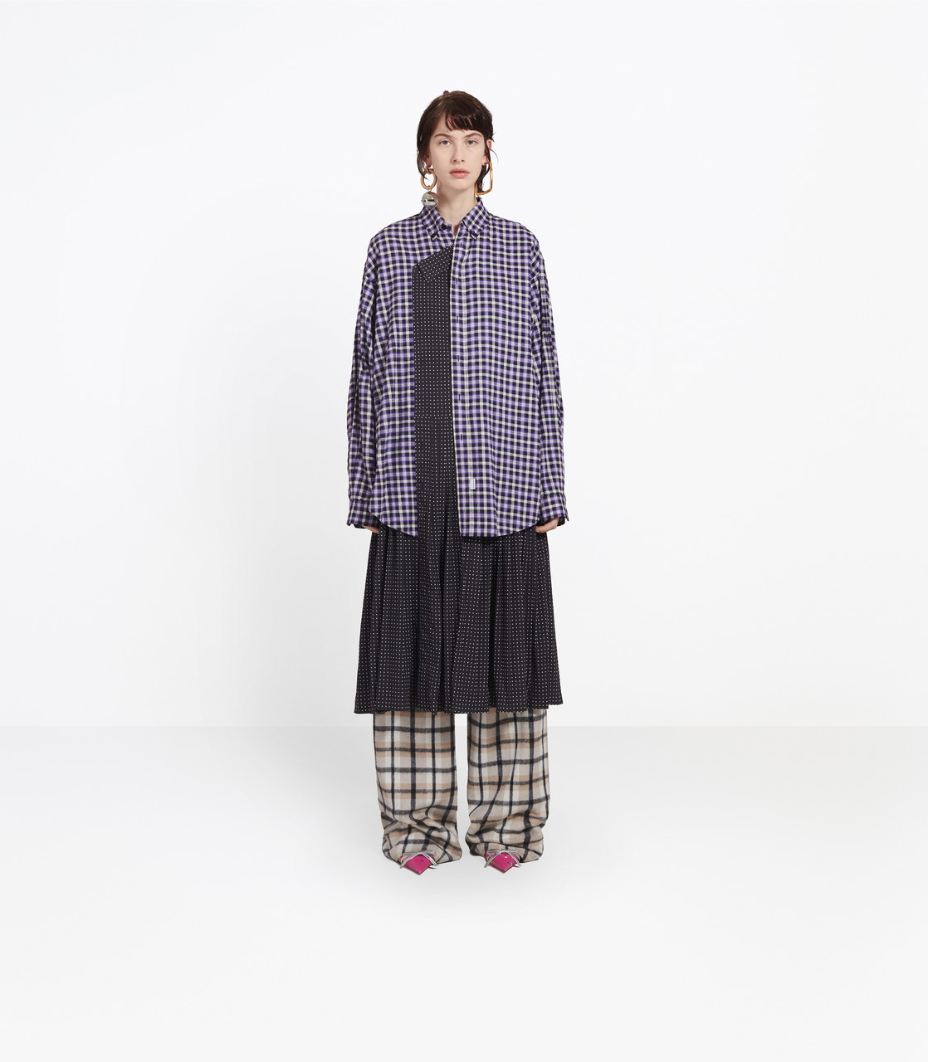
Balenciaga 19
gucci (score=0.69936)
balenciaga (score=0.30064)

