Slide 1
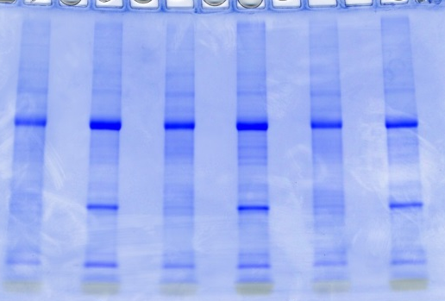
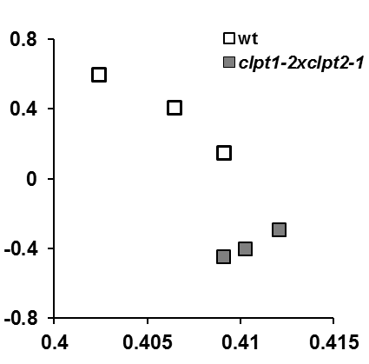
A
B
Total leaf from wild-type and clpt1-2xclpt2-1
3 biological replicates each
SDS-PAGE – 11 bands per gel lane
C
repl 1 repl 2 repl 3
t1t2 wt t1t2 wt t1t2 wt
66 LC-MS/MS LTQ-Orbitrap runs
505050 acquired MS/MS spectra
Plants in box
MASCOT search: TAIR10
(1) Post-MASCOT cleanup:
- ion score &ppm filter
(FDR peptides < 1%)
(2) Select best gene model
2357 proteins [90600 adjSPC]*
(3)Grouping by similarity matrix
2038 proteins
& 126 groups (with 322 proteins)
D
E
(4) Removed proteins with 2< adjSPC; manual group corrections
1755 proteins
& 126 groups (with 322 proteins)
PC2
Annotate for function and subcellular location
Perform statistical analyses (using protein adjSPC) to determine differentially expressed proteins
(GLEE and QSPEC software)
PC1 (97%)
Supplemental Figure Sx. Comparative proteome analysis of wt and clpt1-2xclpt2-1 seedlings grown on soil.
MS analysis and bioinformatics workflow for the. adjSPC, adjusted spectral counts. Three biological replicates per genotype were analyzed resulting in 66 MS/MS runs and searched against TAIR10.The search results were further processed to reduce false positive identifications (steps 1 and 4 ), select the best gene model for each gene (step 2) and group proteins that shared more than 80% of their MS/MS spectra to avoid over-identification of proteins belonging to protein families (step 3).
Notes:
1

