Slide 1
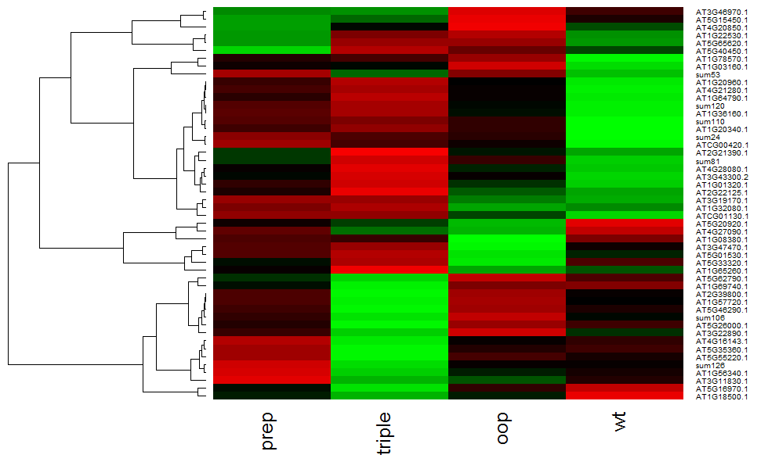
Experiment Giulia
Pair-wise significant (based on adjSPC) between one or more genotypes
(SQPEC 5% FDR AND GLEE <p<0.01)
A
1
PHS2
ClpB3
A – high in prep
B – high in wt
C – high in oop
D – high in triple
2
TPP2
OOP
3
B
4
PREP1,2
C
5
6
7
D
8
9
NadjSPC values are shown

