Slide 1


Social Photo Sharing App
Team 2 (FT)

Slide 2
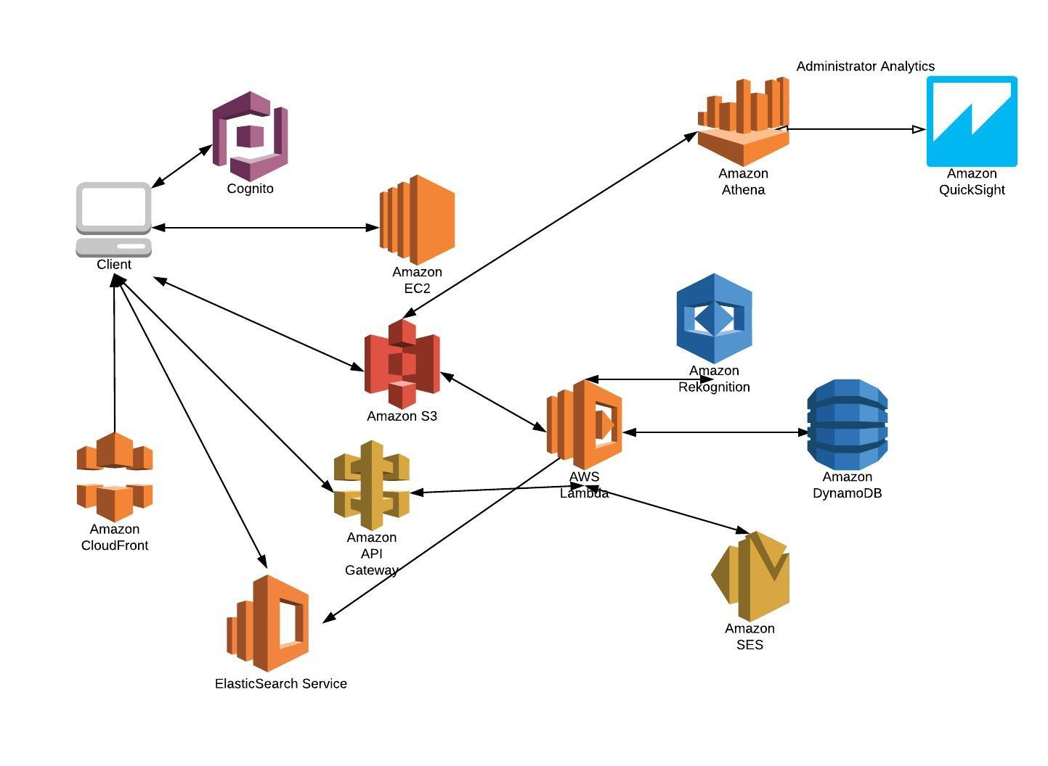
Components Used

Slide 3
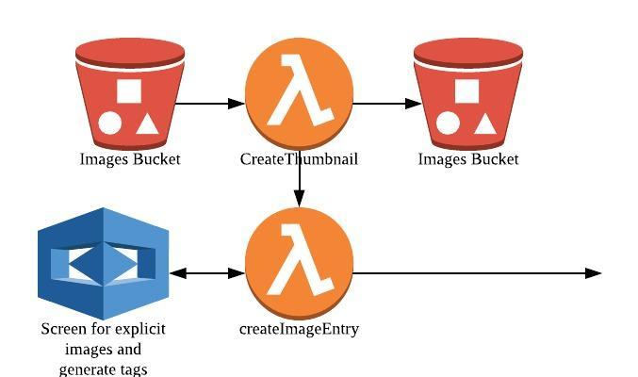
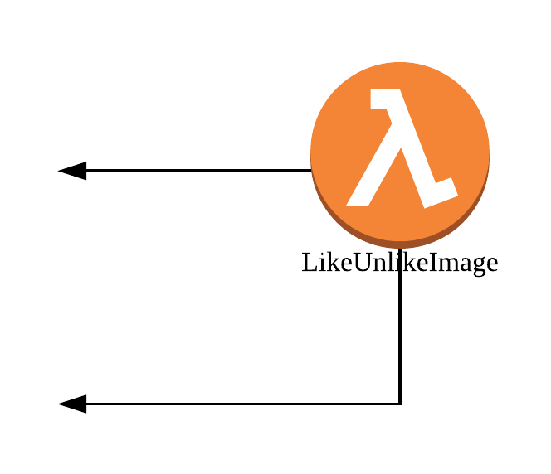
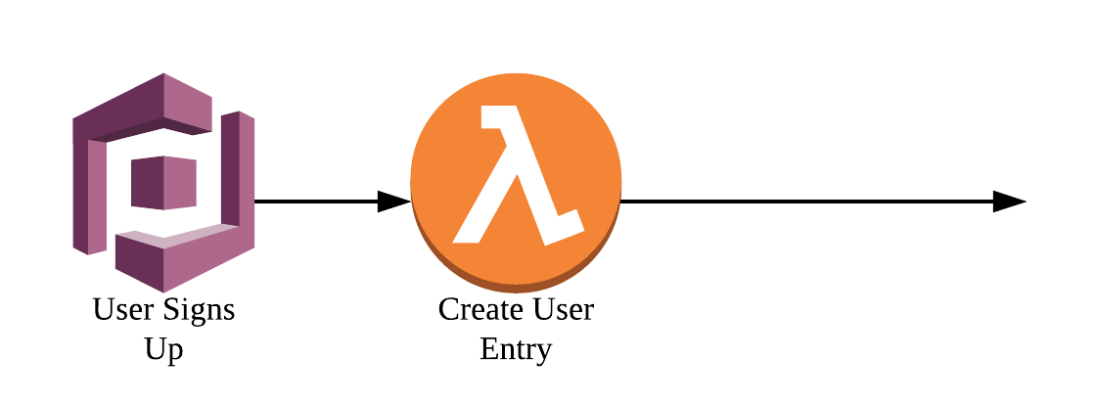
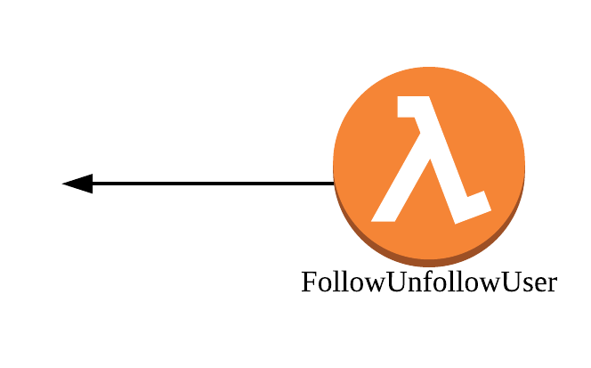
Data
image_details
Key | DataType
id | text
description | text
Tags | list
Time | ISO date time text
title | text
upload_user | text
url_main | text
url_thumb | text
unsafe_image | text
unsafe_name | text
like_by | list
users
Key | DataType
id | text
about | text
account_created_time | ISO date time text
country | text
dob | ISO date text
username | text
gender | text
uploaded_images | list
following | list
followers | list
likes | list

Slide 4






Novel Features and Scalability
AWS Lambda / EC2 Web Server
Serverless, Cloud Native Architecture
Default total concurrent executions 1000
Auto-scaling done for EC2 Web Server upon load
AWS Rekognition
Auto tagging of images with ML
Auto flagging of explicit images with ML
AWS Elastic Search Service
Full text search on tags and names
Interactive search results page
Simple Email Service
Notify users of follows
Notify moderators of explicit images
Data Pipeline
Spins up a EC2 to do daily database backup of our DynamoDB databases to S3
Cognito
User log-in, log-out, authentication
Linking user pool to federation id for authentication of API Gateway calls

Slide 5
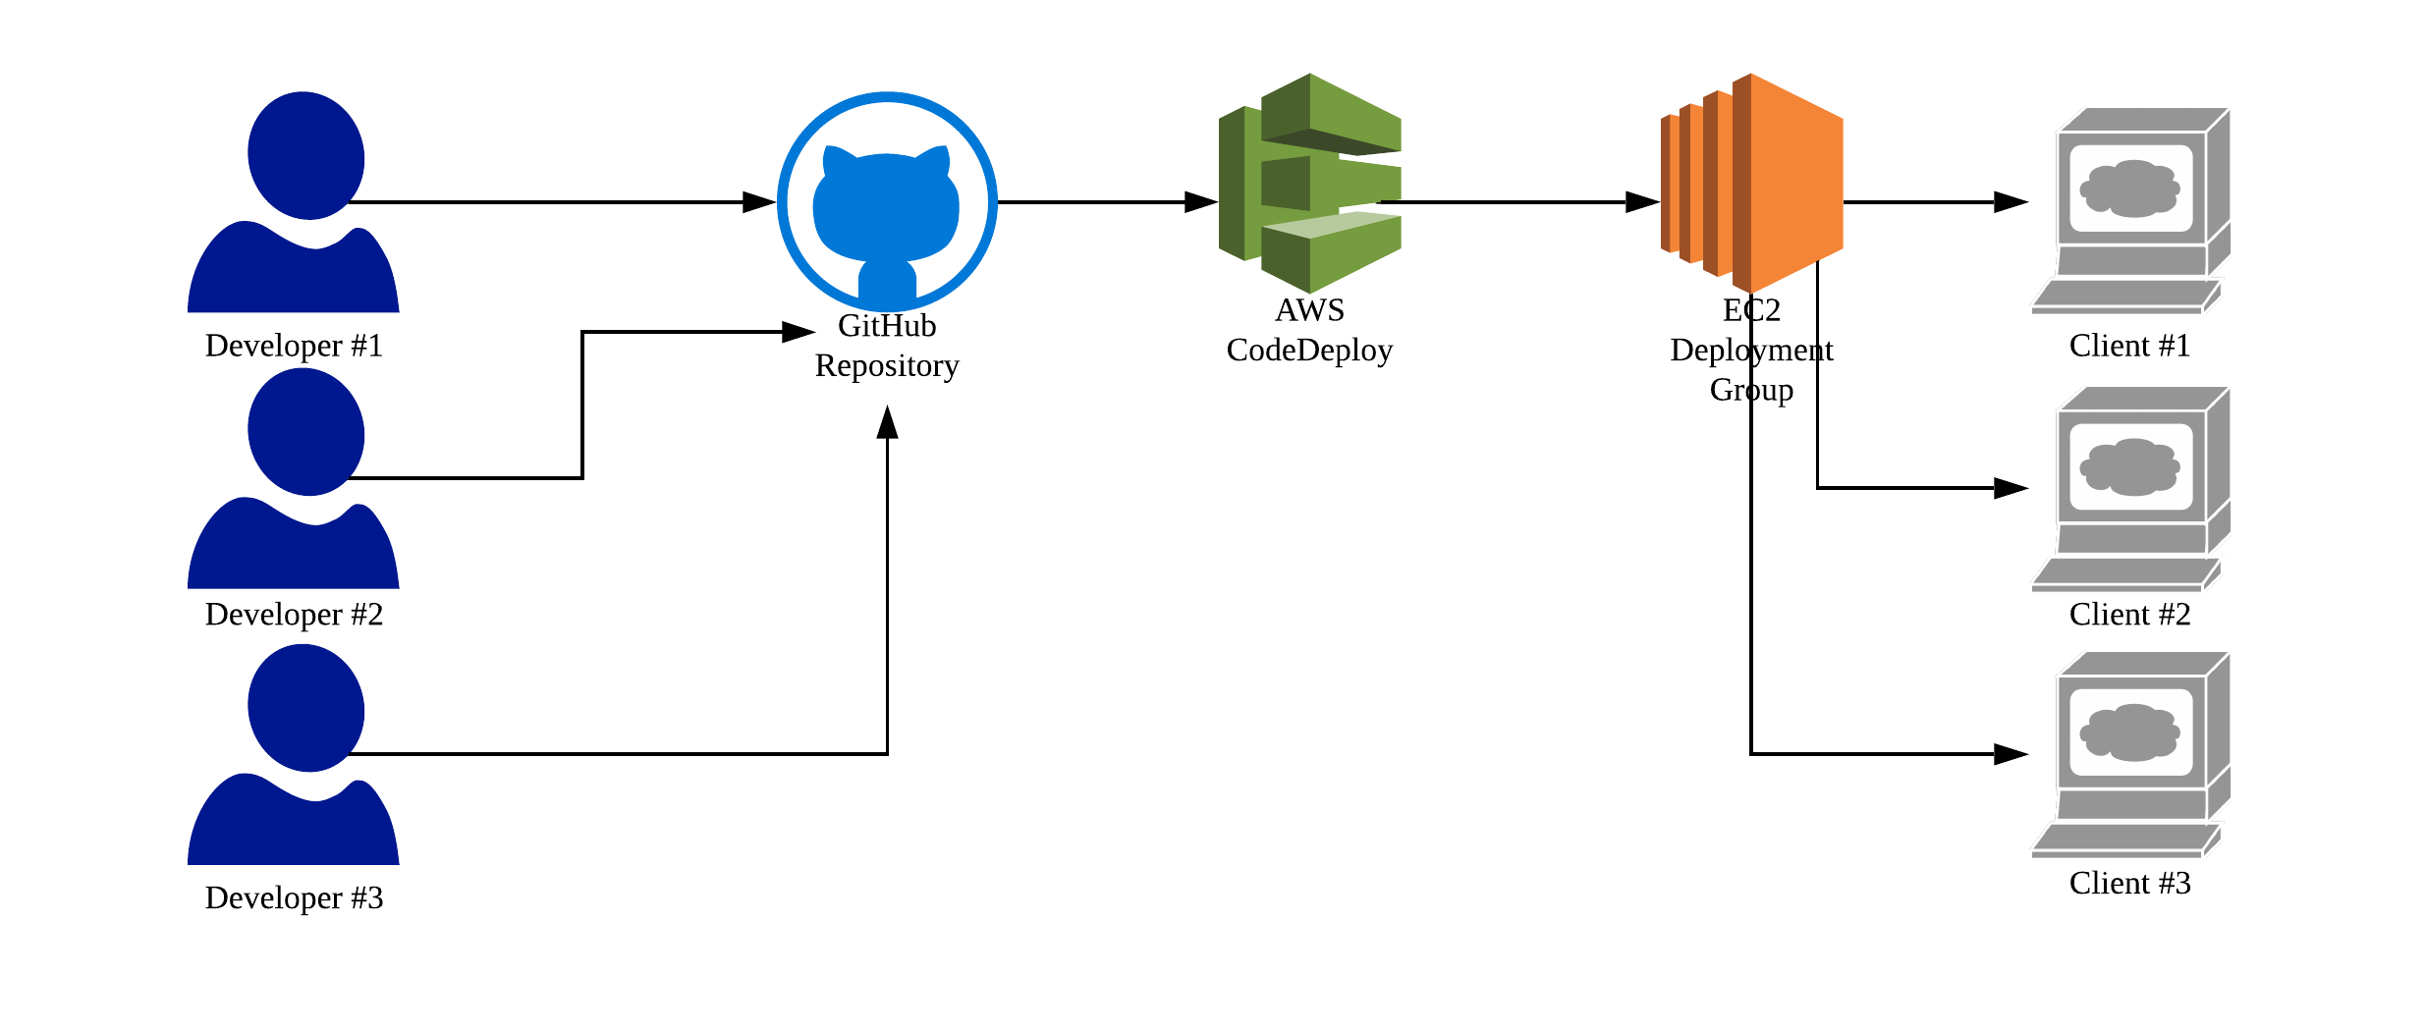
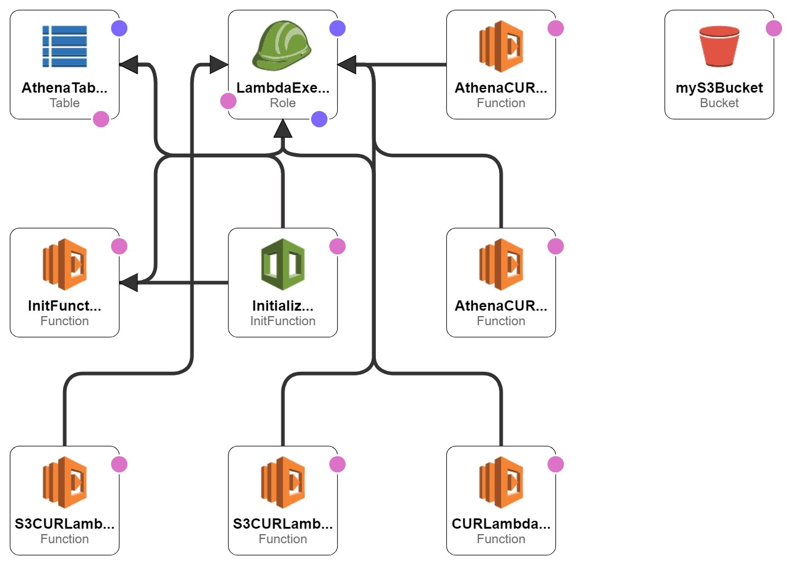
DevOps / Infrastructure as Code
Continuous Deployment
All developers push to GitHub repository
CodeDeploy takes code and pushes to EC2 web server
No down time
CloudFormation
Serverless solution to query AWS Cost and Usage report data
Infrastructure as code concept used to leverage Athena, Lambda, S3 and Quicksight

Slide 6
Cost Projection – Mean Case
Total = USD 3797.262 Per Month

Slide 7
Thank you

