Slide 1
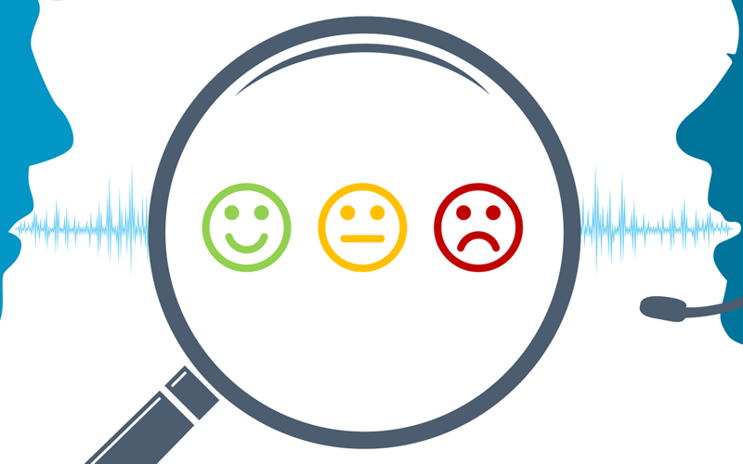
Data analytics Title : Customer Sentiment Analysis
Lingaraj Prachande

Slide 2
Customer Sentiment Analysis : Background
Your most unhappy customers are your greatest source of learning!
- Bill gates

Slide 3
Customer Sentiment Analysis : Background
Customers are always sensitive to their feelings. They can forget what you said and acted; however, they keep remembering how you make them feel
Previously in B-to-B scenario, organizations were getting the customer feedback/pulse using several mechanisms however; it was not sufficient as they were only focusing on 100s of keywords while arriving on decisions
Now, in this digital time, it is quite easy to share feelings and feedback which customers are willing to do & are doing
Understanding this 'Sentiment' from chats, reviews, surveys, shares, likes, tweets and one-to-one feedbacks & analyzing these sentiments accurately & taking proactive measured is a key to keep customers happy
Customer sentiment analysis is the process of automatically detecting emotions of customer when they interact with our products, services, people & brand which is a part of Risk Management process
Customer’s behavior, expectations keep changing that should be intuitive for us to improve our products/services
There are five steps to do ‘Customer Sentiment Analysis’:
Data Collection
Data Preparation
Sentiment Detection : Hybrid approach (Rule based & automation)
Sentiment Classification
Outcome

Slide 4

Title : Customer Sentiment Analysis
Problem Statement:
Today, we (us) are having challenges like commoditization of our traditional markets and strong competition from AWS, Microsoft etc. It is very important to understand customer sentiment to improve our products, serviceability and overall customer happiness index and sustainable business with trust and confidence in customers?
Objective of the Project:
Understanding how we can:
Meet or exceed our customer expectations
Increase customer satisfaction, loyalty, and advocacy
Generate early warnings to our teams to take proactive actions
Leading to maximize the business & profit margins of us
Benefits to the Organization:
Customer Retention
Improved products and services
Better brand & reputation
Process Improvements
Ultimately, higher business & profit margins

Slide 5

Title : Customer Sentiment Analysis
Scope of Work:
Overall scope is sentiment analysis for building recommendation engine, alert mechanism, customer segmentation & insights for Sales, marketing, and service managers / leaders to improve our products, services, processes, and customer experience. This should lead to have an ‘Early Warning System’ for continuous improvement. In Phase 1, I will restrict myself to data collection, data preparation & model building with accuracy & performance measurements (confusion matrix and precision & recall). In phase 2, will take it to the next level of insights and 'Early Warning System’. The language of the data considered would be only ‘English’.
Resources needed for the project, including people, hardware, software, etc:
Python, TextBlob, NLTK
RPA for data collection (UiPath)
Data Warehouse: MS SQL: SSIS, SSRS
Natural Language Processing (NLP) - sentiment lexicon algorithm
Machine Learning (Logistic Regression & Naive Bayes classification etc)
Custom developed alerts and notifications via email, SMS, WhatsApp messages
Power BI for visualization & insights

Slide 6
Title : Customer Sentiment Analysis
This Phase Process Flow

Slide 7
Title : Customer Sentiment Analysis

Slide 8

Title : Customer Sentiment Analysis
Data Collection:
Got a survey and review data from our marketing & insights team
Used this data as ‘Training’ & ‘Test’ data for model building
Considered ‘Twitter’ data collection in phase 1
Created Twitter Developer account
Using this account, accessing Twitter APIs
Code developed for collecting data from twitter using python
Created a job to collect twitter data w.r.t. ‘xyz’ key word
Built a batch file and tested independently
in UiPath configured the batch file & handled errors/exceptions
Running the process to ensure that the data collection is a continuous process
Now, data is getting collected in ‘.csv’ file. In future, we will move it to MS SQL DB

Slide 9

Title : Customer Sentiment Analysis
Assumptions
All numbers and special characters have been dropped
The review language would be only in English
Predicting customer review as good or bad
Using Naive Bayes Classifiers

Slide 10
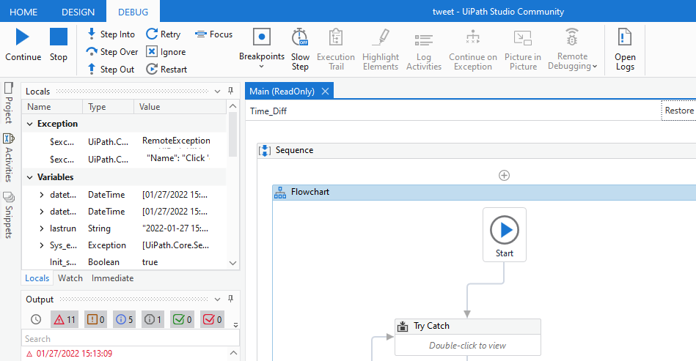
Final Updates : Scheduling Using RPA: UiPath

Slide 11
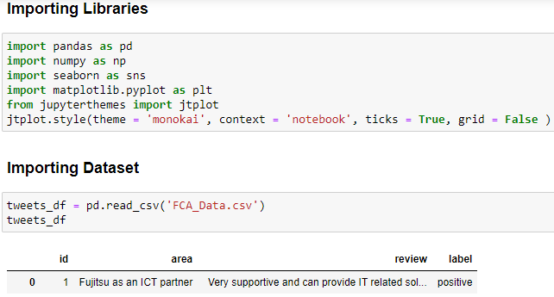
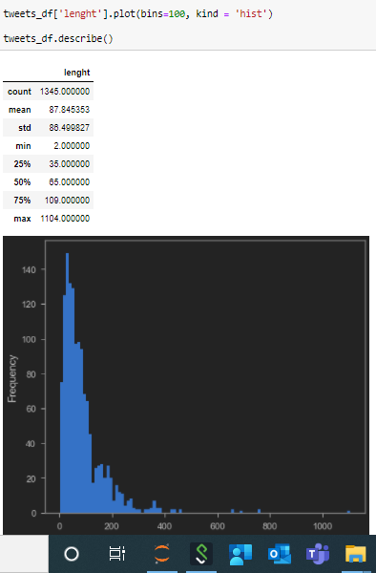
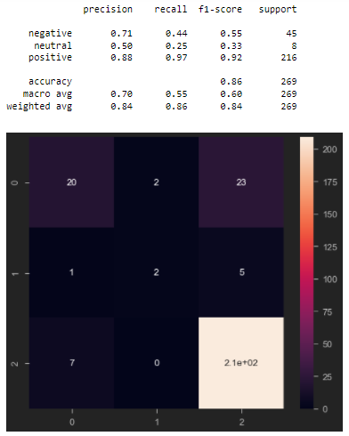
Final Updates : Model Building
Development is still in progress >>
Notes:
Accuracy = TP+TN/TP+FP+FN+TN : A ratio of correctly predicted observation to the total observations.
Precision = TP/TP+FP : A ratio of correctly predicted positive observations to the total predicted positive observations
Recall = TP/TP+FN : A ratio of correctly predicted positive observations to the all observations in actual class - yes
F1 Score = 2*(Recall * Precision) / (Recall + Precision) : The weighted average of Precision and Recall
Support is the number of actual occurrences of the class in the specified dataset. Imbalanced support in the training data may indicate structural weaknesses in the reported scores of the classifier and could indicate the need for stratified sampling or rebalancing

Slide 12
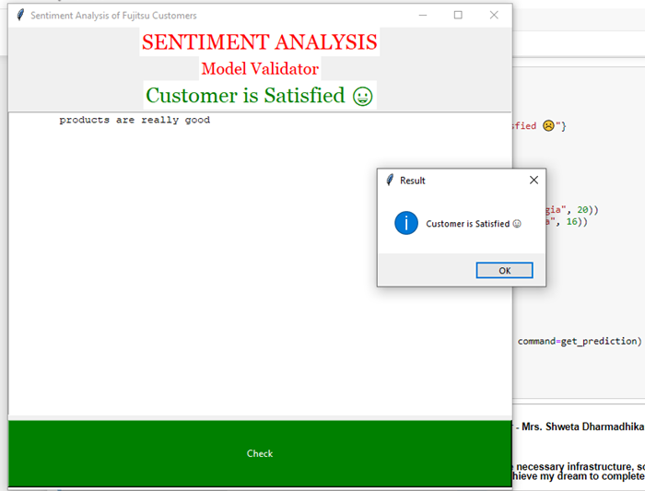
Final Updates : Model Validating
Validated the model using UI based interactions.
Predicted the right sentiment to provided statement
Notes:
Accuracy = TP+TN/TP+FP+FN+TN : A ratio of correctly predicted observation to the total observations.
Precision = TP/TP+FP : A ratio of correctly predicted positive observations to the total predicted positive observations
Recall = TP/TP+FN : A ratio of correctly predicted positive observations to the all observations in actual class - yes
F1 Score = 2*(Recall * Precision) / (Recall + Precision) : The weighted average of Precision and Recall
Support is the number of actual occurrences of the class in the specified dataset. Imbalanced support in the training data may indicate structural weaknesses in the reported scores of the classifier and could indicate the need for stratified sampling or rebalancing

Slide 13
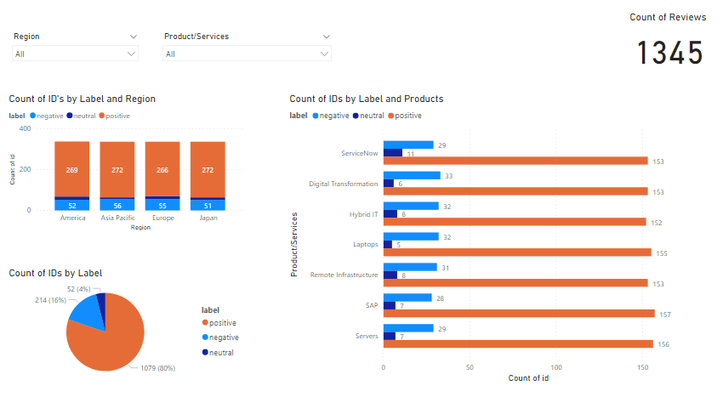
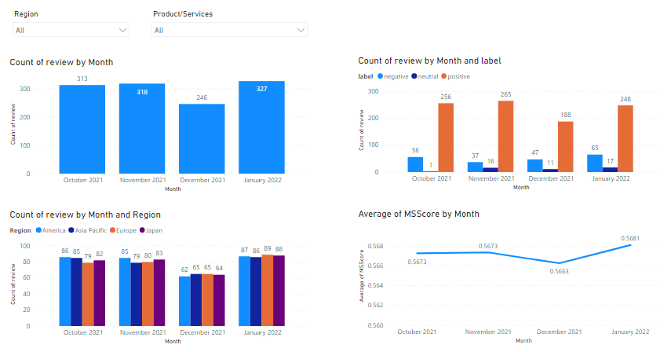
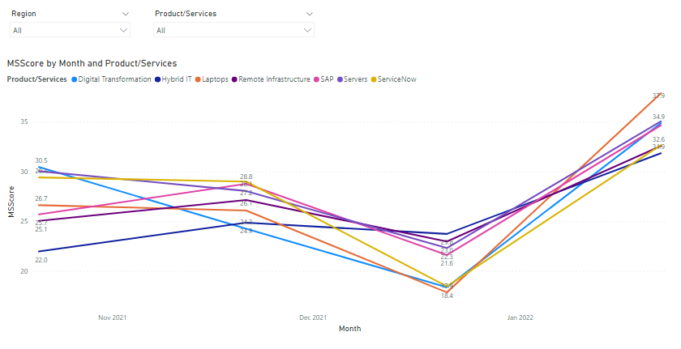
Final Updates : DATA Visualization
Notes:
Accuracy = TP+TN/TP+FP+FN+TN : A ratio of correctly predicted observation to the total observations.
Precision = TP/TP+FP : A ratio of correctly predicted positive observations to the total predicted positive observations
Recall = TP/TP+FN : A ratio of correctly predicted positive observations to the all observations in actual class - yes
F1 Score = 2*(Recall * Precision) / (Recall + Precision) : The weighted average of Precision and Recall
Support is the number of actual occurrences of the class in the specified dataset. Imbalanced support in the training data may indicate structural weaknesses in the reported scores of the classifier and could indicate the need for stratified sampling or rebalancing

Slide 14
Title : Customer Sentiment Analysis
List of Issues & Recommendations
Major Dissatisfaction Areas | Observations & Recommendations
Traditional Approach! No new ideas & innovative solutions | Observations: Overall, the quality of our products are really good! The problem is with Serviceability, Knowledge, Innovative Ideas, empathetic view of customer needs/pains & consistent behavior Recommendations : Improve delivery quality & serviceability Customer connect to understand implied needs Focus on field innovation & new gen technology adoption like Cloud, DX, Mobility, AI & ML Improve employee engagement & motivation
Poor quality & delivery of services due to gap in knowledge
Most of the things will take time to work
Technical ability to support services is weak
Too narrow view!
Lack of flexibility!
Attrition: lot of good people I knew left company
Only focus on transactions : No bird view

Slide 15

Title : Customer Sentiment Analysis

