Slide 1




TEAM ID : Data-230442
Customer Email Feedback Analysis Automation
Challenge 1
TEAM NAME: GONE PHISHERS
TEAM MEMBERS:
PRANESH L
ASHIHA M S
VAISHNAVI M

Slide 2
INTRODUCTION
This project aims to automate customer feedback email processing to streamline customer service operations. The system connects to a specified email inbox (e.g., Gmail), analyzes feedback for sentiment (positive, negative, or neutral), and extracts key details like customer name, order ID, feedback category, and sentiment score. These details are automatically inserted into a Google Form. Additionally, a summary email with the extracted information is sent to the customer service team, enabling faster responses and improving service efficiency..

Slide 3
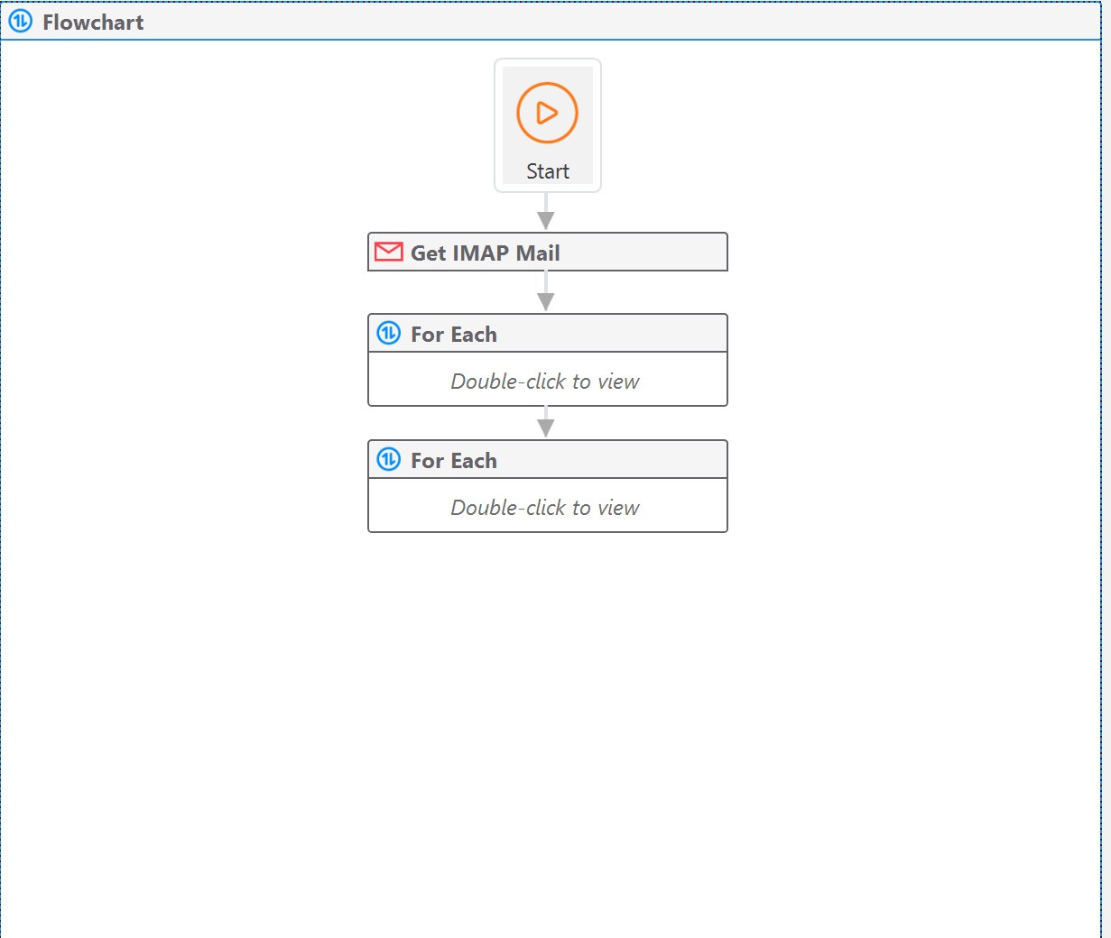

Slide 4
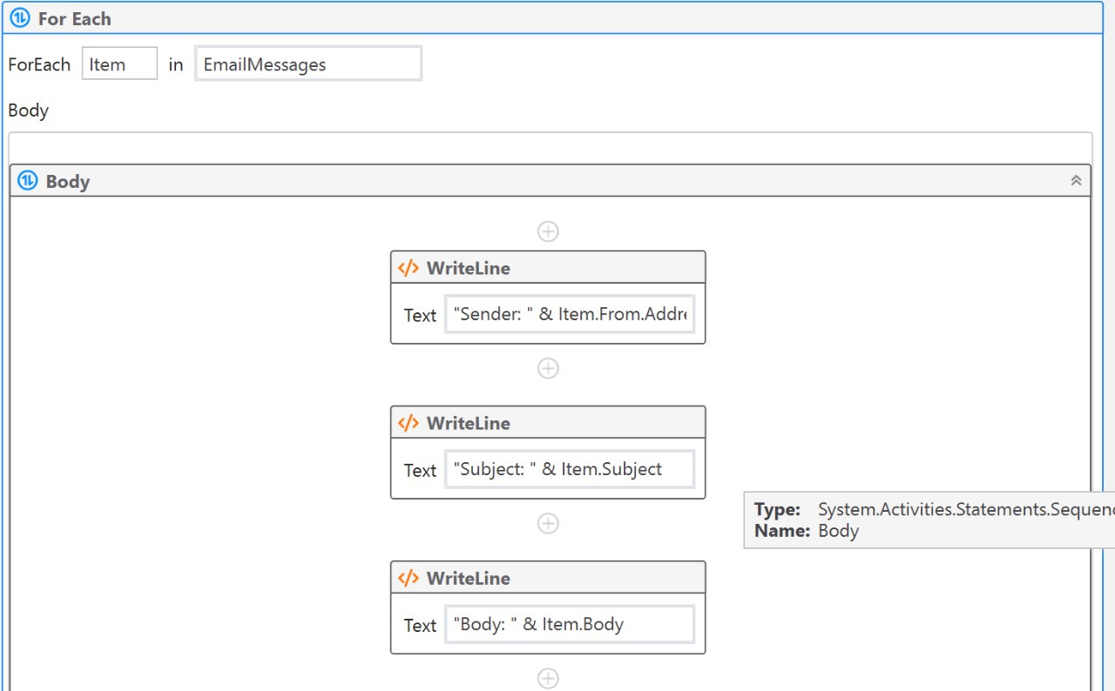

Slide 5
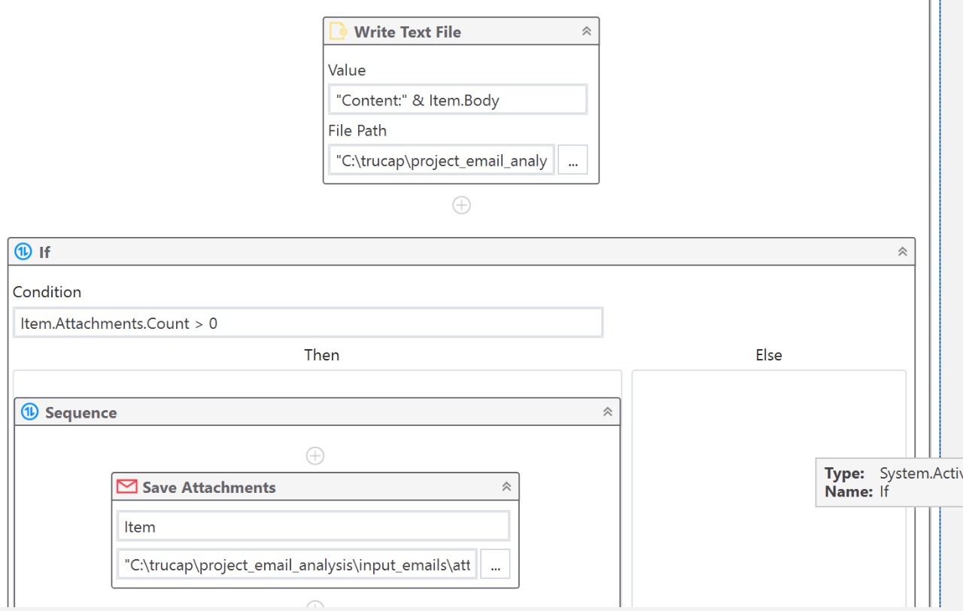

Slide 6
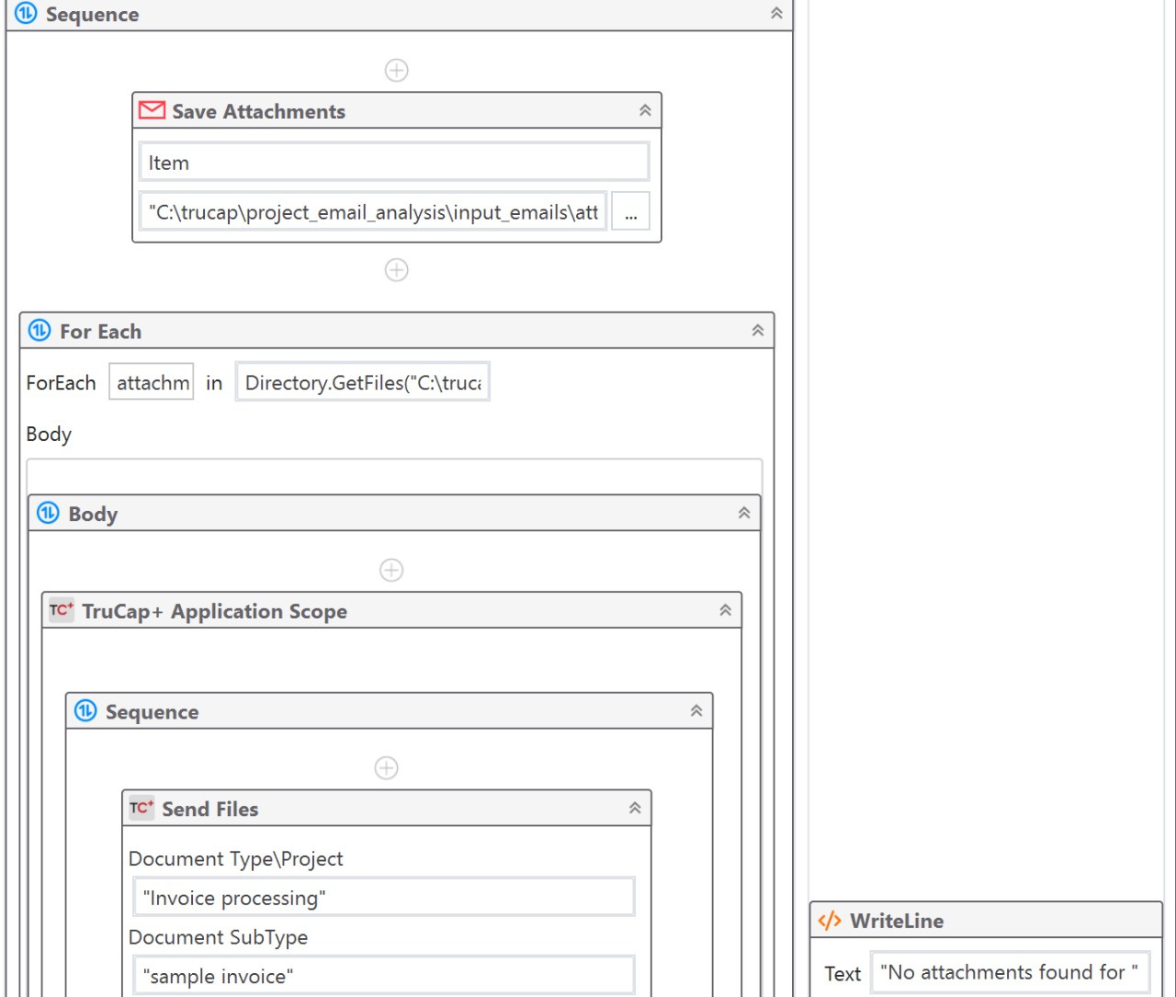

Slide 7
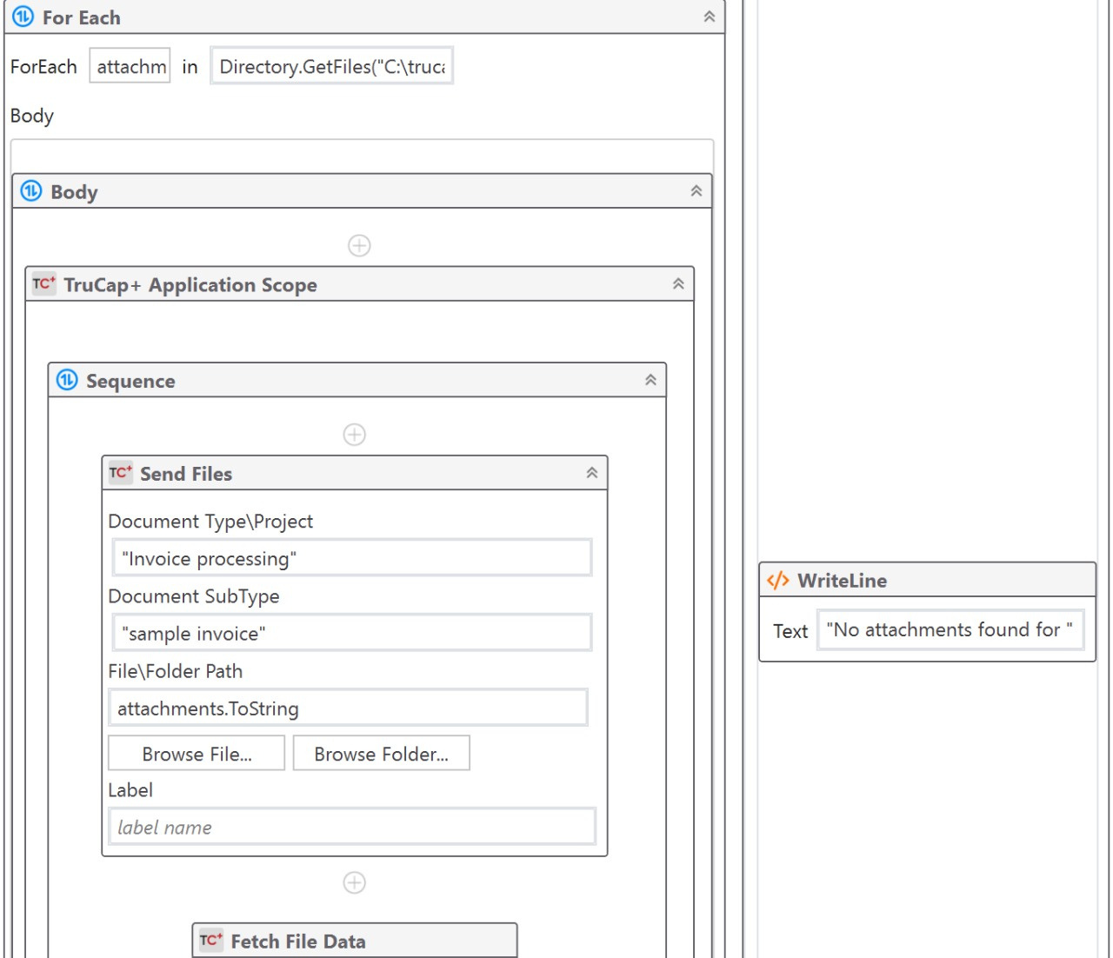

Slide 8
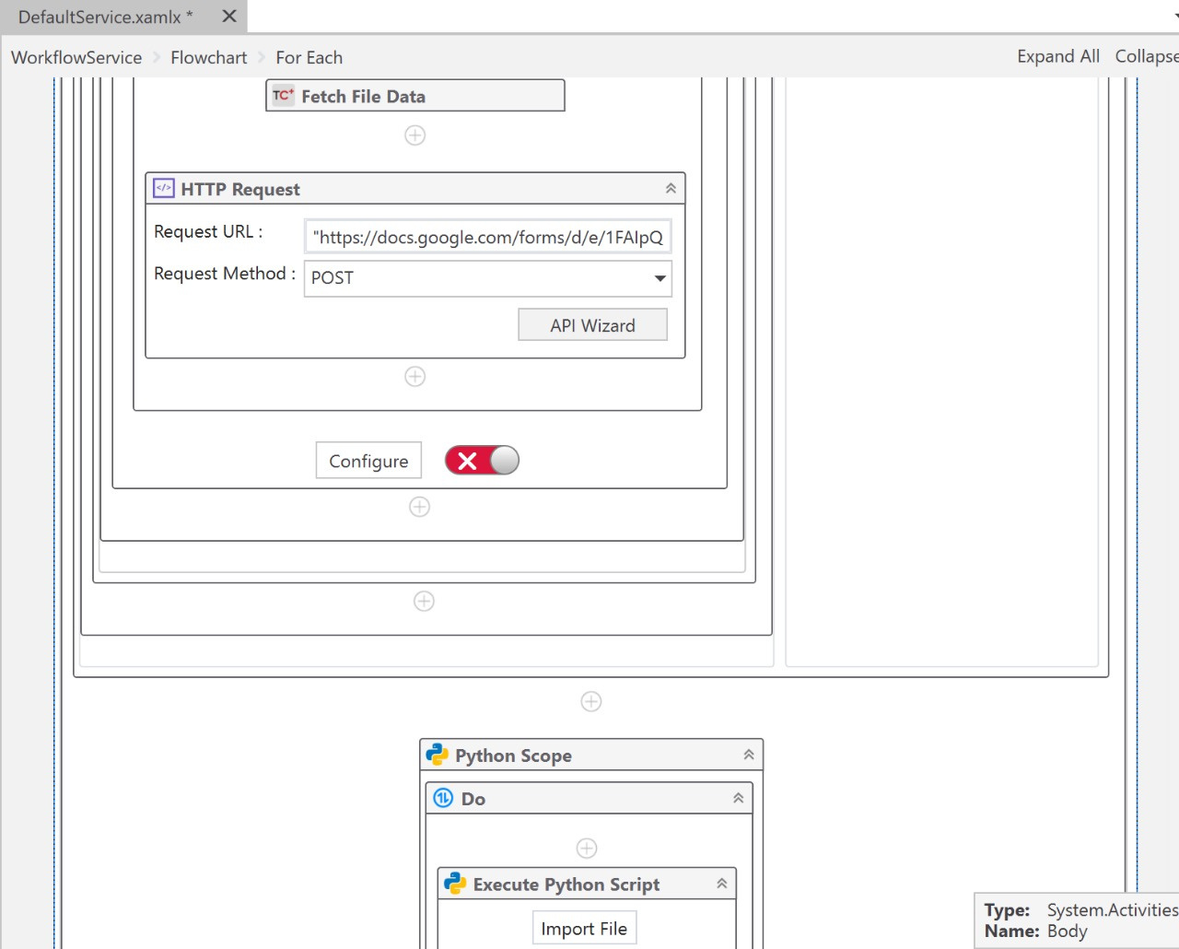

Slide 9
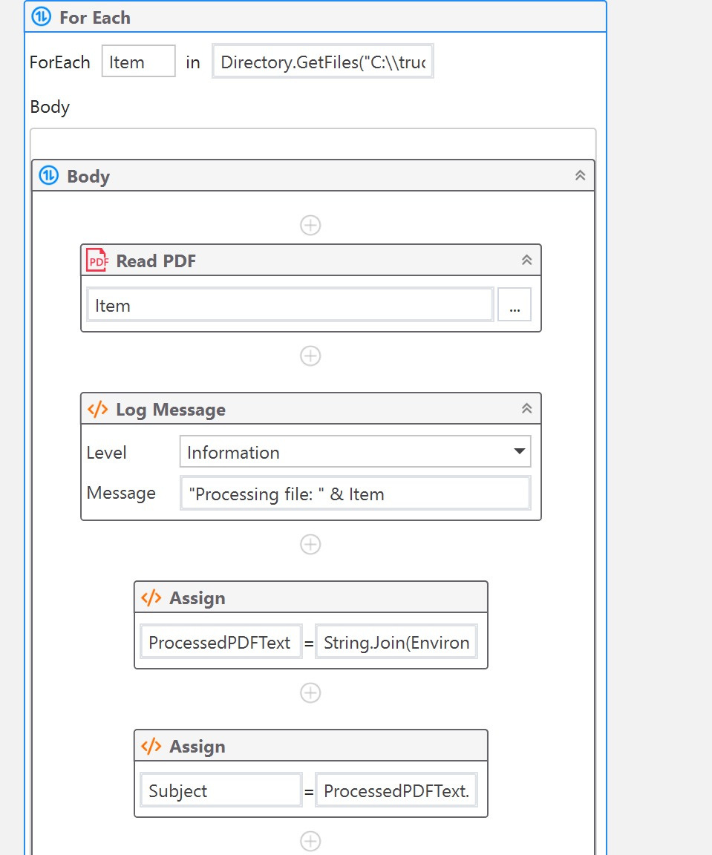

Slide 11
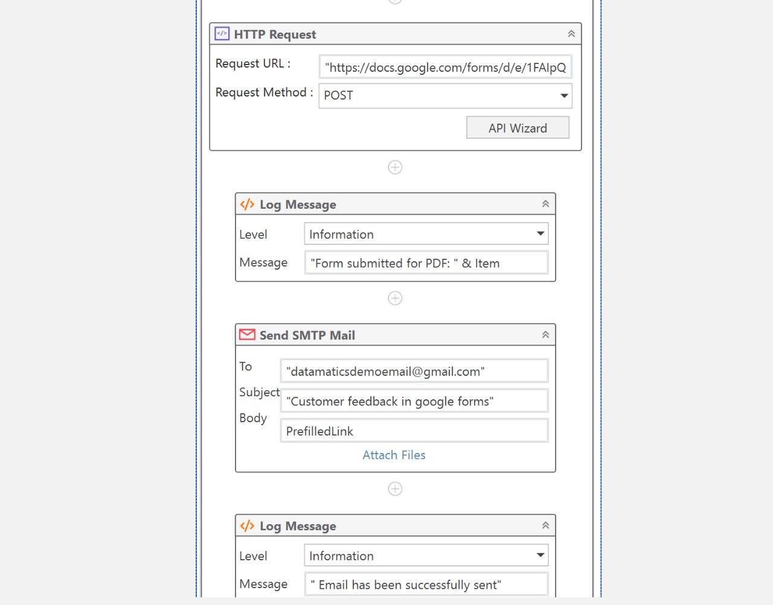

Slide 12
Future Work: Enhancements for Feedback Automation System
Future Work: Enhancements for Feedback Automation System
Automated Email Responses: Implement a system to generate context-aware responses based on the sentiment and feedback category.
Multilingual Support: Integrate a translation model to handle feedback in multiple languages, broadening global reach.
Audio Feedback Processing: Enable audio input handling by incorporating speech-to-text conversion, allowing diverse feedback formats.

Slide 13
Thank
You

