Slide 1

The Fluency
Suite
&
English Learners

Slide 2
The Fluency Suite & English Learners
Fluency is the ability to read a text accurately, quickly, and with expression. Fluency is important because it provides a bridge between word recognition and comprehension.
When fluent readers read silently, they recognize words automatically. They group words quickly to help them gain meaning from what they read.

Slide 3
The Fluency Suite & English Learners
Instruction in fluency can be particularly beneficial for English language learners because activities designed to enhance fluency in reading can also contribute to oral language development in English.
As students practice reading English text accurately, automatically, and prosodically, they are gaining valuable information about the sounds and cadences of spoken English, and they are also developing vocabulary skills that can contribute to oral language fluency, as well as reading and listening comprehension.

Slide 4
The Fluency Suite & English Learners
Even though fluency instruction is important, teachers must remember that many ELLs can be deceptively fast and accurate while reading in English without fully comprehending the meaning of the text they are reading. That is because reading comprehension depends upon a variety of complex skills that are not as important to word reading.
These include deep vocabulary knowledge, syntactical knowledge, and background knowledge of the subject discussed in the text. For this reason, it is always important to pair fluency instruction with good instruction in comprehension.

Slide 5
The Fluency Suite
The Learning Priority Fluency suites provides the reader and teacher with simple authentic tasks to measure fluency, accuracy, prosody, and basic comprehension.
It also allows students tools to self-assess, or peer-assess as well as do immediate feedback word work that is so critical to developing higher level understanding of the content in texts.

Slide 6
The Fluency Suite
Students enjoy the privacy of their fluency suite work as well as the immediate auditory and visual feedback they get when they listen to themselves reading.
The design of the process makes sense to them universally and offers them simple steps to better fluency which leads to opportunities for greater meaning making.

Slide 7
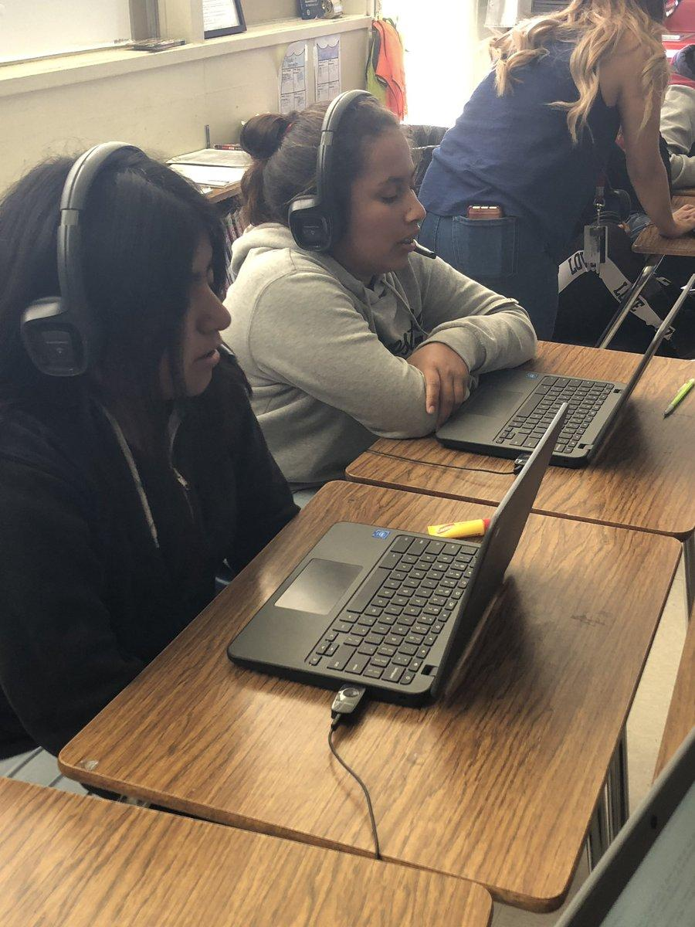
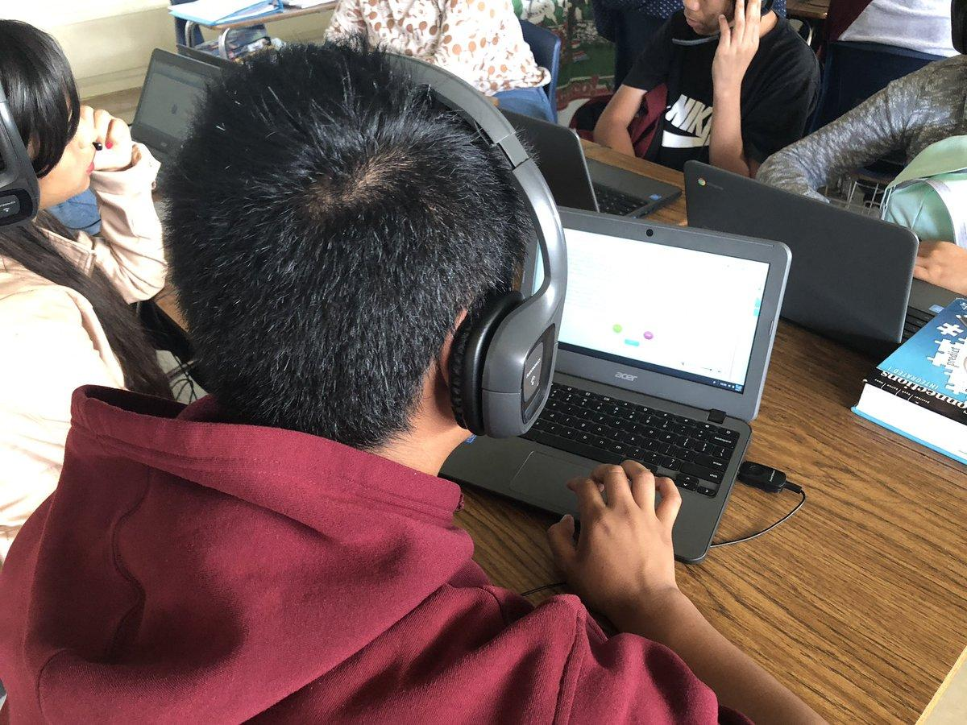
Learning priority designs leverage software to save teacher time so they can spend their time on teaching.

Slide 8
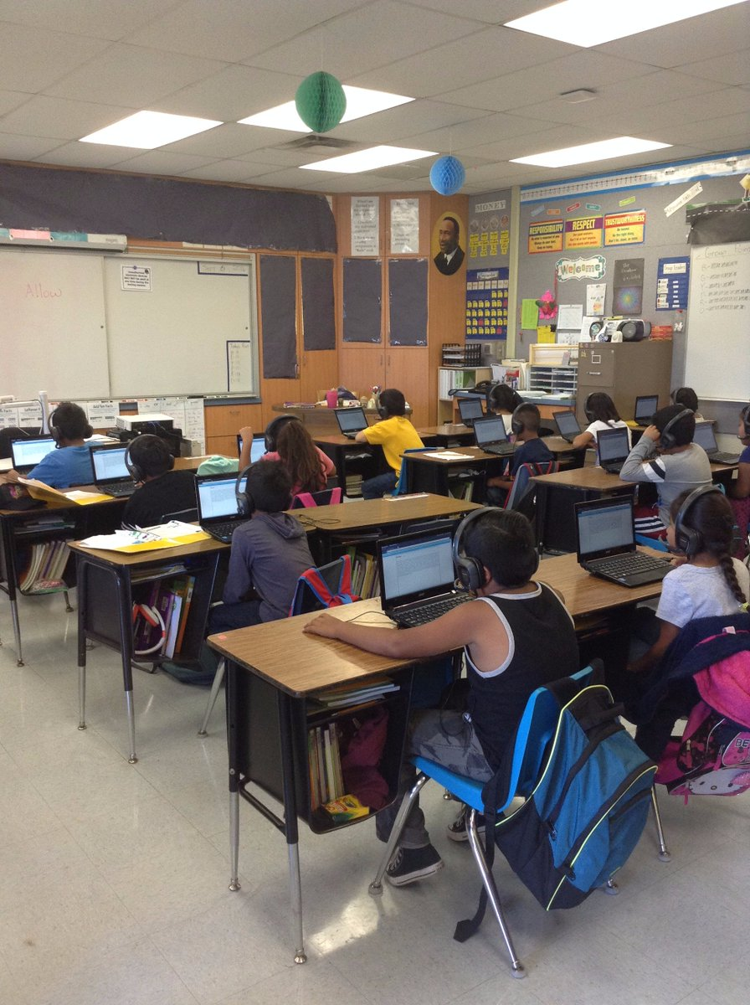
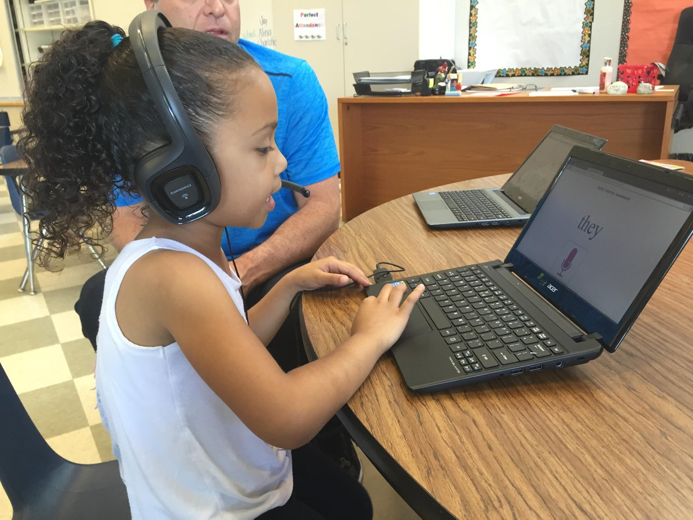
Students of every age and at every level engage with visual text and their own auditory production to make meaning of texts at multiple levels

Slide 9
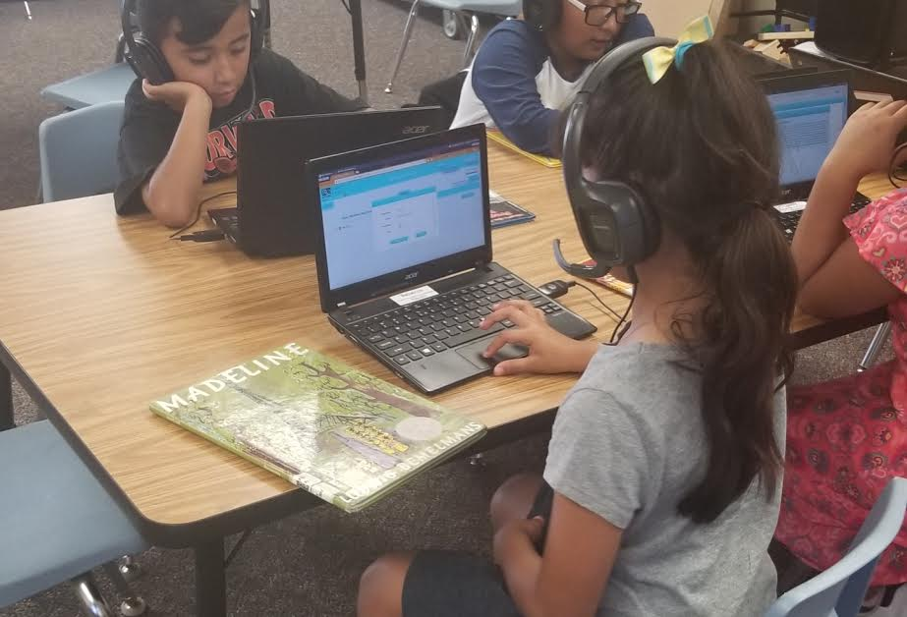
The Reading Register is LP’s newest entry into the Reading Realm.
It brings 21st century thinking to independent reading programs by offering readers choice, meaning making and connections to others through their own creative productions following reading.

Slide 10
Learning Priority makes learning the priority.
LP designs software that works at the intersections of learner, teacher, parent, and peers.
Learning Priority never forgets that learning is socially constructed.

