Slide 1
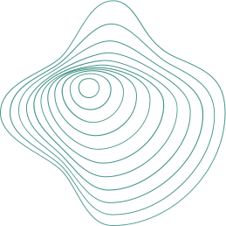

Water Quality
IoT-Based pH Level Monitoring Device
Priya Lama | L5 CS &DF

Slide 2

Contents
Introduction
Data Acquisition
Data Transmission
Data Processing and Management
Data Analysis and Visualization

Slide 3
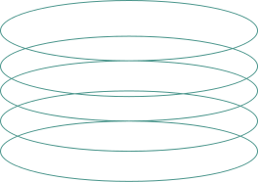
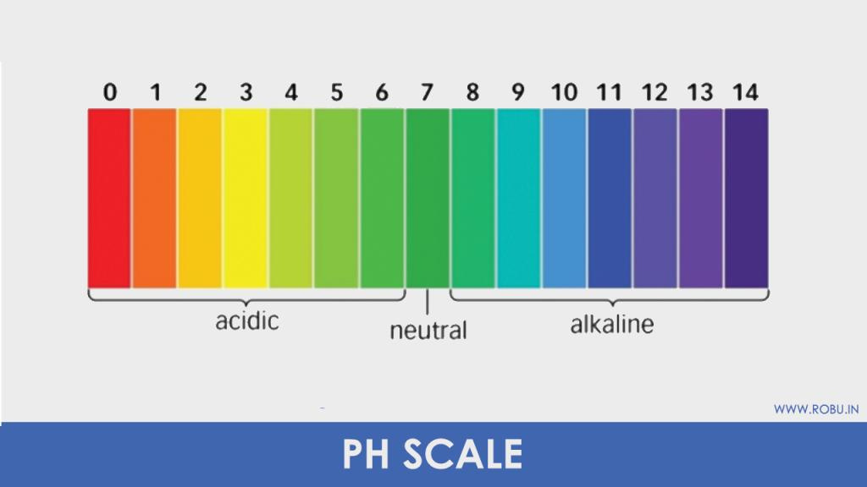
Introduction.
pH Scale
Source: robu.in

Slide 4
Introduction.
Water with unbalanced pH level can cause various types of dieseases.
Recommends ph level for drinking water from 6.5 to 8.5 by the World Health Organization (WHO).

Slide 5
Introduction.
Key components we are going to use in this project are pH Sensor 4502c, Arduino Uno, LCD 16x2,

Slide 6
Data Acquisition.
Conversion of physical parameters to electrical signals
pH measurement on a logarithmic scale (0-14)
Sensor compatibility with Arduino and 5V power supply

Slide 7
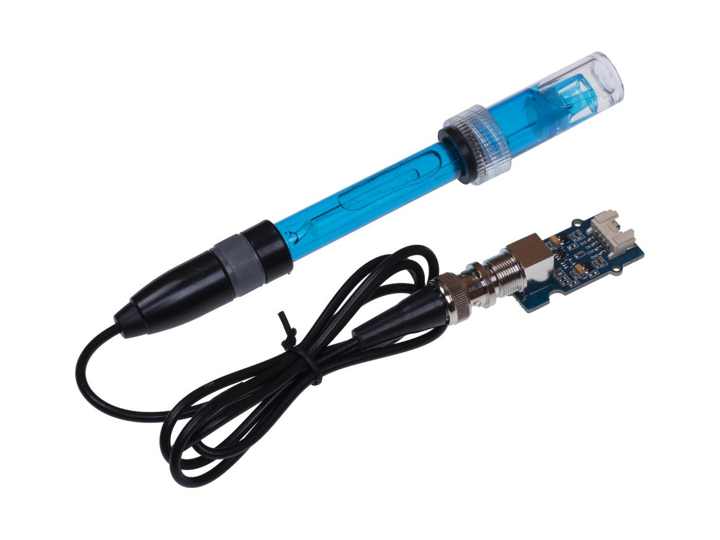
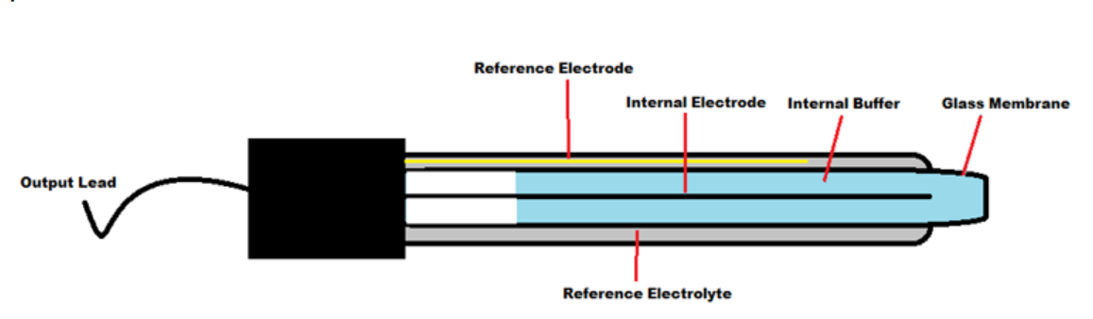
Data Acquisition.
pH sensor
Source: 176iot

Slide 8
Data Acquisition.
Voltage generated corresponds to the concentration of hydrogen ions.
Formation of a gel layer around the glass body occurs upon contact with the liquid.
pH values are measured on a logarithmic scale, with 7 representing a neutral state.

Slide 9
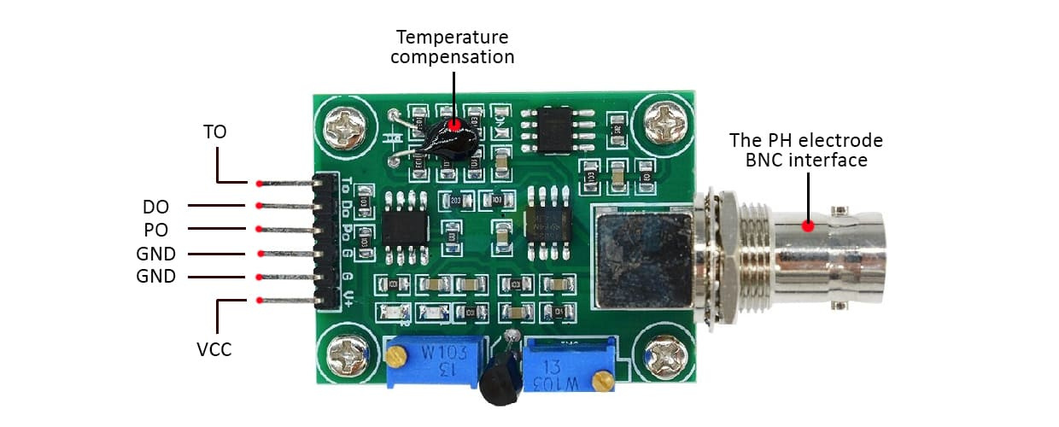
Data Acquisition.
pH sensor
Source: Hamiltonr

Slide 10
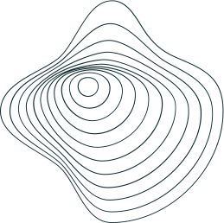
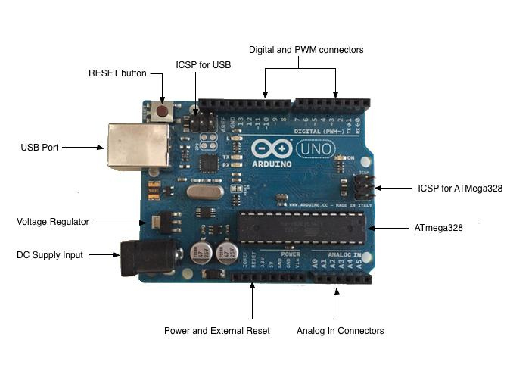
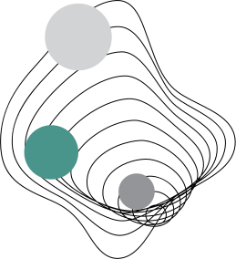
Data Transmission
Source: 176IoT

Slide 11
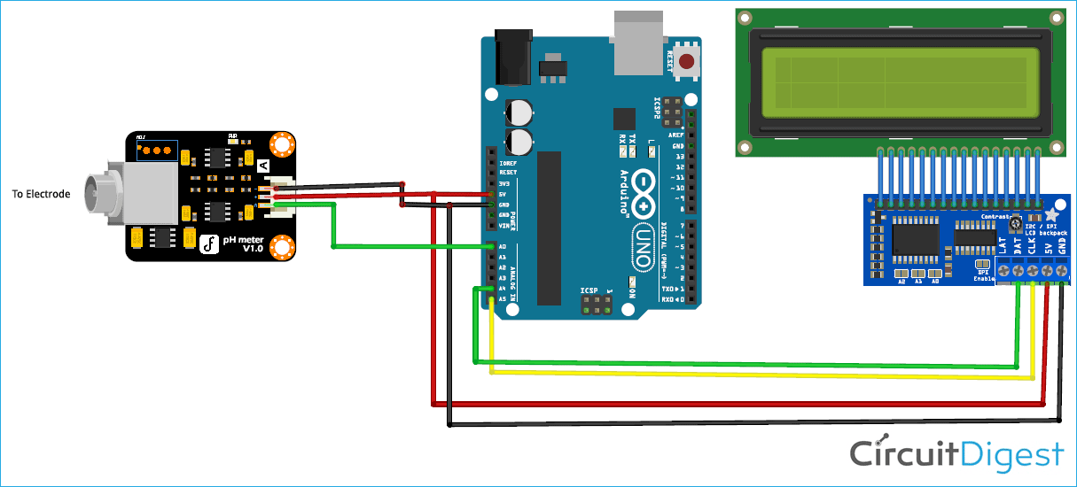
Data Transmission
pH meter Interfacing Arduino and pH Sensor Circuit Diagram
Source: CircuitDigest

Slide 12
Data Transmission
It is equipped with analog to digital converter (ADC).
Arduino occupies the function “analogread()” and reads the signals from the pH sensor continuously.
Source: CircuitDigest

Slide 13
Data Processing and Managment
pH sensor 4502C is an analog sensor, Minimal Internal data processing in the sensor.
The processing has to be handled by external microcontroller, such as ATmega328, which can be found on Arduino Uno board.

Slide 14
Data Processing and Managment
Analog-to-Digital converter (ADC) which is stored in ATmega328, ADC is often referred to as 10-bit ADC. It converts analog signals to digital values ranging from 0 to 1023.
ATmega328 Microcontroller executes program with Arduino IDE which is how Arduino interacts with pH sensor and gives an output.

Slide 15

Data Analysis and Visualization
The LCD screen is connected to the Arduino Uno using specific pins. These connections can be facilitated using the library like LiquidCrystal for Arduino and it continues to update the real-time pH changes to the LCD.
This is a simple project so it does not store any previous data measured by pH sensor, so it needs external applications to store data and to visualize more results.

Slide 16
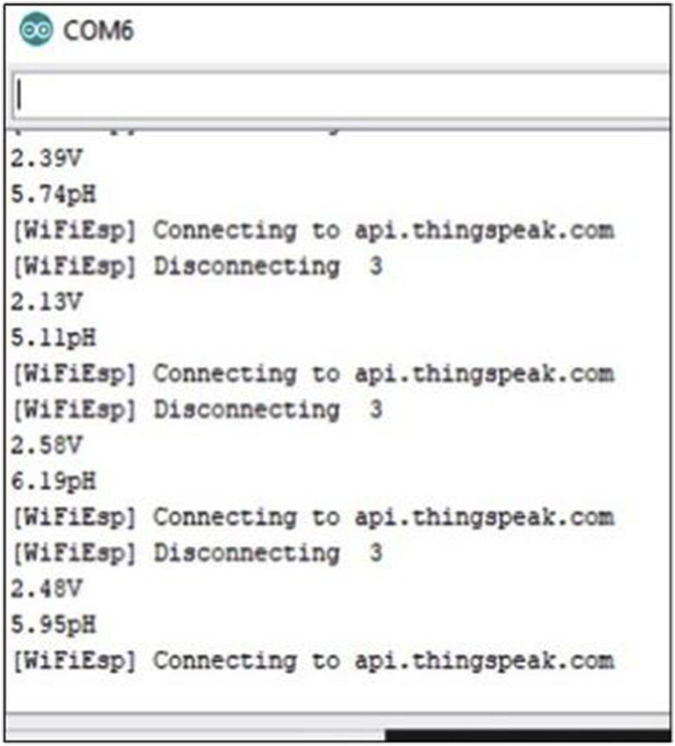
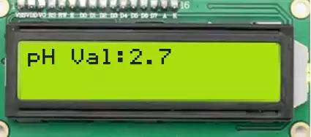
Data Analysis and Visualization
Source: CircuitSchool

Slide 17
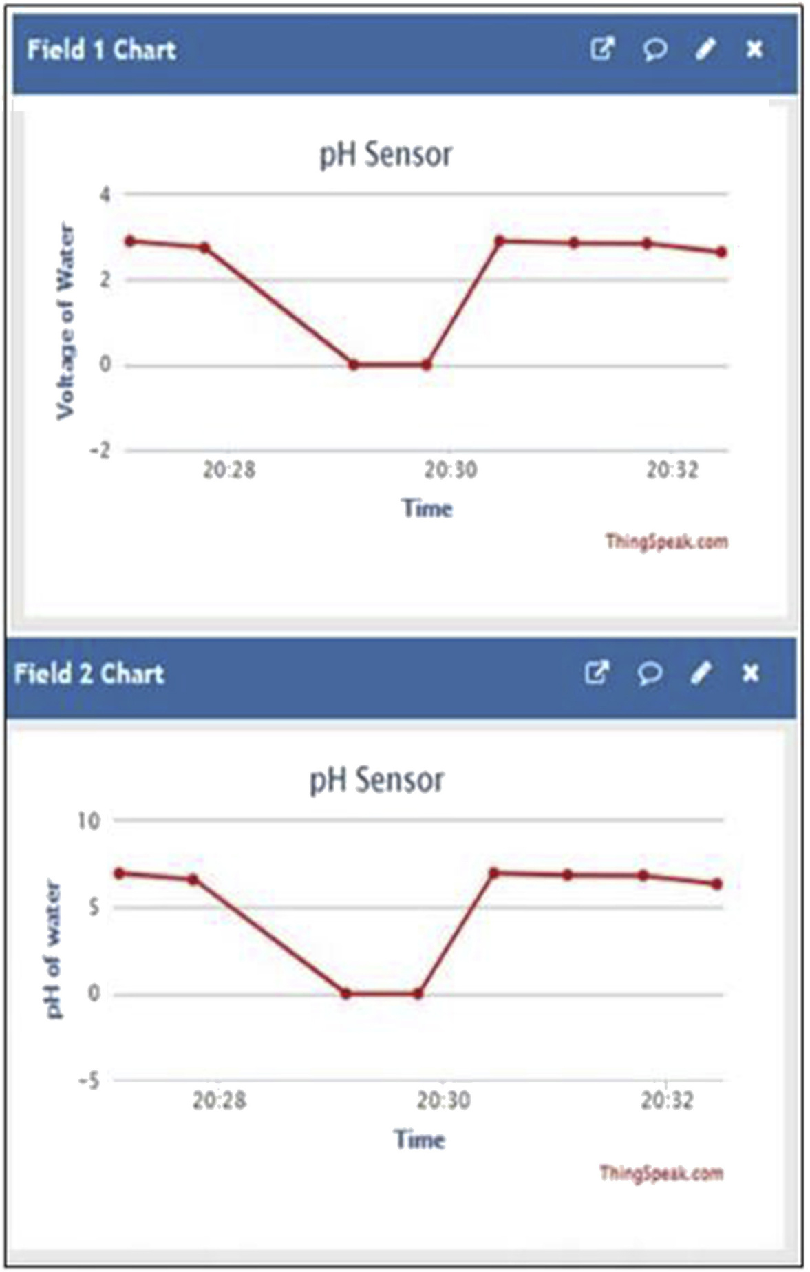
Data Analysis and Visualization
Source: ScienceDirect

Slide 18
Data Analysis and Visualization
Source: ScienceDirect

Slide 19
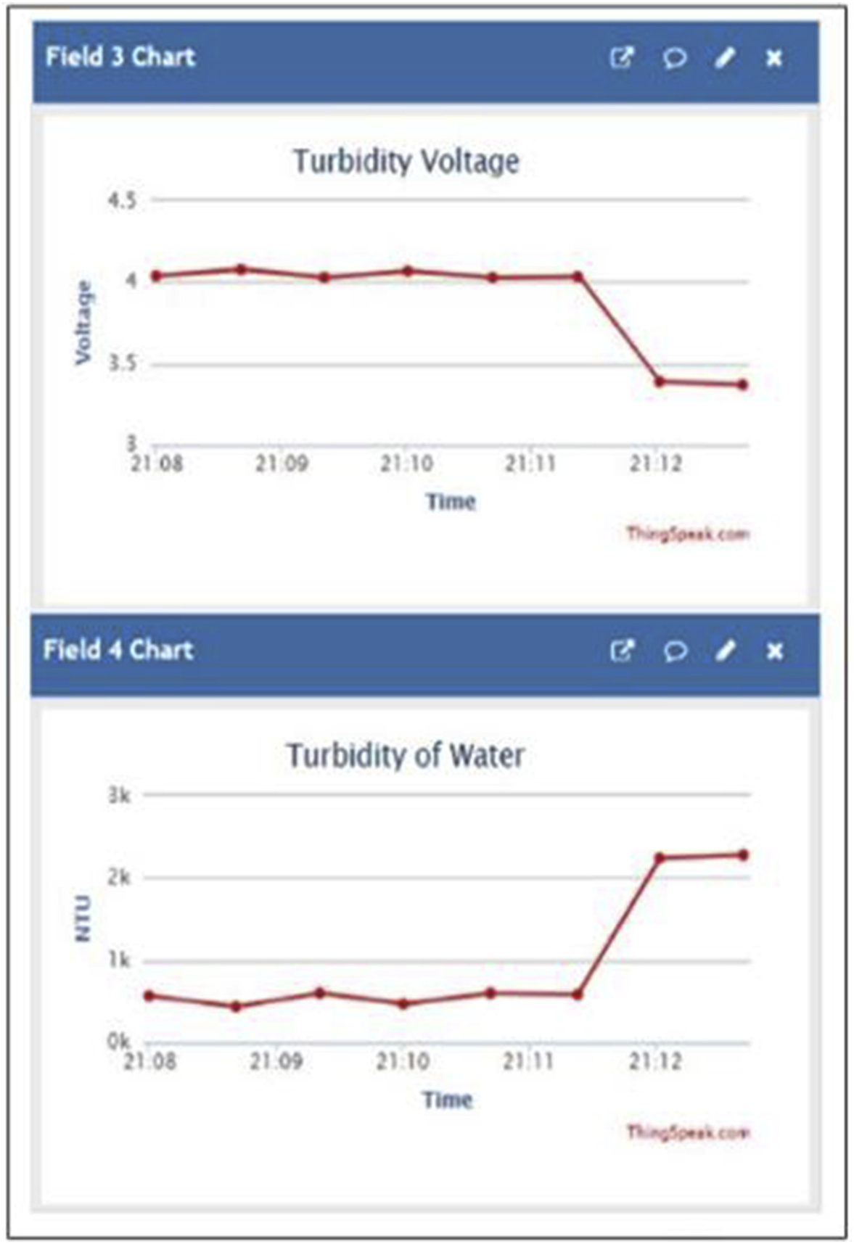
Data Analysis and Visualization
In future we can also upgrade the project and use many more sensors such as turbidity sensor, temperature sensor and water flow sensor to the test the quality of liquid.
Source: ScienceDirect

Slide 20

Thank You

