Slide 1
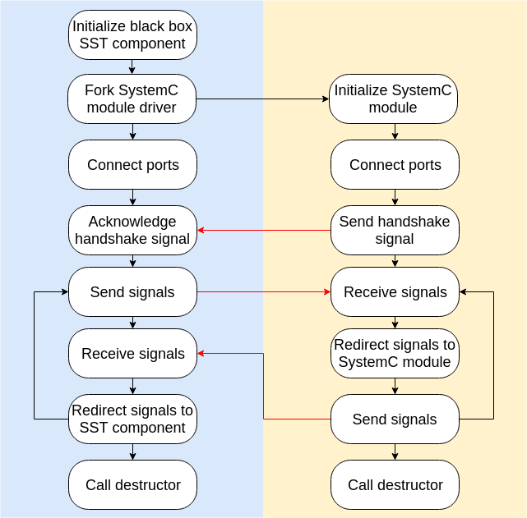
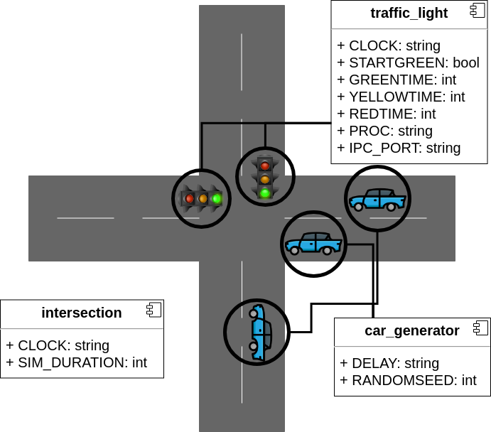
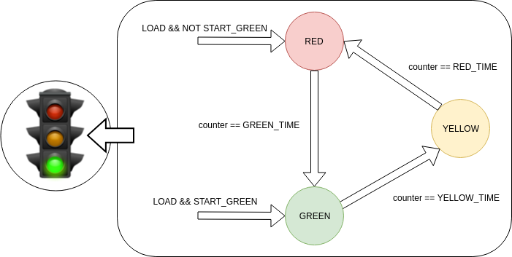
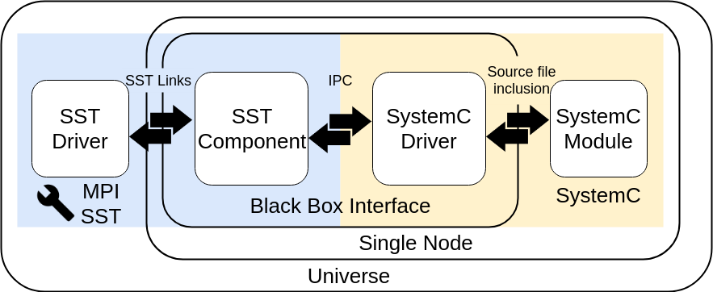
Creating Heterogeneous Simulations with SST and SystemC
Sabbir Ahmed
Booz Allen Hamilton
Background
Communication
Demonstration of Concept
Implementing new computer system designs involves careful study of both programming models and hardware design and organization, a process that frequently introduces distinct challenges. Hardware and software definitions are often simulated to undertake these difficulties.
These complex simulations typically require both custom and off-the-shelf logic functionality in ASICs or FPGAs. High-level commercial tools simulate and model these components in their native environments. On the other end, developers create the register transfer level (RTL) models representing the systems to simulate them with computer-aided design (CAD) tools and test benches. These duplicative strategies require a method that simulates the entire system in one heterogeneous model.
Structural Simulation Toolkit (SST), a parallel event-based simulation framework, is one such toolkit. It allows custom and vendor models to be interconnected to create a system simulation. However, must be able to support models implemented in various frameworks and languages.
SystemC is a popular hardware-level modeling language composed of C++ classes and macros.
The communication
A simple traffic intersection controlled by two traffic lights has been modeled. A flow of traffic is simulated through a road only when its traffic light generates a green or yellow light with the other generating a red light. The number of cars in a traffic flow is represented by random number generators.
SST Components
car_generator: a random binary number generator
traffic_light: generates the light colors of the traffic lights using a simple finite state machine (FSM)
intersection: main driver of the simulation
Objective
Establishing interoperability with SystemC would allow SST to interface numerous existing synthesizable hardware libraries.
Figure 2: Data Flow Diagram
Figure 3: Two-Road Intersection Represented by SST
Design Approach
Black Box Components
SystemC Drivers
Header-only modular implementation
Separate compilation of the frameworks
Boilerplate driver files
Communication interface concealed in black boxes
The black box components are spawned in the same node and therefore utilize interprocess communication. The transport data is represented in a standard vector of strings with predetermined indices and serialized with MessagePack methods.
The following is a list of supported IPC protocols:
Unix domain sockets
ZeroMQ
It is possible to integrate additional IPC protocols to the interface, such as named pipes and shared memory.
traffic_light_fsm: a clock driven FSM representing the colors of a traffic light
SST-Black Box
An SST component can interface the black box via standard SST links. The data is received as an SST-StringEvent object which is casted to a standard string.
Figure 4: Traffic Light Finite State Machine
Figure 1: Black Box Interface
SystemC-Black Box
Conclusion
This strategy allows the SST component to connect with the SystemC process via SST links as if it were a component itself.
Each SystemC modules must have their corresponding driver file to interoperate within the black box interface.
A SystemC module can be interfaced by a standard source file inclusion. The driver does require the overridden entry point, sc_main, to instantiate the module and set up the communication configurations.
The modular implementation of the black box interface allowed for sufficient flexibility in establishing communication between the different systems. This design can, therefore, be configured to interoperate SST with various model simulation frameworks and even hardware to achieve further heterogeneity.

