Slide 1
Computação Gráfica
Aula 21: Ray Marching

Slide 2
http://bentonian.com/Lectures/FGraphics1819/1.%20Ray%20Marching%20and%20Signed%20Distance%20Fields.pdf

Slide 3
Raios
A estratégia de muitos algoritmos (estilo Ray Tracing) é lançar um raio e verificar se ele colidiu em algum objeto.
O raio tem uma origem e um destino.

Slide 4
Origem e Direção
Tanto a origem como a direção do vetor podem ser representados como um vec3 (ou vec2 se for em 2D).
Idealmente trabalhamos com vetores normalizados, ou seja, de magnitude 1.
vec3 origin = vec2(1.0, 2.1, 1.5);
vec3 direction = vec2(3.0, 2.0, 4.0);
vec3 direction = normalize(direction);

Slide 5
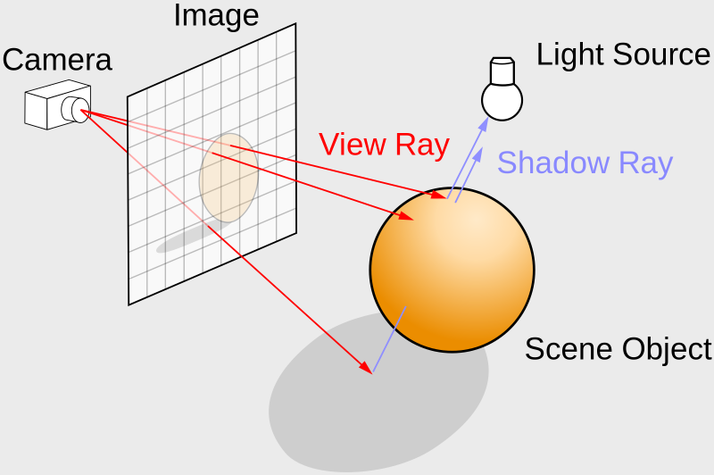
Lançamento de Raios
Uma das propostas é lançar um raio. Procurar a primeira superfície de intersecção desse raio e depois agregar informações como a direção das fontes de luz ou sombras.

Slide 6

Origem dos rais
A origem do lançamento dos raios é a câmera, que podemos dizer que fica atrás da nossa tela.
tela
origem
Z = 0

Slide 7
Setup inicial para Ray Marching
Vamos criar uma cena com a câmera posicionada atrás da tela, apontando para dentro da tela.
void mainImage( out vec4 fragColor, in vec2 fragCoord ) {
vec2 uv = (fragCoord - .5 * iResolution.xy) / iResolution.y;
vec3 ro = vec3(0.0, 0.0, 10.0);
vec3 rd = normalize(vec3(uv, -1));
vec3 col = vec3(smoothstep(0.49, 0.5, abs(uv)),0.0);
fragColor = vec4(col,1.0);
}
https://inspirnathan.com/posts/52-shadertoy-tutorial-part-6

Slide 8
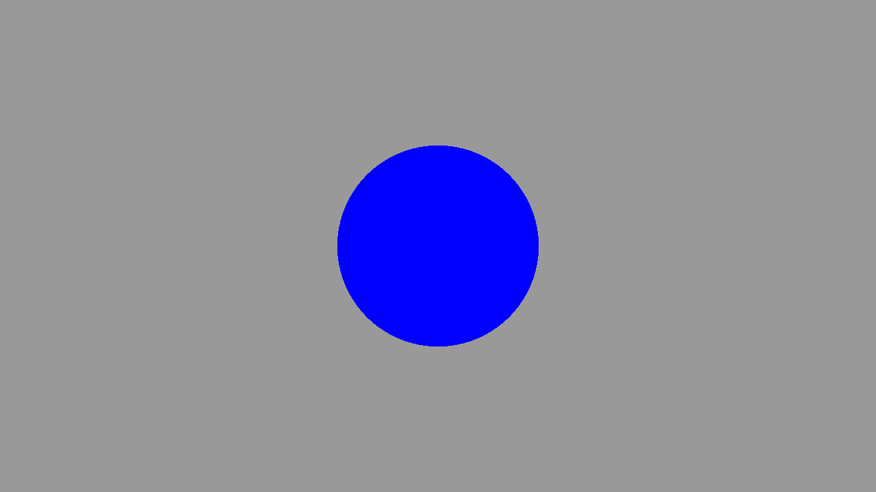
Buscando uma esfera
float sdSphere(vec3 p, float r ) {
return length(p) - r;
}
float rayMarch(vec3 ro, vec3 rd, float start, float end) {
float depth = start;
for (int i = 0; i < 255; i++) {
vec3 p = ro + depth * rd;
float d = sdSphere(p, 1.);
depth += d;
if (d < 0.001 || depth > end) break;
}
return depth;
}
void mainImage( out vec4 fragColor, in vec2 fragCoord ) {
vec2 uv = (fragCoord-.5*iResolution.xy)/iResolution.y;
vec3 col = vec3(0);
vec3 ro = vec3(0, 0, 5);
vec3 rd = normalize(vec3(uv, -1));
float d = rayMarch(ro, rd, 0., 100.);
if (d > 100.0) col = vec3(0.6);
else col = vec3(0, 0, 1);
fragColor = vec4(col, 1.0);
}

Slide 9
Usando #define
Uma estratégia usada por muitos programadores é usar as diretivas ou macros de compilação. Por exemplo, podemos colocar no código:
#define MAX_MARCHING_STEPS 255
#define MIN_DIST 0.0
#define MAX_DIST 100.0
#define PRECISION 0.001

Slide 10
Ray Marching
https://jamie-wong.com/2016/07/15/ray-marching-signed-distance-functions/

Slide 11
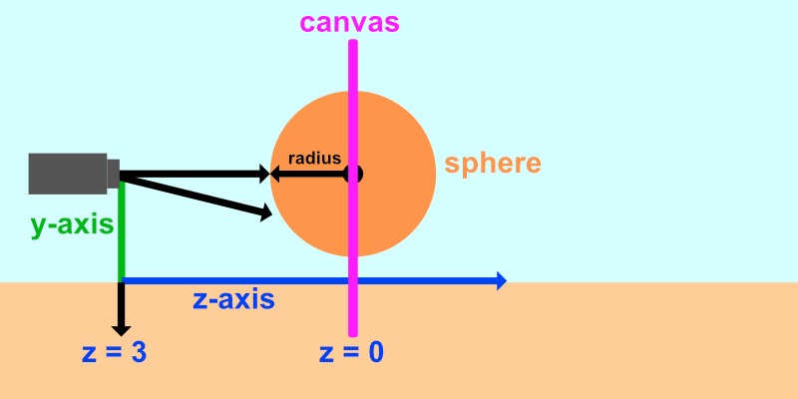

Slide 12
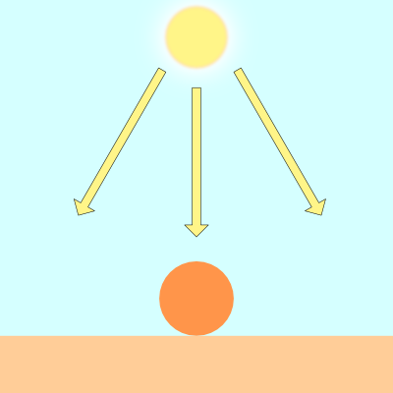
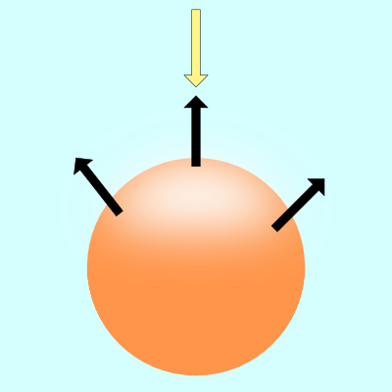
Lambert lighting to simulate diffuse reflection. This is commonly done by taking the dot product between the ray direction of a light source and the direction of a surface normal.
vec3 diffuseReflection = dot(normal, lightDirection);

Slide 13
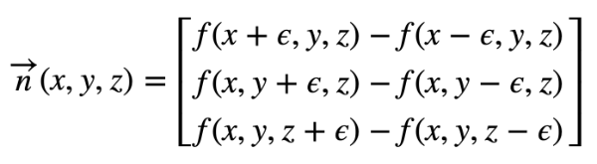
Calculando a Normal
To find the gradient of a surface, we need two points. We'll take a point on the surface of the sphere and subtract a small number from it to get the second point. That'll let us perform a cheap trick to find the gradient. We can then use this gradient value as the surface normal.
Given a surface, f(x,y,z), the gradient along the surface will have the following equation:
vec3 calcNormal(vec3 p) {
float e = 0.0005; // epsilon
float r = 1.; // radius of sphere
return normalize(vec3(
sdSphere(vec3(p.x + e, p.y, p.z), r) - sdSphere(vec3(p.x - e, p.y, p.z), r),
sdSphere(vec3(p.x, p.y + e, p.z), r) - sdSphere(vec3(p.x, p.y - e, p.z), r),
sdSphere(vec3(p.x, p.y, p.z + e), r) - sdSphere(vec3(p.x, p.y, p.z - e), r)
));
}

Slide 14
Na prática
vec3 calcNormal(vec3 p) {
vec2 e = vec2(1.0, -1.0) * 0.0005; // epsilon
float r = 1.; // radius of sphere
return normalize(
e.xyy * sdSphere(p + e.xyy, r) +
e.yyx * sdSphere(p + e.yyx, r) +
e.yxy * sdSphere(p + e.yxy, r) +
e.xxx * sdSphere(p + e.xxx, r));
}

Slide 15
Luz
vec3 lightPosition = vec3(2, 2, 4);
vec3 lightDirection = normalize(lightPosition - p);
float dif = dot(normal, lightDirection); // dif = diffuse reflection
When we take the dot product between the normal and light direction vectors, we may end up with a negative value. To keep the value between zero and one so that we get a bigger range of values, we can use the clamp function.
float dif = clamp(dot(normal, lightDirection), 0., 1.);

Slide 16
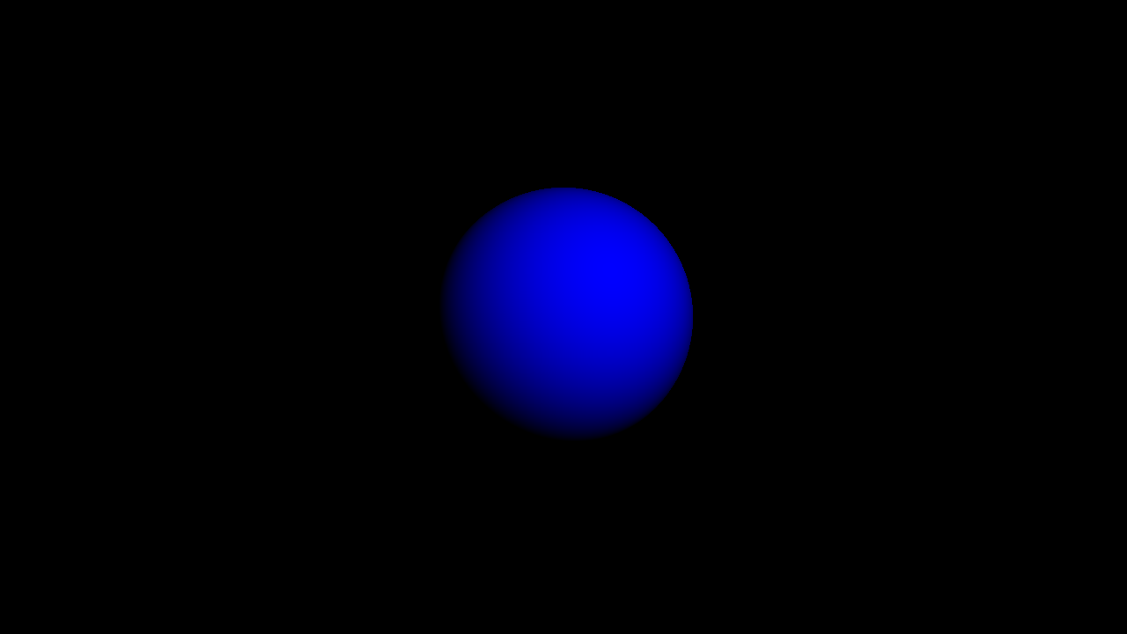
const int MAX_MARCHING_STEPS = 255;
const float MIN_DIST = 0.0;
const float MAX_DIST = 100.0;
const float PRECISION = 0.001;
float sdSphere(vec3 p, float r )
{
vec3 offset = vec3(0, 0, -2);
return length(p - offset) - r;
}
float rayMarch(vec3 ro, vec3 rd, float start, float end) {
float depth = start;
for (int i = 0; i < MAX_MARCHING_STEPS; i++) {
vec3 p = ro + depth * rd;
float d = sdSphere(p, 1.);
depth += d;
if (d < PRECISION || depth > end) break;
}
return depth;
}
vec3 calcNormal(vec3 p) {
vec2 e = vec2(1.0, -1.0) * 0.0005; // epsilon
float r = 1.; // radius of sphere
return normalize(
e.xyy * sdSphere(p + e.xyy, r) +
e.yyx * sdSphere(p + e.yyx, r) +
e.yxy * sdSphere(p + e.yxy, r) +
e.xxx * sdSphere(p + e.xxx, r));
}
void mainImage( out vec4 fragColor, in vec2 fragCoord )
{
vec2 uv = (fragCoord-.5*iResolution.xy)/iResolution.y;
vec3 col = vec3(0);
vec3 ro = vec3(0, 0, 3); // ray origin that represents camera position
vec3 rd = normalize(vec3(uv, -1)); // ray direction
float d = rayMarch(ro, rd, MIN_DIST, MAX_DIST); // distance to sphere
if (d > MAX_DIST) {
col = vec3(0.0); // ray didn't hit anything
} else {
vec3 p = ro + rd * d; // point on sphere we discovered from ray marching
vec3 normal = calcNormal(p);
vec3 lightPosition = vec3(2, 2, 4);
vec3 lightDirection = normalize(lightPosition - p);
// Calculate diffuse reflection by taking the dot product of
// the normal and the light direction.
float dif = clamp(dot(normal, lightDirection), 0., 1.);
col = vec3(0.0, 0.0, dif);
}
// Output to screen
fragColor = vec4(col, 1.0);
}

Slide 17
If you want to add a bit of ambient light color, you can adjust the clamped range, so the sphere doesn't appear completely black in the shaded regions:
float dif = clamp(dot(normal, lightDirection), 0.3, 1.);

Slide 18
Cores
There are multiple techniques people across Shadertoy use to add colors to 3D shapes. One way would be to modify our SDFs to return both the distance to our shape and a color. Therefore, we'd have to modify multiple places in our code to return a vec4 datatype instead of a float. The first value of the vec4 variable would hold the "signed distance" value we normally return from an SDF, and the last three values will hold our color value.

Slide 19
Computação Gráfica
Luciano Soares
<lpsoares@insper.edu.br>

