Slide 1
Computação Gráfica
Aula 15: Revisão

Slide 2
Revisão
Iluminação
Interpolação

Slide 3
Equação de Cores (padrão X3D simplificado)
I_{rgb} = O_{E rgb} + SUM( I_{Lrgb} × (ambient_{i} + diffuse_{i} + specular _{i}))
ambient_{i} = I_{ia} × O_{Drgb} × O_{a}
diffuse_{i} = I_{i} × O_{Drgb} × ( N · L )
specular _{i} = I_{i} × O_{Srgb} × ( N · ((L + V) / |L + V|))^{shininess × 128}
I _{Lrgb} = light color I_{i} = light intensity I_{ia} = light ambientIntensity
O_{Ergb} = material emissiveColor O_{Drgb} = material diffuse colour O_{Srgb} = material specularColor
O_{a} = material ambientIntensity
L = direction of light source
N = normalized normal vector at this point on geometry
V = normalized vector from point on geometry to viewer's position
https://www.web3d.org/documents/specifications/19775-1/V3.3/Part01/components/lighting.html

Slide 4
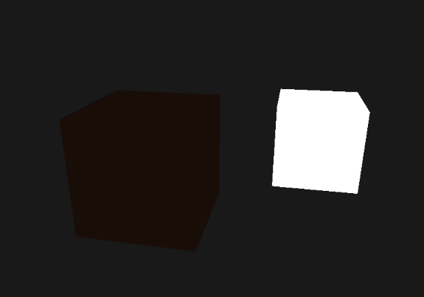

Iluminação/Reflexão Ambiente
A iluminação ambiente (AmbientLight) resulta da dispersão e reflexão da luz originalmente emitida diretamente por fontes de luz. A quantidade de luz ambiente está associada às luzes individuais na cena. Esta é uma aproximação grosseira de como a reflexão ambiental realmente ocorre na natureza.
fonte: https://flylib.com/books/en/2.451.1.18/1/ e https://learnopengl.com/Lighting/Basic-Lighting

Slide 5
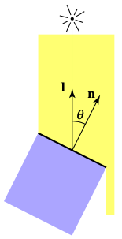
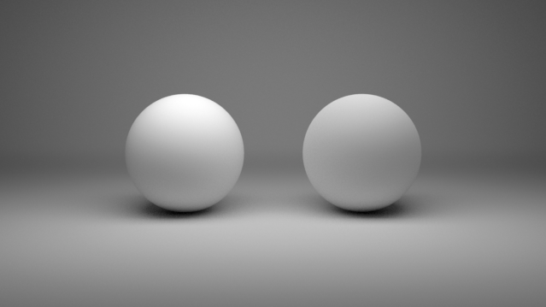
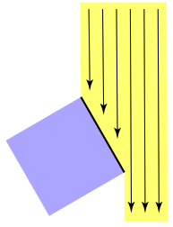
Iluminação/Reflexão Difusa
A iluminação difusa (DiffuseLight) espalha a luz de forma uniforme, assim não depende do ponto de vista, porém depende da sua relação com a normal da superfície.

Slide 6
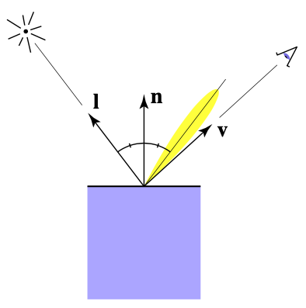
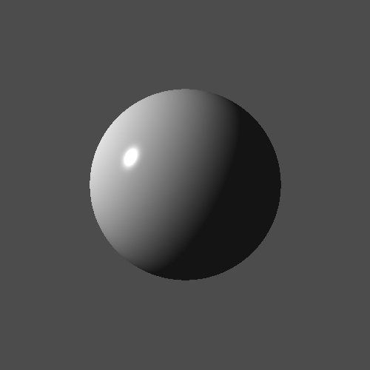
Iluminação/Reflexão Especular
A iluminação especular (SpecularLight) possui uma maior reflexividade, assim dependendo do ponto de vista é possível ver pontos mais iluminados.

Slide 7
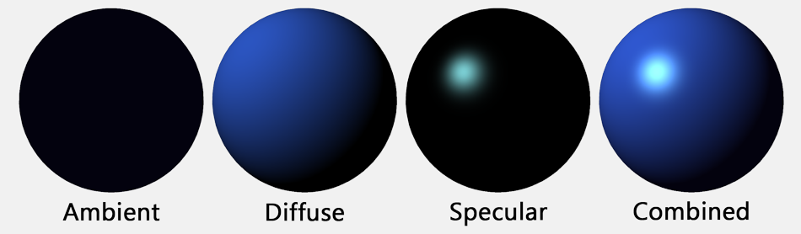
Resultado Final
I_{rgb} = O_{E rgb} + SUM( I_{Lrgb} × (ambient_{i} + diffuse_{i} + specular _{i}))

Slide 8
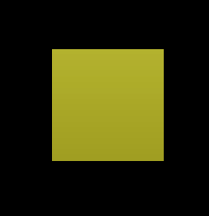
Exemplo X3D
Qual a cor do pixel?
<Viewpoint position="0 0 10"/>
<NavigationInfo headlight='false'/>
<DirectionalLight direction="0 -0.8 -0.6" color="1 1 1" intensity="1" ambientIntensity="0"/>
<Transform>
<Shape>
<Box/>
<Appearance>
<Material specularColor='1.0 1.0 1.0' diffuseColor='1.0 1.0 0.0' shininess='0.2'
ambientIntensity="0.2" emissiveColor="0 0 0"/>
</Appearance>
</Shape>
</Transform>
I _{Lrgb} = (1.0, 1.0, 1.0) I_{i} = 1.0 I_{ia} = 0.0
O_{Ergb} = (0.0, 0.0, 0.0) O_{Drgb} = (1.0, 1.0, 0.0) O_{Srgb} = (1.0, 1.0, 1.0) O_{a} = 0.2
L = (0.0, 0.8, 0.6)
N = (0.0, 0.0, 1.0)
V = (0.0, 0.0, 1.0)* [Supondo no meio da tela]
*(essa é uma aproximação, mas podem usar no projeto se desejarem)
N · L = 0.6
(L + V) / |L + V| = (0.0, 0.8, 1.6)/1.79
(L + V) / |L + V| = (0.0, 0.45, 0.90)
N · ((L + V) / |L + V|)) = 0.9

Slide 9
Exemplo X3D
<Viewpoint position="0 0 10"/>
<NavigationInfo headlight='false'/>
<DirectionalLight direction="0 -0.8 -0.6" color="1 1 1" intensity="1" ambientIntensity="0"/>
<Transform>
<Shape>
<Box/>
<Appearance>
<Material specularColor='1.0 1.0 1.0' diffuseColor='1.0 1.0 0.0' shininess='0.2'
ambientIntensity="0.2" emissiveColor="0 0 0"/>
</Appearance>
</Shape>
</Transform>
ambient_{i} = I_{ia} × O_{Drgb} × O_{a} = 0.0 x (1.0, 1.0, 0.0) x 0.2 = (0.0, 0.0, 0.0)
diffuse_{i} = I_{i} × O_{Drgb} × ( N · L ) = 1.0 x (1.0, 1.0, 0.0) x 0.6 = (0.6, 0.6, 0.0)
specular _{i} = I_{i} × O_{Srgb} × ( N · ((L + V) / |L + V|))^{shininess × 128}
= 1.0 x (1.0, 1.0, 1.0) x 0.9^{25.6} = (0.07, 0.07, 0.07)

Slide 10
Exemplo X3D
<Viewpoint position="0 0 10"/>
<NavigationInfo headlight='false'/>
<DirectionalLight direction="0 -0.8 -0.6" color="1 1 1" intensity="1" ambientIntensity="0"/>
<Transform>
<Shape>
<Box/>
<Appearance>
<Material specularColor='1.0 1.0 1.0' diffuseColor='1.0 1.0 0.0' shininess='0.2'
ambientIntensity="0.2" emissiveColor="0 0 0"/>
</Appearance>
</Shape>
</Transform>
I_{rgb} = O_{E rgb} + SUM( I_{Lrgb} × (ambient_{i} + diffuse_{i} + specular _{i}))
I_{rgb} = (0.0, 0.0, 0.0) + SUM( (1.0, 1.0, 1.0) × ( (0.0, 0.0, 0.0) + (0.6, 0.6, 0.0) + (0.07, 0.07, 0.07) ) )
I_{rgb} = (0.0, 0.0, 0.0) + SUM( (1.0, 1.0, 1.0) × (0.67, 0.67, 0.07) )
I_{rgb} = (0.0, 0.0, 0.0) + (0.67, 0.67, 0.07)
I_{rgb} = (0.67, 0.67, 0.07)

Slide 11
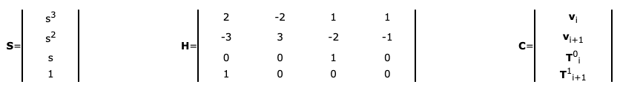
Hermite spline interpolation (X3D simplificado)
(t_{i} ≤ fraction < t_{i+1}), where t_{i} is the key at (i), and t_{i+1} is the key at (i+1)
s = (t - t_{i}) / (t_{i+1} - t_{i})
v_{s} = S^{T} H C
If the velocity vector is not specified, it is calculated as follows:
T_{i} = (v_{i+1} - v_{i-1}) / 2
If the interpolator is not closed, and the first and last velocity vectors are not specified by the author:
T⁰₀ = T¹₀ = T⁰_{N-1} = T¹_{N-1} = 0
https://www.web3d.org/documents/specifications/19775-1/V3.3/Part01/components/interp.html

Slide 12
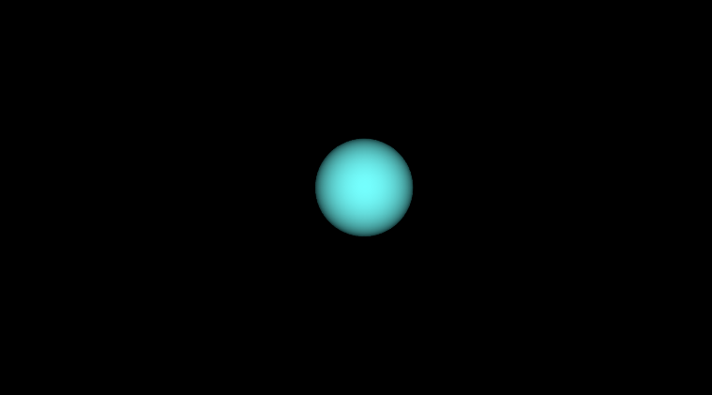
Exemplo X3D
Qual a posição no meio (t=0.5)?
<TimeSensor DEF='relogio' cycleInterval='8' loop='true'/>
<SplinePositionInterpolator DEF="move" closed="false"
key=" 0.00 0.2 0.4 0.6 0.8 1.00"
keyValue="-5 -1 0 -3 1 0 -1 -1 0 1 1 0 3 -1 0 5 1 0"/>
<Transform DEF='esfera'>
<Shape>
<Sphere/>
<Appearance>
<Material diffuseColor='0.0 1.0 1.0'/>
</Appearance>
</Shape>
</Transform>
<ROUTE fromNode='relogio' fromField='fraction_changed' toNode='move' toField='set_fraction'/>
<ROUTE fromNode='move' fromField='value_changed' toNode='esfera' toField='translation'/>
s = (t - t_{i}) / (t_{i+1} - t_{i}) = (0.5 - 0.4) / (0.6 - 0.4) = 0.1 / 0.2 = 0.5
T_{i} = (v_{i+1} - v_{i-1}) / 2:
T₂ = (v₃ - v₁) / 2 = ( (1, 1, 0) - (-3, 1, 0) ) / 2 = (4, 0, 0) / 2 = (2, 0, 0)
T₃ = (v₄ - v₂) / 2 = ( (3, -1, 0) - (-1, -1, 0) ) / 2 = (4, 0, 0) / 2 = (2, 0, 0)

Slide 13
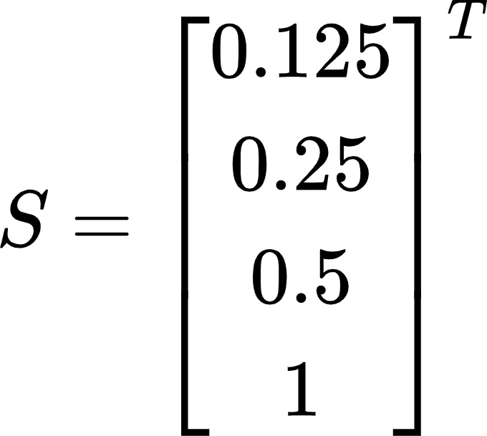
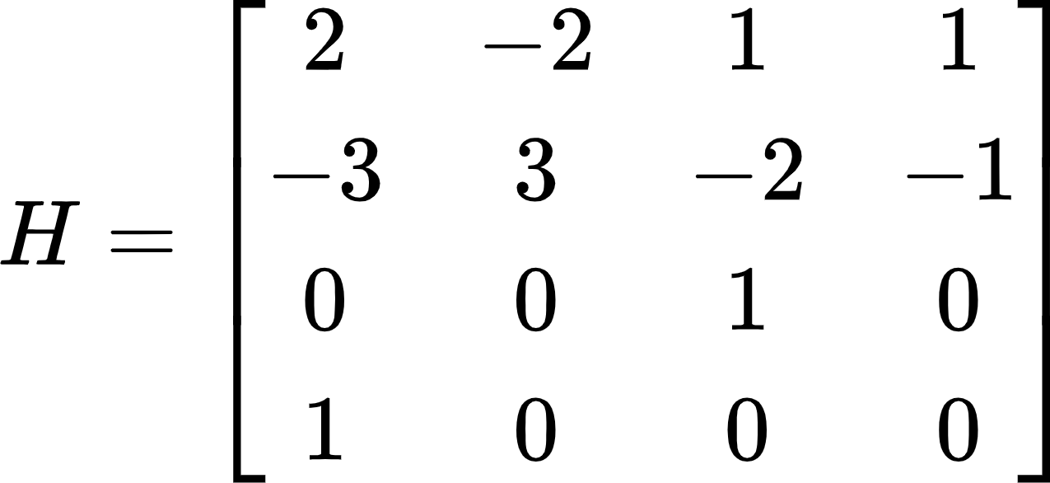
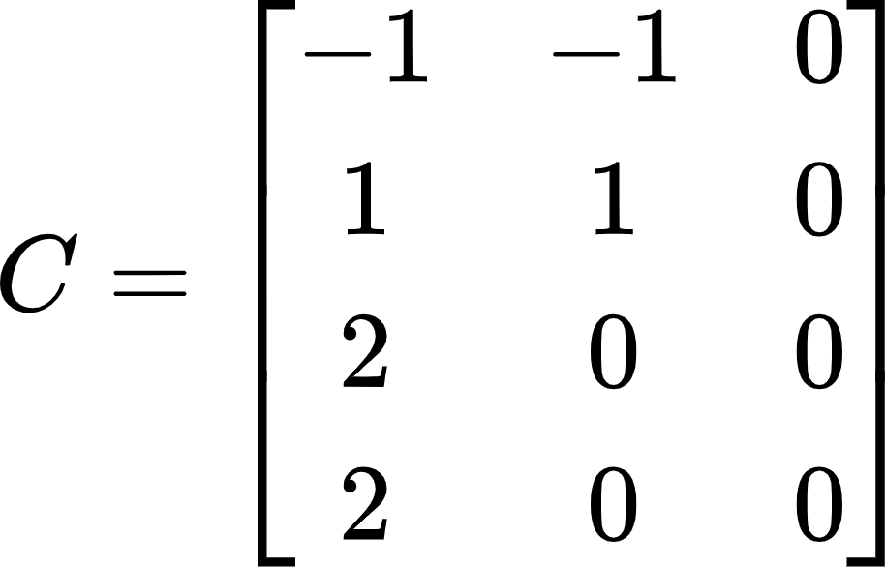
Exemplo X3D
Qual a posição no meio (t=0.5)?
<TimeSensor DEF='relogio' cycleInterval='8' loop='true'/>
<SplinePositionInterpolator DEF="move" closed="false"
key=" 0.00 0.2 0.4 0.6 0.8 1.00"
keyValue="-5 -1 0 -3 1 0 -1 -1 0 1 1 0 3 -1 0 5 1 0"/>
<Transform DEF='esfera'>
<Shape>
<Sphere/>
<Appearance>
<Material diffuseColor='0.0 1.0 1.0'/>
</Appearance>
</Shape>
</Transform>
<ROUTE fromNode='relogio' fromField='fraction_changed' toNode='move' toField='set_fraction'/>
<ROUTE fromNode='move' fromField='value_changed' toNode='esfera' toField='translation'/>
v_{s} = S^{T} H C

Slide 14
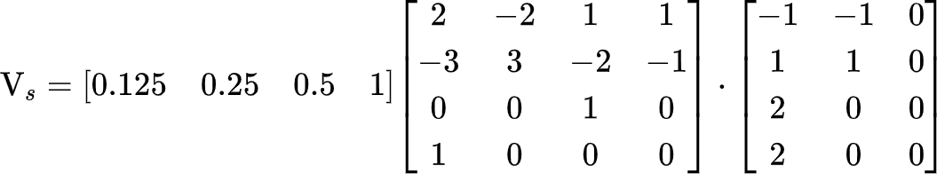
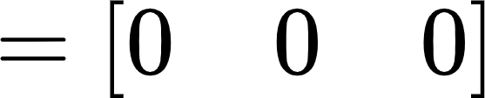
Exemplo X3D
Qual a posição no meio (t=0.5)?
<TimeSensor DEF='relogio' cycleInterval='8' loop='true'/>
<SplinePositionInterpolator DEF="move" closed="false"
key=" 0.00 0.2 0.4 0.6 0.8 1.00"
keyValue="-5 -1 0 -3 1 0 -1 -1 0 1 1 0 3 -1 0 5 1 0"/>
<Transform DEF='esfera'>
<Shape>
<Sphere/>
<Appearance>
<Material diffuseColor='0.0 1.0 1.0'/>
</Appearance>
</Shape>
</Transform>
<ROUTE fromNode='relogio' fromField='fraction_changed' toNode='move' toField='set_fraction'/>
<ROUTE fromNode='move' fromField='value_changed' toNode='esfera' toField='translation'/>

Slide 15
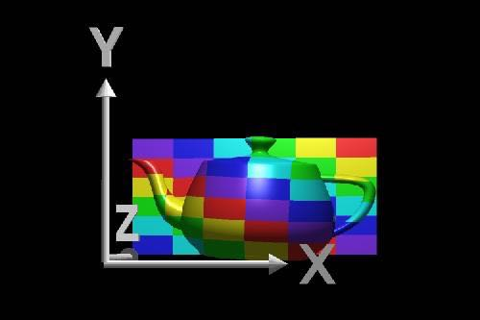
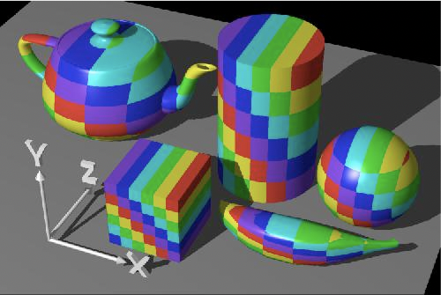
Funções para Coordenadas de Textura
Exemplo: Projeção Planar
Rosalee Wolfe
http://www.siggraph.org/education/materials/HyperGraph/mapping/r_wolfe/r_wolfe_mapping_1.htm

Slide 16
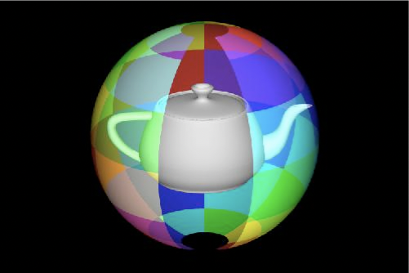
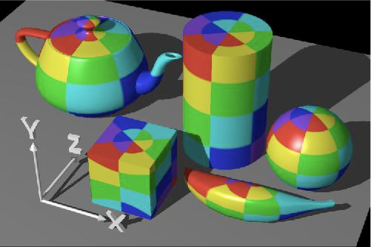
Funções para Coordenadas de Textura
Exemplo: Projeção Esférica
Rosalee Wolfe
http://www.siggraph.org/education/materials/HyperGraph/mapping/r_wolfe/r_wolfe_mapping_1.htm

Slide 17
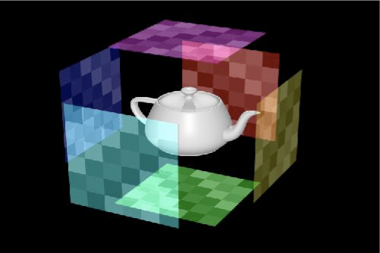
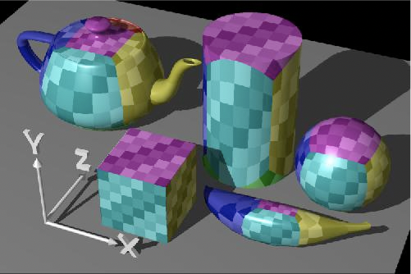
Funções para Coordenadas de Textura
Exemplo: Projeção Cúbica
Rosalee Wolfe
http://www.siggraph.org/education/materials/HyperGraph/mapping/r_wolfe/r_wolfe_mapping_1.htm

Slide 18
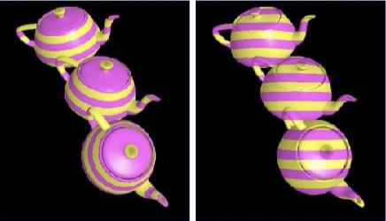
Funções para Coordenadas de Textura
Exemplo: Funções nas coordenadas do objeto e do mundo
Rosalee Wolfe
http://www.siggraph.org/education/materials/HyperGraph/mapping/r_wolfe/r_wolfe_mapping_1.htm

Slide 19
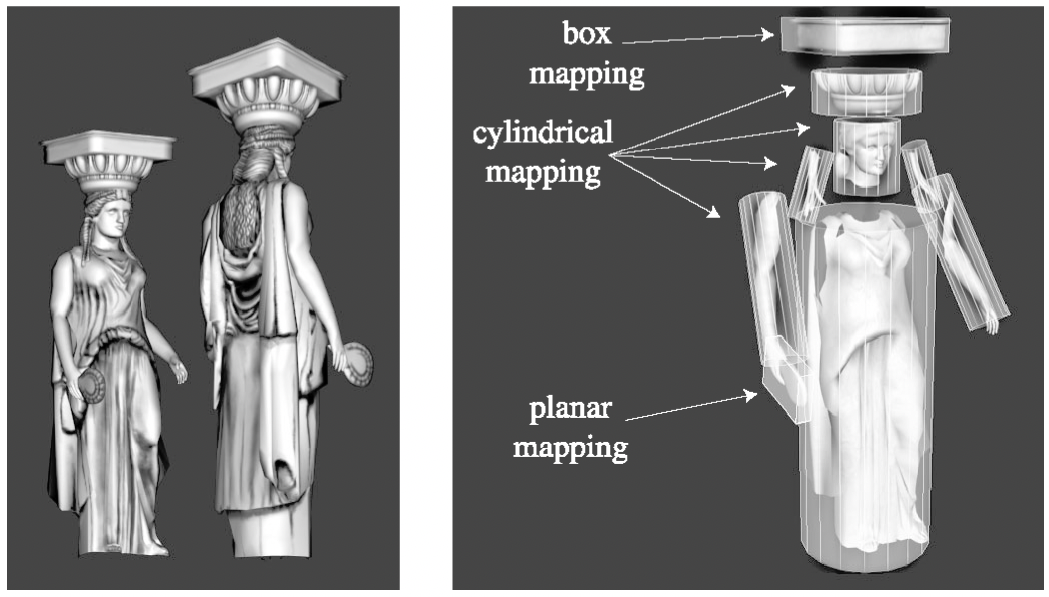
Funções para Coordenadas de Textura
Superfícies Complexas: Use projeções diferentes para cada parte
Rosalee Wolfe
http://www.siggraph.org/education/materials/HyperGraph/mapping/r_wolfe/r_wolfe_mapping_1.htm

Slide 20
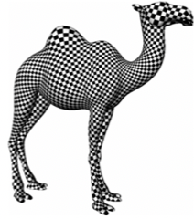
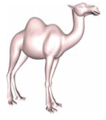
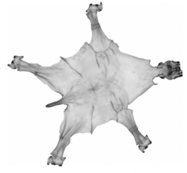
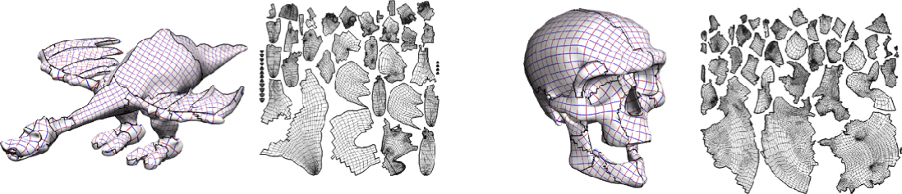
Criar boas coordenadas de superfície é dificil
Finding cuts
Texture atlases
Levy et al: Least Squares Conformal Maps for Automatic Texture Atlas Generation, SIGGRAPH, 2002

Slide 21
Environment Map, Cube Map. Falar.
Fazer clipping (frustum culling)
FOG?

Slide 22
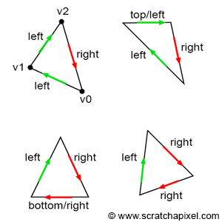
top-left rule

Slide 23
What the top-left rule says though, is that the pixel or point is considered to overlap a triangle if it is either inside the triangle or lies on either a triangle's top edge or any edge that is considered to be a left edge. What is a top and theft edge? If you look at Figure 19, you can easily see what we mean by the top and left edges.
A top edge is an edge that is perfectly horizontal and whose defining vertices are above the third one. Technically this means that the y-coordinates of the vector V[(X+1)%3]-V[X] are equal to 0 and that its x-coordinates are positive (greater than 0).
A left edge is essentially an edge that is going up. Keep in mind that in our case, vertices are defined in clockwise order. An edge is considered to go up if its respective vector V[(X+1)%3]-V[X] (where X can either be 0, 1, 2) has a positive y-coordinate.
https://www.scratchapixel.com/lessons/3d-basic-rendering/rasterization-practical-implementation/rasterization-stage.html

Slide 24
top-left rule
// Does it pass the top-left rule?
Vec2f v0 = { ... };
Vec2f v1 = { ... };
Vec2f v2 = { ... };
float w0 = edgeFunction(v1, v2, p);
float w1 = edgeFunction(v2, v0, p);
float w2 = edgeFunction(v0, v1, p);
Vec2f edge0 = v2 - v1;
Vec2f edge1 = v0 - v2;
Vec2f edge2 = v1 - v0;
bool overlaps = true;
// If the point is on the edge, test if it is a top or left edge,
// otherwise test if the edge function is positive
overlaps &= (w0 == 0 ? ((edge0.y == 0 && edge0.x > 0) || edge0.y > 0) : (w0 > 0));
overlaps &= (w1 == 0 ? ((edge1.y == 0 && edge1.x > 0) || edge1.y > 0) : (w1 > 0));
overlaps &= (w1 == 0 ? ((edge2.y == 0 && edge2.x > 0) || edge2.y > 0) : (w2 > 0));
if (overlaps) {
// pixel overlap the triangle
...
}

Slide 25
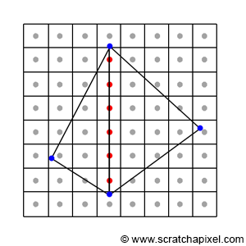
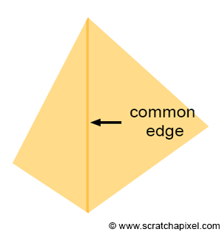
Transparência

Slide 26
Background color e environment map
Incluir no projeto clipping!
Talvez Incluir FOG (já tentei e não lembro por que desisti).

Slide 27
Computação Gráfica
Luciano Soares
<lpsoares@insper.edu.br>

