Slide 1
Computação Gráfica
Revisão: Transformações e Projeções

Slide 2
Exemplo Completo:
Transformações Geométricas
Quatérnios
Transformação de Câmera
Transformação Perspectiva
Coordenadas normalizadas (NDC)
Divisão Homogênea
Transformação de tela

Slide 3
Definindo posição da câmera virtual
y
<Scene>
<Viewpoint/>
</Scene>
V_{up}
(0, 0, 10)
V_{view}
x
z
V_{right}
https://www.web3d.org/documents/specifications/19775-1/V3.3/Part01/components/navigation.html

Slide 4


Definindo posição da câmera virtual
y
<Scene>
<Viewpoint orientation="0 1 0 -1.57"/>
</Scene>
V_{up}
90°
x
z
V_{right}
V_{view}
https://www.web3d.org/documents/specifications/19775-1/V3.3/Part01/components/navigation.html

Slide 5
Definindo posição da câmera virtual
V_{up}
y
V_{right}
V_{view}
<Scene>
<Viewpoint position="-8 1 1" orientation="0 1 0 -1.57"/>
</Scene>
(-8, 1, 1)
x
z
https://www.web3d.org/documents/specifications/19775-1/V3.3/Part01/components/navigation.html

Slide 6


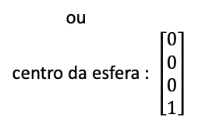
Criando uma esfera no centro do mundo
Visualização do ponto de vista da câmera, mas no sistema de coordenadas do mundo.
y
x
z
<Scene>
<Viewpoint position="-8 1 1" orientation="0 1 0 -1.57"/>
<Transform>
<Shape>
<Sphere radius='0.1'/>
<Appearance>
<Material diffuseColor='1 1 0'/>
</Appearance>
</Shape>
</Transform>
</Scene>
(0, 0, 0)
amarelo
https://www.web3d.org/documents/specifications/19775-1/V3.3/Part01/components/group.html
Notes:
https://www.web3d.org/documents/specifications/19775-1/V3.3/Part01/components/geometry3D.html#Sphere

Slide 7
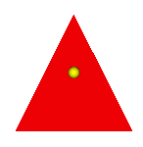
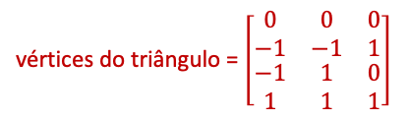
Criando um triângulo no centro do mundo
<Scene>
<Viewpoint position="-8 1 1" orientation="0 1 0 -1.57"/>
<Transform>
<Shape>
<Sphere radius='0.1'/>
<Appearance>
<Material diffuseColor='1 1 0'/>
</Appearance>
</Shape>
</Transform>
<Transform>
<Shape>
<TriangleSet>
<Coordinate point='0 -1 -1 0 -1 1 0 1 0'/>
</TriangleSet>
<Appearance>
<Material diffuseColor='1 0 0'/>
</Appearance>
</Shape>
</Transform>
</Scene>
y
x
(0, 1, 0)
z
(0, -1, -1)
(0, -1, 1)
P₁
P₀
P₂
vermelho
https://www.web3d.org/documents/specifications/19775-1/V3.3/Part01/components/rendering.html

Slide 8
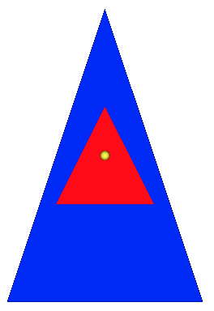

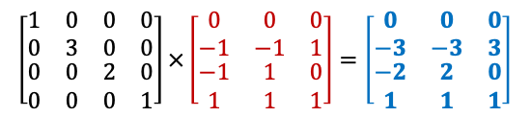
Novo triângulo ampliado
(0, 3, 0)
<Scene>
<Viewpoint position="-8 1 1" orientation="0 1 0 -1.57"/>
<Transform>
<Shape>
<Sphere radius='0.1'/>
<Appearance>
<Material diffuseColor='1 1 0'/>
</Appearance>
</Shape>
</Transform>
<Transform>
<Shape>
<TriangleSet>
<Coordinate point='0 -1 -1 0 -1 1 0 1 0'/>
</TriangleSet>
<Appearance>
<Material diffuseColor='1 0 0'/>
</Appearance>
</Shape>
</Transform>
<Transform scale="1 3 2">
<Shape>
<TriangleSet>
<Coordinate point='0 -1 -1 0 -1 1 0 1 0'/>
</TriangleSet>
<Appearance>
<Material diffuseColor='0 0 1'/>
</Appearance>
</Shape>
</Transform>
</Scene>
y
x
z
(0, -3, 2)
(0, -3, -2)
azul
https://www.web3d.org/documents/specifications/19775-1/V3.3/Part01/components/rendering.html

Slide 9
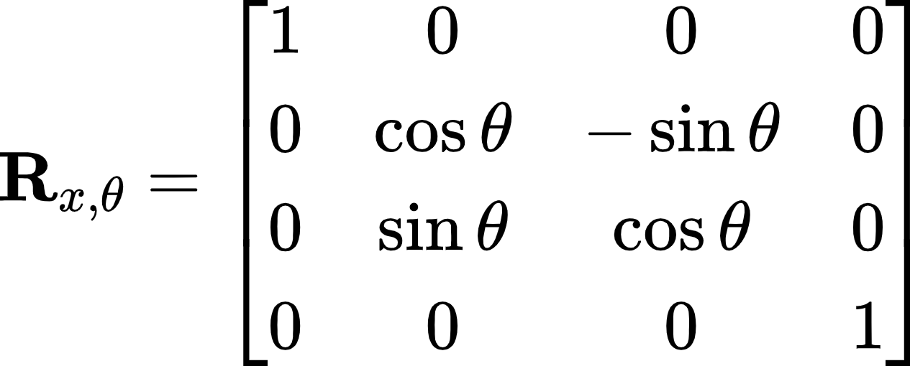
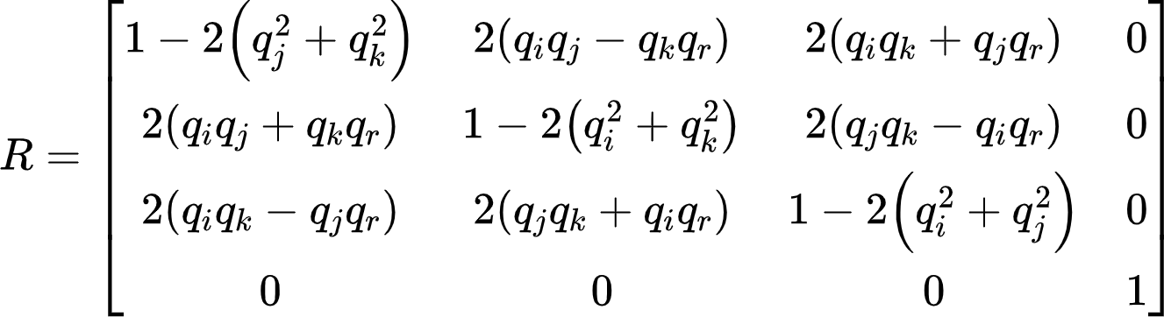
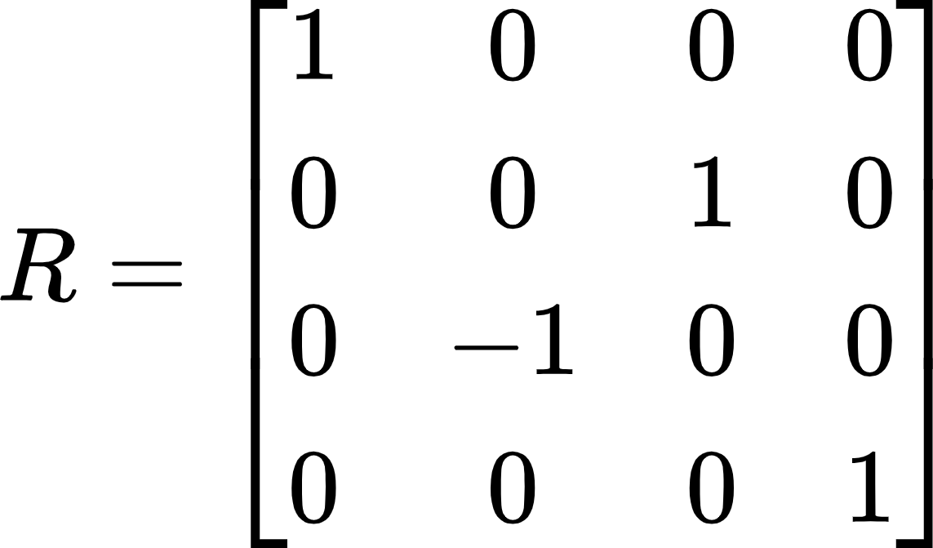
Novo triângulo rotacionado
<Scene>
<Viewpoint position="-8 1 1" orientation="0 1 0 -1.57"/>
<Transform>
<Shape>
<Sphere radius='0.1'/>
<Appearance>
<Material diffuseColor='1 1 0'/>
</Appearance>
</Shape>
</Transform>
<Transform>
<Shape>
<TriangleSet>
<Coordinate point='0 -1 -1 0 -1 1 0 1 0'/>
</TriangleSet>
<Appearance>
<Material diffuseColor='1 0 0'/>
</Appearance>
</Shape>
</Transform>
<Transform scale="1 3 2"
rotation="1 0 0 -1.57">
<Shape>
<TriangleSet>
<Coordinate point='0 -1 -1 0 -1 1 0 1 0'/>
</TriangleSet>
<Appearance>
<Material diffuseColor='0 0 1'/>
</Appearance>
</Shape>
</Transform>
</Scene>
https://www.web3d.org/documents/specifications/19775-1/V3.3/Part01/fieldsDef.html#SFRotationAndMFRotation

Slide 10
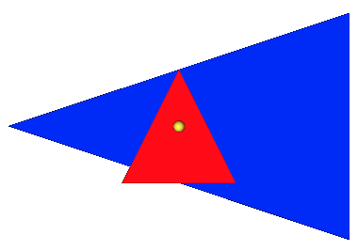
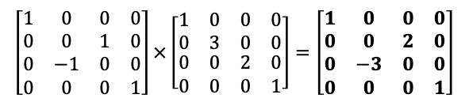
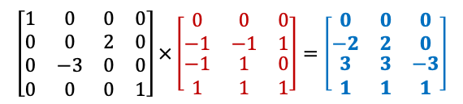
Novo triângulo rotacionado
<Scene>
<Viewpoint position="-8 1 1" orientation="0 1 0 -1.57"/>
<Transform>
<Shape>
<Sphere radius='0.1'/>
<Appearance>
<Material diffuseColor='1 1 0'/>
</Appearance>
</Shape>
</Transform>
<Transform>
<Shape>
<TriangleSet>
<Coordinate point='0 -1 -1 0 -1 1 0 1 0'/>
</TriangleSet>
<Appearance>
<Material diffuseColor='1 0 0'/>
</Appearance>
</Shape>
</Transform>
<Transform scale="1 3 2"
rotation="1 0 0 -1.57">
<Shape>
<TriangleSet>
<Coordinate point='0 -1 -1 0 -1 1 0 1 0'/>
</TriangleSet>
<Appearance>
<Material diffuseColor='0 0 1'/>
</Appearance>
</Shape>
</Transform>
</Scene>
y
(0, 2, 3)
x
z
(0, 0, -3)
(0, -2, 3)
rotação
escala
https://www.web3d.org/documents/specifications/19775-1/V3.3/Part01/fieldsDef.html#SFRotationAndMFRotation

Slide 11
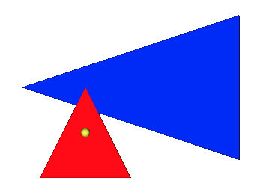
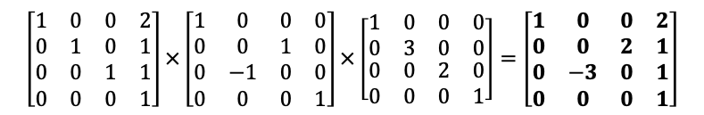
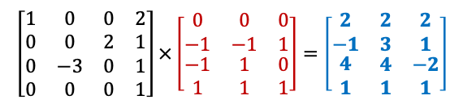
Novo triângulo transladado
<Scene>
<Viewpoint position="-8 1 1" orientation="0 1 0 -1.57"/>
<Transform>
<Shape>
<Sphere radius='0.1'/>
<Appearance>
<Material diffuseColor='1 1 0'/>
</Appearance>
</Shape>
</Transform>
<Transform>
<Shape>
<TriangleSet>
<Coordinate point='0 -1 -1 0 -1 1 0 1 0'/>
</TriangleSet>
<Appearance>
<Material diffuseColor='1 0 0'/>
</Appearance>
</Shape>
</Transform>
<Transform scale="1 3 2"
rotation="1 0 0 -1.57"
translation="2 1 1">
<Shape>
<TriangleSet>
<Coordinate point='0 -1 -1 0 -1 1 0 1 0'/>
</TriangleSet>
<Appearance>
<Material diffuseColor='0 0 1'/>
</Appearance>
</Shape>
</Transform>
</Scene>
(2, 3, 4)
y
x
(2, 1, -2)
z
(2, -1, 4)
translação
rotação
escala
https://www.web3d.org/documents/specifications/19775-1/V3.3/Part01/fieldsDef.html#SFVec3fAndMFVec3f

Slide 12
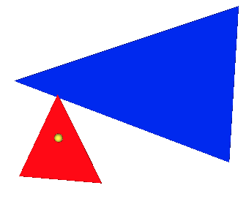

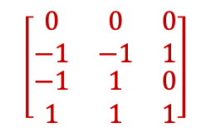
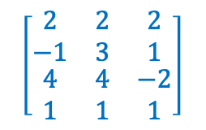
Visualizando de outro ângulo
<Scene>
<Viewpoint position="-8 1 1" orientation="0 1 0 -1.57"/>
<Transform>
<Shape>
<Sphere radius='0.1'/>
<Appearance>
<Material diffuseColor='1 1 0'/>
</Appearance>
</Shape>
</Transform>
<Transform>
<Shape>
<TriangleSet>
<Coordinate point='0 -1 -1 0 -1 1 0 1 0'/>
</TriangleSet>
<Appearance>
<Material diffuseColor='1 0 0'/>
</Appearance>
</Shape>
</Transform>
<Transform scale="1 3 2"
rotation="1 0 0 -1.57"
translation="2 1 1">
<Shape>
<TriangleSet>
<Coordinate point='0 -1 -1 0 -1 1 0 1 0'/>
</TriangleSet>
<Appearance>
<Material diffuseColor='0 0 1'/>
</Appearance>
</Shape>
</Transform>
</Scene>
(2, 3, 4)
y
x
(2, 1, -2)
z
(0, 1, 0)
(0, 0, 0)
(0, -1, -1)
(2, -1, 4)
(0, -1, 1)

Slide 13
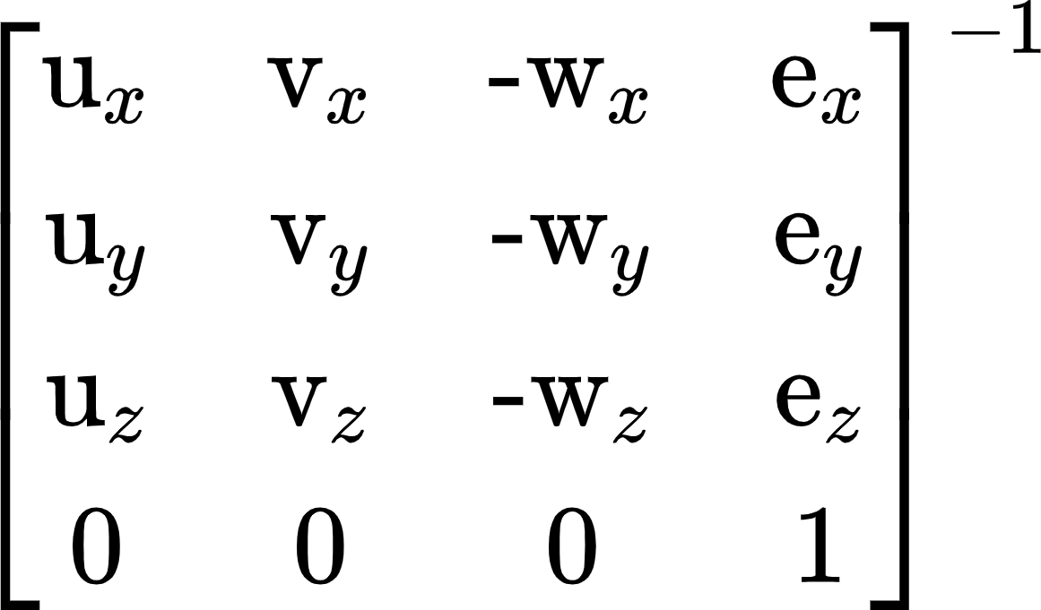
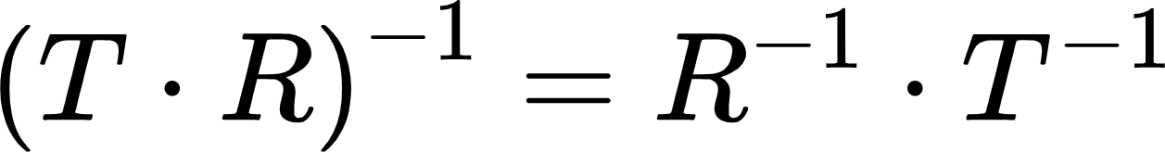
Transformação da Câmera
<Scene>
<Viewpoint position="-8 1 1" orientation="0 1 0 -1.57"/>
<Transform>
<Shape>
<Sphere radius='0.1'/>
<Appearance>
<Material diffuseColor='1 1 0'/>
</Appearance>
</Shape>
</Transform>
<Transform>
<Shape>
<TriangleSet>
<Coordinate point='0 -1 -1 0 -1 1 0 1 0'/>
</TriangleSet>
<Appearance>
<Material diffuseColor='1 0 0'/>
</Appearance>
</Shape>
</Transform>
<Transform scale="1 3 2"
rotation="1 0 0 -1.57"
translation="2 1 1">
<Shape>
<TriangleSet>
<Coordinate point='0 -1 -1 0 -1 1 0 1 0'/>
</TriangleSet>
<Appearance>
<Material diffuseColor='0 0 1'/>
</Appearance>
</Shape>
</Transform>
</Scene>
y
V_{up}
V_{right}
V_{view}
(-8, 1, 1)
x
z
u = V_{right}
v = V_{up}
w = V_{view}

Slide 14
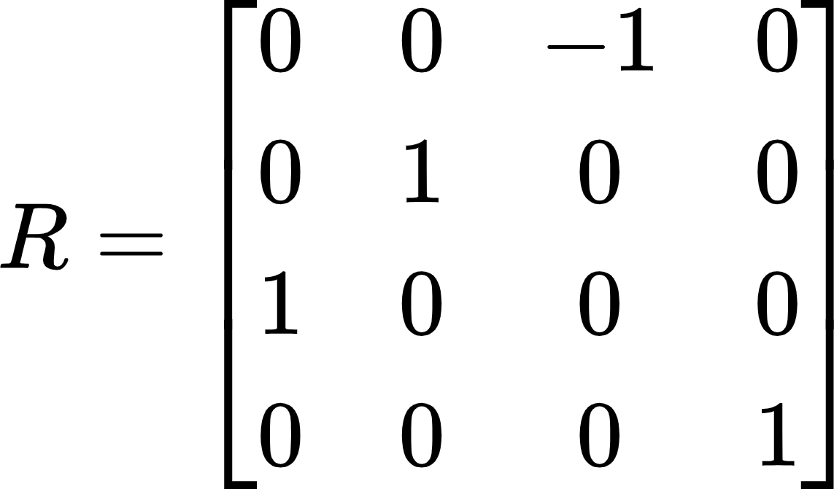
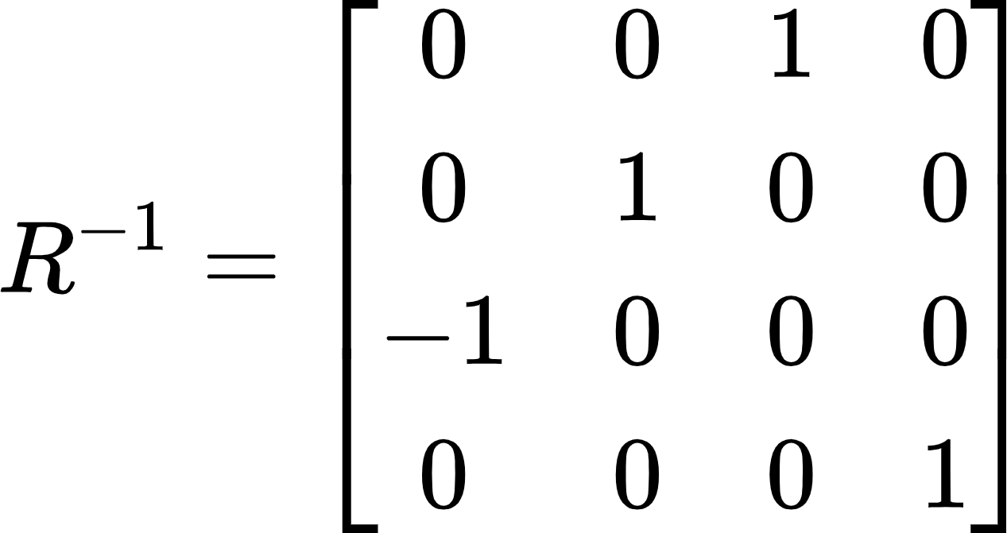
Transformação da Câmera (Rotação)
<Scene>
<Viewpoint position="-8 1 1" orientation="0 1 0 -1.57"/>
<Transform>
<Shape>
<Sphere radius='0.1'/>
<Appearance>
<Material diffuseColor='1 1 0'/>
</Appearance>
</Shape>
</Transform>
<Transform>
<Shape>
<TriangleSet>
<Coordinate point='0 -1 -1 0 -1 1 0 1 0'/>
</TriangleSet>
<Appearance>
<Material diffuseColor='1 0 0'/>
</Appearance>
</Shape>
</Transform>
<Transform scale="1 3 2"
rotation="1 0 0 -1.57"
translation="2 1 1">
<Shape>
<TriangleSet>
<Coordinate point='0 -1 -1 0 -1 1 0 1 0'/>
</TriangleSet>
<Appearance>
<Material diffuseColor='0 0 1'/>
</Appearance>
</Shape>
</Transform>
</Scene>
y
V_{up}
V_{right}
V_{view}
(-8, 1, 1)
x
z
Rotação:
A orientação inicial da câmera é a identidade. Portanto, sua nova orientação é diretamente a rotação de −𝜋/2 em torno de 𝑌.

Slide 15
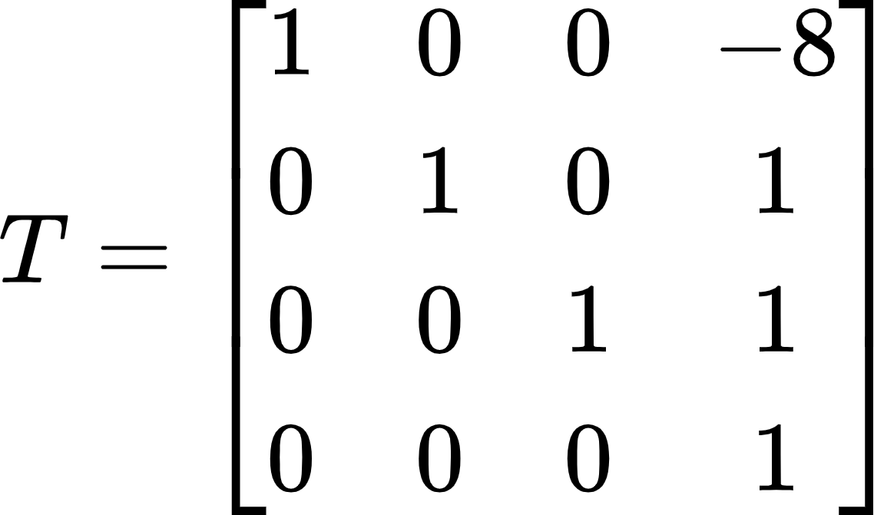
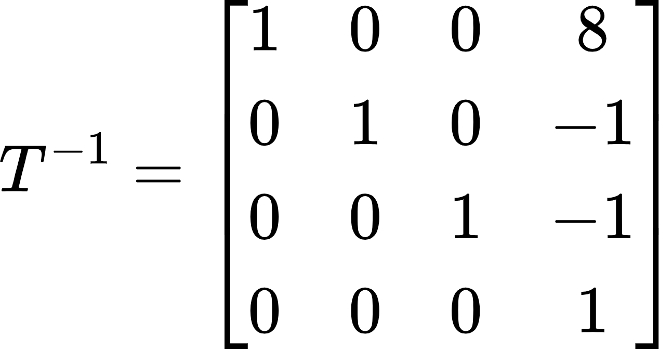
Transformação da Câmera (Translação)
<Scene>
<Viewpoint position="-8 1 1" orientation="0 1 0 -1.57"/>
<Transform>
<Shape>
<Sphere radius='0.1'/>
<Appearance>
<Material diffuseColor='1 1 0'/>
</Appearance>
</Shape>
</Transform>
<Transform>
<Shape>
<TriangleSet>
<Coordinate point='0 -1 -1 0 -1 1 0 1 0'/>
</TriangleSet>
<Appearance>
<Material diffuseColor='1 0 0'/>
</Appearance>
</Shape>
</Transform>
<Transform scale="1 3 2"
rotation="1 0 0 -1.57"
translation="2 1 1">
<Shape>
<TriangleSet>
<Coordinate point='0 -1 -1 0 -1 1 0 1 0'/>
</TriangleSet>
<Appearance>
<Material diffuseColor='0 0 1'/>
</Appearance>
</Shape>
</Transform>
</Scene>
y
V_{up}
V_{right}
V_{view}
(-8, 1, 1)
x
z
Translação:

Slide 16
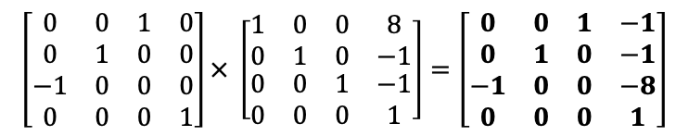
Transformação da Câmera
<Scene>
<Viewpoint position="-8 1 1" orientation="0 1 0 -1.57"/>
<Transform>
<Shape>
<Sphere radius='0.1'/>
<Appearance>
<Material diffuseColor='1 1 0'/>
</Appearance>
</Shape>
</Transform>
<Transform>
<Shape>
<TriangleSet>
<Coordinate point='0 -1 -1 0 -1 1 0 1 0'/>
</TriangleSet>
<Appearance>
<Material diffuseColor='1 0 0'/>
</Appearance>
</Shape>
</Transform>
<Transform scale="1 3 2"
rotation="1 0 0 -1.57"
translation="2 1 1">
<Shape>
<TriangleSet>
<Coordinate point='0 -1 -1 0 -1 1 0 1 0'/>
</TriangleSet>
<Appearance>
<Material diffuseColor='0 0 1'/>
</Appearance>
</Shape>
</Transform>
</Scene>
y
V_{up}
V_{right}
V_{view}
(-8, 1, 1)
x
z
Orientação⁻¹
Translação⁻¹
Matriz de Visualização (view)

Slide 17
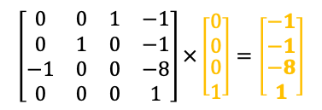
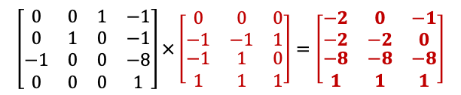
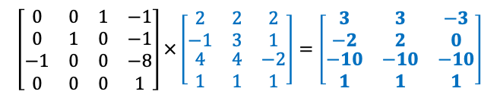
Aplicando Transformação
(3, 2, -10)
câmera (0,0,0)
<Scene>
<Viewpoint position="-8 1 1" orientation="0 1 0 -1.57"/>
<Transform>
<Shape>
<Sphere radius='0.1'/>
<Appearance>
<Material diffuseColor='1 1 0'/>
</Appearance>
</Shape>
</Transform>
<Transform>
<Shape>
<TriangleSet>
<Coordinate point='0 -1 -1 0 -1 1 0 1 0'/>
</TriangleSet>
<Appearance>
<Material diffuseColor='1 0 0'/>
</Appearance>
</Shape>
</Transform>
<Transform scale="1 3 2"
rotation="1 0 0 -1.57"
translation="2 1 1">
<Shape>
<TriangleSet>
<Coordinate point='0 -1 -1 0 -1 1 0 1 0'/>
</TriangleSet>
<Appearance>
<Material diffuseColor='0 0 1'/>
</Appearance>
</Shape>
</Transform>
</Scene>
(-3, 0, -10)
(-1, 0, -8)
(-1, -1, -8)
(3, -2, -10)
(-2, -2, -8)
(0, -2, -8)
Matriz de Visualização
Matriz de Visualização
Matriz de Visualização

Slide 18
Matriz Perspectiva
Resolução: 40 x 20 pixels
<Scene>
<Viewpoint position="-8 1 1" orientation="0 1 0 -1.57"/>
<Transform>
<Shape>
<Sphere radius='0.1'/>
<Appearance>
<Material diffuseColor='1 1 0'/>
</Appearance>
</Shape>
</Transform>
<Transform>
<Shape>
<TriangleSet>
<Coordinate point='0 -1 -1 0 -1 1 0 1 0'/>
</TriangleSet>
<Appearance>
<Material diffuseColor='1 0 0'/>
</Appearance>
</Shape>
</Transform>
<Transform scale="1 3 2"
rotation="1 0 0 -1.57"
translation="2 1 1">
<Shape>
<TriangleSet>
<Coordinate point='0 -1 -1 0 -1 1 0 1 0'/>
</TriangleSet>
<Appearance>
<Material diffuseColor='0 0 1'/>
</Appearance>
</Shape>
</Transform>
</Scene>
Razão de Aspecto = 2:1
fovy = ?
near = 0.5
far = 100
Em X3D o fieldOfView representa o menor ângulo de visão entre as dimensões perpendiculares à direção da câmera.
fieldOfView = 𝜋/4 = 0.7854
fovy = fieldOfView = π/4 ​≈ 0,7854.
https://www.web3d.org/documents/specifications/19775-1/V3.3/Part01/components/navigation.html
Notes:
https://www.shutterstock.com/image-vector/digital-photo-camera-isometric-flat-icon-610333982

Slide 19
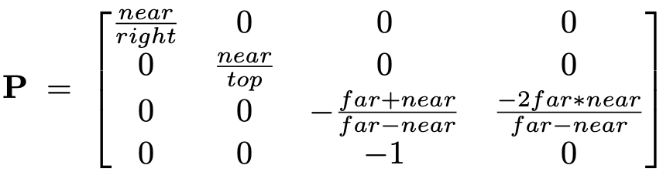
Matriz Perspectiva
Resolução: 40 x 20 pixels
<Scene>
<Viewpoint position="-8 1 1" orientation="0 1 0 -1.57"/>
<Transform>
<Shape>
<Sphere radius='0.1'/>
<Appearance>
<Material diffuseColor='1 1 0'/>
</Appearance>
</Shape>
</Transform>
<Transform>
<Shape>
<TriangleSet>
<Coordinate point='0 -1 -1 0 -1 1 0 1 0'/>
</TriangleSet>
<Appearance>
<Material diffuseColor='1 0 0'/>
</Appearance>
</Shape>
</Transform>
<Transform scale="1 3 2"
rotation="1 0 0 -1.57"
translation="2 1 1">
<Shape>
<TriangleSet>
<Coordinate point='0 -1 -1 0 -1 1 0 1 0'/>
</TriangleSet>
<Appearance>
<Material diffuseColor='0 0 1'/>
</Appearance>
</Shape>
</Transform>
</Scene>
Razão de Aspecto = 2:1
fovy = 0.7854
near = 0.5
far = 100
(Valor errado, mas será usado)
= 0.5*tan(0.7854/2) = 0.1832
= –top = -0.1832
= top * aspect = 0.3663
= –right = -0.3663
top = near * tan (fovy/2)
bottom = –top
right = top * aspect
left = –right
Notes:
https://www.shutterstock.com/image-vector/digital-photo-camera-isometric-flat-icon-610333982

Slide 20
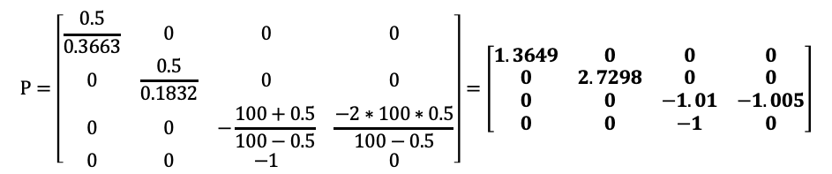
Matriz Perspectiva
Resolução: 40 x 20 pixels
<Scene>
<Viewpoint position="-8 1 1" orientation="0 1 0 -1.57"/>
<Transform>
<Shape>
<Sphere radius='0.1'/>
<Appearance>
<Material diffuseColor='1 1 0'/>
</Appearance>
</Shape>
</Transform>
<Transform>
<Shape>
<TriangleSet>
<Coordinate point='0 -1 -1 0 -1 1 0 1 0'/>
</TriangleSet>
<Appearance>
<Material diffuseColor='1 0 0'/>
</Appearance>
</Shape>
</Transform>
<Transform scale="1 3 2"
rotation="1 0 0 -1.57"
translation="2 1 1">
<Shape>
<TriangleSet>
<Coordinate point='0 -1 -1 0 -1 1 0 1 0'/>
</TriangleSet>
<Appearance>
<Material diffuseColor='0 0 1'/>
</Appearance>
</Shape>
</Transform>
</Scene>
Razão de Aspecto = 2:1
fovy = 0.7854
near = 0.5
far = 100
top = 0.1832
bottom = -0.1832
right = 0.3663
left = -0.3663
Notes:
https://www.shutterstock.com/image-vector/digital-photo-camera-isometric-flat-icon-610333982

Slide 21
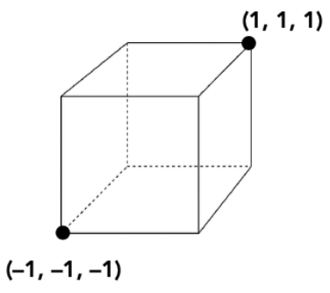
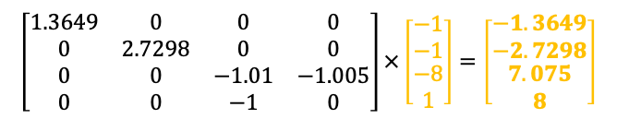
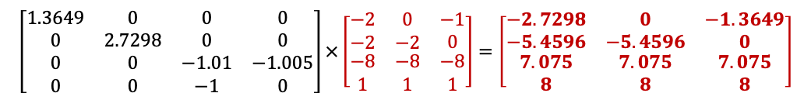
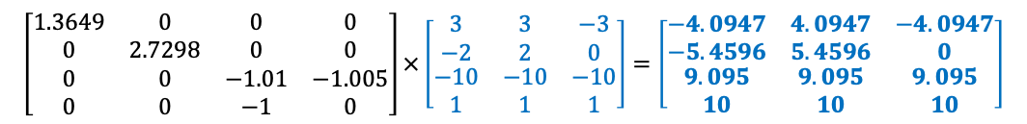
Aplicando Matriz de Projeção Perspectiva
Projeção em NDC (Normalized Device Coordinates)
Projeção Perspectiva
Projeção Perspectiva
Projeção Perspectiva

Slide 22
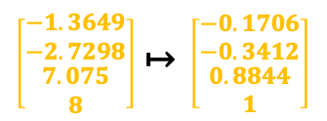
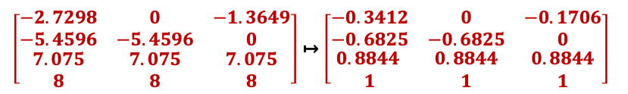
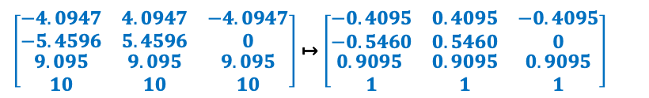
Aplicando Divisão Homogênea
Projeção (0,0)
(0.4095, 0.5460, 0.9095)
Projeção em NDC (Normalized Device Coordinates)
(-0.4095, 0, 0.9095)
(-0.1706, 0, 0.8844)
(-0.1706, -0.3412, 0.8844)
(0.4095, -0.546, 0.9095)
(-0.3412, -0.6825, 0.8844)
(0, -0.6825, 0.8844)

Slide 23
Aplicando Divisão Homogênea
Projeção em NDC (Normalized Device Coordinates)

Slide 24
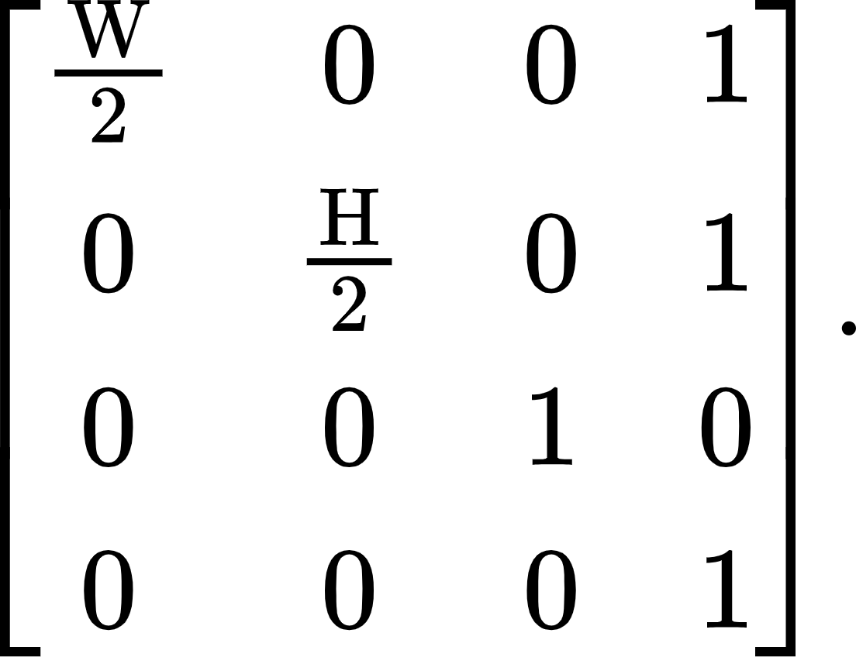
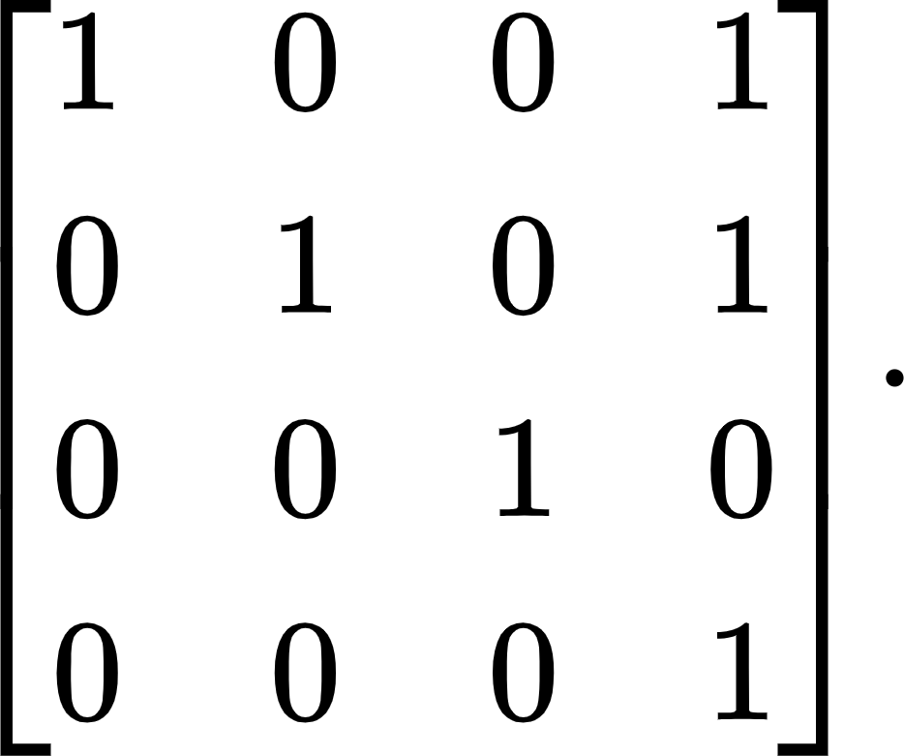
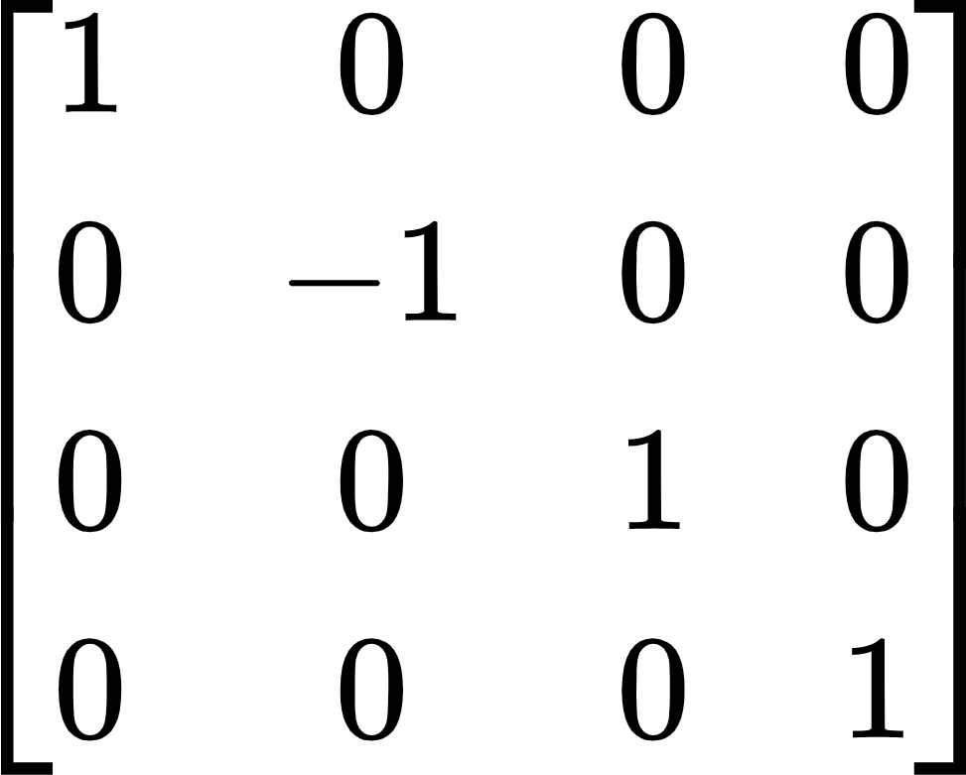
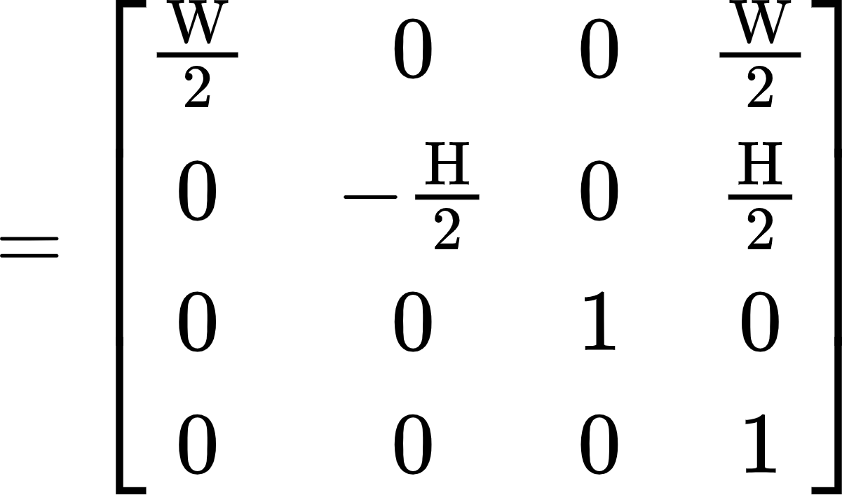
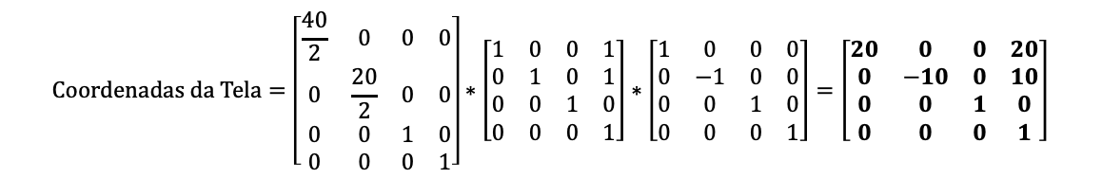
Mapeando coordenadas para tela (screen)
Escala para (W/2, H/2)
Translate por (1,1)
Espelha em Y
Resolução = 40 x 20
S_{40,20}
T_{1,1}
E_{y}
Ordem das matrizes: $S T E_{y}$. Ordem efetiva sobre o ponto: $E_{y}→T→S$.
Obs: Não há necessidade da matriz ser 4x4.

Slide 25
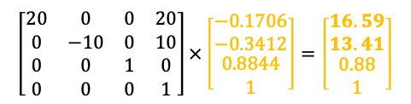
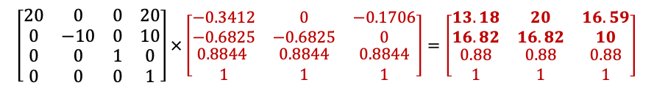
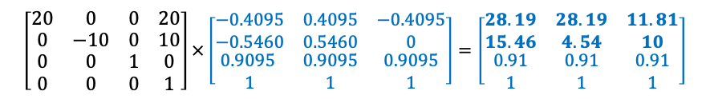
Coordenadas de Tela
0
<Scene>
<Viewpoint position="-8 1 1" orientation="0 1 0 -1.57"/>
<Transform>
<Shape>
<Sphere radius='0.1'/>
<Appearance>
<Material diffuseColor='1 1 0'/>
</Appearance>
</Shape>
</Transform>
<Transform>
<Shape>
<TriangleSet>
<Coordinate point='0 -1 -1 0 -1 1 0 1 0'/>
</TriangleSet>
<Appearance>
<Material diffuseColor='1 0 0'/>
</Appearance>
</Shape>
</Transform>
<Transform scale="1 3 2"
rotation="1 0 0 -1.57"
translation="2 1 1">
<Shape>
<TriangleSet>
<Coordinate point='0 -1 -1 0 -1 1 0 1 0'/>
</TriangleSet>
<Appearance>
<Material diffuseColor='0 0 1'/>
</Appearance>
</Shape>
</Transform>
</Scene>
(28.19, 4.54)
5
Tela (0,0)
10
(11.81, 10)
(16.59, 10)
(16.59, 13.41)
15
(13.18, 16.82)
(28.19, 15.46)
(20, 16.82)
20
15
25
30
Tela
0
5
10
20
35
40
Tela
Tela

Slide 26



Renderização
⬤ | ⬤ | ⬤ | ⬤ | ⬤ | ⬤ | ⬤ | ⬤ | ⬤ | ⬤ | ⬤ | ⬤ | ⬤ | ⬤ | ⬤ | ⬤ | ⬤ | ⬤ | ⬤ | ⬤ | ⬤ | ⬤ | ⬤ | ⬤ | ⬤ | ⬤ | ⬤ | ⬤ | ⬤ | ⬤ | ⬤ | ⬤ | ⬤ | ⬤ | ⬤ | ⬤ | ⬤ | ⬤ | ⬤ | ⬤
⬤ | ⬤ | ⬤ | ⬤ | ⬤ | ⬤ | ⬤ | ⬤ | ⬤ | ⬤ | ⬤ | ⬤ | ⬤ | ⬤ | ⬤ | ⬤ | ⬤ | ⬤ | ⬤ | ⬤ | ⬤ | ⬤ | ⬤ | ⬤ | ⬤ | ⬤ | ⬤ | ⬤ | ⬤ | ⬤ | ⬤ | ⬤ | ⬤ | ⬤ | ⬤ | ⬤ | ⬤ | ⬤ | ⬤ | ⬤
⬤ | ⬤ | ⬤ | ⬤ | ⬤ | ⬤ | ⬤ | ⬤ | ⬤ | ⬤ | ⬤ | ⬤ | ⬤ | ⬤ | ⬤ | ⬤ | ⬤ | ⬤ | ⬤ | ⬤ | ⬤ | ⬤ | ⬤ | ⬤ | ⬤ | ⬤ | ⬤ | ⬤ | ⬤ | ⬤ | ⬤ | ⬤ | ⬤ | ⬤ | ⬤ | ⬤ | ⬤ | ⬤ | ⬤ | ⬤
⬤ | ⬤ | ⬤ | ⬤ | ⬤ | ⬤ | ⬤ | ⬤ | ⬤ | ⬤ | ⬤ | ⬤ | ⬤ | ⬤ | ⬤ | ⬤ | ⬤ | ⬤ | ⬤ | ⬤ | ⬤ | ⬤ | ⬤ | ⬤ | ⬤ | ⬤ | ⬤ | ⬤ | ⬤ | ⬤ | ⬤ | ⬤ | ⬤ | ⬤ | ⬤ | ⬤ | ⬤ | ⬤ | ⬤ | ⬤
⬤ | ⬤ | ⬤ | ⬤ | ⬤ | ⬤ | ⬤ | ⬤ | ⬤ | ⬤ | ⬤ | ⬤ | ⬤ | ⬤ | ⬤ | ⬤ | ⬤ | ⬤ | ⬤ | ⬤ | ⬤ | ⬤ | ⬤ | ⬤ | ⬤ | ⬤ | ⬤ | ⬤ | ⬤ | ⬤ | ⬤ | ⬤ | ⬤ | ⬤ | ⬤ | ⬤ | ⬤ | ⬤ | ⬤ | ⬤
⬤ | ⬤ | ⬤ | ⬤ | ⬤ | ⬤ | ⬤ | ⬤ | ⬤ | ⬤ | ⬤ | ⬤ | ⬤ | ⬤ | ⬤ | ⬤ | ⬤ | ⬤ | ⬤ | ⬤ | ⬤ | ⬤ | ⬤ | ⬤ | ⬤ | ⬤ | ⬤ | ⬤ | ⬤ | ⬤ | ⬤ | ⬤ | ⬤ | ⬤ | ⬤ | ⬤ | ⬤ | ⬤ | ⬤ | ⬤
⬤ | ⬤ | ⬤ | ⬤ | ⬤ | ⬤ | ⬤ | ⬤ | ⬤ | ⬤ | ⬤ | ⬤ | ⬤ | ⬤ | ⬤ | ⬤ | ⬤ | ⬤ | ⬤ | ⬤ | ⬤ | ⬤ | ⬤ | ⬤ | ⬤ | ⬤ | ⬤ | ⬤ | ⬤ | ⬤ | ⬤ | ⬤ | ⬤ | ⬤ | ⬤ | ⬤ | ⬤ | ⬤ | ⬤ | ⬤
⬤ | ⬤ | ⬤ | ⬤ | ⬤ | ⬤ | ⬤ | ⬤ | ⬤ | ⬤ | ⬤ | ⬤ | ⬤ | ⬤ | ⬤ | ⬤ | ⬤ | ⬤ | ⬤ | ⬤ | ⬤ | ⬤ | ⬤ | ⬤ | ⬤ | ⬤ | ⬤ | ⬤ | ⬤ | ⬤ | ⬤ | ⬤ | ⬤ | ⬤ | ⬤ | ⬤ | ⬤ | ⬤ | ⬤ | ⬤
⬤ | ⬤ | ⬤ | ⬤ | ⬤ | ⬤ | ⬤ | ⬤ | ⬤ | ⬤ | ⬤ | ⬤ | ⬤ | ⬤ | ⬤ | ⬤ | ⬤ | ⬤ | ⬤ | ⬤ | ⬤ | ⬤ | ⬤ | ⬤ | ⬤ | ⬤ | ⬤ | ⬤ | ⬤ | ⬤ | ⬤ | ⬤ | ⬤ | ⬤ | ⬤ | ⬤ | ⬤ | ⬤ | ⬤ | ⬤
⬤ | ⬤ | ⬤ | ⬤ | ⬤ | ⬤ | ⬤ | ⬤ | ⬤ | ⬤ | ⬤ | ⬤ | ⬤ | ⬤ | ⬤ | ⬤ | ⬤ | ⬤ | ⬤ | ⬤ | ⬤ | ⬤ | ⬤ | ⬤ | ⬤ | ⬤ | ⬤ | ⬤ | ⬤ | ⬤ | ⬤ | ⬤ | ⬤ | ⬤ | ⬤ | ⬤ | ⬤ | ⬤ | ⬤ | ⬤
⬤ | ⬤ | ⬤ | ⬤ | ⬤ | ⬤ | ⬤ | ⬤ | ⬤ | ⬤ | ⬤ | ⬤ | ⬤ | ⬤ | ⬤ | ⬤ | ⬤ | ⬤ | ⬤ | ⬤ | ⬤ | ⬤ | ⬤ | ⬤ | ⬤ | ⬤ | ⬤ | ⬤ | ⬤ | ⬤ | ⬤ | ⬤ | ⬤ | ⬤ | ⬤ | ⬤ | ⬤ | ⬤ | ⬤ | ⬤
⬤ | ⬤ | ⬤ | ⬤ | ⬤ | ⬤ | ⬤ | ⬤ | ⬤ | ⬤ | ⬤ | ⬤ | ⬤ | ⬤ | ⬤ | ⬤ | ⬤ | ⬤ | ⬤ | ⬤ | ⬤ | ⬤ | ⬤ | ⬤ | ⬤ | ⬤ | ⬤ | ⬤ | ⬤ | ⬤ | ⬤ | ⬤ | ⬤ | ⬤ | ⬤ | ⬤ | ⬤ | ⬤ | ⬤ | ⬤
⬤ | ⬤ | ⬤ | ⬤ | ⬤ | ⬤ | ⬤ | ⬤ | ⬤ | ⬤ | ⬤ | ⬤ | ⬤ | ⬤ | ⬤ | ⬤ | ⬤ | ⬤ | ⬤ | ⬤ | ⬤ | ⬤ | ⬤ | ⬤ | ⬤ | ⬤ | ⬤ | ⬤ | ⬤ | ⬤ | ⬤ | ⬤ | ⬤ | ⬤ | ⬤ | ⬤ | ⬤ | ⬤ | ⬤ | ⬤
⬤ | ⬤ | ⬤ | ⬤ | ⬤ | ⬤ | ⬤ | ⬤ | ⬤ | ⬤ | ⬤ | ⬤ | ⬤ | ⬤ | ⬤ | ⬤ | ⬤ | ⬤ | ⬤ | ⬤ | ⬤ | ⬤ | ⬤ | ⬤ | ⬤ | ⬤ | ⬤ | ⬤ | ⬤ | ⬤ | ⬤ | ⬤ | ⬤ | ⬤ | ⬤ | ⬤ | ⬤ | ⬤ | ⬤ | ⬤
⬤ | ⬤ | ⬤ | ⬤ | ⬤ | ⬤ | ⬤ | ⬤ | ⬤ | ⬤ | ⬤ | ⬤ | ⬤ | ⬤ | ⬤ | ⬤ | ⬤ | ⬤ | ⬤ | ⬤ | ⬤ | ⬤ | ⬤ | ⬤ | ⬤ | ⬤ | ⬤ | ⬤ | ⬤ | ⬤ | ⬤ | ⬤ | ⬤ | ⬤ | ⬤ | ⬤ | ⬤ | ⬤ | ⬤ | ⬤
⬤ | ⬤ | ⬤ | ⬤ | ⬤ | ⬤ | ⬤ | ⬤ | ⬤ | ⬤ | ⬤ | ⬤ | ⬤ | ⬤ | ⬤ | ⬤ | ⬤ | ⬤ | ⬤ | ⬤ | ⬤ | ⬤ | ⬤ | ⬤ | ⬤ | ⬤ | ⬤ | ⬤ | ⬤ | ⬤ | ⬤ | ⬤ | ⬤ | ⬤ | ⬤ | ⬤ | ⬤ | ⬤ | ⬤ | ⬤
⬤ | ⬤ | ⬤ | ⬤ | ⬤ | ⬤ | ⬤ | ⬤ | ⬤ | ⬤ | ⬤ | ⬤ | ⬤ | ⬤ | ⬤ | ⬤ | ⬤ | ⬤ | ⬤ | ⬤ | ⬤ | ⬤ | ⬤ | ⬤ | ⬤ | ⬤ | ⬤ | ⬤ | ⬤ | ⬤ | ⬤ | ⬤ | ⬤ | ⬤ | ⬤ | ⬤ | ⬤ | ⬤ | ⬤ | ⬤
⬤ | ⬤ | ⬤ | ⬤ | ⬤ | ⬤ | ⬤ | ⬤ | ⬤ | ⬤ | ⬤ | ⬤ | ⬤ | ⬤ | ⬤ | ⬤ | ⬤ | ⬤ | ⬤ | ⬤ | ⬤ | ⬤ | ⬤ | ⬤ | ⬤ | ⬤ | ⬤ | ⬤ | ⬤ | ⬤ | ⬤ | ⬤ | ⬤ | ⬤ | ⬤ | ⬤ | ⬤ | ⬤ | ⬤ | ⬤
⬤ | ⬤ | ⬤ | ⬤ | ⬤ | ⬤ | ⬤ | ⬤ | ⬤ | ⬤ | ⬤ | ⬤ | ⬤ | ⬤ | ⬤ | ⬤ | ⬤ | ⬤ | ⬤ | ⬤ | ⬤ | ⬤ | ⬤ | ⬤ | ⬤ | ⬤ | ⬤ | ⬤ | ⬤ | ⬤ | ⬤ | ⬤ | ⬤ | ⬤ | ⬤ | ⬤ | ⬤ | ⬤ | ⬤ | ⬤
⬤ | ⬤ | ⬤ | ⬤ | ⬤ | ⬤ | ⬤ | ⬤ | ⬤ | ⬤ | ⬤ | ⬤ | ⬤ | ⬤ | ⬤ | ⬤ | ⬤ | ⬤ | ⬤ | ⬤ | ⬤ | ⬤ | ⬤ | ⬤ | ⬤ | ⬤ | ⬤ | ⬤ | ⬤ | ⬤ | ⬤ | ⬤ | ⬤ | ⬤ | ⬤ | ⬤ | ⬤ | ⬤ | ⬤ | ⬤
<Scene>
<Viewpoint position="-8 1 1" orientation="0 1 0 -1.57"/>
<Transform>
<Shape>
<Sphere radius='0.1'/>
<Appearance>
<Material diffuseColor='1 1 0'/>
</Appearance>
</Shape>
</Transform>
<Transform>
<Shape>
<TriangleSet>
<Coordinate point='0 -1 -1 0 -1 1 0 1 0'/>
</TriangleSet>
<Appearance>
<Material diffuseColor='1 0 0'/>
</Appearance>
</Shape>
</Transform>
<Transform scale="1 3 2"
rotation="1 0 0 -1.57"
translation="2 1 1">
<Shape>
<TriangleSet>
<Coordinate point='0 -1 -1 0 -1 1 0 1 0'/>
</TriangleSet>
<Appearance>
<Material diffuseColor='0 0 1'/>
</Appearance>
</Shape>
</Transform>
</Scene>
Rasterizar os Triângulos

Slide 27
Resultado Final
Resolução Final: 40 x 20 pixels

Slide 28
Anti-Aliasing
Supersampling 2x2
R:0, G:0, B:0
R:0, G:0, B:0
R:0, G:0, B:0
R:0, G:0, B:255
R:0, G:0, B:64
R:0, G:0, B:0
R:255, G:0, B:0
R:0, G:0, B:0
R:255, G:0, B:0
R:128, G:0, B:0

Slide 29
Resultado Final (sem anti-aliasing)
Resolução Final: 20 x 10 pixels

Slide 30
Revisão Numpy
numpy.array: cria matrizes (ndarray) do tipo numpy
numpy.matmul: realiza produto matricial
A partir do Python 3.5 você pode usar o arroba (@)
* : serve para multiplicar todos os valores da matriz por um escalar
numpy.multiply se quiser fazer uma chamada de função
/ : serve para dividir todos os valores da matriz por um escalar
numpy.empty: cria vetor/matriz iniciada com valores não iniciados
numpy.zeros: matriz com todos os valores sendo zero
numpy.ones: matriz com todos os valores sendo um
np.uint8, np.uint16, np.float32: tipos de dados para numpy
CUIDADO
numpy.dot: realiza o cálculo do produto escalar
(mas também algumas multiplicações de matrizes)
(mas é confuso e não funciona em todos os casos)

Slide 31
Resultados Esperados
No final dos arquivos X3D existem comentários com os valores esperados das matrizes.
<!--
camera
[[-9.99999996e-01 0.00000000e+00 9.26535897e-05 4.63267948e-04]
[ 0.00000000e+00 1.00000000e+00 0.00000000e+00 0.00000000e+00]
[-9.26535897e-05 0.00000000e+00 -9.99999996e-01 -4.99999998e+00]
[ 0.00000000e+00 0.00000000e+00 0.00000000e+00 1.00000000e+00]]
persp
[[ 1.37417368 0. 0. 0. ]
[ 0. 2.06126053 0. 0. ]
[ 0. 0. -1.00002 -0.0200002 ]
[ 0. 0. -1. 0. ]]
screen
[[ 150. 0. 0. 150.]
[ 0. -100. 0. 100.]
[ 0. 0. 1. 0.]
[ 0. 0. 0. 1.]]
view
[[-2.06112154e+02 0.00000000e+00 1.50019098e+02 7.50095488e+02]
[ 9.26535897e-03 -2.06126053e+02 9.99999996e+01 4.99999998e+02]
[ 9.26554428e-05 0.00000000e+00 1.00002000e+00 4.98009978e+00]
[ 9.26535897e-05 0.00000000e+00 9.99999996e-01 4.99999998e+00]]
model (transform)
[[ 1.00000000e+00 0.00000000e+00 0.00000000e+00 0.00000000e+00]
[ 0.00000000e+00 -9.99999996e-01 9.26535897e-05 0.00000000e+00]
[ 0.00000000e+00 -9.26535897e-05 -9.99999996e-01 5.00000000e+00]
[ 0.00000000e+00 0.00000000e+00 0.00000000e+00 1.00000000e+00]]
-->

Slide 32
Computação Gráfica
Luciano Soares
<lpsoares@insper.edu.br>
Fabio Orfali
<fabioO1@insper.edu.br>

