Slide 1
Computação Gráfica
Aula: Raytracing (ª parte)

Slide 2
Motion Blur

Slide 3
class ray {
public:
ray() {}
ray(const point3& origin, const vec3& direction, double time = 0.0)
: orig(origin), dir(direction), tm(time)
{}
point3 origin() const { return orig; }
vec3 direction() const { return dir; }
double time() const { return tm; }
point3 at(double t) const {
return orig + t*dir;
}
public:
point3 orig;
vec3 dir;
double tm;
};
Listing 1: [ray.h] Ray with time information

Slide 4
class camera {
public:
camera(
point3 lookfrom,
point3 lookat,
vec3 vup,
double vfov, // vertical field-of-view in degrees
double aspect_ratio,
double aperture,
double focus_dist,
double _time0 = 0,
double _time1 = 0
) {
auto theta = degrees_to_radians(vfov);
auto h = tan(theta/2);
auto viewport_height = 2.0 * h;
auto viewport_width = aspect_ratio * viewport_height;
w = unit_vector(lookfrom - lookat);
u = unit_vector(cross(vup, w));
v = cross(w, u);
origin = lookfrom;
horizontal = focus_dist * viewport_width * u;
vertical = focus_dist * viewport_height * v;
lower_left_corner = origin - horizontal/2 - vertical/2 - focus_dist*w;
lens_radius = aperture / 2;
time0 = _time0;
time1 = _time1;
}
ray get_ray(double s, double t) const {
vec3 rd = lens_radius * random_in_unit_disk();
vec3 offset = u * rd.x() + v * rd.y();
return ray(
origin + offset,
lower_left_corner + s*horizontal + t*vertical - origin - offset,
random_double(time0, time1)
);
}
private:
point3 origin;
point3 lower_left_corner;
vec3 horizontal;
vec3 vertical;
vec3 u, v, w;
double lens_radius;
double time0, time1; // shutter open/close times
};
Listing 2: [camera.h] Camera with time information

Slide 5
#ifndef MOVING_SPHERE_H
#define MOVING_SPHERE_H
#include "rtweekend.h"
#include "hittable.h"
class moving_sphere : public hittable {
public:
moving_sphere() {}
moving_sphere(
point3 cen0, point3 cen1, double _time0, double _time1, double r, shared_ptr<material> m)
: center0(cen0), center1(cen1), time0(_time0), time1(_time1), radius(r), mat_ptr(m)
{};
virtual bool hit(
const ray& r, double t_min, double t_max, hit_record& rec) const override;
point3 center(double time) const;
public:
point3 center0, center1;
double time0, time1;
double radius;
shared_ptr<material> mat_ptr;
};
point3 moving_sphere::center(double time) const {
return center0 + ((time - time0) / (time1 - time0))*(center1 - center0);
}
#endif
Listing 3: [moving_sphere.h] A moving sphere

Slide 6
bool moving_sphere::hit(const ray& r, double t_min, double t_max, hit_record& rec) const {
vec3 oc = r.origin() - center(r.time());
auto a = r.direction().length_squared();
auto half_b = dot(oc, r.direction());
auto c = oc.length_squared() - radius*radius;
auto discriminant = half_b*half_b - a*c;
if (discriminant < 0) return false;
auto sqrtd = sqrt(discriminant);
// Find the nearest root that lies in the acceptable range.
auto root = (-half_b - sqrtd) / a;
if (root < t_min || t_max < root) {
root = (-half_b + sqrtd) / a;
if (root < t_min || t_max < root)
return false;
}
rec.t = root;
rec.p = r.at(rec.t);
auto outward_normal = (rec.p - center(r.time())) / radius;
rec.set_face_normal(r, outward_normal);
rec.mat_ptr = mat_ptr;
return true;
}
Listing 4: [moving_sphere.h] Moving sphere hit function

Slide 7
class lambertian : public material {
...
virtual bool scatter(
const ray& r_in, const hit_record& rec, color& attenuation, ray& scattered
) const override {
auto scatter_direction = rec.normal + random_unit_vector();
// Catch degenerate scatter direction
if (scatter_direction.near_zero())
scatter_direction = rec.normal;
scattered = ray(rec.p, scatter_direction, r_in.time());
attenuation = albedo;
return true;
}
...
};
class metal : public material {
...
virtual bool scatter(
const ray& r_in, const hit_record& rec, color& attenuation, ray& scattered
) const override {
vec3 reflected = reflect(unit_vector(r_in.direction()), rec.normal);
scattered = ray(rec.p, reflected + fuzz*random_in_unit_sphere(), r_in.time());
attenuation = albedo;
return (dot(scattered.direction(), rec.normal) > 0);
}
...
};
class dielectric : public material {
...
virtual bool scatter(
...
scattered = ray(rec.p, direction, r_in.time());
return true;
}
...
};
Listing 5: [material.h] Handle ray time in the material::scatter() methods

Slide 8
...
#include "moving_sphere.h"
...
hittable_list random_scene() {
hittable_list world;
auto ground_material = make_shared<lambertian>(color(0.5, 0.5, 0.5));
world.add(make_shared<sphere>(point3(0,-1000,0), 1000, ground_material));
for (int a = -11; a < 11; a++) {
for (int b = -11; b < 11; b++) {
auto choose_mat = random_double();
point3 center(a + 0.9*random_double(), 0.2, b + 0.9*random_double());
if ((center - vec3(4, 0.2, 0)).length() > 0.9) {
shared_ptr<material> sphere_material;
if (choose_mat < 0.8) {
// diffuse
auto albedo = color::random() * color::random();
sphere_material = make_shared<lambertian>(albedo);
auto center2 = center + vec3(0, random_double(0,.5), 0);
world.add(make_shared<moving_sphere>(
center, center2, 0.0, 1.0, 0.2, sphere_material));
} else if (choose_mat < 0.95) {
// metal
auto albedo = color::random(0.5, 1);
auto fuzz = random_double(0, 0.5);
sphere_material = make_shared<metal>(albedo, fuzz);
world.add(make_shared<sphere>(center, 0.2, sphere_material));
} else {
// glass
sphere_material = make_shared<dielectric>(1.5);
world.add(make_shared<sphere>(center, 0.2, sphere_material));
}
}
}
}
auto material1 = make_shared<dielectric>(1.5);
world.add(make_shared<sphere>(point3(0, 1, 0), 1.0, material1));
auto material2 = make_shared<lambertian>(color(0.4, 0.2, 0.1));
world.add(make_shared<sphere>(point3(-4, 1, 0), 1.0, material2));
auto material3 = make_shared<metal>(color(0.7, 0.6, 0.5), 0.0);
world.add(make_shared<sphere>(point3(4, 1, 0), 1.0, material3));
return world;
}
Listing 6: [main.cc] Last book's final scene, but with moving spheres

Slide 9
int main() {
// Image
auto aspect_ratio = 16.0 / 9.0;
int image_width = 400;
int samples_per_pixel = 100;
const int max_depth = 50;
...
// Camera
point3 lookfrom(13,2,3);
point3 lookat(0,0,0);
vec3 vup(0,1,0);
auto dist_to_focus = 10.0;
auto aperture = 0.1;
int image_height = static_cast<int>(image_width / aspect_ratio);
camera cam(lookfrom, lookat, vup, 20, aspect_ratio, aperture, dist_to_focus, 0.0, 1.0);
Listing 7: [main.cc] Viewing parameters

Slide 10
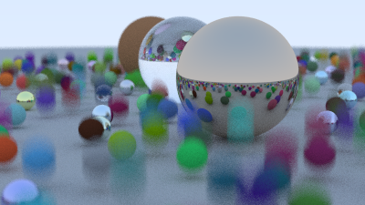
Resultado

Slide 11
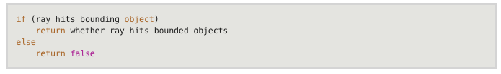
Bounding Volume Hierarchies

Slide 12
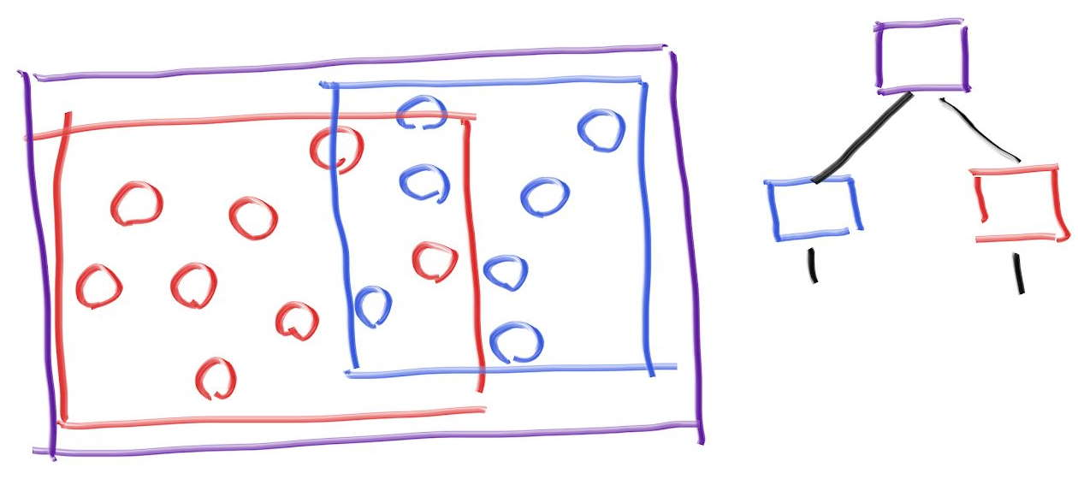
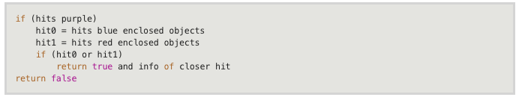
Bounding Volume Hierarchies

Slide 13
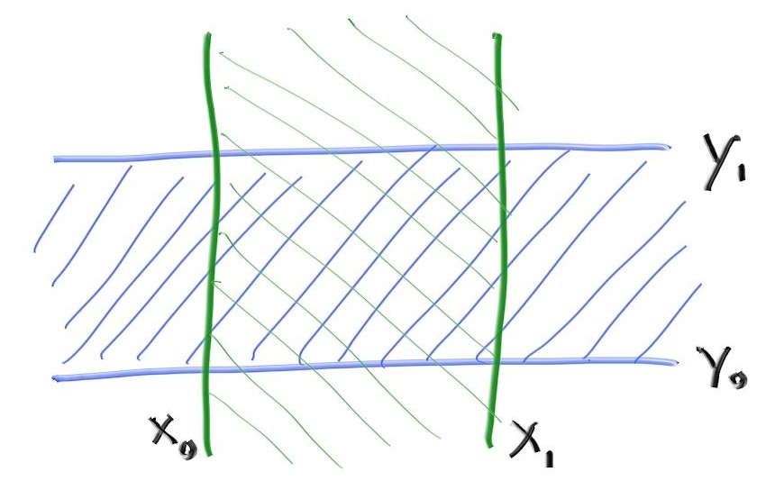
Axis-Aligned Bounding Boxes (AABBs)
two intervals overlapping makes a 2D AABB (a rectangle):

Slide 14
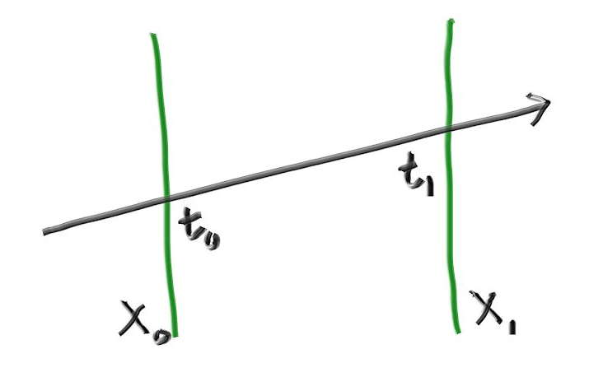
Interseção Ray-slab

Slide 15
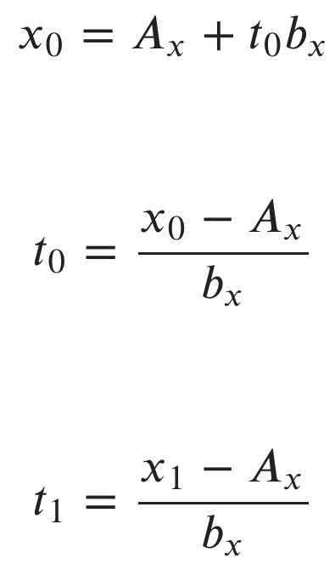

Intersecção

Slide 16
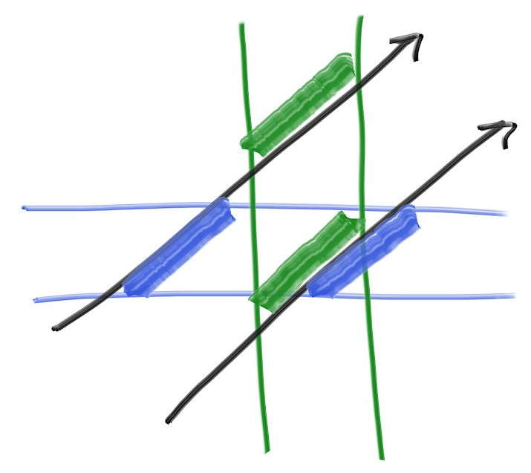
the t-intervals need to overlap

Slide 17

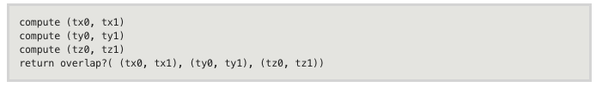

Slide 18
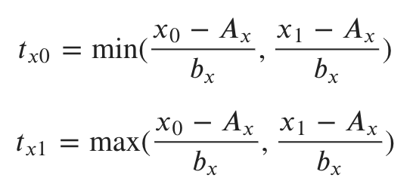
Intersecção
Temos de ter cuidado com bx = 0. Porém se isso acontece, ambos os Txs serão infinito.

Slide 19
#ifndef AABB_H
#define AABB_H
#include "rtweekend.h"
class aabb {
public:
aabb() {}
aabb(const point3& a, const point3& b) { minimum = a; maximum = b;}
point3 min() const {return minimum; }
point3 max() const {return maximum; }
bool hit(const ray& r, double t_min, double t_max) const {
for (int a = 0; a < 3; a++) {
auto t0 = fmin((minimum[a] - r.origin()[a]) / r.direction()[a],
(maximum[a] - r.origin()[a]) / r.direction()[a]);
auto t1 = fmax((minimum[a] - r.origin()[a]) / r.direction()[a],
(maximum[a] - r.origin()[a]) / r.direction()[a]);
t_min = fmax(t0, t_min);
t_max = fmin(t1, t_max);
if (t_max <= t_min)
return false;
}
return true;
}
point3 minimum;
point3 maximum;
};
#endif
Listing 8: [aabb.h] Axis-aligned bounding box class

Slide 20
inline bool aabb::hit(const ray& r, double t_min, double t_max) const {
for (int a = 0; a < 3; a++) {
auto invD = 1.0f / r.direction()[a];
auto t0 = (min()[a] - r.origin()[a]) * invD;
auto t1 = (max()[a] - r.origin()[a]) * invD;
if (invD < 0.0f)
std::swap(t0, t1);
t_min = t0 > t_min ? t0 : t_min;
t_max = t1 < t_max ? t1 : t_max;
if (t_max <= t_min)
return false;
}
return true;
}
Listing 9: [aabb.h] Axis-aligned bounding box hit function

Slide 21
#include "aabb.h"
...
class hittable {
public:
...
virtual bool hit(const ray& r, double t_min, double t_max, hit_record& rec) const = 0;
virtual bool bounding_box(double time0, double time1, aabb& output_box) const = 0;
...
};
Listing 10: [hittable.h] Hittable class with bounding-box

Slide 22
class sphere : public hittable {
public:
...
virtual bool hit(
const ray& r, double t_min, double t_max, hit_record& rec) const override;
virtual bool bounding_box(double time0, double time1, aabb& output_box) const override;
...
};
...
bool sphere::bounding_box(double time0, double time1, aabb& output_box) const {
output_box = aabb(
center - vec3(radius, radius, radius),
center + vec3(radius, radius, radius));
return true;
}
Listing 11: [sphere.h] Sphere with bounding box

Slide 23
...
#include "aabb.h"
...
class moving_sphere : public hittable {
public:
...
virtual bool hit(
const ray& r, double t_min, double t_max, hit_record& rec) const override;
virtual bool bounding_box(
double _time0, double _time1, aabb& output_box) const override;
...
};
...
bool moving_sphere::bounding_box(double _time0, double _time1, aabb& output_box) const {
aabb box0(
center(_time0) - vec3(radius, radius, radius),
center(_time0) + vec3(radius, radius, radius));
aabb box1(
center(_time1) - vec3(radius, radius, radius),
center(_time1) + vec3(radius, radius, radius));
output_box = surrounding_box(box0, box1);
return true;
}
Listing 12: [moving_sphere.h] Moving sphere with bounding box

Slide 24
...
#include "aabb.h"
...
class hittable_list : public hittable {
public:
...
virtual bool hit(
const ray& r, double t_min, double t_max, hit_record& rec) const override;
virtual bool bounding_box(
double time0, double time1, aabb& output_box) const override;
...
};
...
bool hittable_list::bounding_box(double time0, double time1, aabb& output_box) const {
if (objects.empty()) return false;
aabb temp_box;
bool first_box = true;
for (const auto& object : objects) {
if (!object->bounding_box(time0, time1, temp_box)) return false;
output_box = first_box ? temp_box : surrounding_box(output_box, temp_box);
first_box = false;
}
return true;
}
Listing 13: [hittable_list.h] Hittable list with bounding box

Slide 25
aabb surrounding_box(aabb box0, aabb box1) {
point3 small(fmin(box0.min().x(), box1.min().x()),
fmin(box0.min().y(), box1.min().y()),
fmin(box0.min().z(), box1.min().z()));
point3 big(fmax(box0.max().x(), box1.max().x()),
fmax(box0.max().y(), box1.max().y()),
fmax(box0.max().z(), box1.max().z()));
return aabb(small,big);
}
Listing 14: [aabb.h] Surrounding bounding box

Slide 26
#ifndef BVH_H
#define BVH_H
#include "rtweekend.h"
#include "hittable.h"
#include "hittable_list.h"
class bvh_node : public hittable {
public:
bvh_node();
bvh_node(const hittable_list& list, double time0, double time1)
: bvh_node(list.objects, 0, list.objects.size(), time0, time1)
{}
bvh_node(
const std::vector<shared_ptr<hittable>>& src_objects,
size_t start, size_t end, double time0, double time1);
virtual bool hit(
const ray& r, double t_min, double t_max, hit_record& rec) const override;
virtual bool bounding_box(double time0, double time1, aabb& output_box) const override;
public:
shared_ptr<hittable> left;
shared_ptr<hittable> right;
aabb box;
};
bool bvh_node::bounding_box(double time0, double time1, aabb& output_box) const {
output_box = box;
return true;
}
#endif
Listing 15: [bvh.h] Bounding volume hierarchy

Slide 27
bool bvh_node::hit(const ray& r, double t_min, double t_max, hit_record& rec) const {
if (!box.hit(r, t_min, t_max))
return false;
bool hit_left = left->hit(r, t_min, t_max, rec);
bool hit_right = right->hit(r, t_min, hit_left ? rec.t : t_max, rec);
return hit_left || hit_right;
}
Listing 16: [bvh.h] Bounding volume hierarchy hit function

Slide 28
#include <algorithm>
...
bvh_node::bvh_node(
std::vector<shared_ptr<hittable>>& src_objects,
size_t start, size_t end, double time0, double time1
) {
auto objects = src_objects; // Create a modifiable array of the source scene objects
int axis = random_int(0,2);
auto comparator = (axis == 0) ? box_x_compare
: (axis == 1) ? box_y_compare
: box_z_compare;
size_t object_span = end - start;
if (object_span == 1) {
left = right = objects[start];
} else if (object_span == 2) {
if (comparator(objects[start], objects[start+1])) {
left = objects[start];
right = objects[start+1];
} else {
left = objects[start+1];
right = objects[start];
}
} else {
std::sort(objects.begin() + start, objects.begin() + end, comparator);
auto mid = start + object_span/2;
left = make_shared<bvh_node>(objects, start, mid, time0, time1);
right = make_shared<bvh_node>(objects, mid, end, time0, time1);
}
aabb box_left, box_right;
if ( !left->bounding_box (time0, time1, box_left)
|| !right->bounding_box(time0, time1, box_right)
)
std::cerr << "No bounding box in bvh_node constructor.\n";
box = surrounding_box(box_left, box_right);
}
Listing 17: [bvh.h] Bounding volume hierarchy node

Slide 29
inline int random_int(int min, int max) {
// Returns a random integer in [min,max].
return static_cast<int>(random_double(min, max+1));
}
Listing 18: [rtweekend.h] A function to return random integers in a range

Slide 30
inline bool box_compare(const shared_ptr<hittable> a, const shared_ptr<hittable> b, int axis) {
aabb box_a;
aabb box_b;
if (!a->bounding_box(0,0, box_a) || !b->bounding_box(0,0, box_b))
std::cerr << "No bounding box in bvh_node constructor.\n";
return box_a.min().e[axis] < box_b.min().e[axis];
}
bool box_x_compare (const shared_ptr<hittable> a, const shared_ptr<hittable> b) {
return box_compare(a, b, 0);
}
bool box_y_compare (const shared_ptr<hittable> a, const shared_ptr<hittable> b) {
return box_compare(a, b, 1);
}
bool box_z_compare (const shared_ptr<hittable> a, const shared_ptr<hittable> b) {
return box_compare(a, b, 2);
}
Listing 19: [bvh.h] BVH comparison function, X-axis

Slide 31
Texturas Sólidas

Slide 32
#ifndef TEXTURE_H
#define TEXTURE_H
#include "rtweekend.h"
class texture {
public:
virtual color value(double u, double v, const point3& p) const = 0;
};
class solid_color : public texture {
public:
solid_color() {}
solid_color(color c) : color_value(c) {}
solid_color(double red, double green, double blue)
: solid_color(color(red,green,blue)) {}
virtual color value(double u, double v, const vec3& p) const override {
return color_value;
}
private:
color color_value;
};
#endif
Listing 20: [texture.h] A texture class

Slide 33
struct hit_record {
vec3 p;
vec3 normal;
shared_ptr<material> mat_ptr;
double t;
double u;
double v;
bool front_face;
...
Listing 21: [hittable.h] Adding U,V coordinates to the hit_record

Slide 34
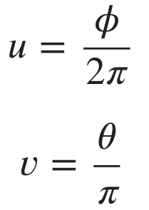
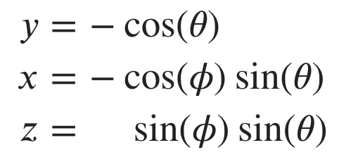
Coordenadas de texturas para esferas

Slide 35




Coordenadas de texturas para esferas

Slide 36
class sphere : public hittable {
...
private:
static void get_sphere_uv(const point3& p, double& u, double& v) {
// p: a given point on the sphere of radius one, centered at the origin.
// u: returned value [0,1] of angle around the Y axis from X=-1.
// v: returned value [0,1] of angle from Y=-1 to Y=+1.
// <1 0 0> yields <0.50 0.50> <-1 0 0> yields <0.00 0.50>
// <0 1 0> yields <0.50 1.00> < 0 -1 0> yields <0.50 0.00>
// <0 0 1> yields <0.25 0.50> < 0 0 -1> yields <0.75 0.50>
auto theta = acos(-p.y());
auto phi = atan2(-p.z(), p.x()) + pi;
u = phi / (2*pi);
v = theta / pi;
}
};
Listing 22: [sphere.h] get_sphere_uv function

Slide 37
bool sphere::hit(...) {
...
rec.t = root;
rec.p = r.at(rec.t);
vec3 outward_normal = (rec.p - center) / radius;
rec.set_face_normal(r, outward_normal);
get_sphere_uv(outward_normal, rec.u, rec.v);
rec.mat_ptr = mat_ptr;
return true;
}
Listing 23: [sphere.h] Sphere UV coordinates from hit

Slide 38
#include "texture.h"
...
class lambertian : public material {
public:
lambertian(const color& a) : albedo(make_shared<solid_color>(a)) {}
lambertian(shared_ptr<texture> a) : albedo(a) {}
virtual bool scatter(
const ray& r_in, const hit_record& rec, color& attenuation, ray& scattered
) const override {
auto scatter_direction = rec.normal + random_unit_vector();
// Catch degenerate scatter direction
if (scatter_direction.near_zero())
scatter_direction = rec.normal;
scattered = ray(rec.p, scatter_direction, r_in.time());
attenuation = albedo->value(rec.u, rec.v, rec.p);
return true;
}
public:
shared_ptr<texture> albedo;
};
Listing 24: [material.h] Lambertian material with texture

Slide 39
class checker_texture : public texture {
public:
checker_texture() {}
checker_texture(shared_ptr<texture> _even, shared_ptr<texture> _odd)
: even(_even), odd(_odd) {}
checker_texture(color c1, color c2)
: even(make_shared<solid_color>(c1)) , odd(make_shared<solid_color>(c2)) {}
virtual color value(double u, double v, const point3& p) const override {
auto sines = sin(10*p.x())*sin(10*p.y())*sin(10*p.z());
if (sines < 0)
return odd->value(u, v, p);
else
return even->value(u, v, p);
}
public:
shared_ptr<texture> odd;
shared_ptr<texture> even;
};
Listing 25: [texture.h] Checkered texture

Slide 40
hittable_list random_scene() {
hittable_list world;
auto checker = make_shared<checker_texture>(color(0.2, 0.3, 0.1), color(0.9, 0.9, 0.9));
world.add(make_shared<sphere>(point3(0,-1000,0), 1000, make_shared<lambertian>(checker)));
for (int a = -11; a < 11; a++) {
...
Listing 26: [main.cc] Checkered texture in use

Slide 41
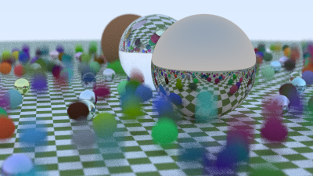
Resultado

Slide 42
hittable_list two_spheres() {
hittable_list objects;
auto checker = make_shared<checker_texture>(color(0.2, 0.3, 0.1), color(0.9, 0.9, 0.9));
objects.add(make_shared<sphere>(point3(0,-10, 0), 10, make_shared<lambertian>(checker)));
objects.add(make_shared<sphere>(point3(0, 10, 0), 10, make_shared<lambertian>(checker)));
return objects;
}
Listing 27: [main.cc] Scene with two checkered spheres

Slide 43
// World
hittable_list world;
point3 lookfrom;
point3 lookat;
auto vfov = 40.0;
auto aperture = 0.0;
switch (0) {
case 1:
world = random_scene();
lookfrom = point3(13,2,3);
lookat = point3(0,0,0);
vfov = 20.0;
aperture = 0.1;
break;
default:
case 2:
world = two_spheres();
lookfrom = point3(13,2,3);
lookat = point3(0,0,0);
vfov = 20.0;
break;
}
// Camera
vec3 vup(0,1,0);
auto dist_to_focus = 10.0;
int image_height = static_cast<int>(image_width / aspect_ratio);
camera cam(lookfrom, lookat, vup, vfov, aspect_ratio, aperture, dist_to_focus, 0.0, 1.0);
...
Listing 28: [main.cc] Second scene

Slide 44
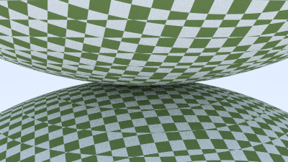
Resultado

Slide 45
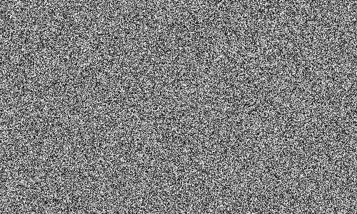
Perlin Noise
Perlin texture doesn’t return white noise like this:

Slide 46
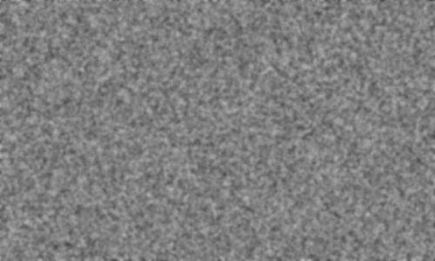
Perlin Noise
Instead it returns something similar to blurred white noise:

Slide 47
Computação Gráfica
Luciano Soares
<lpsoares@insper.edu.br>
Fabio Orfali
<fabioo1@insper.edu.br>

Slide 48
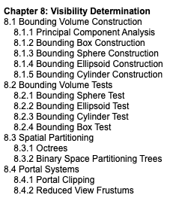
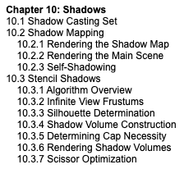
Tópicos da Aula
VER:

Slide 49
VER: http://15462.courses.cs.cmu.edu/spring2021/lecture/spatial

Slide 50

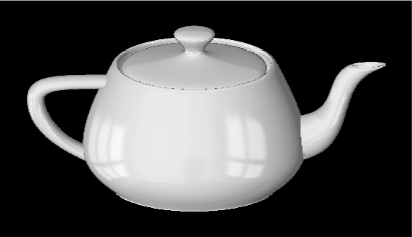
Environment Map
Uma função esférica para cores, que é armazenada como uma textura.
Mapeamento de textura Lat/Long
Vetores de reflexão no mapa de textura
[Blinn & Newell 1976]

Slide 51
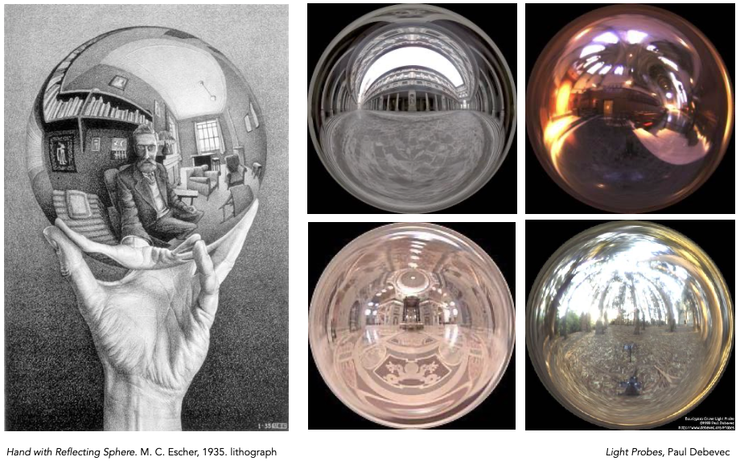
Environment Map Esférico

Slide 52
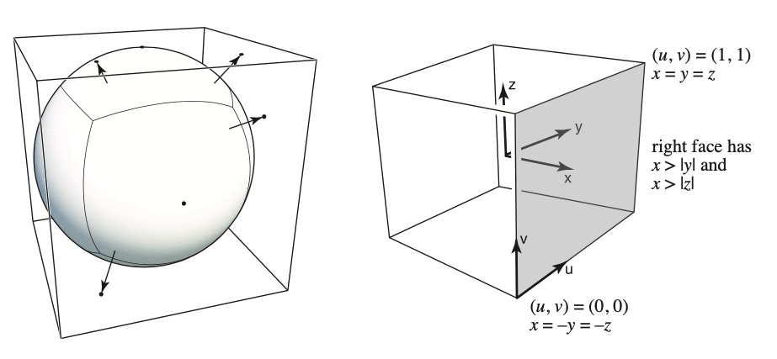
Cube Map
Um vetor mapeia para um ponto no cubo ao longo da direção.
O cubo é texturizado com 6 mapas de textura quadrados.

Slide 53
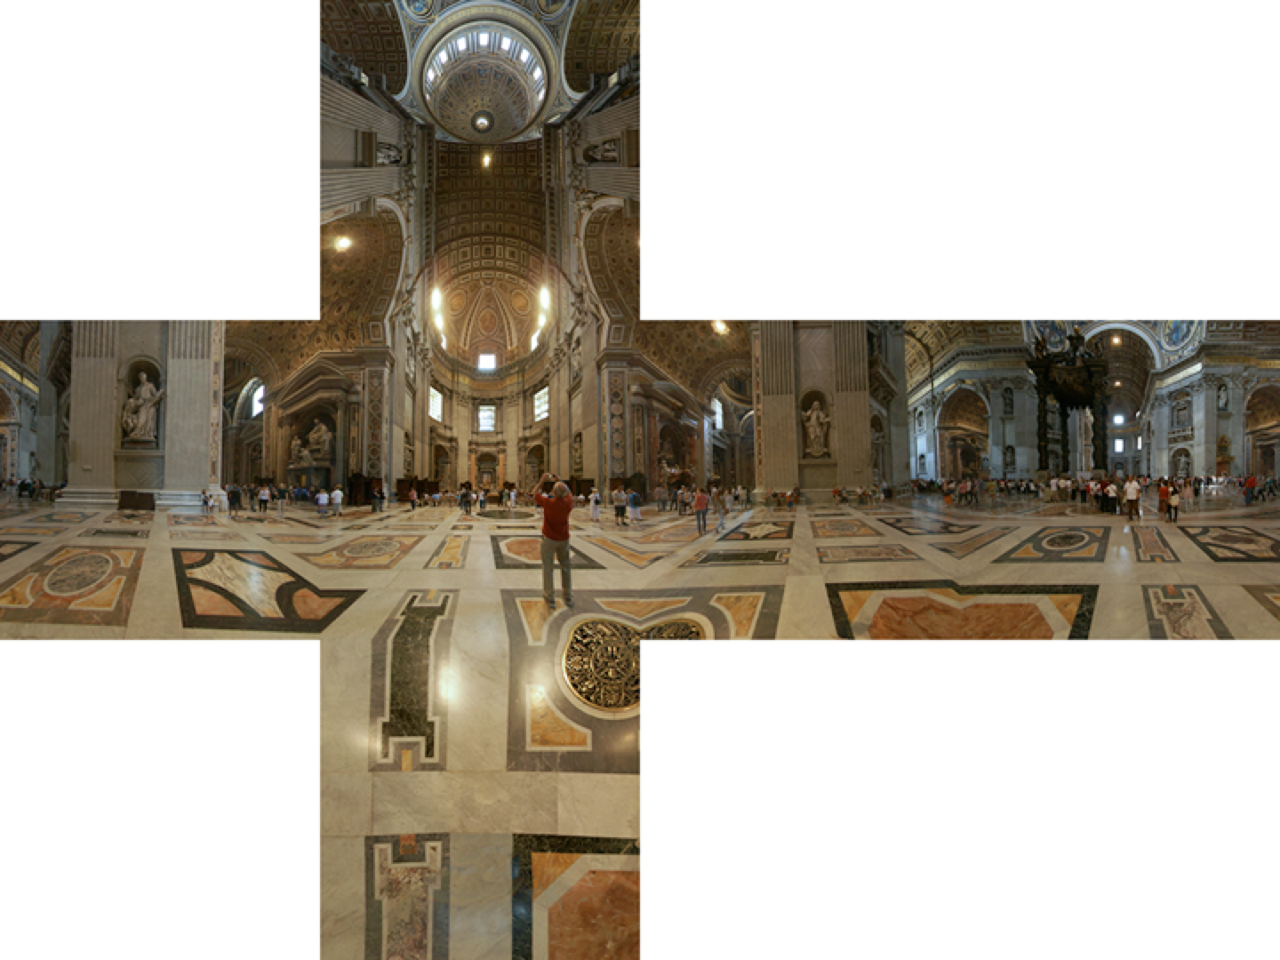
Cube Map
[Emil Persson]
Notes:
http://www.cs.cornell.edu/courses/cs4620/2020fa/

Slide 54
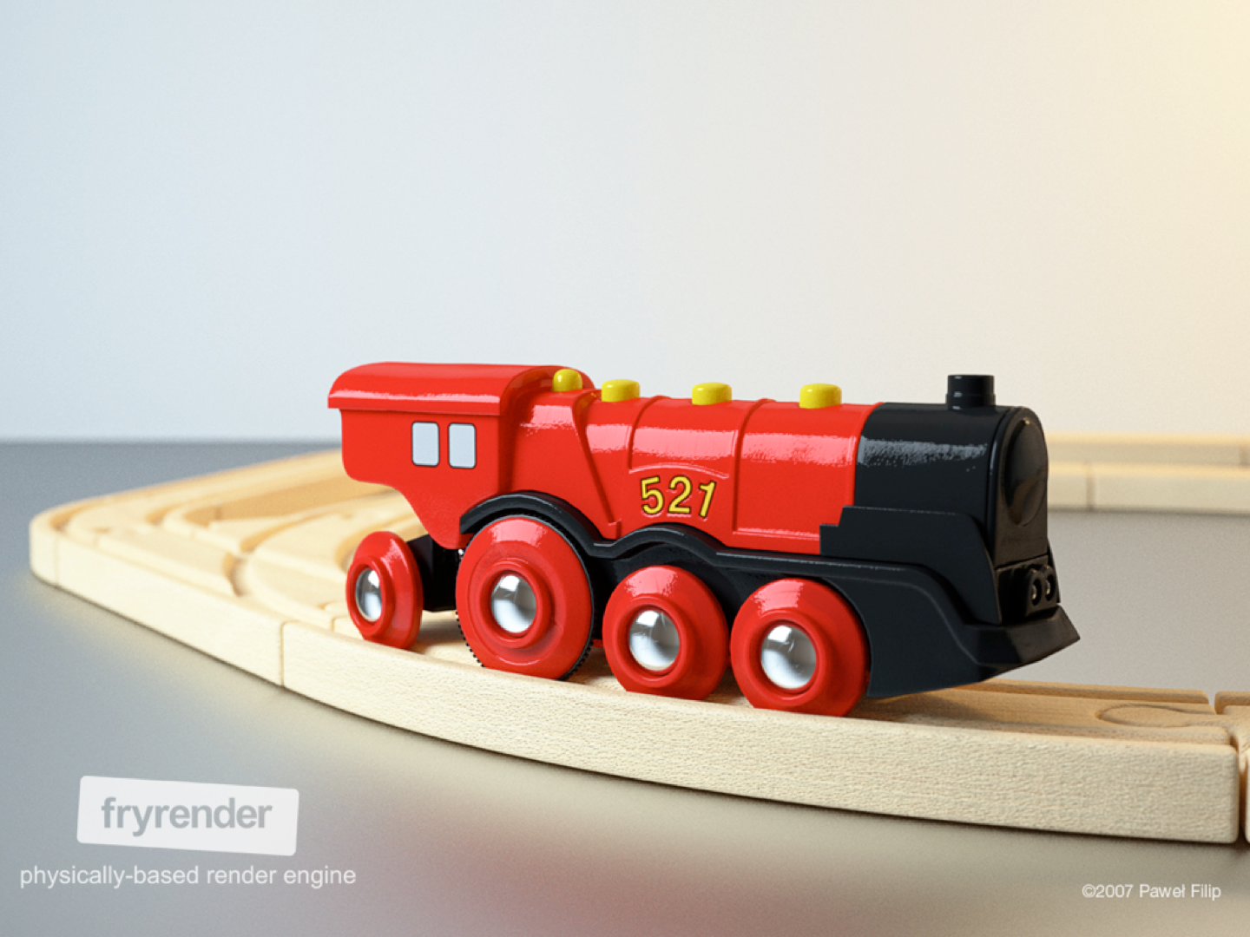
Displacement Mapping
A Textura armazena as perturbações da superfície.

Slide 55
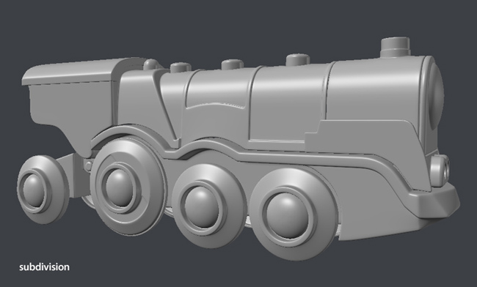
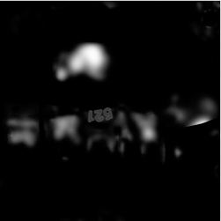

Displacement Mapping
Superfície Base
Displacement Map
Paweł Filip
tolas.wordpress.com
Superfície com perturbações

Slide 56
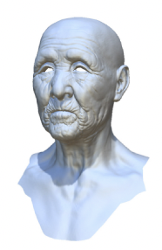
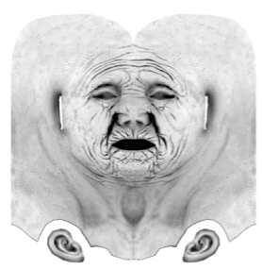
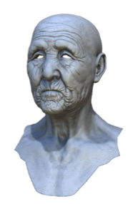
Shading Pré Computado
Shading Simples
Ambient Occlusion
texture map
com Ambient Occlusion
Autodesk

Slide 57
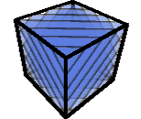
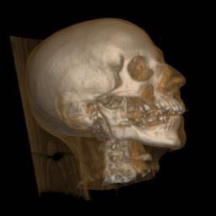
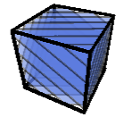
Texturas 3D e Renderização Volumétrica

Slide 58
Acho que não é momento, não falamos disso nessa aula
VER: https://www.scratchapixel.com/lessons/mathematics-physics-for-computer-graphics/mathematics-of-shading

