Slide 1
Computação Gráfica
Aula 08x: Revisão 2 Malhas e Grafo de Cena

Slide 2
Tipos de Malhas Triangulares estudadas
triangleSet
triangleStripSet
indexedTriangleStripSet
indexedFaceSet

Slide 3
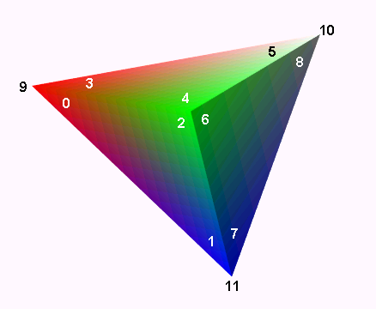
TriangleSet
O nó TriangleSet representa uma geometria 3D que representa uma coleção de triângulos individuais. Cada triângulo é formado por um conjunto consecutivo de três vértices do nó Coordinate. Se o nó de coordenadas não contém um múltiplo de três valores de coordenadas, os vértices restantes devem ser ignorados.
TriangleSet : X3DComposedGeometryNode {
MFNode [in,out] attrib [] [X3DVertexAttributeNode]
SFNode [in,out] color NULL [X3DColorNode]
SFNode [in,out] coord NULL [X3DCoordinateNode]
SFNode [in,out] fogCoord NULL [FogCoordinate]
SFNode [in,out] metadata NULL [X3DMetadataObject]
SFNode [in,out] normal NULL [X3DNormalNode]
SFNode [in,out] texCoord NULL [X3DTextureCoordinateNode]
SFBool [] ccw TRUE
SFBool [] colorPerVertex TRUE
SFBool [] normalPerVertex TRUE
SFBool [] solid TRUE
}
https://www.web3d.org/documents/specifications/19775-1/V3.3/Part01/components/rendering.html#TriangleSet

Slide 4

Exemplo de TriangleSet
<X3D>
<Scene>
<NavigationInfo headlight="false"/>
<Viewpoint orientation='0 -1 0 0.05' position='0.13 2.51 11.24’/>
<Transform>
<Shape>
<Appearance>
<Material emissiveColor='0 .1 0.6’/>
</Appearance>
<TriangleSet>
<Coordinate point=‘
-4 1 3
-2 2 1
-3 4 0
0 2 0
2 3 1
-2 3 1
5 5 -2
4 3 1
6 4 2
‘/>
</TriangleSet>
</Shape>
</Transform>
</Scene>
</X3D>
https://x3dgraphics.com/examples/X3dForWebAuthors/Chapter13GeometryTrianglesQuadrilaterals/TriangleSetExampleIndex.html

Slide 5
TriangleStripSet
Um TriangleStripSet representa uma forma geométrica 3D composta por faixas de triângulos. O campo stripCount descreve quantos vértices devem ser usados em cada faixa do Coordinate. As coordenadas são atribuídas a cada faixa pegando os vértices stripCount[i] do campo de coordenadas, onde i é um índice sequencial de stripCount.
TriangleStripSet : X3DComposedGeometryNode {
MFNode [in,out] attrib [] [X3DVertexAttributeNode]
SFNode [in,out] color NULL [X3DColorNode]
SFNode [in,out] coord NULL [X3DCoordinateNode]
SFNode [in,out] fogCoord NULL [FogCoordinate]
SFNode [in,out] metadata NULL [X3DMetadataObject]
SFNode [in,out] normal NULL [X3DNormalNode]
MFInt32 [in,out] stripCount [] [3,∞)
SFNode [in,out] texCoord NULL [X3DTextureCoordinateNode]
SFBool [] ccw TRUE
SFBool [] colorPerVertex TRUE
SFBool [] normalPerVertex TRUE
SFBool [] solid TRUE
}
https://www.web3d.org/documents/specifications/19775-1/V3.3/Part01/components/rendering.html#TriangleStripSet

Slide 6
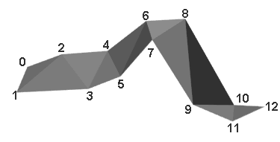
TriangleStripSet (exemplo)
<Shape>
<TriangleStripSet stripCount=‘13'>
<Coordinate point=‘
-4.0 -1.0 -0.5
-4.5 -2.0 -0.5
-3.0 -0.5 0.0
-2.5 -1.5 -0.5
-2.0 -0.5 -1.0
-1.5 -1.5 -0.5
-0.5 0.5 -0.5
0.0 0.0 0.0
1.0 0.5 -0.5
1.5 -2.0 -1.0
2.5 -2.0 -0.5
2.5 -2.5 -0.5
3.5 -2.0 -1.0
'/>
</TriangleStripSet> <Appearance> <Material diffuseColor='0.5 0.5 0.5'/> </Appearance>
</Shape>
Os vértices são conectados de 3 em 3. Assim o primeiro triângulos será ligando os vértices (0, 1, 2), o segundo (1, 2, 3) e assim por diante, até chegar a contagem definida em stripCount. Perceba que stripCount é uma lista.
-> P_{0_}
-> P_{1_}
-> P_{2_}
-> P_{3_}
-> P_{4_}
-> P_{5_}
-> P_{6_}
-> P_{7_}
-> P_{8_}
-> P_{9_}
-> P₁₀
-> P₁₁
-> P₁₂
https://www.web3d.org/documents/specifications/19775-1/V3.3/Part01/components/rendering.html#TriangleStripSet

Slide 7
IndexedTriangleStripSet
Um IndexedTriangleStripSet representa uma forma 3D composta de um conjunto de triângulos em forma de uma tira, são usados nos índices do campo index para especificar como montar faixa de triângulos. Um índice de "−1" indica que a faixa atual terminou e a próxima começa.
IndexedTriangleStripSet : X3DComposedGeometryNode {
MFInt32 [in] set_index [] [0,∞) or −1
MFNode [in,out] attrib [] [X3DVertexAttributeNode]
SFNode [in,out] color NULL [X3DColorNode]
SFNode [in,out] coord NULL [X3DCoordinateNode]
SFNode [in,out] fogCoord NULL [FogCoordinate]
SFNode [in,out] metadata NULL [X3DMetadataObject]
SFNode [in,out] normal NULL [X3DNormalNode]
SFNode [in,out] texCoord NULL [X3DTextureCoordinateNode]
SFBool [] ccw TRUE
SFBool [] colorPerVertex TRUE
SFBool [] normalPerVertex TRUE
SFBool [] solid TRUE
MFInt32 [] index [] [0,∞) or −1
}
https://www.web3d.org/documents/specifications/19775-1/V3.3/Part01/components/rendering.html#IndexedTriangleStripSet

Slide 8
IndexedTriangleStripSet (exemplo)
<Shape>
<IndexedTriangleStripSet index='0 1 2 3 4 5 6 7 8 9 10 11 12 -1'>
<Coordinate point=‘
-4.0 -1.0 -0.5
-4.5 -2.0 -0.5
-3.0 -0.5 0.0
-2.5 -1.5 -0.5
-2.0 -0.5 -1.0
-1.5 -1.5 -0.5
-0.5 0.5 -0.5
0.0 0.0 0.0
1.0 0.5 -0.5
1.5 -2.0 -1.0
2.5 -2.0 -0.5
2.5 -2.5 -0.5
3.5 -2.0 -1.0
'/>
</IndexedTriangleStripSet> <Appearance> <Material diffuseColor='0.5 0.5 0.5'/> </Appearance>
</Shape>
Os vértices são conectados seguindo a ordem definida no campo index. Ligando de 3 em 3 vértices até encontrar um valor -1. Outras listas de índices podem aparecer na sequencia.
-> P_{0_}
-> P_{1_}
-> P_{2_}
-> P_{3_}
-> P_{4_}
-> P_{5_}
-> P_{6_}
-> P_{7_}
-> P_{8_}
-> P_{9_}
-> P₁₀
-> P₁₁
-> P₁₂
https://www.web3d.org/documents/specifications/19775-1/V3.3/Part01/components/rendering.html#IndexedTriangleStripSet

Slide 9
Cuidado
A direção de montagem dos triângulos precisa ser constantemente alternada, senão a detecção de triângulos irá falhar
2
4
6
0
3
5
1
Um dos truques é inverter a ordem de conexão, assim nos triângulos pares, inverte a conexão de dois vértices.
Por exemplo, conecte: (0,1,2), depois (1,3,2), depois (2,3,4) e assim por diante.

Slide 10
IndexedFaceSet
Um IndexedFaceSet representa uma forma 3D composta de um conjunto de polígonos, são usados nos índices do campo coordIndex para especificar como montar os triângulos, o campo colordIndex para especificar como mapear as cores por vértices, e o campo texCoordIndex
para mapear as coordenadas de textura.
IndexedFaceSet : X3DComposedGeometryNode {
MFInt32 [in] set_colorIndex
MFInt32 [in] set_coordIndex
MFInt32 [in] set_normalIndex
MFInt32 [in] set_texCoordIndex
MFNode [in,out] attrib [] [X3DVertexAttributeNode]
SFNode [in,out] color NULL [X3DColorNode]
SFNode [in,out] coord NULL [X3DCoordinateNode]
SFNode [in,out] fogCoord NULL [FogCoordinate]
SFNode [in,out] metadata NULL [X3DMetadataObject]
SFNode [in,out] normal NULL [X3DNormalNode]
SFNode [in,out] texCoord NULL [X3DTextureCoordinateNode]
SFBool [] ccw TRUE
MFInt32 [] colorIndex [] [0,∞) or -1
SFBool [] colorPerVertex TRUE
SFBool [] convex TRUE
MFInt32 [] coordIndex [] [0,∞) or -1
SFFloat [] creaseAngle 0 [0,∞)
MFInt32 [] normalIndex [] [0,∞) or -1
SFBool [] normalPerVertex TRUE
SFBool [] solid TRUE
MFInt32 [] texCoordIndex [] [-1,∞)
}
https://www.web3d.org/documents/specifications/19775-1/V3.3/Part01/components/geometry3D.html#IndexedFaceSet

Slide 11
IndexedFaceSet
O nó IndexedFaceSet representa uma forma 3D formada pela construção de faces (polígonos) de vértices listados no campo coord.
IndexedFaceSet usa os índices em seu campo coordIndex para especificar as faces poligonais indexando nas coordenadas no nó Coordinate. Um índice de "−1" indica que a face atual terminou e a próxima começa.
Cada face do IndexedFaceSet deve ter:
- pelo menos três vértices não coincidentes;
- vértices que definem um polígono planar;
- vértices não possuem auto-intersecção.
https://www.web3d.org/documents/specifications/19775-1/V3.3/Part01/components/geometry3D.html#IndexedFaceSet

Slide 12
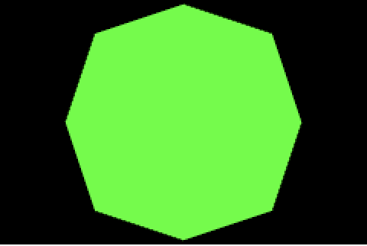
Exemplo IndexedFaceSet
<Shape>
<IndexedFaceSet coordIndex='0 1 2 3 4 5 6 7 -1'>
<Coordinate point=‘
-3 3 0
-4 0 0
-3 -3 0
0 -4 0
3 -3 0
4 0 0
3 3 0
0 4 0
'/>
</IndexedFaceSet> <Appearance> <Material emissiveColor=‘0 1 0'/> </Appearance>
</Shape>
P₇
-> P_{0_}
-> P_{1_}
-> P_{2_}
-> P_{3_}
-> P_{4_}
-> P_{5_}
-> P_{6_}
-> P_{7_}
P₀
P₆
P₁
P₅
P₂
P₄
P₃
Os pontos são o contorna da superfície.

Slide 13
Exemplo IndexedFaceSet
Possível solução
P₇
P₀
P₆
P₁
P₅
P₂
P₄
P₃

Slide 14
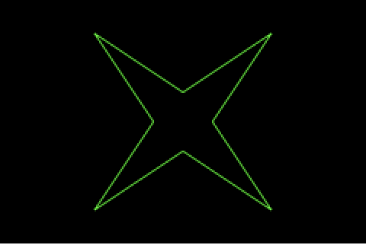
Exemplo IndexedFaceSet
Mas e se a geometria fosse assim:
<Shape>
<IndexedFaceSet coordIndex='0 1 2 3 4 5 6 7 -1'>
<Coordinate point=‘
-3 3 0
-1 0 0
-3 -3 0
0 -1 0
3 -3 0
1 0 0
3 3 0
0 1 0
'/>
</IndexedFaceSet> <Appearance> <Material emissiveColor=‘0 1 0'/> </Appearance>
</Shape>
-> P_{0_}
-> P_{1_}
-> P_{2_}
-> P_{3_}
-> P_{4_}
-> P_{5_}
-> P_{6_}
-> P_{7_}
P₀
P₆
P₇
P₁
P₅
P₃
P₂
P₄
Dessa forma também não funcionaria pela especificação X3D e geraria uma geometria errada. Para funcionar você deveria especifica convex=“false”, porém não vamos trabalhar com essa situação.

Slide 15
Grafo de Cena

Slide 16
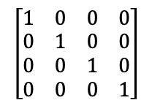
Criando Matriz Identidade
Início
<Scene>
<Transform scale="2 2 2">
<Shape>
<TriangleSet>
<Coordinate point='-1 -1 0 1 -1 0 0 1 0'/>
</TriangleSet>
<Appearance>
<Material diffuseColor='1 0 0'/>
</Appearance>
</Shape>
<Transform scale="2 1 1">
<Transform translation="0 -1 -1">
<Shape>
<TriangleSet>
<Coordinate point='-1 -1 0 1 -1 0 0 1 0'/>
</TriangleSet>
<Appearance>
<Material diffuseColor='0 1 0'/>
</Appearance>
</Shape>
</Transform>
<Transform translation="0 1 -2">
<Transform rotation="0 0 1 3.14">
<Shape>
<TriangleSet>
<Coordinate point='-1 -1 0 1 -1 0 0 1 0'/>
</TriangleSet>
<Appearance>
<Material diffuseColor='0 0 1'/>
</Appearance>
</Shape>
</Transform>
</Transform>
</Transform>
</Transform>
</Scene>
MATRIZ
PILHA
Notes:
PILHA

Slide 17
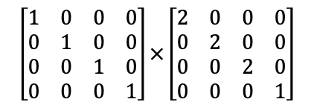
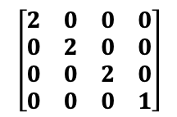
Empilhando e Atualizando Transformação
<Scene>
<Transform scale="2 2 2">
<Shape>
<TriangleSet>
<Coordinate point='-1 -1 0 1 -1 0 0 1 0'/>
</TriangleSet>
<Appearance>
<Material diffuseColor='1 0 0'/>
</Appearance>
</Shape>
<Transform scale="2 1 1">
<Transform translation="0 -1 -1">
<Shape>
<TriangleSet>
<Coordinate point='-1 -1 0 1 -1 0 0 1 0'/>
</TriangleSet>
<Appearance>
<Material diffuseColor='0 1 0'/>
</Appearance>
</Shape>
</Transform>
<Transform translation="0 1 -2">
<Transform rotation="0 0 1 3.14">
<Shape>
<TriangleSet>
<Coordinate point='-1 -1 0 1 -1 0 0 1 0'/>
</TriangleSet>
<Appearance>
<Material diffuseColor='0 0 1'/>
</Appearance>
</Shape>
</Transform>
</Transform>
</Transform>
</Transform>
</Scene>
push
MATRIZ
PILHA
Notes:
PILHA

Slide 18

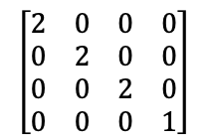
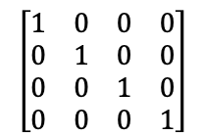
Desenhando Triângulo Vermelho
<Scene>
<Transform scale="2 2 2">
<Shape>
<TriangleSet>
<Coordinate point='-1 -1 0 1 -1 0 0 1 0'/>
</TriangleSet>
<Appearance>
<Material diffuseColor='1 0 0'/>
</Appearance>
</Shape>
<Transform scale="2 1 1">
<Transform translation="0 -1 -1">
<Shape>
<TriangleSet>
<Coordinate point='-1 -1 0 1 -1 0 0 1 0'/>
</TriangleSet>
<Appearance>
<Material diffuseColor='0 1 0'/>
</Appearance>
</Shape>
</Transform>
<Transform translation="0 1 -2">
<Transform rotation="0 0 1 3.14">
<Shape>
<TriangleSet>
<Coordinate point='-1 -1 0 1 -1 0 0 1 0'/>
</TriangleSet>
<Appearance>
<Material diffuseColor='0 0 1'/>
</Appearance>
</Shape>
</Transform>
</Transform>
</Transform>
</Transform>
</Scene>
draw
MATRIZ
PILHA
Notes:
PILHA

Slide 19
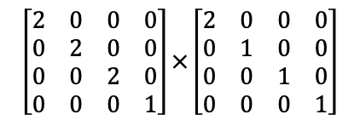
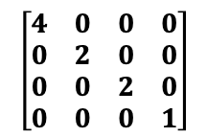
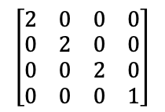
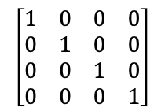
Empilhando e Atualizando Transformação
<Scene>
<Transform scale="2 2 2">
<Shape>
<TriangleSet>
<Coordinate point='-1 -1 0 1 -1 0 0 1 0'/>
</TriangleSet>
<Appearance>
<Material diffuseColor='1 0 0'/>
</Appearance>
</Shape>
<Transform scale="2 1 1">
<Transform translation="0 -1 -1">
<Shape>
<TriangleSet>
<Coordinate point='-1 -1 0 1 -1 0 0 1 0'/>
</TriangleSet>
<Appearance>
<Material diffuseColor='0 1 0'/>
</Appearance>
</Shape>
</Transform>
<Transform translation="0 1 -2">
<Transform rotation="0 0 1 3.14">
<Shape>
<TriangleSet>
<Coordinate point='-1 -1 0 1 -1 0 0 1 0'/>
</TriangleSet>
<Appearance>
<Material diffuseColor='0 0 1'/>
</Appearance>
</Shape>
</Transform>
</Transform>
</Transform>
</Transform>
</Scene>
push
MATRIZ
PILHA
Notes:
PILHA

Slide 20
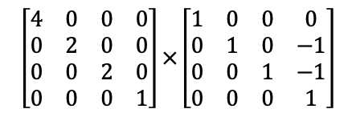
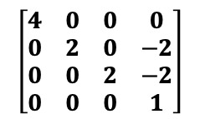
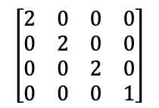
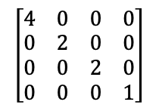
Empilhando e Atualizando Transformação
<Scene>
<Transform scale="2 2 2">
<Shape>
<TriangleSet>
<Coordinate point='-1 -1 0 1 -1 0 0 1 0'/>
</TriangleSet>
<Appearance>
<Material diffuseColor='1 0 0'/>
</Appearance>
</Shape>
<Transform scale="2 1 1">
<Transform translation="0 -1 -1">
<Shape>
<TriangleSet>
<Coordinate point='-1 -1 0 1 -1 0 0 1 0'/>
</TriangleSet>
<Appearance>
<Material diffuseColor='0 1 0'/>
</Appearance>
</Shape>
</Transform>
<Transform translation="0 1 -2">
<Transform rotation="0 0 1 3.14">
<Shape>
<TriangleSet>
<Coordinate point='-1 -1 0 1 -1 0 0 1 0'/>
</TriangleSet>
<Appearance>
<Material diffuseColor='0 0 1'/>
</Appearance>
</Shape>
</Transform>
</Transform>
</Transform>
</Transform>
</Scene>
push
MATRIZ
PILHA
Notes:
PILHA

Slide 21

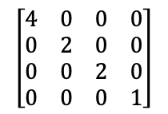
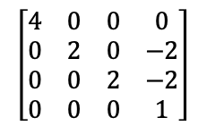
Desenhando Triângulo Verde
<Scene>
<Transform scale="2 2 2">
<Shape>
<TriangleSet>
<Coordinate point='-1 -1 0 1 -1 0 0 1 0'/>
</TriangleSet>
<Appearance>
<Material diffuseColor='1 0 0'/>
</Appearance>
</Shape>
<Transform scale="2 1 1">
<Transform translation="0 -1 -1">
<Shape>
<TriangleSet>
<Coordinate point='-1 -1 0 1 -1 0 0 1 0'/>
</TriangleSet>
<Appearance>
<Material diffuseColor='0 1 0'/>
</Appearance>
</Shape>
</Transform>
<Transform translation="0 1 -2">
<Transform rotation="0 0 1 3.14">
<Shape>
<TriangleSet>
<Coordinate point='-1 -1 0 1 -1 0 0 1 0'/>
</TriangleSet>
<Appearance>
<Material diffuseColor='0 0 1'/>
</Appearance>
</Shape>
</Transform>
</Transform>
</Transform>
</Transform>
</Scene>
draw
MATRIZ
PILHA
Notes:
PILHA

Slide 22
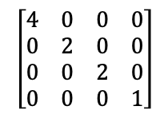
Desempilhando e Atualizando Transformação
<Scene>
<Transform scale="2 2 2">
<Shape>
<TriangleSet>
<Coordinate point='-1 -1 0 1 -1 0 0 1 0'/>
</TriangleSet>
<Appearance>
<Material diffuseColor='1 0 0'/>
</Appearance>
</Shape>
<Transform scale="2 1 1">
<Transform translation="0 -1 -1">
<Shape>
<TriangleSet>
<Coordinate point='-1 -1 0 1 -1 0 0 1 0'/>
</TriangleSet>
<Appearance>
<Material diffuseColor='0 1 0'/>
</Appearance>
</Shape>
</Transform>
<Transform translation="0 1 -2">
<Transform rotation="0 0 1 3.14">
<Shape>
<TriangleSet>
<Coordinate point='-1 -1 0 1 -1 0 0 1 0'/>
</TriangleSet>
<Appearance>
<Material diffuseColor='0 0 1'/>
</Appearance>
</Shape>
</Transform>
</Transform>
</Transform>
</Transform>
</Scene>
pop
MATRIZ
PILHA
Notes:
PILHA

Slide 23
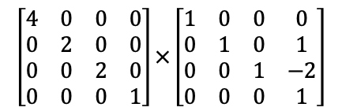
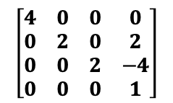
Empilhando e Atualizando Transformação
<Scene>
<Transform scale="2 2 2">
<Shape>
<TriangleSet>
<Coordinate point='-1 -1 0 1 -1 0 0 1 0'/>
</TriangleSet>
<Appearance>
<Material diffuseColor='1 0 0'/>
</Appearance>
</Shape>
<Transform scale="2 1 1">
<Transform translation="0 -1 -1">
<Shape>
<TriangleSet>
<Coordinate point='-1 -1 0 1 -1 0 0 1 0'/>
</TriangleSet>
<Appearance>
<Material diffuseColor='0 1 0'/>
</Appearance>
</Shape>
</Transform>
<Transform translation="0 1 -2">
<Transform rotation="0 0 1 3.14">
<Shape>
<TriangleSet>
<Coordinate point='-1 -1 0 1 -1 0 0 1 0'/>
</TriangleSet>
<Appearance>
<Material diffuseColor='0 0 1'/>
</Appearance>
</Shape>
</Transform>
</Transform>
</Transform>
</Transform>
</Scene>
push
MATRIZ
PILHA
Notes:
PILHA

Slide 24
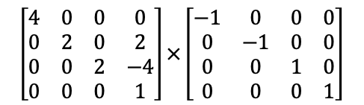
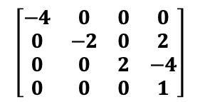
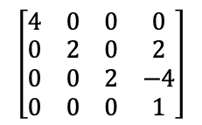
Empilhando e Atualizando Transformação
<Scene>
<Transform scale="2 2 2">
<Shape>
<TriangleSet>
<Coordinate point='-1 -1 0 1 -1 0 0 1 0'/>
</TriangleSet>
<Appearance>
<Material diffuseColor='1 0 0'/>
</Appearance>
</Shape>
<Transform scale="2 1 1">
<Transform translation="0 -1 -1">
<Shape>
<TriangleSet>
<Coordinate point='-1 -1 0 1 -1 0 0 1 0'/>
</TriangleSet>
<Appearance>
<Material diffuseColor='0 1 0'/>
</Appearance>
</Shape>
</Transform>
<Transform translation="0 1 -2">
<Transform rotation="0 0 1 3.14">
<Shape>
<TriangleSet>
<Coordinate point='-1 -1 0 1 -1 0 0 1 0'/>
</TriangleSet>
<Appearance>
<Material diffuseColor='0 0 1'/>
</Appearance>
</Shape>
</Transform>
</Transform>
</Transform>
</Transform>
</Scene>
push
MATRIZ
PILHA
Notes:
PILHA

Slide 25
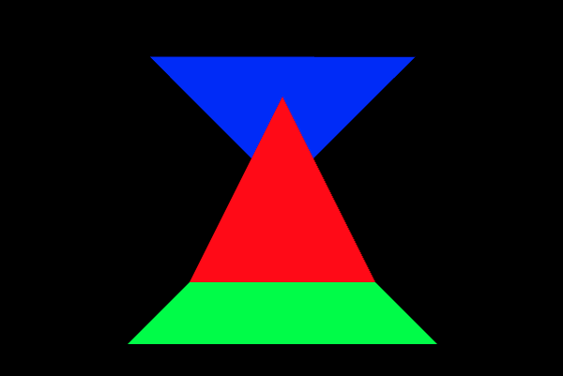
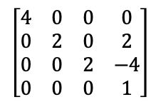
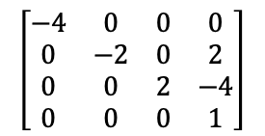
Desenhando Triângulo Azul
<Scene>
<Transform scale="2 2 2">
<Shape>
<TriangleSet>
<Coordinate point='-1 -1 0 1 -1 0 0 1 0'/>
</TriangleSet>
<Appearance>
<Material diffuseColor='1 0 0'/>
</Appearance>
</Shape>
<Transform scale="2 1 1">
<Transform translation="0 -1 -1">
<Shape>
<TriangleSet>
<Coordinate point='-1 -1 0 1 -1 0 0 1 0'/>
</TriangleSet>
<Appearance>
<Material diffuseColor='0 1 0'/>
</Appearance>
</Shape>
</Transform>
<Transform translation="0 1 -2">
<Transform rotation="0 0 1 3.14">
<Shape>
<TriangleSet>
<Coordinate point='-1 -1 0 1 -1 0 0 1 0'/>
</TriangleSet>
<Appearance>
<Material diffuseColor='0 0 1'/>
</Appearance>
</Shape>
</Transform>
</Transform>
</Transform>
</Transform>
</Scene>
draw
MATRIZ
PILHA
Notes:
PILHA

Slide 26
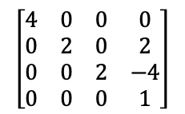
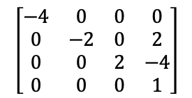
Desempilhando e Atualizando Transformação
<Scene>
<Transform scale="2 2 2">
<Shape>
<TriangleSet>
<Coordinate point='-1 -1 0 1 -1 0 0 1 0'/>
</TriangleSet>
<Appearance>
<Material diffuseColor='1 0 0'/>
</Appearance>
</Shape>
<Transform scale="2 1 1">
<Transform translation="0 -1 -1">
<Shape>
<TriangleSet>
<Coordinate point='-1 -1 0 1 -1 0 0 1 0'/>
</TriangleSet>
<Appearance>
<Material diffuseColor='0 1 0'/>
</Appearance>
</Shape>
</Transform>
<Transform translation="0 1 -2">
<Transform rotation="0 0 1 3.14">
<Shape>
<TriangleSet>
<Coordinate point='-1 -1 0 1 -1 0 0 1 0'/>
</TriangleSet>
<Appearance>
<Material diffuseColor='0 0 1'/>
</Appearance>
</Shape>
</Transform>
</Transform>
</Transform>
</Transform>
</Scene>
pop
MATRIZ
PILHA
Notes:
PILHA

Slide 27
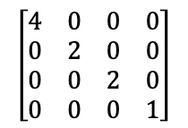
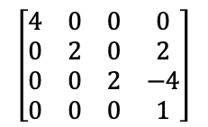
Desempilhando e Atualizando Transformação
<Scene>
<Transform scale="2 2 2">
<Shape>
<TriangleSet>
<Coordinate point='-1 -1 0 1 -1 0 0 1 0'/>
</TriangleSet>
<Appearance>
<Material diffuseColor='1 0 0'/>
</Appearance>
</Shape>
<Transform scale="2 1 1">
<Transform translation="0 -1 -1">
<Shape>
<TriangleSet>
<Coordinate point='-1 -1 0 1 -1 0 0 1 0'/>
</TriangleSet>
<Appearance>
<Material diffuseColor='0 1 0'/>
</Appearance>
</Shape>
</Transform>
<Transform translation="0 1 -2">
<Transform rotation="0 0 1 3.14">
<Shape>
<TriangleSet>
<Coordinate point='-1 -1 0 1 -1 0 0 1 0'/>
</TriangleSet>
<Appearance>
<Material diffuseColor='0 0 1'/>
</Appearance>
</Shape>
</Transform>
</Transform>
</Transform>
</Transform>
</Scene>
pop
MATRIZ
PILHA
Notes:
PILHA

Slide 28
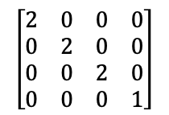
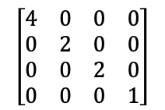
Desempilhando e Atualizando Transformação
<Scene>
<Transform scale="2 2 2">
<Shape>
<TriangleSet>
<Coordinate point='-1 -1 0 1 -1 0 0 1 0'/>
</TriangleSet>
<Appearance>
<Material diffuseColor='1 0 0'/>
</Appearance>
</Shape>
<Transform scale="2 1 1">
<Transform translation="0 -1 -1">
<Shape>
<TriangleSet>
<Coordinate point='-1 -1 0 1 -1 0 0 1 0'/>
</TriangleSet>
<Appearance>
<Material diffuseColor='0 1 0'/>
</Appearance>
</Shape>
</Transform>
<Transform translation="0 1 -2">
<Transform rotation="0 0 1 3.14">
<Shape>
<TriangleSet>
<Coordinate point='-1 -1 0 1 -1 0 0 1 0'/>
</TriangleSet>
<Appearance>
<Material diffuseColor='0 0 1'/>
</Appearance>
</Shape>
</Transform>
</Transform>
</Transform>
</Transform>
</Scene>
pop
MATRIZ
PILHA
Notes:
PILHA

Slide 29
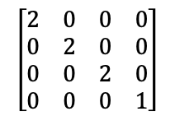
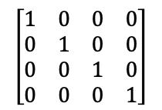
Desempilhando e Atualizando Transformação
<Scene>
<Transform scale="2 2 2">
<Shape>
<TriangleSet>
<Coordinate point='-1 -1 0 1 -1 0 0 1 0'/>
</TriangleSet>
<Appearance>
<Material diffuseColor='1 0 0'/>
</Appearance>
</Shape>
<Transform scale="2 1 1">
<Transform translation="0 -1 -1">
<Shape>
<TriangleSet>
<Coordinate point='-1 -1 0 1 -1 0 0 1 0'/>
</TriangleSet>
<Appearance>
<Material diffuseColor='0 1 0'/>
</Appearance>
</Shape>
</Transform>
<Transform translation="0 1 -2">
<Transform rotation="0 0 1 3.14">
<Shape>
<TriangleSet>
<Coordinate point='-1 -1 0 1 -1 0 0 1 0'/>
</TriangleSet>
<Appearance>
<Material diffuseColor='0 0 1'/>
</Appearance>
</Shape>
</Transform>
</Transform>
</Transform>
</Transform>
</Scene>
MATRIZ
PILHA
pop
Notes:
PILHA

Slide 30
Computação Gráfica
Luciano Soares
<lpsoares@insper.edu.br>

