Slide 1
Computação Gráfica
Revisão: Transformações e Projeções

Slide 2
Exemplo Completo:
Transformações Geométricas
Quatérnios
Transformação Look-at
Transformação Perspectiva
Coordenadas normalizadas (NDC)
Divisão Homogênea
Transformação de tela
Supersampling

Slide 3
Definindo posição da câmera virtual
y
<Scene>
<Viewpoint/>
</Scene>
V_{up}
(0, 0, 10)
V_{view}
x
z
V_{right}
https://www.web3d.org/documents/specifications/19775-1/V3.3/Part01/components/navigation.html

Slide 4


Definindo posição da câmera virtual
y
<Scene>
<Viewpoint orientation="0 1 0 -1.57"/>
</Scene>
V_{up}
90°
x
z
V_{right}
V_{view}
https://www.web3d.org/documents/specifications/19775-1/V3.3/Part01/components/navigation.html

Slide 5
Definindo posição da câmera virtual
V_{up}
y
V_{right}
V_{view}
<Scene>
<Viewpoint position="-8 1 1" orientation="0 1 0 -1.57"/>
</Scene>
(-8, 1, 1)
x
z
https://www.web3d.org/documents/specifications/19775-1/V3.3/Part01/components/navigation.html

Slide 6


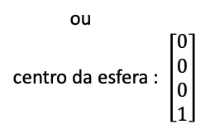
Criando uma esfera no centro do mundo
Visualização do ponto de vista da câmera mas no sistema de coordenadas do mundo.
y
x
z
<Scene>
<Viewpoint position="-8 1 1" orientation="0 1 0 -1.57"/>
<Transform>
<Shape>
<Sphere radius='0.1'/>
<Appearance>
<Material diffuseColor='1 1 0'/>
</Appearance>
</Shape>
</Transform>
</Scene>
(0, 0, 0)
amarelo
https://www.web3d.org/documents/specifications/19775-1/V3.3/Part01/components/group.html
Notes:
https://www.web3d.org/documents/specifications/19775-1/V3.3/Part01/components/geometry3D.html#Sphere

Slide 7
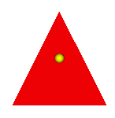
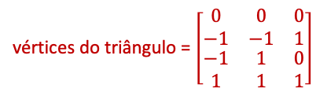
Criando um triângulo no centro do mundo
<Scene>
<Viewpoint position="-8 1 1" orientation="0 1 0 -1.57"/>
<Transform>
<Shape>
<Sphere radius='0.1'/>
<Appearance>
<Material diffuseColor='1 1 0'/>
</Appearance>
</Shape>
</Transform>
<Transform>
<Shape>
<TriangleSet>
<Coordinate point='0 -1 -1 0 -1 1 0 1 0'/>
</TriangleSet>
<Appearance>
<Material diffuseColor='1 0 0'/>
</Appearance>
</Shape>
</Transform>
</Scene>
y
x
(0, 1, 0)
z
(0, -1, -1)
(0, -1, 1)
P₁
P₀
P₂
vermelho
https://www.web3d.org/documents/specifications/19775-1/V3.3/Part01/components/rendering.html

Slide 8
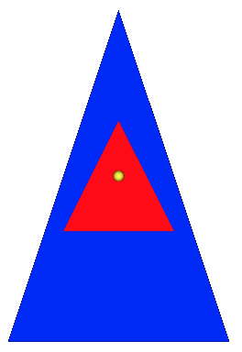

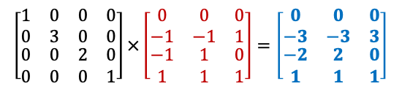
Novo triângulo ampliado
(0, 3, 0)
<Scene>
<Viewpoint position="-8 1 1" orientation="0 1 0 -1.57"/>
<Transform>
<Shape>
<Sphere radius='0.1'/>
<Appearance>
<Material diffuseColor='1 1 0'/>
</Appearance>
</Shape>
</Transform>
<Transform>
<Shape>
<TriangleSet>
<Coordinate point='0 -1 -1 0 -1 1 0 1 0'/>
</TriangleSet>
<Appearance>
<Material diffuseColor='1 0 0'/>
</Appearance>
</Shape>
</Transform>
<Transform scale="1 3 2">
<Shape>
<TriangleSet>
<Coordinate point='0 -1 -1 0 -1 1 0 1 0'/>
</TriangleSet>
<Appearance>
<Material diffuseColor='0 0 1'/>
</Appearance>
</Shape>
</Transform>
</Scene>
y
x
z
(0, -3, 2)
(0, -3, -2)
azul
https://www.web3d.org/documents/specifications/19775-1/V3.3/Part01/components/rendering.html

Slide 9
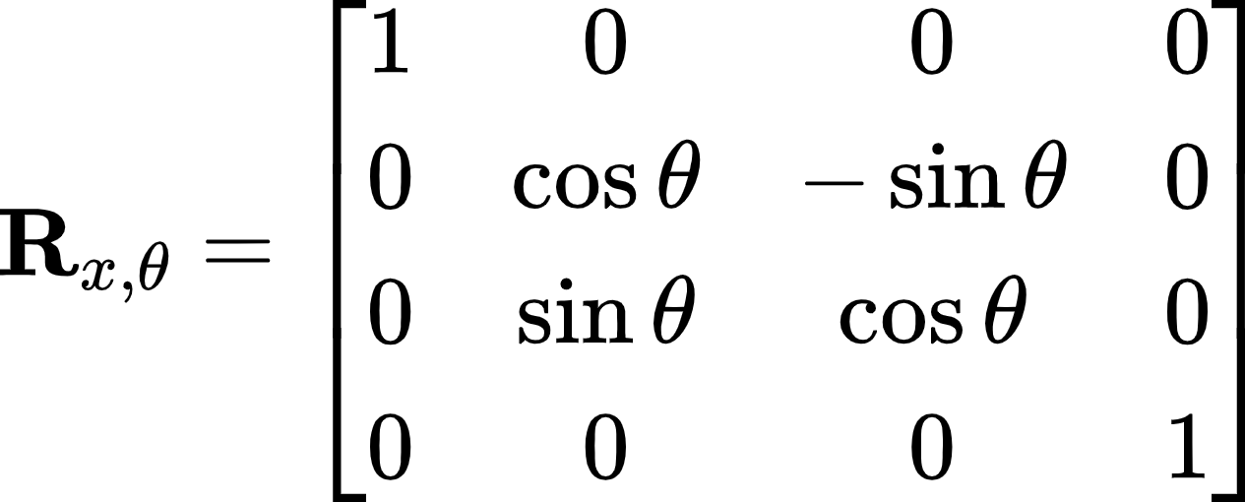
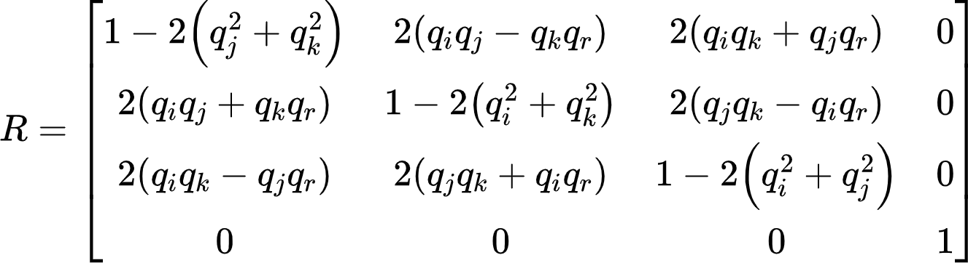
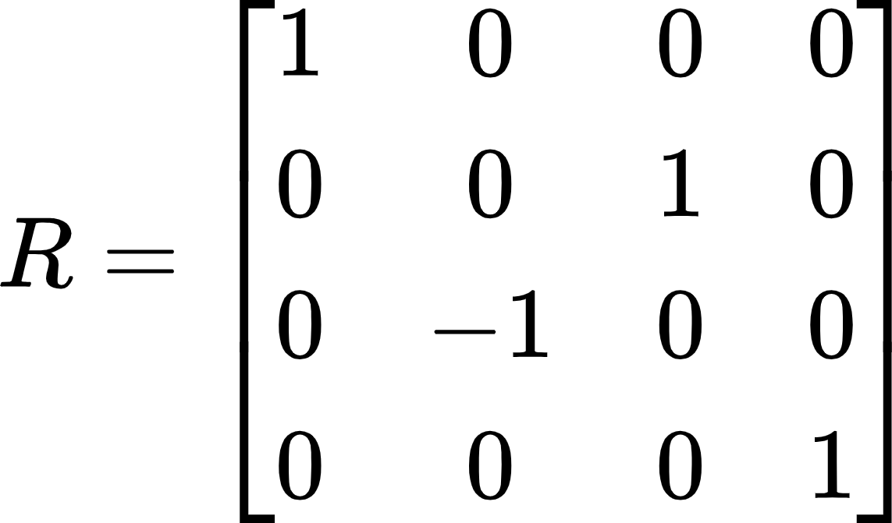
Novo triângulo rotacionado
<Scene>
<Viewpoint position="-8 1 1" orientation="0 1 0 -1.57"/>
<Transform>
<Shape>
<Sphere radius='0.1'/>
<Appearance>
<Material diffuseColor='1 1 0'/>
</Appearance>
</Shape>
</Transform>
<Transform>
<Shape>
<TriangleSet>
<Coordinate point='0 -1 -1 0 -1 1 0 1 0'/>
</TriangleSet>
<Appearance>
<Material diffuseColor='1 0 0'/>
</Appearance>
</Shape>
</Transform>
<Transform scale="1 3 2"
rotation="1 0 0 -1.57">
<Shape>
<TriangleSet>
<Coordinate point='0 -1 -1 0 -1 1 0 1 0'/>
</TriangleSet>
<Appearance>
<Material diffuseColor='0 0 1'/>
</Appearance>
</Shape>
</Transform>
</Scene>
https://www.web3d.org/documents/specifications/19775-1/V3.3/Part01/fieldsDef.html#SFRotationAndMFRotation

Slide 10
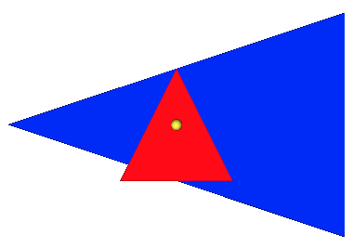
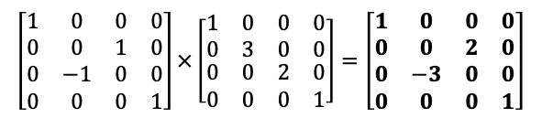
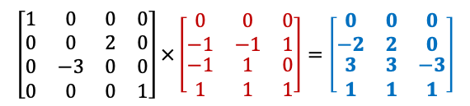
Novo triângulo rotacionado
<Scene>
<Viewpoint position="-8 1 1" orientation="0 1 0 -1.57"/>
<Transform>
<Shape>
<Sphere radius='0.1'/>
<Appearance>
<Material diffuseColor='1 1 0'/>
</Appearance>
</Shape>
</Transform>
<Transform>
<Shape>
<TriangleSet>
<Coordinate point='0 -1 -1 0 -1 1 0 1 0'/>
</TriangleSet>
<Appearance>
<Material diffuseColor='1 0 0'/>
</Appearance>
</Shape>
</Transform>
<Transform scale="1 3 2"
rotation="1 0 0 -1.57">
<Shape>
<TriangleSet>
<Coordinate point='0 -1 -1 0 -1 1 0 1 0'/>
</TriangleSet>
<Appearance>
<Material diffuseColor='0 0 1'/>
</Appearance>
</Shape>
</Transform>
</Scene>
y
(0, 2, 3)
x
z
(0, 0, -3)
(0, -2, 3)
rotação
escala
https://www.web3d.org/documents/specifications/19775-1/V3.3/Part01/fieldsDef.html#SFRotationAndMFRotation

Slide 11
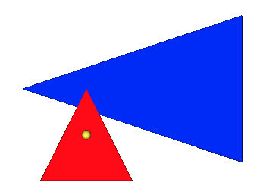
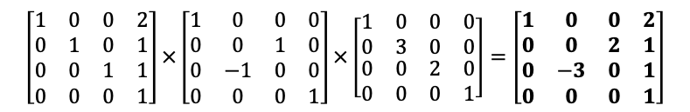
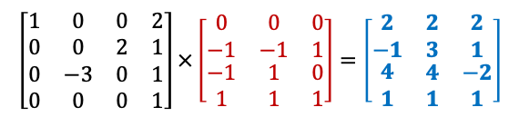
Novo triângulo transladando
<Scene>
<Viewpoint position="-8 1 1" orientation="0 1 0 -1.57"/>
<Transform>
<Shape>
<Sphere radius='0.1'/>
<Appearance>
<Material diffuseColor='1 1 0'/>
</Appearance>
</Shape>
</Transform>
<Transform>
<Shape>
<TriangleSet>
<Coordinate point='0 -1 -1 0 -1 1 0 1 0'/>
</TriangleSet>
<Appearance>
<Material diffuseColor='1 0 0'/>
</Appearance>
</Shape>
</Transform>
<Transform scale="1 3 2"
rotation="1 0 0 -1.57"
translation="2 1 1">
<Shape>
<TriangleSet>
<Coordinate point='0 -1 -1 0 -1 1 0 1 0'/>
</TriangleSet>
<Appearance>
<Material diffuseColor='0 0 1'/>
</Appearance>
</Shape>
</Transform>
</Scene>
(2, 3, 4)
y
x
(2, 1, -2)
z
(2, -1, 4)
translação
rotação
escala
https://www.web3d.org/documents/specifications/19775-1/V3.3/Part01/fieldsDef.html#SFVec3fAndMFVec3f

Slide 12
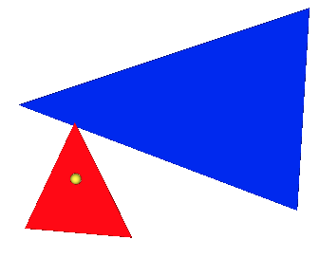

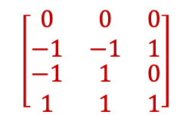
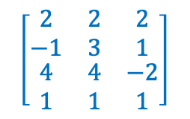
Visualizando de outro ângulo
<Scene>
<Viewpoint position="-8 1 1" orientation="0 1 0 -1.57"/>
<Transform>
<Shape>
<Sphere radius='0.1'/>
<Appearance>
<Material diffuseColor='1 1 0'/>
</Appearance>
</Shape>
</Transform>
<Transform>
<Shape>
<TriangleSet>
<Coordinate point='0 -1 -1 0 -1 1 0 1 0'/>
</TriangleSet>
<Appearance>
<Material diffuseColor='1 0 0'/>
</Appearance>
</Shape>
</Transform>
<Transform scale="1 3 2"
rotation="1 0 0 -1.57"
translation="2 1 1">
<Shape>
<TriangleSet>
<Coordinate point='0 -1 -1 0 -1 1 0 1 0'/>
</TriangleSet>
<Appearance>
<Material diffuseColor='0 0 1'/>
</Appearance>
</Shape>
</Transform>
</Scene>
(2, 3, 4)
y
x
(2, 1, -2)
z
(0, 1, 0)
(0, 0, 0)
(0, -1, -1)
(2, -1, 4)
(0, -1, 1)

Slide 13
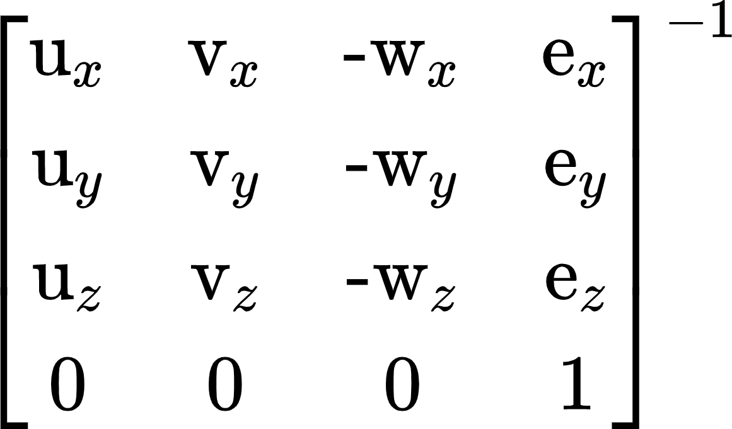
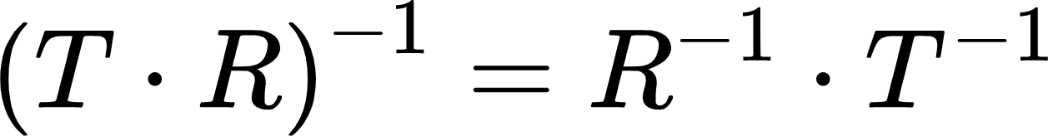
Transformação da Câmera
<Scene>
<Viewpoint position="-8 1 1" orientation="0 1 0 -1.57"/>
<Transform>
<Shape>
<Sphere radius='0.1'/>
<Appearance>
<Material diffuseColor='1 1 0'/>
</Appearance>
</Shape>
</Transform>
<Transform>
<Shape>
<TriangleSet>
<Coordinate point='0 -1 -1 0 -1 1 0 1 0'/>
</TriangleSet>
<Appearance>
<Material diffuseColor='1 0 0'/>
</Appearance>
</Shape>
</Transform>
<Transform scale="1 3 2"
rotation="1 0 0 -1.57"
translation="2 1 1">
<Shape>
<TriangleSet>
<Coordinate point='0 -1 -1 0 -1 1 0 1 0'/>
</TriangleSet>
<Appearance>
<Material diffuseColor='0 0 1'/>
</Appearance>
</Shape>
</Transform>
</Scene>
y
V_{up}
V_{right}
V_{view}
(-8, 1, 1)
x
z
u = V_{right}
v = V_{up}
w = V_{view}

Slide 14
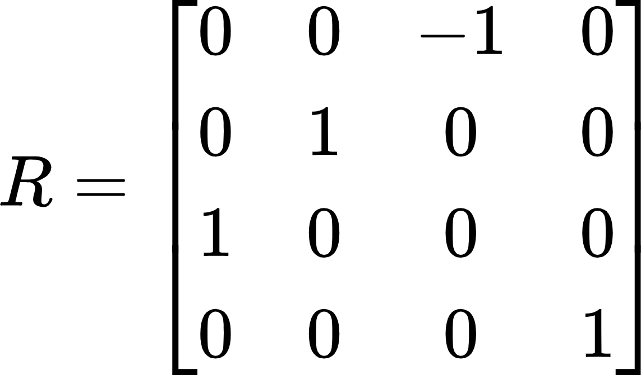
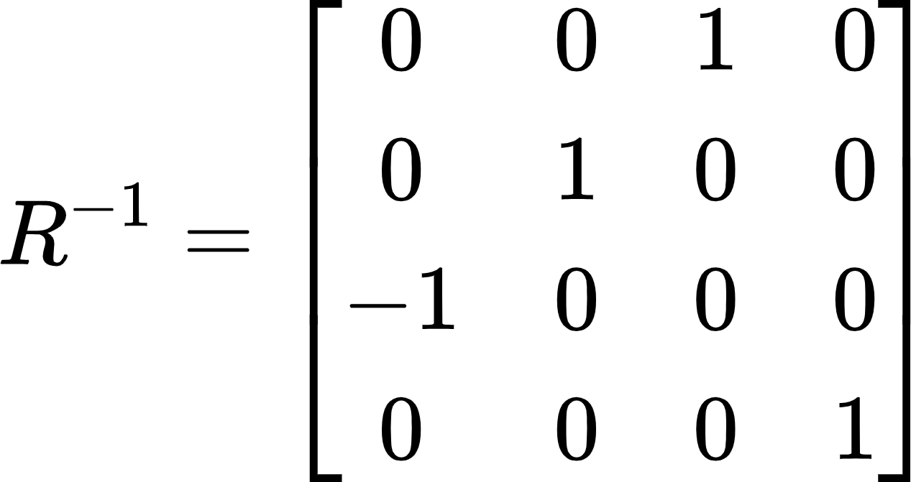
Transformação da Câmera (Rotação)
<Scene>
<Viewpoint position="-8 1 1" orientation="0 1 0 -1.57"/>
<Transform>
<Shape>
<Sphere radius='0.1'/>
<Appearance>
<Material diffuseColor='1 1 0'/>
</Appearance>
</Shape>
</Transform>
<Transform>
<Shape>
<TriangleSet>
<Coordinate point='0 -1 -1 0 -1 1 0 1 0'/>
</TriangleSet>
<Appearance>
<Material diffuseColor='1 0 0'/>
</Appearance>
</Shape>
</Transform>
<Transform scale="1 3 2"
rotation="1 0 0 -1.57"
translation="2 1 1">
<Shape>
<TriangleSet>
<Coordinate point='0 -1 -1 0 -1 1 0 1 0'/>
</TriangleSet>
<Appearance>
<Material diffuseColor='0 0 1'/>
</Appearance>
</Shape>
</Transform>
</Scene>
y
V_{up}
V_{right}
V_{view}
(-8, 1, 1)
x
z
Rotação:
Como temos uma câmera que estava na base da cena (ou seja identidade), podemos usar diretamente a rotação realizada para calcular a nova matriz.

Slide 15
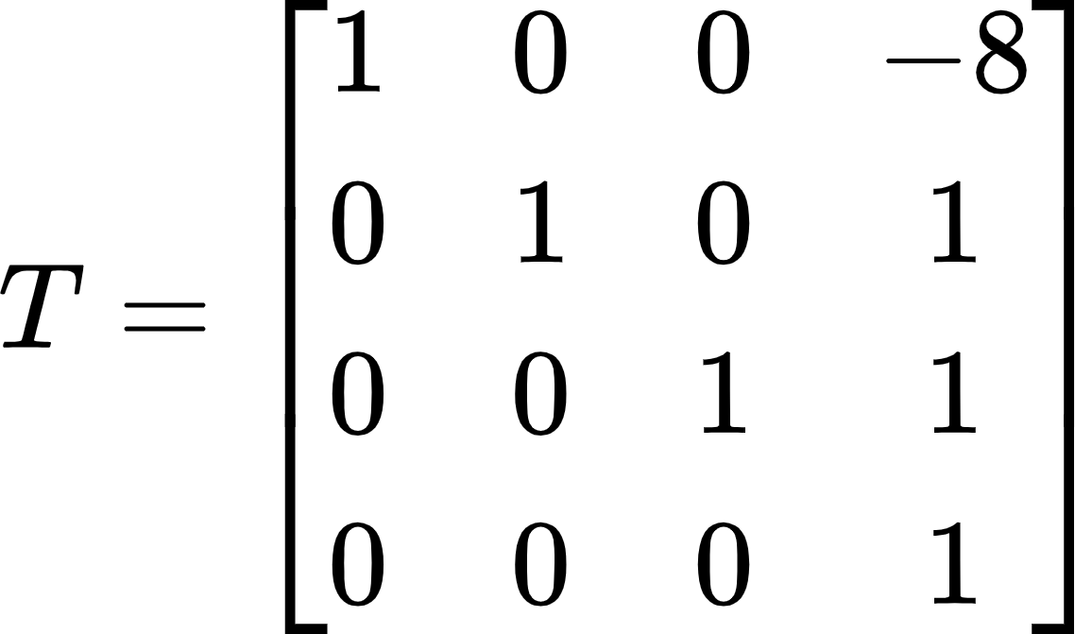
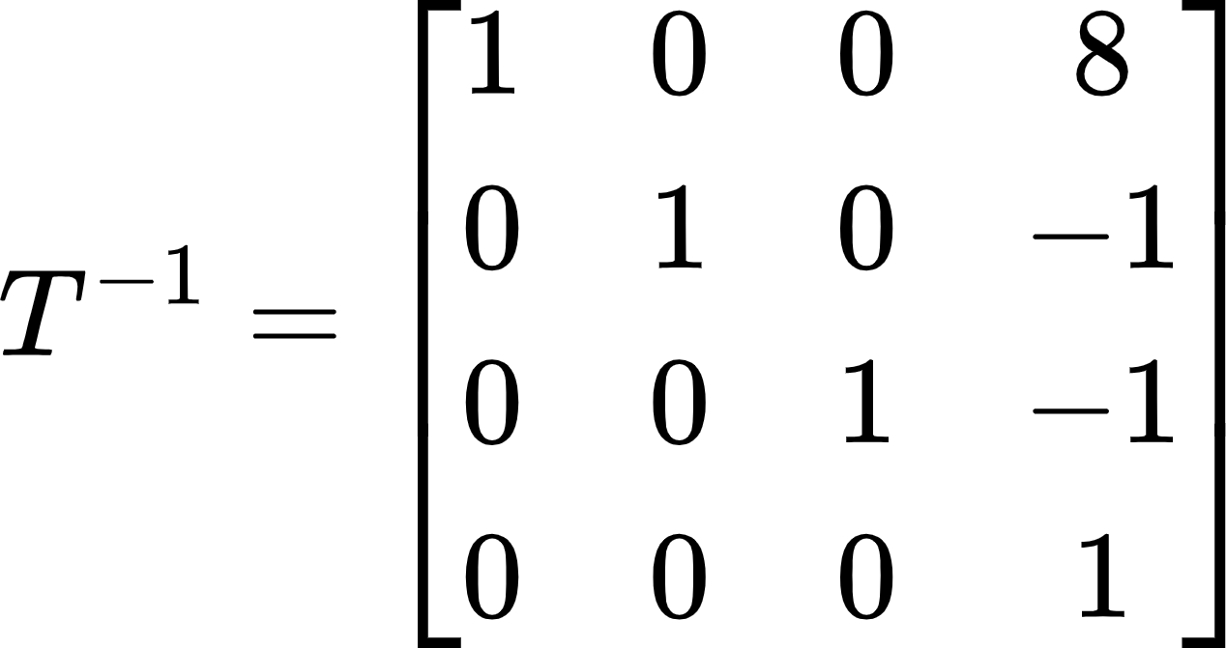
Transformação da Câmera (Translação)
<Scene>
<Viewpoint position="-8 1 1" orientation="0 1 0 -1.57"/>
<Transform>
<Shape>
<Sphere radius='0.1'/>
<Appearance>
<Material diffuseColor='1 1 0'/>
</Appearance>
</Shape>
</Transform>
<Transform>
<Shape>
<TriangleSet>
<Coordinate point='0 -1 -1 0 -1 1 0 1 0'/>
</TriangleSet>
<Appearance>
<Material diffuseColor='1 0 0'/>
</Appearance>
</Shape>
</Transform>
<Transform scale="1 3 2"
rotation="1 0 0 -1.57"
translation="2 1 1">
<Shape>
<TriangleSet>
<Coordinate point='0 -1 -1 0 -1 1 0 1 0'/>
</TriangleSet>
<Appearance>
<Material diffuseColor='0 0 1'/>
</Appearance>
</Shape>
</Transform>
</Scene>
y
V_{up}
V_{right}
V_{view}
(-8, 1, 1)
x
z
Translação:

Slide 16
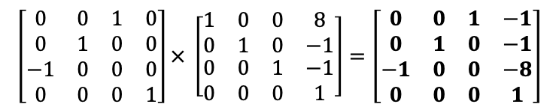
Transformação da Câmera
<Scene>
<Viewpoint position="-8 1 1" orientation="0 1 0 -1.57"/>
<Transform>
<Shape>
<Sphere radius='0.1'/>
<Appearance>
<Material diffuseColor='1 1 0'/>
</Appearance>
</Shape>
</Transform>
<Transform>
<Shape>
<TriangleSet>
<Coordinate point='0 -1 -1 0 -1 1 0 1 0'/>
</TriangleSet>
<Appearance>
<Material diffuseColor='1 0 0'/>
</Appearance>
</Shape>
</Transform>
<Transform scale="1 3 2"
rotation="1 0 0 -1.57"
translation="2 1 1">
<Shape>
<TriangleSet>
<Coordinate point='0 -1 -1 0 -1 1 0 1 0'/>
</TriangleSet>
<Appearance>
<Material diffuseColor='0 0 1'/>
</Appearance>
</Shape>
</Transform>
</Scene>
y
V_{up}
V_{right}
V_{view}
(-8, 1, 1)
x
z
Orientação⁻¹
Translação⁻¹
Matriz de Visualização (view)

Slide 17
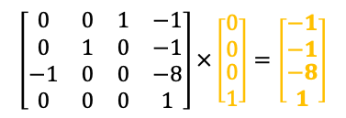
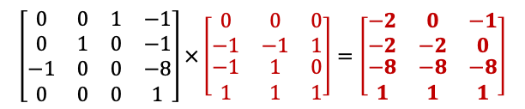
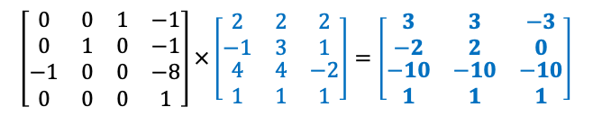
Aplicando Transformação
(3, 2, -10)
câmera (0,0)
<Scene>
<Viewpoint position="-8 1 1" orientation="0 1 0 -1.57"/>
<Transform>
<Shape>
<Sphere radius='0.1'/>
<Appearance>
<Material diffuseColor='1 1 0'/>
</Appearance>
</Shape>
</Transform>
<Transform>
<Shape>
<TriangleSet>
<Coordinate point='0 -1 -1 0 -1 1 0 1 0'/>
</TriangleSet>
<Appearance>
<Material diffuseColor='1 0 0'/>
</Appearance>
</Shape>
</Transform>
<Transform scale="1 3 2"
rotation="1 0 0 -1.57"
translation="2 1 1">
<Shape>
<TriangleSet>
<Coordinate point='0 -1 -1 0 -1 1 0 1 0'/>
</TriangleSet>
<Appearance>
<Material diffuseColor='0 0 1'/>
</Appearance>
</Shape>
</Transform>
</Scene>
(-3, 0, -10)
(-1, 0, -8)
(-1, -1, -8)
(3, -2, -10)
(-2, -2, -8)
(0, -2, -8)
Matriz de Visualização
Matriz de Visualização
Matriz de Visualização

Slide 18
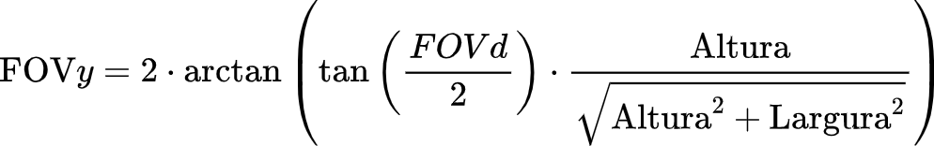
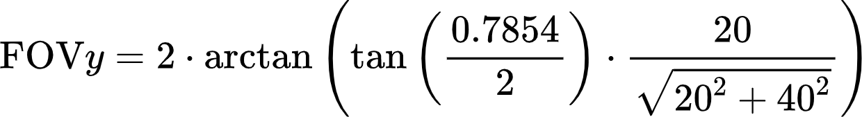

Matriz Perspectiva
Resolução: 40 x 20 pixels
<Scene>
<Viewpoint position="-8 1 1" orientation="0 1 0 -1.57"/>
<Transform>
<Shape>
<Sphere radius='0.1'/>
<Appearance>
<Material diffuseColor='1 1 0'/>
</Appearance>
</Shape>
</Transform>
<Transform>
<Shape>
<TriangleSet>
<Coordinate point='0 -1 -1 0 -1 1 0 1 0'/>
</TriangleSet>
<Appearance>
<Material diffuseColor='1 0 0'/>
</Appearance>
</Shape>
</Transform>
<Transform scale="1 3 2"
rotation="1 0 0 -1.57"
translation="2 1 1">
<Shape>
<TriangleSet>
<Coordinate point='0 -1 -1 0 -1 1 0 1 0'/>
</TriangleSet>
<Appearance>
<Material diffuseColor='0 0 1'/>
</Appearance>
</Shape>
</Transform>
</Scene>
Razão de Aspecto = 2:1
fovy = ?
near = 0.5
fielOfView = 𝜋/4 = 0.7854
far = 100
https://www.web3d.org/documents/specifications/19775-1/V3.3/Part01/components/navigation.html
Notes:
https://www.shutterstock.com/image-vector/digital-photo-camera-isometric-flat-icon-610333982

Slide 19
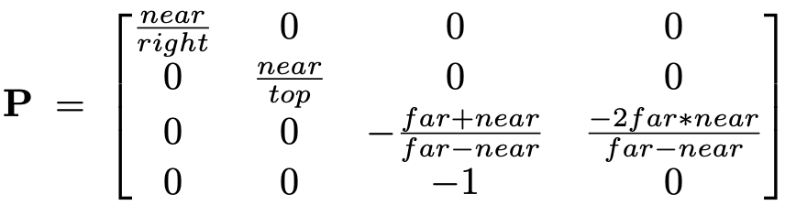
Matriz Perspectiva
Resolução: 40 x 20 pixels
<Scene>
<Viewpoint position="-8 1 1" orientation="0 1 0 -1.57"/>
<Transform>
<Shape>
<Sphere radius='0.1'/>
<Appearance>
<Material diffuseColor='1 1 0'/>
</Appearance>
</Shape>
</Transform>
<Transform>
<Shape>
<TriangleSet>
<Coordinate point='0 -1 -1 0 -1 1 0 1 0'/>
</TriangleSet>
<Appearance>
<Material diffuseColor='1 0 0'/>
</Appearance>
</Shape>
</Transform>
<Transform scale="1 3 2"
rotation="1 0 0 -1.57"
translation="2 1 1">
<Shape>
<TriangleSet>
<Coordinate point='0 -1 -1 0 -1 1 0 1 0'/>
</TriangleSet>
<Appearance>
<Material diffuseColor='0 0 1'/>
</Appearance>
</Shape>
</Transform>
</Scene>
Razão de Aspecto = 2:1
fovy = 0.3663
near = 0.5
far = 100
= 0.5 * 0.3663 = 0.1832
= –top = -0.1832
= top * aspect = 0.3663
= –right = -0.3663
top = near * tan (fovy)
bottom = –top
right = top * aspect
left = –right
Notes:
https://www.shutterstock.com/image-vector/digital-photo-camera-isometric-flat-icon-610333982

Slide 20
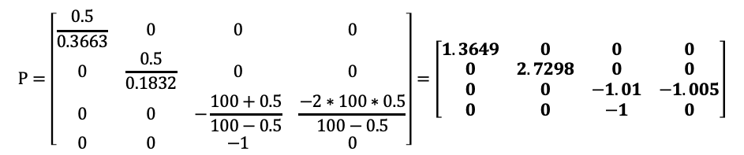
Matriz Perspectiva
Resolução: 40 x 20 pixels
<Scene>
<Viewpoint position="-8 1 1" orientation="0 1 0 -1.57"/>
<Transform>
<Shape>
<Sphere radius='0.1'/>
<Appearance>
<Material diffuseColor='1 1 0'/>
</Appearance>
</Shape>
</Transform>
<Transform>
<Shape>
<TriangleSet>
<Coordinate point='0 -1 -1 0 -1 1 0 1 0'/>
</TriangleSet>
<Appearance>
<Material diffuseColor='1 0 0'/>
</Appearance>
</Shape>
</Transform>
<Transform scale="1 3 2"
rotation="1 0 0 -1.57"
translation="2 1 1">
<Shape>
<TriangleSet>
<Coordinate point='0 -1 -1 0 -1 1 0 1 0'/>
</TriangleSet>
<Appearance>
<Material diffuseColor='0 0 1'/>
</Appearance>
</Shape>
</Transform>
</Scene>
Razão de Aspecto = 2:1
fovy = 0.3663
near = 0.5
far = 100
top = 0.1832
bottom = -0.1832
right = 0.3663
left = -0.3663
Notes:
https://www.shutterstock.com/image-vector/digital-photo-camera-isometric-flat-icon-610333982

Slide 21
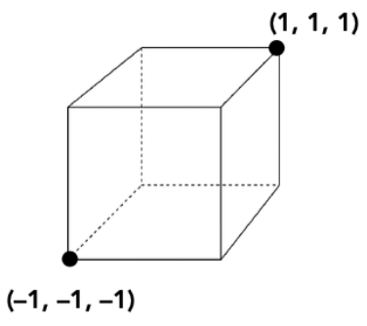
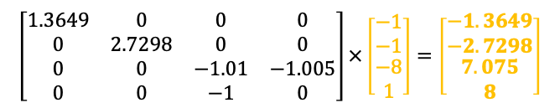
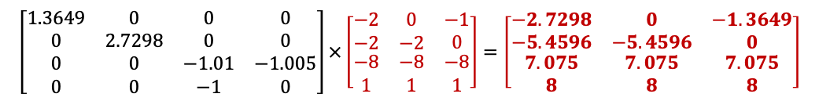
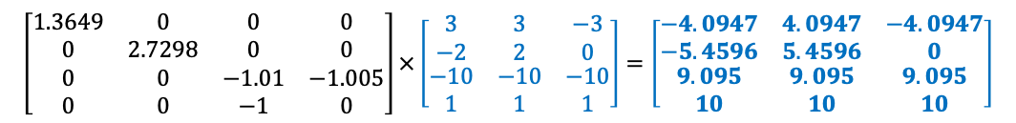
Aplicando Matriz de Projeção Perspectiva
Projeção em NDC (Normalized Device Coordinate)
Projeção Perspectiva
Projeção Perspectiva
Projeção Perspectiva

Slide 22
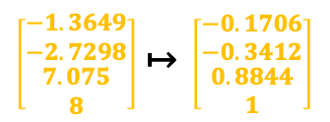
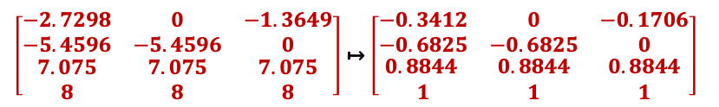
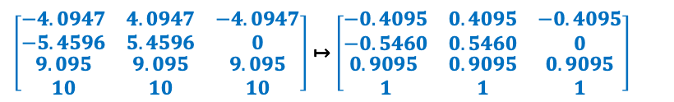
Aplicando Divisão Homogênea
Projeção (0,0)
(0.4095, 0.5460, 0.9095)
Projeção em NDC (Normalized Device Coordinate)
(-0.4095, 0, 0.9095)
(-0.1706, 0, 0.8844)
(-0.1706, -0.3412, 0.8844)
(0.4095, -0.546, 0.9095)
(-0.3412, -0.6825, 0.8844)
(0, -0.6825, 0.8844)

Slide 23
Aplicando Divisão Homogênea
Projeção em NDC (Normalized Device Coordinate)

Slide 24
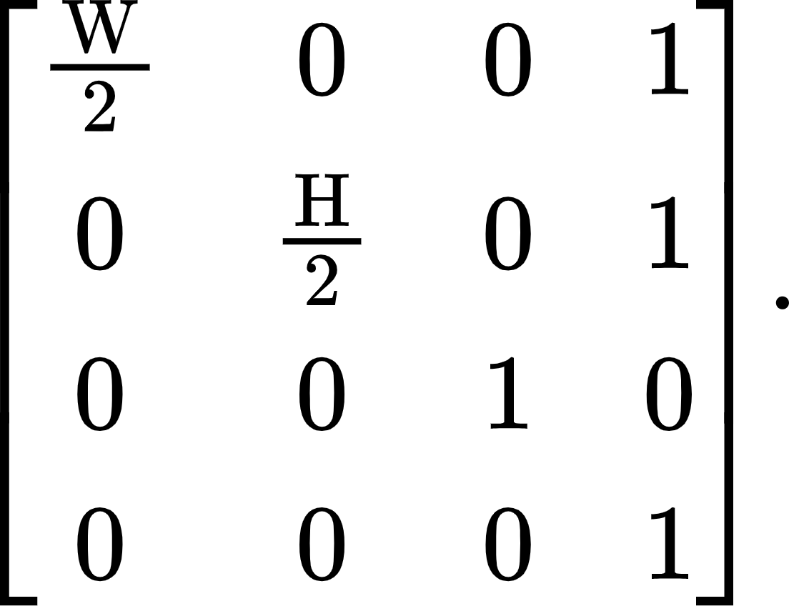
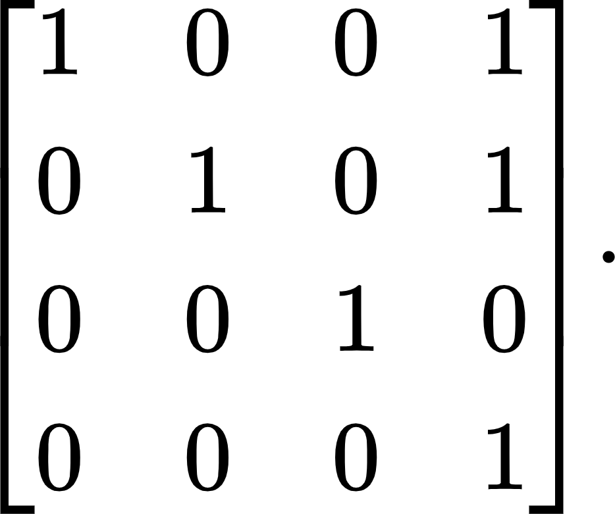
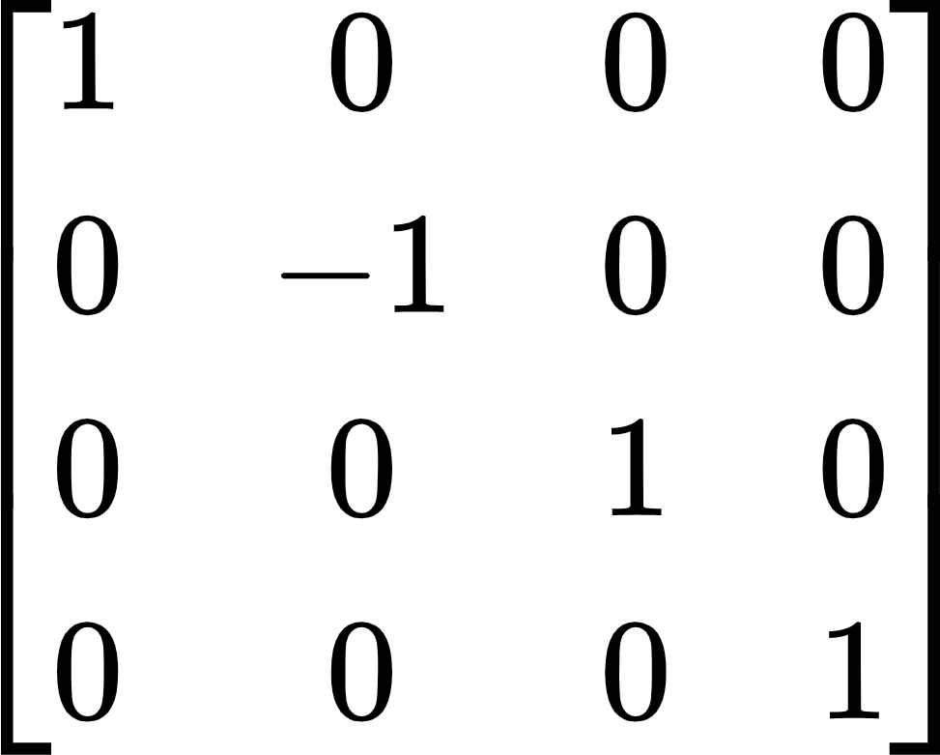
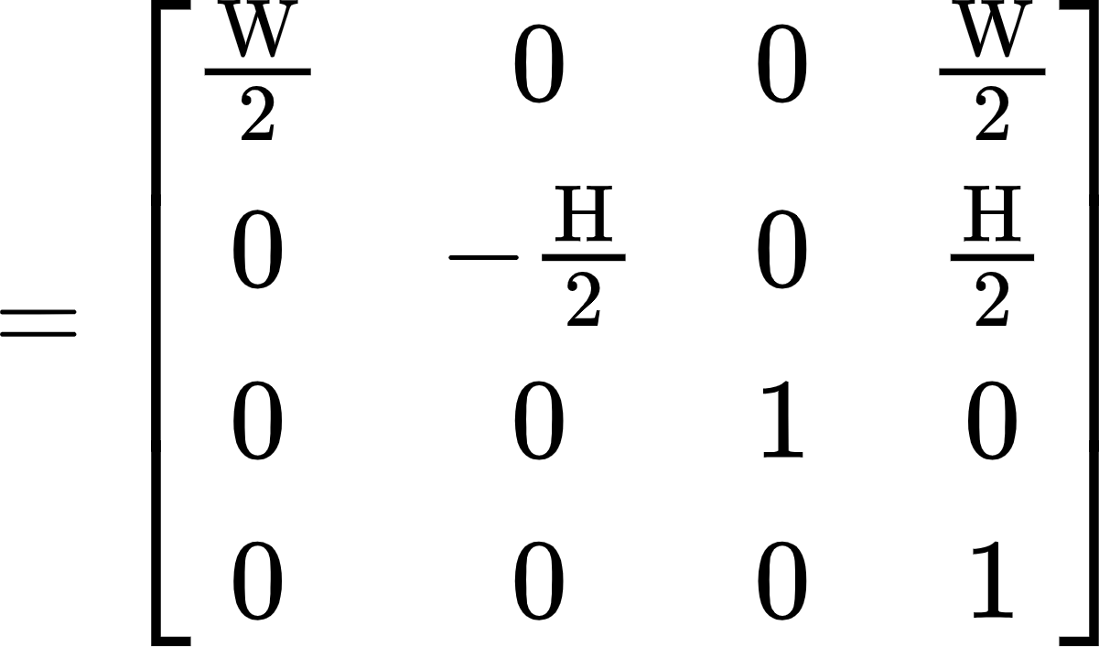
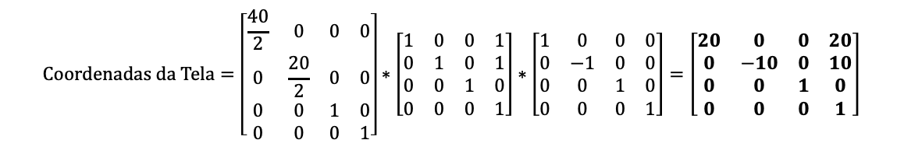
Mapeando coordenadas para tela (screen)
Escala para (W/2, H/2)
Translate por (1,1)
Espelha em Y
Resolução = 40 x 20
S_{40,20}
T_{1,1}
E_{y}
Obs: Não há necessidade da matriz ser 4x4.

Slide 25
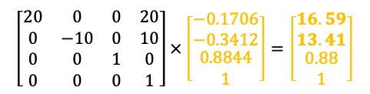
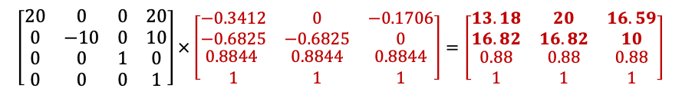
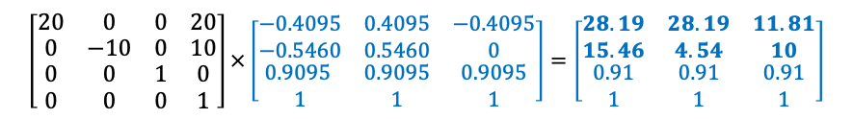
Coordenadas de Tela
0
<Scene>
<Viewpoint position="-8 1 1" orientation="0 1 0 -1.57"/>
<Transform>
<Shape>
<Sphere radius='0.1'/>
<Appearance>
<Material diffuseColor='1 1 0'/>
</Appearance>
</Shape>
</Transform>
<Transform>
<Shape>
<TriangleSet>
<Coordinate point='0 -1 -1 0 -1 1 0 1 0'/>
</TriangleSet>
<Appearance>
<Material diffuseColor='1 0 0'/>
</Appearance>
</Shape>
</Transform>
<Transform scale="1 3 2"
rotation="1 0 0 -1.57"
translation="2 1 1">
<Shape>
<TriangleSet>
<Coordinate point='0 -1 -1 0 -1 1 0 1 0'/>
</TriangleSet>
<Appearance>
<Material diffuseColor='0 0 1'/>
</Appearance>
</Shape>
</Transform>
</Scene>
(28.19, 4.54)
5
Tela (0,0)
10
(11.81, 10)
(16.59, 10)
(16.59, 13.41)
15
(13.18, 16.82)
(28.19, 15.46)
(20, 16.82)
20
15
25
30
Tela
0
5
10
20
35
40
Tela
Tela

Slide 26



Renderização
⬤ | ⬤ | ⬤ | ⬤ | ⬤ | ⬤ | ⬤ | ⬤ | ⬤ | ⬤ | ⬤ | ⬤ | ⬤ | ⬤ | ⬤ | ⬤ | ⬤ | ⬤ | ⬤ | ⬤ | ⬤ | ⬤ | ⬤ | ⬤ | ⬤ | ⬤ | ⬤ | ⬤ | ⬤ | ⬤ | ⬤ | ⬤ | ⬤ | ⬤ | ⬤ | ⬤ | ⬤ | ⬤ | ⬤ | ⬤
⬤ | ⬤ | ⬤ | ⬤ | ⬤ | ⬤ | ⬤ | ⬤ | ⬤ | ⬤ | ⬤ | ⬤ | ⬤ | ⬤ | ⬤ | ⬤ | ⬤ | ⬤ | ⬤ | ⬤ | ⬤ | ⬤ | ⬤ | ⬤ | ⬤ | ⬤ | ⬤ | ⬤ | ⬤ | ⬤ | ⬤ | ⬤ | ⬤ | ⬤ | ⬤ | ⬤ | ⬤ | ⬤ | ⬤ | ⬤
⬤ | ⬤ | ⬤ | ⬤ | ⬤ | ⬤ | ⬤ | ⬤ | ⬤ | ⬤ | ⬤ | ⬤ | ⬤ | ⬤ | ⬤ | ⬤ | ⬤ | ⬤ | ⬤ | ⬤ | ⬤ | ⬤ | ⬤ | ⬤ | ⬤ | ⬤ | ⬤ | ⬤ | ⬤ | ⬤ | ⬤ | ⬤ | ⬤ | ⬤ | ⬤ | ⬤ | ⬤ | ⬤ | ⬤ | ⬤
⬤ | ⬤ | ⬤ | ⬤ | ⬤ | ⬤ | ⬤ | ⬤ | ⬤ | ⬤ | ⬤ | ⬤ | ⬤ | ⬤ | ⬤ | ⬤ | ⬤ | ⬤ | ⬤ | ⬤ | ⬤ | ⬤ | ⬤ | ⬤ | ⬤ | ⬤ | ⬤ | ⬤ | ⬤ | ⬤ | ⬤ | ⬤ | ⬤ | ⬤ | ⬤ | ⬤ | ⬤ | ⬤ | ⬤ | ⬤
⬤ | ⬤ | ⬤ | ⬤ | ⬤ | ⬤ | ⬤ | ⬤ | ⬤ | ⬤ | ⬤ | ⬤ | ⬤ | ⬤ | ⬤ | ⬤ | ⬤ | ⬤ | ⬤ | ⬤ | ⬤ | ⬤ | ⬤ | ⬤ | ⬤ | ⬤ | ⬤ | ⬤ | ⬤ | ⬤ | ⬤ | ⬤ | ⬤ | ⬤ | ⬤ | ⬤ | ⬤ | ⬤ | ⬤ | ⬤
⬤ | ⬤ | ⬤ | ⬤ | ⬤ | ⬤ | ⬤ | ⬤ | ⬤ | ⬤ | ⬤ | ⬤ | ⬤ | ⬤ | ⬤ | ⬤ | ⬤ | ⬤ | ⬤ | ⬤ | ⬤ | ⬤ | ⬤ | ⬤ | ⬤ | ⬤ | ⬤ | ⬤ | ⬤ | ⬤ | ⬤ | ⬤ | ⬤ | ⬤ | ⬤ | ⬤ | ⬤ | ⬤ | ⬤ | ⬤
⬤ | ⬤ | ⬤ | ⬤ | ⬤ | ⬤ | ⬤ | ⬤ | ⬤ | ⬤ | ⬤ | ⬤ | ⬤ | ⬤ | ⬤ | ⬤ | ⬤ | ⬤ | ⬤ | ⬤ | ⬤ | ⬤ | ⬤ | ⬤ | ⬤ | ⬤ | ⬤ | ⬤ | ⬤ | ⬤ | ⬤ | ⬤ | ⬤ | ⬤ | ⬤ | ⬤ | ⬤ | ⬤ | ⬤ | ⬤
⬤ | ⬤ | ⬤ | ⬤ | ⬤ | ⬤ | ⬤ | ⬤ | ⬤ | ⬤ | ⬤ | ⬤ | ⬤ | ⬤ | ⬤ | ⬤ | ⬤ | ⬤ | ⬤ | ⬤ | ⬤ | ⬤ | ⬤ | ⬤ | ⬤ | ⬤ | ⬤ | ⬤ | ⬤ | ⬤ | ⬤ | ⬤ | ⬤ | ⬤ | ⬤ | ⬤ | ⬤ | ⬤ | ⬤ | ⬤
⬤ | ⬤ | ⬤ | ⬤ | ⬤ | ⬤ | ⬤ | ⬤ | ⬤ | ⬤ | ⬤ | ⬤ | ⬤ | ⬤ | ⬤ | ⬤ | ⬤ | ⬤ | ⬤ | ⬤ | ⬤ | ⬤ | ⬤ | ⬤ | ⬤ | ⬤ | ⬤ | ⬤ | ⬤ | ⬤ | ⬤ | ⬤ | ⬤ | ⬤ | ⬤ | ⬤ | ⬤ | ⬤ | ⬤ | ⬤
⬤ | ⬤ | ⬤ | ⬤ | ⬤ | ⬤ | ⬤ | ⬤ | ⬤ | ⬤ | ⬤ | ⬤ | ⬤ | ⬤ | ⬤ | ⬤ | ⬤ | ⬤ | ⬤ | ⬤ | ⬤ | ⬤ | ⬤ | ⬤ | ⬤ | ⬤ | ⬤ | ⬤ | ⬤ | ⬤ | ⬤ | ⬤ | ⬤ | ⬤ | ⬤ | ⬤ | ⬤ | ⬤ | ⬤ | ⬤
⬤ | ⬤ | ⬤ | ⬤ | ⬤ | ⬤ | ⬤ | ⬤ | ⬤ | ⬤ | ⬤ | ⬤ | ⬤ | ⬤ | ⬤ | ⬤ | ⬤ | ⬤ | ⬤ | ⬤ | ⬤ | ⬤ | ⬤ | ⬤ | ⬤ | ⬤ | ⬤ | ⬤ | ⬤ | ⬤ | ⬤ | ⬤ | ⬤ | ⬤ | ⬤ | ⬤ | ⬤ | ⬤ | ⬤ | ⬤
⬤ | ⬤ | ⬤ | ⬤ | ⬤ | ⬤ | ⬤ | ⬤ | ⬤ | ⬤ | ⬤ | ⬤ | ⬤ | ⬤ | ⬤ | ⬤ | ⬤ | ⬤ | ⬤ | ⬤ | ⬤ | ⬤ | ⬤ | ⬤ | ⬤ | ⬤ | ⬤ | ⬤ | ⬤ | ⬤ | ⬤ | ⬤ | ⬤ | ⬤ | ⬤ | ⬤ | ⬤ | ⬤ | ⬤ | ⬤
⬤ | ⬤ | ⬤ | ⬤ | ⬤ | ⬤ | ⬤ | ⬤ | ⬤ | ⬤ | ⬤ | ⬤ | ⬤ | ⬤ | ⬤ | ⬤ | ⬤ | ⬤ | ⬤ | ⬤ | ⬤ | ⬤ | ⬤ | ⬤ | ⬤ | ⬤ | ⬤ | ⬤ | ⬤ | ⬤ | ⬤ | ⬤ | ⬤ | ⬤ | ⬤ | ⬤ | ⬤ | ⬤ | ⬤ | ⬤
⬤ | ⬤ | ⬤ | ⬤ | ⬤ | ⬤ | ⬤ | ⬤ | ⬤ | ⬤ | ⬤ | ⬤ | ⬤ | ⬤ | ⬤ | ⬤ | ⬤ | ⬤ | ⬤ | ⬤ | ⬤ | ⬤ | ⬤ | ⬤ | ⬤ | ⬤ | ⬤ | ⬤ | ⬤ | ⬤ | ⬤ | ⬤ | ⬤ | ⬤ | ⬤ | ⬤ | ⬤ | ⬤ | ⬤ | ⬤
⬤ | ⬤ | ⬤ | ⬤ | ⬤ | ⬤ | ⬤ | ⬤ | ⬤ | ⬤ | ⬤ | ⬤ | ⬤ | ⬤ | ⬤ | ⬤ | ⬤ | ⬤ | ⬤ | ⬤ | ⬤ | ⬤ | ⬤ | ⬤ | ⬤ | ⬤ | ⬤ | ⬤ | ⬤ | ⬤ | ⬤ | ⬤ | ⬤ | ⬤ | ⬤ | ⬤ | ⬤ | ⬤ | ⬤ | ⬤
⬤ | ⬤ | ⬤ | ⬤ | ⬤ | ⬤ | ⬤ | ⬤ | ⬤ | ⬤ | ⬤ | ⬤ | ⬤ | ⬤ | ⬤ | ⬤ | ⬤ | ⬤ | ⬤ | ⬤ | ⬤ | ⬤ | ⬤ | ⬤ | ⬤ | ⬤ | ⬤ | ⬤ | ⬤ | ⬤ | ⬤ | ⬤ | ⬤ | ⬤ | ⬤ | ⬤ | ⬤ | ⬤ | ⬤ | ⬤
⬤ | ⬤ | ⬤ | ⬤ | ⬤ | ⬤ | ⬤ | ⬤ | ⬤ | ⬤ | ⬤ | ⬤ | ⬤ | ⬤ | ⬤ | ⬤ | ⬤ | ⬤ | ⬤ | ⬤ | ⬤ | ⬤ | ⬤ | ⬤ | ⬤ | ⬤ | ⬤ | ⬤ | ⬤ | ⬤ | ⬤ | ⬤ | ⬤ | ⬤ | ⬤ | ⬤ | ⬤ | ⬤ | ⬤ | ⬤
⬤ | ⬤ | ⬤ | ⬤ | ⬤ | ⬤ | ⬤ | ⬤ | ⬤ | ⬤ | ⬤ | ⬤ | ⬤ | ⬤ | ⬤ | ⬤ | ⬤ | ⬤ | ⬤ | ⬤ | ⬤ | ⬤ | ⬤ | ⬤ | ⬤ | ⬤ | ⬤ | ⬤ | ⬤ | ⬤ | ⬤ | ⬤ | ⬤ | ⬤ | ⬤ | ⬤ | ⬤ | ⬤ | ⬤ | ⬤
⬤ | ⬤ | ⬤ | ⬤ | ⬤ | ⬤ | ⬤ | ⬤ | ⬤ | ⬤ | ⬤ | ⬤ | ⬤ | ⬤ | ⬤ | ⬤ | ⬤ | ⬤ | ⬤ | ⬤ | ⬤ | ⬤ | ⬤ | ⬤ | ⬤ | ⬤ | ⬤ | ⬤ | ⬤ | ⬤ | ⬤ | ⬤ | ⬤ | ⬤ | ⬤ | ⬤ | ⬤ | ⬤ | ⬤ | ⬤
⬤ | ⬤ | ⬤ | ⬤ | ⬤ | ⬤ | ⬤ | ⬤ | ⬤ | ⬤ | ⬤ | ⬤ | ⬤ | ⬤ | ⬤ | ⬤ | ⬤ | ⬤ | ⬤ | ⬤ | ⬤ | ⬤ | ⬤ | ⬤ | ⬤ | ⬤ | ⬤ | ⬤ | ⬤ | ⬤ | ⬤ | ⬤ | ⬤ | ⬤ | ⬤ | ⬤ | ⬤ | ⬤ | ⬤ | ⬤
<Scene>
<Viewpoint position="-8 1 1" orientation="0 1 0 -1.57"/>
<Transform>
<Shape>
<Sphere radius='0.1'/>
<Appearance>
<Material diffuseColor='1 1 0'/>
</Appearance>
</Shape>
</Transform>
<Transform>
<Shape>
<TriangleSet>
<Coordinate point='0 -1 -1 0 -1 1 0 1 0'/>
</TriangleSet>
<Appearance>
<Material diffuseColor='1 0 0'/>
</Appearance>
</Shape>
</Transform>
<Transform scale="1 3 2"
rotation="1 0 0 -1.57"
translation="2 1 1">
<Shape>
<TriangleSet>
<Coordinate point='0 -1 -1 0 -1 1 0 1 0'/>
</TriangleSet>
<Appearance>
<Material diffuseColor='0 0 1'/>
</Appearance>
</Shape>
</Transform>
</Scene>
Rasterizar os Triângulos

Slide 27
Resultado Final
Resolução Final: 40 x 20 pixels

Slide 28
Anti-Aliasing
Supersampling 2x2
R:0, G:0, B:0
R:0, G:0, B:0
R:0, G:0, B:0
R:0, G:0, B:255
R:0, G:0, B:64
R:0, G:0, B:0
R:255, G:0, B:0
R:0, G:0, B:0
R:255, G:0, B:0
R:128, G:0, B:0

Slide 29
Resultado Final (sem anti-aliasing)
Resolução Final: 20 x 10 pixels

Slide 30
Revisão Numpy
numpy.array: cria matrizes tipo numpy
numpy.matmul: multiplica matrizes numpy
A partir do Python 3.5 você pode usar o arroba (@)
* : multiplica todos os valores da matriz por um escalar
numpy.multiply se quiser fazer uma chamada de função
/ : divide todos os valores da matriz por um escalar
numpy.empty: matriz iniciada com valores não iniciados
numpy.zeros: matriz com todos os valores sendo zero
numpy.ones: matriz com todos os valores sendo um
np.uint8, np.uint16, np.float32: tipos de dados para numpy
CUIDADO
numpy.dot: realiza o cálculo do produto escalar
(mas também algumas multiplicações de matrizes)
(mas é confuso e não funciona em todos os casos)

Slide 31
Resultados Esperados
No final dos arquivos X3D existe um comentários com os valores esperados das matrizes.
<!--
camera
[[-9.99999996e-01 0.00000000e+00 9.26535897e-05 4.63267948e-04]
[ 0.00000000e+00 1.00000000e+00 0.00000000e+00 0.00000000e+00]
[-9.26535897e-05 0.00000000e+00 -9.99999996e-01 -4.99999998e+00]
[ 0.00000000e+00 0.00000000e+00 0.00000000e+00 1.00000000e+00]]
persp
[[ 1.37417368 0. 0. 0. ]
[ 0. 2.06126053 0. 0. ]
[ 0. 0. -1.00002 -0.0200002 ]
[ 0. 0. -1. 0. ]]
screen
[[ 150. 0. 0. 150.]
[ 0. -100. 0. 100.]
[ 0. 0. 1. 0.]
[ 0. 0. 0. 1.]]
view
[[-2.06112154e+02 0.00000000e+00 1.50019098e+02 7.50095488e+02]
[ 9.26535897e-03 -2.06126053e+02 9.99999996e+01 4.99999998e+02]
[ 9.26554428e-05 0.00000000e+00 1.00002000e+00 4.98009978e+00]
[ 9.26535897e-05 0.00000000e+00 9.99999996e-01 4.99999998e+00]]
model (transform)
[[ 1.00000000e+00 0.00000000e+00 0.00000000e+00 0.00000000e+00]
[ 0.00000000e+00 -9.99999996e-01 9.26535897e-05 0.00000000e+00]
[ 0.00000000e+00 -9.26535897e-05 -9.99999996e-01 5.00000000e+00]
[ 0.00000000e+00 0.00000000e+00 0.00000000e+00 1.00000000e+00]]
-->

Slide 32
Computação Gráfica
Luciano Soares
<lpsoares@insper.edu.br>
Fabio Orfali
<fabioO1@insper.edu.br>

