Slide 1
Computação Gráfica
Aula 21: Ray Marching

Slide 2
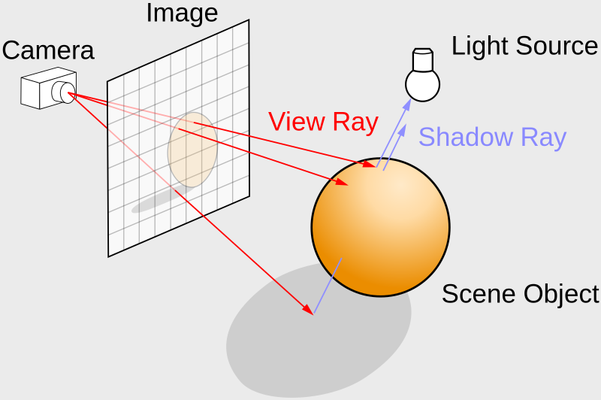
ray tracing or ray marching algorithm.
ariable in GLSL to represent an origin and direction:
vec2 rayOrigin = vec2(0, 0);
vec2 rayDirection = vec2(1, 0);

Slide 3
Ray Marching
https://jamie-wong.com/2016/07/15/ray-marching-signed-distance-functions/

Slide 4
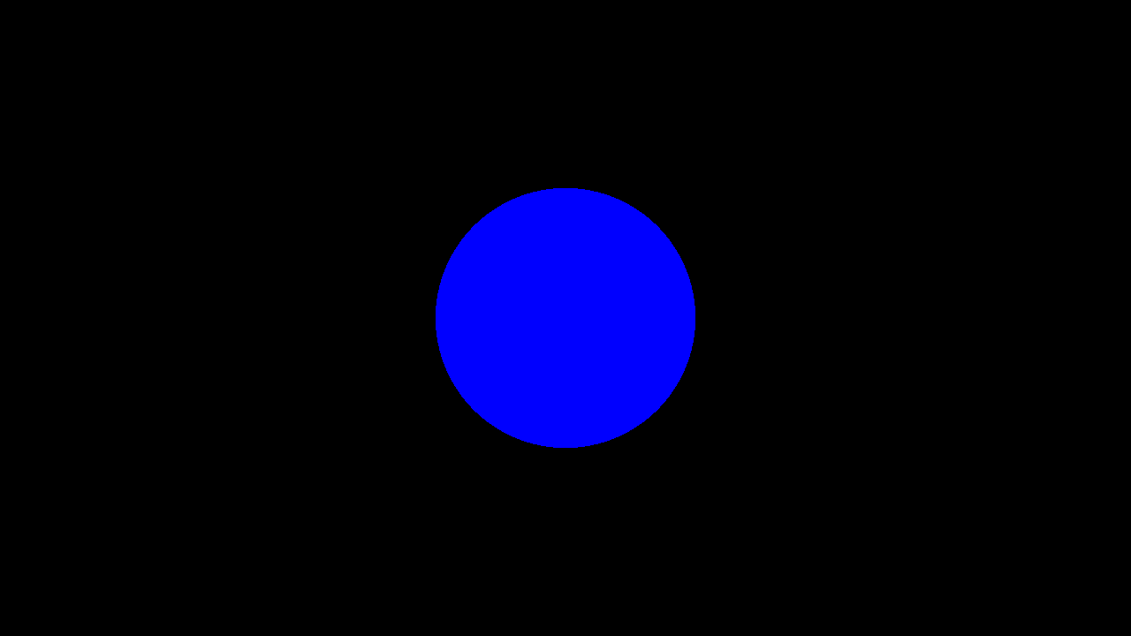
Ray Marching
const int MAX_MARCHING_STEPS = 255;
const float MIN_DIST = 0.0;
const float MAX_DIST = 100.0;
const float PRECISION = 0.001;
float sdSphere(vec3 p, float r )
{
return length(p) - r;
}
float rayMarch(vec3 ro, vec3 rd, float start, float end) {
float depth = start;
for (int i = 0; i < MAX_MARCHING_STEPS; i++) {
vec3 p = ro + depth * rd;
float d = sdSphere(p, 1.);
depth += d;
if (d < PRECISION || depth > end) break;
}
return depth;
}
void mainImage( out vec4 fragColor, in vec2 fragCoord )
{
vec2 uv = (fragCoord-.5*iResolution.xy)/iResolution.y;
vec3 col = vec3(0);
vec3 ro = vec3(0, 0, 5); // ray origin that represents camera position
vec3 rd = normalize(vec3(uv, -1)); // ray direction
float d = rayMarch(ro, rd, MIN_DIST, MAX_DIST); // distance to sphere
if (d > MAX_DIST) {
col = vec3(0.0); // ray didn't hit anything
} else {
col = vec3(0, 0, 1); // ray hit something
}
// Output to screen
fragColor = vec4(col, 1.0);
}

Slide 5
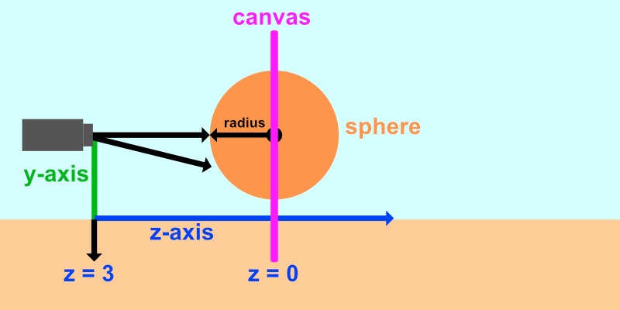

Slide 6
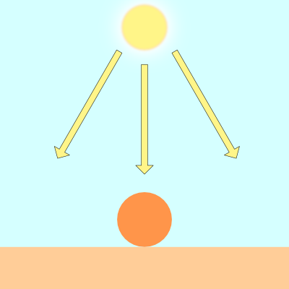
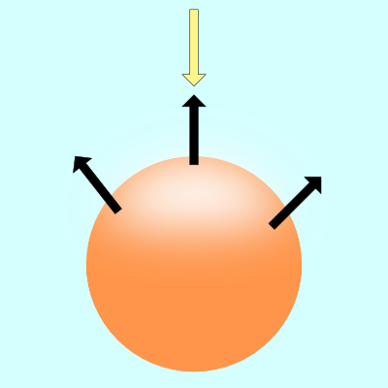
Lambert lighting to simulate diffuse reflection. This is commonly done by taking the dot product between the ray direction of a light source and the direction of a surface normal.
vec3 diffuseReflection = dot(normal, lightDirection);

Slide 7
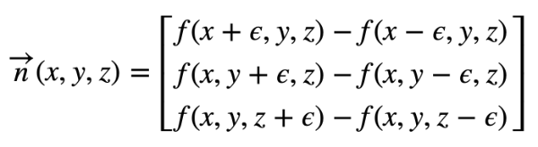
Calculando a Normal
To find the gradient of a surface, we need two points. We'll take a point on the surface of the sphere and subtract a small number from it to get the second point. That'll let us perform a cheap trick to find the gradient. We can then use this gradient value as the surface normal.
Given a surface, f(x,y,z), the gradient along the surface will have the following equation:
vec3 calcNormal(vec3 p) {
float e = 0.0005; // epsilon
float r = 1.; // radius of sphere
return normalize(vec3(
sdSphere(vec3(p.x + e, p.y, p.z), r) - sdSphere(vec3(p.x - e, p.y, p.z), r),
sdSphere(vec3(p.x, p.y + e, p.z), r) - sdSphere(vec3(p.x, p.y - e, p.z), r),
sdSphere(vec3(p.x, p.y, p.z + e), r) - sdSphere(vec3(p.x, p.y, p.z - e), r)
));
}

Slide 8
Na prática
vec3 calcNormal(vec3 p) {
vec2 e = vec2(1.0, -1.0) * 0.0005; // epsilon
float r = 1.; // radius of sphere
return normalize(
e.xyy * sdSphere(p + e.xyy, r) +
e.yyx * sdSphere(p + e.yyx, r) +
e.yxy * sdSphere(p + e.yxy, r) +
e.xxx * sdSphere(p + e.xxx, r));
}

Slide 9
Luz
vec3 lightPosition = vec3(2, 2, 4);
vec3 lightDirection = normalize(lightPosition - p);
float dif = dot(normal, lightDirection); // dif = diffuse reflection
When we take the dot product between the normal and light direction vectors, we may end up with a negative value. To keep the value between zero and one so that we get a bigger range of values, we can use the clamp function.
float dif = clamp(dot(normal, lightDirection), 0., 1.);

Slide 10
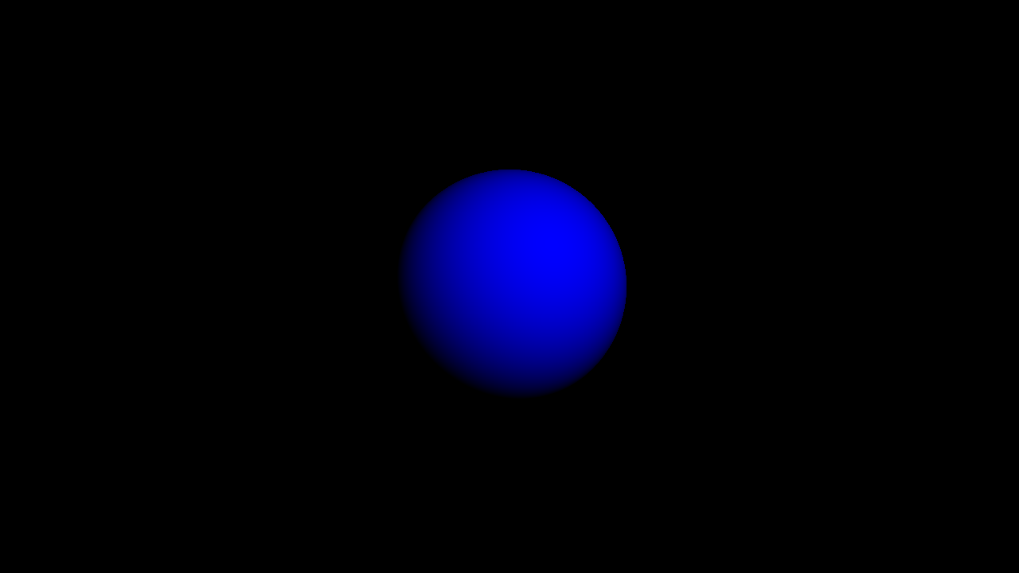
const int MAX_MARCHING_STEPS = 255;
const float MIN_DIST = 0.0;
const float MAX_DIST = 100.0;
const float PRECISION = 0.001;
float sdSphere(vec3 p, float r )
{
vec3 offset = vec3(0, 0, -2);
return length(p - offset) - r;
}
float rayMarch(vec3 ro, vec3 rd, float start, float end) {
float depth = start;
for (int i = 0; i < MAX_MARCHING_STEPS; i++) {
vec3 p = ro + depth * rd;
float d = sdSphere(p, 1.);
depth += d;
if (d < PRECISION || depth > end) break;
}
return depth;
}
vec3 calcNormal(vec3 p) {
vec2 e = vec2(1.0, -1.0) * 0.0005; // epsilon
float r = 1.; // radius of sphere
return normalize(
e.xyy * sdSphere(p + e.xyy, r) +
e.yyx * sdSphere(p + e.yyx, r) +
e.yxy * sdSphere(p + e.yxy, r) +
e.xxx * sdSphere(p + e.xxx, r));
}
void mainImage( out vec4 fragColor, in vec2 fragCoord )
{
vec2 uv = (fragCoord-.5*iResolution.xy)/iResolution.y;
vec3 col = vec3(0);
vec3 ro = vec3(0, 0, 3); // ray origin that represents camera position
vec3 rd = normalize(vec3(uv, -1)); // ray direction
float d = rayMarch(ro, rd, MIN_DIST, MAX_DIST); // distance to sphere
if (d > MAX_DIST) {
col = vec3(0.0); // ray didn't hit anything
} else {
vec3 p = ro + rd * d; // point on sphere we discovered from ray marching
vec3 normal = calcNormal(p);
vec3 lightPosition = vec3(2, 2, 4);
vec3 lightDirection = normalize(lightPosition - p);
// Calculate diffuse reflection by taking the dot product of
// the normal and the light direction.
float dif = clamp(dot(normal, lightDirection), 0., 1.);
col = vec3(0.0, 0.0, dif);
}
// Output to screen
fragColor = vec4(col, 1.0);
}

Slide 11
If you want to add a bit of ambient light color, you can adjust the clamped range, so the sphere doesn't appear completely black in the shaded regions:
float dif = clamp(dot(normal, lightDirection), 0.3, 1.);

Slide 12
Cores
There are multiple techniques people across Shadertoy use to add colors to 3D shapes. One way would be to modify our SDFs to return both the distance to our shape and a color. Therefore, we'd have to modify multiple places in our code to return a vec4 datatype instead of a float. The first value of the vec4 variable would hold the "signed distance" value we normally return from an SDF, and the last three values will hold our color value.

Slide 13
Computação Gráfica
Luciano Soares
<lpsoares@insper.edu.br>

