Slide 1
Computação Gráfica
Aula 13: Revisão 2

Slide 2
Grafo de Cena

Slide 3
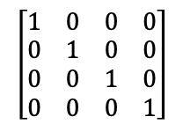
Criando Matriz Identidade
Início
<Scene>
<Transform scale="2 2 2">
<Shape>
<TriangleSet>
<Coordinate point='-1 -1 0 1 -1 0 0 1 0'/>
</TriangleSet>
<Appearance>
<Material diffuseColor='1 0 0'/>
</Appearance>
</Shape>
<Transform scale="2 1 1">
<Transform translation="0 -1 -1">
<Shape>
<TriangleSet>
<Coordinate point='-1 -1 0 1 -1 0 0 1 0'/>
</TriangleSet>
<Appearance>
<Material diffuseColor='0 1 0'/>
</Appearance>
</Shape>
</Transform>
<Transform translation="0 1 -2">
<Transform rotation="0 0 1 3.14">
<Shape>
<TriangleSet>
<Coordinate point='-1 -1 0 1 -1 0 0 1 0'/>
</TriangleSet>
<Appearance>
<Material diffuseColor='0 0 1'/>
</Appearance>
</Shape>
</Transform>
</Transform>
</Transform>
</Transform>
</Scene>
MATRIZ
PILHA
Notes:
PILHA

Slide 4
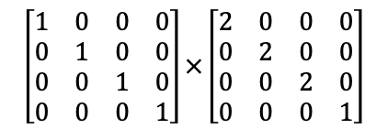
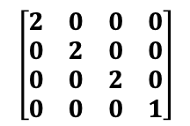
Empilhando e Atualizando Transformação
<Scene>
<Transform scale="2 2 2">
<Shape>
<TriangleSet>
<Coordinate point='-1 -1 0 1 -1 0 0 1 0'/>
</TriangleSet>
<Appearance>
<Material diffuseColor='1 0 0'/>
</Appearance>
</Shape>
<Transform scale="2 1 1">
<Transform translation="0 -1 -1">
<Shape>
<TriangleSet>
<Coordinate point='-1 -1 0 1 -1 0 0 1 0'/>
</TriangleSet>
<Appearance>
<Material diffuseColor='0 1 0'/>
</Appearance>
</Shape>
</Transform>
<Transform translation="0 1 -2">
<Transform rotation="0 0 1 3.14">
<Shape>
<TriangleSet>
<Coordinate point='-1 -1 0 1 -1 0 0 1 0'/>
</TriangleSet>
<Appearance>
<Material diffuseColor='0 0 1'/>
</Appearance>
</Shape>
</Transform>
</Transform>
</Transform>
</Transform>
</Scene>
push
MATRIZ
PILHA
Notes:
PILHA

Slide 5

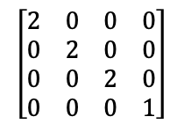
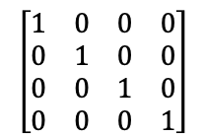
Desenhando Triângulo Vermelho
<Scene>
<Transform scale="2 2 2">
<Shape>
<TriangleSet>
<Coordinate point='-1 -1 0 1 -1 0 0 1 0'/>
</TriangleSet>
<Appearance>
<Material diffuseColor='1 0 0'/>
</Appearance>
</Shape>
<Transform scale="2 1 1">
<Transform translation="0 -1 -1">
<Shape>
<TriangleSet>
<Coordinate point='-1 -1 0 1 -1 0 0 1 0'/>
</TriangleSet>
<Appearance>
<Material diffuseColor='0 1 0'/>
</Appearance>
</Shape>
</Transform>
<Transform translation="0 1 -2">
<Transform rotation="0 0 1 3.14">
<Shape>
<TriangleSet>
<Coordinate point='-1 -1 0 1 -1 0 0 1 0'/>
</TriangleSet>
<Appearance>
<Material diffuseColor='0 0 1'/>
</Appearance>
</Shape>
</Transform>
</Transform>
</Transform>
</Transform>
</Scene>
draw
MATRIZ
PILHA
Notes:
PILHA

Slide 6
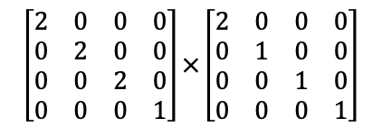
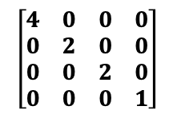
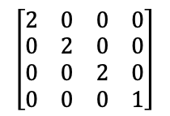
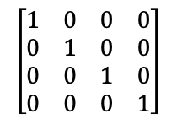
Empilhando e Atualizando Transformação
<Scene>
<Transform scale="2 2 2">
<Shape>
<TriangleSet>
<Coordinate point='-1 -1 0 1 -1 0 0 1 0'/>
</TriangleSet>
<Appearance>
<Material diffuseColor='1 0 0'/>
</Appearance>
</Shape>
<Transform scale="2 1 1">
<Transform translation="0 -1 -1">
<Shape>
<TriangleSet>
<Coordinate point='-1 -1 0 1 -1 0 0 1 0'/>
</TriangleSet>
<Appearance>
<Material diffuseColor='0 1 0'/>
</Appearance>
</Shape>
</Transform>
<Transform translation="0 1 -2">
<Transform rotation="0 0 1 3.14">
<Shape>
<TriangleSet>
<Coordinate point='-1 -1 0 1 -1 0 0 1 0'/>
</TriangleSet>
<Appearance>
<Material diffuseColor='0 0 1'/>
</Appearance>
</Shape>
</Transform>
</Transform>
</Transform>
</Transform>
</Scene>
push
MATRIZ
PILHA
Notes:
PILHA

Slide 7
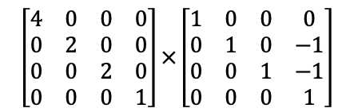
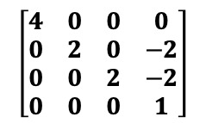
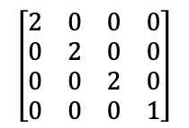
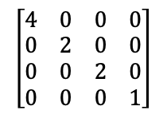
Empilhando e Atualizando Transformação
<Scene>
<Transform scale="2 2 2">
<Shape>
<TriangleSet>
<Coordinate point='-1 -1 0 1 -1 0 0 1 0'/>
</TriangleSet>
<Appearance>
<Material diffuseColor='1 0 0'/>
</Appearance>
</Shape>
<Transform scale="2 1 1">
<Transform translation="0 -1 -1">
<Shape>
<TriangleSet>
<Coordinate point='-1 -1 0 1 -1 0 0 1 0'/>
</TriangleSet>
<Appearance>
<Material diffuseColor='0 1 0'/>
</Appearance>
</Shape>
</Transform>
<Transform translation="0 1 -2">
<Transform rotation="0 0 1 3.14">
<Shape>
<TriangleSet>
<Coordinate point='-1 -1 0 1 -1 0 0 1 0'/>
</TriangleSet>
<Appearance>
<Material diffuseColor='0 0 1'/>
</Appearance>
</Shape>
</Transform>
</Transform>
</Transform>
</Transform>
</Scene>
push
MATRIZ
PILHA
Notes:
PILHA

Slide 8

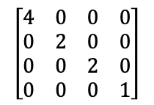
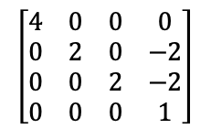
Desenhando Triângulo Verde
<Scene>
<Transform scale="2 2 2">
<Shape>
<TriangleSet>
<Coordinate point='-1 -1 0 1 -1 0 0 1 0'/>
</TriangleSet>
<Appearance>
<Material diffuseColor='1 0 0'/>
</Appearance>
</Shape>
<Transform scale="2 1 1">
<Transform translation="0 -1 -1">
<Shape>
<TriangleSet>
<Coordinate point='-1 -1 0 1 -1 0 0 1 0'/>
</TriangleSet>
<Appearance>
<Material diffuseColor='0 1 0'/>
</Appearance>
</Shape>
</Transform>
<Transform translation="0 1 -2">
<Transform rotation="0 0 1 3.14">
<Shape>
<TriangleSet>
<Coordinate point='-1 -1 0 1 -1 0 0 1 0'/>
</TriangleSet>
<Appearance>
<Material diffuseColor='0 0 1'/>
</Appearance>
</Shape>
</Transform>
</Transform>
</Transform>
</Transform>
</Scene>
draw
MATRIZ
PILHA
Notes:
PILHA

Slide 9
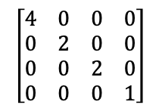
Desempilhando e Atualizando Transformação
<Scene>
<Transform scale="2 2 2">
<Shape>
<TriangleSet>
<Coordinate point='-1 -1 0 1 -1 0 0 1 0'/>
</TriangleSet>
<Appearance>
<Material diffuseColor='1 0 0'/>
</Appearance>
</Shape>
<Transform scale="2 1 1">
<Transform translation="0 -1 -1">
<Shape>
<TriangleSet>
<Coordinate point='-1 -1 0 1 -1 0 0 1 0'/>
</TriangleSet>
<Appearance>
<Material diffuseColor='0 1 0'/>
</Appearance>
</Shape>
</Transform>
<Transform translation="0 1 -2">
<Transform rotation="0 0 1 3.14">
<Shape>
<TriangleSet>
<Coordinate point='-1 -1 0 1 -1 0 0 1 0'/>
</TriangleSet>
<Appearance>
<Material diffuseColor='0 0 1'/>
</Appearance>
</Shape>
</Transform>
</Transform>
</Transform>
</Transform>
</Scene>
pop
MATRIZ
PILHA
Notes:
PILHA

Slide 10
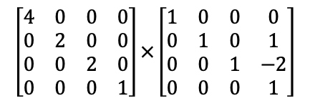
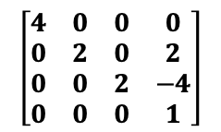
Empilhando e Atualizando Transformação
<Scene>
<Transform scale="2 2 2">
<Shape>
<TriangleSet>
<Coordinate point='-1 -1 0 1 -1 0 0 1 0'/>
</TriangleSet>
<Appearance>
<Material diffuseColor='1 0 0'/>
</Appearance>
</Shape>
<Transform scale="2 1 1">
<Transform translation="0 -1 -1">
<Shape>
<TriangleSet>
<Coordinate point='-1 -1 0 1 -1 0 0 1 0'/>
</TriangleSet>
<Appearance>
<Material diffuseColor='0 1 0'/>
</Appearance>
</Shape>
</Transform>
<Transform translation="0 1 -2">
<Transform rotation="0 0 1 3.14">
<Shape>
<TriangleSet>
<Coordinate point='-1 -1 0 1 -1 0 0 1 0'/>
</TriangleSet>
<Appearance>
<Material diffuseColor='0 0 1'/>
</Appearance>
</Shape>
</Transform>
</Transform>
</Transform>
</Transform>
</Scene>
push
MATRIZ
PILHA
Notes:
PILHA

Slide 11
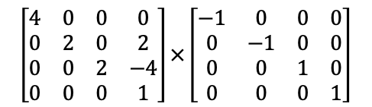
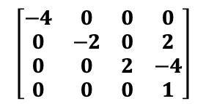
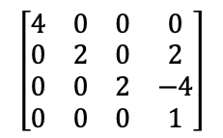
Empilhando e Atualizando Transformação
<Scene>
<Transform scale="2 2 2">
<Shape>
<TriangleSet>
<Coordinate point='-1 -1 0 1 -1 0 0 1 0'/>
</TriangleSet>
<Appearance>
<Material diffuseColor='1 0 0'/>
</Appearance>
</Shape>
<Transform scale="2 1 1">
<Transform translation="0 -1 -1">
<Shape>
<TriangleSet>
<Coordinate point='-1 -1 0 1 -1 0 0 1 0'/>
</TriangleSet>
<Appearance>
<Material diffuseColor='0 1 0'/>
</Appearance>
</Shape>
</Transform>
<Transform translation="0 1 -2">
<Transform rotation="0 0 1 3.14">
<Shape>
<TriangleSet>
<Coordinate point='-1 -1 0 1 -1 0 0 1 0'/>
</TriangleSet>
<Appearance>
<Material diffuseColor='0 0 1'/>
</Appearance>
</Shape>
</Transform>
</Transform>
</Transform>
</Transform>
</Scene>
push
MATRIZ
PILHA
Notes:
PILHA

Slide 12
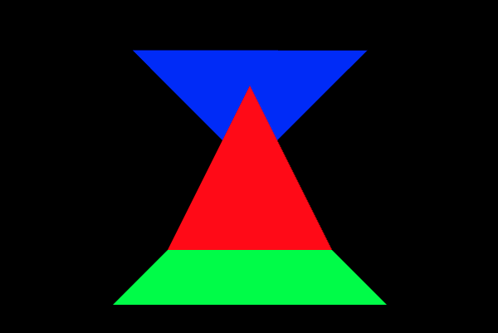
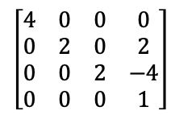
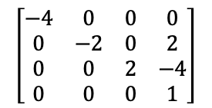
Desenhando Triângulo Azul
<Scene>
<Transform scale="2 2 2">
<Shape>
<TriangleSet>
<Coordinate point='-1 -1 0 1 -1 0 0 1 0'/>
</TriangleSet>
<Appearance>
<Material diffuseColor='1 0 0'/>
</Appearance>
</Shape>
<Transform scale="2 1 1">
<Transform translation="0 -1 -1">
<Shape>
<TriangleSet>
<Coordinate point='-1 -1 0 1 -1 0 0 1 0'/>
</TriangleSet>
<Appearance>
<Material diffuseColor='0 1 0'/>
</Appearance>
</Shape>
</Transform>
<Transform translation="0 1 -2">
<Transform rotation="0 0 1 3.14">
<Shape>
<TriangleSet>
<Coordinate point='-1 -1 0 1 -1 0 0 1 0'/>
</TriangleSet>
<Appearance>
<Material diffuseColor='0 0 1'/>
</Appearance>
</Shape>
</Transform>
</Transform>
</Transform>
</Transform>
</Scene>
draw
MATRIZ
PILHA
Notes:
PILHA

Slide 13
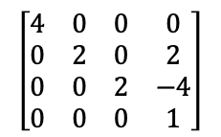
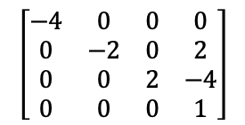
Desempilhando e Atualizando Transformação
<Scene>
<Transform scale="2 2 2">
<Shape>
<TriangleSet>
<Coordinate point='-1 -1 0 1 -1 0 0 1 0'/>
</TriangleSet>
<Appearance>
<Material diffuseColor='1 0 0'/>
</Appearance>
</Shape>
<Transform scale="2 1 1">
<Transform translation="0 -1 -1">
<Shape>
<TriangleSet>
<Coordinate point='-1 -1 0 1 -1 0 0 1 0'/>
</TriangleSet>
<Appearance>
<Material diffuseColor='0 1 0'/>
</Appearance>
</Shape>
</Transform>
<Transform translation="0 1 -2">
<Transform rotation="0 0 1 3.14">
<Shape>
<TriangleSet>
<Coordinate point='-1 -1 0 1 -1 0 0 1 0'/>
</TriangleSet>
<Appearance>
<Material diffuseColor='0 0 1'/>
</Appearance>
</Shape>
</Transform>
</Transform>
</Transform>
</Transform>
</Scene>
pop
MATRIZ
PILHA
Notes:
PILHA

Slide 14
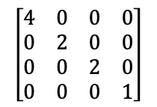
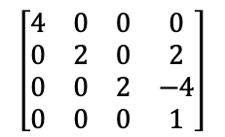
Desempilhando e Atualizando Transformação
<Scene>
<Transform scale="2 2 2">
<Shape>
<TriangleSet>
<Coordinate point='-1 -1 0 1 -1 0 0 1 0'/>
</TriangleSet>
<Appearance>
<Material diffuseColor='1 0 0'/>
</Appearance>
</Shape>
<Transform scale="2 1 1">
<Transform translation="0 -1 -1">
<Shape>
<TriangleSet>
<Coordinate point='-1 -1 0 1 -1 0 0 1 0'/>
</TriangleSet>
<Appearance>
<Material diffuseColor='0 1 0'/>
</Appearance>
</Shape>
</Transform>
<Transform translation="0 1 -2">
<Transform rotation="0 0 1 3.14">
<Shape>
<TriangleSet>
<Coordinate point='-1 -1 0 1 -1 0 0 1 0'/>
</TriangleSet>
<Appearance>
<Material diffuseColor='0 0 1'/>
</Appearance>
</Shape>
</Transform>
</Transform>
</Transform>
</Transform>
</Scene>
pop
MATRIZ
PILHA
Notes:
PILHA

Slide 15
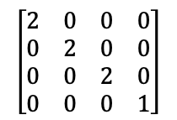
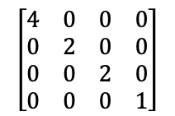
Desempilhando e Atualizando Transformação
<Scene>
<Transform scale="2 2 2">
<Shape>
<TriangleSet>
<Coordinate point='-1 -1 0 1 -1 0 0 1 0'/>
</TriangleSet>
<Appearance>
<Material diffuseColor='1 0 0'/>
</Appearance>
</Shape>
<Transform scale="2 1 1">
<Transform translation="0 -1 -1">
<Shape>
<TriangleSet>
<Coordinate point='-1 -1 0 1 -1 0 0 1 0'/>
</TriangleSet>
<Appearance>
<Material diffuseColor='0 1 0'/>
</Appearance>
</Shape>
</Transform>
<Transform translation="0 1 -2">
<Transform rotation="0 0 1 3.14">
<Shape>
<TriangleSet>
<Coordinate point='-1 -1 0 1 -1 0 0 1 0'/>
</TriangleSet>
<Appearance>
<Material diffuseColor='0 0 1'/>
</Appearance>
</Shape>
</Transform>
</Transform>
</Transform>
</Transform>
</Scene>
pop
MATRIZ
PILHA
Notes:
PILHA

Slide 16
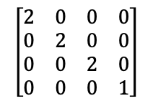
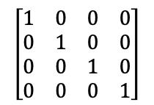
Desempilhando e Atualizando Transformação
<Scene>
<Transform scale="2 2 2">
<Shape>
<TriangleSet>
<Coordinate point='-1 -1 0 1 -1 0 0 1 0'/>
</TriangleSet>
<Appearance>
<Material diffuseColor='1 0 0'/>
</Appearance>
</Shape>
<Transform scale="2 1 1">
<Transform translation="0 -1 -1">
<Shape>
<TriangleSet>
<Coordinate point='-1 -1 0 1 -1 0 0 1 0'/>
</TriangleSet>
<Appearance>
<Material diffuseColor='0 1 0'/>
</Appearance>
</Shape>
</Transform>
<Transform translation="0 1 -2">
<Transform rotation="0 0 1 3.14">
<Shape>
<TriangleSet>
<Coordinate point='-1 -1 0 1 -1 0 0 1 0'/>
</TriangleSet>
<Appearance>
<Material diffuseColor='0 0 1'/>
</Appearance>
</Shape>
</Transform>
</Transform>
</Transform>
</Transform>
</Scene>
MATRIZ
PILHA
pop
Notes:
PILHA

Slide 17
Interpolação em Triângulos

Slide 18
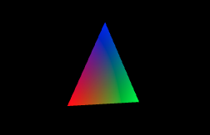
Triângulo com vértices de cores diferentes
<Scene>
<Transform rotation="0 1 0 0.52">
<Shape>
<IndexedFaceSet colorPerVertex='true' coordIndex='0 1 2 -1'>
<Coordinate point='-1 -1 0 1 -1 0 0 1 0'/>
<Color color='1 0 0 0 1 0 0 0 1'/>
</IndexedFaceSet>
</Shape>
</Transform>
</Scene>
30°
Pixel (28, 22)
Distâncias do ponto(28, 22) as arestas
L₀ = 27.85
L₁ = 2.60
L₂ = 8.49
P₂
3D(0, 1, 0)
Dentro !!!
2D(30, 16.65)
Pesos
α = 0.715
β = 0.067
γ = 0.218
R = αR₀ + βR₁ + γR₂ = 0.715
G = αG₀ + βG₁ + γG₂ = 0.066
B = αB₀ + βB₁ + γB₂ = 0.218
P₀
P₁
3D(-0.87, -1, 0.5)
3D(0.87, -1, -0.5)
2D(26.95, 23.52)
2D(32.77, 23.18)

Slide 19
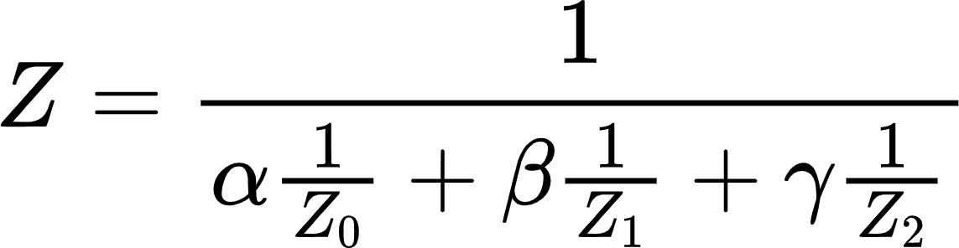
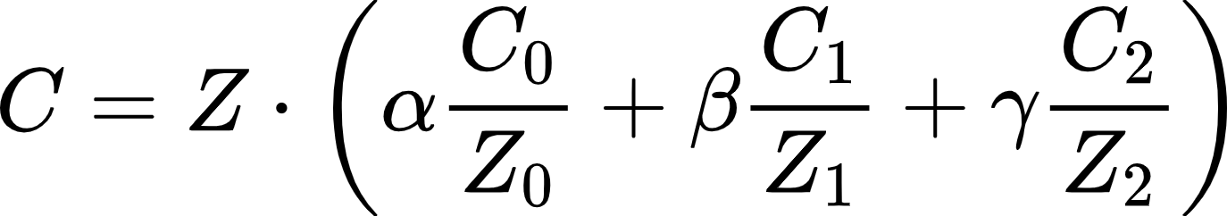
Cores do Triângulo com Correção Perspectiva
<Scene>
<Transform rotation="0 1 0 0.52">
<Shape>
<IndexedFaceSet colorPerVertex='true' coordIndex='0 1 2 -1'>
<Coordinate point='-1 -1 0 1 -1 0 0 1 0'/>
<Color color='1 0 0 0 1 0 0 0 1'/>
</IndexedFaceSet>
</Shape>
</Transform>
</Scene>
30°
Pesos
α = 0.715
β = 0.067
γ = 0.218
Pixel (28, 22)
P₂
3D(0, 1, 0)
2D(30, 16.65)
Z₀ = 0.5
Z₁ = -0.5
Z₂ = 0.0
Z = 0.331
P₀
P₁
3D(-0.87, -1, 0.5)
3D(0.87, -1, -0.5)
C = (0.728, 0.061, 0.211)
2D(26.95, 23.52)
2D(32.77, 23.18)

Slide 20
Aplicando Texturas

Slide 21

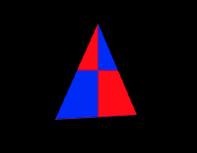
Triângulo com Texturas
chess.png (32x32)
<Scene>
<Transform rotation="0 1 0 0.52">
<Shape>
<IndexedFaceSet coordIndex='0 1 2 -1'>
<Coordinate point='-1 -1 0 1 -1 0 0 1 0'/>
<TextureCoordinate point='0.0 0.0 1.0 0.0 0.5 1.0'/>
</IndexedFaceSet>
<Appearance>
<ImageTexture url=' "chess.png" '/>
</Appearance>
</Shape>
</Transform>
</Scene>
v
u
Pesos
α = 0.715
β = 0.067
γ = 0.218
P₂
U = αU₀ + βU₁ + γU₂
V = αV₀ + βV₁ + γV₂
Pixel (28, 22)
= 0.176
= 0.218
P₁
P₀

Slide 22
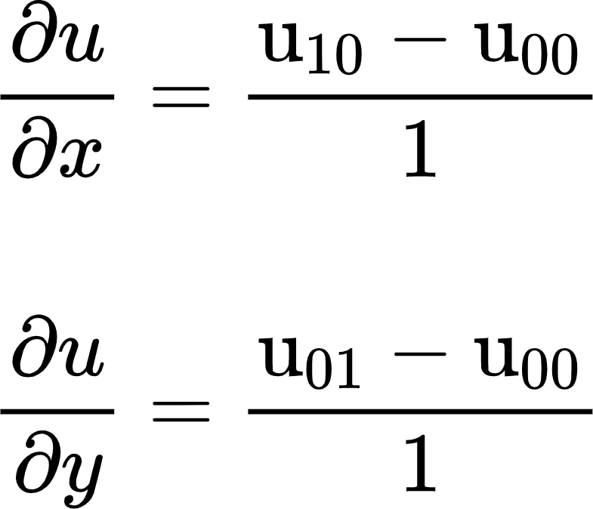
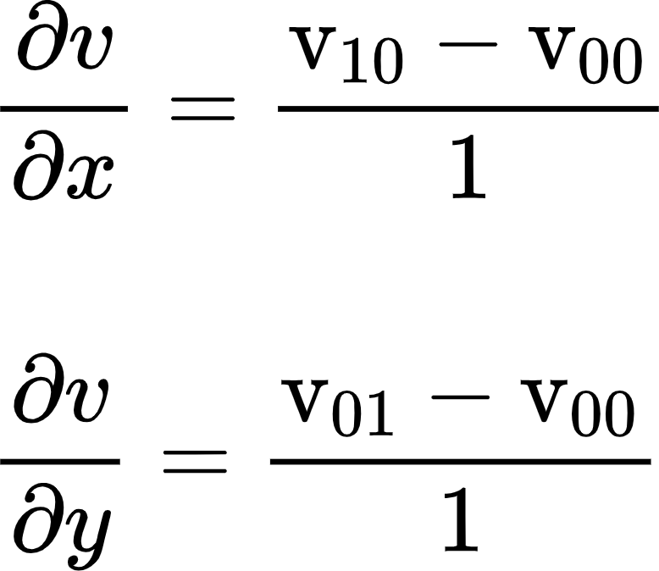
Triângulo com Texturas MipMap
chess.png (32x32)
<Scene>
<Transform rotation="0 1 0 0.52">
<Shape>
<IndexedFaceSet coordIndex='0 1 2 -1'>
<Coordinate point='-1 -1 0 1 -1 0 0 1 0'/>
<TextureCoordinate point='0.0 0.0 1.0 0.0 0.5 1.0'/>
</IndexedFaceSet>
<Appearance>
<ImageTexture url=' "chess.png" '/>
</Appearance>
</Shape>
</Transform>
</Scene>
0
U = 0.176
V = 0.218
Coordenadas (u,v)
pixel (29, 22) = (0.348, 0.210)
pixel (28, 23) = (0.180, 0.069)
1 (16x16)
P₂
Pixel (28, 22)
2 (8x8)
P₁
3 (4x4)
P₀

Slide 23

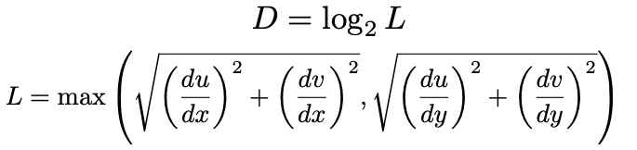
Triângulo com Texturas MipMap
chess.png (32x32)
Coordenadas (u,v)
pixel (29, 22) = (0.348, 0.210)
pixel (28, 23) = (0.180, 0.069)
U = 0.176
V = 0.218
0
= 5.06
= -0.26
= 0.00
= -4.62
1 (16x16)
P₂
Pixel (28, 22)
2 (8x8)
L = 5.071221148745826
P₁
D = 2.3423331896563995
3 (4x4)
P₀
D = 2

Slide 24
Z-Buffer

Slide 25
Desenhando com Z-Buffer
Cores
<Scene>
<Transform translation="1 0 0">
<Shape>
<TriangleSet>
<Coordinate point='-2 -2 0 2 -2 0 0 2 0'/>
</TriangleSet>
<Appearance>
<Material diffuseColor='1 0 0'/>
</Appearance>
</Shape>
</Transform>
<Transform translation="-1 0 0">
<Shape>
<TriangleSet>
<Coordinate point='-2 -2 -1 2 -2 -1 0 2 -1'/>
</TriangleSet>
<Appearance>
<Material diffuseColor='0 0 1'/>
</Appearance>
</Shape>
</Transform>
</Scene>
Profundidade
1 | 1 | 1 | 1 | 1 | 1 | 1 | 1 | 1 | 1 | 1 | 1
1 | 1 | 1 | 1 | 1 | 1 | 1 | 1 | 1 | 1 | 1 | 1
1 | 1 | 1 | 1 | 1 | 1 | 1 | 1 | 1 | 1 | 1 | 1
1 | 1 | 1 | 1 | 1 | 1 | 1 | 1 | 1 | 1 | 1 | 1
1 | 1 | 1 | 1 | 1 | 1 | 1 | 1 | 1 | 1 | 1 | 1
1 | 1 | 1 | 1 | 1 | 1 | 1 | 1 | 1 | 1 | 1 | 1
1 | 1 | 1 | 1 | 1 | 1 | 1 | 1 | 1 | 1 | 1 | 1
1 | 1 | 1 | 1 | 1 | 1 | 1 | 1 | 1 | 1 | 1 | 1

Slide 26
Desenhando com Z-Buffer
Cores
<Scene>
<Transform translation="1 0 0">
<Shape>
<TriangleSet>
<Coordinate point='-2 -2 0 2 -2 0 0 2 0'/>
</TriangleSet>
<Appearance>
<Material diffuseColor='1 0 0'/>
</Appearance>
</Shape>
</Transform>
<Transform translation="-1 0 0">
<Shape>
<TriangleSet>
<Coordinate point='-2 -2 -1 2 -2 -1 0 2 -1'/>
</TriangleSet>
<Appearance>
<Material diffuseColor='0 0 1'/>
</Appearance>
</Shape>
</Transform>
</Scene>
Profundidade
1 | 1 | 1 | 1 | 1 | 1 | 1 | 1 | 1 | 1 | 1 | 1
1 | 1 | 1 | 1 | 0.8 | 1 | 1 | 1 | 1 | 1 | 1 | 1
1 | 1 | 1 | 0.8 | 0.8 | 0.8 | 1 | 1 | 1 | 1 | 1 | 1
1 | 1 | 1 | 0.8 | 0.8 | 0.8 | 1 | 1 | 1 | 1 | 1 | 1
1 | 1 | 0.8 | 0.8 | 0.8 | 0.8 | 0.8 | 1 | 1 | 1 | 1 | 1
1 | 1 | 0.8 | 0.8 | 0.8 | 0.8 | 0.8 | 1 | 1 | 1 | 1 | 1
1 | 1 | 1 | 1 | 1 | 1 | 1 | 1 | 1 | 1 | 1 | 1
1 | 1 | 1 | 1 | 1 | 1 | 1 | 1 | 1 | 1 | 1 | 1

Slide 27
Desenhando com Z-Buffer
Cores
<Scene>
<Transform translation="1 0 0">
<Shape>
<TriangleSet>
<Coordinate point='-2 -2 0 2 -2 0 0 2 0'/>
</TriangleSet>
<Appearance>
<Material diffuseColor='1 0 0'/>
</Appearance>
</Shape>
</Transform>
<Transform translation="-1 0 0">
<Shape>
<TriangleSet>
<Coordinate point='-2 -2 -1 2 -2 -1 0 2 -1'/>
</TriangleSet>
<Appearance>
<Material diffuseColor='0 0 1'/>
</Appearance>
</Shape>
</Transform>
</Scene>
Profundidade
1 | 1 | 1 | 1 | 1 | 1 | 1 | 1 | 1 | 1 | 1 | 1
1 | 1 | 1 | 1 | 0.8 | 1 | 1 | 0.9 | 1 | 1 | 1 | 1
1 | 1 | 1 | 0.8 | 0.8 | 0.8 | 0.9 | 0.9 | 0.9 | 1 | 1 | 1
1 | 1 | 1 | 0.8 | 0.8 | 0.8 | 0.9 | 0.9 | 0.9 | 1 | 1 | 1
1 | 1 | 0.8 | 0.8 | 0.8 | 0.8 | 0.8 | 0.9 | 0.9 | 0.9 | 1 | 1
1 | 1 | 0.8 | 0.8 | 0.8 | 0.8 | 0.8 | 0.9 | 0.9 | 0.9 | 1 | 1
1 | 1 | 1 | 1 | 1 | 1 | 1 | 1 | 1 | 1 | 1 | 1
1 | 1 | 1 | 1 | 1 | 1 | 1 | 1 | 1 | 1 | 1 | 1

Slide 28
Computação Gráfica
Luciano Soares
<lpsoares@insper.edu.br>
Fabio Orfali
<fabioo1@insper.edu.br>

